Slide 1
Progress Meeting

Slide 2
Overview
Work Done
Debugged Rewards
Exploration Strategies
Results
QMIX
New Rewards
Future work
Network connectivity (?)
Results of other things

Slide 3
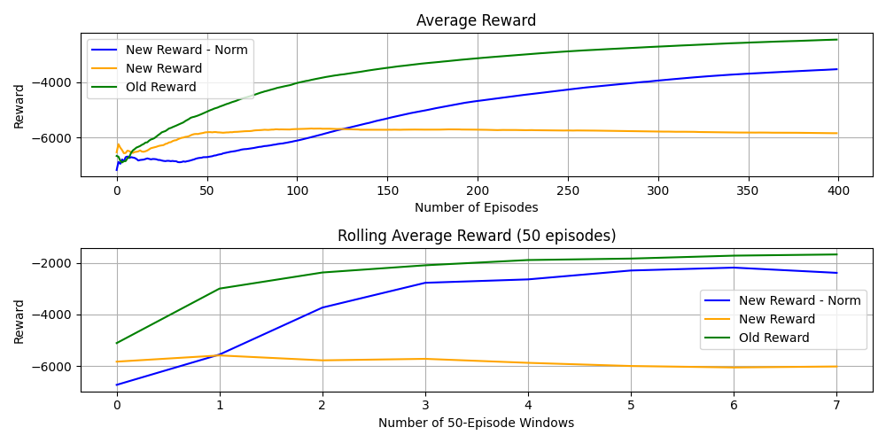
New Rewards - Comparison

Slide 4
New Rewards - Comparison
‘Basic’ New Rewards lead to the agent not learning
Reward too sparse – Not enough ‘feedback’
Agents 0-3 can get a 0 reward up to 70% of the times
Reward normalization greatly improves upon that
Not better than common reward
Can we improve the results?
What about an hybrid reward? (E.g. 70% individual reward and 30% group?)

Slide 5
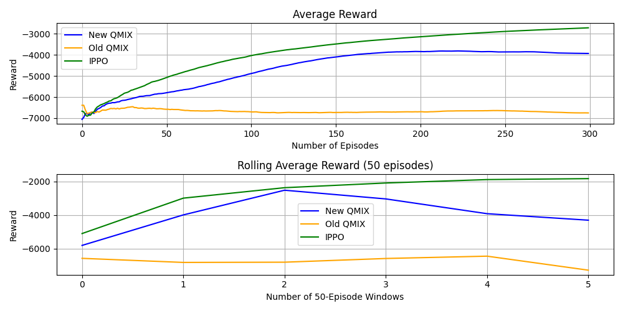
PeR + Bolzman Softmax - QMIX

Slide 6
QMIX - Discussion
New Exploration strategy and Experience Replay improve the results
Drop-off midway trough the training: Maxima reached or hyperparameters issue?
Which contributed the most: PeR or Bolzman-Softmax?
To test
VDN – Not usefu anymore for a discussion

Slide 7
PeR - MADDPG
In MADDPG we can only introduce PeR
Results do not improve for this method
Reasons: The PeR is not enough to get the agent to learn
Exploration strategy does not fit the environment enough
To test: QMIX without PeR (with Bolzman)

Slide 8
Agents Policy Analysis – No Sleep
AllowTrafficZone: Most chosen action (avg: 25%)
Analyse: More detailed analysis preferred over simpler one (avg:15-20%)
Remove: remove a red agent from the network (avg:15-20%)
Deploy Decoy: deploy decoy service (avg:15-20%)
Restore: ‘Longest’ action, restore the full system (avg:10-15%)
Block Traffic – Monitor: Least used actions (avg: <5%)

Slide 9
Future Works
Finish the work on Network connectivity
Continue results collection, especially for the new settings
Resume discussion of Part 1 in light of new additions

