Slide 1
Progress Meeting

Slide 2
Overview
Work Done
Added different agents configurations
New exploration strategies
Results
IPPO + Exploration
Reward change
Future work
Finish exploration strategies
Debug current rewards

Slide 3
PPO - Exploration
Possible Problem: PPO seem to reach a local maxima
Can we improve exploration?
Entropy bonus
Learning Rate Annealing
Intrinsic Exploration Rewards
Never Give Up

Slide 4
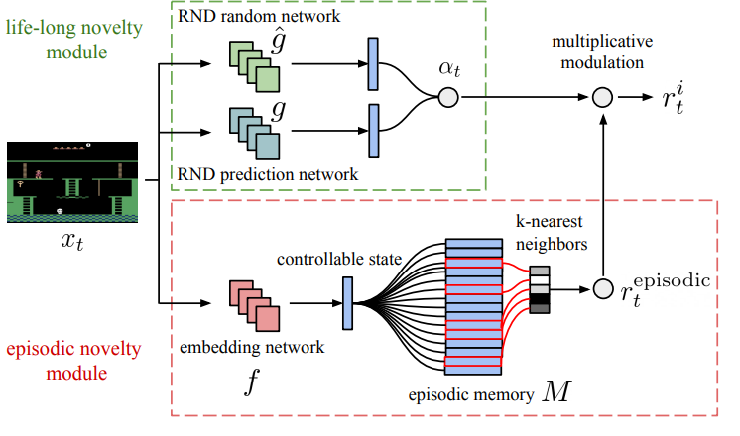
Never Give Up (NGU)

Slide 5
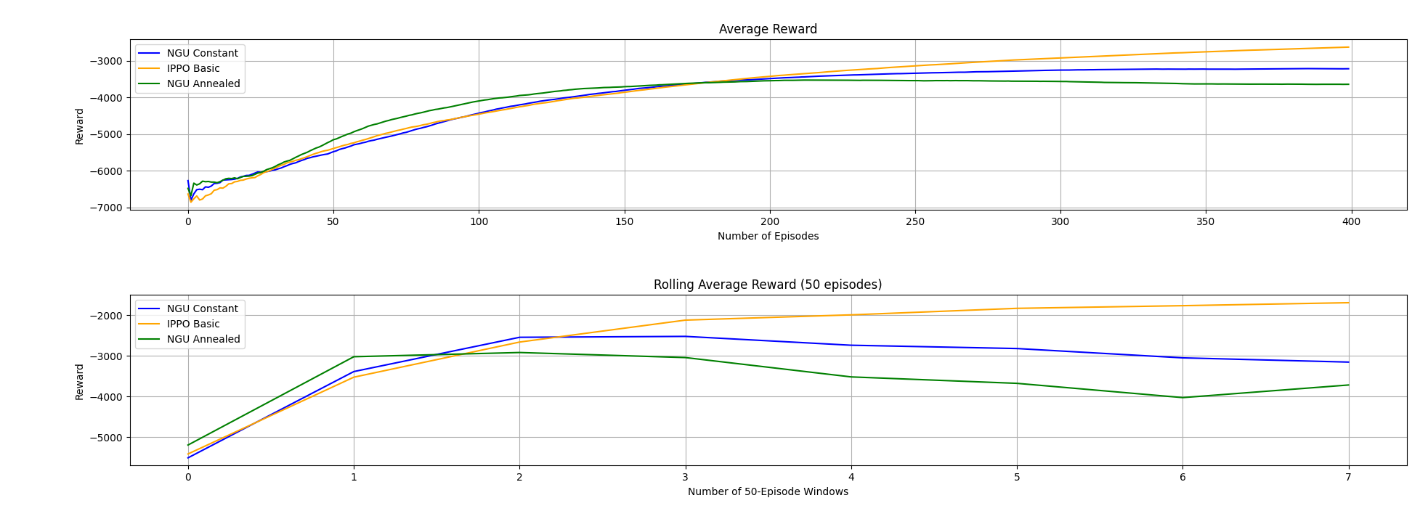
PPO + NGU - Results

Slide 6
Other Methods - Exploration
(QMIX + VDN): EPS-Greedy Might not be a suitable exploration mechanism
Bolzman softmax: Probability distribution over the actions
(QMIX + VDN + MADDPG): Replay buffer can have ‘outdated’ data
Prioritized Experience Replay
Work in progress
If the results do not improve?
Emphasis on the off-policy nature of such methods

Slide 7
Agents Policy Analysis
Red/Blue Action Correlation
Sleep is still the most common action
Can we remove Sleep?
‘Block Traffic Zone’ the least common reaction for all Red Attacks
‘Monitor’ very uncommon reaction, ‘Analyse’ is preferred
‘Deploy Decoy’ is the most common defense action as a response to most Red Actions

Slide 8
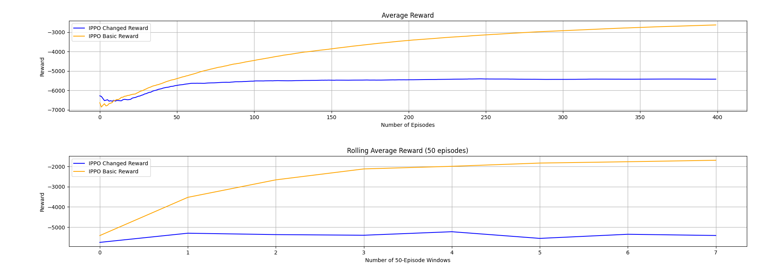
New Reward - Results

Slide 9
New Rewards – Why?
Not investigated yet the results in detail
Individual reward should help the agents
Small bug in reward assignment
Could lead to agents not learning properly in the long run
Numerically, this bug accounts for little of the reward
It could still lead agents to take the wrong actions

Slide 10
Changes to CybORG to Test
Implementation of 3 Agents and 7 Agents configuration
To test Against the baseline implementation with 5 agents
Immediate Action Timestep

Slide 11
Future Works
Finish and test methods with
Bolzman Softmax function
Priority Experience Replay
Debug Reward Function
Remove Sleep Action
To get a better analysis of Red-Blue action policy
Start working with the network connectivity

