Slide 1
Progress Meeting

Slide 2
Overview
Work Done
Overview of work done in July
Work Done in the past few weeks
Future work
Continuation of the project
Final steps before presentation

Slide 3
PPO Results Discussion
PPO seems to reach a similar maxima in all of its variants:
(IPPO, MAPPO, R_IPPO, R_MAPPO) + Messages achieve very similar results
Did PPO reach a local maxima?
Message Results – 2 Bits consistently (slightly) worse than 8 bit and Action (similar convergence speed)
Can we improve exploration to avoid being stuck on the maxima?
Entropy bonus
Learning Rate Annealing
Intrinsic Exploration Rewards
Never Give Up

Slide 4
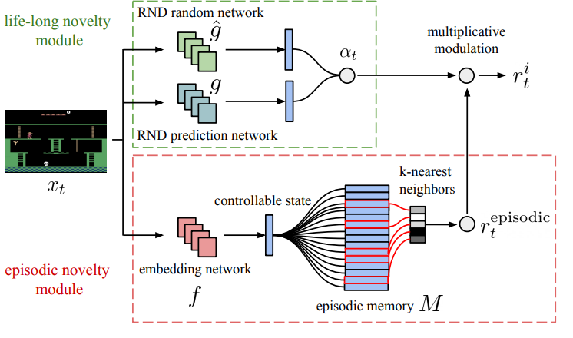
Never Give Up (NGU)

Slide 5
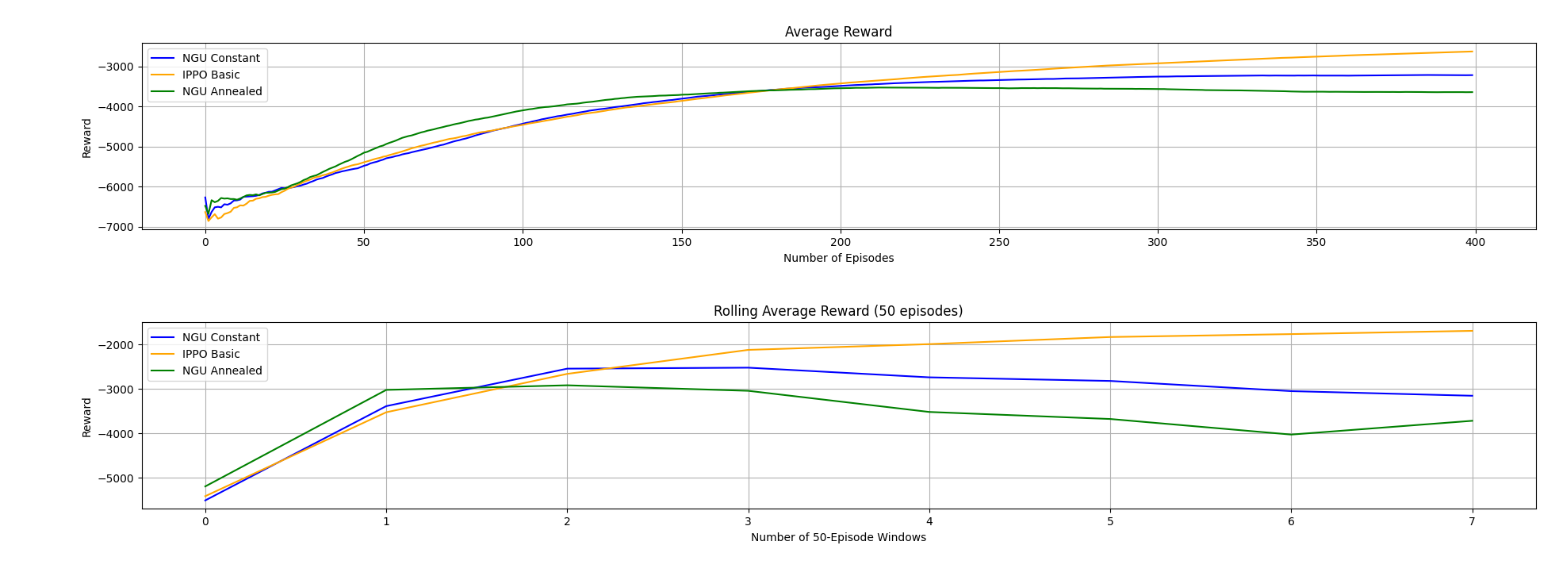
PPO + NGU - Results

Slide 6
MADDPG/QMIX Result Discussion
Why do they not learn in the CybORG environments?
Many possible reasons (implementation errors, hyperparameters etc.)
Exploration Strategy (eps-greedy for QMIX, Gumbel-Softmax for MADDPG)
Replay Buffer (Outdated and not useful data)
What can we change to test those hypothesis?
Prioritized Experienced Replay (MADDPG + QMIX)
Bolzman softmax: Probability distribution over the actions (QMIX)

Slide 7
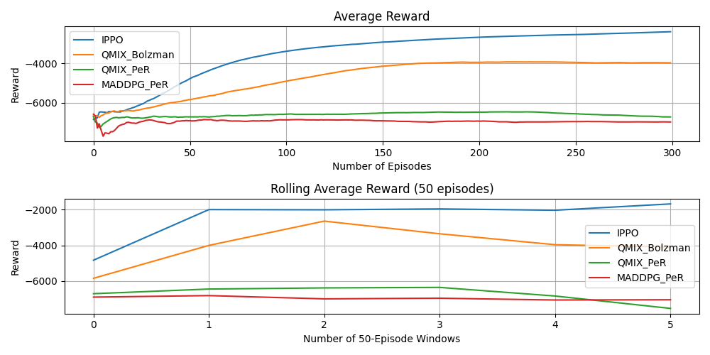
MADDPG/QMIX New Results

Slide 8
Changes to CybORG
Changed reward from global to individual – Total reward value stays the same, its just divided it between agents (Done+Tested)
Change in defenders configurations - 3 and 7 defenders config. added (Done + Tested)
Immediate actions - timestep set to 0 (Done + Tested)
Changed network topology, emphasize HQ network (Done)

Slide 9
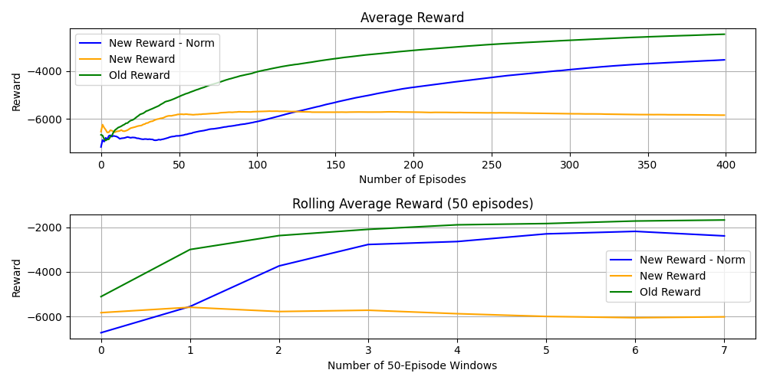
New Rewards - Comparison

Slide 10
New Rewards - Comparison
‘Basic’ New Rewards lead to the agent not learning
Reward too sparse – Not enough ‘feedback’
Agents 0-3 can get a 0 reward up to 70% of the times
Reward normalization greatly improves upon that
Not better than common reward
Can we improve the results?
What about an hybrid reward? (E.g. 70% individual reward and 30% group?)

Slide 11
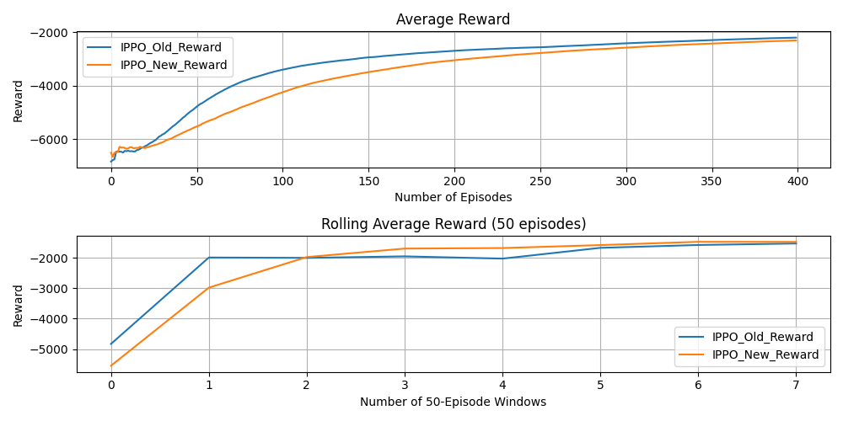
Mix-Rewards - Results

Slide 12
Rewards – Where Next?
Test the new reward schema with the NGU module
NGU can help with sparse rewards
Test different variation of ‘importance’ of the reward
E.g. Put more emphasis on the individual reward

Slide 13
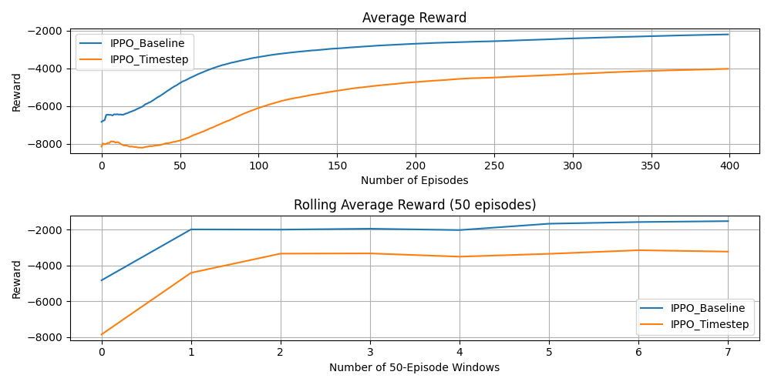
Immediate Actions - Results

Slide 14
Immediate Actions - Discussion
Better performance with more ‘realistic’ action set – Why?
Red agent is directly advantaged in it from the beginning of training
Any other reasons?
Check agent policy
Test with timestep 0 only for Blue Agents (?)

Slide 15
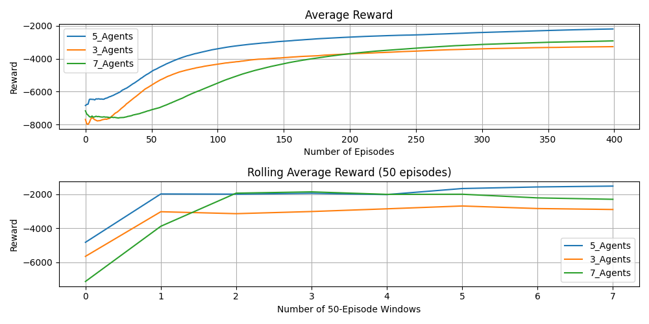
Agents Configurations - Results

Slide 16
Agents Configurations - Discussion
5 Agents configuration is better than 3 and 7 agents – Why?
3 Agents worse than 5 due to less defenders
7 Agents worse than 5 due non-stationarity?
Check reward partitioning between agents
Check agent policy

Slide 17
Agents Policy Analysis – No Sleep
AllowTrafficZone: Most chosen action (avg: 25%)
Analyse: More detailed analysis preferred over simpler one (avg:15-20%)
Remove: remove a red agent from the network (avg:15-20%)
Deploy Decoy: deploy decoy service (avg:15-20%)
Restore: ‘Longest’ action, restore the full system (avg:10-15%)
Block Traffic – Monitor: Least used actions (avg: <5%)

Slide 18
Future Works
Gather literature w.r.t the results
Resume the writing of the thesis
Finish up coding (code cleaning etc.)
Continue testing Methods + Environments
Later: Investigate other possible solutions for CybORG
E.g. Game theory based solutions
Presentation: Mid-October (?)

