Slide 1


Diamond Carat Classification
Part I : Machine Learning models with AWS SageMaker
Alessi Nicola – Giorgio Davide Antonino
Student id: s291550 – s291477
nicola.alessi@studenti.polito.it davideantonino.giorgio@studenti.polito.it

Slide 2
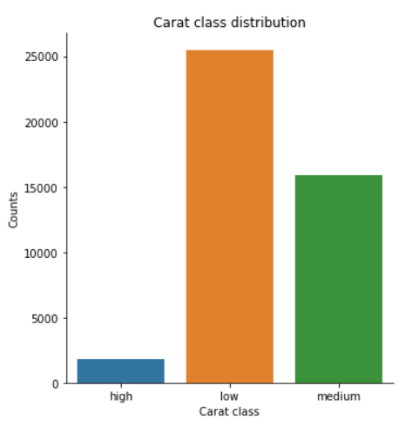
Exploratory Data Analysis
Dataset Features
Cut: quality of the cut (Fair, Good, Very Good, Premium, Ideal)
Color: possible values D (best),F,G,H,I, J (worst)
Clarity: a measurement of how clear the diamond is (I1 (worst), SI2, SI1, VS2, VS1, VVS2, VVS1, IF (best))
Price: price in US dollars
X: length in mm
Y: width in mm
Z: depth in mm
Depth: total depth percentage = z / mean(x, y) = 2 * z / (x + y)
Table: width of top of diamond relative to widest point
Carat_class (LABEL): it assumes the following values (low, medium, high).
Dataset base stats
Train set counts 43K rows
Test set counts 10K rows.
The dataset has 43170 rows.
The dataset has 0 duplicated rows.

Slide 3
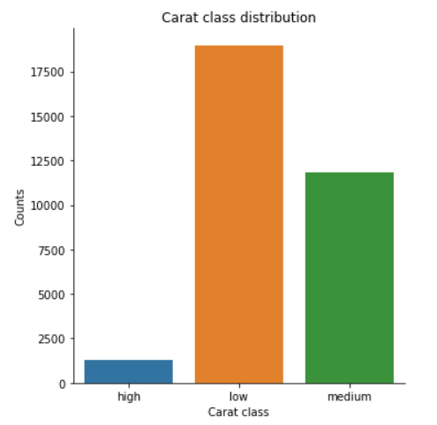
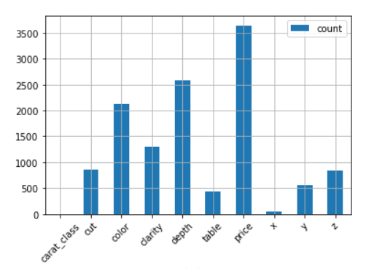
Dropping NULL values
Null values distribution
After dropping null values there are 32.127 rows (74.42% left)
Label distribution after removing null values remains the same

Slide 4
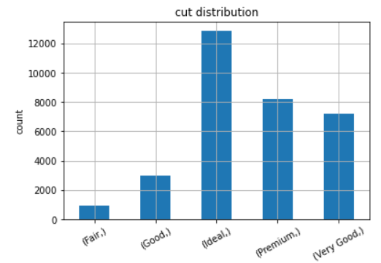
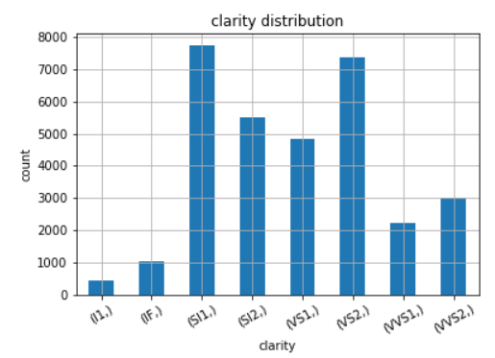
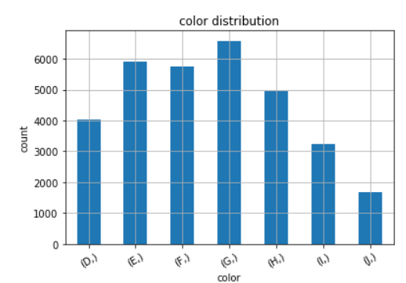
Distribution of categorical attributes

Slide 5
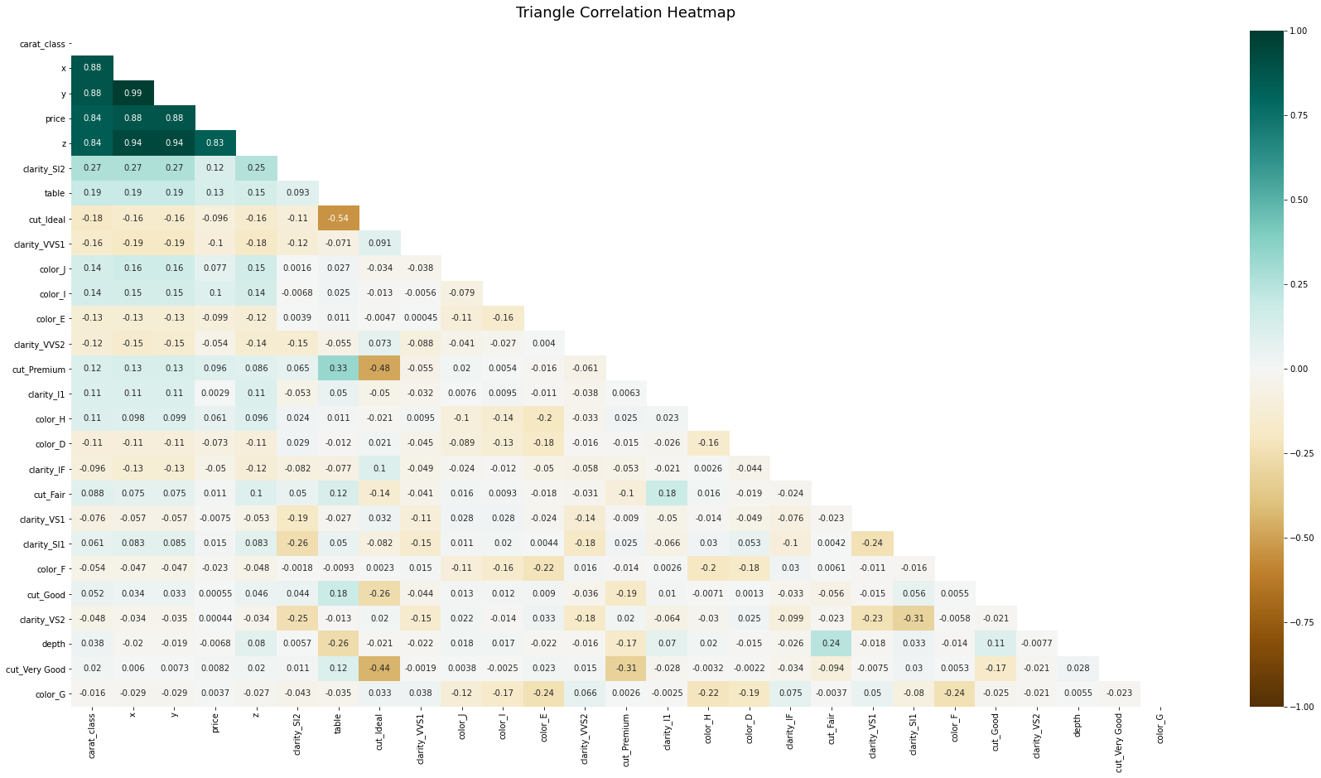
Triangle correlation heatmap
Notes:
After one hot encoding…

Slide 6
Triangle correlation heatmap – Zoom In

Slide 7
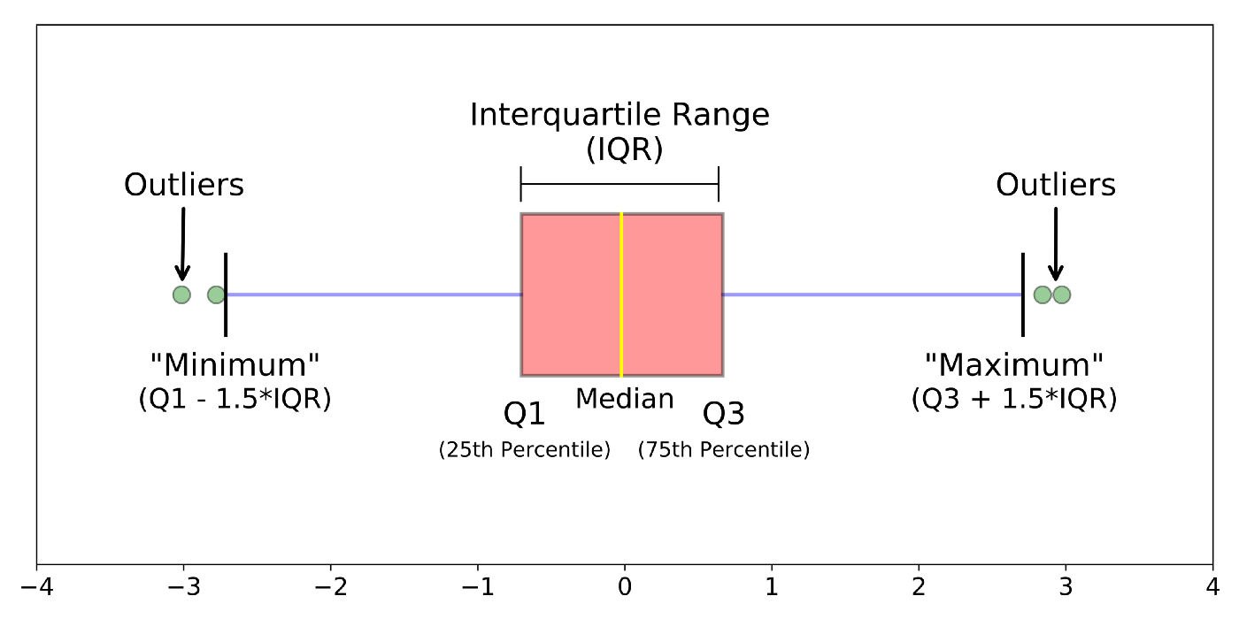
Outlier detection – Boxplot analysis
Understanting boxplots
first quartile (Q1/25th Percentile): the middle number between the smallest number and the median of the dataset.
median (Q2/50th Percentile): the middle value of the dataset.
third quartile (Q3/75th Percentile): the middle value between the median and the highest value of the dataset.
interquartile range (IQR): 25th to the 75th percentile.
“maximum”: Q3 + 1.5*IQR
“minimum”: Q1 -1.5*IQR
Notes:
whiskers (shown in blue)
outliers (shown as green circles)

Slide 8
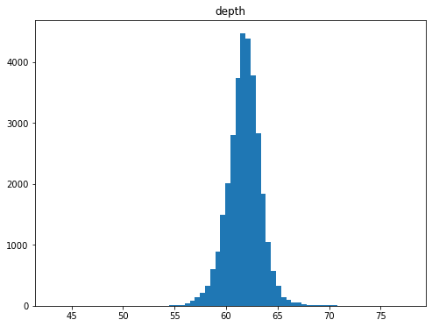
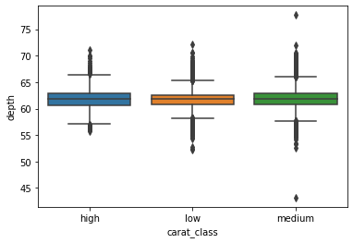
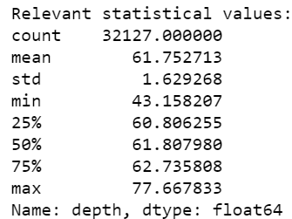
Outliers: depth
IQR: 1.9295529543454322
P90: 63.618944645659354
Notes:
The IQR describes the middle 50% of values when ordered from lowest to highest. To find the interquartile range (IQR), ​first find the median (middle value) of the lower and upper half of the data. These values are quartile 1 (Q1) and quartile 3 (Q3). The IQR is the difference between Q3 and Q1.

Slide 9
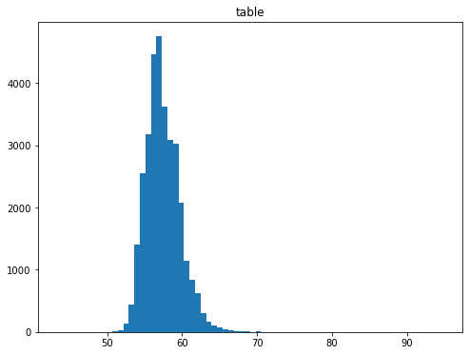
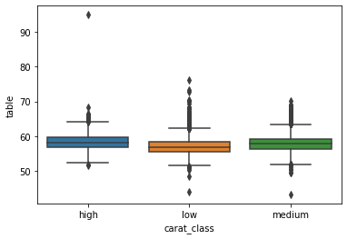
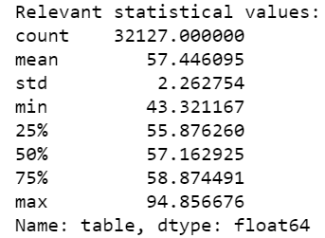
Outliers: table
IQR : 2.9982311563258364
P90 : 60.31023171264552

Slide 10
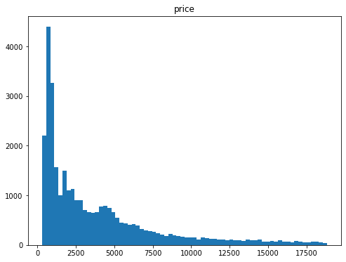
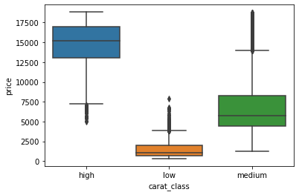
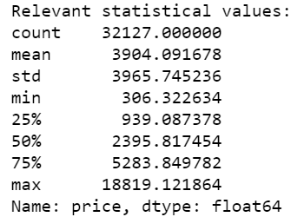
Outliers: price
IQR: 4344.762403569417
P90: 9665.819756301418

Slide 11
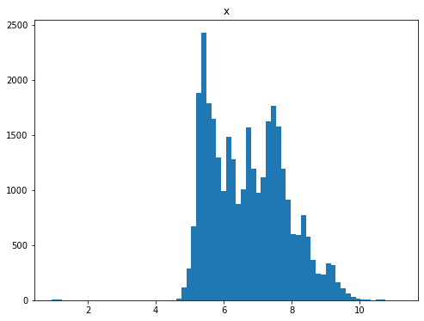
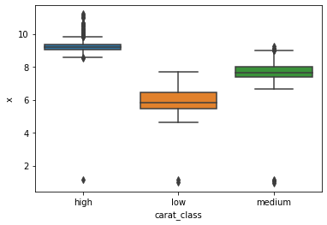
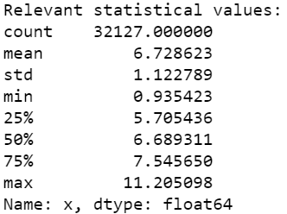
Outliers: x
IQR : 1.8402139253466157
P90: 8.279235108458636

Slide 12
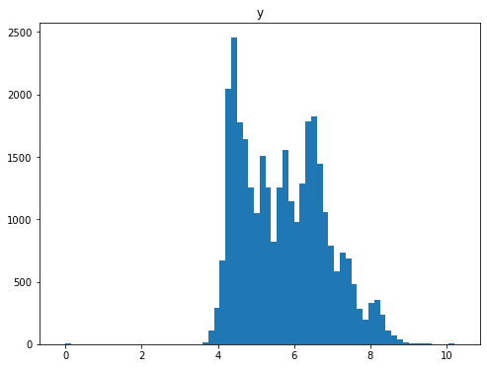
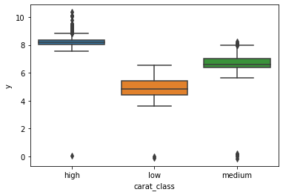
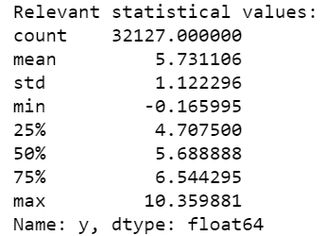
Outliers: y
IQR : 1.836795375931576
P90: 7.274324902875422

Slide 13
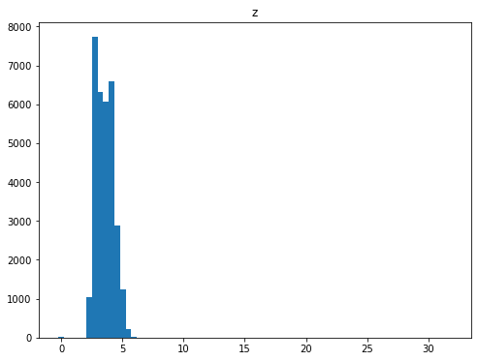
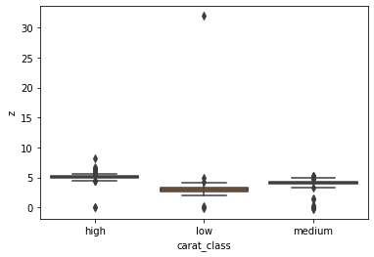
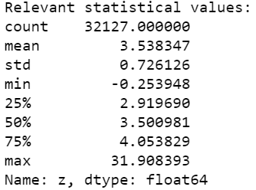
Outliers: z
IQR: 1.1341387787070825
P90: 4.485139600889474

Slide 14
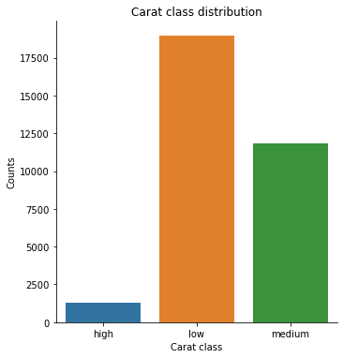
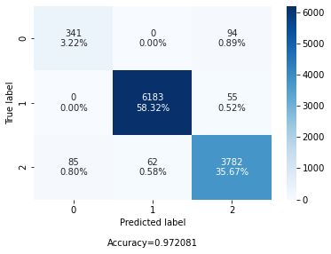
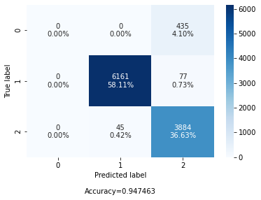
Scikit-learn Models – No sanification
No sanification of unbalanced label data
Decision Tree Classifier
Random Forest Classifier

Slide 15
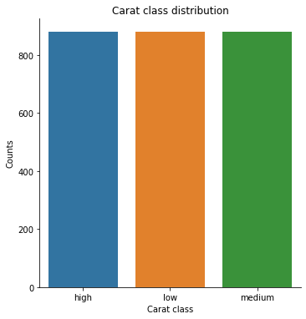
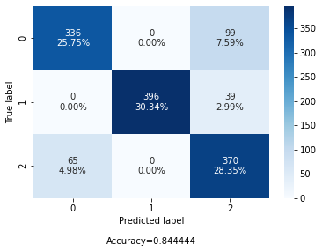
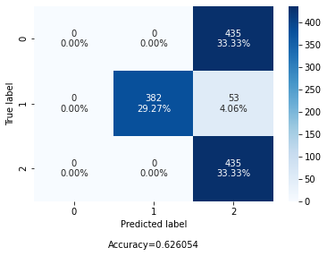
Scikit-learn Models – Undersampling
UNDERSAMPLING
Decision Tree Classifier
Random Forest Classifier

Slide 16
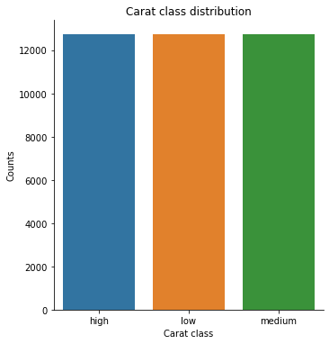
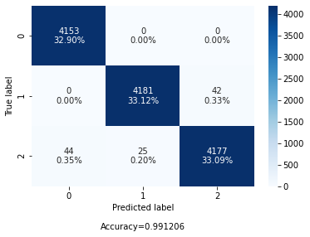
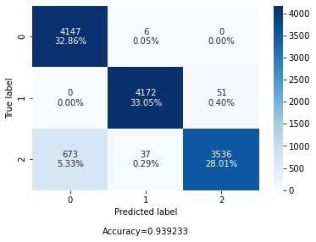
Scikit-learn Models – Oversampling
OVERSAMPLING
Decision Tree Classifier
Random Forest Classifier

Slide 17


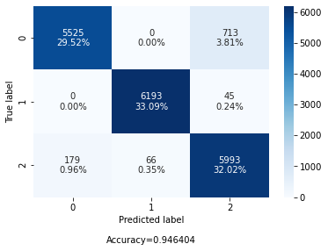

Scikit-learn Models – Stacking Models
OVERSAMPLING + STACKING MODELS
STACKING MODEL:
-Random Forest
-Linear SVC with std scaler
Final estimator: LogisticRegression
KNORA-Eliminate
Pool of 10 Random Forest
This model was deployed on AWS Sagemaker to classify new data
Notes:
SUPPORT VECTOR CLASSIFICATION

Slide 18
Diamond Carat Classification
Part II : Cloud Data Engineering with AWS and Terraform
Alessi Nicola – Giorgio Davide Antonino
Student id: s291550 – s291477
nicola.alessi@studenti.polito.it davideantonino.giorgio@studenti.polito.it

Slide 19
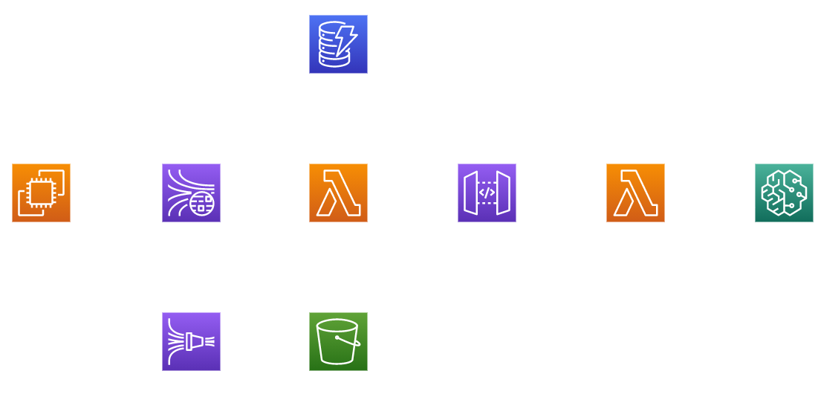
Microservices Architecture

Slide 20
Prediction block
The goal is to exploit the ML model to predict the carat class (low, medium, high) of a diamond.
The characteristics of the diamond should be transferred to the model through a HTTP REST GET request exposed by API GATEWAY.
The predicted class is returned to the user in this form:
{
"statusCode":200,
"headers":{
"my_header":"my_value"
},
"body":{
"prediction":"high"
},
"isBase64Encoded":false
}

Slide 21
Lambda API Gateway - SageMaker
This lambda should take the request that is sent from API GATEWAY and contacts the Sagemaker endpoint passing the parameters.
The resources to create a lambda using terraform are:
Create a aws_iam_role
Create a aws_iam_policy
Attach the policy to the iam_role
Create aws_lambda_function
Allow aws_lambda_permission to invoke the sagemaker endpoint
Load the source code of the function
…
resource "aws_lambda_function" "lambda_rest_to_sagemaker" {
filename = "${path.module}/outputs/lambda_rest_to_sagemaker_payload.zip"
function_name = "lambda_rest_to_sagemaker"
role = aws_iam_role.iam_for_lambda_sagemaker.arn
handler = "lambda_rest_to_sagemaker.rest_to_sagemaker_handler"
runtime = "python3.8"
}

Slide 22
API Gateway
This service is more complex to configure. It needs to collect all the requests from the outside and then forward them to the lambda. In the terraform resources we need to define also the mapping of the parameters.
resource "aws_api_gateway_integration" "diamond_integration" {
rest_api_id = aws_api_gateway_rest_api.diamond_rest_api.id
resource_id = aws_api_gateway_resource.diamond_resource.id
http_method = aws_api_gateway_method.get_method.http_method
integration_http_method = "POST"
type = "AWS"
uri = var.sagemaker_lambda.invoke_arn
request_templates = {
"application/json" = <<REQUEST_TEMPLATE
{
"depth": "$input.params('depth')",
"table": "$input.params('table')",
"price": "$input.params('price')",
"x": "$input.params('x')",
…
resource "aws_api_gateway_resource" "diamond_resource" {
rest_api_id = aws_api_gateway_rest_api.diamond_rest_api.id
parent_id = aws_api_gateway_rest_api.diamond_rest_api.root_resource_id
path_part = "diamond"
}
resource "aws_api_gateway_method" "get_method" {
rest_api_id = aws_api_gateway_rest_api.diamond_rest_api.id
resource_id = aws_api_gateway_resource.diamond_resource.id
http_method = "GET"
authorization = "NONE"
api_key_required = false
}

Slide 23
Data collection block
The goal of this part is to create:
A lambda that will collect the messages from a kinesis data stream topic and then contact the api gateway to collect a response on a given observation. Then it is stored in a DynamoDB table.
DynamoDB to store the predictions
Kinesis Data Stream to create a topic of messages
Kinesis Firehose to store the messages into an S3 bucket
An S3 bucket to store the messages coming from Kinesis Firehose
EC2 instance to inject data to the kinesis topic

Slide 24
Lambda Kinesis – API Gateway - DynamoDB
This lambda is the core of our application. It is used for:
Get the messages from Kinesis Data Stream Topic
Contact the endpoint provided by API Gateway
Store the response to a DynamoDB table
The source file of the lambda is dynamically populated by terraform and then used to deploy the lambda. It needs to insert:
API Gateway endpoint
DynamoDB table name
resource "aws_lambda_function" "lambda_kinesis_to_dynamo" {
filename = data.archive_file.archive.output_path
function_name = "lambda_kinesis_to_dynamo"
role = aws_iam_role.iam_for_lambda_kinesis.arn
handler = "lambda_kinesis_to_dynamo.kinesis_to_dynamo_handler"
runtime = "python3.8"
}
API_GATEWAY_ENDPOINT = '${api_url_complete}'
TABLE_NAME = '${dynamodb_prediction_table}'

Slide 25
DynamoDB
DynamoDB is used to store all the predictions of the application. It stores:
An unique uuid
Set of features used
Prediction of the carat_class
resource "aws_dynamodb_table" "alessi-giorgio-prediction-diamonds-table" {
name = "prediction-diamonds-table"
billing_mode = "PROVISIONED"
read_capacity = 5
write_capacity = 5
hash_key = "PredictionId"
attribute {
name = "PredictionId"
type = "S"
}
ttl {
attribute_name = "TimeToExist"
enabled = false
}
tags = {
Name = "prediction-diamonds-table"
Environment = "production"
}
}

Slide 26
Kinesis Data Stream
This resource is used to create a message topic to sent the requests coming from the EC2 instance to the lambda. These messages will be stored also in a S3 bucket.
resource "aws_kinesis_stream" "kinesis_stream" {
name = "diamond-kinesis-stream"
shard_count = 1
retention_period = 48
shard_level_metrics = [
"IncomingBytes",
"OutgoingBytes",
]
tags = {
Environment = "test"
}
}

Slide 27
Kinesis Firehose
Thanks to this resource we can push buffers of messages directly into an S3 bucket to make analysis in the future.
The records are store into a directory “data/”
resource "aws_kinesis_firehose_delivery_stream" "diamond_firehose_delivery_stream" {
name = "diamond-firehose-delivery-stream"
destination = "s3"
kinesis_source_configuration {
kinesis_stream_arn = var.kinesis_stream_arn
role_arn = aws_iam_role.firehose_role.arn
}
s3_configuration {
role_arn = aws_iam_role.firehose_role.arn
bucket_arn = var.diamond_bucket
prefix = "data/"
cloudwatch_logging_options {
enabled = true
log_group_name = "diamond_firehose_logging_group"
log_stream_name = "diamond_firehose_logging"
}
} }

Slide 28
S3 Bucket
resource "aws_s3_bucket" "diamond_bucket" {
bucket = "s3-diamond-bucket"
acl = "private"
}
Just an S3 Bucket to store the messages coming from Kinesis Firehose.

Slide 29
EC2 Data-Producer
# A simple EC2 Instance.
resource "aws_instance" "diamond_ec2_instance" {
ami = "ami-0f89681a05a3a9de7"
availability_zone = var.availability_zone
instance_type = "t2.micro"
key_name = aws_key_pair.diamond_key_pair.key_name
vpc_security_group_ids = [aws_security_group.protected.id]
subnet_id = aws_subnet.diamond_subnet.id
root_block_device {
volume_size = 50
}
tags = {
Name = "${var.tag_name}-ec2"
}
}
An EC2 instance has been used to produce a set of records to inject directly in the topic data stream.
…
while True:
print("Producing 5 records...")
rows = test_data.sample(n=5).to_dict(orient="records")
kinesis.put_records(
Records=[
{
"Data": json.dumps(x).encode("utf-8"),
"PartitionKey": "0"
}
for x in rows
],
StreamName="diamond-kinesis-stream"
)
print("Sleeping 10 seconds...")
time.sleep(10)

Slide 30

Extra work – S3 Bucket whitepage frontend
Available on:
http://diamond-frontend-bucket.s3-website-eu-west-1.amazonaws.com/

Slide 31
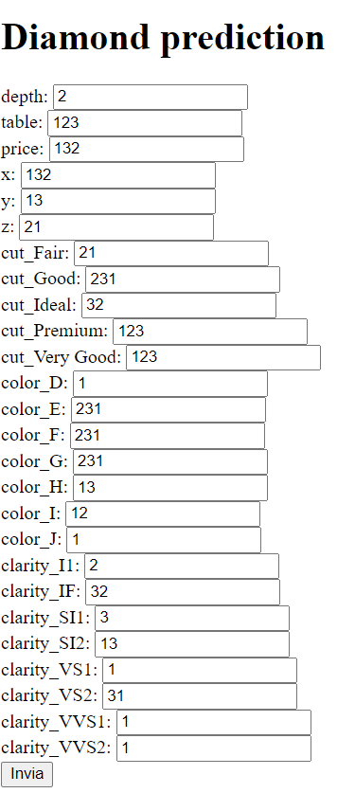
Extra work – S3 Bucket whitepage frontend
Output
{
"statusCode":200,
"headers":{
"my_header":“CaratHeader"
},
"body":{
"prediction":"low"
},
"isBase64Encoded":false
}
Available on:
http://diamond-frontend-bucket.s3-website-eu-west-1.amazonaws.com/

Slide 32
Thank You!
Alessi Nicola – Giorgio Davide Antonino
Student id: s291550 – s291477
nicola.alessi@studenti.polito.it davideantonino.giorgio@studenti.polito.it

