Slide 1
OS161 - SHELL PROJECT Operating Systems 2021/2022 Project C2
Altamore Davide (s290166)
Coniglione Simone (s289554)
Rolle Luca (s304803)

Slide 2
What is OS161?
Open-source UNIX-like operating system.
Run on a 32-bit MIPS architecture.
Allow to customize the system calls and kernel operations.
Our implementation was designed to work as a simple shell and support most of the common system calls useful to work on terminal, manage files and add processes.

Slide 3
Project C2: SHELL
Shell features
Implement process and file handling.
System calls: special procedures that interfaces user programs and kernel
fork – to create new runnable processes
getpid – to find the current process identifier
wait & exit – to manage synchronisation between processes
execv – to replace the executable code of a running process
open, read, write, close, lseek, dup2, chdir & getcwd – to handle file operations
Manage error-case operations to avoid system crash

Slide 4
How to handle a system call
The system has a trap handling function mips_trap() that is called by the assembly language exception handler once the trapframe has been set up.
Trapframe
Set of 32-bit registers which are given to the assembly runnable code
Registers used to store inputs and outputs of the system calls
A possible cause of trap is a system call.
In that case, the trap handler calls the system call dispatcher passing also the trapframe.
Trapframe keeps information about the code of the system call to execute and the arguments to pass to it.
After the system call execution, the return value is collected in the trapframe (with a special management for 64 bits values).

Slide 5
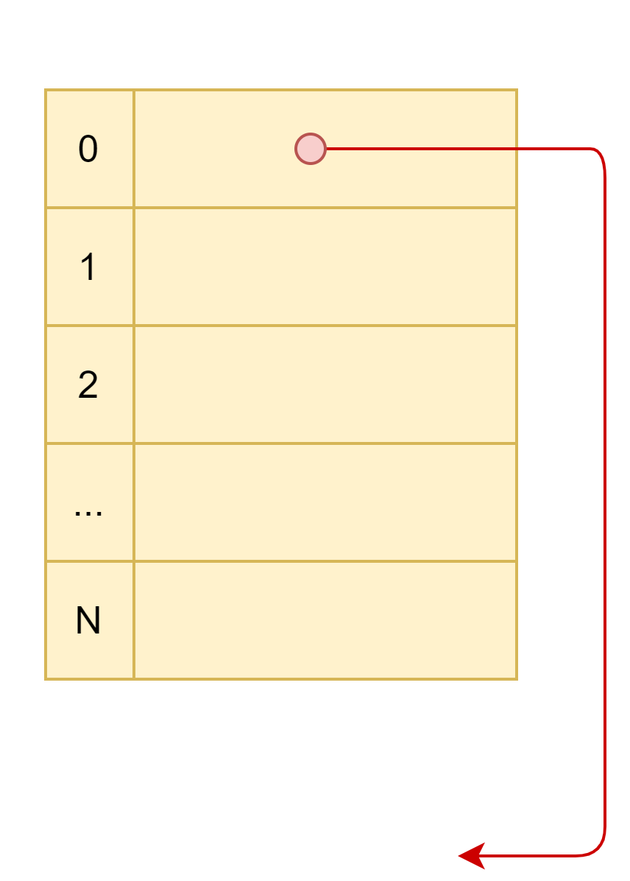
Process handling
Processes features:
Processes are single-threaded.
The OS supports multi-process programming (limited by a maximum related to the memory implementation).
New processes are created by forking.
To keep track of running processes, OS adopts a process table, a shared table of pointers to proc structures:
Each process is defined by its own proc struct containing its main parameters, needed to handle process operation.
The process table is indexed by an integer number called PID (that means for Process IDentifier).
Proc struct takes advantage of two global items:
a semaphore
a counter of the active processes
struct proc {
Process name
Semaphore
Number of threads ​
CWD's string & vnode ​
Filetable ​
Pid ​& Parent Pid​
Wait & Exit control variables
}

Slide 6
fork
pid_t fork(void)
The fork system call creates a new process that runs in parallel an exact copy of the code in execution.
The child process, beside the executable code, inherits some elements of its parent as:
address space
trapframe
file table and cwd information
There are also no-inherited elements:
PID (that will be the first free slot in proctable)
parent PID
return value (0 in child process and child pid in parent process)
At the end thread_fork() makes the child process' thread runnable that enters user mode by means of enter_forked_process().
getpid
pid_t getpid(void)
The getpid system call is used to retrieve the current process PID.
When called by a process, the return value is the process identifier set previously inside the proc struct.

Slide 7
exit
void exit(int exitcode)
The exit system call terminates the execution of a process with a specified exit code.
In more detail:
The pointer to the proc structure is set to NULL, so the correspondent PID is available again.
The running thread detaches itself from the process, thus stop running on the processor. The thread becomes zombie and subsequentially will be removed by exorcise() function.
The proc structure field int exitcode is set to share it with an eventual parent process that waits for it.
waitpid
pid_t waitpid(pid_t pid, int *status, int options)
The waitpid system call can be used to synchronise two processes: the calling process (parent) enters an idle status waiting for the exit command, called by the second process (child).
The calling process can wait only for one of its own children at a time.
The waitpid system call acquires the exit status when the exit system call terminates, then destroy the child process which has been already detached from the processor, thus its address space and proc structure are cleared (the memory is freed).

Slide 8
exit & waitpid
parent
fork()
fork()
waitpid
(child_1 pid)
Wait on sem
(idle state)
Returned status = 7
Destroy proc child_1
Signal sem
exit(7)
Process detached
Set exitcode = 7
Process destroyed
(Memory freed)
child_1
child_2
exit(1)
Process detached
Set exitcode = 1
Process zombie

Slide 9
execv
int execv(char *progname, char **args)
The execv system call replaces the current executable code with a new one. The user must specify the path of the new executable code and an array of arguments which can be passed.
A tricky task is the arguments passing, performed by copying them into the user stack (see the next slide for a more detailed analysis).
When the system call is called, the kernel does the following steps:
Copy arguments from user space into a kernel buffer.
Load the new executable code (elf file) in memory and create the correspondent user address space.
Copy the arguments from kernel buffer into user stack.
Call enter_new_process() to warp in user mode.
Runprogram
The core of execv (step 2 above) is also performed by runprogram() function. It is called by cmd_prog (p) that creates new user processes and assigns runprogram() as their first thread function. In this way the new program (passed to cmd_prog) is loaded and executed.
Exactly like execv, runprogram can manage arguments. The difference is that it can handle at most a single argument.

Slide 10
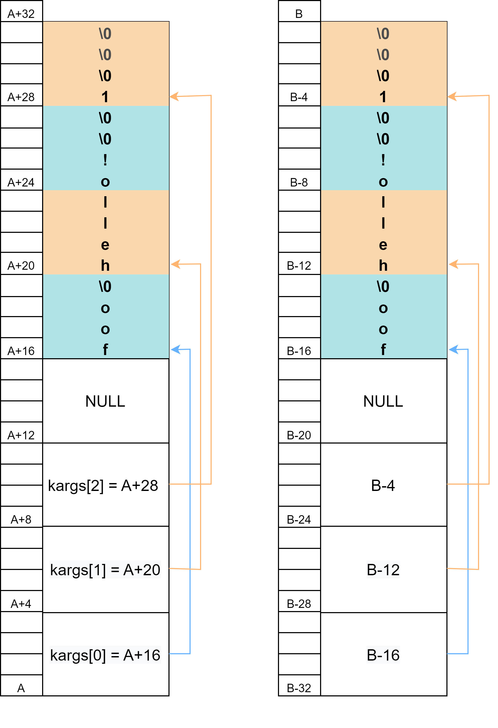
execv – arguments management
Kernel buffer – array inside kernel heap to support the arguments passing (it is placed at address A).
User stack – specific memory region in the process address space starting at B address.
Data should be organized in multiple of 4 bytes. Since 1 char occupies 1 byte, a 0-padding of the arguments is needed.
The last argument should be NULL to identify the number of valid arguments passed.
Arguments passing steps:
Fill the kernel buffer with padded arguments and pointers.
Modify the pointers to match the arguments positions inside the stack (to allow the next step).
Copy the whole kernel buffer inside the user stack.
Pass the initial stack position (B-32 on side) to enter_new_process() as the address of the userspace where find the arguments.

Slide 11
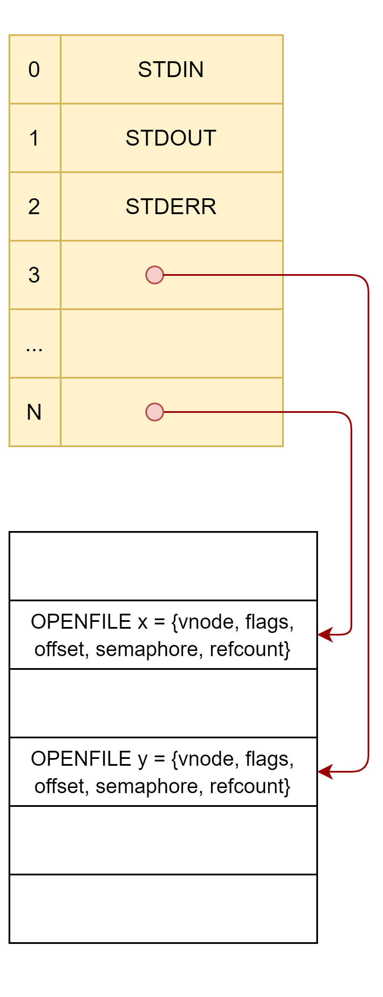
File Handling
Each opened file is associated to an openfile structure to manage it.
openfile = { vnode, flag, offset, semaphore, refcount }
A Filetable is an array of pointers to openfile struct indexed by means of File Descriptor FD.
For each process, a filetable is exploited to collect opened files.
Openfile structs are collected in the system filetable located in kernel address space.
Each openfile struct in system filetable can be pointed by more than one process by means of the FD of each process-owned filetable.
File management has been achieved by these system calls:
open, close, read, write, dup2, lseek, chdir & getcwd
First three items of each filetable are called console files. They need to be initialized in runprogram(), which is called when the kernel executes the command that creates the first user process. And next forked processes will just inherit these three standard items.
STD_INPUT (FD = 0)
STD_OUTPUT (FD = 1)
STD_ERROR (FD = 2)

Slide 12
Some support structures
VNODE is an abstract low-level representation of a file. Indeed, it is the main support for the file handling in the OS. The associated functions are:
vfs_open() - generates the vnode structure associated to the file to open.
vfs_close() - closes the opened vnode structure.
vfs_chdir() - changes the working directory (both vnode and string with pathname) of the current process.
vfs_getcwd() - gets the working directory (both vnode and string with pathname) of the current process.
UIO is an abstraction used to manage blocks of data moved around by the kernel. Indeed, it can be used to read/write on a file. On regard the functions are:
VOP_READ() - reads data from file at offset previously specified and store it into uio. Offset and resid fields are consequently updated.
VOP_WRITE() - writes data from uio (previously filled) to file at offset previously specified. Offset and resid fields are consequently updated.

Slide 13
open
int open(const char *filename, int flags)
The open system call permits to open a file specified by its own pathname filename in a way determined by the flags argument. This last should be one of the following:
O_RDONLY, O_WRONLY & O_RDWR
More specific open options can be applied by properly OR the following flags:
O_CREAT, O_EXCL, O_TRUNC & O_APPEND
The main aim is to create an openfile structure associated to the target file and make it available to the process through the filetable:
A vnode object associated to the passed file is obtained by vfs_open().
The openfile struct in the system file table is properly filled to manage the opened file.
The openfile pointer is placed in the process' filetable at the first free fd.
On success, the open system call returns the file descriptor manageable by other system calls such as close, read, write, dup2 and lseek while on error it returns –1.
close
int close(int fd)
(*) refcount
number of pointers to that openfile present in filetable. If 0, that file can be closed.
The close system call is performed to close the file specified through its file descriptor in the fd argument. Since multiple opens are allowed, the target file is removed from the filetable only if its refcount is 0 (*), otherwise it is just decremented.
On success, it returns 0, whereas on error it returns –1.

Slide 14
read
ssize_t read(int fd, void *buf, size_t buflen)
The read system call allows to read the file previously opened in O_RDONLY or O_RDWR mode and specified by the fd argument.
It reads at most buflen characters starting by the offset of the file set in the related openfile structure and store them in the space pointed by the buf argument.
On success, the read system call returns the number of bytes effectively read, while on error it returns –1.
Read and write operations are performed by VOP_READ and VOP_WRITE.
write
ssize_t write(int fd, const void *buf, size_t buflen)
The write system call is performed to write the file previously opened in O_WRONLY or O_RDWR mode and specified by the fd argument.
It writes at most buflen characters stored where the buf argument points starting by the offset position set in the correspondent openfile structure.
On success, the write system call returns the number of bytes effectively written, whereas on error it returns –1.

Slide 15
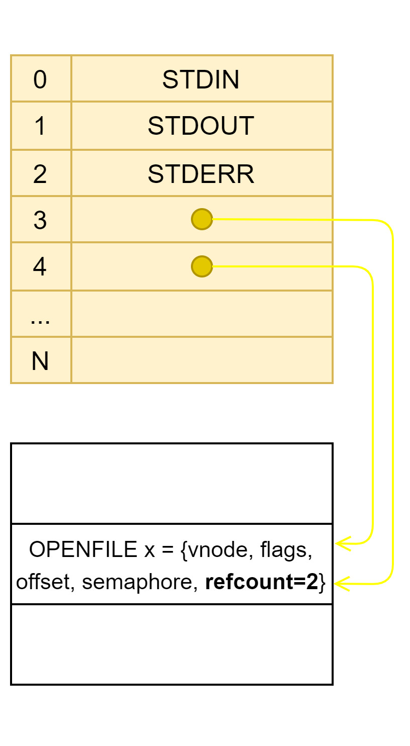
dup2
int dup2(int oldfd, int newfd)
The dup2 system call permits to duplicate the file descriptor (oldfd argument) onto a new one (newfd argument).
Therefore, process filetable will have two pointers to the same openfile structure in the system file table. The refcount is consequently updated (see below figure). On success, the dup2 system call returns newfd, while on error it returns –1.
lseek
off_t lseek(int fd, off_t pos, int whence)
The lseek system call is exploited to move the current seek position of the file specified by the fd argument accordingly to the pos argument (to update the offset of the pointed openfile) and whence argument which specifies from where the seek should be done:
SEEK_SET (from the beginning of the file) > offset = pos
SEEK_CUR (from the current value of the pointer) > offset = offset + pos
SEEK_END (from the end of the file) > offset = filesize + pos
Note that the pos argument could be negative.
On success, the lseek system call returns the new offset of the pointer from the beginning of the file, whereas on error it returns –1.

Slide 16
chdir
int chdir(const char *pathname)
The chdir system call allows to change the current process' directory with the one specified in the pathname argument. On this regard the proc structure's fields p_cwd and p_cwdpath[] are set up.
This operation is performed at all by vfs_chdir().
Translate the directory pathname in a vnode object - vfs_lookup()
This last is associated to p_cwd field - vfs_setcurdir()
Pathname is parsed (to properly detect relative and absolute path) and p_cwdpath is set up with the new evaluated absolute path - set_cwd()
On success, the chdir system call returns 0, while on error it returns –1.
getcwd
int getcwd(char *buf, size_t buflen)
The getcwd system call permits to retrieve the current working directory by setting accordingly the uio structure and using the vfs_getcwd() function, then store it in the space pointed and specified by the buf argument with length buflen.
This operation is performed by reading the p_cwdpath field of the current proc structure previously set.
On success, the getcwd system call returns 0, whereas on error it returns –1.

Slide 17
THANKS FOR YOUR ATTENTION!!!

