Slide 1

Twitter DeepFake Detection
Caterina Bruchi – Davide Bruni

Slide 2
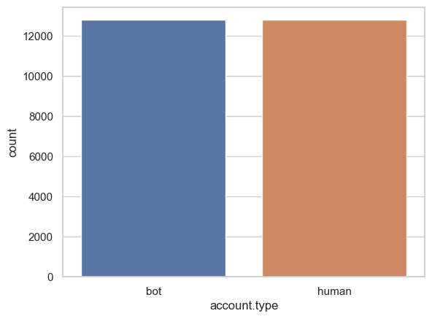
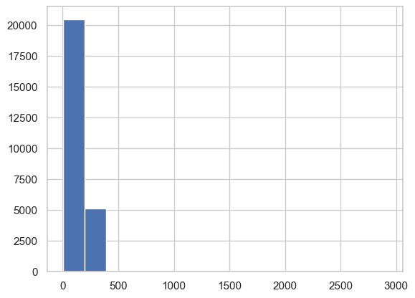
Original Dataset
We obtained our dataset from the authors of the paper ”TweepFake: About detecting deepfake tweets”
ATTRIBUTES:
user id
status id
text
screen name
screen name anonymized
account type
class type
For our classification task we will actually only use text and acccount type
25’836 Tweets
Dataset Balance
The dataset contains no null values
The dataset we obtained was divided into a train, validation and test set.
We put it all together again mantaining consistence and removing duplicates
Tweet Lenght
Data Preprocessing

Slide 3
Data Cleaning
Discrepancy of unique text count and unique status id count
Some of them were actually double and related to the same user.
Removed
They were actually duplicated records
Deprecated tweet cleaning
Bad memorization of the quoting marks and the apostrophe
with the two glyphs
ï¿½
Ã¯Â¿Â½
Substitute with a single apostrophe
Discrepancy between the number of unique text and the size of dataset
2 couples of identical tweets
Different status id they were different tweets not duplicates
Dropped
Only 4 involved we decided to drop them.
Data Preprocessing

Slide 4
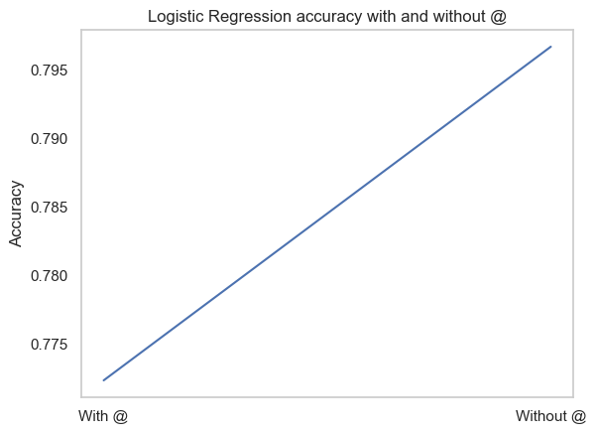
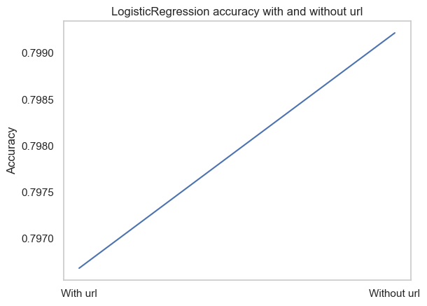
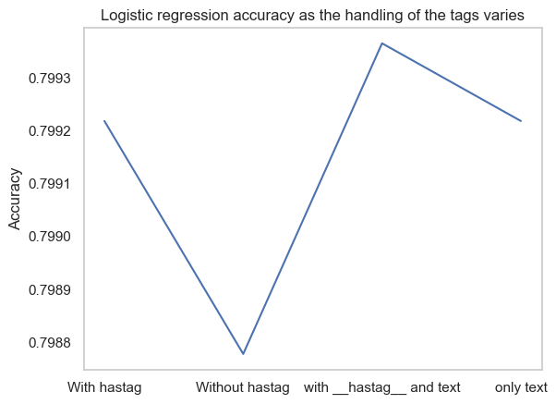
Data Transformation
How to handle user mentions
How to handle URLs
How to handle hashtag
Keep them or replace with __user_mention__
Keep them or replace with __url__
#twitter → twitter
#twitter → __hashtag__
#twitter → __hashtag__ twitter
Data Preprocessing

Slide 5
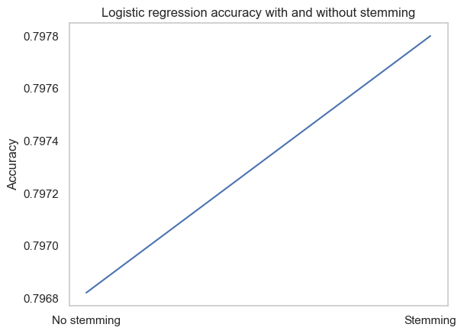
Text Elaboration
BOW
We use TF-IDF as weighting schema in order to weight up rare words
STOP WORD
We perform stop words filtering to remove articles, conjunctions, prepositions, pronouns, words appearing very often in a particular language or in a context
STEMMING
Wilcoxon test indicates no differences between pipeline with and without stemming
Data Preprocessing

Slide 6
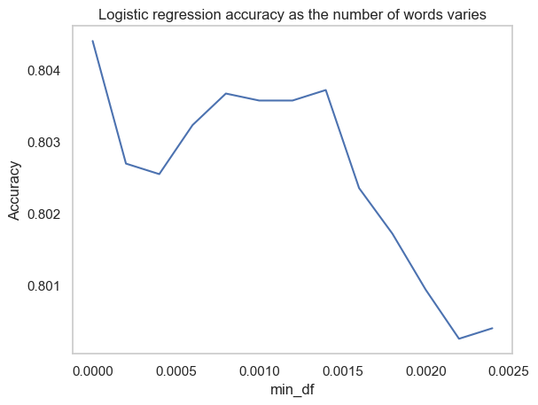
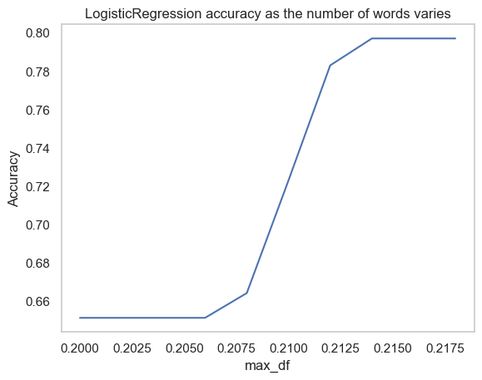
Feature Selection
VOCABULARY CONSTRUCTION
Ignore tokens with higher frequency than 0.22
and
lower frequency than 0.0012
The number of tokens change from 27482 to 1412
BECAUSE
of the high presence of meaningless tokens .
Data Preprocessing

Slide 7
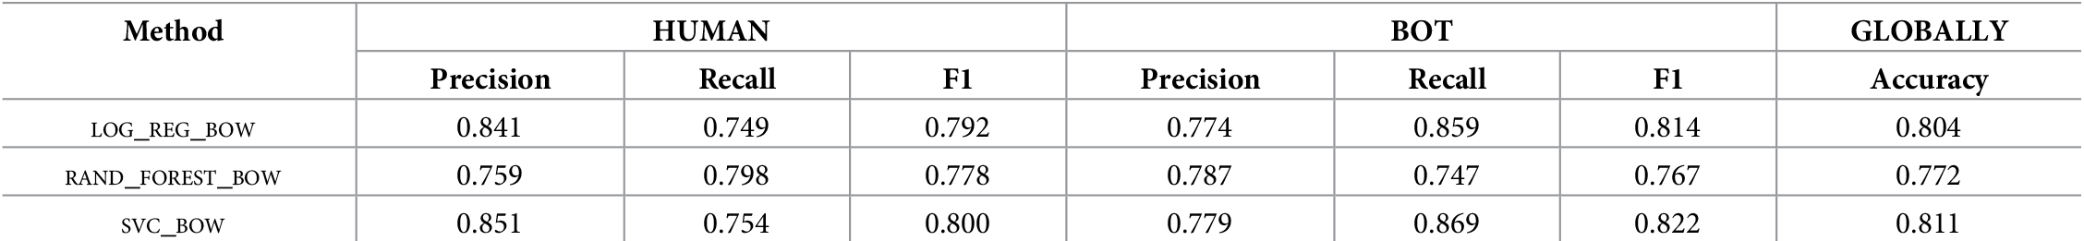
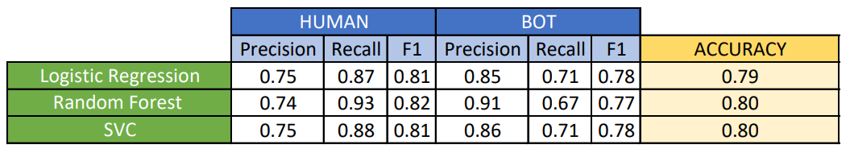
Paper Results
25000 words
1412 words
We try different parameters and by Wilcoxon and Accuracy results their parameters are actually the best available.
The only exception is RF for which we find a better tuning.
OUR PARAMETERS:
min_samples_leaf = 4
max_depth = 30
min_samples_split = 50
n_estimators = 100
PAPER PARAMETERS:
min_samples_leaf = 2
max_depth = 30
min_samples_split = 15
n_estimators = 500
Classifier Choice

Slide 8
Classifier results
CLASSIFIER | Accuracy | F1-score | Best parameters
Log Regression | 0.797 | 0.796 | C = 1
Random Forest | 0.801 | 0.799 | min_samples_leaf = 4, max_depth = 30, min_samples_split = 50, n_estimators = 100
SVC | 0.800 | 0.798 | Kernel = linear
MultinomialNB | 0.726 | 0.724
Adaboost | 0.804 | 0.802 | n_estimators = 100
We try two different combination for voting classifier
Random forest, SVC, Logistic Regression
Random forest, SVC, Adaboost
But accuracy is lower than the previous ones
→ we excluded them
To choose among the other models since the Wilcoxon test
between Random Forest, SVC, Adaboost and Logistic regression shows no differences
→ we choose the simplest model
LOGISTIC REGRESSION
Classifier Choice

Slide 9
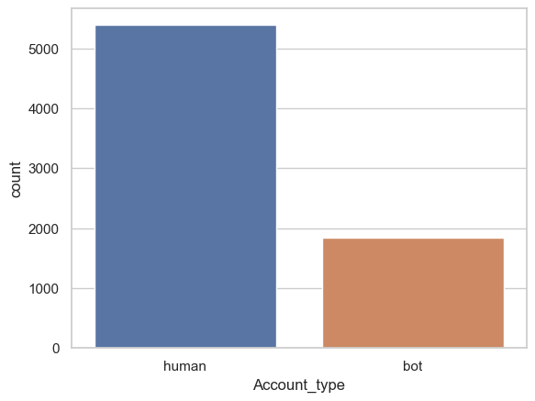
Data stream
Rewrited in Python the code of TweetedAt
10 years of tweets
Concentrated from mid 2018 to mid 2020.
Check accuracy with tweets from 2020 to 2023
Web Service → Extracts date and time from the tweet ID by reverse-engineering Twitter Snowflake
NEEDED TWEETS TIMESTAMP
We used Twint to retrieve new tweets avoiding the Twitter API limitations.
Class balance
Data Stream

Slide 10
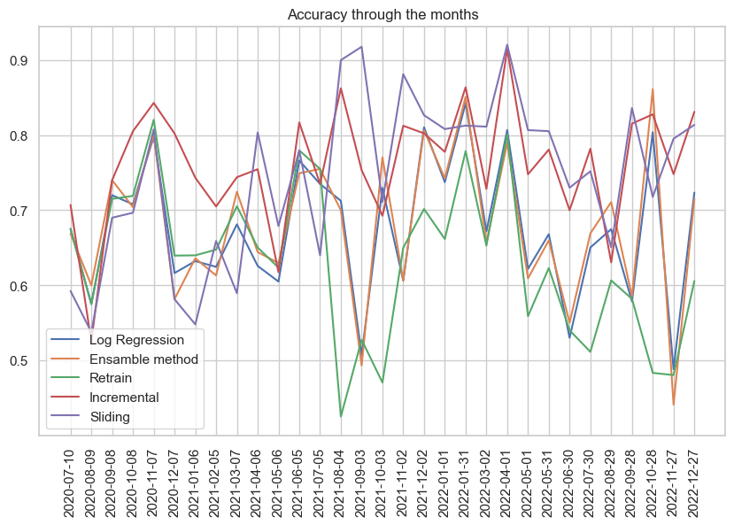
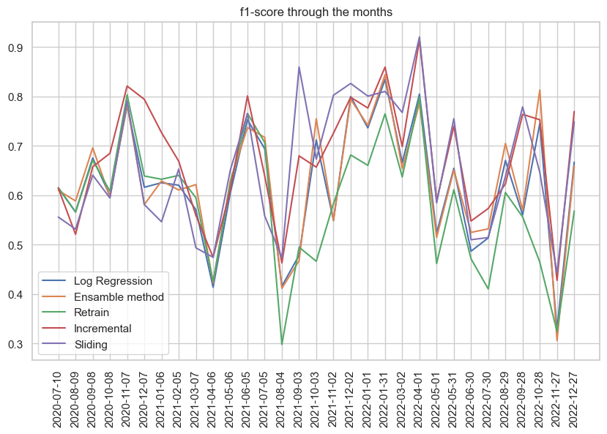
Handle data stream
Each labeled chunk of tweet contains a month worths of tweets.
Voting classifier with
Random forest
SVC
Logistic Regression
Extends training set with each new labeled chunk of tweets.
Whole classification pipeline is retrained from scratch.
Add SMOTE
- Analogous to retrain but oldest tweets are removed
- Remove tweets older than’2019-01-06’ then add tweets of the most recent two months and remove the oldest two months.
- Add SMOTE.
ENSAMBLE METHOD
RETRAIN
INCREMENTAL
SLIDING
Update model based on the new labeled chunk of tweets with a partial fitting
Naïve Bayesian Classifier
Data Stream

Slide 11
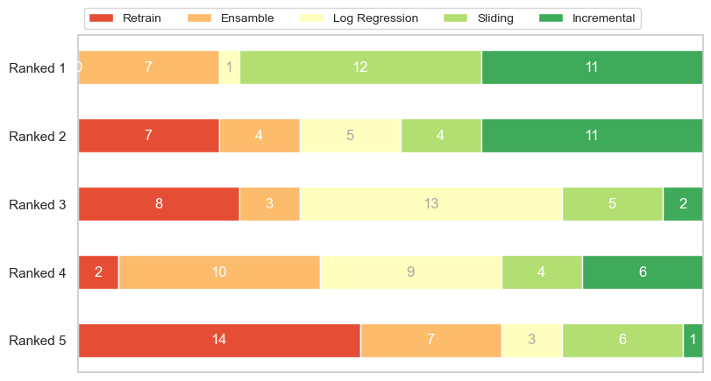
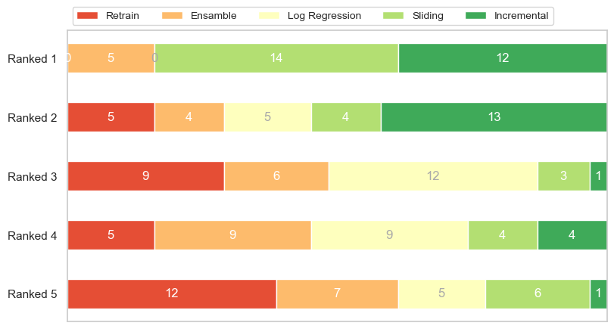
Data stream
F1-Score
Accuracy
1.SLIDING
2.INCREMENTAL
WHY?
These result could be due to an over-training problem, since several account are no longer active and we have a lower diversity of accounts.
Data Stream

Slide 12
Test on tweets of unseen people
We collect a total of 192 Tweets of unseen people equally divided between human and bot generated
 | Accuracy | F1-Score
Logistic Regression | 0.77 | 0.77
Incremental | 0.61 | 0.57
Sliding | 0.55 | 0.49
Ensamble | 0.81 | 0.81
Normal to have poor performances
Topic of discussion changed a lot
People who write changed
The models are trained on actual people
Unseen People

Slide 13
Thank You for the attention
Caterina Bruchi
Davide Bruni

