Slide 1
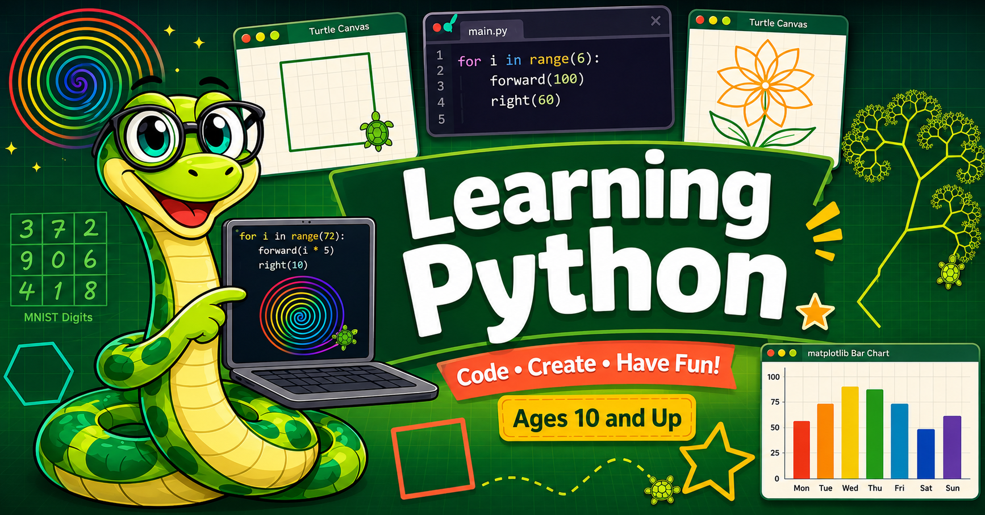
Beginning Python
From Blocks to Code with Monty
An intelligent textbook for ages 10 and up — free, interactive, and open source

Slide 2

Why This Book
Python is the #1 most-taught language in U.S. K-12 schools, yet most beginner resources assume too much. This book is built on a 450-concept learning graph, with every early chapter powered by live Skulpt labs — no installs, no accounts required.

Slide 3
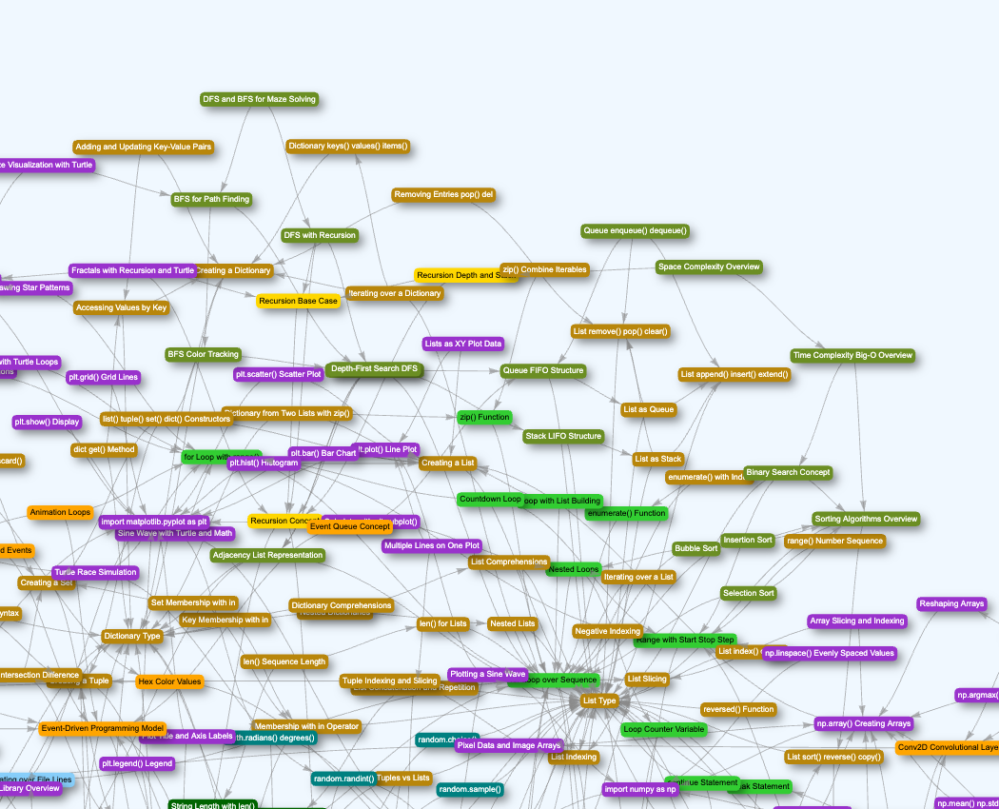
The Learning Graph
450 concepts across 14 taxonomy categories, linked by 838 dependency edges. Foundational ideas sit on the left with no prerequisites; the most advanced topics — like neural networks — sit on the right, reachable only after everything they depend on is mastered.

Slide 4
38 Chapters, Beginner to Advanced
38
450
1,057
Chapters
Concepts
Equivalent Pages
Ch 1: Welcome to Python & Skulpt → Ch 5: Turtle Graphics → Ch 24: Recursion & Fractals → Ch 32: Data Viz with Matplotlib → Ch 38: Neural Networks & MNIST

Slide 5
See It. Run It. Modify It.
👀
▶️
✏️
See It
Run It
Modify It
A short, working turtle program
Click Run, watch Monty draw it live
Change a color, a shape, a number

Slide 6

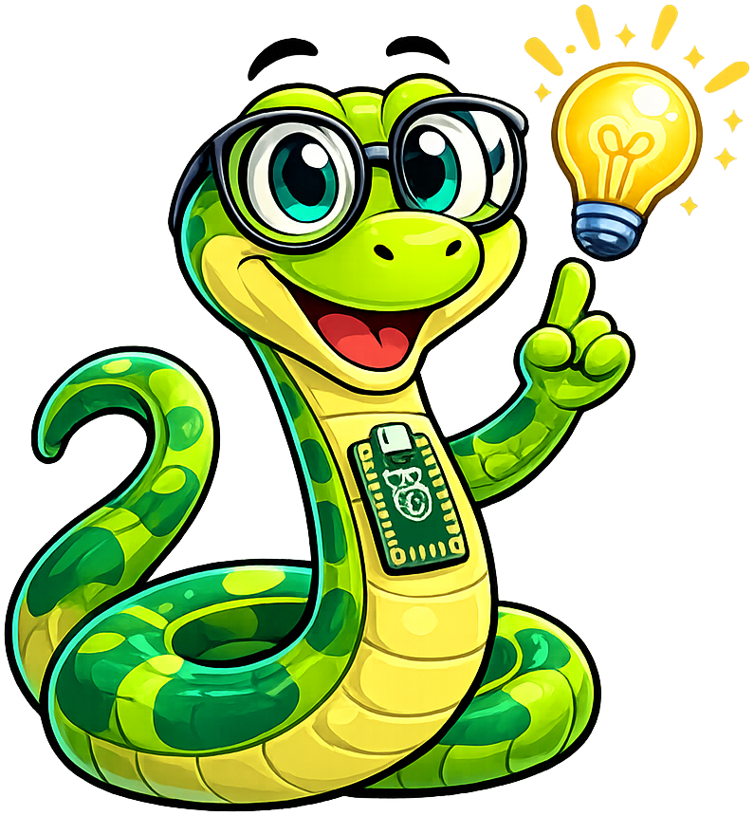




Meet Monty, Your Guide
Chapter openings
Predictions & key ideas
Helpful hints
Spot-the-bug challenges
Tough concepts
Chapter wrap-ups
General asides

Slide 7
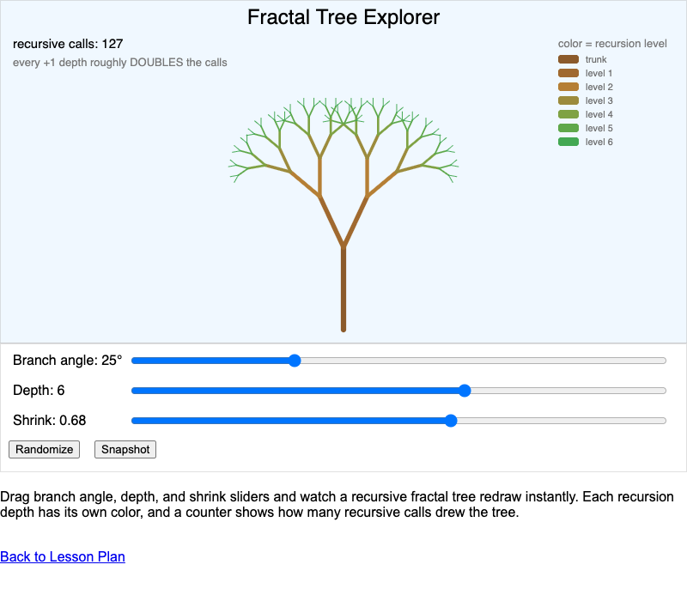
31 Interactive MicroSims
MicroSims are small, playable simulations embedded right in the page — no separate app, no install. This Fractal Tree Explorer lets students drag sliders for branch angle, depth, and shrink, and watch recursion draw itself in real time.

Slide 8
Beyond the Chapters
📖
❓
📝
📚
338 Terms
83 Answers
380 Questions
380 References
ISO 11179-style glossary
Frequently asked questions
Self-check quizzes, every chapter
Annotated, curated sources

Slide 9
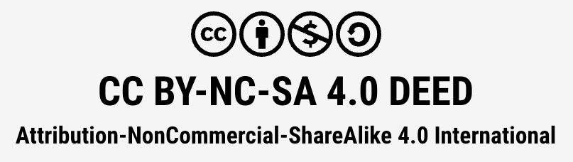
Open License, Yours to Adapt
Free to share, remix, and build on — CC BY-NC-SA 4.0. Swap in your own school's colors, logo, and mascot, as long as you keep it open and give credit.

Slide 10
Add a New Chapter in an Afternoon
📋
🕸️
✍️
📖
Describe It
Map It
Generate It
Ship It
A short course description
Concepts slot into the learning graph
AI skills draft the lesson
Same mascot, same style, same rigor

Slide 11
📊
Built to Keep Improving
Every page and MicroSim already reports real usage through Google Analytics — the foundation for agents that can propose new content or MicroSim variants and let engagement data help pick the winner.

Slide 12
Why Students & Teachers Love It
✅
450 concepts, 0 dependency violations
✅
31 interactive MicroSims, playable in-browser
✅
338 glossary terms · 380 quiz questions · 380 references
✅
No installs, no accounts — Skulpt runs in the browser
✅
Free, open source, and yours to customize

Slide 13
Ready to Start Coding?
dmccreary.github.io/learning-python
github.com/dmccreary/learning-python
450 concepts • 38 chapters • 31 MicroSims • free & open source

