Slide 1

dashboarding
On the JRC Big Data Analytics Platform
Davide De Marchi, Pierre Soille, Franck Eyraud
24th November 2022

Slide 2
Agenda
09:30-10:00: 1: Forewords by PS. Introduction to Voilà and showcase of some dashboards
10:00-10:30: 2: Working with widgets to interact with the user and to subdivide the page space
10:30-11:00: 3: Introduction to the BDAP voilalibrary
11:00-11:15: Coffee break
11:15-11:30: 4: Visualizations of Pandas tabular data and Plotly charts
11:30-12:00: 5: Deploy of dashboards in production on the BDAP VaaS (FE)
12:00-14:00: Lunch break
14:00-14:30: 6: Custom visualizations/interactions/animations with SVG
14:30-15:15: 7: Geospatial data display and interaction
15:15-15:45: 8: Step by step analysis of a real dashboard: Energy consumption in Europe
15:45-16:00: Coffee break
16:00-16:30: 9: Elements of responsive dashboards design

Slide 3





Course objectives
The course aims at creating a community of JRC developers that can publish their scientific output as modern dashboards backed by a fully-fledged data science environment.
Illustrate how to create and deploy vivid and powerful data visualization dashboards inside the BDAP Voilà service.
Experiment the recently created BDAP voilalibrary that greatly simplifies the development of the dashboard GUI.
This is a training for programmers!
Some Python & Gitlab skills are required

Slide 4
Prerequisites
Be a registered user of the BDAP platform
Be able to access JEO-lab (using the OTP) and GITLAB
Have knowledge of Python programming language
Have some knowledge of git/gitlab
BDAP Home page: https://jeodpp.jrc.ec.europa.eu/

Slide 5
Voilà
Voilà is a Jupyter plugin that converts Jupyter notebooks into standalone web applications.
Notebooks are rendered displaying only the output of the cells, while the source code is hidden.
Widgets and any multimedia content displayed in the notebook continue to work in Voilà in the same exact way as in the notebooks.
Scientist can prototype their processing in the notebooks (using a fully-fledged exploratory research environment) and communicate the results with the same tools.
Voilà dashboards need programming skill to be created.

Slide 6
Examples of Voilà dashboards
Conference on the Future of Europe (CoFE) (I.3 unit)
Dashboard that collects all the inputs sent by EU citizens on the topics of the conference. It was used by the external company in charge of creating the reports for the Parliament and the Commission
Mining JRC areas of work (Pubsy) (CSS4P, B.6, I.3 units)
Using a semantic-enriched search for mining JRC publications
Example on Energy Consumption in Europe (I.3 unit)
Sample dashboard that will be built step by step during this training course

Slide 7
Other examples of Voilà dashboards
Astronomy picture of the day
Responsive dashboard for browsing the full collection of APOD pictures
State of the union speech and JRC portfolios
Text mining dashboard to visually represent the similarities among the SOTEU 2022 speech and the descriptions of the JRC portfolios
Multivariate Choropleth Map
Dashboard created with the voilalibrary to demonstrate the functions for the creation of bivariate and trivariate legends on vector geospatial datasets

Slide 8
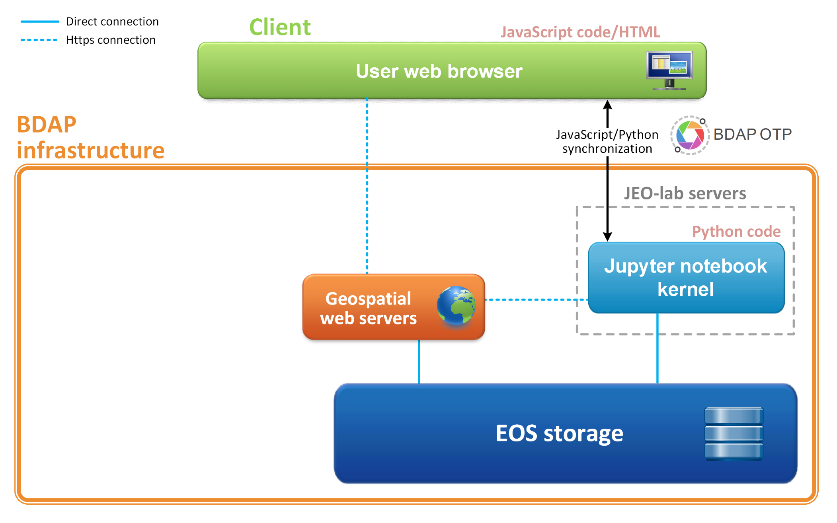
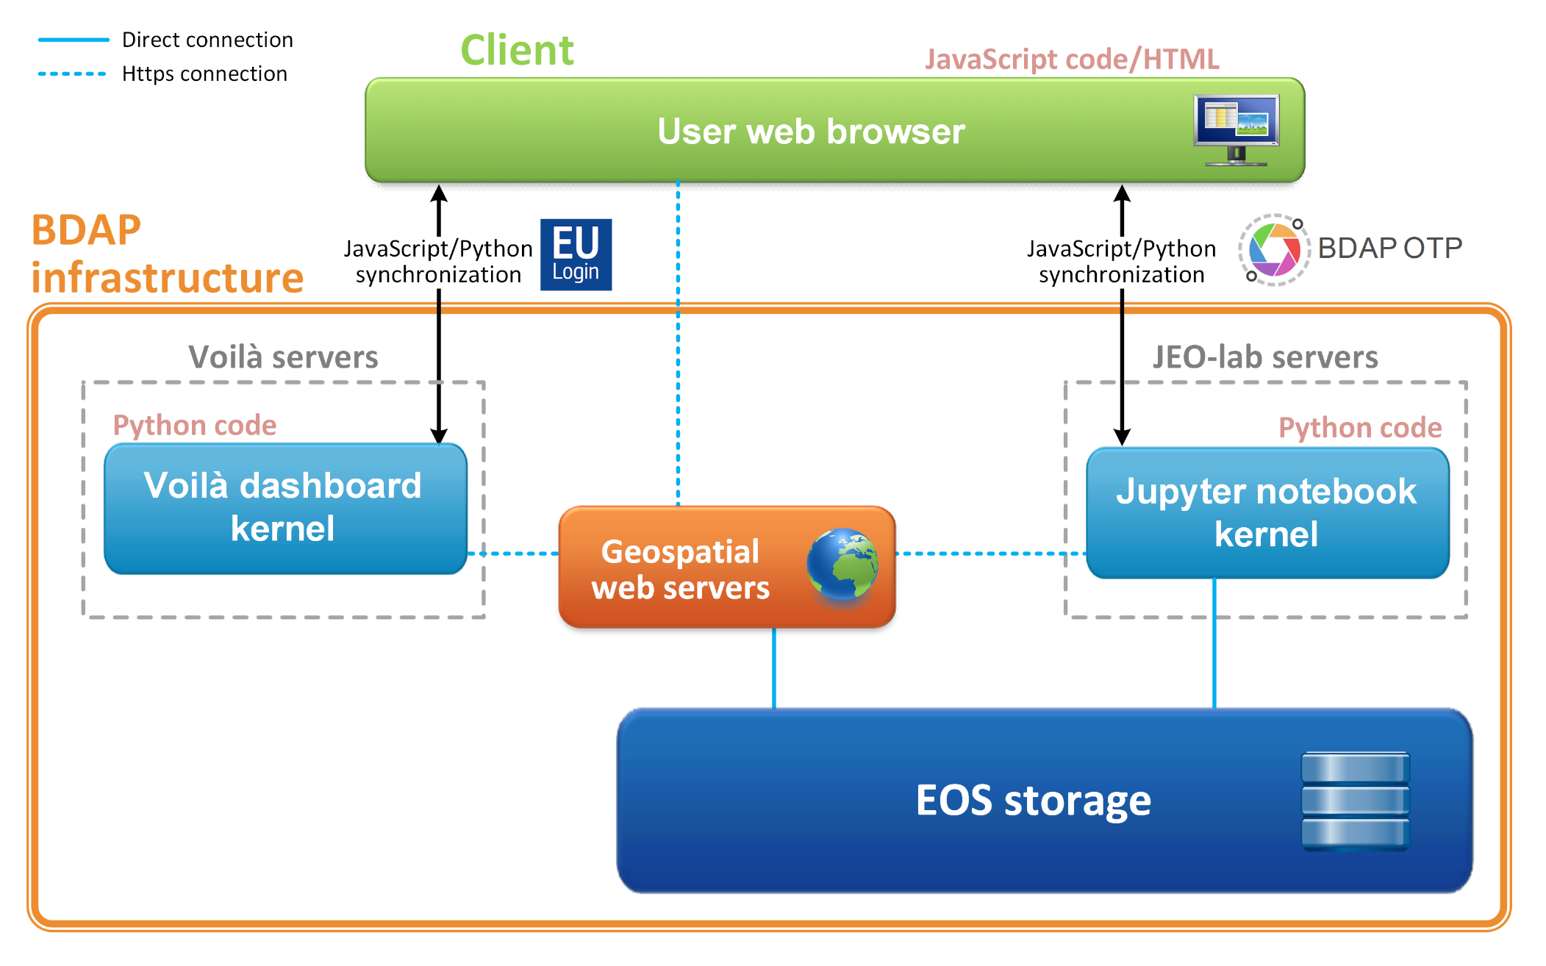
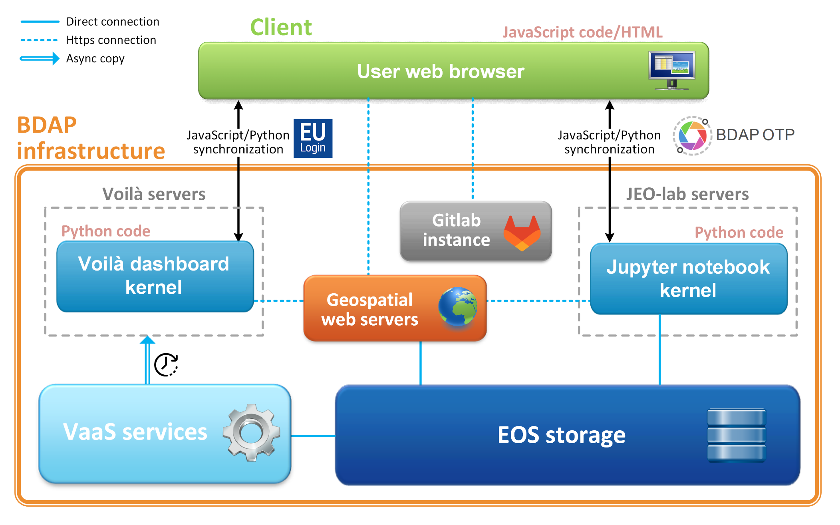
Development and deployment
1. Development in JEO-lab
2. Render in Voilà
3. Deployment on Vaas

Slide 9










Widgets and libraries used to create Voilà dashboards
ipywidgets, ipyvuetify
ipyleaflet
qgrid, ipyvuetify
bqplot, plotly, matplotlib, bokeh
ipycanvas
ipytree, ipyvuetify
ipyevents

Slide 10
How to be ready for the Voilà training!
Before the beginning of the Voilà training please take care of the following 3 steps:
Obtain credentials to access BDAP by following the instructions detailed here
Successfully access BDAP JupyterLab service (JEO-lab) at least once by following the steps detailed here
Download the course material in JupyterLab by following the steps detailed in the next slides.

Slide 11
Create a gitlab access token - 1
If you have never done it before,
create an access token for the BDAP gitlab instance
Open gitlab: https://jeodpp.jrc.ec.europa.eu/apps/gitlab/
Select “Preferences” from the top-right menu
Select “Access Tokens” from the top-left menu

Slide 12
Create a gitlab access token - 2
Give a name to the token and select all the scopes
Click on “Create personal access token”
Copy the generated access token password in a safe place, since it will not be visible anymore.

Slide 13
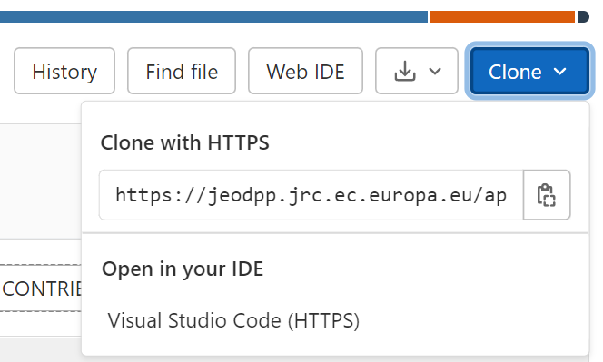
Download the course material in JupyterLab - 1
All the material for the Voilà training is stored in the following BDAP gitlab repository:
https://jeodpp.jrc.ec.europa.eu/apps/gitlab/for-everyone/libraries/vaas/voila-training-november-2022
(Short url: https://europa.eu/!6cDYNd)
Go to the repo
Click on button «Clone» in the top-right side
Copy the shown URL

Slide 14
Download the course material in JupyterLab - 2
Go to JEO-lab https://jeodpp.jrc.ec.europa.eu/jhub/ and enter with your BDAP credentials
Select the first docker image of the list: “Interactive Processing – JupyterLab - Python 3”
Start the docker image by providing your OTP
Please note: In case you already have a JEO-lab instance running from the past, stop it and remove it in order to restart it with all the updated libraries. (none of your jobs will get lost!)

Slide 15
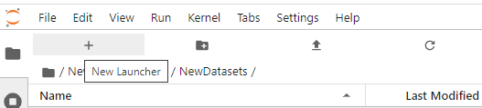
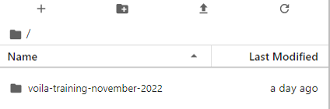
Download the course material in JupyterLab - 3
Open a Terminal window
Execute the following commands:
V.I.: remember to use as password for git clone the «gitlab access token»!
cd /home/$USERNAME
git clone https://jeodpp.jrc.ec.europa.eu/apps/gitlab/for-everyone/libraries/vaas/voila-training-november-2022.git
(the link you copied)
The voilà training repository should appear in your JEO-Lab home!

Slide 16
Content of the training repo
examples/EnergyConsumption: contains the step by step notebooks for the construction of a dashboard to analyse and display data on Energy Consumption in Europe
examples/notebooks: contains one notebook example for each of the modules of the voilalibrary and constitutes a first-aid resource for the usage of the library (many of the examples are the same that are included in the online documentation here)
training: contains learning material and notebooks used and showcased during the training
voilalibrary: copy of the source code of the voilalibrary
Online documentation on voilalibrary: https://jeodpp.jrc.ec.europa.eu/services/shared/voilalibrary/

Slide 17

IP aspects when sharing data
Data produced solely by JRC/Commission
Include licence on page:
© European Union, [year of first publication and last update]
(in rare cases CC0 if data are raw measurements)
Meaning people who reuse the data shall indicate the source
Commission has no liability for the data (and its reuse)
Data produced by third party and in collaboration with third party
Assess any downstream restrictions that third party might impose via licences
(It might be that restrictions prohibit sharing the data on a public website)
Refer to the source and appropriate licence on page
In case you need assistance in assessing downstream restrictions, the central IP service can help (EC-IPR@ec.europa.eu)

Slide 18
VaaS deployment - overview
Dashboards on git repositories
Develop using JEO-lab
Deploy to VaaS server
Automatic regular checks (every 15 minutes) of new changes
Feedback after deployment
Notebook accessible

Slide 19
VaaS development – Create a git repository
Fork the Voilà template repository
Choose correctly its name (will be mentioned in the access url)
Start to develop or insert there the notebook already developed
Voilà template URL :
https://jeodpp.jrc.ec.europa.eu/apps/gitlab/for-everyone/libraries/vaas/voila-notebook-template

Slide 20
VaaS development – Use JEO-Lab
Development can be done using JEO-Lab accessible through https://jeodpp.jrc.ec.europa.eu/jhub/
Start the image called
“Interactive Processing - JupyterLab - Python 3”
which is the first in the dropdown list.

Slide 21
Voilà development – Clone the repository
Clone your repository from the JEO-Lab terminal
Example:
cd /home/<myusername>
mkdir voila
cd voila
git clone https://jeodpp.jrc.ec.europa.eu/.../username/myvoilarepo.git

Slide 22
Voilà development – Create your notebook
Develop one (or more) Jupyter notebook (.ipynb file) using the JupyterLab environment and voilalibrary.
You can add additional ASCII files (csv, geojson, python libraries) or small binary files (shape files), subfolders
Consider that git is a change tracking system, not a storage location, a repository has to be limited in size (10MB including all history is large)
Submit your changes using git commands
git commit
git push

Slide 23
VaaS deployment – Declare your dashboard
First time you want to publish your notebook, open an issue in the Voilà template project to ask for it to be deployed.
Provide simple information :
Root: Root name where the project associated to this repo will be deployed (your use case name)
Description: a brief description of the scope of the dashboards
Project: full path of the forked copy of the template gitlab repository, for example:https://jeodpp.jrc.ec.europa.eu/apps/gitlab/username/myvoilarepo
If everything OK, you will get confirmation in the ticket

Slide 24
VaaS deployment – Automatic deploy
Once the dashboard is added for deployment, some regular automatic runs:
check last changes
if modifications, extract the repo and checks for consistency
synchronize the repo content to VaaS server
Sends feedback in gitlab (should trigger an email)

Slide 25
VaaS deployment – Access your notebook
One unique url by notebook
Example: given that: Root name is usecase1
forked Project name is myvoilarepo
A notebook having name dashboard1.ipynb can be accessed using this direct URL:
https://jeodpp.jrc.ec.europa.eu/eu/vaas/voila/render/usecase1/myvoilarepo/dashboard1.ipynb
Deployed dashboards will be visible to any EUlogin user with an email ending with europa.eu

Slide 26
VaaS deployment – Use files from storage
The VaaS server is isolated for security reason. No direct access to BDAP storage.
To use files from BDAP storage, you can ask for synchronization, using the voila-data-location file. One path per line (folders or single files).
Files are synchronized at each deploy of your dashboard. To have them copied, you need to create a commit.
Size limit : 10GB of data.

Slide 27

Thank you
© European Union 2022
Unless otherwise noted the reuse of this presentation is authorised under the CC BY 4.0 license. For any use or reproduction of elements that are not owned by the EU, permission may need to be sought directly from the respective right holders.
Notes:
Update/add/delete parts of the copy right notice where appropriate.
More information: https://myintracomm.ec.europa.eu/corp/intellectual-property/Documents/2019_Reuse-guidelines%28CC-BY%29.pdf

