Slide 1
Build high performance distributed apps with Azure Cosmos DB
Speaker Name
Email
Etc.

Slide 2
Session objectives
Understand the relationship between consistency, availability and latency when building distributed applications.

Slide 3
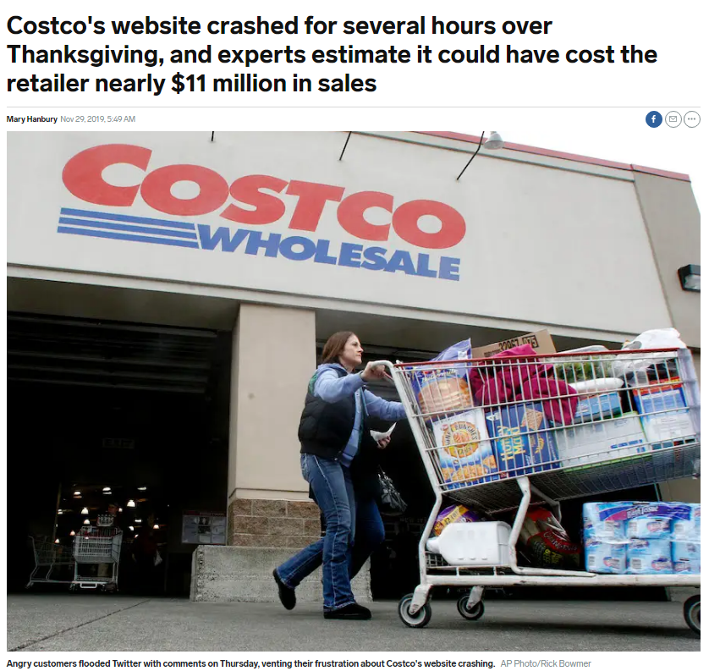
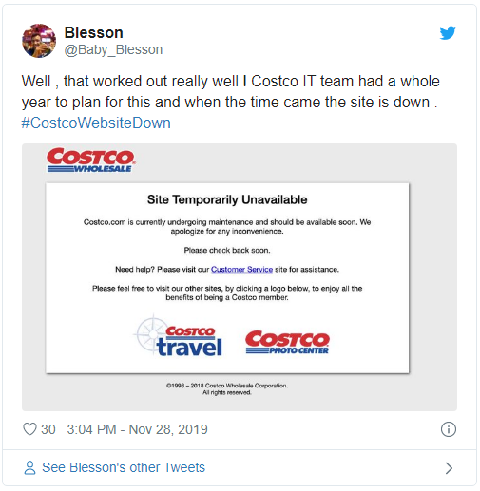
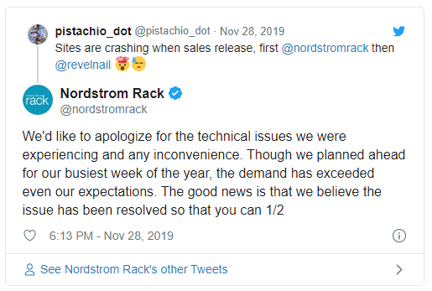
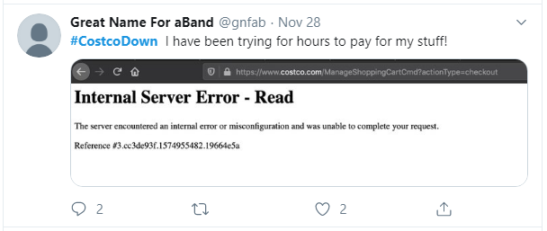
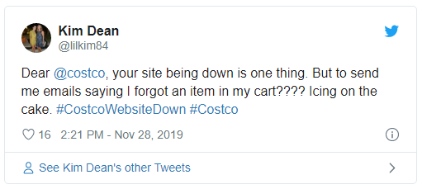
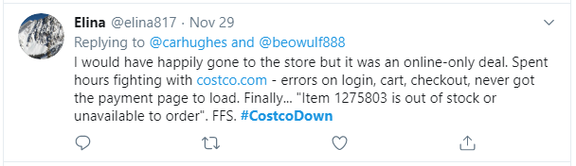
Availability
Thanksgiving: $4.2B
Black Friday: $6.2B
Cyber Monday: $9.4B

Slide 4
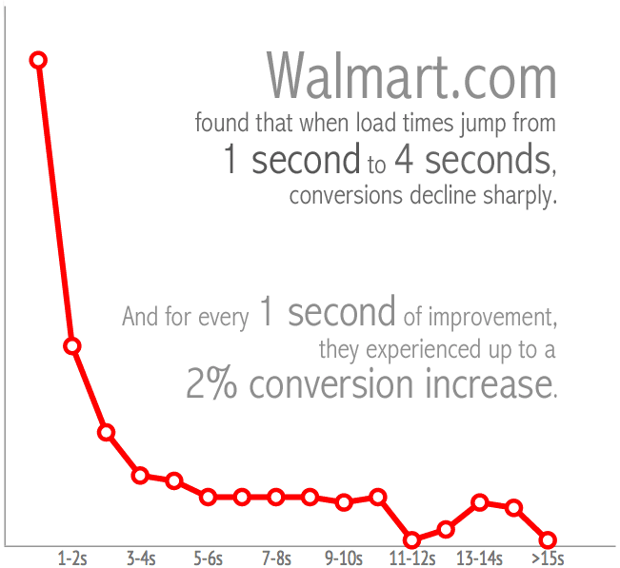
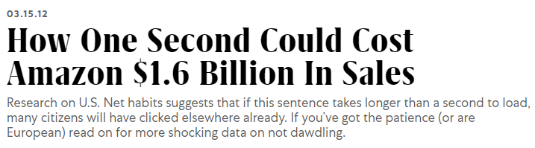
Latency
Latency = Performance
Performance = User Experience
User experience = $ and loyalty
https://www.fastcompany.com/1825005/how-one-second-could-cost-amazon-16-billion-sales
https://blog.radware.com/applicationdelivery/wpo/2014/04/web-page-speed-affect-conversions-infographic/

Slide 5

Science Time

Slide 6
Concepts
Consistency
Latency
Availability

Slide 7
Defining consistency
A
Atomicity
C
Consistency
I
Isolation
D
Durability

Slide 8
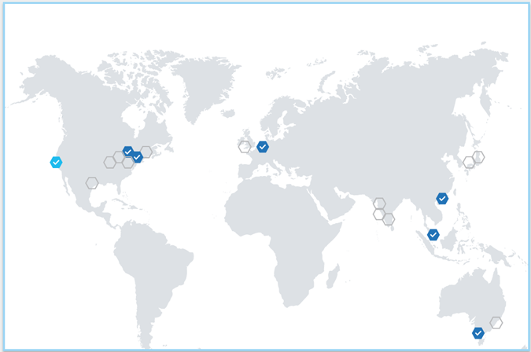
Defining consistency

Slide 9
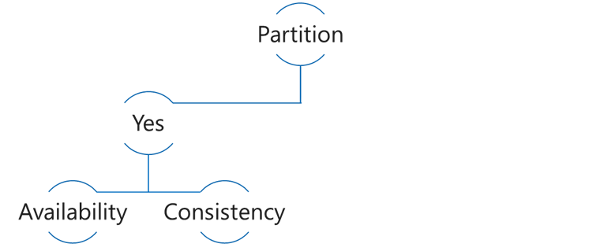
CAP Theorem
Consistency: Always get the most recent write, or an error
Availability: Every request receives a response, even if not the latest data
Partition tolerance: Continues to work even if replica connectivity lost
Choose Availability
5
5
6
5

Slide 10
CAP Theorem
Choose Consistency
5
5
6

Slide 11
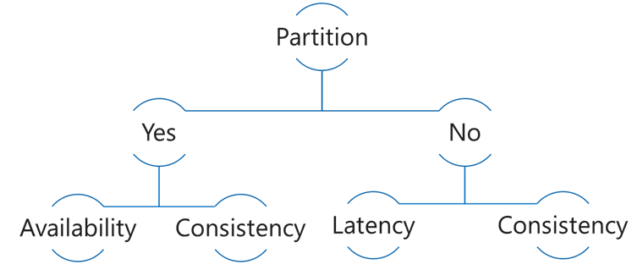
PACELC Theorem
In the case of network Partitioning in a distributed computer system, one has to choose between Availability and Consistency, but Else, even when the system is running normally in the absence of partitions, one has to choose between Latency and Consistency.
Choose Consistency
5
5
6
6

Slide 12
PACELC Theorem
Choose Latency
5
5
6
6
7
7

Slide 13
Read Latency

Slide 14
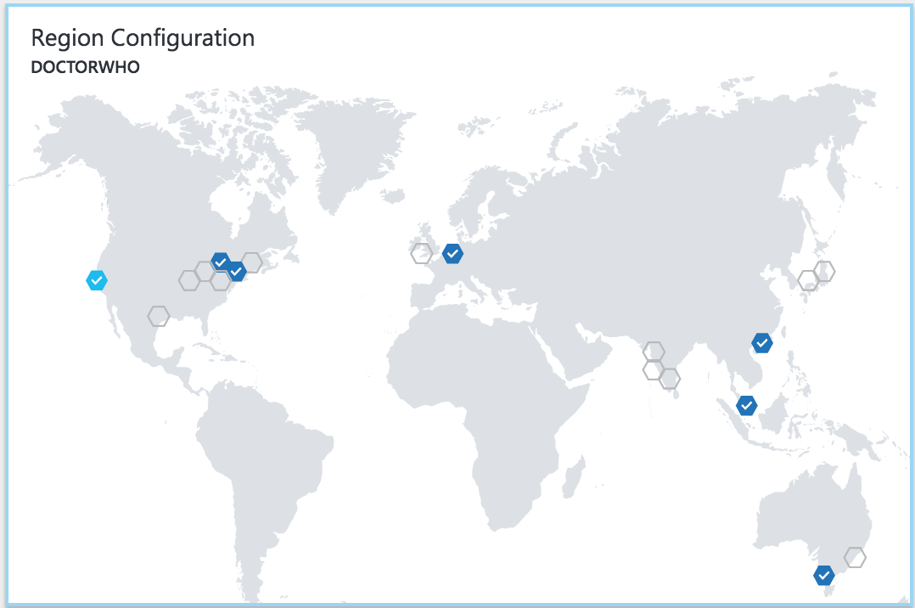
Latency
The lower the latency, the better the performance and experience

Slide 15
Demo
Read Latency with single region, vs multi-region

Slide 16
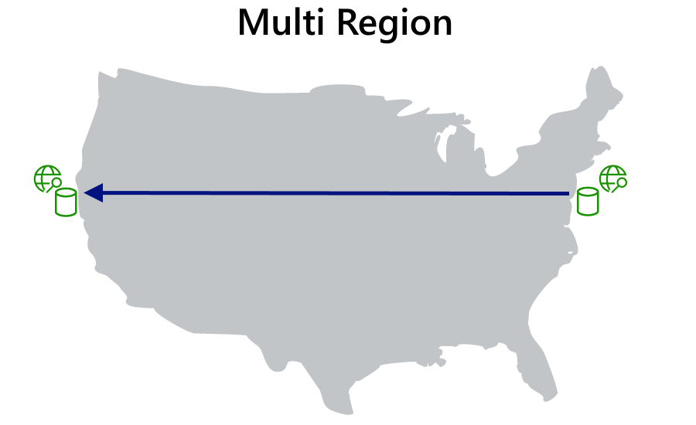
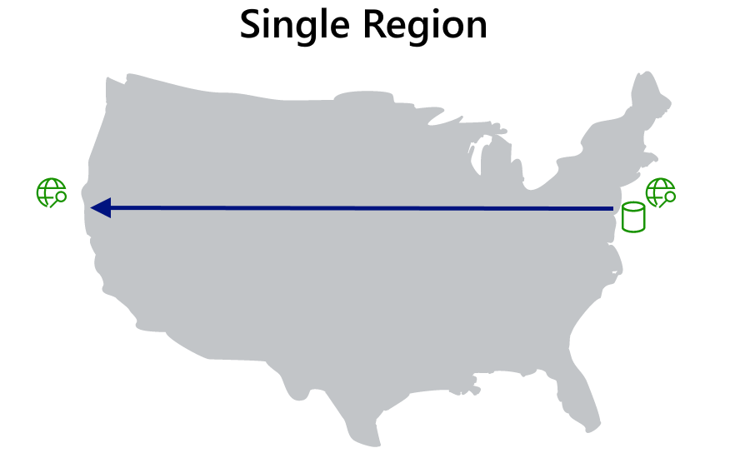
Read Latency

Slide 17
Write Latency

Slide 18




Azure Cosmos DB Multi Master​
Every region writable​
<10 ms read write latency​
99.999% Availability​
Unlimited endpoint scalability
Flexible conflict resolution​​
Master
(read/write)
Region A
Master
(read/write)
Master
(read/write)
Region B
Replica
(read)
Azure Traffic Manager
Master
(read/write)
Region C
Replica
(read)

Slide 19
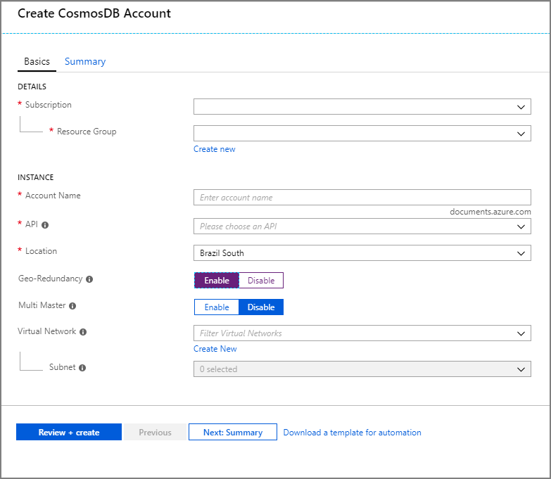
Adding multi master support
Create new Cosmos DB account
Enable Multi Master

Slide 20
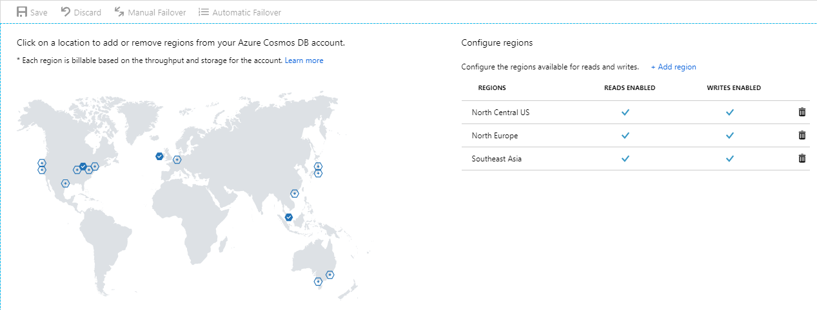
Configure regions
Add regions

Slide 21
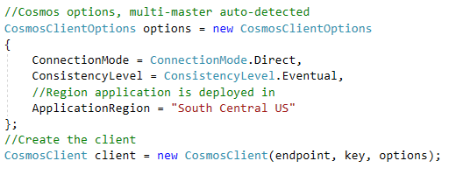
In your apps
Detected automatically
Just set the region deployed in

Slide 22
Demo
Write latency for single-write vs. multi-write

Slide 23
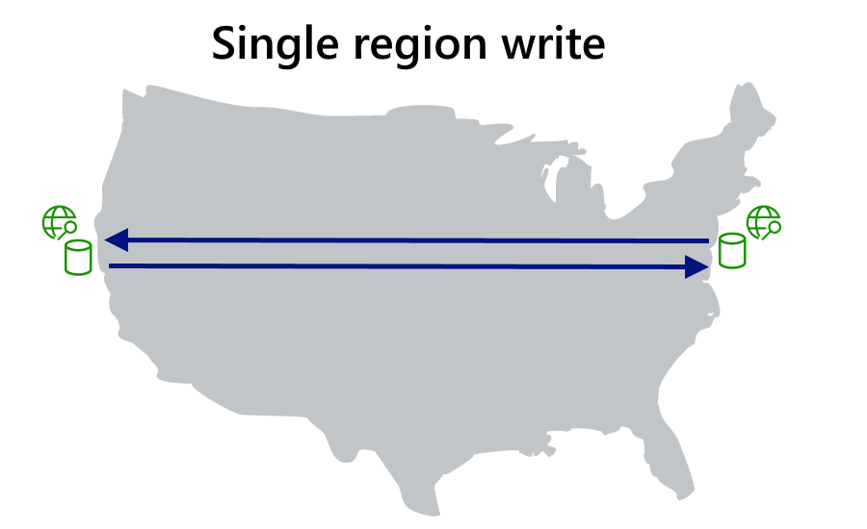
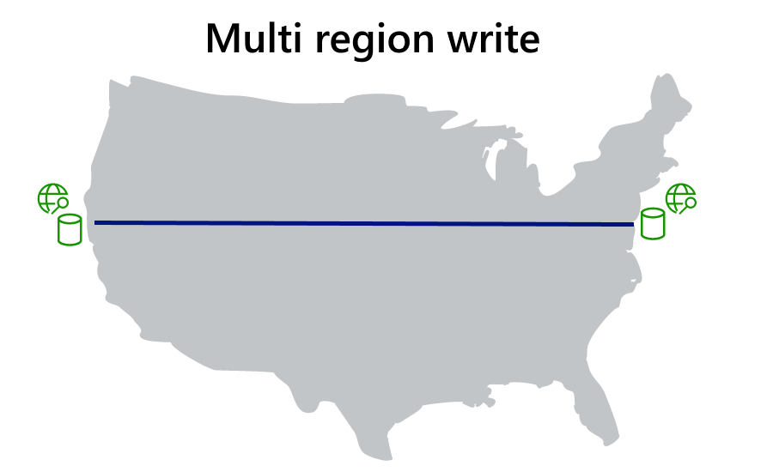
Write Latency

Slide 24
Consistency

Slide 25
FIVE WELL-DEFINED CONSISTENCY MODELS
Five consistency models to choose from
Choose the best consistency model for your app
Provides control over performance-consistency tradeoffs, backed by comprehensive SLAs
An intuitive programming model offering low latency and high availability for your planet-scale app
Strong
Bounded-staleness
Session
Consistent prefix
Eventual

Slide 26
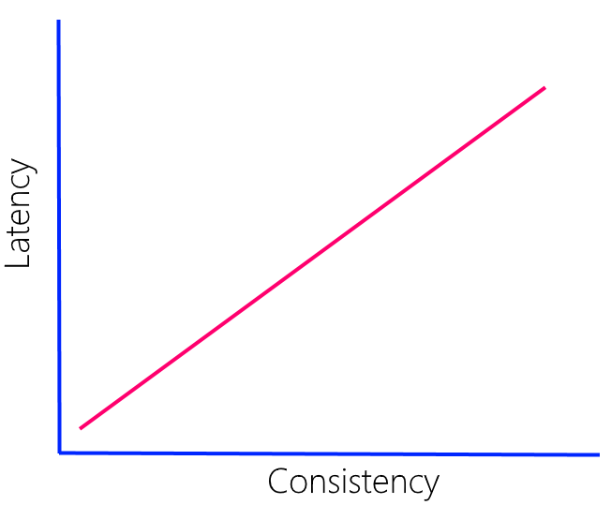
Latency vs. Consistency
Direct relationship
More pronounce with greater distance
Speed of light
WAN 10-15% slower
Strong consistency - multiple regions (<5000 miles)

Slide 27
Consistency vs. Throughput
Replica Set
follower
follower
follower
Consistency Level | Quorum Reads | Quorum Writes
Strong | Local Minority (2 RU) | Global Majority (5 RU)
Bounded Staleness | Local Minority (2 RU) | Local Majority (5 RU)
Session | Single replica using session token(1 RU) | Local Majority (5 RU)
Consistent Prefix | Single replica (1 RU) | Local Majority (5 RU)
Eventual | Single replica (1 RU) | Local Majority (5 RU)

Slide 28
Dynamic Read Quorum
Maintain availability for Strong consistency if 3+ regions

Slide 29
Demo
Consistency vs. Latency
Consistency vs. Throughput

Slide 30
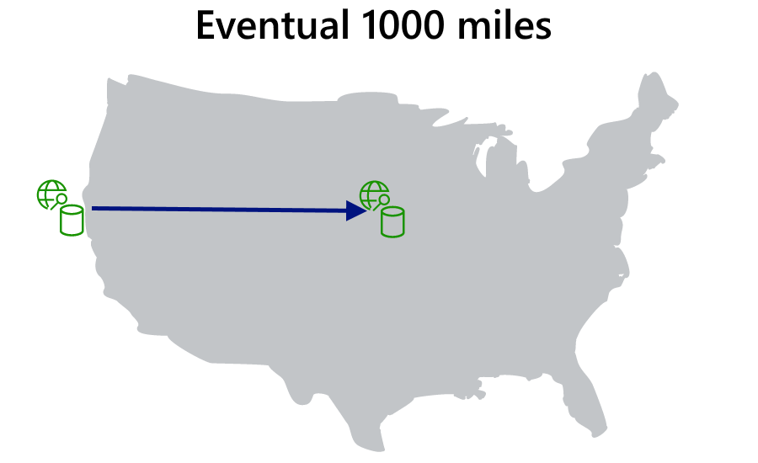

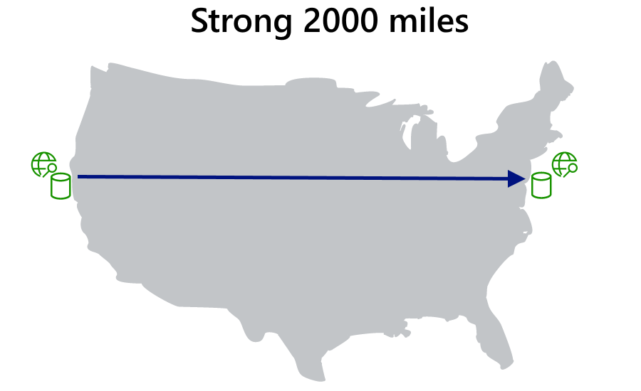
Consistency vs. Latency

Slide 31
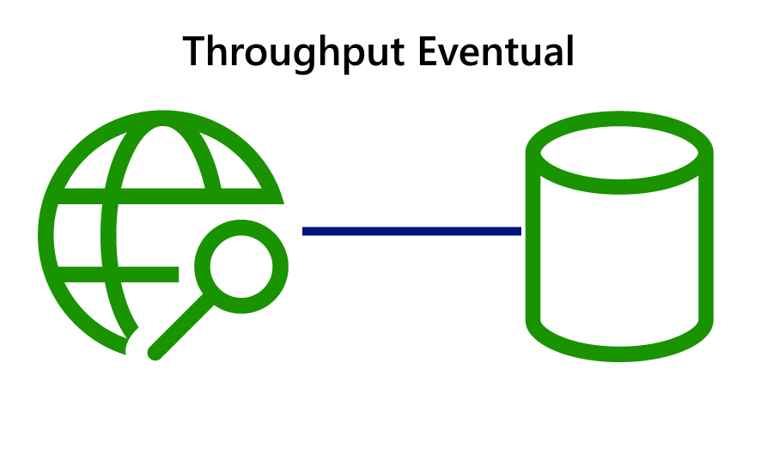

Consistency vs. Throughput

Slide 32
Availability

Slide 33
In-region redundacy
follower
follower
follower

Slide 34
Durability and Recovery time
RPO =
RTO =
how long did you lose data
how long are you down

Slide 35
Data Durability and Availability
Partition
Yes
Latency
Availability
Consistency
No
Consistency
Region(s) | Mode | Consistency | RPO | RTO
1 | Any | Any | < 240 minutes | < 1 week
>1 | Single Master | Session, Consistent Prefix, Eventual | < 15 minutes | < 15 minutes
>1 | Single Master | Bounded Staleness | K & T* | < 15 minutes
>1 | Single Master | Strong | 0 | < 15 minutes
>1 | Multi Master | Session, Consistent Prefix, Eventual | < 15 minutes | 0
>1 | Multi Master | Bounded Staleness | K & T* | 0
>1 | Multi Master | Strong | N/A | N/A
*Number of "K" updates of an item or "T" time. In >1 regions, K=100,000 updates or T=5 minutes.

Slide 36
Managing conflicts

Slide 37
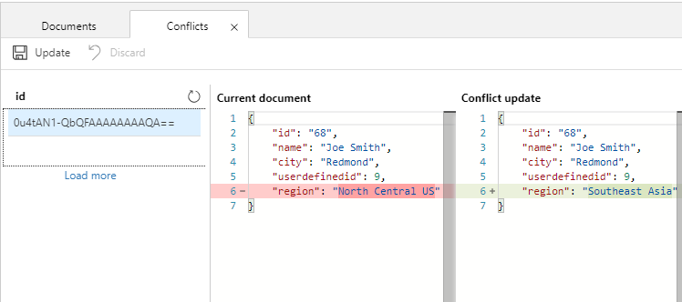
Flexible conflict management
Last Writer Wins
Custom Merge Stored Procedure
None – Conflict Feed

Slide 38
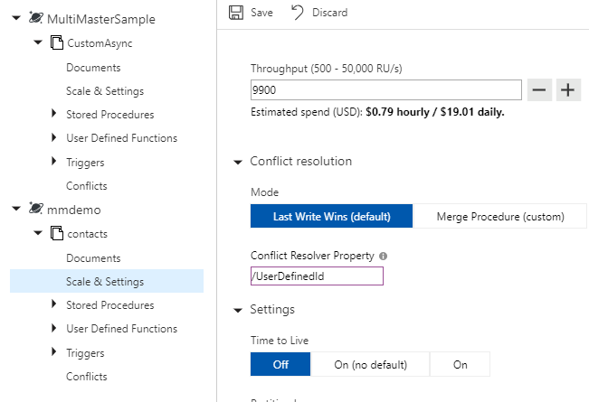
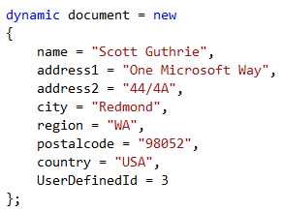
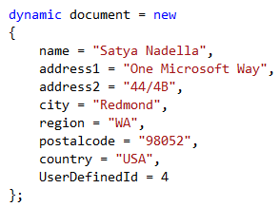
Last Writer Wins
Default
Use “_ts” for all APIs
User defined numeric value for SQL-API

Slide 39
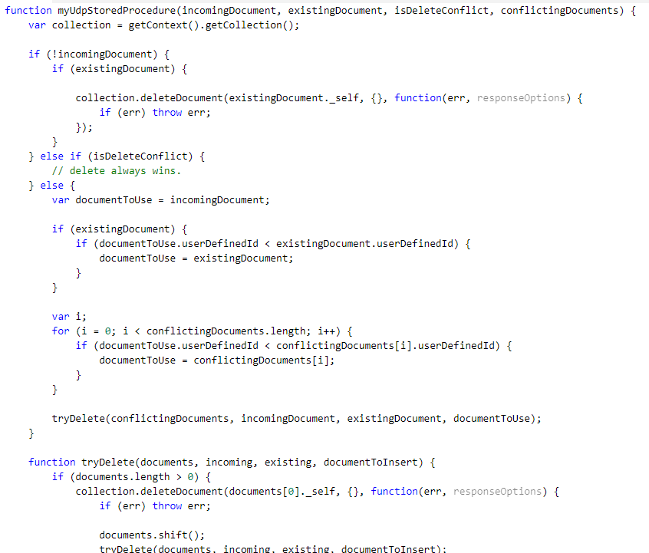
Custom Merge Stored Procedure
Register stored procedure
Special signature
Scope to container only
Exactly once guarantee
Executed as part of commit
Available for SQL API only

Slide 40
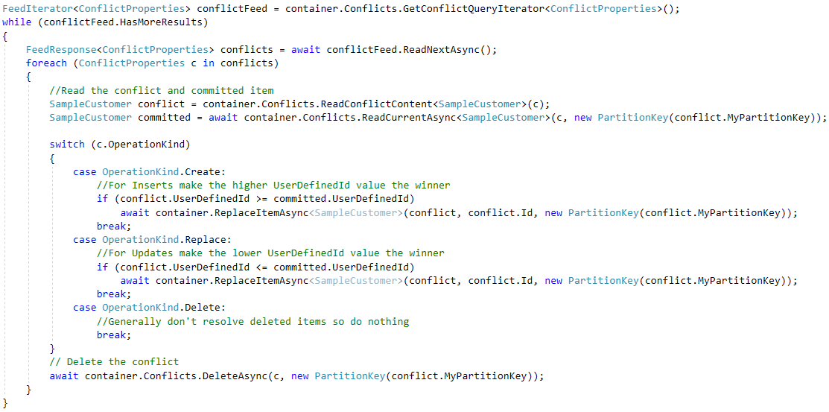
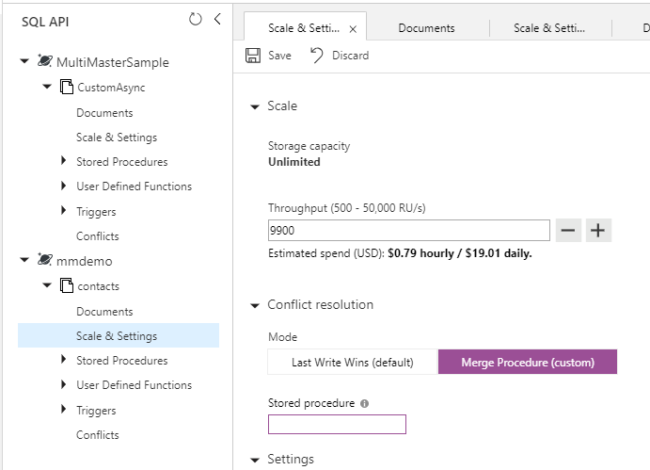
Conflict Feed
Leave procedure blank
Or exception in stored proc
Manually resolve

Slide 41
Demo
Conflict Resolution

Slide 42
Session takeaways
Understand the relationship between consistency, availability and latency when building modern applications

Slide 43
Session resources
Demos: https://aka.ms/cosmos-global-demos
Global Distribution: https://aka.ms/cosmos-global-distribution
Consistency: https://aka.ms/cosmos-consistency-levels
High Availability: https://aka.ms/cosmos-high-availability

Slide 44
Q&A

