Slide 1
Build high performance distributed apps with Azure Cosmos DB
Mark Brown
Principal Program Manger
Azure Cosmos DB
mjbrown@microsoft.com
@markjbrown

Slide 2
Session objectives
Understand the relationship between consistency, availability and latency when building distributed applications.

Slide 3
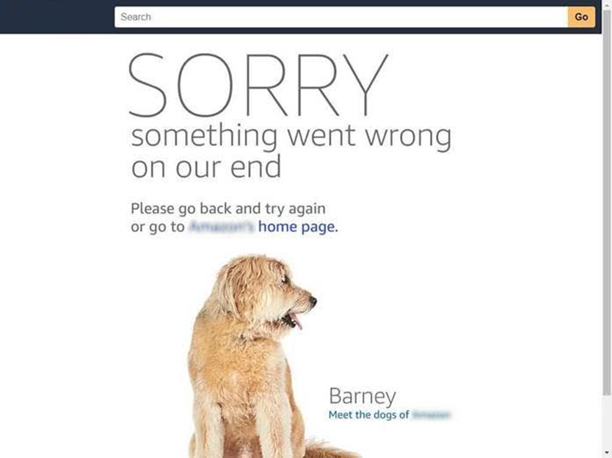
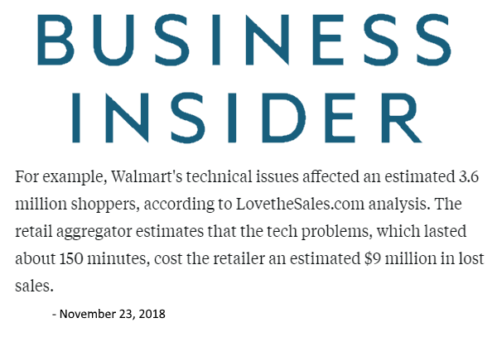
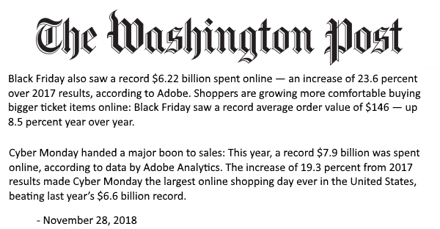
Availability
Thanksgiving: $3.7B
Black Friday: $6.2B
Cyber Monday: $7.9B
In addition to the revenue impact of lost sales, the bigger impact is the loyal customers a brand might lose from having a non-functioning website on one of the biggest shopping days of the year.
- Mehdi Daoudi, CEO Catchpoint
Multiple active replicas
+ Availability
+ Scale

Slide 4
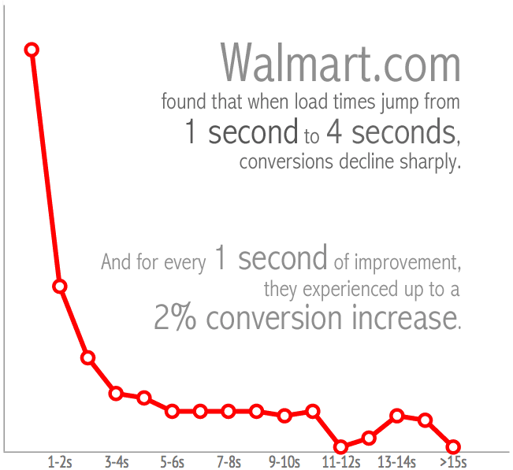
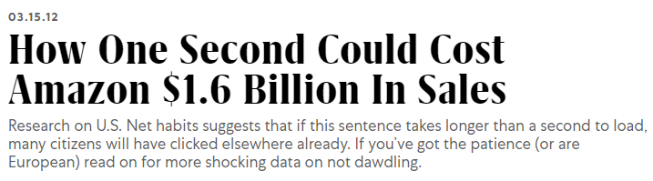
Latency
Latency = Performance
Performance = User Experience
User experience = $ and loyalty
https://www.fastcompany.com/1825005/how-one-second-could-cost-amazon-16-billion-sales
https://blog.radware.com/applicationdelivery/wpo/2014/04/web-page-speed-affect-conversions-infographic/

Slide 5





Azure Cosmos DB
A globally distributed, massively scalable, multi-model database service
Core (SQL) API
Table API
MongoDB
Column-family
Document
Key-value
Graph
Guaranteed low latency at the 99th percentile
Elastic scale out
of storage & throughput
Five well-defined consistency models
Turnkey global distribution
Comprehensive SLAs

Slide 6

Science Time

Slide 7
Concepts
Consistency
Latency
Availability

Slide 8
Defining consistency
A
Atomicity
C
Consistency
I
Isolation
D
Durability

Slide 9
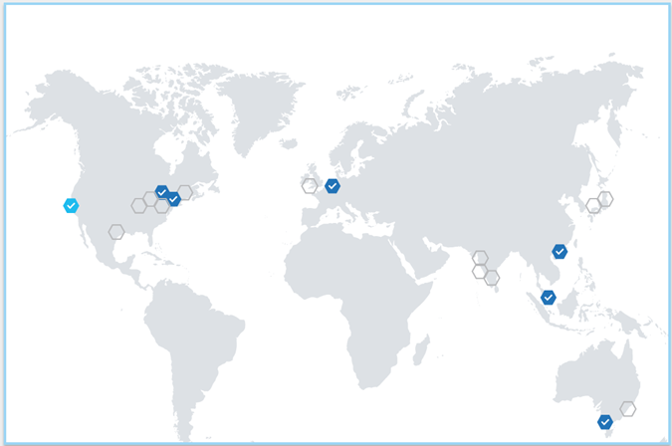
Defining consistency

Slide 10
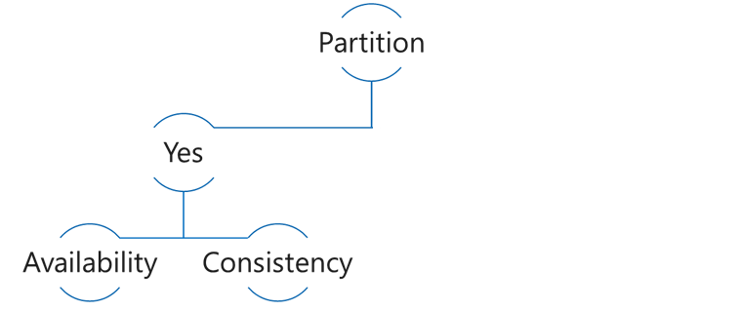
CAP Theorem
Consistency: Always get the most recent write, or an error
Availability: Every request receives a response, even if not the latest data
Partition tolerance: Continues to work even if replica connectivity lost
Choose Availability
5
5
6
5

Slide 11
CAP Theorem
Choose Consistency
5
5
6

Slide 12
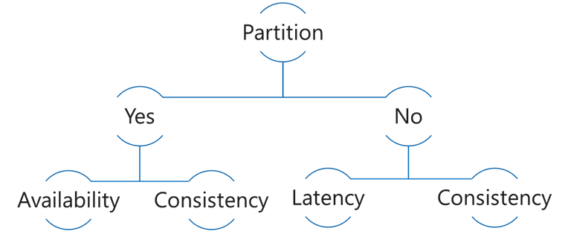
PACELC Theorem
In the case of network Partitioning in a distributed computer system, one has to choose between Availability and Consistency, but Else, even when the system is running normally in the absence of partitions, one has to choose between Latency and Consistency.
Choose Consistency
5
5
6
6

Slide 13
PACELC Theorem
Choose Latency
5
5
6
6
7
7

Slide 14
Read Latency

Slide 15
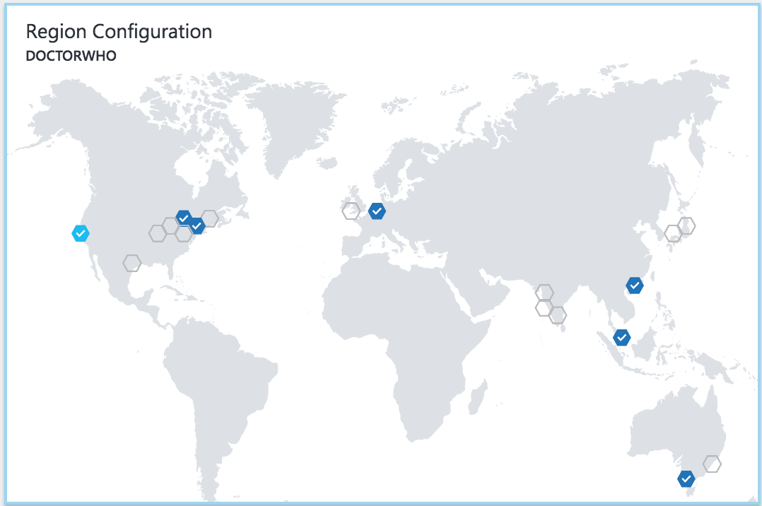
Latency
The lower the latency, the better the performance and experience

Slide 16
Demo
Read Latency with single region, vs multi-region

Slide 17
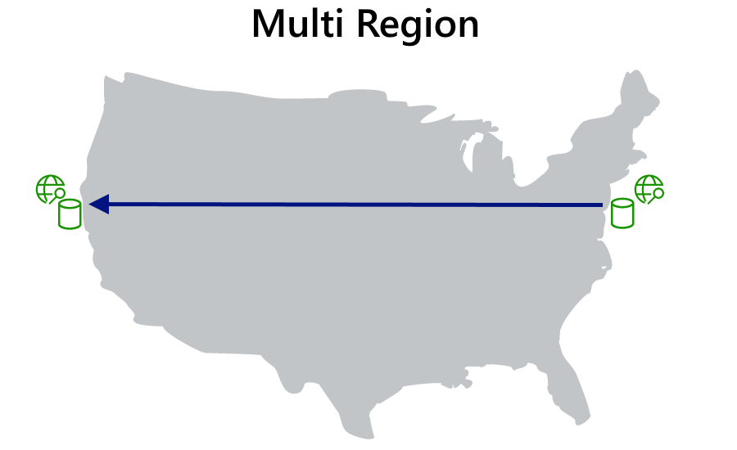
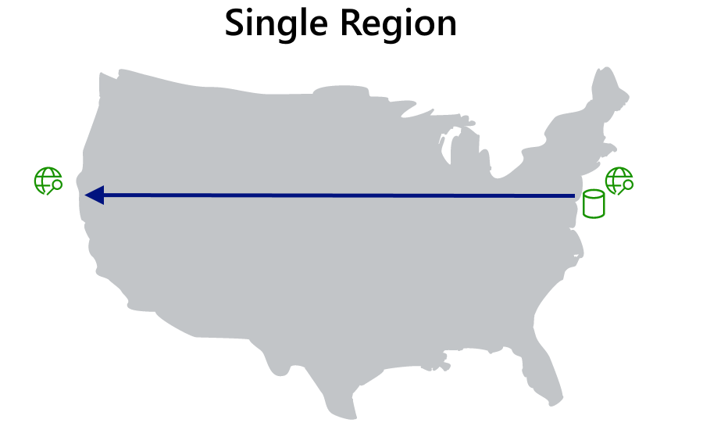
Read Latency

Slide 18
Write Latency

Slide 19




Azure Cosmos DB Multi Master​
Every region writable​
<10 ms read write latency​
99.999% Availability​
Unlimited endpoint scalability
Flexible conflict resolution​​
Master
(read/write)
Region A
Master
(read/write)
Master
(read/write)
Region B
Replica
(read)
Azure Traffic Manager
Master
(read/write)
Region C
Replica
(read)

Slide 20
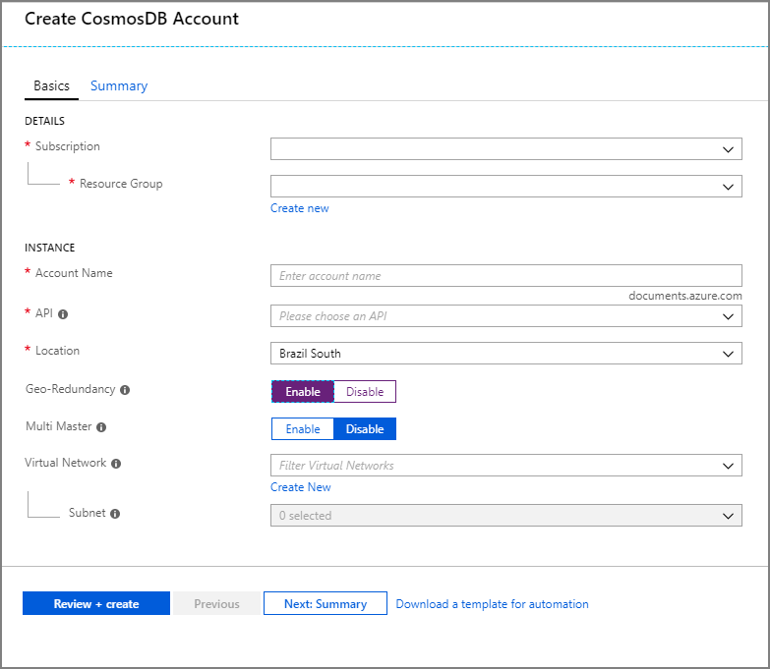
Adding multi master support
Create new Cosmos DB account
Enable Multi Master

Slide 21
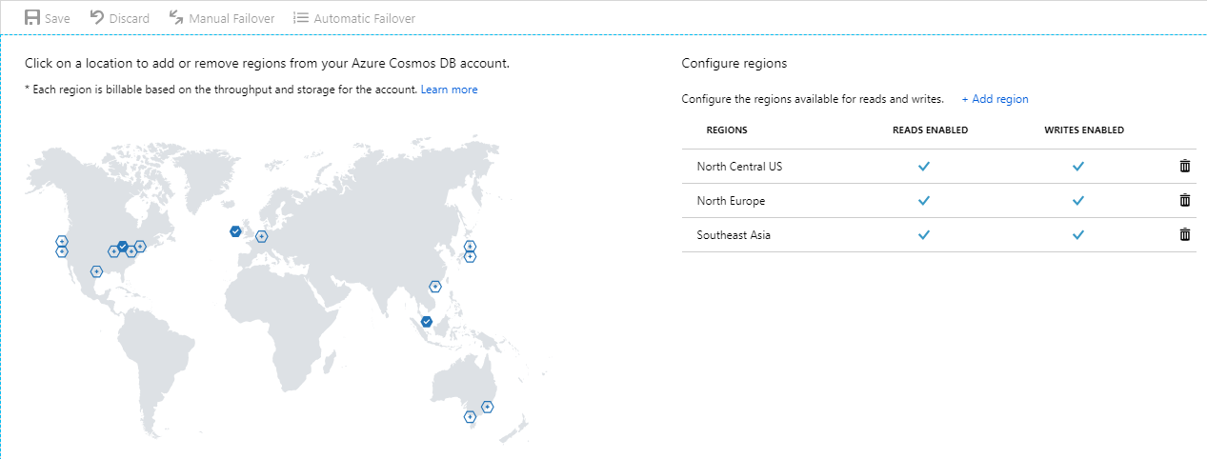
Configure regions
Add regions

Slide 22
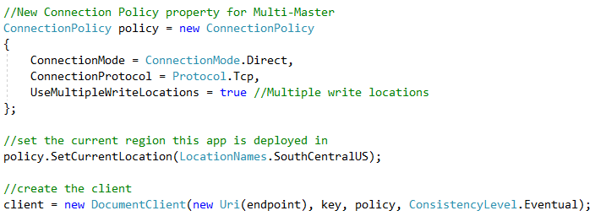
In your apps
UseMultipleWriteLocations
SetCurrentLocation

Slide 23
Demo
Write latency for single-write vs. multi-write

Slide 24
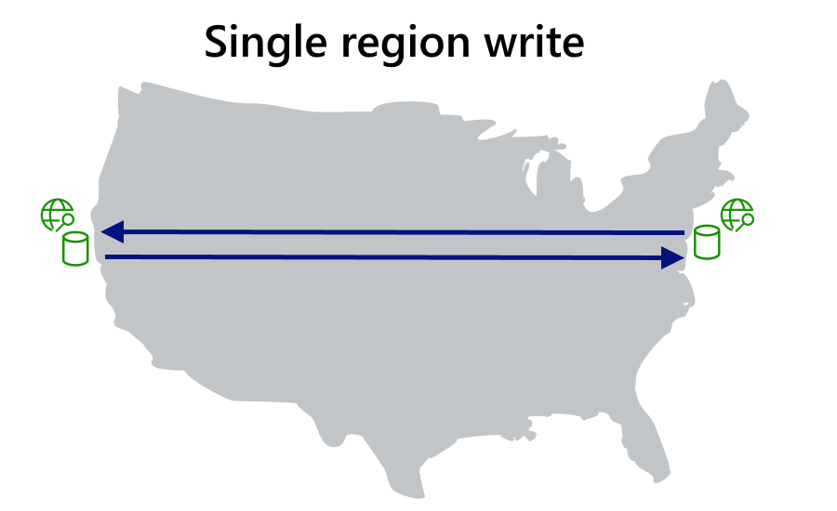
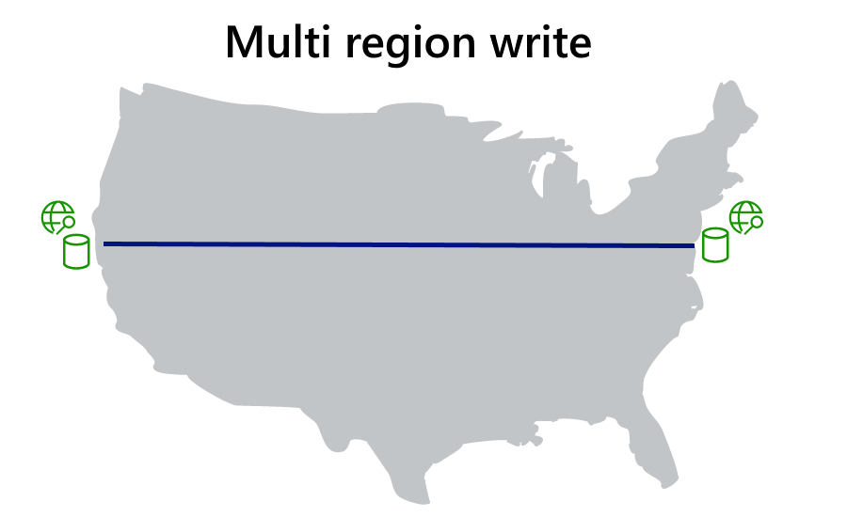
Write Latency

Slide 25
Consistency

Slide 26
FIVE WELL-DEFINED CONSISTENCY MODELS
Five consistency models to choose from
Choose the best consistency model for your app
Provides control over performance-consistency tradeoffs, backed by comprehensive SLAs
An intuitive programming model offering low latency and high availability for your planet-scale app
Strong
Bounded-staleness
Session
Consistent prefix
Eventual

Slide 27
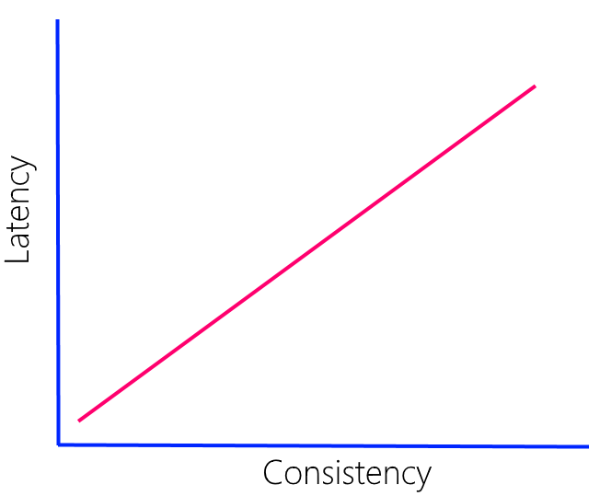
Latency vs. Consistency
Direct relationship
More pronounce with greater distance
Speed of light
WAN 10-15% slower
Strong consistency - multiple regions (<5000 miles)

Slide 28
Consistency vs. Throughput
Replica Set
forwarder
follower
follower
Consistency Level | Quorum Reads | Quorum Writes
Strong | Local Minority (2 RU) | Global Majority (8 RU)
Bounded Staleness | Local Minority (2 RU) | Local Majority (8 RU)
Session | Single replica using session token(1 RU) | Local Majority (8 RU)
Consistent Prefix | Single replica (1 RU) | Local Majority (8 RU)
Eventual | Single replica (1 RU) | Local Majority (8 RU)

Slide 29
Demo
Consistency vs. Latency
Consistency vs. Throughput

Slide 30
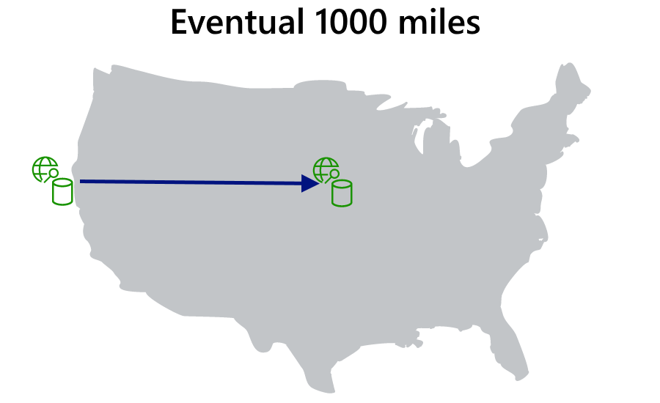

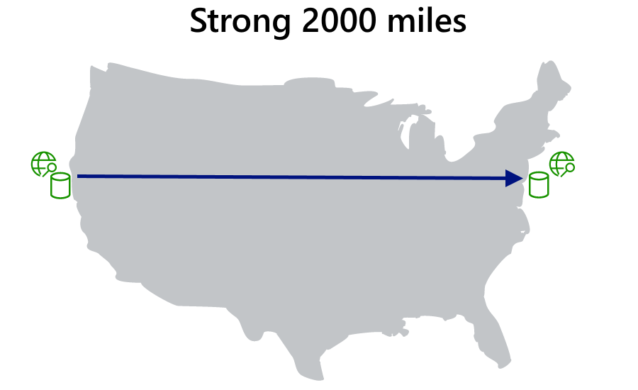
Consistency vs. Latency

Slide 31
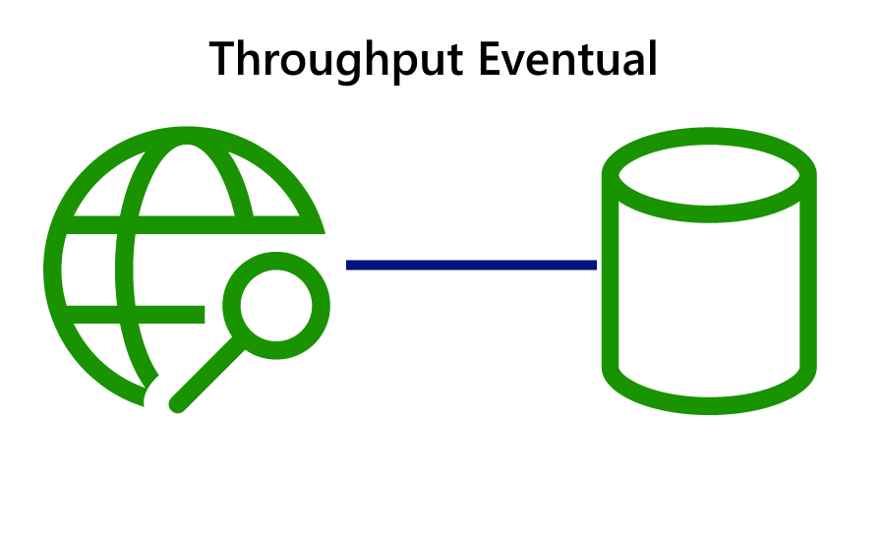

Consistency vs. Throughput

Slide 32
Availability

Slide 33
In-region redundacy
forwarder
follower
follower

Slide 34
Durability and Recovery time
RPO =
RTO =
how long did you lose data
how long are you down

Slide 35
Data Durability and Availability
Partition
Yes
Latency
Availability
Consistency
No
Consistency
Region(s) | Mode | Consistency | RPO | RTO
1 | Any | Any | < 240 minutes | < 1 week
>1 | Single Master | Session, Consistent Prefix, Eventual | < 15 minutes | < 15 minutes
>1 | Single Master | Bounded Staleness | K & T* | < 15 minutes
>1 | Single Master | Strong | 0 | < 15 minutes
>1 | Multi Master | Session, Consistent Prefix, Eventual | < 15 minutes | 0
>1 | Multi Master | Bounded Staleness | K & T* | 0
>1 | Multi Master | Strong | N/A | N/A
*Number of "K" updates of an item or "T" time. In >1 regions, K=100,000 updates or T=5 minutes.

Slide 36
Managing conflicts

Slide 37
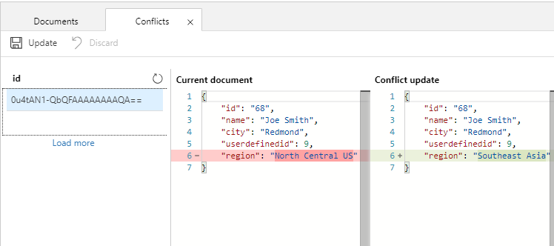
Flexible conflict management
Last Writer Wins
Custom Merge Stored Procedure
None – Conflict Feed

Slide 38
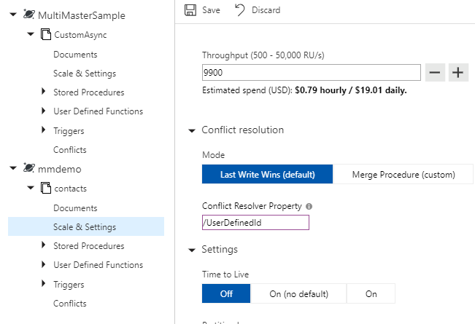
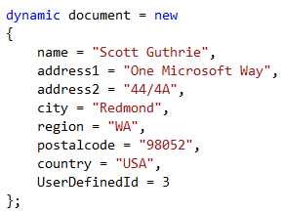
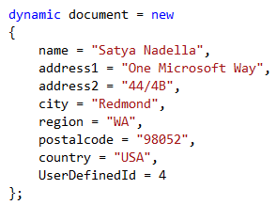
Last Writer Wins
Default
Use “_ts” for all APIs
User defined numeric value for SQL-API

Slide 39
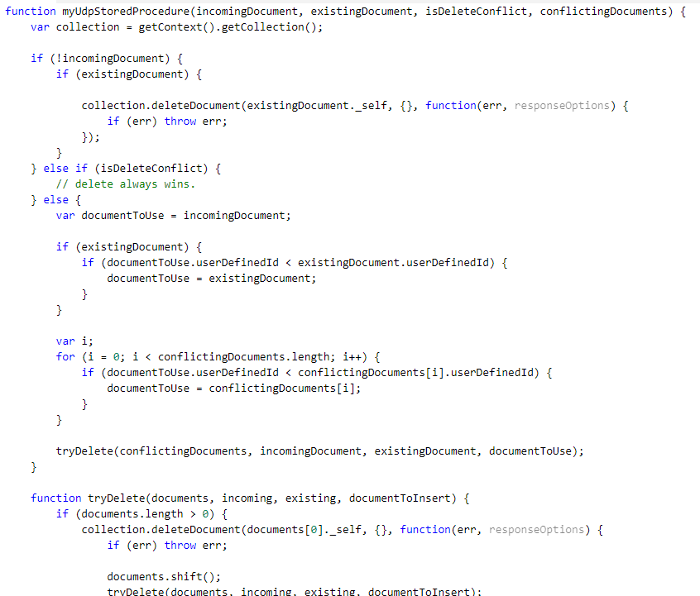
Custom Merge Stored Procedure
Register stored procedure
Special signature
Scope to container only
Exactly once guarantee
Executed as part of commit
Available for SQL API only

Slide 40
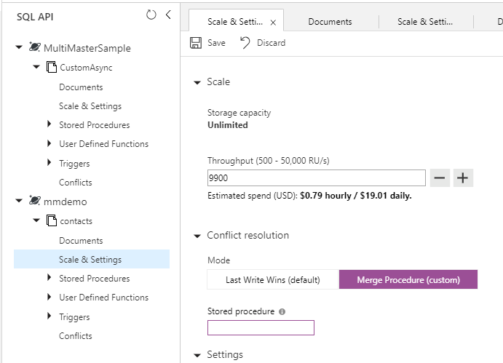
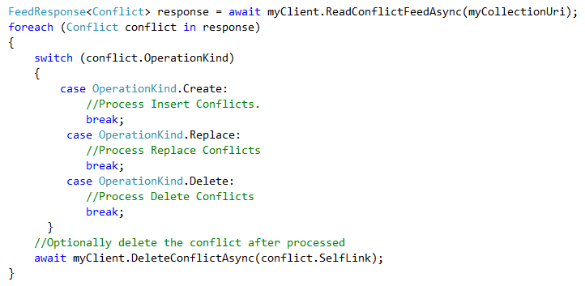
Conflict Feed
Leave procedure blank
Or exception in stored proc
Manually resolve

Slide 41
Demo
Conflict Resolution

Slide 42
Custom Synchronization

Slide 43
Custom Synchronization
5 well defined consistency levels
Defined at account level, span all regions

Slide 44
Demo
Custom Synchronization

Slide 45
Session takeaways
Recommend multi-master and global distribution capabilities in Cosmos DB based on customer requirements
Demonstrate and implement multi-master capabilities in Cosmos DB
Understand the relationship between consistency, availability and latency when building modern applications

Slide 46
Session resources
Demos: https://aka.ms/cosmos-global-demos
Global Distribution: https://aka.ms/cosmos-global-distribution
Consistency: https://aka.ms/cosmos-consistency-levels
High Availability: https://aka.ms/cosmos-high-availability

Slide 47
Q&A
If you have questions please proceed to the Q&A MICROPHONE located in your session room.

