Slide 1
Build high performance distributed apps with Azure Cosmos DB
Mark Brown
Principal Program Manager
Azure Cosmos DB
@markjbrown

Slide 2
Why build distributed applications?
Availability
What happens to your application if a region becomes unavailable?
Latency
How do you improve response times when users are on another continent?

Slide 3
Concepts
Consistency
Latency
Availability

Slide 4
Defining consistency
A
Atomicity
C
Consistency
I
Isolation
D
Durability

Slide 5
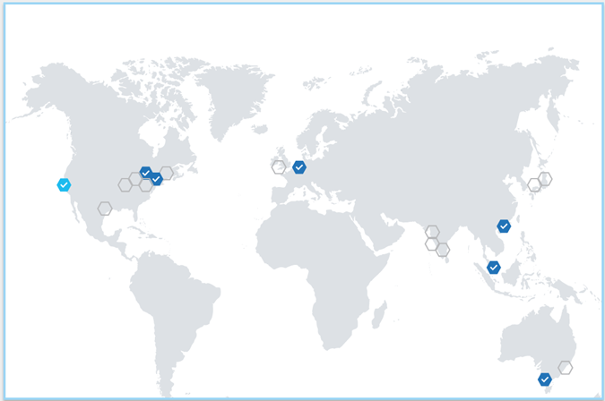
Defining consistency

Slide 6
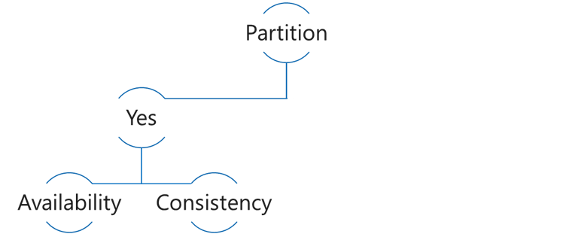
CAP Theorem
Consistency: Always get the most recent write, or an error
Availability: Every request receives a response, even if not the latest data
Partition tolerance: Continues to work even if replica connectivity lost
Choose Availability
5
5
6
5

Slide 7
CAP Theorem
Choose Consistency
5
5
6

Slide 8
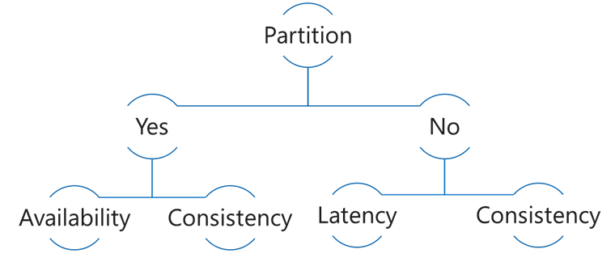
PACELC Theorem
In the case of network Partitioning in a distributed computer system, one has to choose between Availability and Consistency, but Else, even when the system is running normally in the absence of partitions, one has to choose between Latency and Consistency.
Choose Consistency
5
5
6
6

Slide 9
PACELC Theorem
Choose Latency
5
5
6
6
7
7

Slide 10
Read Latency

Slide 11
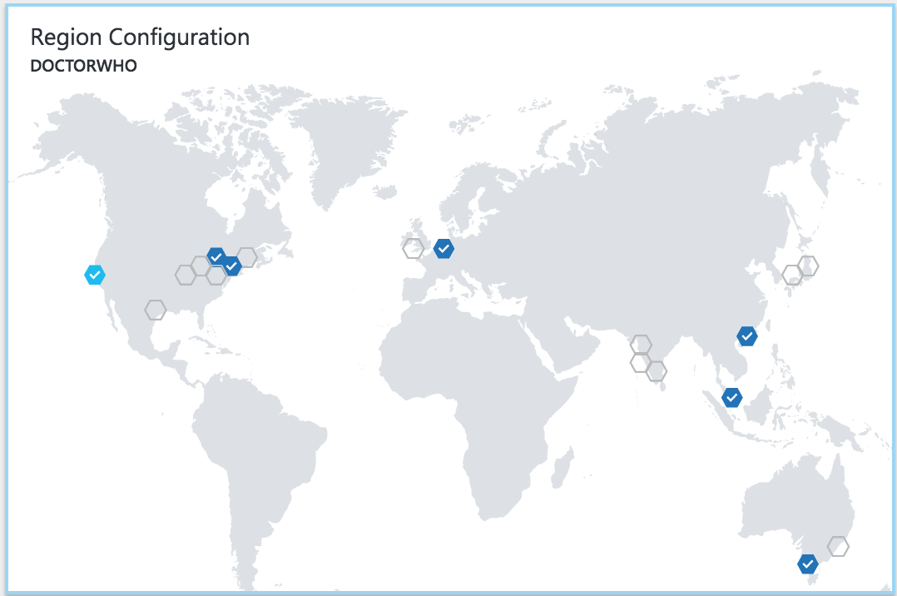
Latency
The lower the latency, the better the performance and experience

Slide 12
Demo
Read Latency with single region, vs multi-region

Slide 13
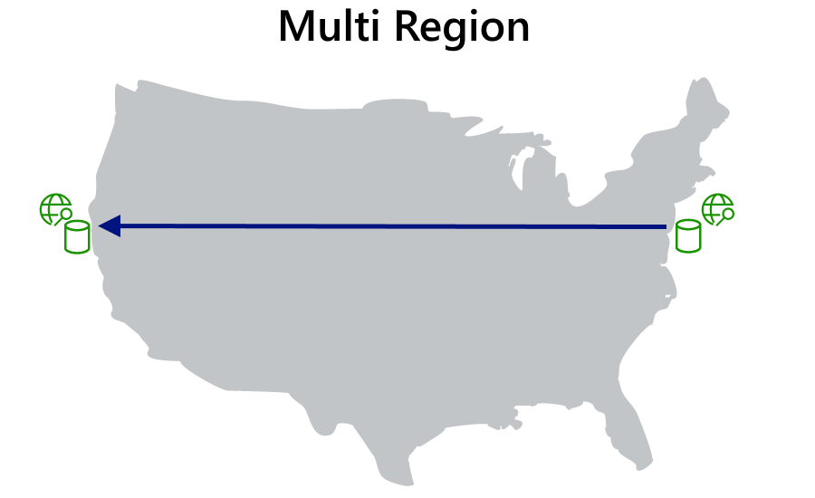
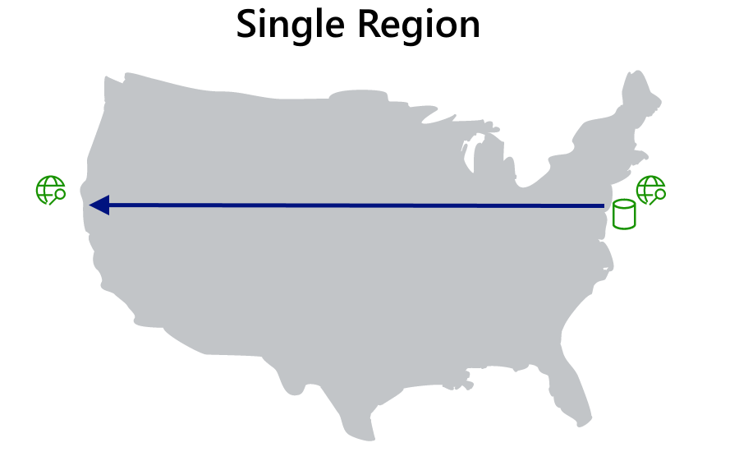
Read Latency

Slide 14
Write Latency

Slide 15




Azure Cosmos DB Multi Master​
Every replica fully writable​
<10 ms read write latency​
Master
(read/write)
Region A
Master
(read/write)
Master
(read/write)
Region B
Replica
(read)
Azure Traffic Manager
Master
(read/write)
Region C
Replica
(read)

Slide 16
Demo
Write latency for single-write vs. multi-write

Slide 17
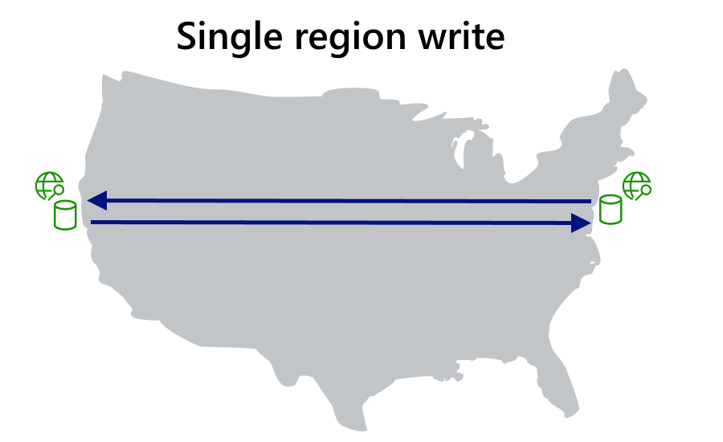
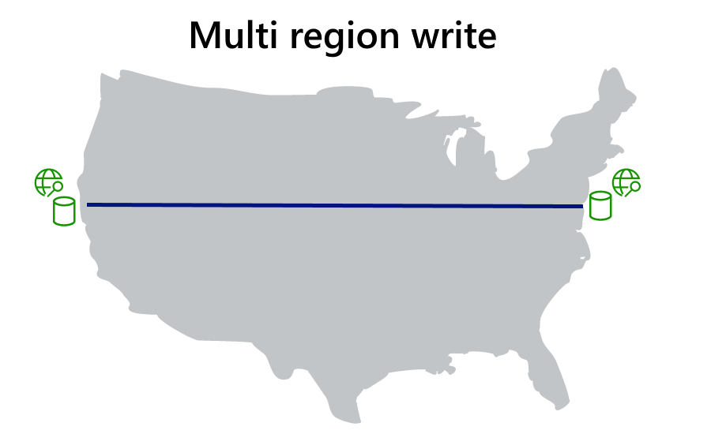
Write Latency

Slide 18
Consistency

Slide 19
CONSISTENCY MODELS
Strong
Bounded-staleness
Session
Consistent prefix
Eventual
Stronger consistency
Weaker consistency
Higher latency
Lower latency
Lower throughput
Higher throughput

Slide 20
Strong

Slide 21
Bounded Staleness

Slide 22
Session

Slide 23
Consistent Prefix

Slide 24
Eventual

Slide 25
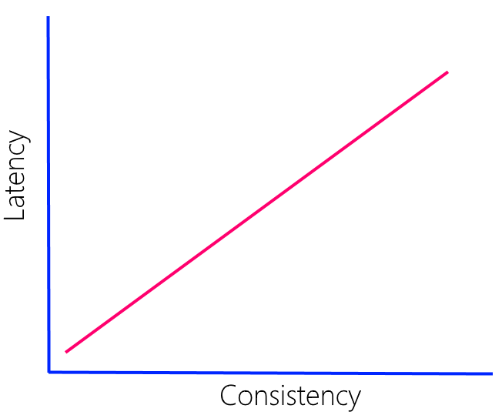
Latency vs. Consistency
Direct relationship
More pronounce with greater distance
Speed of light
WAN 10-15% slower
Strong consistency - multiple regions (<5000 miles)

Slide 26
Consistency vs. Throughput
Replica Set
follower
follower
follower
Consistency Level | Quorum Reads | Quorum Writes
Strong | Local Minority (2 RU) | Global Majority (8 RU)
Bounded Staleness | Local Minority (2 RU) | Local Majority (8 RU)
Session | Single replica using session token(1 RU) | Local Majority (8 RU)
Consistent Prefix | Single replica (1 RU) | Local Majority (8 RU)
Eventual | Single replica (1 RU) | Local Majority (8 RU)

Slide 27
Dynamic Read Quorum
Maintain availability for Strong consistency if 3+ regions

Slide 28
Demo
Consistency vs. Latency
Consistency vs. Throughput

Slide 29
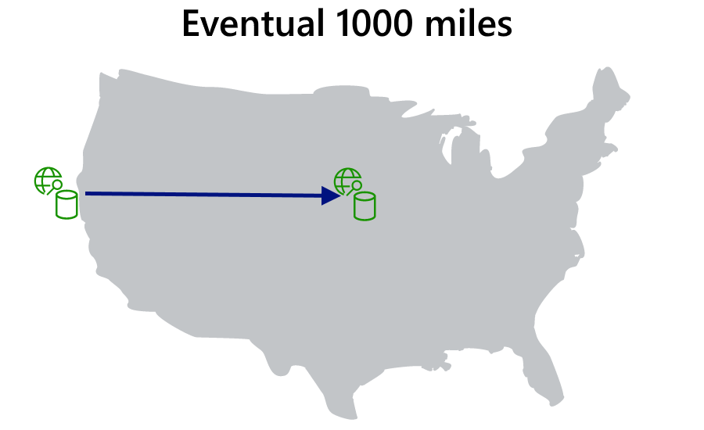

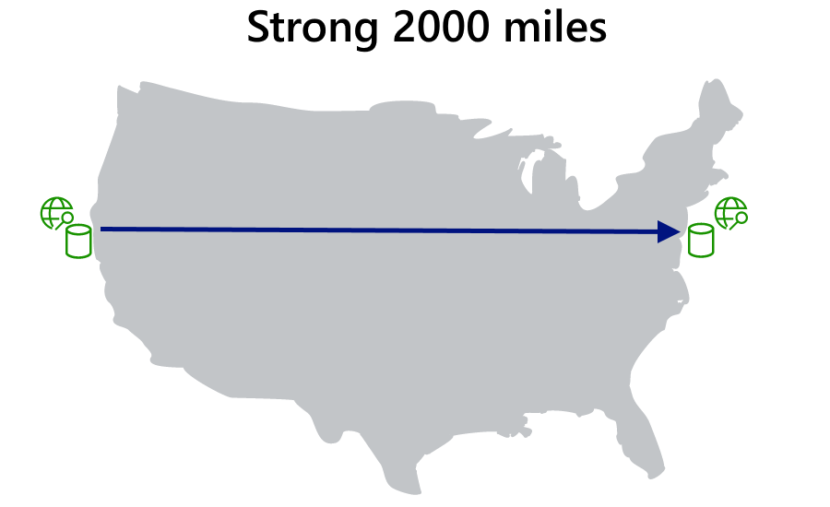
Consistency vs. Latency

Slide 30
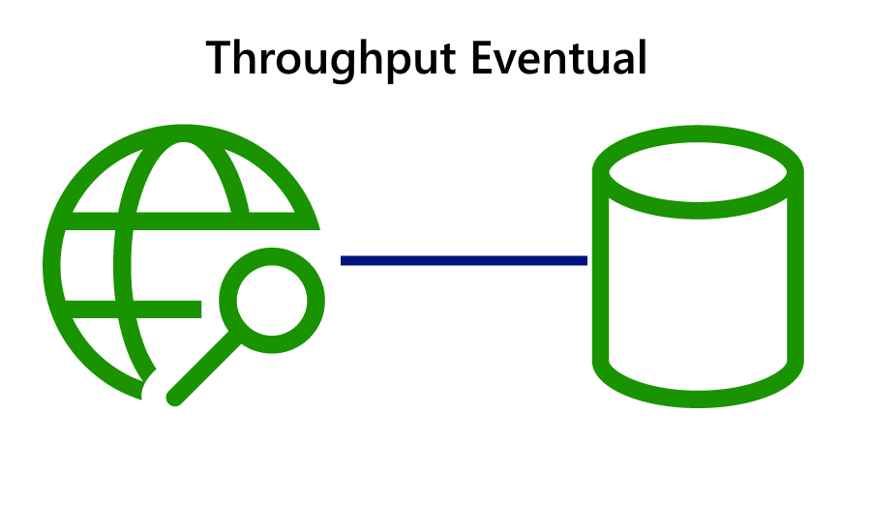

Consistency vs. Throughput

Slide 31
Availability

Slide 32
In-region redundancy
follower
follower
follower

Slide 33
Durability and Recovery time
RPO =
RTO =
how long did you lose data
how long are you down

Slide 34
Data Durability and Availability
Partition
Yes
Latency
Availability
Consistency
No
Consistency
Region(s) | Mode | Consistency | RPO | RTO
1 | Any | Any | < 240 minutes | < 1 week
>1 | Single Master | Session, Consistent Prefix, Eventual | < 15 minutes | < 15 minutes
>1 | Single Master | Bounded Staleness | K & T* | < 15 minutes
>1 | Single Master | Strong | 0 | < 15 minutes
>1 | Multi Master | Session, Consistent Prefix, Eventual | < 15 minutes | 0
>1 | Multi Master | Bounded Staleness | K & T* | 0
>1 | Multi Master | Strong | N/A | N/A
*Number of "K" updates of an item or "T" time. In >1 regions, K=100,000 updates or T=5 minutes.

Slide 35
Session resources
Benchmarks: https://aka.ms/cosmos-global-demos
Global Distribution: https://aka.ms/cosmos-global-distribution
Consistency: https://aka.ms/cosmos-consistency-levels
High Availability: https://aka.ms/cosmos-high-availability
@AzureCosmosDB
https://gotcosmos.com

Slide 36
Q&A

