Slide 1
SOCIAL MEDIA
ANALYTICS
Reddit Discourse Analysis
Pre-Olympics Sentiment, NER & Social Network
OLYMPICS WINTER GAMES
MILANO – CORTINA 2026
💬
🔍
🕸
Sentiment Analysis
Named Entity Rec.
Social Network
VADER + RoBERTa
55% globally positive
8,000 comments sampled
Athletes, nations, orgs.
690 nodes · 2,571 edges
74 communities
Sentiment & Social Network Analysis on Reddit
24,745
Period: December 2024 – March 2025
Comments analysed
Davide Fabio Loreti (865309) · Carlo Pegoraro (865329)
9,355
Unique authors
7
Subreddits

Slide 2
1. Project Objectives
2 / 14
Framework: Social Media Analytics applied to the Milan-Cortina 2026 Winter Olympic Games
💬 Sentiment Analysis
🔍 Named Entity Recognition (NER)
🕸 Social Network Analysis (SNA)
▸ Measure the emotional tone of comments across thematic subreddits
▸ Identify the most mentioned entities: athletes, nations, orgs.
▸ Reconstruct the user interaction network
▸ Distinguish positive, negative and neutral comments
▸ Understand which subjects dominate the conversation
▸ Identify the most influential users and communities
▸ Track the temporal evolution of sentiment
▸ spaCy on a sample of 8,000 comments (5 categories)
▸ Greedy Modularity on filtered subgraph (≥5 interactions)
Milano-Cortina 2026 – Social Media Analytics

Slide 3
2. Data & Dataset
3 / 14
📡 Collection Strategy
📊 Dataset Statistics
API:
Arctic Shift – Reddit historical archive, no rate-limit
908
24,745
Processed posts
Total comments collected
Phase 1:
908 posts from 7 subreddits (keywords: 'Milano-Cortina', '2026 Olympics'…)
9,355
20,691
Phase 2:
Paginated download of comments via /api/comments/search
Unique authors
Network edges (user-to-user)
Filters:
Excluded [deleted], [removed] and empty comments
7
8,000
Delay:
0.8s between requests to respect API usage policies
Subreddits analysed
Comments sampled for NER
Milano-Cortina 2026 – Social Media Analytics

Slide 4
3. Analysis Models
4 / 14
VADER · Rule-based Lexical Model
RoBERTa · cardiffnlp/twitter-roberta-base-sentiment
▸ Compound score in [-1, +1]
▸ Transformer fine-tuned on Twitter data
▸ >0.05 = positive · <-0.05 = negative
▸ 3 classes: positive / neutral / negative
▸ Applied to the full corpus (24,745 comments)
▸ Captures long-distance contextual dependencies
▸ Efficient for informal text and expressive punctuation
▸ Applied to a sample for comparison with VADER
NER (spaCy) · en_core_web_sm – 8,000 comments
SNA · Social Network Analysis – Greedy Modularity
▸ 5 categories: PERSON, GPE, ORG, EVENT, LOC
▸ In-degree, PageRank, community detection
▸ Text limited to 1,000 chars per comment
▸ Filtered subgraph: ≥5 interactions
▸ Entities aggregated by frequency and sentiment
▸ 690 nodes · 2,571 edges · 74 communities
▸ Stratified random sample
▸ Fruchterman-Reingold layout
Milano-Cortina 2026 – Social Media Analytics

Slide 5
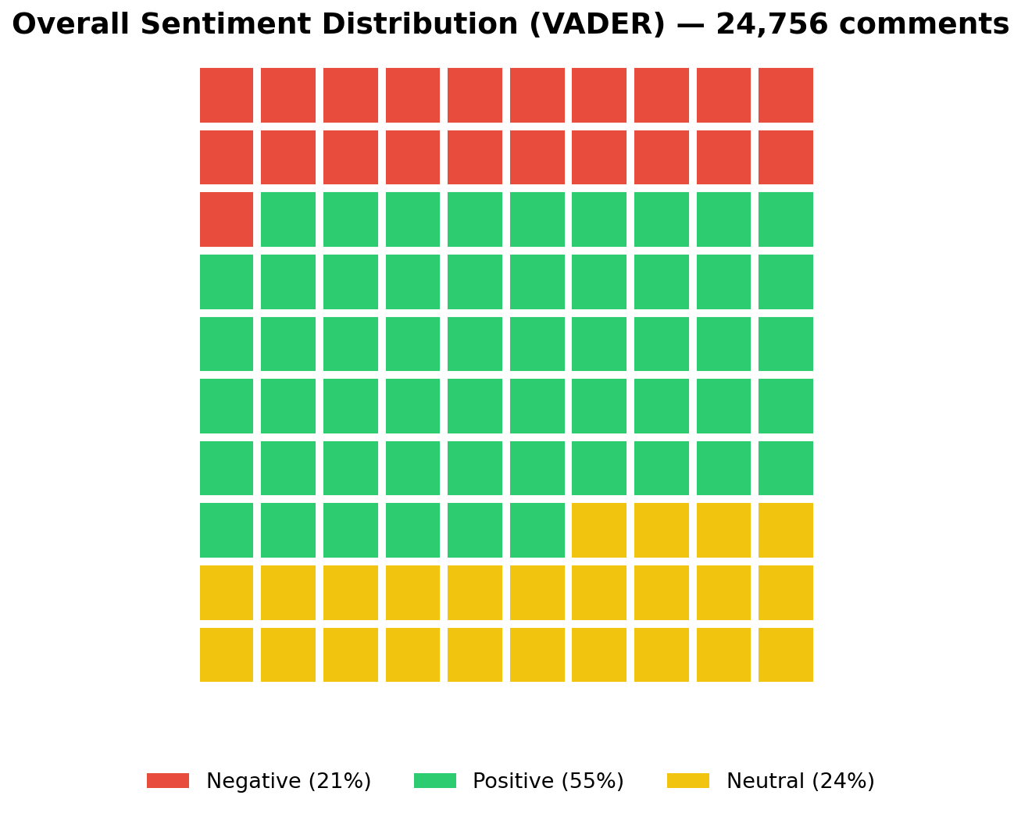
4.1 Global Sentiment
5 / 14
The corpus is predominantly positive
55%
Positive
24%
Neutral
21%
Negative
Average VADER compound score: +0.24
(neutral threshold: ±0.05)
Milano-Cortina 2026 – Social Media Analytics

Slide 6
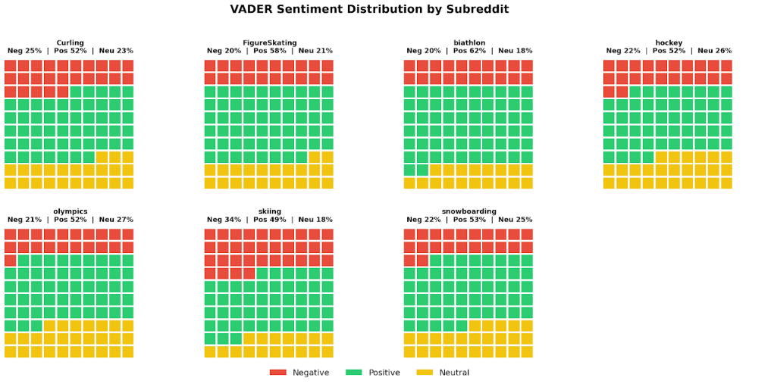
4.2 Sentiment by Subreddit
6/ 14

Slide 7
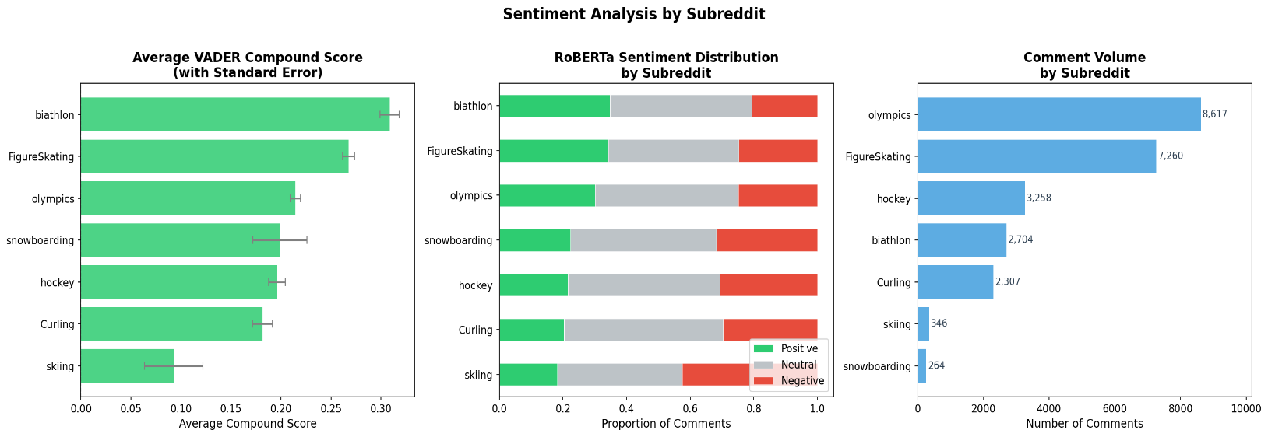
Sentiment by Subreddit
7 / 14
💡 Key Findings
🥇 Biathlon: 62% positive (VADER 0.31)
⛸ FigureSkating: 58% positive
⛷ Skiing: 34% negative (VADER 0.09)
📊 Olympics: most heterogeneous
Milano-Cortina 2026 – Social Media Analytics

Slide 8
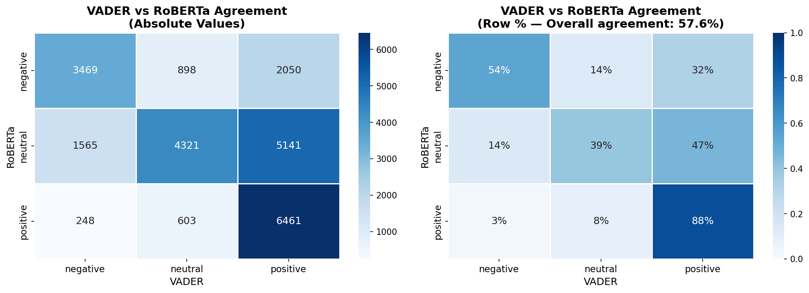
4.3 VADER vs. RoBERTa Comparison
8 / 14
Interpretation
57.6%
overall agreement
88%
agreement on positives
54%
agreement on negatives
47%
RoBERTa neutral → VADER positive
VADER tends to overestimate positivity in ambiguous, ironic, or negated comments.
Milano-Cortina 2026 – Social Media Analytics

Slide 9
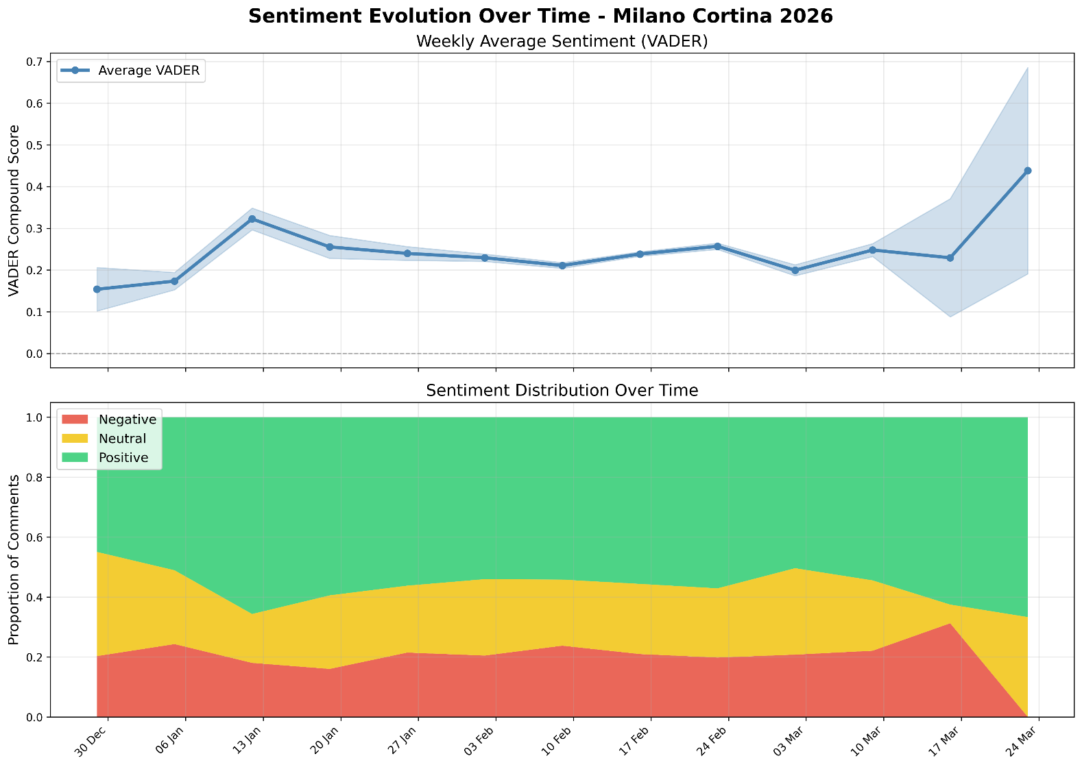
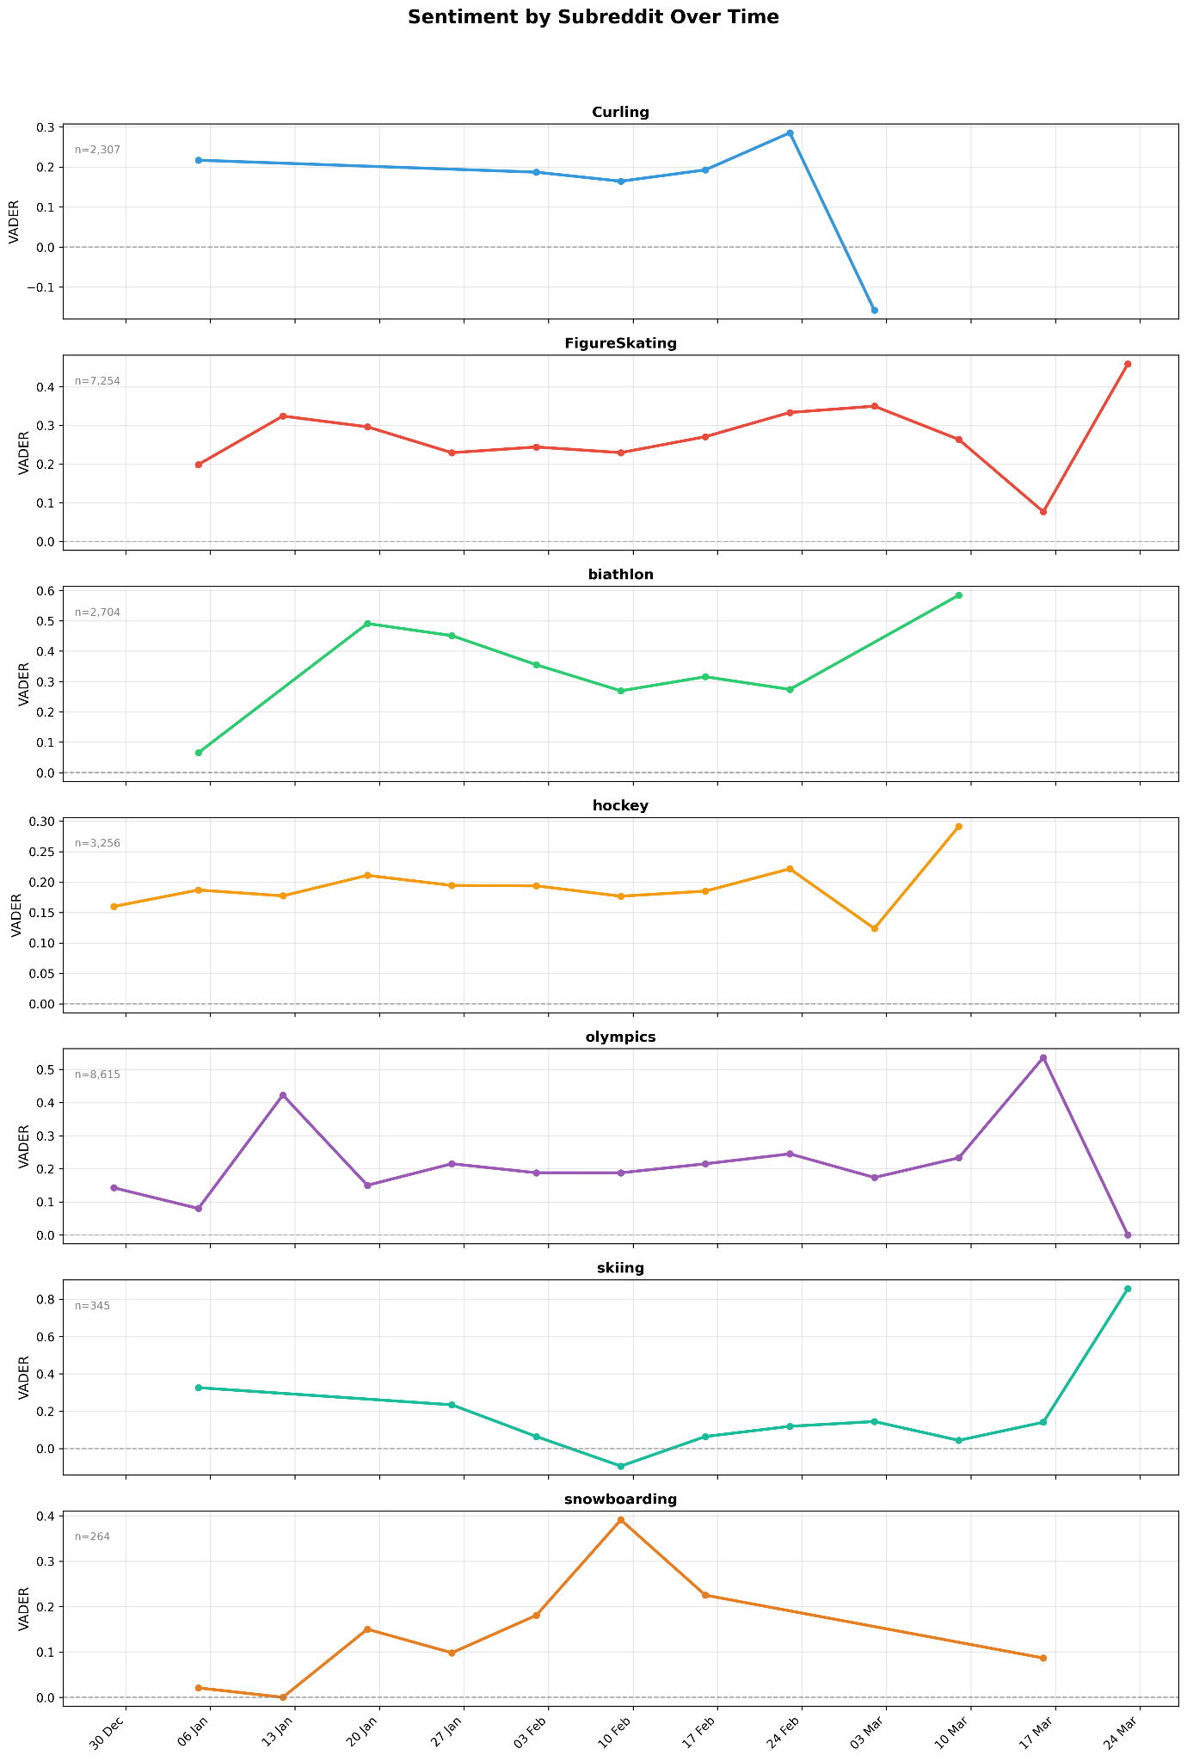
4.4 Temporal Evolution of Sentiment
9 / 14
Milano-Cortina 2026 – Social Media Analytics

Slide 10
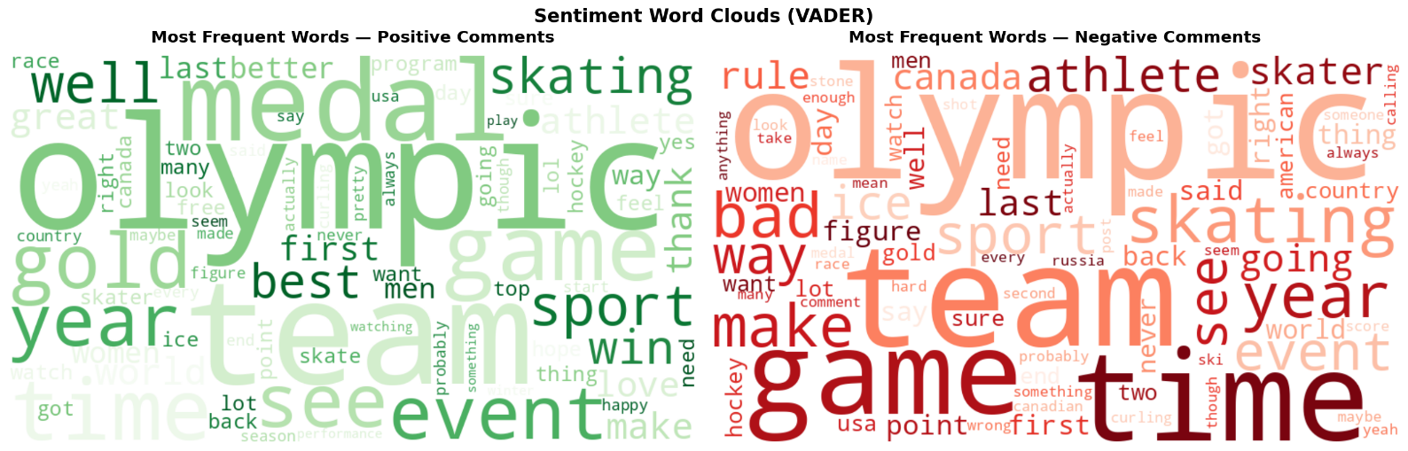
4.4–4.5 Key Moments & Sentiment Vocabulary
10/ 14
⏱ Key Moments
13 Jan 2025
VADER ~0.32
Initial peak: positive announcements from the Organising Committee and growing expectations
3 Mar 2025
VADER ~0.20
Moderate dip: organisational controversies and/or sporting disappointments. Only negative case: Curling (VADER ~-0.14)
Late Mar 2025
VADER ~0.44
Maximum peak: strong collective enthusiasm with near-zero negative comments
Milano-Cortina 2026 – Social Media Analytics

Slide 11
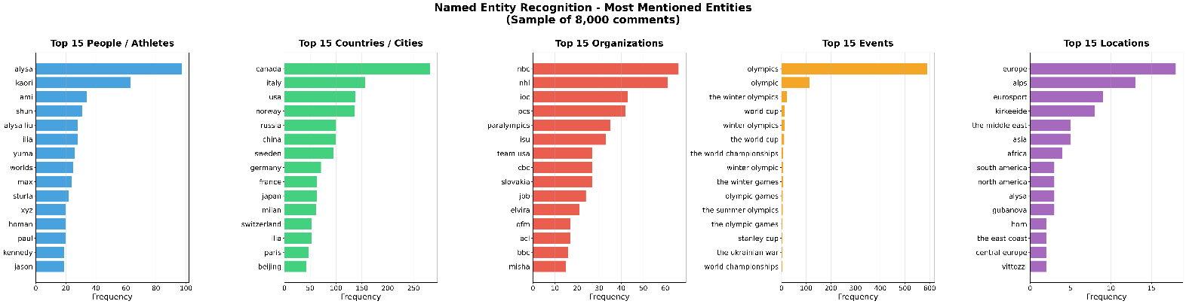
4.6 Named Entity Recognition – Top Entities
11/ 14
Top 15 entities per category (sample 8,000 comments): People · GPE · Organisations · Events · Locations
👤 People
🌍 Countries/Cities
Alysa Liu (~100 mentions), Kaori Sakamoto, Ami Sato – all figure skaters
Canada (~270), Italy (~175), USA (~150) – strong fan communities on Reddit
🏢 Organisations
🏆 Events
NBC and NHL lead – importance of US TV coverage and professional hockey
'Olympics' >550 occurrences – most frequent event entity in the corpus
Milano-Cortina 2026 – Social Media Analytics

Slide 12
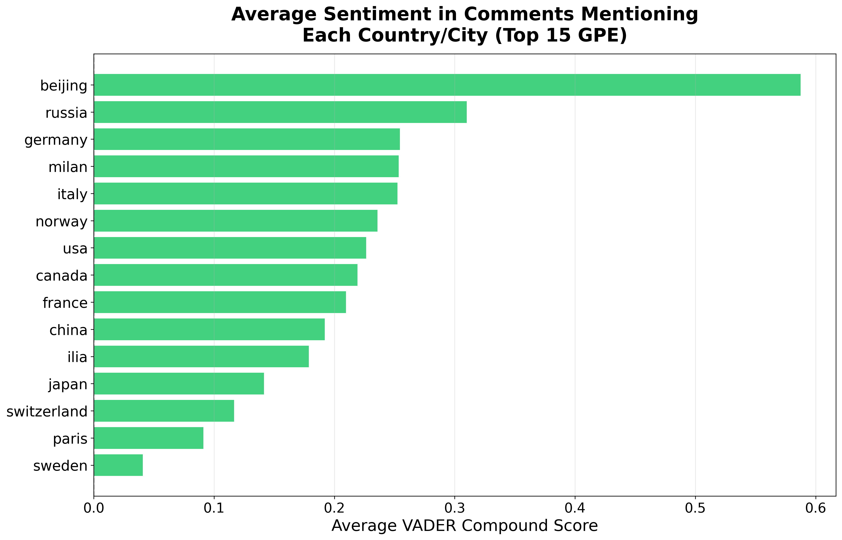
4.6 NER – Athletes by Subreddit & Sentiment by Country
12 / 14
Milano-Cortina 2026 – Social Media Analytics

Slide 13
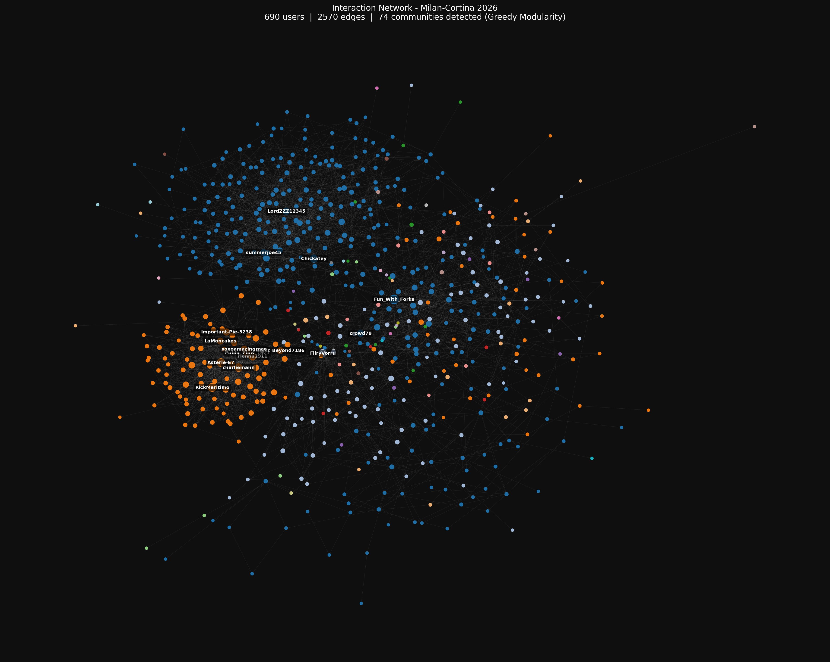
4.7 Social Network Analysis – Network Structure
13 / 14
🕸 Structure
▸ Fruchterman-Reingold layout
▸ Nodes coloured by community (74 clusters)
▸ Node size ∝ in-degree
▸ Labels only for high-centrality users
▸ Highly skewed degree distribution → few hubs with many connections
▸ Strong thematic separation by subreddit
Milano-Cortina 2026 – Social Media Analytics

Slide 14
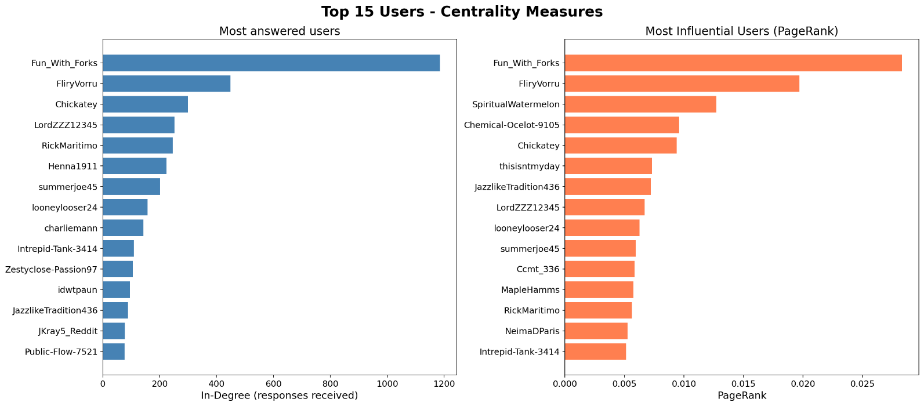
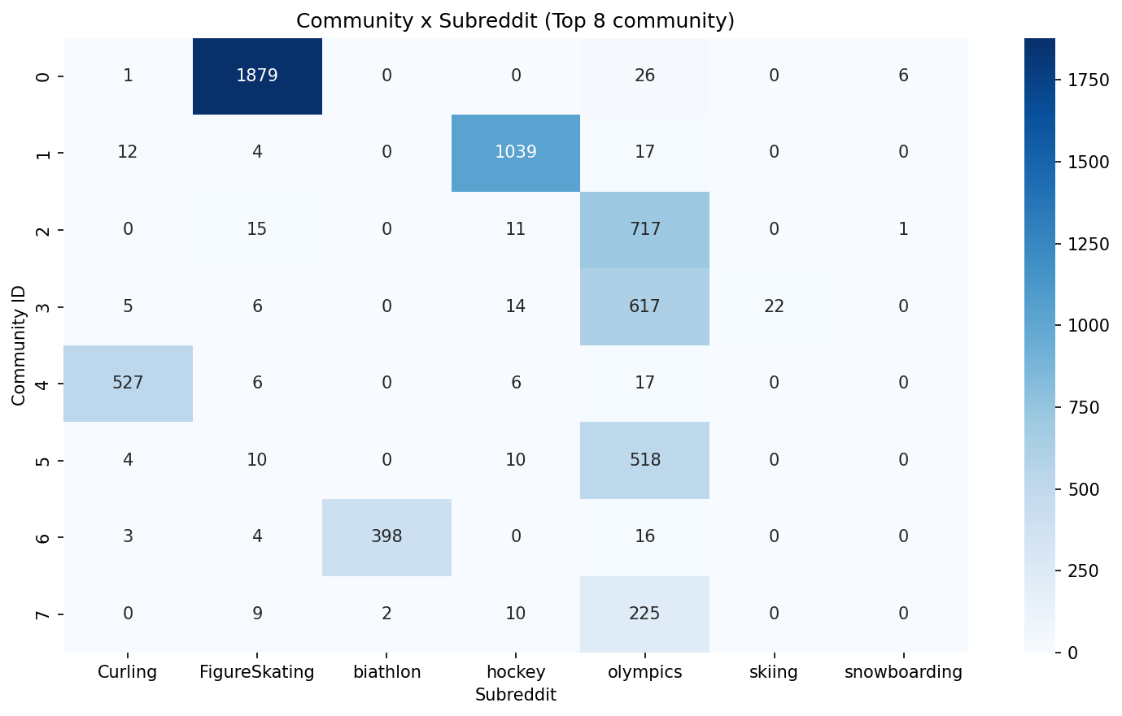
4.7 User Centrality & Community Distribution
14/ 14
Top 15 users by In-degree and PageRank
Community Heatmap – Subreddit × Top 8 Communities
Key Users in the Network
Fun_With_Forks
FliryVorru
SpiritualWatermelon
[Dominant Hub]
[Second Hub]
[Qualitative Influence]
1st for in-degree (>1,200 replies) AND PageRank (~0.028). Central hub role: receives many replies from well-connected users.
2nd in both metrics. Confirms a stable hierarchy in the network with a few super-influential users.
3rd in PageRank but not in top in-degree: replies come from particularly influential users.
Milano-Cortina 2026 – Social Media Analytics

Slide 15
5. Conclusions
💬 Positive Global Sentiment
⛸ Differentiated Communities
📈 Growing Temporal Trend
55% of comments positive (VADER). Average score +0.24 – widespread enthusiasm from the international winter sports community.
Biathlon and FigureSkating: most positive communities. Skiing: most critical (34% neg). Curling: only negative compound case (Mar 2025).
Sentiment peak in late March 2025 (VADER ~0.44), consistent with the approaching Games date. Enthusiasm grew in the final weeks.
🔍 Dominant Entities
🕸 Thematic Echo Chambers
Figure skating dominates (Alysa Liu, Kaori Sakamoto). Canada, USA and Italy/Milan the most mentioned countries/cities. NBC and NHL lead organisations.
74 communities with near one-to-one subreddit↔community correspondence. Few dominant hubs (Fun_With_Forks). Limited cross-pollination across sports.
Davide Fabio Loreti (865309) · Carlo Pegoraro (865329) · Social Media Analytics

