Slide 1
Hiraku - 開曲
Davide Gioiosa
Davide dal cortivo

Slide 2



Goals
Have you ever thought about join a live performance with an artist adding in a song the riff that you have in mind? Or take part of a session in another part of the world sending your ideas?
HIRAKU, is a project created and based on the idea of communication with music through the use of internet. Started from a first idea of Davide Gioiosa, HIRAKU (開曲) means open melody or open composition, representing the idea music creation with shared ideas. It has been developed by a team of two members: Davide Gioiosa and Davide Dal Cortivo.
The web-application has the main goal of connect people’s ideas, in whatever place they are, and create new music and infinites performances scenarios.

Slide 3
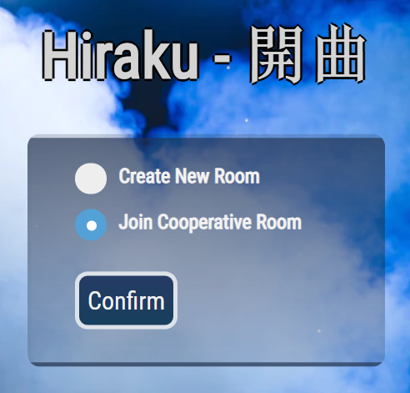
Room: Create / Join
First option leads to the insertion of the nickname and the creation of a new room in which the user is the owner and Master. The room will be allocated into the database with an unique ID and will contain information about musical messages, loop selected and datas about time synchronization.
Second option leads, like the previous one, to the choice of the nickname and is followed by the insertion of the ID of the room in which it wants to participate, which must be provided by the master. Subsequently, the user accesses the Guest interface containing the keyboard, through which he can communicate and compose messages to be sent to the master.

Slide 4
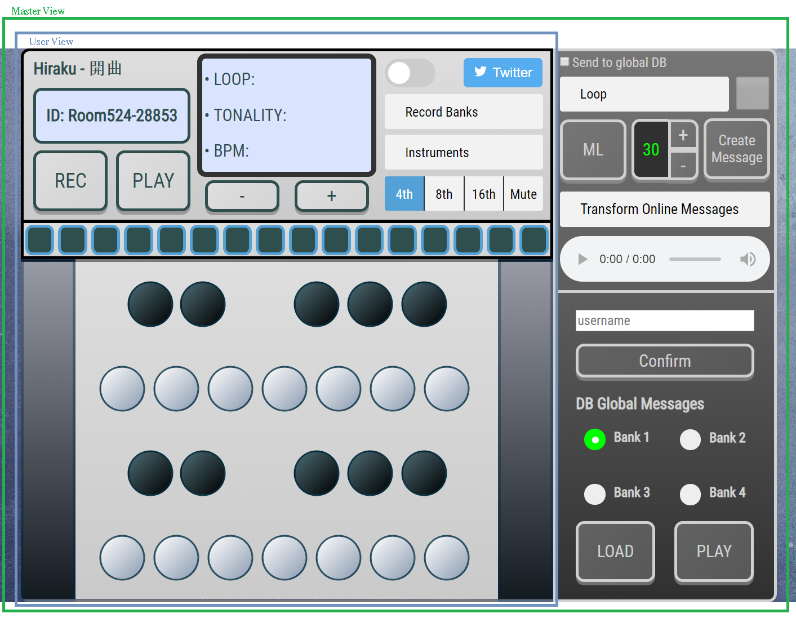

Slide 5
CONCEPT OF MUSICAL MESSAGE
Hiraku introduces and is based on the concept of musical message (mm). The program, after pressing the rec button, processes what is played by the user on the keyboard-interface and at the end of the recording generates, through a conversion algorithm, a message. This will be the transcription of the performed performance, ie a music sheet that can be translated by the program in order to be played.
This encoding / decoding technique allows to record and stored the messages, the listening and the sending of a music composition performed on the application.

Slide 6
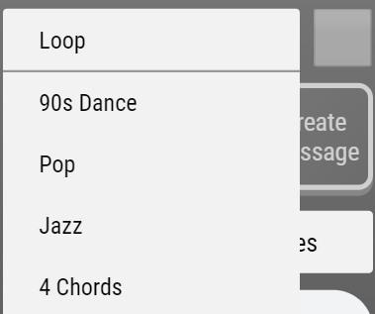
Loop characteristics and buffer Audio
Loops have been created with FL Studio and some VST. They are stored in a Dropbox account and, when one of them is selected, it will be decoded in an audio buffer ready to be played. A loop contains a lot of information saved on Firebase (duration, tonality, time signature, bpm etc…). This information is very important, because it modifies several aspects in the program such as the progress bar.

Slide 7
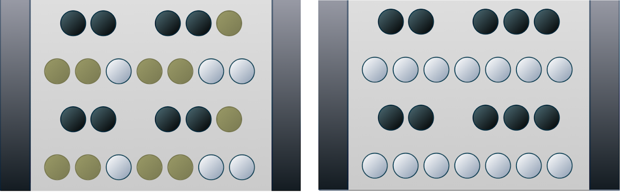
Tonality Limitations and Pro version
This program isn’t designed only for musicians, so the tonality of a loop puts restrictions on playable notes. This is to limit wrong notes during a registration on a particular loop. If you are a musician don’t worry, you can switch to “PRO” mode and all notes will be available again.
A function calculates the degrees of the ionian scale of a particular tonality to decide the playable notes. If the tonality is minor, it refers to his relative major for the calculus.

Slide 8
Graphic responsive - Progress Bar
This bar represents the length of a loop, expressed in pulses. The squares turn on one by one following the rhythm and the “on-color” changes related to the time signature of the loop. It’s created dynamically in Javascript when a new loop is selected and it’s controlled by a Web Worker.

Slide 9
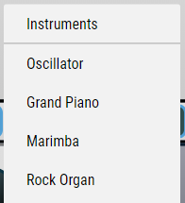
Instruments
Instruments are imported from WebAudioFont library except for the Oscillator that was created directly in Javascript. We have chosen them thought to be played in a solo performance on a loop, so they had to be versatile with a pleasant middle-high register sound. You can play only from C3 to B6 on the PC keyboard, but you can extend the range from A0 to C8 (like a piano range) with the connection of an external midi controller.

Slide 10
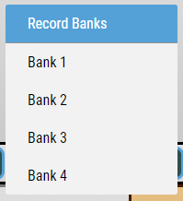

Master records, Local banks, Metronome
The “REC” button starts a registration. The length of a registration is equal to the length of the selected loop and it starts at the beginning of the loop. The registration is sent to the master and saved in one of four record Banks, the one that is selected.
You can listen your registration with the “PLAY” button or overwritten it with a new registration on the same record Bank. A recorded message is modeled with an array of objects having a structure “note, frequency, duration”.
A user guest can record only when a loop is playing, a master also when it’s not. With the “check” on “Send to global DB”, a master can send a recorded message to global DB that can be loaded and played by another master at any time.

Slide 11
Metronome and Web Worker
The metronome is managed by a Web Worker that schedules in the future the “ticks” that will be played with an oscillator. You can play 4th notes, 8th notes, 16th notes or you can turn off it with the “Mute” button. Web Worker controls also the illumination of the squares in the progress bar.
We have chosen to use a Web Worker in order to obtain the better possibile precision of the “ticks”, because this program is based on record messages played on a loop.
Functions related to metronome and Web Worker were taken from the follow link, where there’s also a tutorial that explains how you can create a very precise metronome. Obviously, the functions have been modified for our purposes.

Slide 12
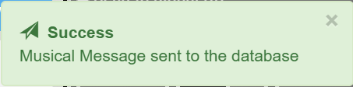
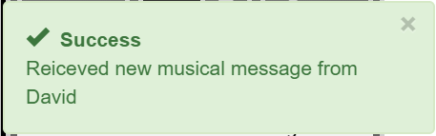
MM, SEND AND RECEPTION WITH FIREBASE
When room’s Master or an user logged into the room completes the creation of a musical message on the selected loop, the mm is send directly on the database and received in real time by the Master, that is listening on database room’s updates. The operations are notified in the application with notifications. once received, the musical messages are decoding by the translation algorithm and ready to be played.

Slide 13
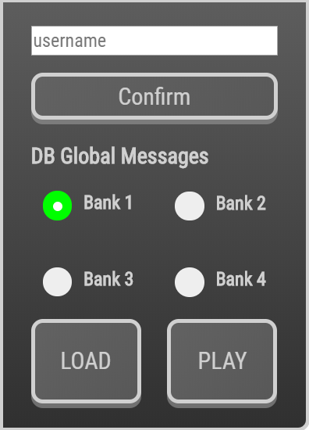
MM GLOBAL MESSAGES
This operation will permit to every other master of other rooms to get and play the global uploaded MM. In fact in the panel controls of the room exists the database’s Global Messages Area: the user inserts the username of the owner of the message that wants to load in the application, choose the bank where the message was stored (one of four) related to the account searched, loads it and then the MM can be played applying the decoding and translation algorithm. This function allows a global communication channel between users with the use of MM.

Slide 14

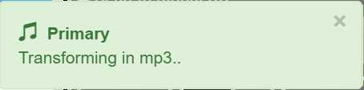
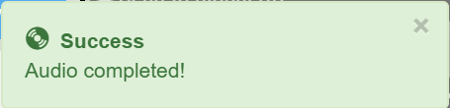
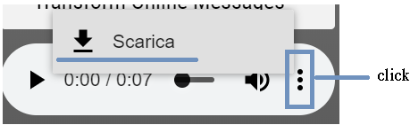
Blob-mp3 of MM Received
Once the master has decided to perform the messages that he has received, he will hit the button “Transform Online Messages”. Starting from the collection of all MM received, the web-application will play them one by one internally, in a Media Recorder, saving the informations in chunks with whom is created an audio type Blob. From that it will be created an audio with the url containing the informations, and it will be downloadable in MP3 format.

Slide 15
User synchro-records with master, metronome-Worker and local banks
After several attempts in order to synchronize recorded messages with loops, a very good result has been achieved. Firstly, we tried to execute any action in a single thread, but it caused lag: the continuous update of the progress bar became less precise over time. Moreover, recorded messages are played in real time on a loop and it also caused lag.
Subsequently, we decided to create an audio type Blob from a recorded message (see “Blob-mp3 of MM Received” section for more information) and manage the metronome and the progress bar with a Web Worker (see “Metronome and Web Worker” section for more information). These changes increase considerably the synchronization between recorded messages and loops.
After the creation of an audio type Blob, loop and messages are ready to be played together. So when the loop is restarted, the audio containing the messages will be played in synchro creating the effect of a collaborative improvisation on a music piece.

Slide 16
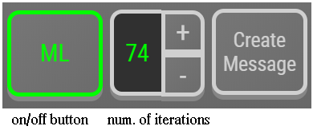
Markov-Chain and Bot Riff Creation
One of the main features of Hiraku is the Machine Learning Algorithm which allows the application to achieve the ability of creating new musical messages inferring from the MM that has received from the users that have participated to the join session, clustering all the received informations.
The algorithm has been created entirely starting from 0 and its reasoning creation process is based on Markov-Chain principles.

Slide 17
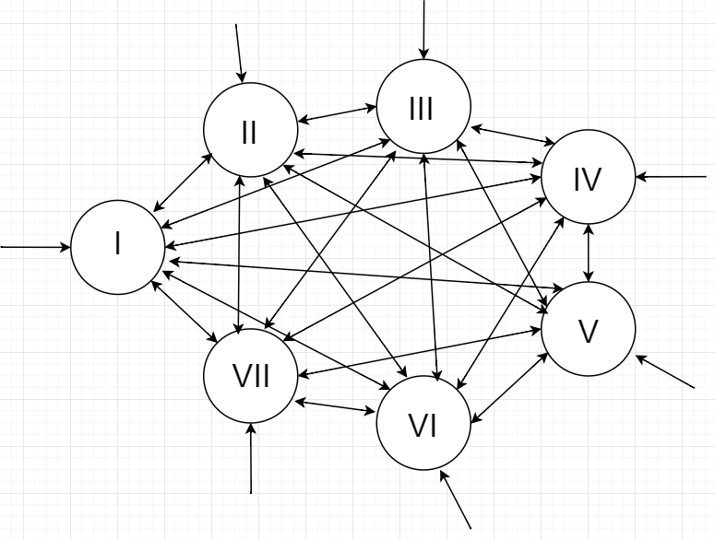
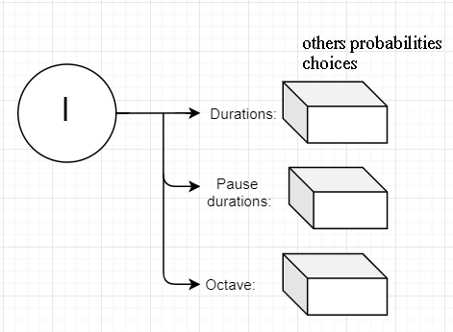
Markov-Chain and Bot Riff Creation
After setting the number of iterations that the algorithm will do into the MC, clicking the ‘Create Message’ button, it will be constructed a new MM based on the probabilistic information path and at the end applying duration cuts to allow the correct fit of the message.
The Markov Chain structure implemented into the program: is based on the first level on a probabilistic choice between notes grades sequences - in the first picture every arc that starts from a Note Grade has his own probability, and the sum of all the probabilities arcs that starts from that note is 1. Then there are further levels on the other informations such as duration, pauses and octaves changes, with their own probabilities. Having this structure the bot riff generator receives the number of iterations to make into the structure creating a musical message based on all the previous MM received by the user.

Slide 18
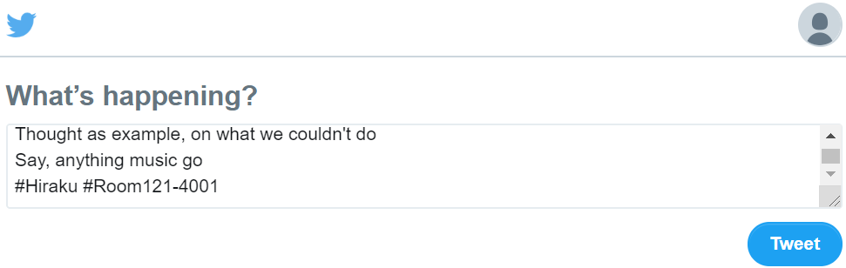
Twitter text conversion
A further feature of Hiraku is the possibility to share the MM created on Twitter in a text-version format clicking on the button on the top right of the keyboard. In fact after the creation and submission of the message played on the keyboard, there is an algorithm that converts locally the MM created in text-lyrics, using an hashmap association with words. This feature permits to store into Twitter timeline all the messages received in a session, creating a memory record of the performance.

Slide 19
TWITTER: PYTHON CRAWLER
Furthermore this option was designed to allow the possibility to send a mm for a Master without using the Hiraku application directly. In fact an user could send a text message on Twitter with a final hashtag #Hiraku and through the use of a Python program running on a room Master computer, the owner of a room can receive mm also in this format. At the moment the Python is completed, and then this conversion feature will be one of the future updates of the program.

Slide 20
Conclusions
Hiraku was designed as a scalable application and contains already feature that will be implemented in the future in the next updates. We would like to thank our university professors for the acquired knowledge and support during the development.
Our next goal is to extend the program with other ideas that we have in mind, and present our project in musical events (an opportunity can be the FestiValle in august 2019).
Project Link: http://hiraku.surge.sh/
INTRODUCTION VIDEO: https://youtu.be/SxgZyMuagbQ
The Hiraku project team,
Davide Gioiosa
Davide Dal Cortivo

Slide 21
Owners and Rights
The project was entirely realized by Davide Gioiosa and Davide Dal Cortivo, graduates in Computer Engineering and students of Music and Acoustics Engineering at Politecnico di Milano. To them belong all the rights of the application.

