Slide 1

CONTROLLER PROJECT
AUTOMATIC CONTROLS
2023/2024
Mari Davide

Slide 2
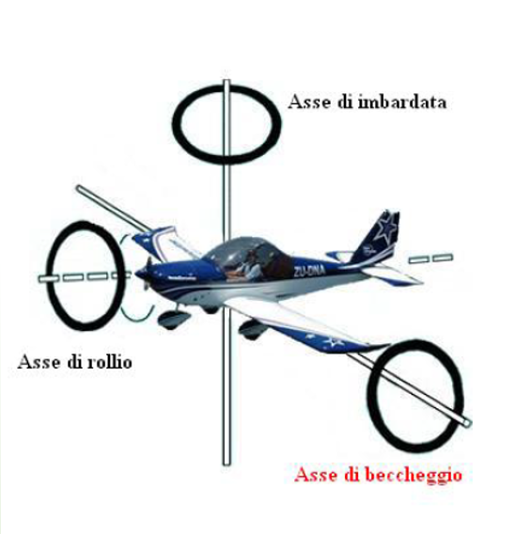
AIRCRAFT PITCH CONTROL
The project focuses on developing an automatic control system to manage the pitch of an airplane. Pitch refers to the upward or downward pitching motion of the aircraft about its longitudinal axis. In other words, the goal is to implement a feedback system that adjusts the aircraft's pitch in a controlled and precise manner.

Slide 3
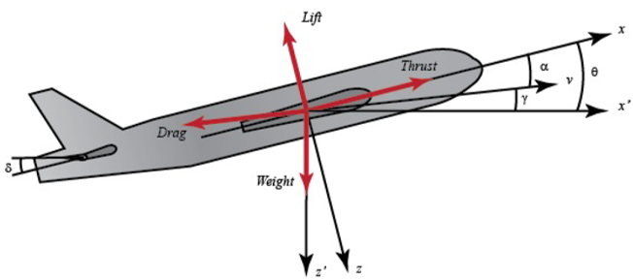
SYSTEM PROFILE(1/4)
Acting forces
Along x axis: thrust and resistance
Along y axis: weight and lift
Elevators angle→Reference input
Pitch angle→Exit
NOTE
The system is assumed to have constant cruising speed and altitude. In this case the forces acting on the plane along the x axis, i.e. thrust and resistance, are balanced, as are those along the y axis, the weight and lift. The problem is also simplified by assuming that the speed of the aircraft does not change during the pitch variation

Slide 4
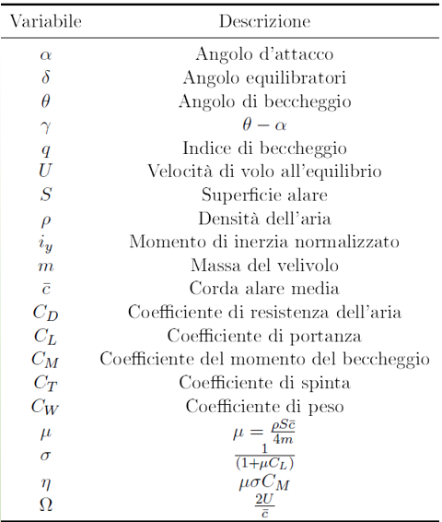
SYSTEM PROFILE(2/4)
Variables
α= Angle of incidence
θ= Pitch angle
𝜸=𝜽−𝜶 = Pitch speed

Slide 5
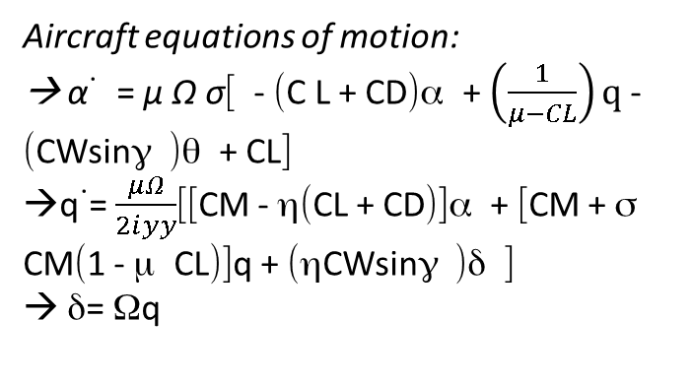
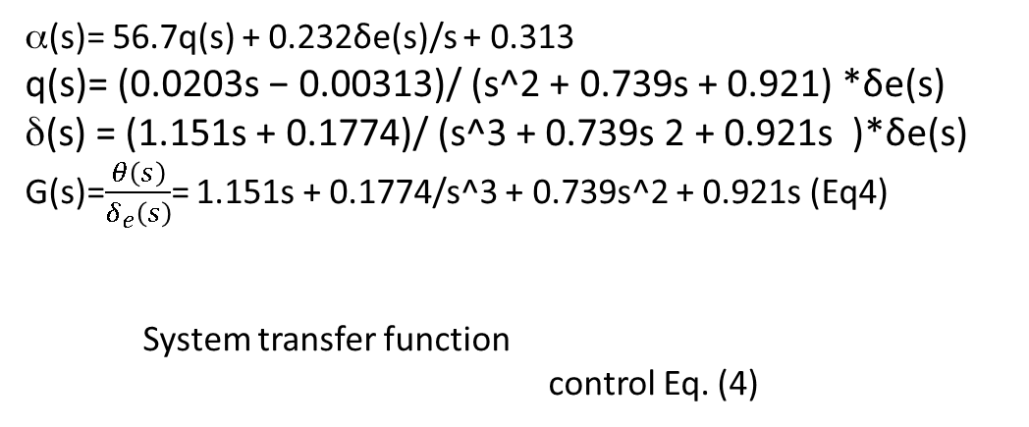
SYSTEM PROFILE(3/4)
STEP 1:
STEP 2:
Aircraft equations of motion:
→ α˙ = μ Ω σ[ - (C L + CD)α + $\left(\frac{1}{μ−CL}\right)q$ - (CWsinγ )θ + CL]
→q˙= $\frac{μΩ}{2ⅈyy}$[[CM - η(CL + CD)]α + [CM + σ CM(1 - μ CL)]q + (ηCWsinγ )δ ]
→ δ= Ωq
Extraction of a mathematical model(using Boeing values):
α˙ = - 0.313α + 56.7 q + 0.232δ
q˙ = 0.0139α - 0.426 q + 0.0203δ
δ = 56.7q
STEP 3:
STEP 4:
Laplace transformTo determine the transfer function of the system you must firstperform the Laplace transform on the previous equations, rememberingto assume zero initial conditions. Proceeds:
sα(s) = - 0.313 α(s) + 56.7q(s) + 0.232δ(s)
s q(s) = - 0.0139 α(s) − 0.426q(s) + 0.0203 δ(s)
s δ(s) = 56.7 q(s)
REVENUE TRANSFER FUNCTION of P(s):
α(s)= 56.7q(s) + 0.232δe(s)/s + 0.313
q(s)= (0.0203s − 0.00313)/ (s^2 + 0.739s + 0.921) *δe(s) δ(s) = (1.151s + 0.1774)/ (s^3 + 0.739s 2 + 0.921s )*δe(s)
G(s)=$\frac{θ\left(s\right)}{δ_{e}\left(s\right)}$= 1.151s + 0.1774/s^3 + 0.739s^2 + 0.921s (Eq4)
System transfer function
control Eq. (4)

Slide 6
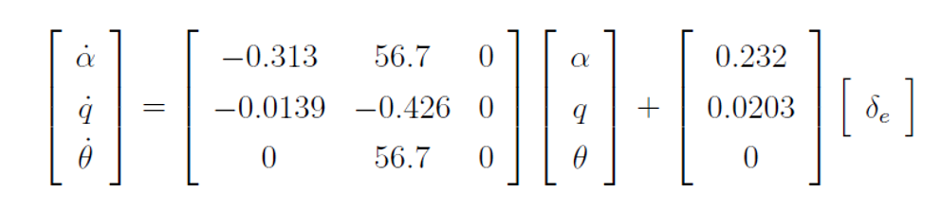
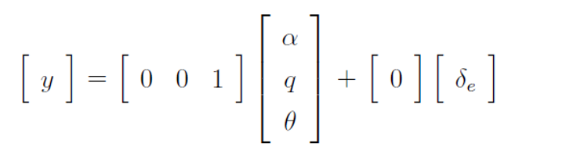
SYSTEM PROFILE(4/4)
From the transfer function I obtain the state model and the output of the system under consideration:
STATE MODEL
OUTPUT(PITCH ANGLE)

Slide 7

SPECIFICHE PROGETTO
When fully operational it is required:
→ Asymptotic null error for ramp tracking.
In the transitional period, the following is required:
-Settling time:
→ As small as possible
-Overshoot:
→ <15%

Slide 8
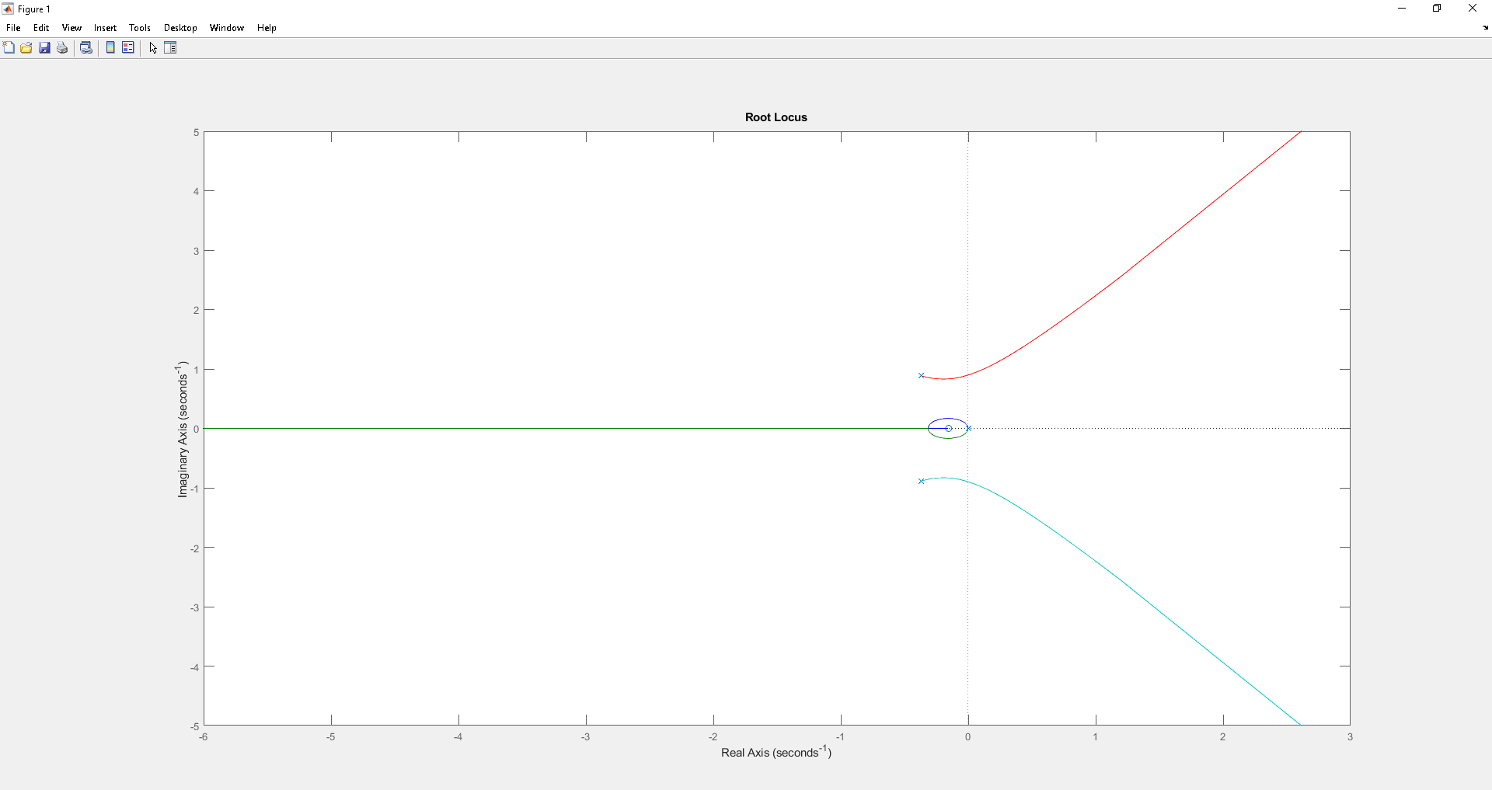
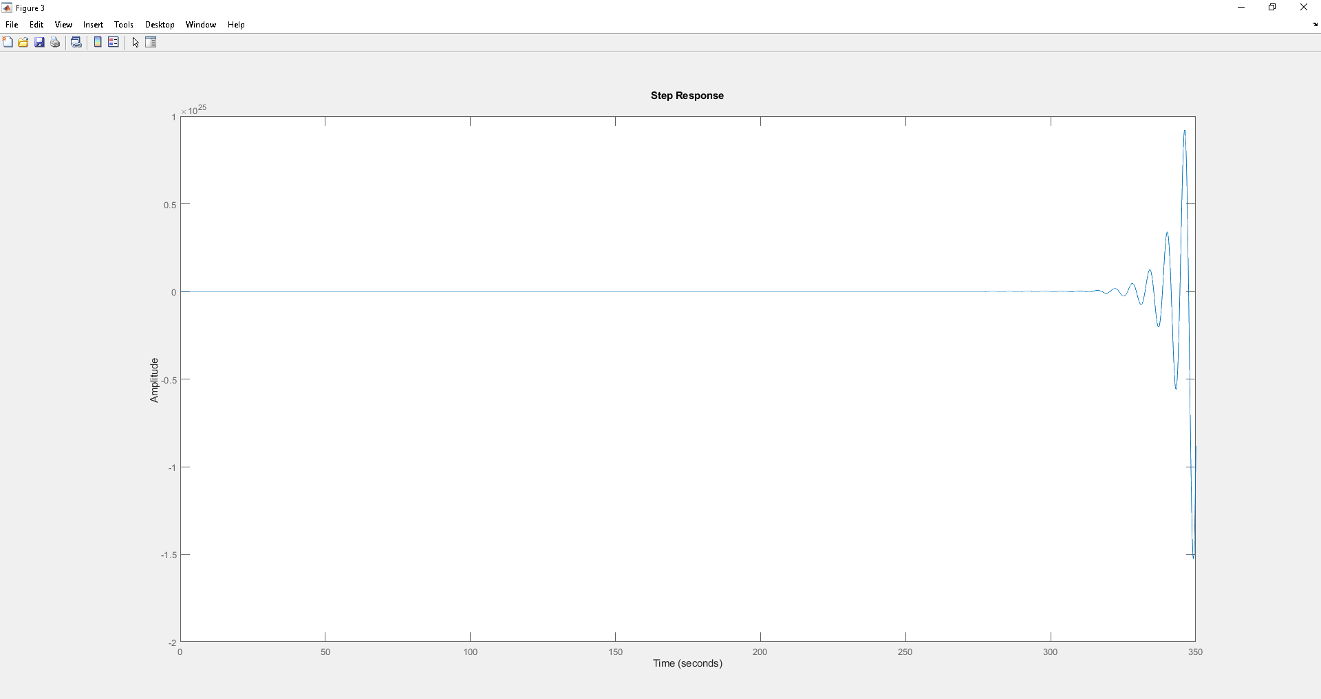
CONTROLLER DESIGN(1/4)
Figure 1 represents the locus of L(s) while figure 2 represents the Wyr in its initial state considering C=1/s as the controller (chosen to have zero error). You can see that the system is unstable.
Fig.1 Root Locus of L(s) with C=1/s
Fig.2 Step di Wyr(s) with C=1/s

Slide 9
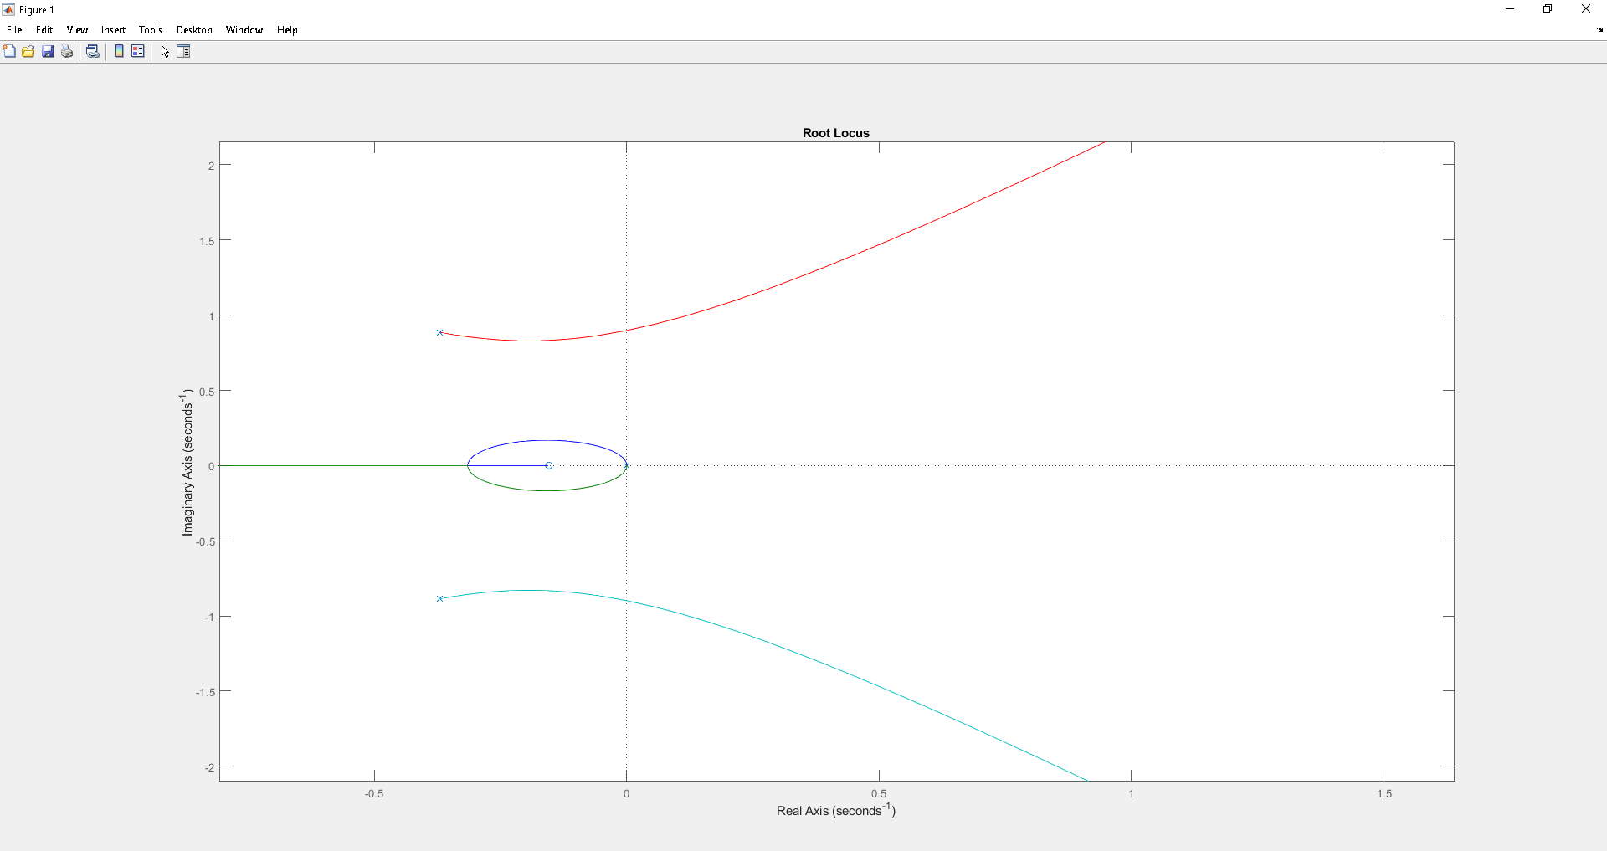

Slide 11
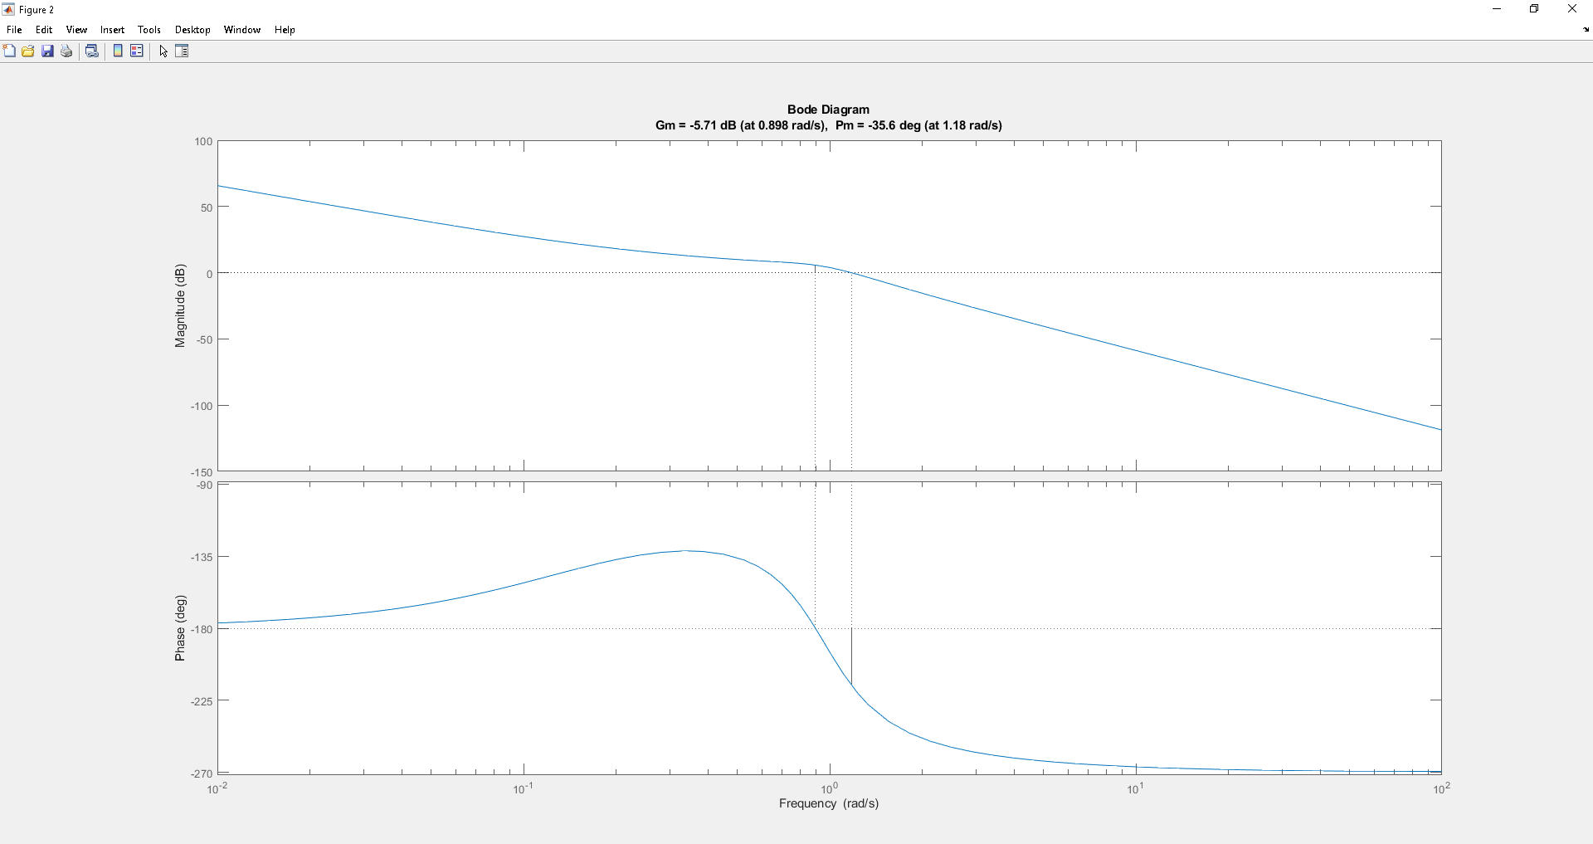
Subsequently, figure 3 represents the initial bode diagram with the respective values ​​of Gm(gain margin) and Pm(phase margin).
Fig. Bode plot with C=1/s

Slide 12
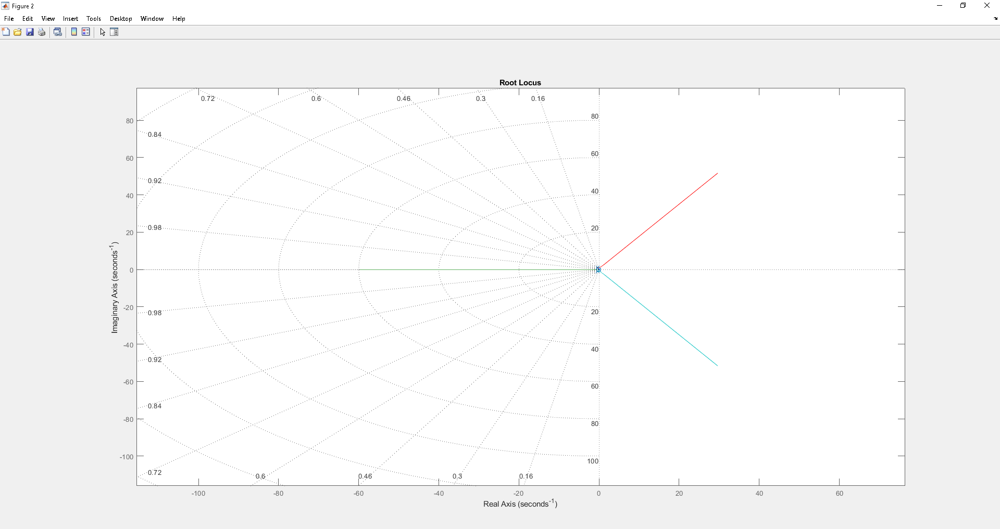
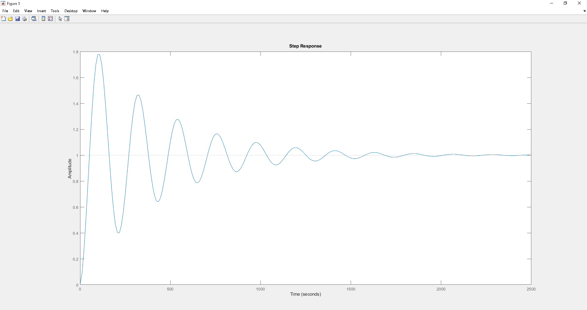
CONTROLLER DESIGN(2/5)
figures 4 and 5 represent respectively the place of the roots of L(s) and the Wyr after numerous tests in which I tried to vary the gain/add poles to the controller in order to obtain a good percentage of overshoot, settling time and good levels of phase margin and gain. The controller that optimizes these performances is C=0.00432/s. Below are the graphs:
Fig.4 Root Locus of L(s) with C=0.00432/s
Fig.5 Step of Wyr(s) with C=0.00432/s

Slide 13
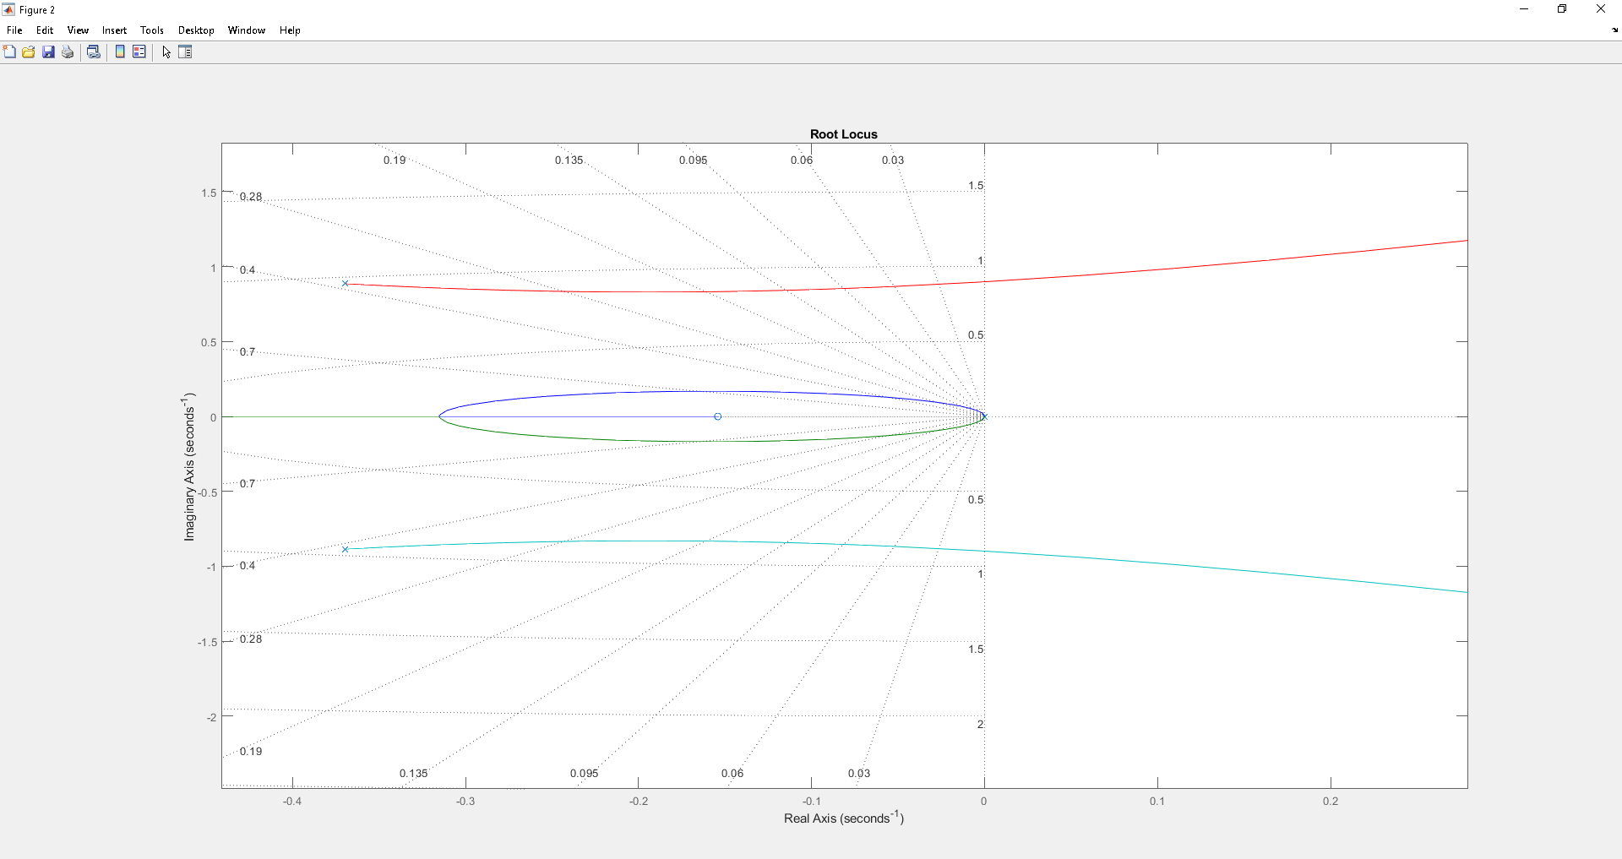

Slide 14
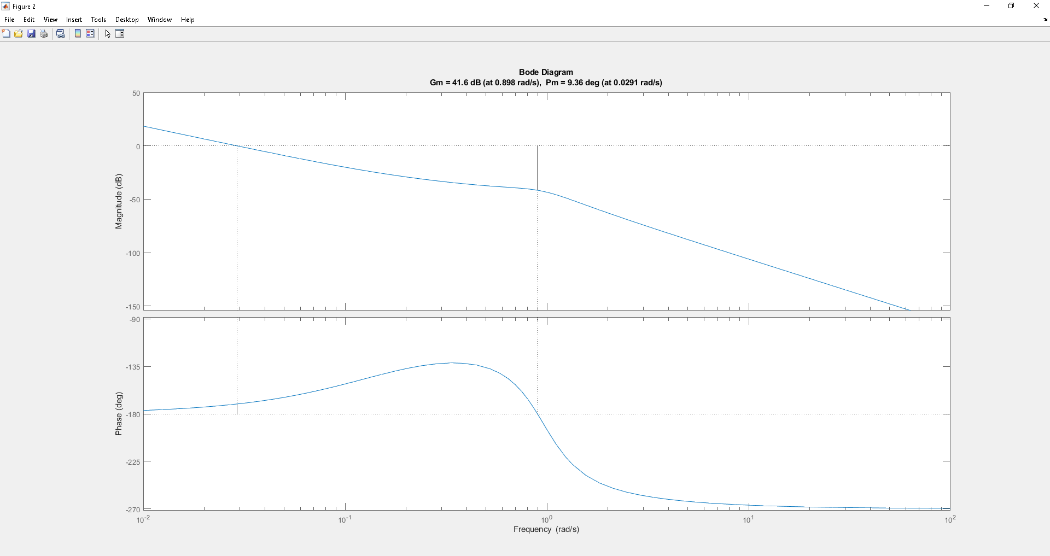
Fig.6 Bode plot wthC=0.00432/s

Slide 15
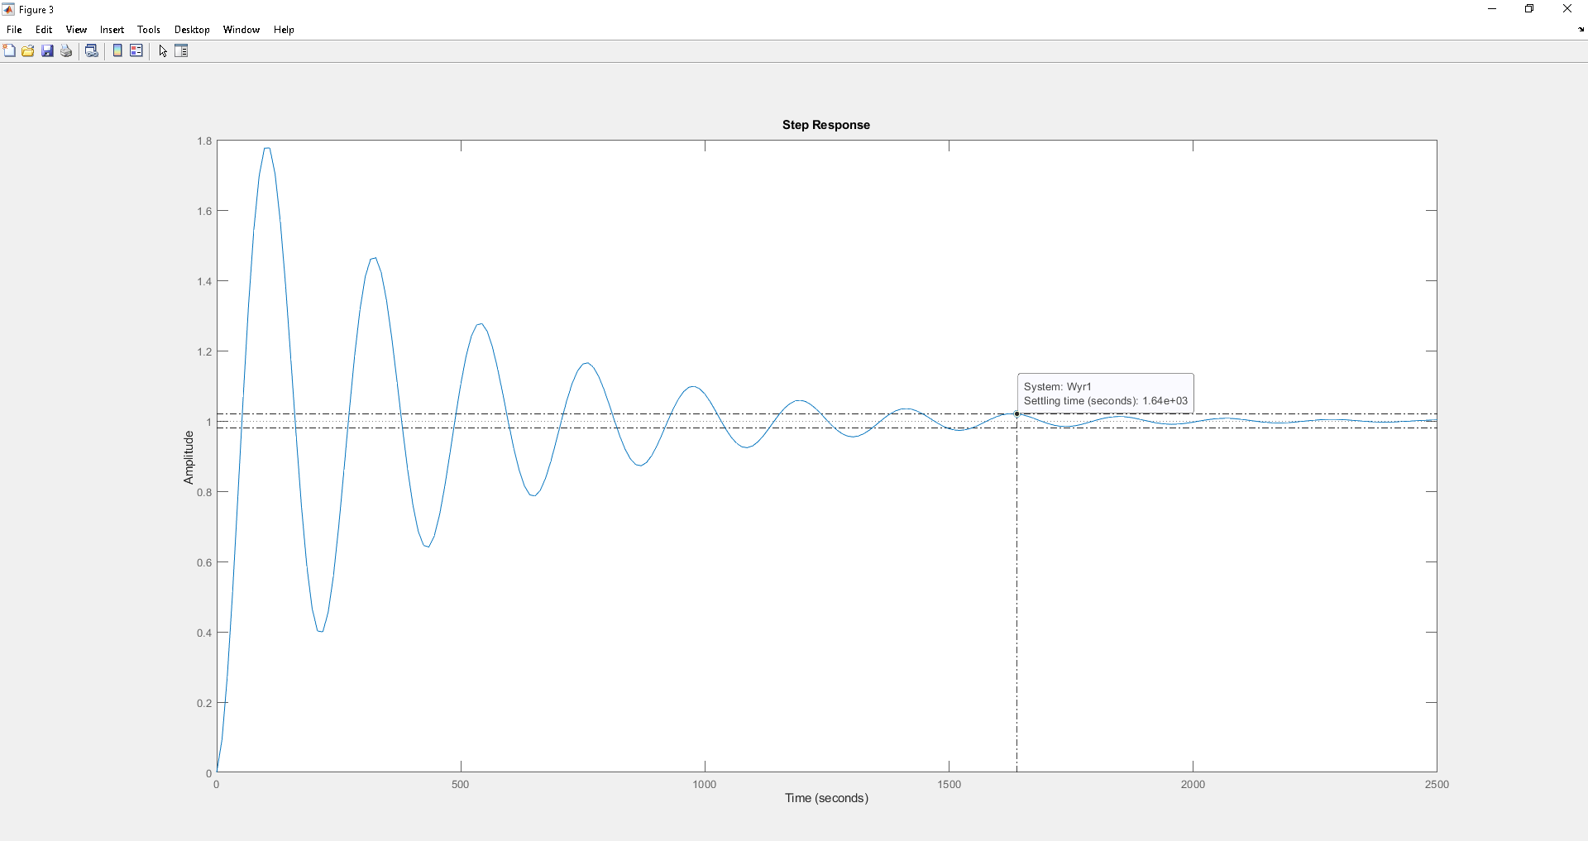
CONTROLLER DESIGN(3/4)
Figure 7 represents the Wyr in its final state considering C=0.00432/s as controller.
With this controller the Ta of the system is very high.
Fig.7 Step of Wyr(s) before inserting the FeedForward filter

Slide 16
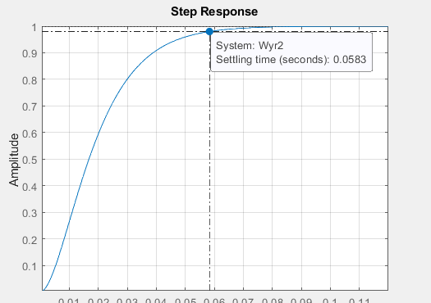
CONTROLLER DESIGN(4/4)
Let's add a Feed Forward to the system equal to: Ff = (1 / P)/((1+tau_ff*s)^2)
with tau_ff = 0.01
With this filter the Ta of the system is equal to 0.0583 seconds.
I notice that with the addition of the feed forward filter the overshoot is 0% and I have a good settling time.
Fig.8 Step of Wyr(s) with FeedForward

Slide 17
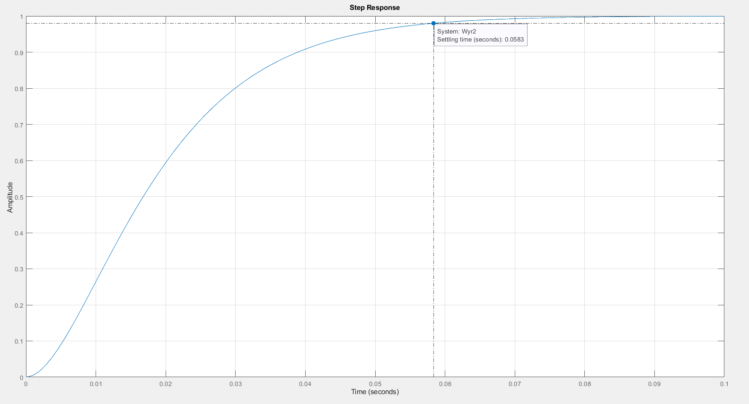

Slide 18
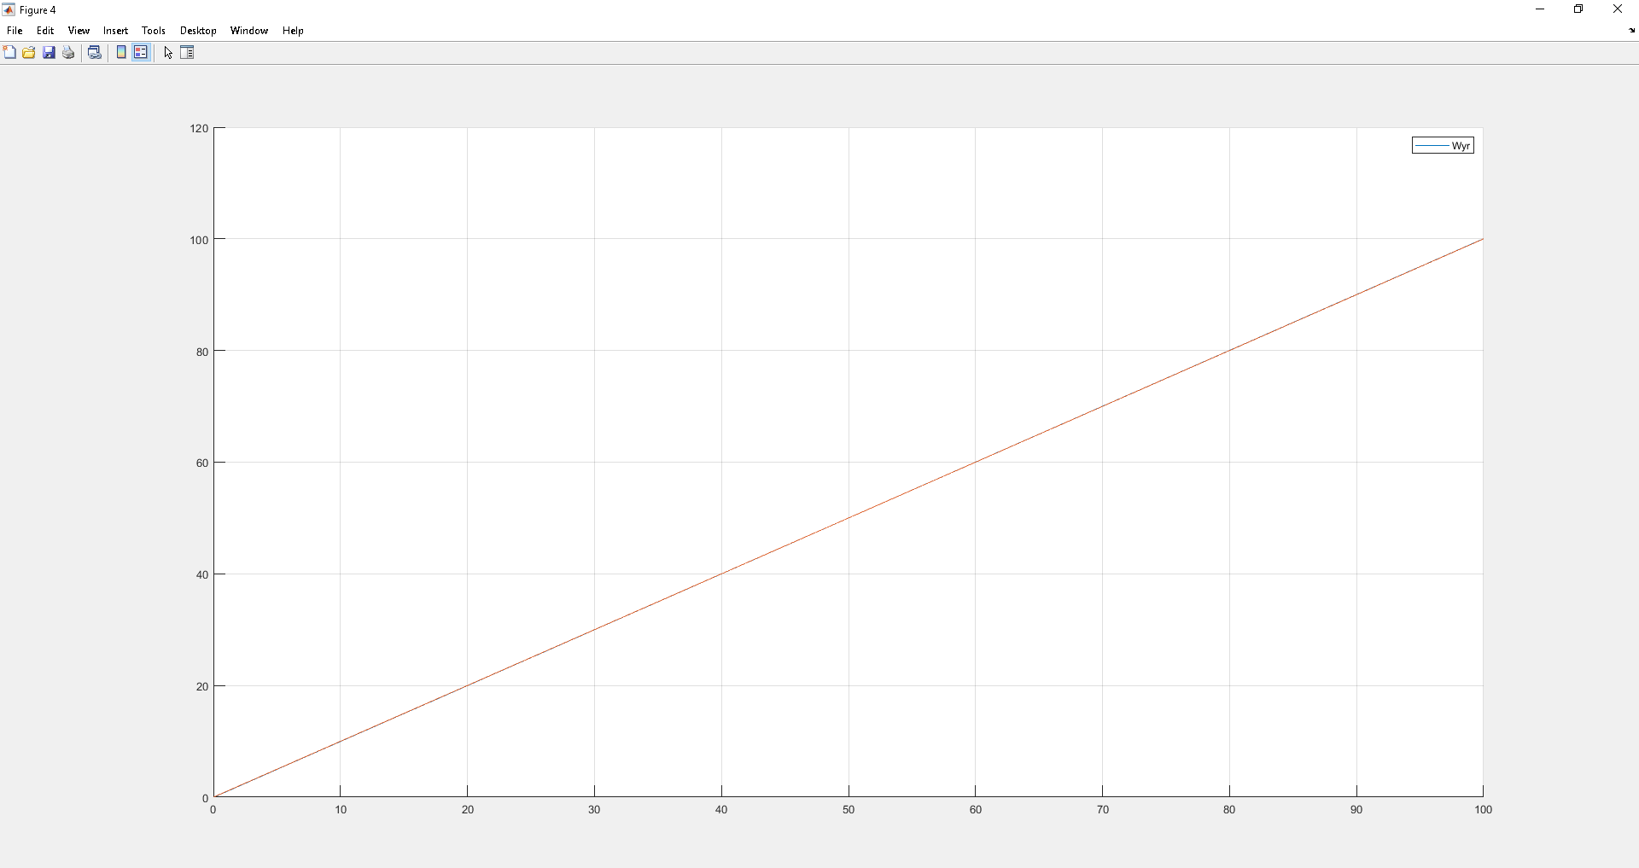
RAMP TRACKING ANALYSIS
Figure 9 represents the Wyry) with ramp reference signal (u). As can be seen, the system has a zero-state error since y and u overlap.
Fig.9 Simulation Ramp

Slide 19
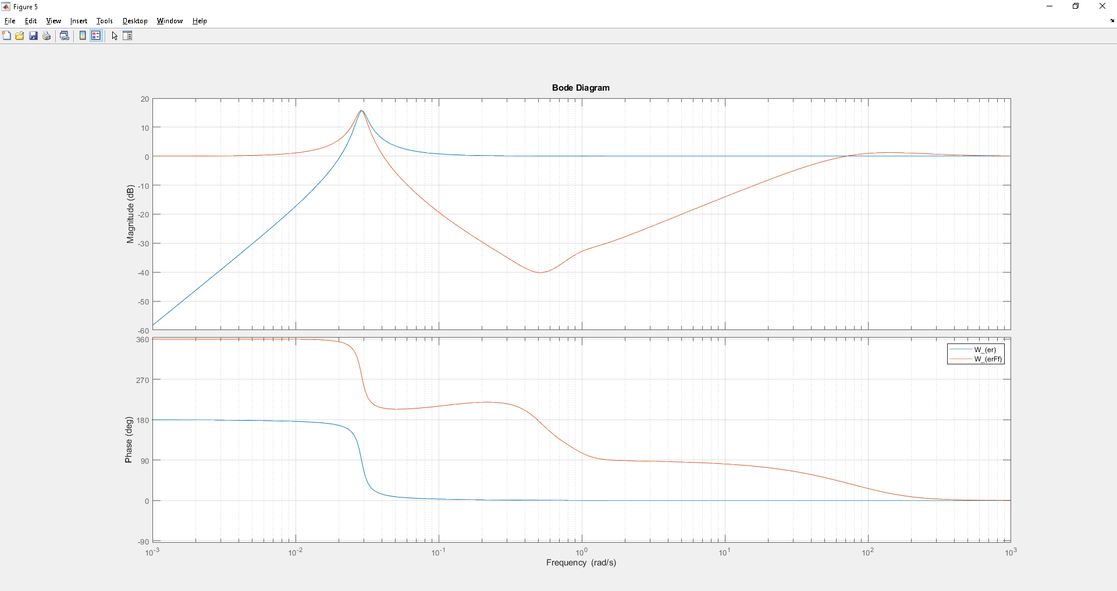
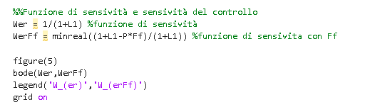
SENSITIVITY
MATLAB code
conclusions
Around the value 10^-3 the system is robust
Fig.10 Bode plot of Wer

Slide 20

MAXIMUM ALLOWABLE DELAY
By analyzing the Bode diagram (figure 12) of L=P*C we can calculate the maximum admissible delay following the formula:
T < µ_𝝓 /𝝎_𝝉 with:
µ_𝜙 = 9.36*π/180= 0.163rad
𝜔_𝜏 = 0.0291rad/s
T < 5.6s
Fig.12 Margin of L

Slide 21
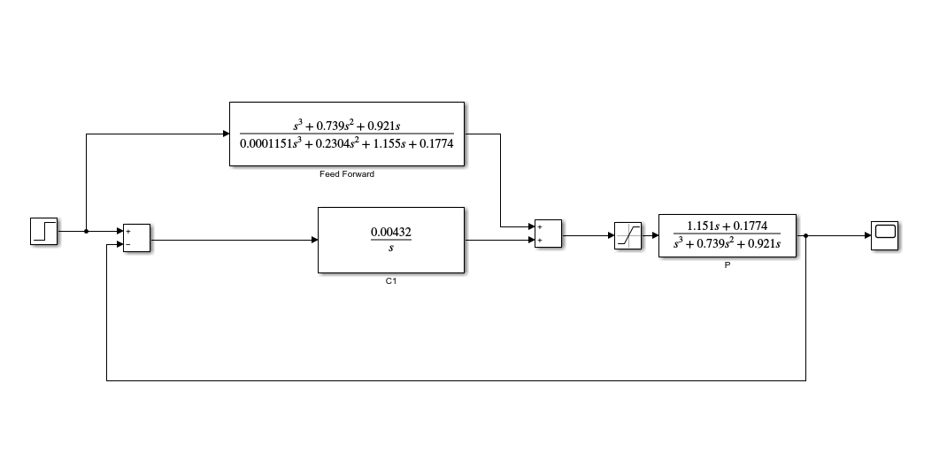
SATURATION (1/3)
Once the model was recreated in the Simulink environment, a saturation was added to the system for ramp entrances.
Fig.13 Diagramma a blocchi del sistema con saturazione

Slide 22
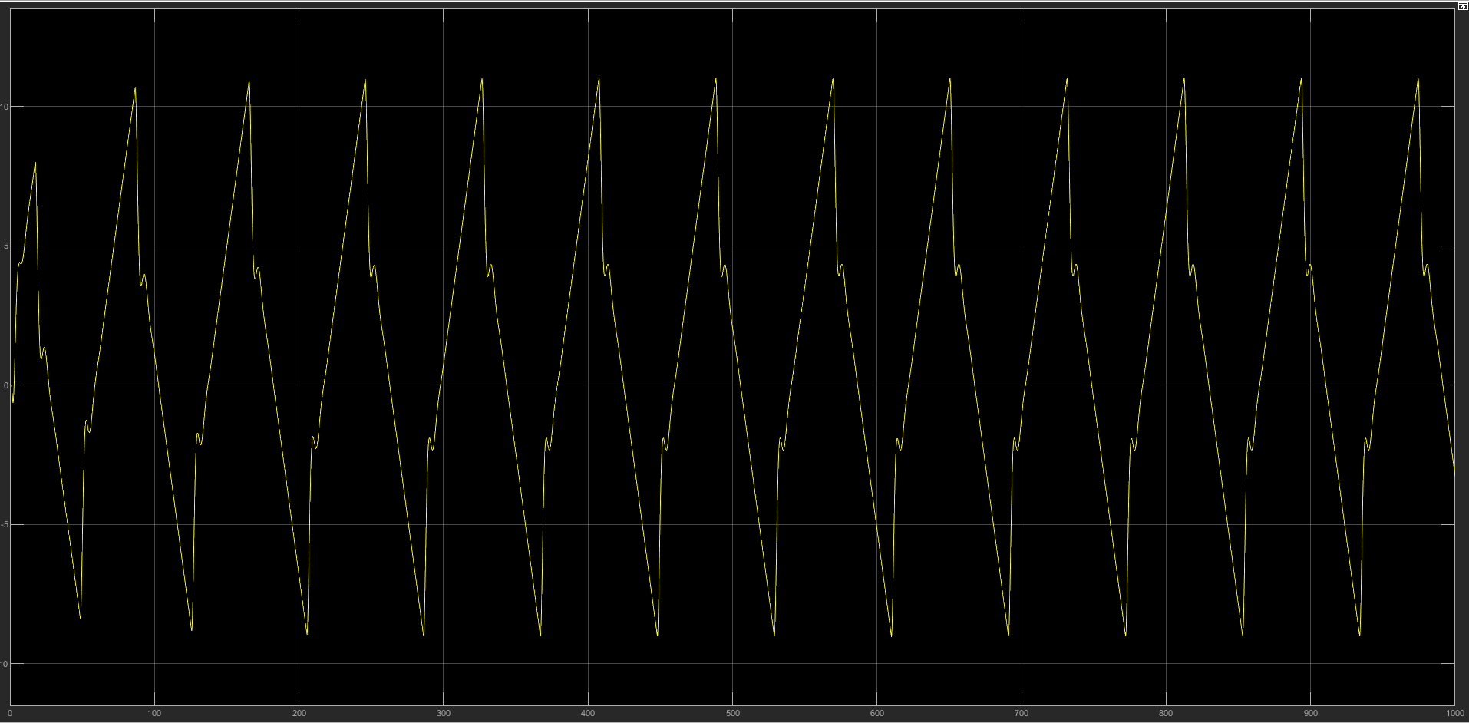
SATURATION(2/3)
You can see from the graph (for ramp input) that the controller of my system is not very robust.
Fig.14 Wyr scope with saturation (ramp input) with feed-forword filter

Slide 23
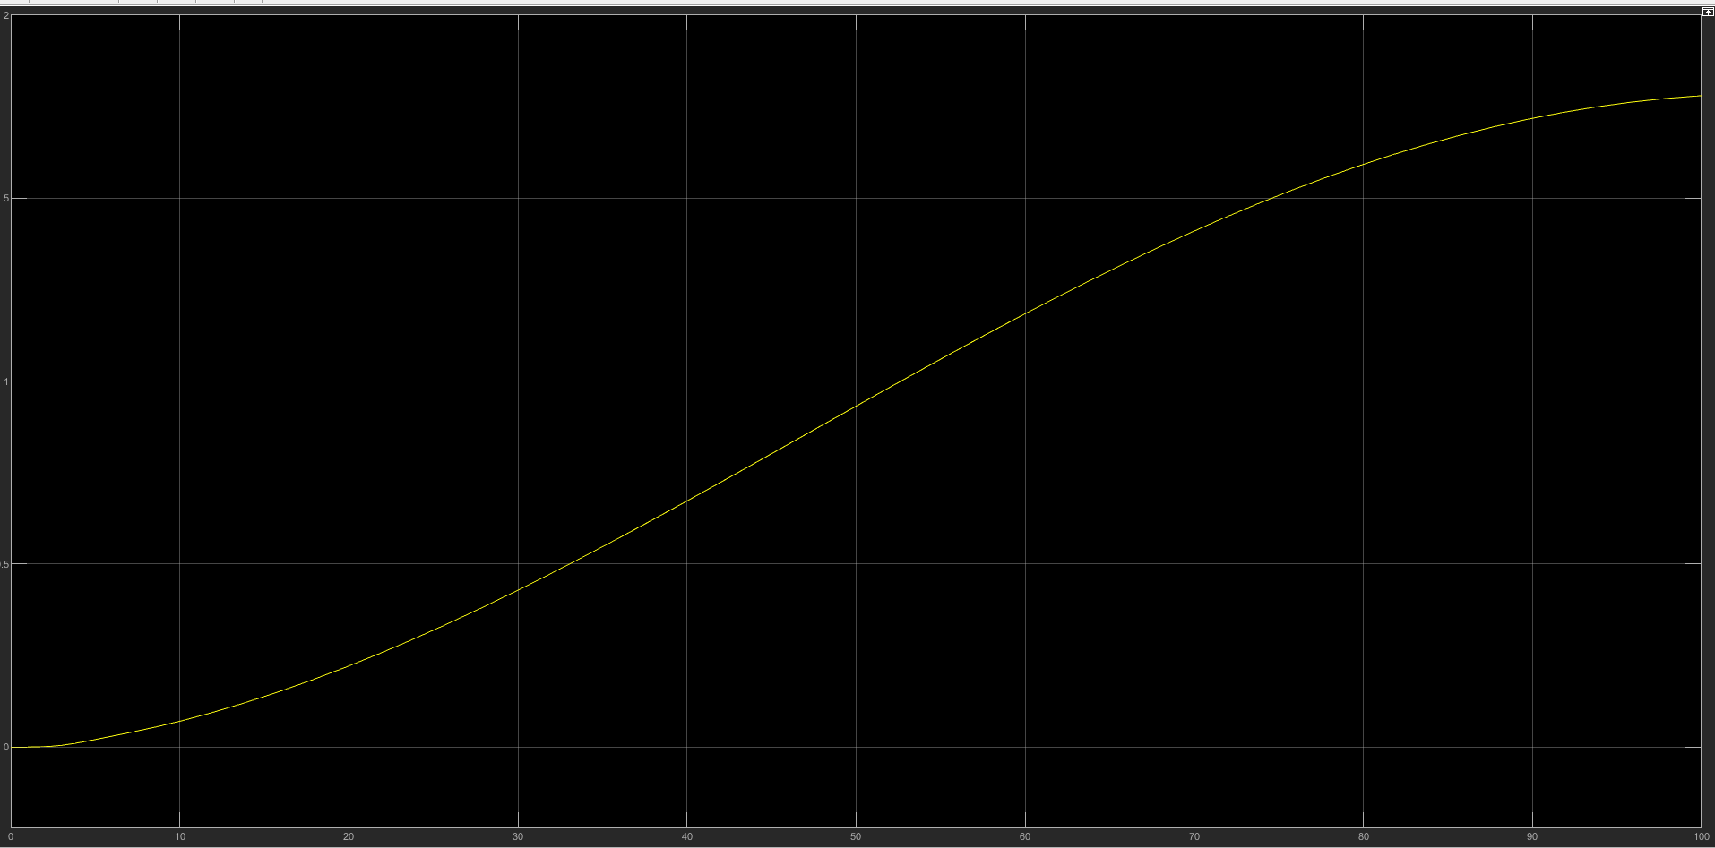
SATURATION (3/3)
As you can see from the graph, even in this case the controller of my system is not very robust but as regards the simulation on Simulink it is slightly better without the use of the feed-forword filter.
Fig.15 Wyr scope with saturation (ramp input) without feed-forword filter

