Slide 1

Critical Mass of Nuclear Weapons
Davide Marro
References:
Graham Griffiths. Neutron diffusion. 02 2018

Slide 2
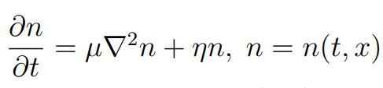




THE EQUATION
Neutron density
Diffusion constant
Dirichlet boundary conditions
Neutron rate of formation constant
Neutron transport free path
Neutron speed
Initial conditions
Neutron fission free path
Secondary neutron created by fission

Slide 3
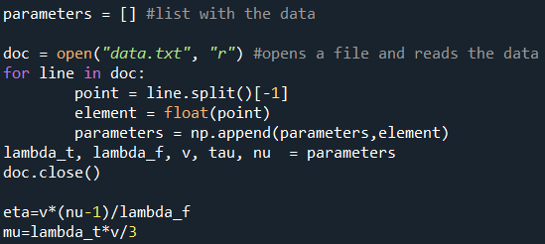
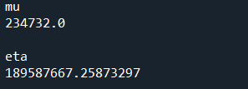




We will use the following values that refere to the $U^{235}$
$λ_{t}=\text{ 0.360 }\text{m}$ trasport free path
$λ_{f}=01689 m$ fission free path
$v=1.9561×{10}^{7}$ neutron speed
$τ=8.6347×{10}^{−9}$ mean travel time to neutron fission
$ν=2.6370$ secondary neutrons created by fission
From whitch we derive $μ$ and $η$
$$m^{2}/s$$
$$1/s$$

Slide 4
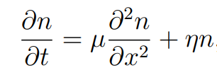
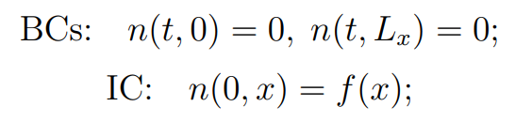
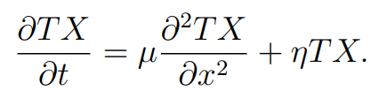
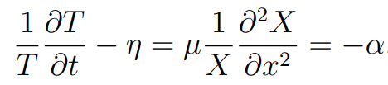

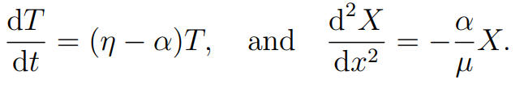
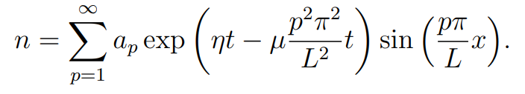
1D IN CARTESIAN COORDINATES
CAN BE SOLVED ANALITICALLY
The problem reduces to the solution of two ODEs

Slide 5
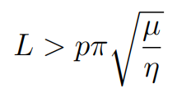
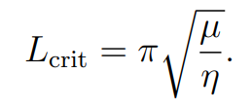


n becomes unbounded when
If we take p=1 we find the critical condition

Slide 6
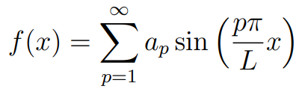

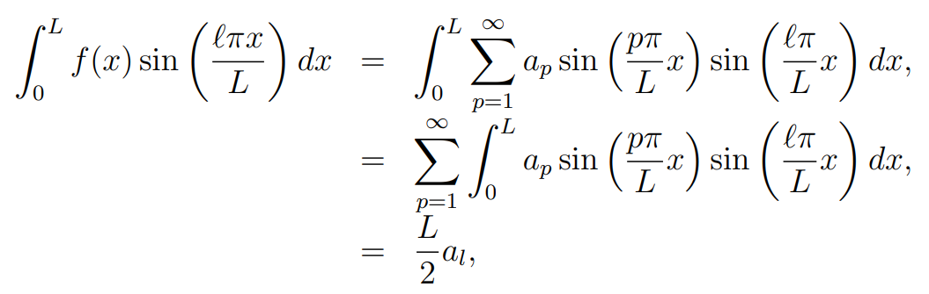
From the orthogonality of the functions $\sin{kπx/L}$ and $\sin{lπx/L}$ follows

Slide 7
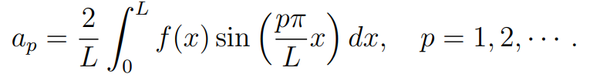
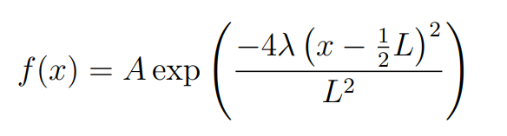

We set the Gaussian initial conditions
With $A=1, λ=100$
So we can proceede to the computation of the coefficients

Slide 8
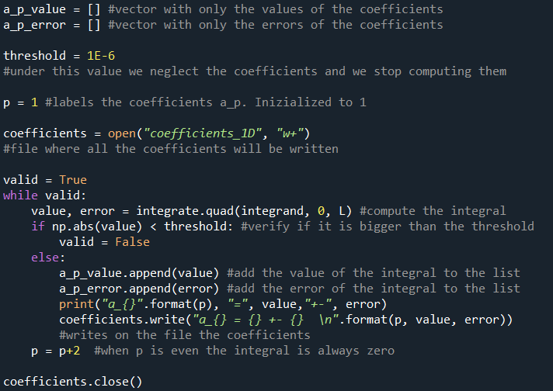

Slide 9
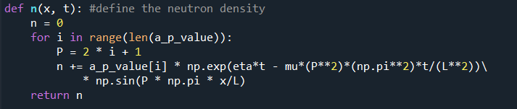
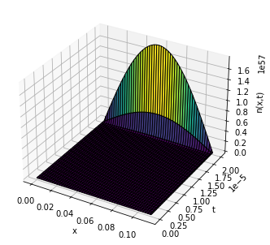
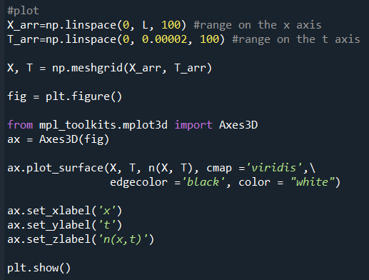

Slide 10
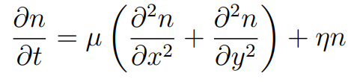
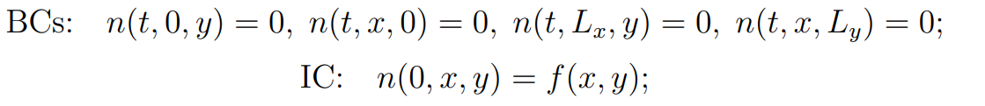

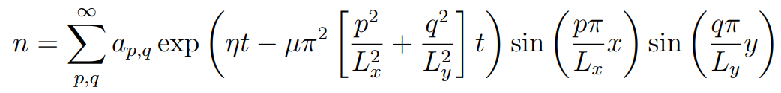
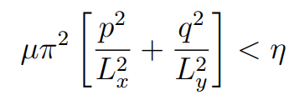
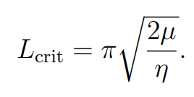

2D IN CARTESIAN COORDINATES
n becomes unbounded when
If we take p=q=1 we find the critical condition

Slide 11
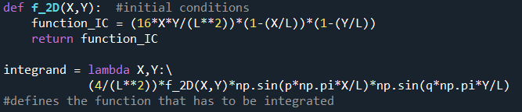
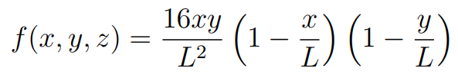
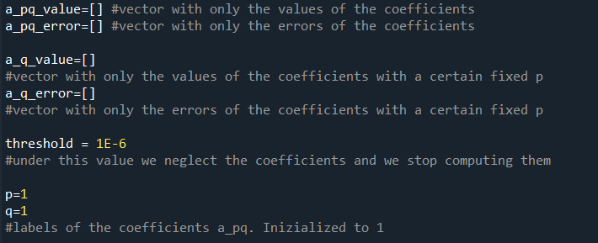

Slide 12
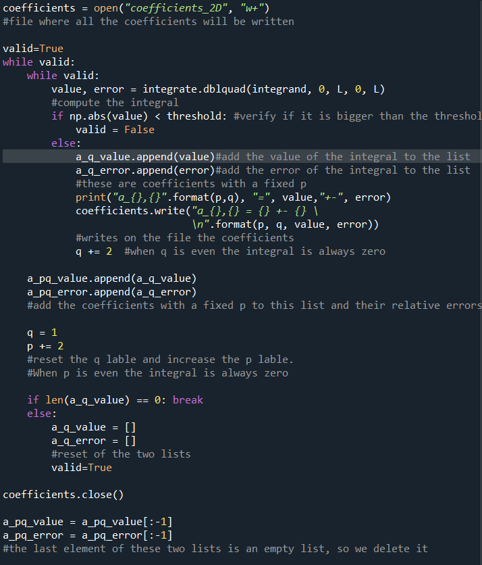

Slide 13
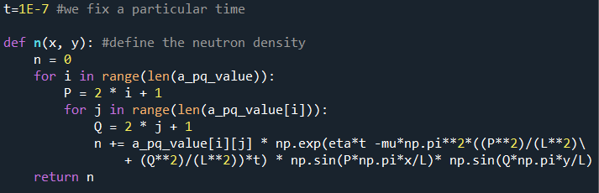
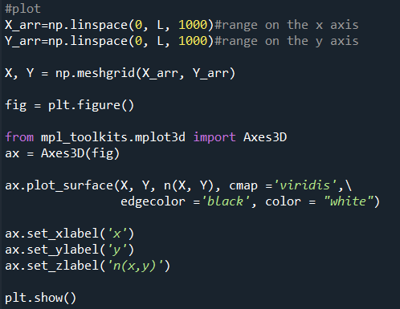
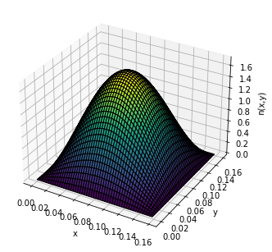

Slide 14
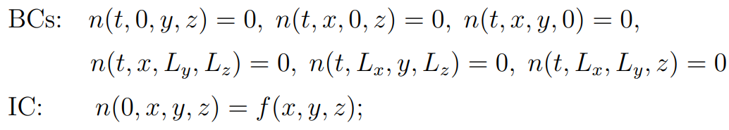
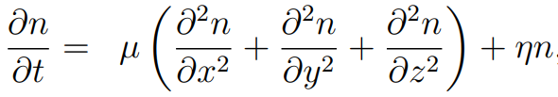
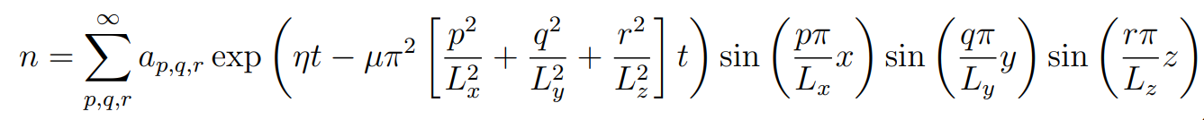
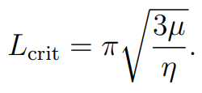

3D IN CARTESIAN COORDINATES
With critical condition

Slide 15
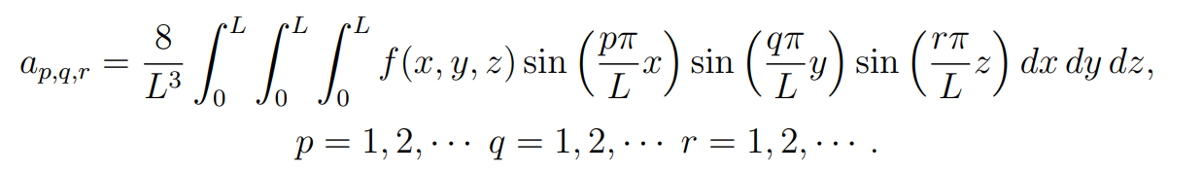
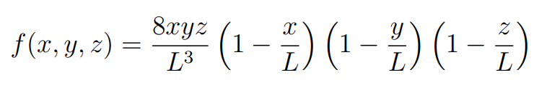
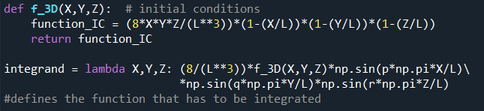
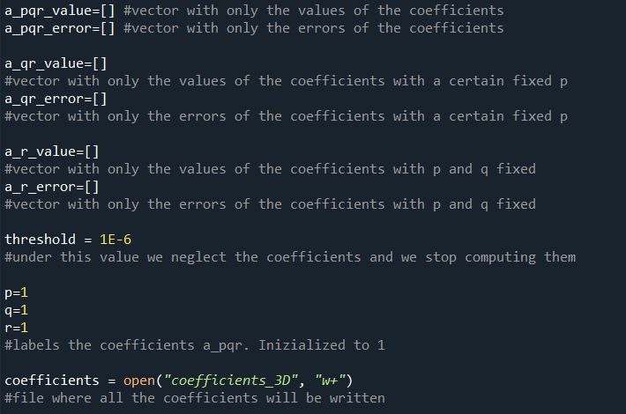

Slide 16
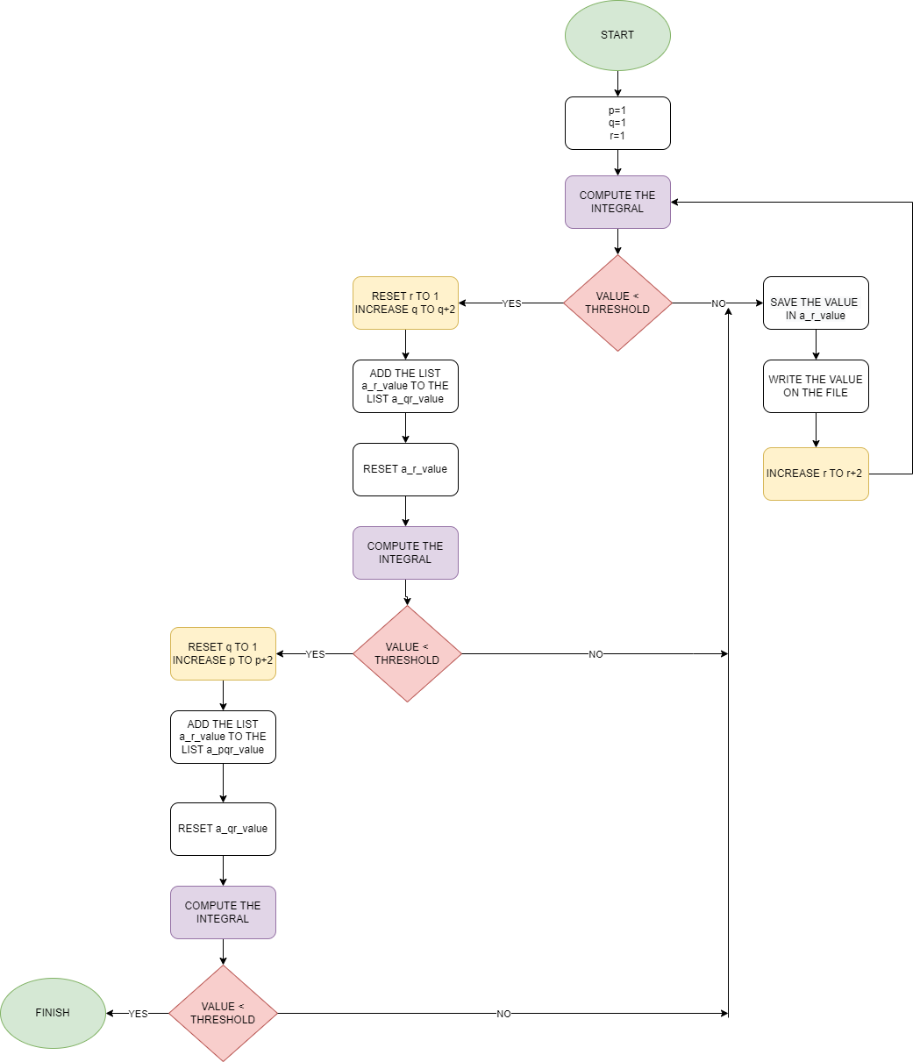
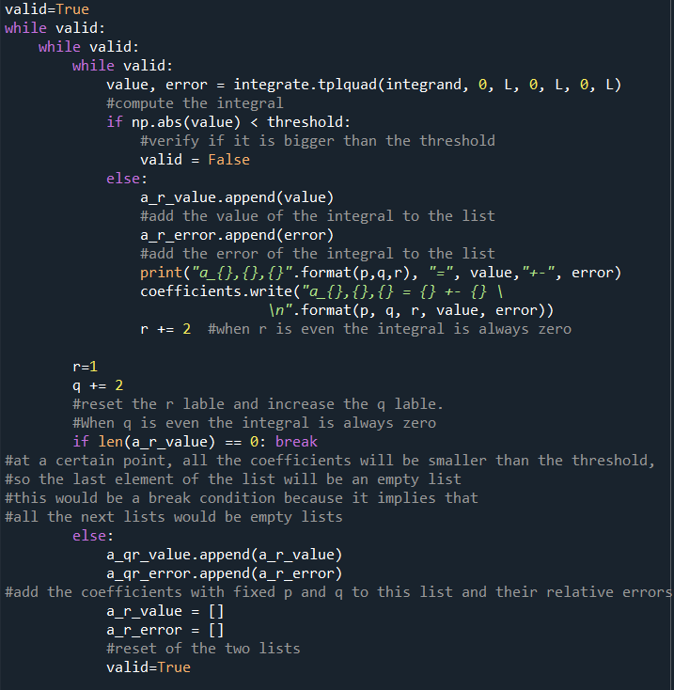

Slide 18
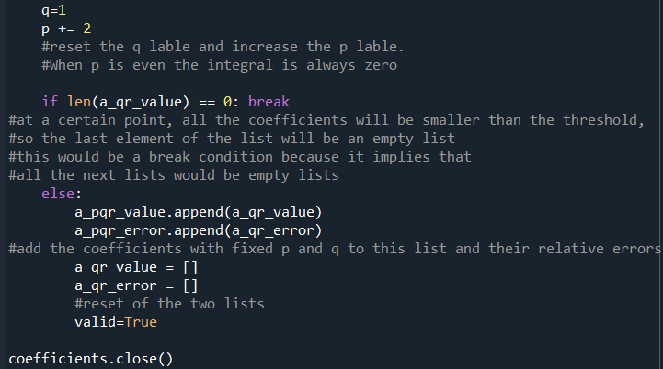

Slide 19
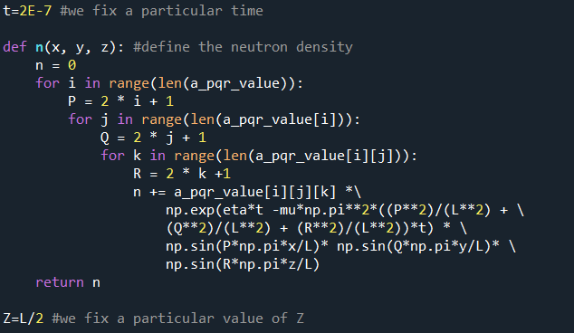

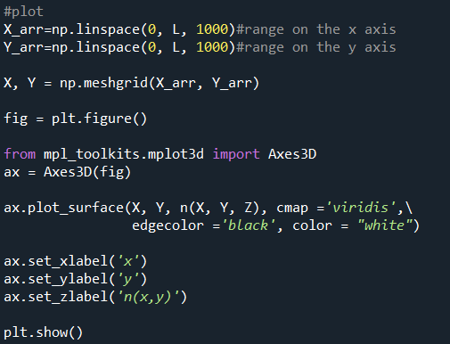

Slide 20


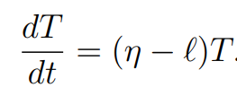

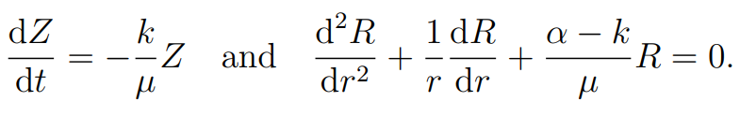
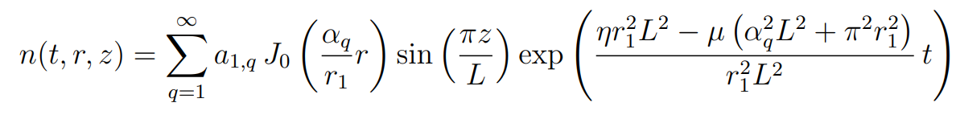
3D IN CILINDRICAL COORDINATES
Same as the cartesian case
The problem reduces to the solution of three ODEs
Bessel function of the first kind
Zeros of theBessel function

Slide 21

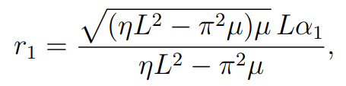
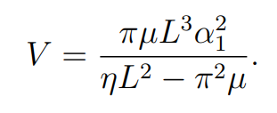
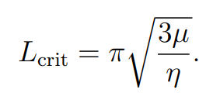


n becomes unbounded when
Setting q=1 we find the critical condition
We use this radius to calculate the critival volume
Differentiating V with respect to L and equating to zero, we obtain the critical length of the cylinder

Slide 22




Slide 23




Slide 24







3D IN SPHERICAL COORDINATES
n becomes unbounded when
Setting p=1 we find the critical condition

Slide 25




With initial conditions

Slide 26




Slide 27









3D IN SPHERICAL COORDINATES WITH NEUMANN BC
Where
Solving the equation for R and imposing the boundari conditions leads to the equation
This equation needs to be solved numerically
Setting $α=0$ we find the critical condition

Slide 28






In order to find k we substitute r1 in the previous equation ed solve again for k
Now we can also find $α$
and A by setting $n\left(r_{1},t=0\right)=1$. We set this particular value because we are using an over critical radius, so n would grow exponentially with time in any case.

Slide 29





