Slide 1
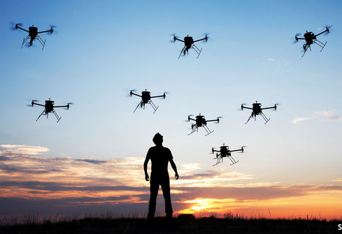

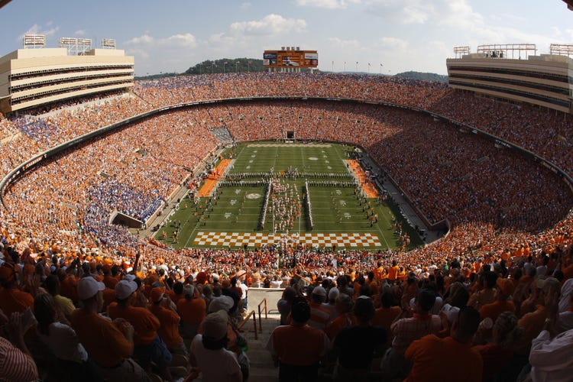
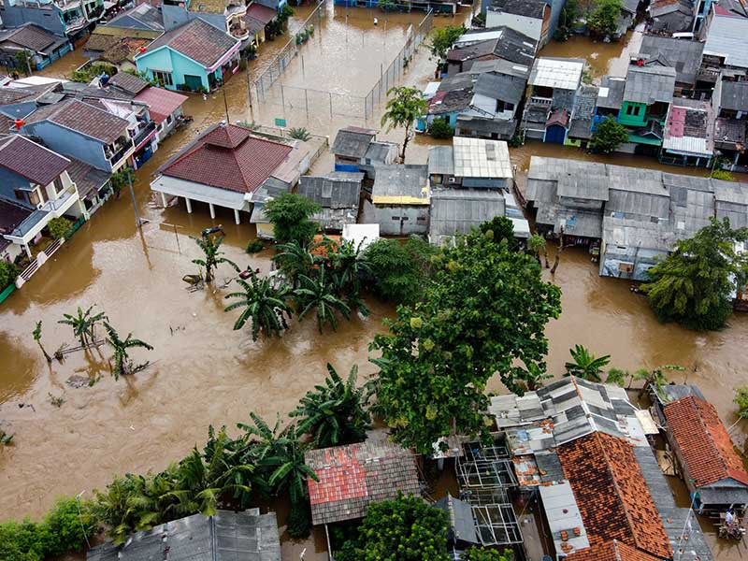
A VNF-Chaining Approach for Enhancing Ground Network with UAVs in a Crowd-Based Environment
Davide Montagno Bozzone - 535910
- All the images may be subject to copyright.
- For bibliografy please refer to Michele Girolami Federica Paganelli Davide Montagno B.,Stefano Chessa. A vnf-chaining approach for enhancing ground network with uavs in a crowd-based environment. 2023 IEEE Symposium on Computers and Communications (ISCC) - 13th Workshop on Management of Cloud and Smart City Systems (MoCS 2023)

Slide 2
Agenda
Motivation
State-of-art
Scenario & Use cases
Architecture
Experiments
Results
Conclusion & Future Works

Slide 3

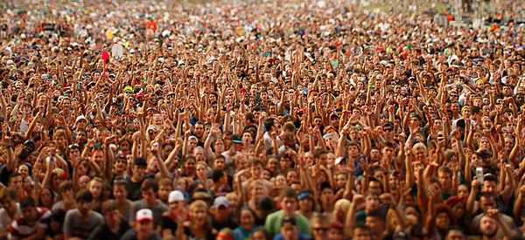
Motivation
High-speed & reliable networks
5G Architecture
Heavy investments
UAVs integration

Slide 4


State of art
5G mobile networks
High speed and high mobility
100 times more energy-efficient
Network Functions Virtualization
Virtual Network Functions
Infrastructure
Management & Orchestration
VNF chaining
UAVs management

Slide 5
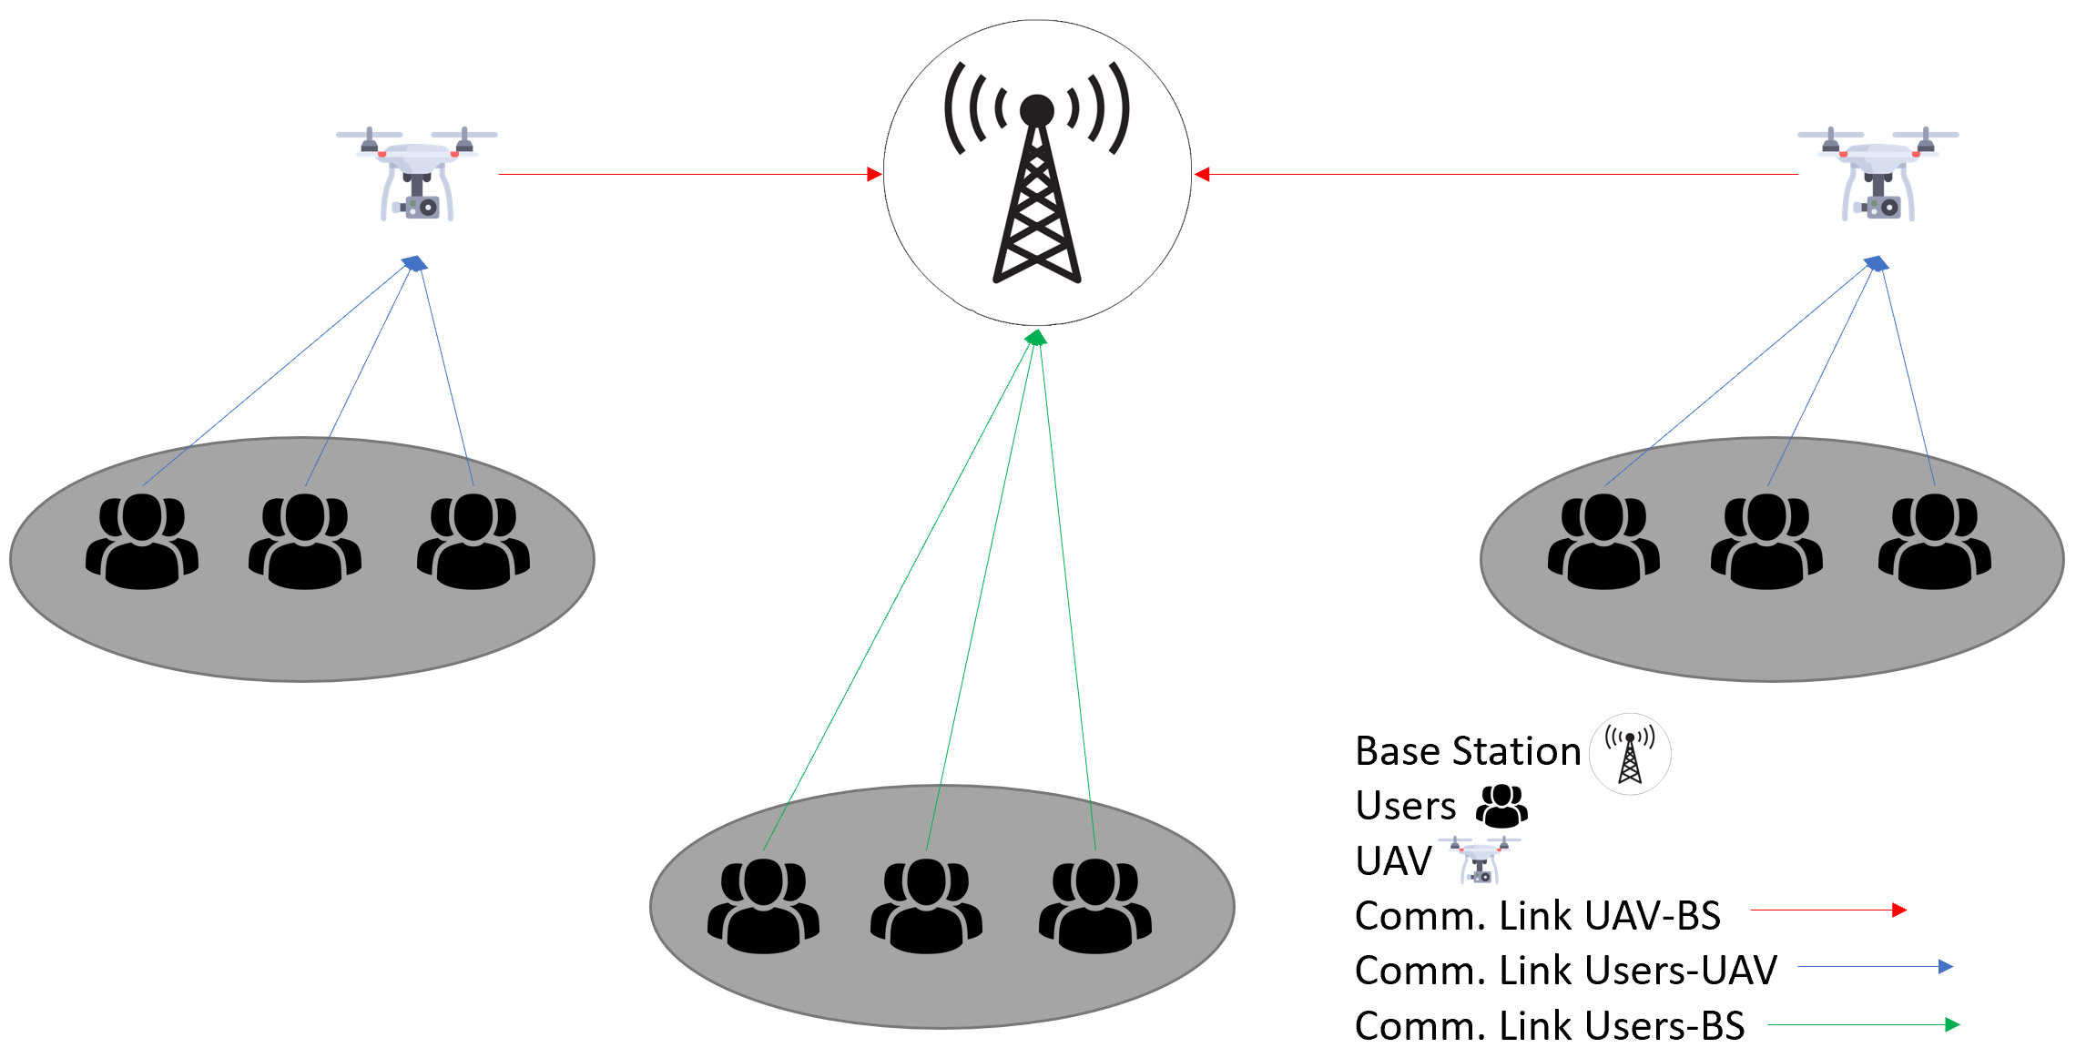
Scenario & Use cases
Star topology
Some assumptions
Communication aspects & channel modelling
Objective
Use case
Remote monitoring
Security

Slide 6
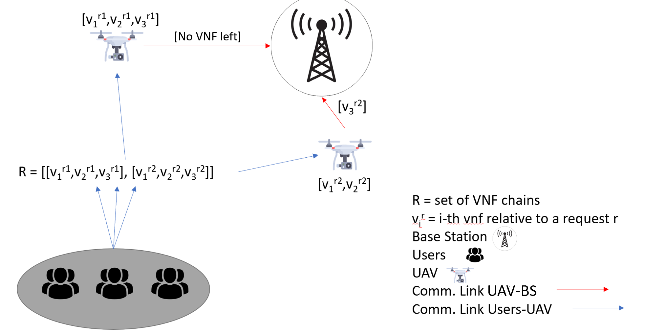
Architecture – An example
Parameter | Description | Value
C_max^BS | Max CPU capacity BS | 34,000 Mbps
BJ_i | Initial battery charge | 277,200 J
P_i^flight | Inst. Power consumption hover flight mode | 100 W
C_i^proc-active | Cost for keeping CPU active | 8.5 W
C_i^radio-active | Cost for keeping Radio active | 8 W
C_i^proc-idle | Cost of idle CPU usage | 1/3 C_i^proc-active
C_i^radio-idle | Cost of idle Radio usage | 1/3 C_i^radio-active
CR_i | Max CPU capacity BS | 2,000 Mbps
CC_i | Max Radio capacity BS | 4,000 Mbps
CA_i | Cost of reaching a destination | 5,544 J
CB_i | Cost to return to the charging station | 5,544 J
v_1 | First VNF filter percentage | [0, 20]
v_2 | Second VNF filter percentage | [21, 40]
v_3 | Third VNF filter percentage | [41, 55]
n | Maximum number of drones | 30

Slide 7

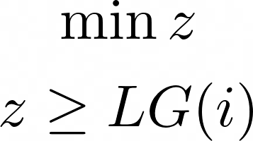
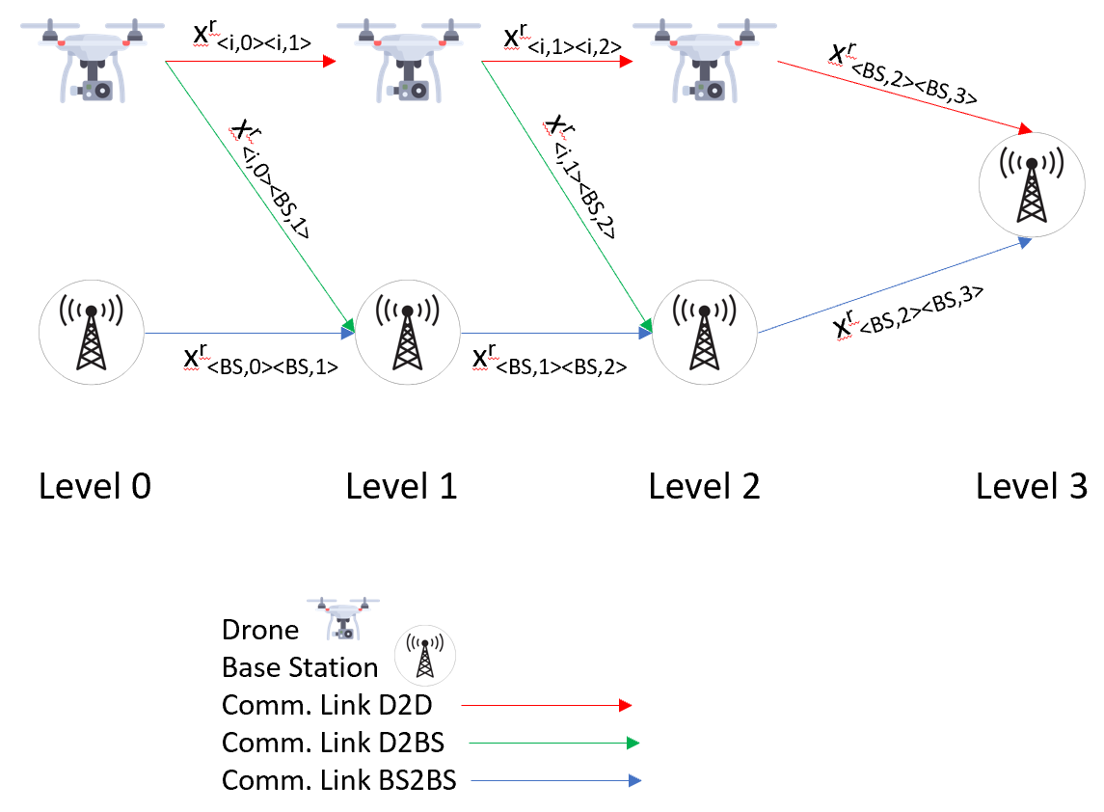

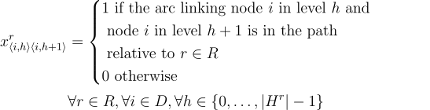
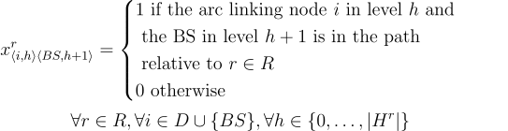
Architecture – Problem formulation

Slide 8
Experiments – Syntethic dataset to set requests R
Group | Users | Avg rate per user | Tot rate group | R_low | R_med | R_high | |R| | |VNF|
0 | 10000 | 3 | 30000 | 30 | 25 | 20 | 75 | 140
1 | 10000 | 5 | 50000 | 50 | 25 | 25 | 100 | 175
2 | 10000 | 2 | 20000 | 20 | 20 | 20 | 60 | 120
3 | 10000 | 3.5 | 35000 | 25 | 25 | 30 | 80 | 165
4 | 10000 | 6 | 60000 | 70 | 50 | 30 | 150 | 260

Slide 9



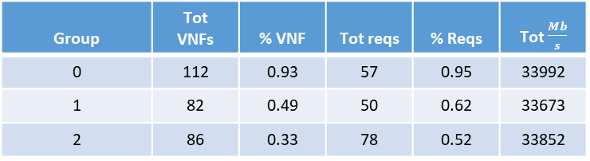
Results – Use case DDoS attack - 1
Group | Users | Avg rate per user | Tot rate group | r_low | r_med | r_high | |R| | |VNF|
0 | 10000 | 2 | 20000 | 20 | 20 | 20 | 60 | 120
1 | 10000 | 3.5 | 35000 | 25 | 25 | 30 | 80 | 165
2 | 10000 | 6 | 60000 | 70 | 50 | 30 | 150 | 260
Group | Tot VNFs | % VNF | Tot reqs | % Reqs | Tot $\frac{Mb}{s}$
0 | 112 | 0.93 | 57 | 0.95 | 33992
1 | 82 | 0.49 | 50 | 0.62 | 33673
2 | 86 | 0.33 | 78 | 0.52 | 33852
Group | Total TP | Enhancement | |D|
0 | 36403 | 0.07 | 1
1 | 65155 | 0.92 | 10
2 | 96069 | 1.83 | 24

Slide 10
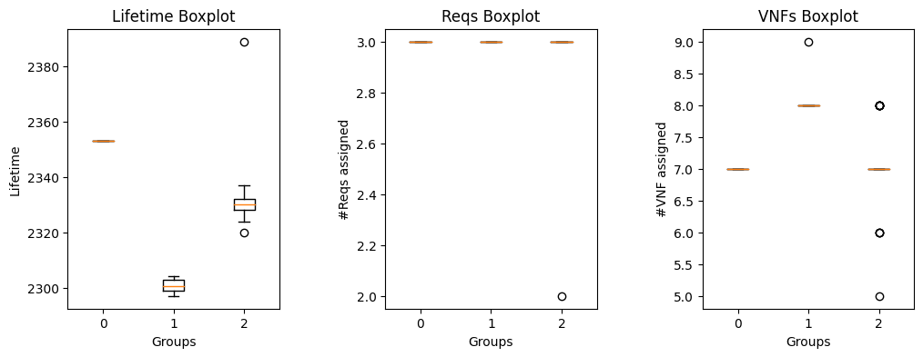
Results – Use case DDoS attack - 2
Relationship | Group 0 | Group 1 | Group 2
Avg. lifetime UAVs vs #UAVs used | 0.73 | 0.95 | 0.87
Avg. CPU usage vs #UAVs used | -0.81 | -0.97 | -0.99
Avg. Radio usage vs #UAVs used | -0.58 | -0.79 | 0.21

Slide 11
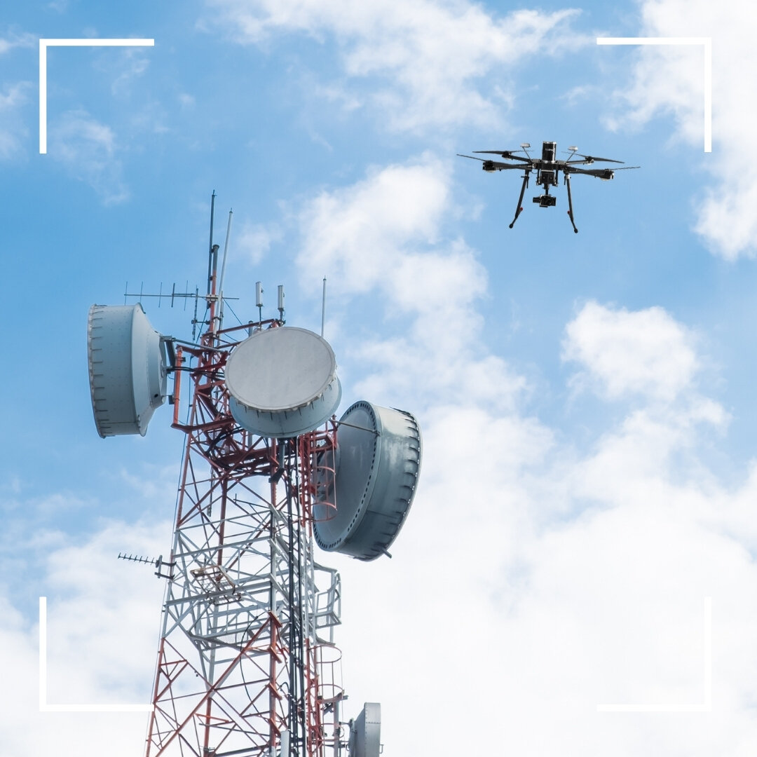
Conclusion & Future works
Model contribution
Further researches
Final considerations

Slide 12

THANK YOU

