Slide 1
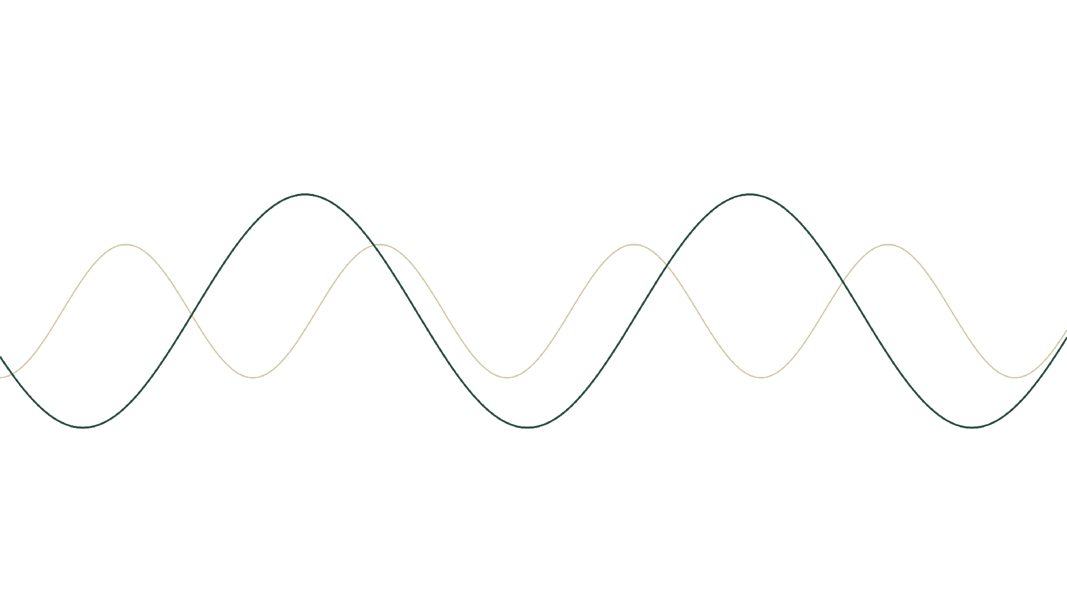
SIGNAL / NOISE
READING THE MARKET'S HIDDEN CYCLE
A four-step method that separates real cycles from the random noise intrinsic in the market, and ranks the ones that actually move prices.
01 DETREND · 02 DETECT · 03 VALIDATE · 04 RANK
01 / 16
Notes:
Open here. Don't name the source yet — that's your line. The deck explains the concept end to end: how to pull one dominant cycle out of noisy price data, four steps.

Slide 2
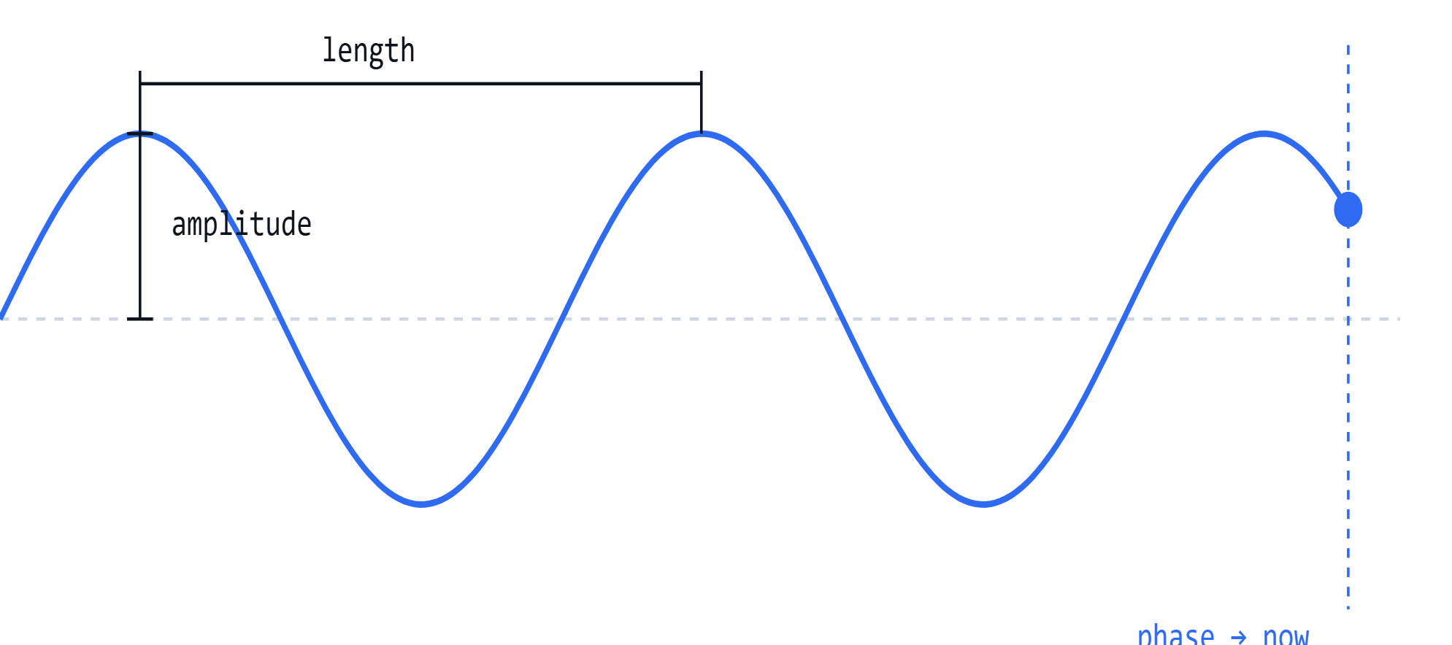
PRIMER · ANATOMY OF A CYCLE
03 / 16
Three numbers can describe any cycle
LENGTH · WAVELENGTH
ONE IDEALISED CYCLE
How many bars one full swing takes — the period.
AMPLITUDE
How big the swing is, peak to trough.
PHASE — RIGHT NOW
Where we sit in the swing at the latest bar.
Notes:
Quick primer so the rest of the deck has vocabulary. Any cycle is fully described by three numbers: length (wavelength), amplitude (size of the swing), and phase (where in the swing we are right now). The whole algorithm exists to estimate these three for the dominant cycle.

Slide 3
THE METHOD
04 / 16
Four steps to one dominant cycle.
Each step either cleans up or narrows down what the next one sees. The output of one is the input of the next.
01
02
03
04
Detrend
Detect
Validate
Rank
→
Scan every cycle length; find the ones that repeat strongly.
→
→
Remove the long drift so only the swings remain.
Test each one: genuine rhythm, or a fluke?
Order survivors by how hard they move price.
Notes:
The map. Four steps, each feeding the next: clean the data, find candidate cycles, test which are genuine, rank by real influence. Note the in→out under each card — the output of one step is the input of the next.

Slide 4
STEP 01 · DETRENDING
05 / 16
01 DETREND
02 DETECT
03 VALIDATE
04 RANK
Subtract the trend, keep the swing.
An HP filter splits the series into a smooth trend and a cyclic remainder. Subtract the trend and what's left is pure oscillation — the clean input every later step depends on.
BEFORE
AFTER
Notes:
Step one, the key visual. An HP filter splits the series into a smooth trend plus a cyclic remainder. Subtract the trend and you get pure oscillation — the input every later step needs. Show raw+trend on the left, detrended on the right.

Slide 5
STEP 01 · DETRENDING
06 / 16
01 DETREND
02 DETECT
03 VALIDATE
04 RANK
One dial changes everything: λ.
The filter has a single smoothing parameter — lambda. It sets how stiff the trend line is, and that choice strongly shapes which cycles survive into the residual.
min_{τ} Σ (y_{t} − τ_{t})² + λ Σ [(τ_{t+1} − τ_{t}) − (τ_{t} − τ_{t−1})]²
fit term — keep the trend τ close to the data
smoothness term — λ weights how stiff the trend is
FIG 03
Same series, three values of λ
overlay the residual at low / tuned / high λ to see how much it moves
Notes:
The technical heart of step one. The HP filter has one smoothing parameter, lambda. It decides how stiff the trend is — and it strongly shapes which cycles survive. Too low absorbs real cycles; too high leaks trend and can manufacture spurious cycles. Tune it to the data's frequency, then cross-check in step 3.

Slide 6
STEP 01 · CAVEAT
07 / 16
01 DETREND
02 DETECT
03 VALIDATE
04 RANK
WATCH OUT
Detrending can manufacture cycles.
Real cycle, or filter artifact?
Because the filter reshapes the series, a wiggle in the residual isn't proof of a real cycle — HP filtering can produce cyclic behaviour even when none exists in the original data.
detrended residual — which swings persist, which are noise?
So every detected cycle stays a candidate . Cross-correlation checks and the genuineness test in Step 3 are what separate the real ones from filter artifacts.
Notes:
The honest caveat that motivates step 3. Because the filter reshapes the data, a wiggle in the residual is not proof of a real cycle — HP filtering can produce cyclic behaviour even when none exists. So every candidate stays provisional. Cross-correlation checks plus the genuineness test catch the fakes.

Slide 7
STEP 02 · DETECTION
08 / 16
01 DETREND
02 DETECT
03 VALIDATE
04 RANK
Sweep every length; find what repeats.
Test each candidate wavelength and measure how strongly the residual oscillates there. Rather than a blanket transform, the scanner uses a targeted DFT that evaluates one frequency at a time.
Scanning across wavelengths
GDFT response as the test length sweeps from short to long
▸
Born to pull a known tone out of noise — the same shape as the market problem.
▸
Accurate on short, noisy windows where a broad FFT smears.
▸
Outperforms wavelets and MESA when noise > signal.
method · Goertzel DFT (GDFT), swept across all wavelengths
Notes:
Step two. Sweep every candidate wavelength and measure how strongly the data oscillates at each. Instead of a blanket FFT, use a targeted DFT that evaluates one frequency at a time — efficient and accurate on short, noisy data. Its original job was pulling a known tone out of noise, which is exactly the market problem. Studies show it beats wavelets and MESA when noise outweighs signal.

Slide 8
STEP 02 · DETECTION
09 / 16
01 DETREND
02 DETECT
03 VALIDATE
04 RANK
The sweep produces a spectrum: strength vs cycle length . Wherever the curve spikes, the data repeats strongly at that length — a candidate cycle worth keeping.
Peaks are the candidates.
FIG 06
Cycle-length spectrum
x = cycle length, y = strength — mark the peaks as candidates
Notes:
The result of the sweep is a spectrum: strength on the y-axis, cycle length on the x-axis. Peaks are the candidate cycles. Each peak comes with three readings — its length, its amplitude, and its phase.

Slide 9
STEP 02 · WHAT WE CAPTURE
10 / 16
01 DETREND
02 DETECT
03 VALIDATE
04 RANK
We want the cycle that's active now.
FIG 07
LENGTH
How many bars one full swing takes.
AMPLITUDE
One cycle on recent price
How big the swing is, peak to trough.
single detected cycle overlaid; mark its phase at the right edge
PHASE — AT THE LAST BAR
A second pass on a short recent window fixes where we are now — not the historical average.
Notes:
For each candidate we record three things: length, amplitude, and — crucially — the phase at the last bar, not the historical average. A second pass on a short recent window pins down where the cycle is right now. That 'now' phase is what makes a forward projection trustworthy.

Slide 10
STEP 03 · VALIDATION
11 / 16
01 DETREND
02 DETECT
03 VALIDATE
04 RANK
FIG 08
Real rhythm, or coincidence?
Persistent vs one-off
Detection returns everything that looks periodic — including fakes. Validation is the gate that keeps only cycles with a stable, repeating structure.
genuine cycle repeats every window; a fluke appears once and fades
WHAT WE'RE FILTERING OUT
Detrending artifacts from the HP filter
One-time event spikes (a single news shock)
Short-lived patterns that don't persist
Notes:
Step three. Detection happily returns cycles — including detrending artifacts and one-off flukes from news. Validation is the gate that keeps only cycles with stable, repeating structure. We're guarding against three things: HP artifacts, one-time event spikes, and short-lived patterns.

Slide 11
STEP 03 · THE TEST
12 / 16
01 DETREND
02 DETECT
03 VALIDATE
04 RANK
Test for persistence, not presence.
Slice the data into consecutive windows, each one cycle-length long , and ask: does the cycle reappear with the same amplitude and phase every time?
GENUINE
SPURIOUS
Repeats consistently across every window — the same beat, window after window. Persistent.
Strong in one window, gone in the next. Driven by a one-off event, not a real rhythm.
THE SCORE
A raw value from 0 to 1 — the probability the pattern is pure chance. Lower = more reliable.
method · Bartels test of significance
Notes:
How the test works, explained plainly. Slice the series into consecutive windows, each one cycle-length long, and check whether the cycle shows up with consistent amplitude and phase in every window. Genuine cycles are persistent; flukes appear once. The test returns a number from 0 to 1 — the probability the pattern is just chance. Lower is more reliable.

Slide 12
STEP 03 · KEEP OR DROP
13 / 16
01 DETREND
02 DETECT
03 VALIDATE
04 RANK
From raw score to a clear call.
Genuine % = (1 − score) × 100
0% = random · 100% = rock-solid
Genuineness scores
49%
the recommended cutoff — score below it and the cycle is discarded before any forecasting.
bar per candidate cycle vs % score, with the 49% cutoff line drawn in
TUNABLE FILTER
The genuine score is a knob, not a verdict — raise the cutoff to keep only the most reliable cycles, or lower it to let more through.
Notes:
Turn the raw score into a human-readable keep/drop call. Genuine % = (1 − score) × 100. 0% is random, 100% is rock-solid. The recommended cutoff is about 49%: keep cycles above it, discard the rest before any forecasting.

Slide 13
STEP 04 · RANKING
14 / 16
01 DETREND
02 DETECT
03 VALIDATE
04 RANK
Biggest isn't strongest.
A long, tall cycle can still be a weak day-to-day driver. What matters is force per bar. strength = amplitude ÷ length
CYCLE A — THE "BIGGER" ONE
CYCLE B — THE "SMALLER" ONE
WINNER
Length
Amplitude
Length
Amplitude
110
300
60
200
2.7
3.3
Strength / bar
Strength / bar
Notes:
Step four. The survivors are all real — but amplitude alone doesn't say which drives price day to day. The right measure is force per bar: strength = amplitude ÷ length. Walk the two examples — the shorter cycle wins despite the smaller amplitude.

Slide 14
STEP 04 · OUTPUT
15 / 16
01 DETREND
02 DETECT
03 VALIDATE
04 RANK
Sort by strength. Take the top.
Order the genuine cycles by strength per bar. The one at the top is the dominant cycle — the single output the whole engine is built to produce.
FIG 10
Genuine cycles, ranked by strength
horizontal bars sorted high→low; highlight the top cycle
Notes:
Rank every genuine cycle by strength. The one on top is the dominant cycle — that's the output of the whole engine.

Slide 15
THE PAYOFF
16 / 16
The dominant market vibration.
The winner gives you two things: its length (the rhythm) and its phase right now (where we sit in the swing) — enough to project it forward onto the right side of the chart.
FINAL
Dominant cycle, projected forward
recent price + the winning cycle extended past the last bar
Detrend
Detect
Validate
Rank → dominant cycle
Notes:
The payoff. The top cycle hands you two things — its length (the rhythm) and its phase right now (where we are in the swing) — enough to project the rhythm forward onto the right side of the chart. That projected dominant cycle is the takeaway.

