Slide 1
Naive Bayes
The Task of Text Classification
Notes:
In this lecture we define the Naive Bayes classifier, a basic text classifier that will allow us to introduce many of the fundamental issues in text classification.

Slide 2
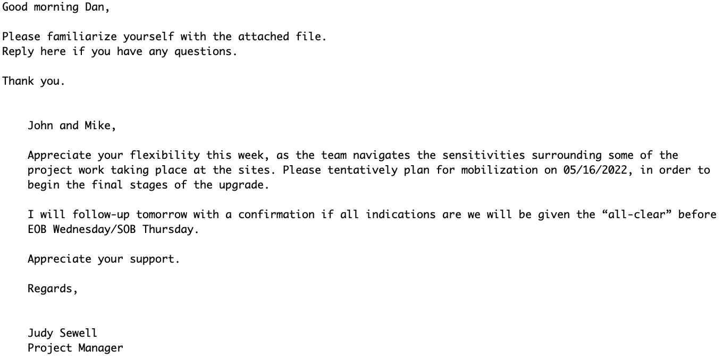
Is this spam?

Slide 3
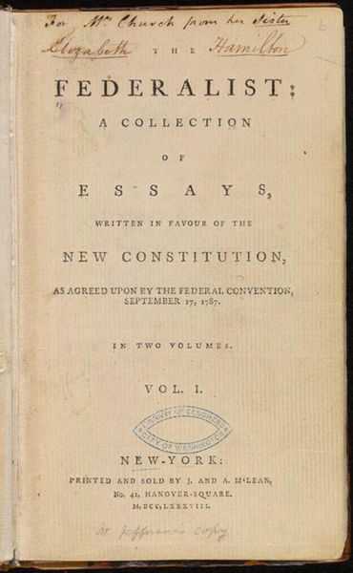
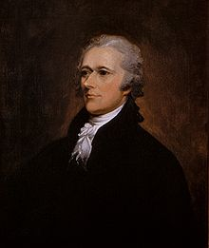
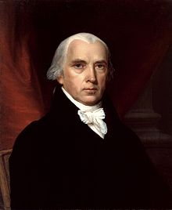
Who wrote which Federalist Papers?
1787-8: essays anonymously written by:
Alexander Hamilton, James Madison, and John Jay
to convince New York to ratify U.S Constitution
Authorship of 12 of the letters unclear between:
1963: solved by Mosteller and Wallace using Bayesian methods
Alexander Hamilton
James Madison

Slide 4


Positive or negative movie review?
unbelievably disappointing
Full of zany characters and richly applied satire, and some great plot twists
this is the greatest screwball comedy ever filmed
It was pathetic. The worst part about it was the boxing scenes.

Slide 5
What is the subject of this article?
MEDLINE Article
MeSH Subject Category Hierarchy
Antogonists and Inhibitors
Blood Supply
Chemistry
Drug Therapy
Embryology
Epidemiology
…
?

Slide 6
Text Classification
Assigning subject categories, topics, or genres
Spam detection
Authorship identification (who wrote this?)
Language Identification (is this Portuguese?)
Sentiment analysis
…

Slide 7
Text Classification: definition
Input:
a document d
a fixed set of classes C = {c₁, c₂,…, c_{J}}
Output: a predicted class c ∈ C

Slide 8
Basic Classification Method: Hand-coded rules
Rules based on combinations of words or other features
spam: black-list-address OR (“dollars” AND “have been selected”)
Accuracy can be high
In very specific domains
If rules are carefully refined by experts
But:
building and maintaining rules is expensive
they are too literal and specific: "high-precision, low-recall"

Slide 9
Classification Method: Supervised Machine Learning
Input:
a document d
a fixed set of classes C = {c₁, c₂,…, c_{J}}
A training set of m hand-labeled documents (d₁,c₁),....,(d_{m},c_{m})
Output:
a learned classifier γ:d → c

Slide 10
Classification Methods: Supervised Machine Learning
Many kinds of classifiers!
Naïve Bayes (this lecture)
Logistic regression
Neural networks
k-nearest neighbors
…
We can also use pretrained large language models!
Fine-tuned as classifiers
Prompted to give a classification

Slide 11
Naive Bayes
The Naive Bayes Classifier
Notes:
In this lecture we define the Naive Bayes classifier, a basic text classifier that will allow us to introduce many of the fundamental issues in text classification.

Slide 12
Naive Bayes Intuition
Simple ("naive") classification method based on Bayes rule
Relies on very simple representation of document
Bag of words

Slide 13
The Bag of Words Representation

Slide 14

The bag of words representation
seen | 2
sweet | 1
whimsical | 1
recommend | 1
happy | 1
... | ...
γ(
)=c

Slide 15
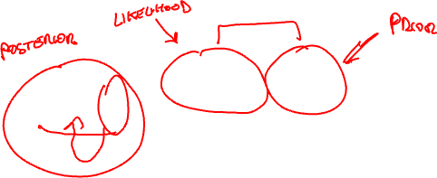
Bayes’ Rule Applied to Documents and Classes
For a document d and a class c

Slide 16
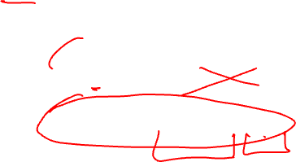
Naive Bayes Classifier (I)
MAP is “maximum a posteriori” = most likely class
Bayes Rule
Dropping the denominator

Slide 17
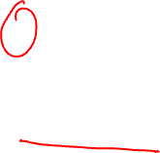
Naive Bayes Classifier (II)
"Likelihood"
"Prior"
Document d represented as features x1..xn

Slide 18
Naïve Bayes Classifier (IV)
O(|X|^{n}•|C|) parameters
How often does this class occur?
Could only be estimated if a very, very large number of training examples was available.
We can just count the relative frequencies in a corpus

Slide 19
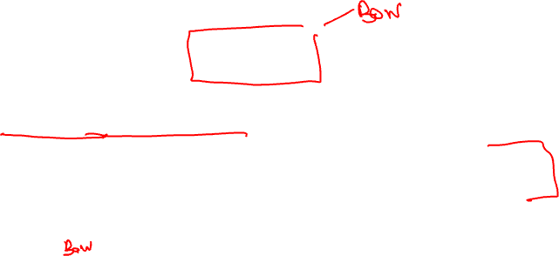
Multinomial Naive Bayes Independence Assumptions
Bag of Words assumption: Assume position doesn’t matter
Conditional Independence: Assume the feature probabilities P(x_{i}|c_{j}) are independent given the class c.

Slide 20
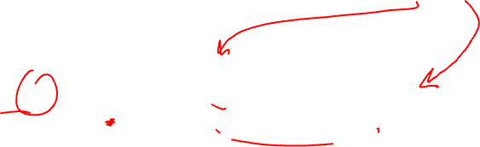
Multinomial Naive Bayes Classifier

Slide 21
Applying Multinomial Naive Bayes Classifiers to Text Classification
positions ← all word positions in test document

Slide 22
We actually do everything in log space
Instead of this:
This:
Notes:
1) Taking log doesn't change the ranking of classes!
The class with highest probability also has highest log probability!
2) It's a linear model:
Just a max of a sum of weights: a linear function of the inputs
So naive bayes is a linear classifier

Slide 23
Text Classification and Naïve Bayes
Naive Bayes: Learning

Slide 24
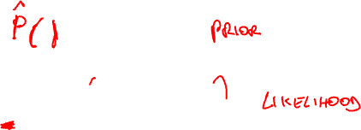
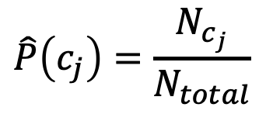
Learning the Multinomial Naive Bayes Model
Sec.13.3
First attempt: maximum likelihood estimates
simply use the frequencies in the data
$$\hat{P}\left(c_{j}\right)=\frac{N_{c_{j}}}{N_{total}}$$

Slide 25
Parameter estimation
fraction of times word w_{i} appears
among all words in documents of topic c_{j}
Create mega-document for topic j by concatenating all docs in this topic
Use frequency of w in mega-document

Slide 26
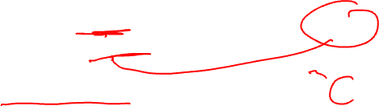
Problem with Maximum Likelihood
Sec.13.3
What if we have seen no training documents with the word fantastic and classified in the topic positive (thumbs-up)?
Zero probabilities cannot be conditioned away, no matter the other evidence!

Slide 27
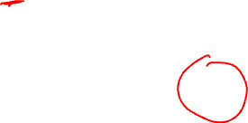
Laplace (add-1) smoothing for Naïve Bayes

Slide 28
Multinomial Naïve Bayes: Learning
From training corpus, extract Vocabulary
Calculate P(c_{j}) terms
For each c_{j} in C do
docs_{j} ← all docs with class =c_{j}
Calculate P(w_{k} | c_{j}) terms
Text_{j} ← single doc containing all docs_{j}
For each word w_{k} in Vocabulary
n_{k} ← # of occurrences of w_{k} in Text_{j}

Slide 29
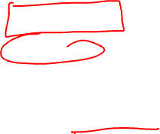
Optimizing for sentiment analysis
For tasks like sentiment, word occurrence seems to be more important than word frequency.
The occurrence of the word fantastic tells us a lot
The fact that it occurs 5 times may not tell us much more.
Binary multinominal naive bayes, or binary NB
Clip our word counts at 1

Slide 30
Summary: Naive Bayes is Not So Naive
Very Fast, low storage requirements
Work well with very small amounts of training data
Robust to Irrelevant Features
Irrelevant Features cancel each other without affecting results
Very good in domains with many equally important features
Decision Trees suffer from fragmentation in such cases – especially if little data
Optimal if the independence assumptions hold: If assumed independence is correct, then it is the Bayes Optimal Classifier for problem
A good dependable baseline for text classification
But we will see other classifiers that give better accuracy
Slide from Chris Manning

Slide 31
Naive Bayes
Precision, Recall, and F1
Notes:
In this lecture we introduce the concepts of precision and recall, and the F1 metric that combines them. These concepts are central to the evaluation of classifiers, and we'll use them throughout NLP, not just for Naïve Bayes but also for logistic regression and neural models.

Slide 32
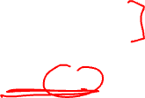
Evaluating Classifiers: How well does our classifier work?
Let's first address binary classifiers:
Is this email spam?
spam (+) or not spam (-)
Is this post about Delicious Pie Company?
about Del. Pie Co (+) or not about Del. Pie Co(-)
We'll need to know
What did our classifier say about each email or post?
What should our classifier have said, i.e., the correct answer, usually as defined by humans ("gold label")
Notes:
Let's first consider binary classifiers. So that might include a simple binary decision about email (spam or not-spam). Or imagine that we are the proprietors of the Delicious Pie Company and we want to find out what people are saying about our pies on social media. We want to know if a particular social media post is talking about our pies (positive) or isn't (negative). To evaluate such a binary classifier, we'll need to know two things. What our classifier said about each email or post, and what it should have said, i.e. the correct answer, usually as defined by human labelers.

Slide 33
First step in evaluation: The confusion matrix
Notes:
The first step is the confusion matrix a table for visualizing how an algorithm performs with respect to the human gold labels, We use two dimensions (system output and gold labels), and each cell labels a set of possible outcomes.
In the pie detection case, for example, true positives are posts that are indeed about Delicious Pie (indicated by human-created gold labels) that our system correctly said were about pie. False negatives are posts that are indeed about pie but our system incorrectly labeled as pie. False positives are posts that aren't about pie but our system incorrectly said they were. And true negatives are non-pie-posts that are system correctly said were not about pie

Slide 34
Accuracy on the confusion matrix
Notes:
. Here is the equation for accuracy: what percentage of all the observations (for the spam or pie examples that means all emails or tweets) our system labeled correctly. Although accuracy might seem a natural metric, we generally don’t use it for text classification tasks.
Although accuracy might seem a natural metric, we generally don’t use it for text classification tasks.

Slide 35
Why don't we use accuracy?
Accuracy doesn't work well when we're dealing with uncommon or imbalanced classes
Suppose we look at 1,000,000 social media posts to find Delicious Pie-lovers (or haters)
100 of them talk about our pie
999,900 are posts about something unrelated
Imagine the following simple classifier
Every post is "not about pie"
Notes:
Why don't we use accuracy? …Accuracy doesn't work well when we're dealing with uncommon or imbalanced classes. Suppose we look at a million social media posts to find Delicious Pie-lovers. Now most posts on the web are not about our pie, so let's imagine that only 100 posts are about our pie, and 999,900 are about something else.
Now imagine we have the following really simple classifier: Every post is "not about pie"

Slide 36
Accuracy re: pie posts
100 posts are about pie; 999,900 aren't
Notes:
Let's see what happens.

Slide 37
Why don't we use accuracy?
Accuracy of our "nothing is pie" classifier
999,900 true negatives and 100 false negatives
Accuracy is 999,900/1,000,000 = 99.99%!
But useless at finding pie-lovers (or haters)!!
Which was our goal!
Accuracy doesn't work well for unbalanced classes
Most tweets are not about pie!
Notes:
But this fabulous ‘no pie’ classifier would be completely useless, since it wouldn’t find a single one of the customer comments we are looking for. In other words, accuracy is not a good metric when the goal is to discover something that is rare, or at least not completely balanced in frequency, which is a very common situation in the world.

Slide 38
Instead of accuracy we use precision and recall
Precision: % of selected items that are correct
Recall: % of correct items that are selected
Notes:
Precision is out of the things the system selected (the set of emails or tweets the sytstem claimed were positive, i.e. spam or pie-related), how many did it get right? how many were true positives, out of what I selected (true positives _ false positives). Recall is out of all the correct items that should have been positive, what % of them did the system select? So out of all the things that are gold positive, how many did the system find as true positives? So precision is about how much garbage we included in our findings; recall is more about making sure we didn't miss any treasure.

Slide 39

Precision/Recall aren't fooled by the"just call everything negative" classifier!
Stupid classifier: Just say no: every tweet is "not about pie"
100 tweets talk about pie, 999,900 tweets don't
Accuracy = 999,900/1,000,000 = 99.99%
But the Recall and Precision for this classifier are terrible:
Notes:
Recall and Precision will correctly evaluate our stupid "just say no" classifier as a bad classifier. The recall will be 0, since we returned no true positives out of the 100 true pie tweets (0 + 100). Precision is similarly 0 or in fact undefined, since both the numerator and denominator are 0. The metrics correctly assigns bad scores to our useless classifier.
[note that this is a particular egregious example, but in normal situations there is typically a trade-off between precision and recall!]
[to get high precision, a system should be very reluctant to guess – but then it may miss somethings and have poor recall]
[to get high recall, a system shoul dbe very willing to guess– but then it may return some junk and have poor precision]

Slide 40
A combined measure: F1
F1 is a combination of precision and recall.
Notes:
a combined measure: F-1:
Why this function instead of just the arithmetic or geometric mean? F1 turns out to be the harmonic mean between precision and recall

Slide 41
F1 is a special case of the general "F-measure"
F-measure is the (weighted) harmonic mean of precision and recall
F1 is a special case of F-measure with β=1, α=½
Notes:
F1 is a special case of the F-measure: weighted harmonic mean of precision and recall.
The harmonic mean of a set of numbers is the reciprocal of the arithmetic mean of reciprocals.
You can see here that F score is the harmonic mean, if we replace alpha with ½ we get 2/ (1/p + 1/r).
The Harmonic mean of two values is closer to the minimum of the two numbers than arithmetic or geometric mean, so it weighs the lower of the two numbers more heavily. That is, if P and R are far apart, F will be nearer the lower value, which makes it a kind of conservative mean in this situation. Thus to do well on F1, you have to do well on BOTH P and R.
Why the weights? in some applications you may care more about P or R. In practice we mainly use the balanced measure with beta = 1 and alpha =1/2

Slide 42
Suppose we have more than 2 classes?
Lots of text classification tasks have more than two classes.
Sentiment analysis (positive, negative, neutral) , named entities (person, location, organization)
We can define precision and recall for multiple classes like this 3-way email task:
Notes:
Lots of classification tasks have more than two classes, like sentiment could be 3-way. Consider the confusion matrix for a hypothetical 3-way email categorization decision (urgent, normal, spam). Notice that the system mistakenly labeled one spam document as urgent. We can compute distinct precision and recall values for each class. For example, the precision of the urgent category is 8 (the true positive urgents) over the true positives + false positives (the 10 normal and that 1 spam). The result, however, is 3 separate precision values and 3 separaterecall values!

Slide 43
How to combine P/R values for different classes: Microaveraging vs Macroaveraging
Notes:
To derive a single metric from these 3 sets of precisions and recalls, we can combine these in two ways. In macroaveraging, we compute the performance for each class, and then average over classes. That is, we take the same precisions and recalls we computed on the previsions slide, one set for Urgent, one set for Normal, and one set for spam, and we just average those precisions to get a single macro average.
In microaveraging, we instead first combine the decisions for all classes in a single confusion matrix, and then compute precision and recall from that table.
Note that the microaverage is dominated by the more frequent class (in this case spam), since the counts are pooled and F1 is dominated by the count of true positives. The macroaverage better reflects the statistics of the smaller classes, and so is more appropriate when performance on all the classes is equally important.

