Slide 1
RAG
Retrieval Augmented Generation

Slide 2
Information Retrieval + Transformer = RAG
In the last two years we observed an increasing interest towards an hybrid approach Information Retrieval (IR) + Generative models.
RAG are the union of language modeling capabilities of transformer-based architectures and the classical concepts from Information Retrieval.

Slide 3
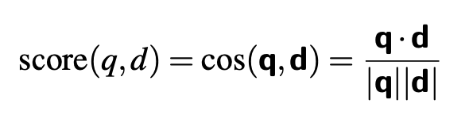
Information Retrieval in a nutshell
Given a query q, we look for the best document d w.r.t to q (best in the sense of relevance).
Using the vector model, we score each document d by the cosine of its vector d with the query vector q, and we pick the one with the highest score:

Slide 4
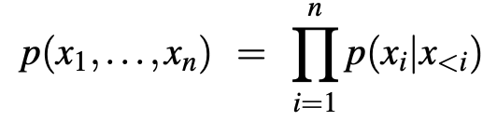
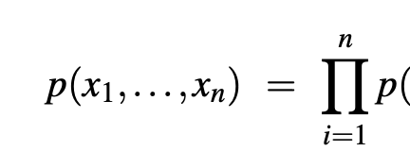


Q&A without context
Recall that simple autoregressive language modeling computes the probability of a string from the previous tokens:
In a simple conditional generation for question answering, it adds a prompt like Q: ,followed by a query q , and A:, all concatenated:

Slide 5
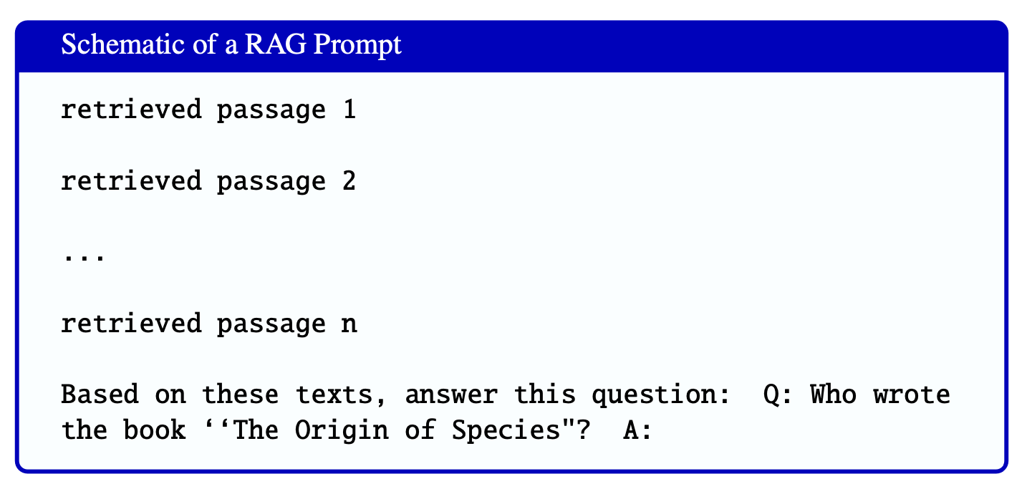
Adding (retrieved) context

Slide 6
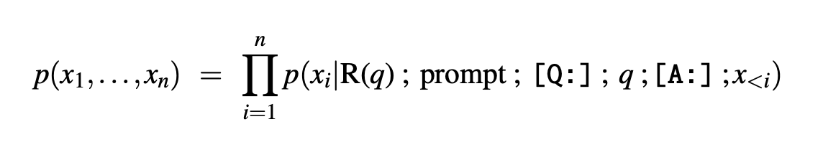
Adding (retrieved) context
query q
set of retrieved passages based on it R(q)

Slide 7
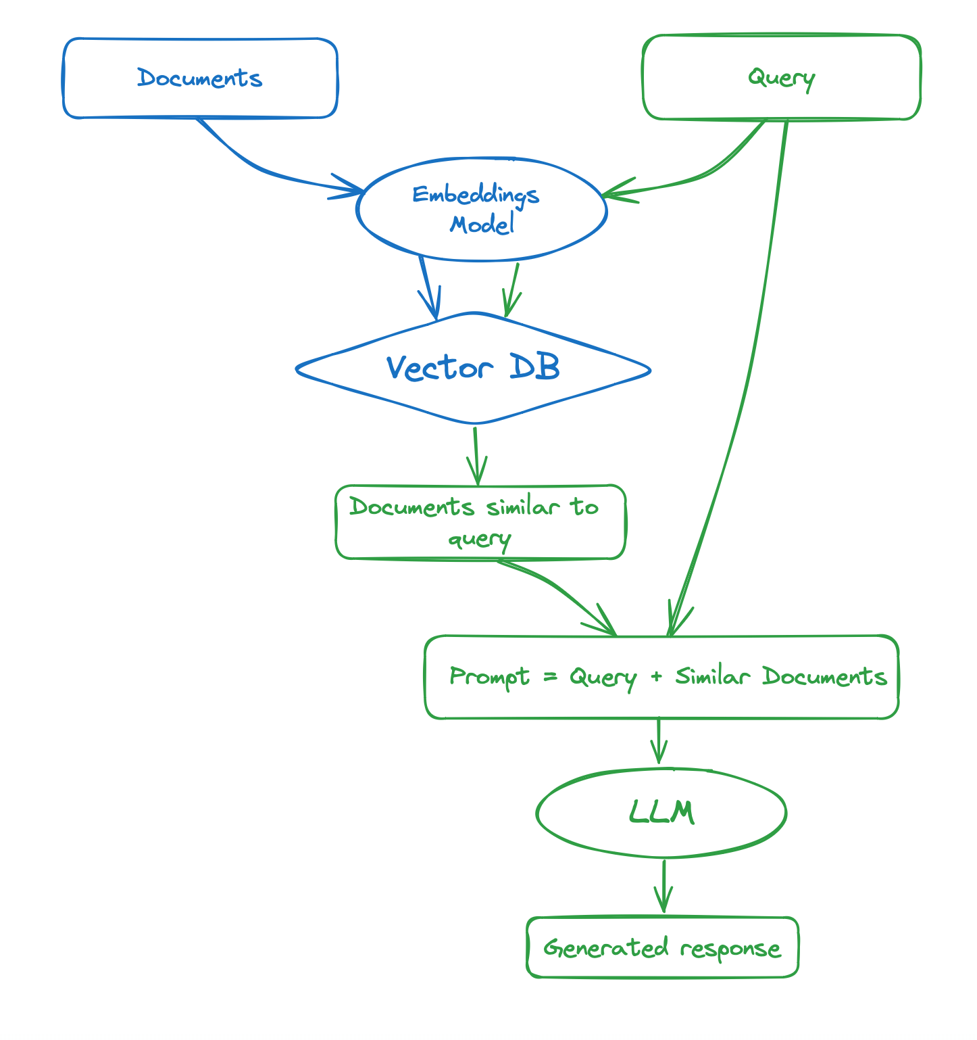
https://huggingface.co/learn/cookbook/en/rag_zephyr_langchain

Slide 8
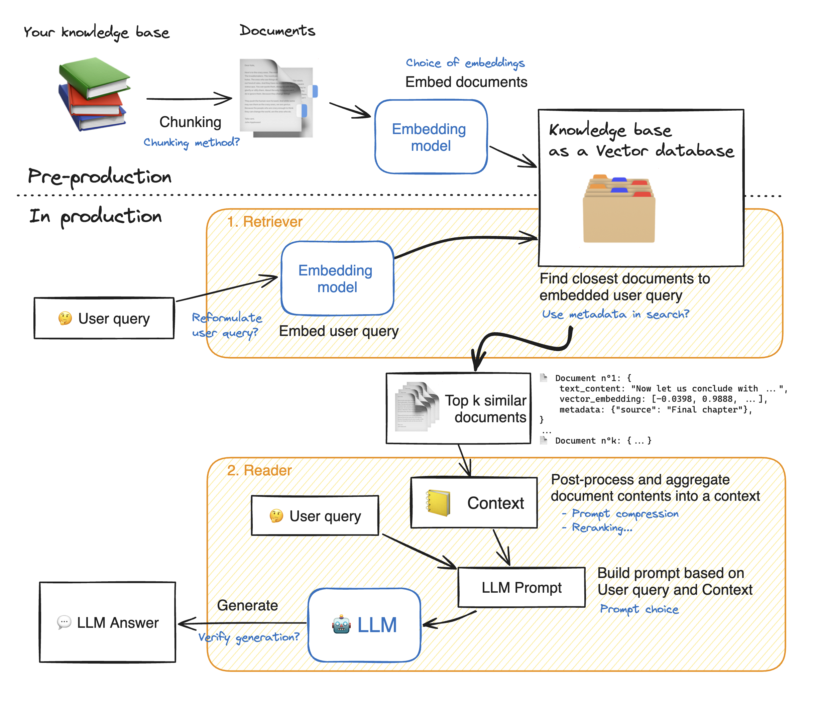
https://huggingface.co/learn/cookbook/en/advanced_rag

Slide 9
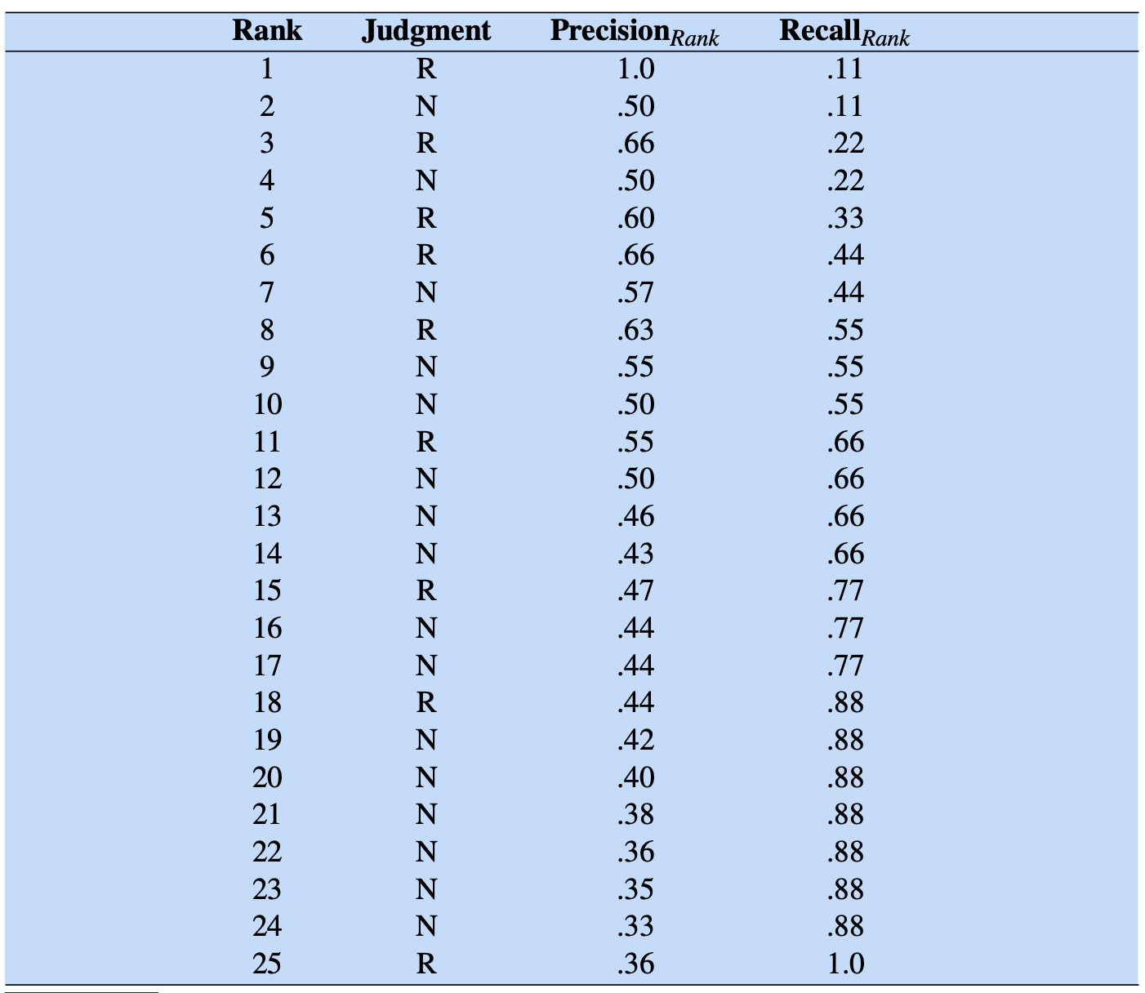
RAG Evaluation (IR-based, relevance)
Ranked Precision and Recall (w.r.t. relevant vs not relevant)

Slide 10
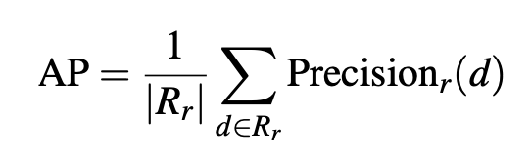
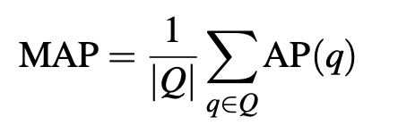
RAG Evaluation (IR-based, relevance)
MAP (Mean Average Precision)
It provides a single metric that can be used to compare competing systems or approaches.
We descend through the ranked list of items, but we note the precision only at those points where a relevant item has been encountered. For a single query, we average these individual precision measurements over the return set (up to some fixed cutoff).
If we assume that R_{r} is the set of relevant documents at or above a recall level r, then the average precision (AP) for a single query is the average of Precision_{r}(d), that is the precision measured at the rank at which document d was found.
For an ensemble of queries Q, we then average over these averages, to get our final MAP measure:

Slide 11
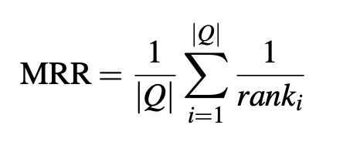
RAG Evaluation (Q&A-based, correctness)
MRR (Mean Reciprocal Rank)
MRR is designed for systems that return a short ranked list of answers or passages for each test set question, which we can compare against the (human-labeled) correct answer. First, each test set question is scored with the reciprocal of the rank of the first correct answer. For example if the system returned five answers to a question but
the first three are wrong (so the highest-ranked correct answer is ranked fourth), the reciprocal rank for that question is 1/4 . The score for questions that return no correct answer is 0. The MRR of a system is the average of the scores for each question in the test set.

Slide 12
Alkemy’s Evaluation Framework
 | Metrics | Description
AQM (Answers Quality Metrics) | Relevancy | Quanto la risposta è rilevante data la query
 | Toxicity | Se ci sono elementi "tossici" nella risposta (insulti, bias, ecc)
 | Correctness | Quanto la risposta è corretta
 | Hallucination | Quanto la risposta ha i caratteri di allucinazione
 | Context Precision | Precision degli elementi del contesto usati per la risposta
 | Context Recall | Recall degli elementi del contesto usati per la risposta
 | Faithfulness | Quanto la risposta è in linea con il contesto
UAM (Users Analytics Metrics) | Satisfaction | Percentuale di feedback positivi (se raccolti)
 | Sentiment Analysis | Sentiment delle risposte (positivo o negativo, score da -1 a 1)
 | Topics | Argomenti maggiormente richiesti dagli utenti
 | Conversation Length | Lunghezza media delle conversazioni
SOM (System Operations Metrics) | Latency | Latenza
 | In/out tokens | Token in entrata e in uscita
 | Cost | Costo delle interazioni

Slide 13
Extra Notebooks
https://huggingface.co/learn/cookbook/en/rag_zephyr_langchain
https://huggingface.co/learn/cookbook/en/advanced_rag
https://github.com/sergiopaniego/RAG_local_tutorial?tab=readme-ov-file (local RAG with Ollama)
https://colab.research.google.com/github/lancedb/vectordb-recipes/blob/main/tutorials/RAG-from-Scratch/RAG_from_Scratch.ipynb (LanceDb-based RAG)

