Slide 1
Cyber Physical System
Davide Roznowicz

Slide 2
Damped Pendulum as basis for a dashpot system

Slide 3
Agenda
INTRODUCTION & GOAL 4
SETTING – HOW IT WORKS 6
PHYSICAL MODEL 9
PID CONTROL 11
CONCLUSIONS 26

Slide 4
Introduction & Goal

Slide 5
Introduction
Definition: A dashpot is a system to damp shock and vibration, designed in order to achieve a certain objective.
Goal: We aim at showing how a damped pendulum can effectively display the basic principles of the functioning of a dashpot. Our reference problem in mind is an automatic door which, starting from an open position, must be gently closed without violent impact.

Slide 6
Setting – How it works

Slide 7
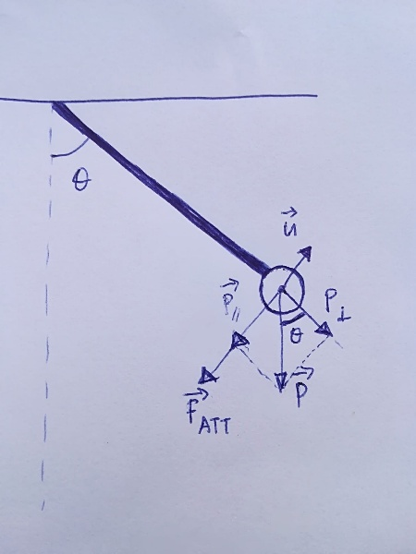
Setting Description
The pendulum is made of inextensible wire and a small ball is connected to its extremity
The standard starting position corresponds to an agle theta=90 degrees (corresponding to being close to the ceiling, horizontally) and angular velocity w=0
A target of theta = 10,20,30,40 degrees is analysed.
Action: The pendulum is let free and starts swinging downwards, until it reaches the target angle. The gradual dampening of its movement happens thanks to the PID controller.

Slide 8
High-level requirements
Small overshoot: we do not want the pendulum to violently impact any surface
Settiling time: does not have to be short
Oscillations: should not be large to avoid any mechanical damage

Slide 9
Physical model

Slide 10

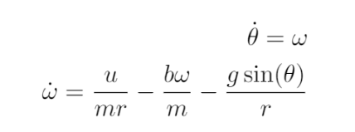
Equations
Equilibrium of the forces
Final differential equations

Slide 11
PID control model

Slide 12
PID control model
The process from building and testing the PID control prototype was a three-step process:
First Simulation and manual hyperparameter settings
Verification of Formal Requirements
Falsification

Slide 13
Simulation
The PID constants are manually tuned in a careful way to achieve the desired effects together with model stability:
We increase K_p until a reasonable error is achieved.
Then, K_i is increased a little bit to achieve long-term convergence; however, it is not increased much because it would trigger a higher overshoot.
K_d is the last parameter to be acted upon to regularize the system

Slide 14
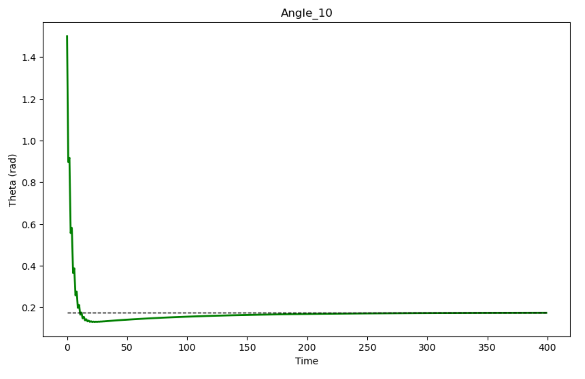
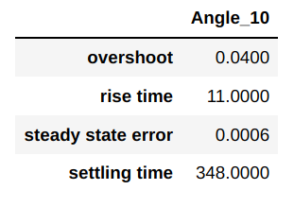
Simulation
Simulation of PID with (theta, omega) = (1.5, 0.0) and target of 45 degrees. with manual hyperparameters tuning
Slight overshoot observed, but within expectation
Convergence is achieved even if it takes a while, with minor swings

Slide 15
Verification – Formal Requirements
φ1 = G[10, 400](abs(θ(t) − θ(t − 1)) < 0.1): light oscillations to preserve correct long term movement.
φ2 = G[10, 400](abs(θ(t) − θtarget) < 0.08): we want to avoid big overshoots exceeding 5 degrees or 0.08 rads
φ3 = G[0, 400](θ(t) > 0.08): we always want the angle to be higher than 5 degrees as we know there is always a hard object at 0 degrees

Slide 16
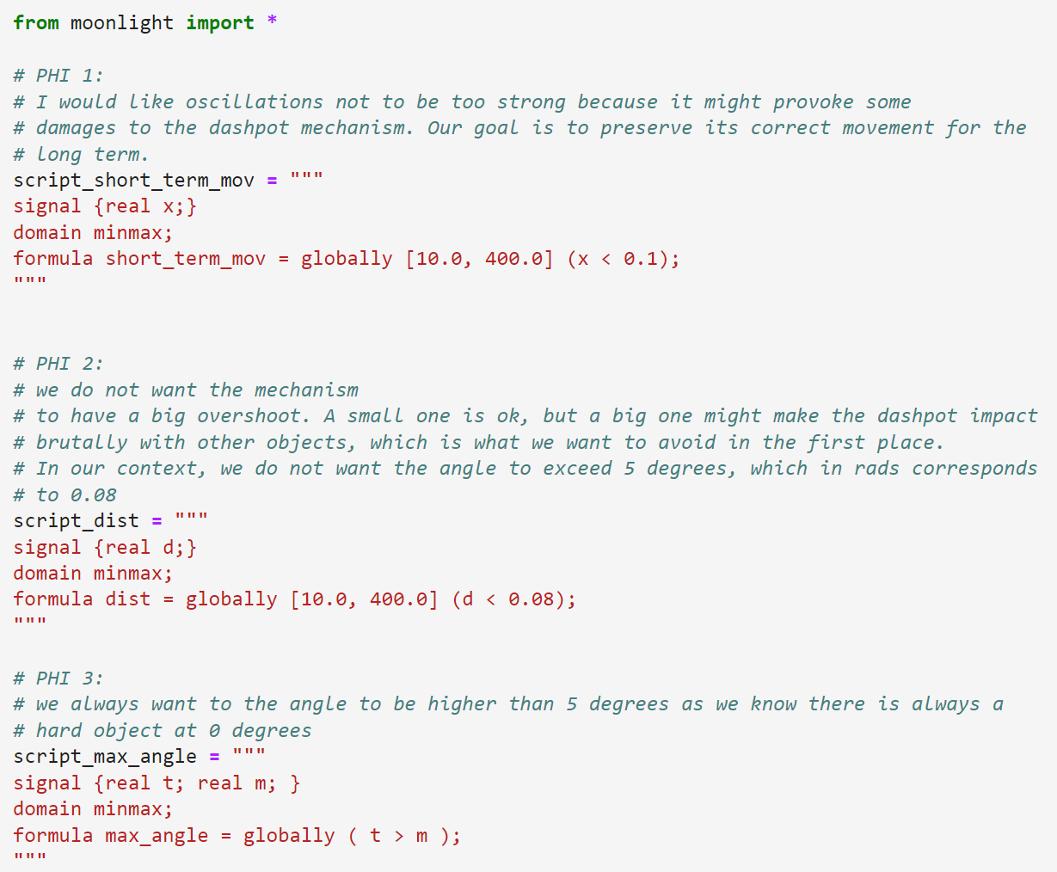
Verification – Requirements in Moonlight

Slide 17
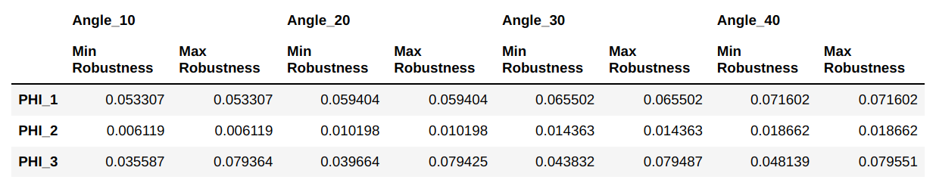
Verification – Robustness Test (1)
Robustness at varying target angles | no noise | start from theta of 90° | initial_omega = 0

Slide 18
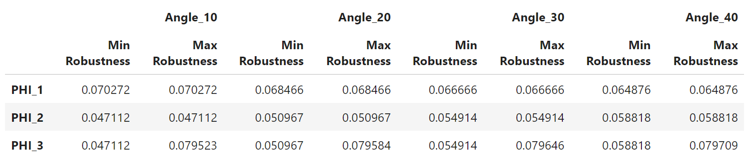
Verification – Robustness Test (2)
Robustness at varying angles | no noise | start from theta of 60° | initial_omega = 50

Slide 19
Falsification
The falsification process involves the following two categories of experiments:
Add perturbations (noise) to theta values
Change initial values and increase the initial angular velocity

Slide 20
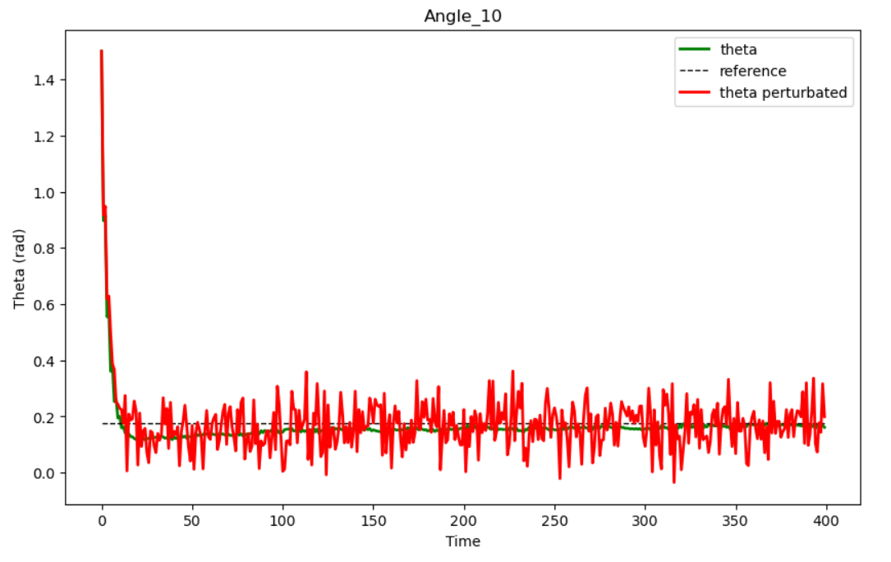
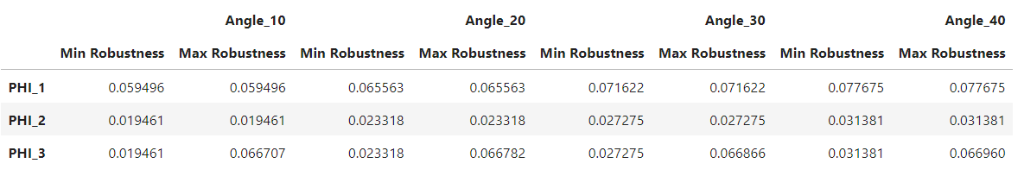
Falsification – Add noise to theta estimates
Robustness at varying angles | big noise | start from theta of 90° | initial_omega = 0

Slide 21
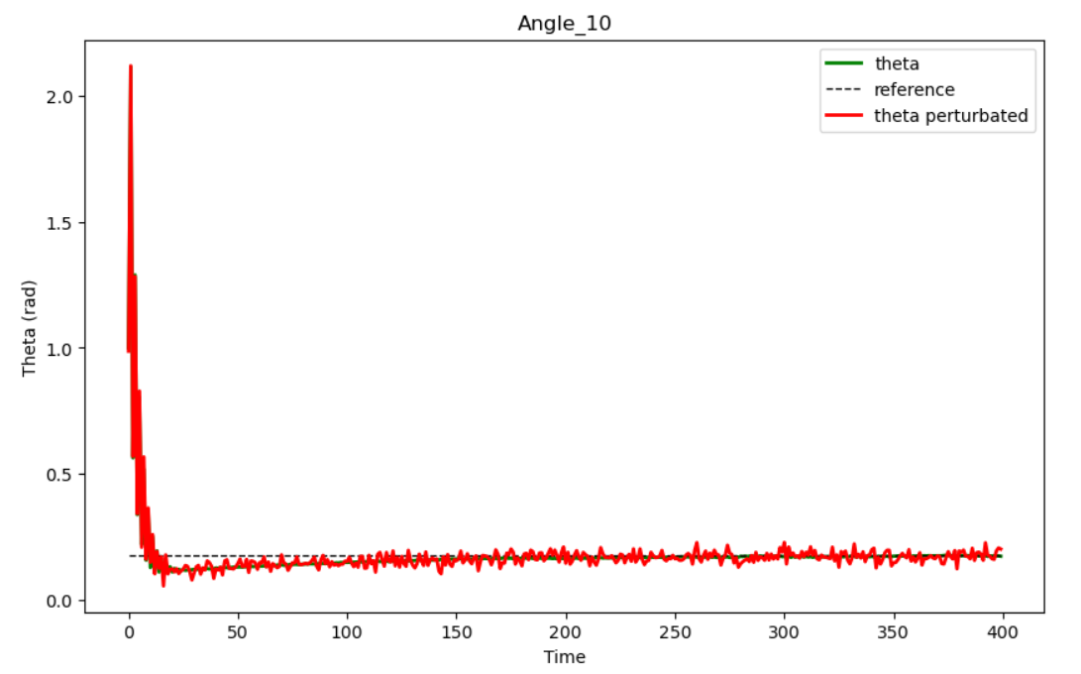
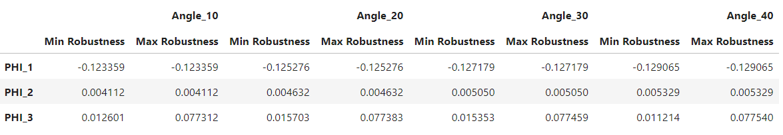
Falsification – Add noise to theta estimates
Robustness at varying angles | small noise | start from 60° | initial_omega=300

Slide 22
Further Experiments with new reference signals

Slide 23
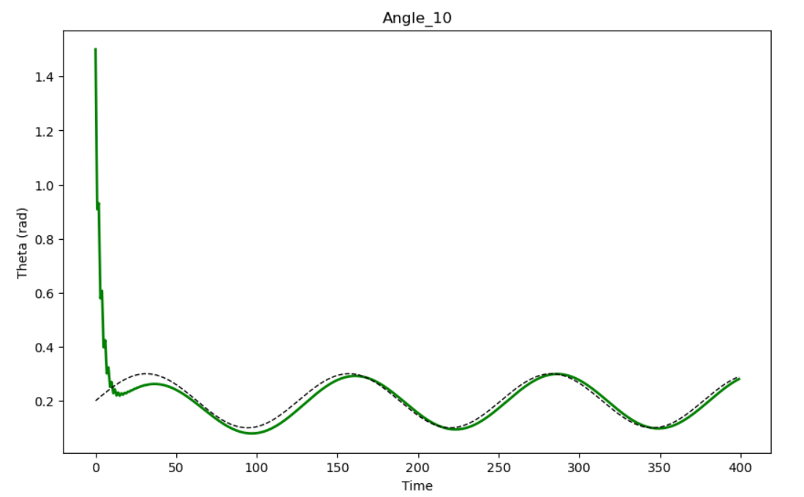
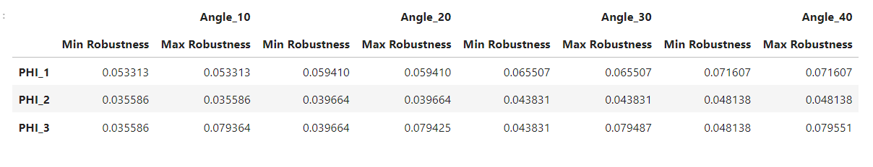
Sinusoidal Reference Signal
Robustness at varying angles | no noise | start from theta of 90° | initial_omega = 0

Slide 24
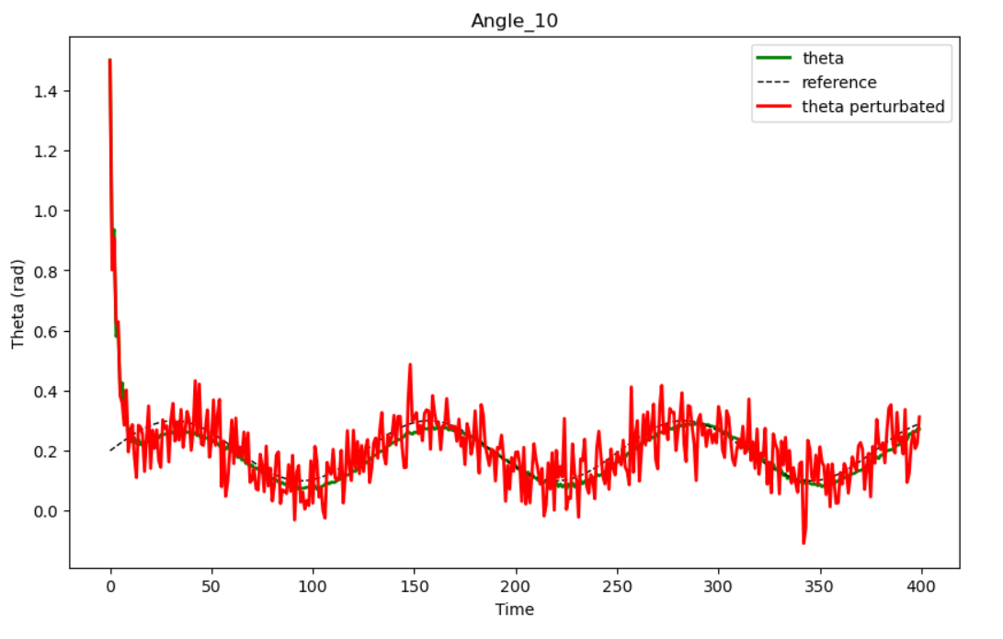
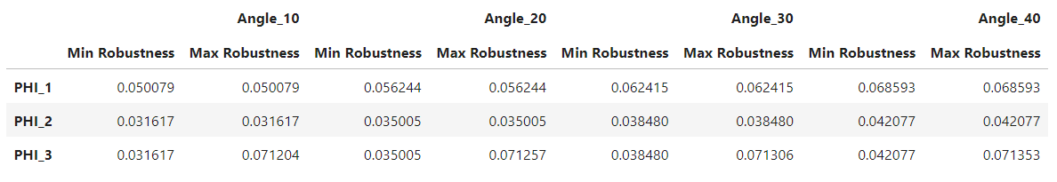
Sinusoidal Reference Signal
Robustness at varying angles | big noise | start from theta of 90° | initial_omega = 0

Slide 25
Conclusion

Slide 26
Conclusion & Improvements
Most of the performed robustness tests have passed
All of the performed tests were robust for the property related to overshoot control which was the most important
In the last falsification experiment, the system has been pushed up to breakage point, which showed that the first property to fail is the one related to oscillation control
Further PID parameter automatic optimization might help in the design of a better control system

Slide 27
Thank you !
Davide Roznowicz
droznowi@sissa.it

