Slide 1
The Stock Transformer*
Multi-dimensional financial time-series forecasting via self-attention
Davide Roznowicz◊○ | Emanuele Ballarin◊
* which is not actually a Transformer :)
Deep Learning end-of-course project
University of Trieste, 26/07/2021
◊ University of Trieste, Dept. of Mathematics ○ SISSA

Slide 2
Introduction (1)
In order to intuitively figure out why this specific problem and this peculiar Deep Learning technique have been chosen to dig into, imagine the following real-world scenario:
A trading professional/fund manager might need support to make better decisions at his trading desk, in his day-to-day operations.
As many others, he specializes in trading few stocks.
Thus, he needs to have insightful quantitative indicators about the overall market, seen as an aggregate of (mainly) stocks to grasp the mood/behaviour of different interacting phenomena.
Roznowicz, Ballarin – The Stock Transformer
University of Trieste, 26/07/2021

Slide 3
Introduction (2): customer requirements
Often tends to rebalance his portfolio weekly;
Has enough computational power to potentially re-train a model often;
Would like to integrate the model among his main quantitative indicators;
Wants a relevant subset of the market to be taken into account by the model: not only to forecast single-stock-prices directions, but also sectors behaviour as a whole;
Believes that not only stock time series should be included, but also some relevant macro indicators about commodities, market-health and volatility.
Roznowicz, Ballarin – The Stock Transformer
University of Trieste, 26/07/2021

Slide 4
Why not... recurrent models?
Previous attempts at end-to-end time series modelling mainly relied on deep recurrent models, eventually gated.
Inability to grasp substantial long-term dependencies (see Vecoven et al., 2020);
Inability to transparently model hierarchical structures;
Computational burden in training (w.r.t. e.g. CNNs, FCNs... even on GPUs!);
Difficulty in handling > 1D
Outcomes: mixed, generally inconclusive. But huge online popularity.
Roznowicz, Ballarin – The Stock Transformer
University of Trieste, 26/07/2021

Slide 5
Why not... learning system dynamics?
RNN & friends are generally regarded as models of dynamical systems. Once learned, they should be able to map any sequence of past input sequences into their (most likely) future evolution. E.g.: learning laws of physics.
The existence of such laws for financial markets is strongly debated;
Some even question their learnability altogether (brittleness and the fat tails problem);
Such laws may change in time, due to external interaction (e.g. social, legislative, ...)
Also, not a problem to retrain whenever needed (even daily‽)
→ Exploit the almost-overfitting regime: learn an input/output map conditional on the present.
Roznowicz, Ballarin – The Stock Transformer
University of Trieste, 26/07/2021

Slide 6
Transforming the transformer for time series data
Transformers (and transformer-like architectures) solve or ease many of the issues traditionally associated to RNNs (except: multidimensional data handling), and better suit the learning of conditional mappings.
On the other hand, they were conceived for language modelling tasks.
Input to the model must be a sequence of tokens (usually dictionary-embedded words);
It models output sequence probabilities, conditioned on previous outputs, in the space of tokens (a.k.a. proper encoding/decoding);
Embeddings must be easily reversible, and the same for input and output.
¿So what?
Roznowicz, Ballarin – The Stock Transformer
University of Trieste, 26/07/2021

Slide 7
The Stock Transformer... for real!
Browsable map
of the architecture
Link to the original
transformer architecture
Roznowicz, Ballarin – The Stock Transformer
University of Trieste, 26/07/2021

Slide 8
Gathering data from raw data (1)
Daily, adjusted closing price for the largest stocks by market cap in the SP500
Raw data
source (API)
Daily, adjusted closing prices for macroeconomic indicators and commodities
Financial time series, subsequently called financials
Roznowicz, Ballarin – The Stock Transformer
University of Trieste, 26/07/2021

Slide 9
Gathering data from raw data (2)
Raw data
source (API)
Contextual data, giving information about time:
e.g. daily, monthly, yearly, infinite frequencies
Contextual time series, subsequently called context
Roznowicz, Ballarin – The Stock Transformer
University of Trieste, 26/07/2021

Slide 10
Pre-processing
Financials:
Consider a set of time series (i.e. a multidimensional t.s.), each containing daily adjusted closing prices;
Since missing data might occur for some days, fill them via linear interpolation;
Compute daily returns.
Context:
Consider a set of time series (i.e. a multidimensional t.s.), each containing domain-specific contextual information;
Convert them to the corresponding frequencies;
When needed: apply specific token-wise aggregation function.
Roznowicz, Ballarin – The Stock Transformer
University of Trieste, 26/07/2021

Slide 11
Training (1): optimizers, overview
Less mainstream, but more robust (to gradient noise, to gradient variance, to loss-landscape raggedness) optimization techniques have been chosen:
RAdam within a Lookahead loop
Why, exactly?
Roznowicz, Ballarin – The Stock Transformer
University of Trieste, 26/07/2021

Slide 12
Training (2): optimizers, detail
Why an adaptive optimization method (and not, e.g., SGD)?
Great simplification of l.r. scheduling, which may become beneficial when the parameter space is large.
The go-to optimizer Adam has scarce generalization ability and stability when gradients are small (in norm);
Adam gradients have high variance in the initial steps (often requiring warmup).
Why RAdam, among all adaptive optimizers?
Why additionally adopting inner-loop optimization,
i.e. Lookahead?
Greater robustness to loss-landscape noise.
Roznowicz, Ballarin – The Stock Transformer
University of Trieste, 26/07/2021

Slide 13
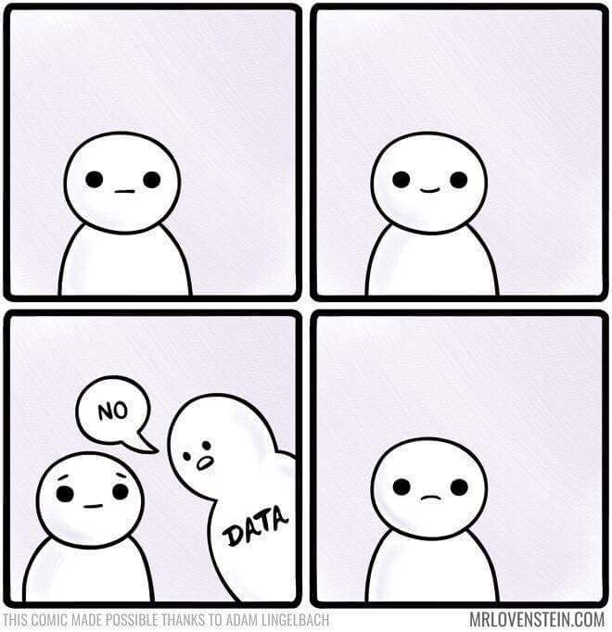
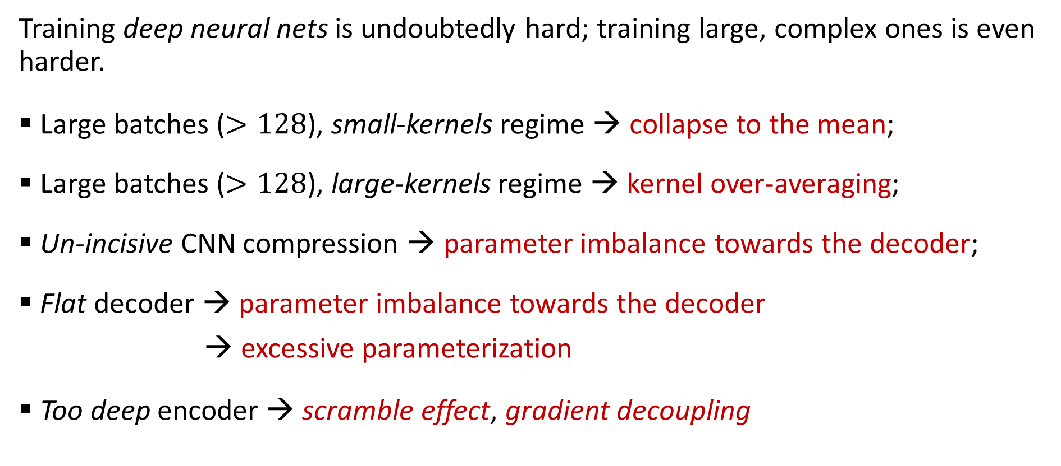
Training (3): pitfalls
Training deep neural nets is undoubtedly hard; training large, complex ones is even harder.
Large batches ($>128$), small-kernels regime → collapse to the mean;
Large batches ($>128$), large-kernels regime → kernel over-averaging;
Un-incisive CNN compression → parameter imbalance towards the decoder;
Flat decoder → parameter imbalance towards the decoder
→ excessive parameterization
Too deep encoder → scramble effect, gradient decoupling
Roznowicz, Ballarin – The Stock Transformer
University of Trieste, 26/07/2021

Slide 14
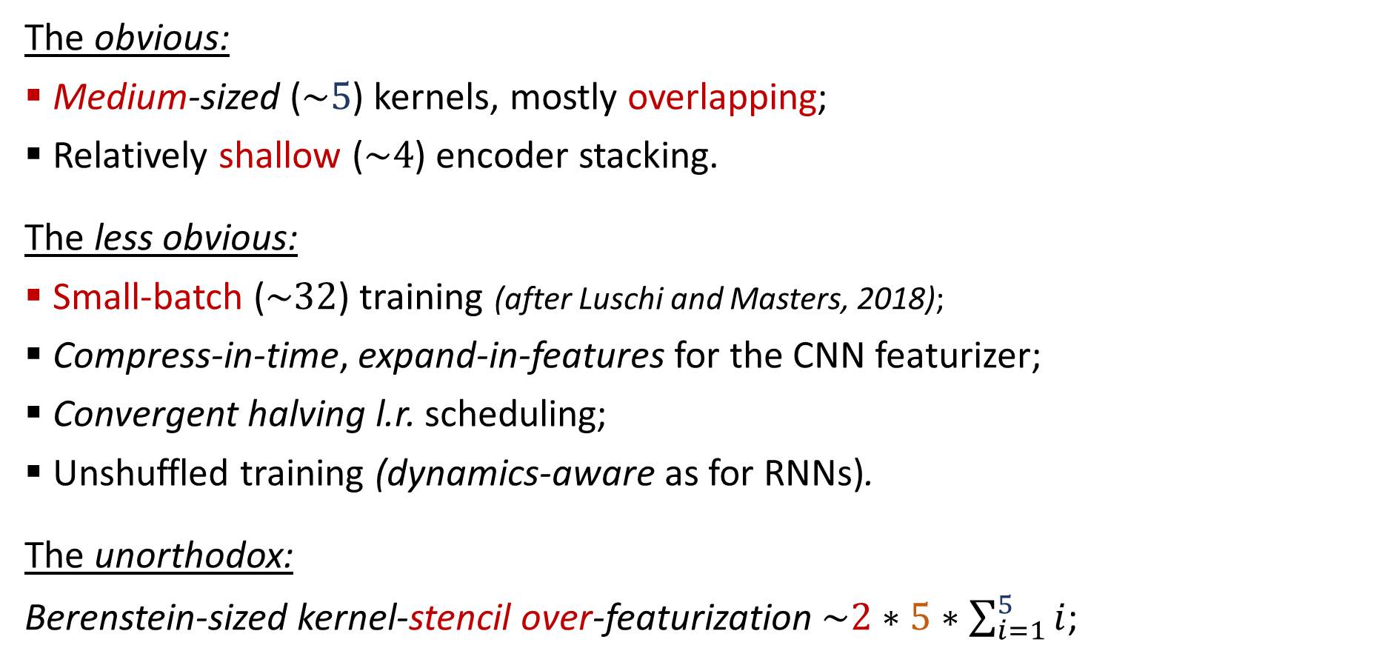
Fantastic tricks... and where to find them
The obvious:
Medium-sized ($\sim 5$) kernels, mostly overlapping;
Relatively shallow ($\sim 4$) encoder stacking.
The less obvious:
Small-batch ($\sim 32$) training (after Luschi and Masters, 2018);
Compress-in-time, expand-in-features for the CNN featurizer;
Convergent halving l.r. scheduling;
Unshuffled training (dynamics-aware as for RNNs).
The unorthodox:
Berenstein-sized kernel-stencil over-featurization $\sim 2∗5∗\sum_{i=1}^{5}{i}$;
Roznowicz, Ballarin – The Stock Transformer
University of Trieste, 26/07/2021

Slide 15
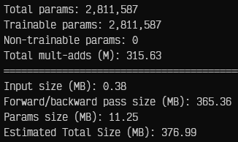
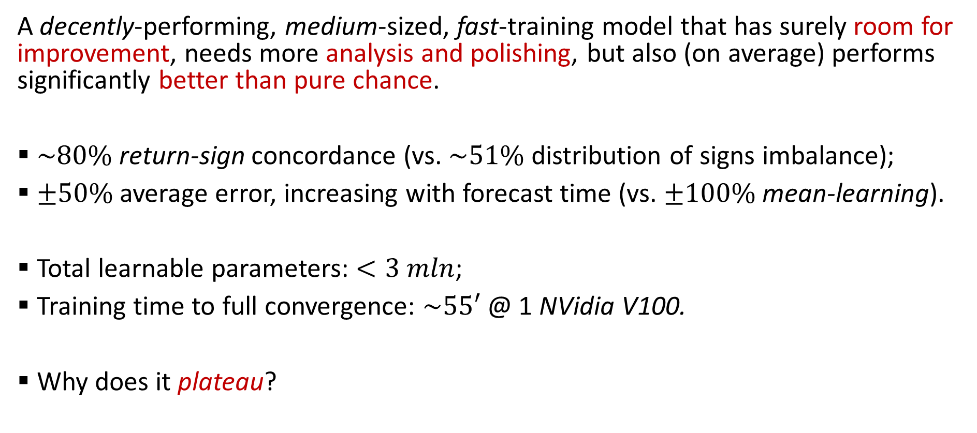
The actual results (so far)
A decently-performing, medium-sized, fast-training model that has surely room for improvement, needs more analysis and polishing, but also (on average) performs significantly better than pure chance.
$\sim 80\%$ return-sign concordance (vs. $\sim 51\%$ distribution of signs imbalance);
$±50\%$ average error, increasing with forecast time (vs. $±100\%$ mean-learning).
Total learnable parameters: $<3 mln$;
Training time to full convergence: $\sim 55′$ @ 1 NVidia V100.
Why does it plateau?
Roznowicz, Ballarin – The Stock Transformer
University of Trieste, 26/07/2021

Slide 16
Future developments and open problems
Depth-first:
Principled analysis of what the model actually learns;
Principled analysis of the nature of the loss plateau;
Ablation study on the correlator;
Improvement of contextual information and its processing;
Exploration of different architectures: proper Transformer and impedance-matching Transformer, fully-convolutional approaches.
Breadth-first:
Frequent re-training and transfer learning dynamics;
Integration with pre-existing “classical” feature banks or filters.
Roznowicz, Ballarin – The Stock Transformer
University of Trieste, 26/07/2021

Slide 17
Bibliographic inspiration
“Temperature Forecasting via Convolutional Recurrent Neural Networks Based on Time-Series Data” (Zhang et al., 2019);
“Deep Convolutional Cascade for Face Alignment In The Wild” (Dapogny et al., 2019);
“Attention Is All You Need” (Vaswani et al., 2017)
“Sparse attention based separable dilated convolutional neural network for targeted sentiment analysis” (Gan et al., 2019);
“Enhancing the Locality and Breaking the Memory Bottleneck of Transformer on Time Series Forecasting” (Li et al., 2020);
Dilated causal convolution with multi-head self attention for sensor human activity recognition (Hamad et al., 2021);
“On the Variance of the Adaptive Learning Rate and Beyond” (Liu et al., 2020);
“Revisiting Small Batch Training for Deep Neural Networks” (Masters and Luschi, 2018);
Training Very Deep Networks (Srivastava et al., 2011).
Roznowicz, Ballarin – The Stock Transformer
University of Trieste, 26/07/2021

Slide 18
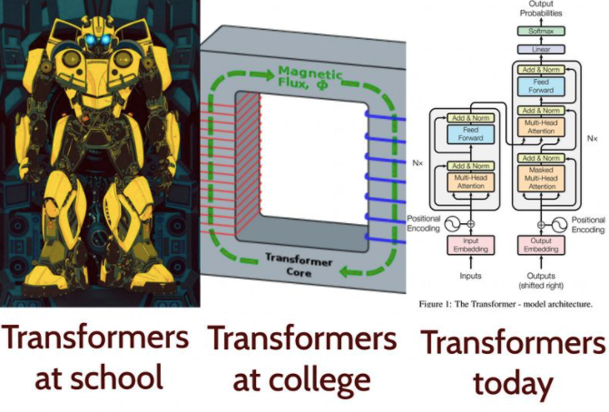
Thanks for your... attention!
[ https://github.com/emaballarin/financial-wholenamycs ]
Roznowicz, Ballarin – The Stock Transformer
University of Trieste, 26/07/2021

Slide 19
End of slides

Slide 20
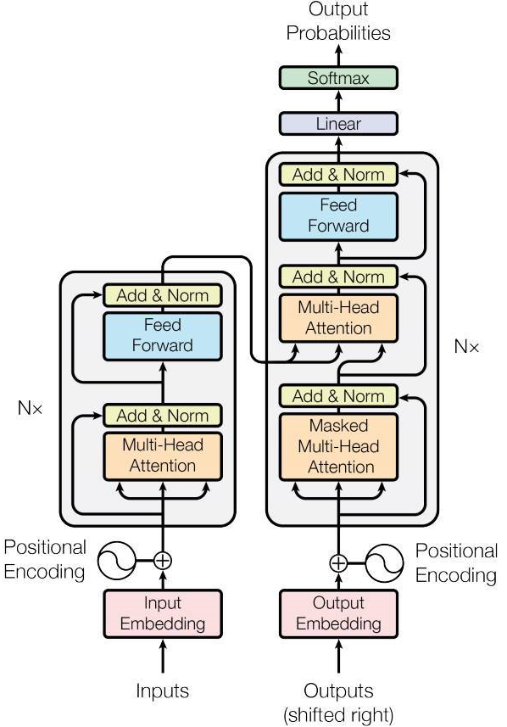
Back

Slide 21
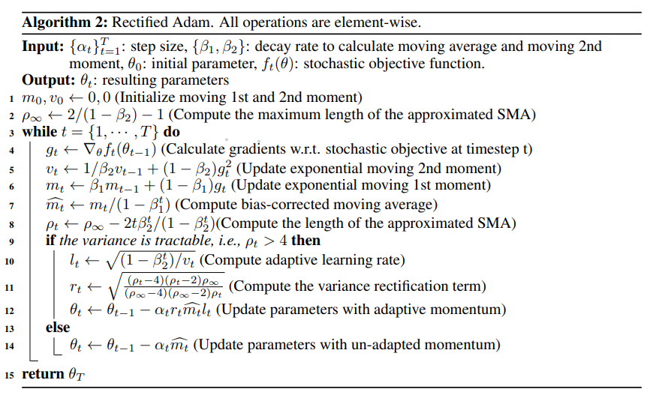
Back

