Slide 1
Requirement 1
Stochastic environment

Slide 2
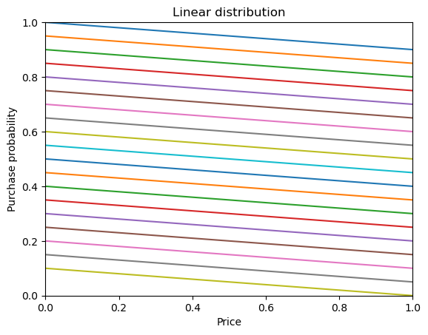
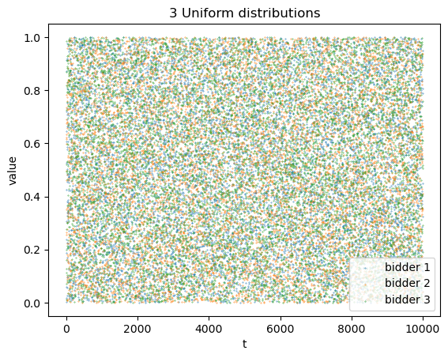
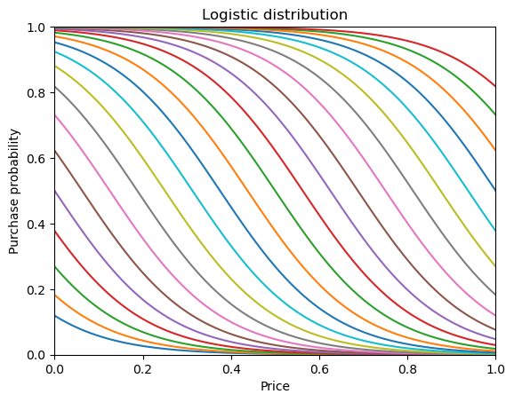
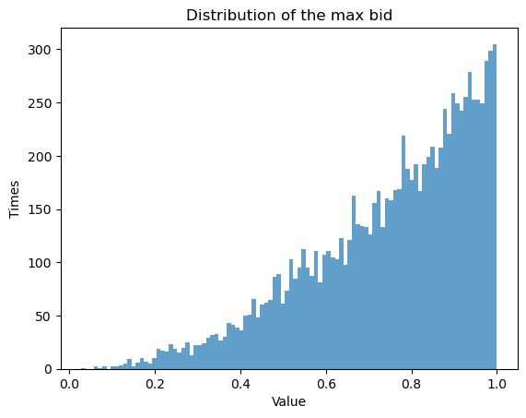
Pricing & Bidding Environments: distributions
Purchase probability
Opponent bids (example with 3 opponents)

Slide 3
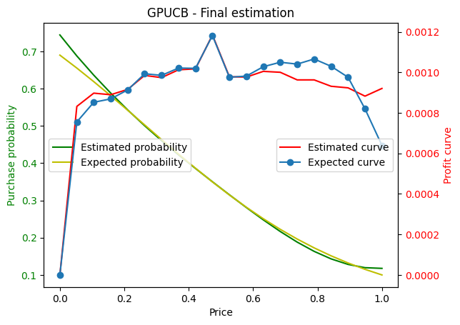
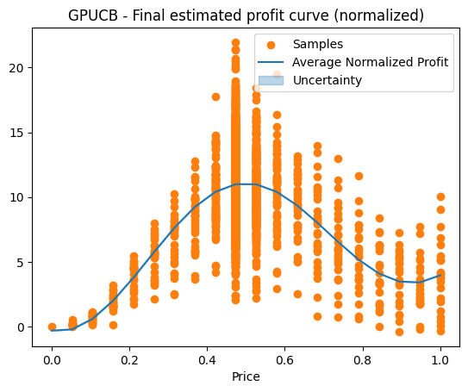
Pricing Agent Gaussian Process UCB agent
Pricing agent’s price chosing logic :
1. Use GP to sample purchase probabilities of prices (per customer)
2. Probabilities * prices => estimated profit
3. Estimated profits – average bidding cost => estimated net profit
4. Estimate net profit * average customer number => net profit (total)
Bidding
Agent
Bidding Environment
Pricing
Agent
Pricing Environment
Fig.1 : GP fitted on purchase probability
Fig.2 : GP fitted on total profit

Slide 4
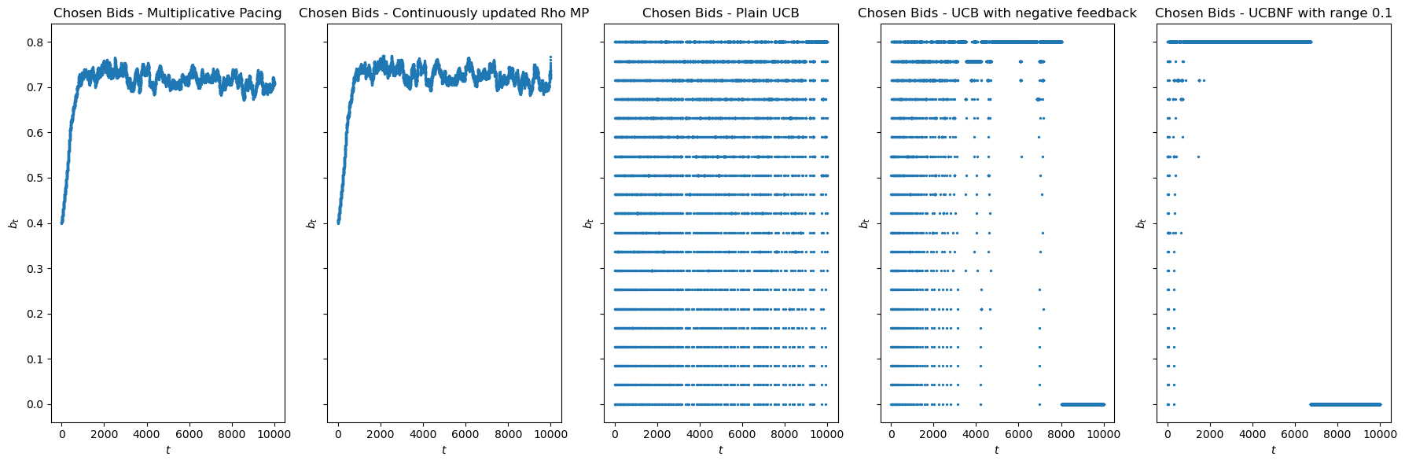
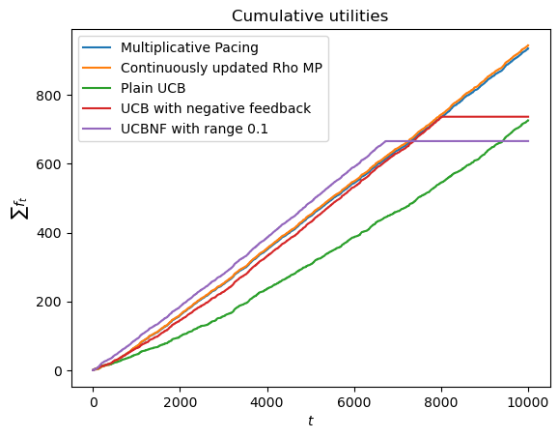
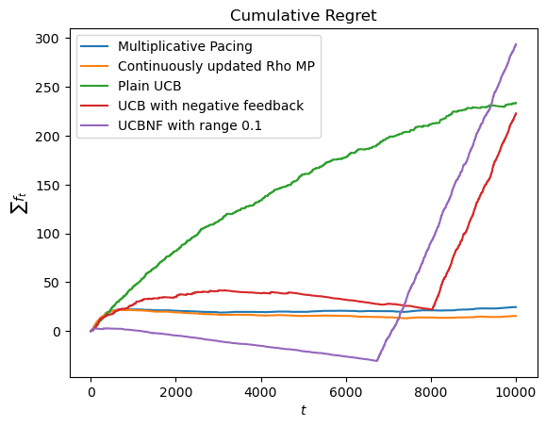
Bidding Agents 1. Primal-Dual algorithm for truthful auctions 2. UCB-like algorithm
def update(self, f_t, c_t):
self.N_pulls[self.a_t] += 1
if(f_t>0):
self.won_time += 1
self.winning_total_reward += f_t
elif(self.t >= self.K):
f_t = -(self.total_reward/self.won_time)
self.average_rewards[self.a_t] +=
(f_t-self.average_rewards[self.a_t])/self.N_pulls[self.a_t]
self.budget -= c_t
self.t += 1
def update(self, f_t, c_t):
# update lmbd and budget
# …
# update rho (per round budget)
self.t += 1
self.rho = self.budget/(self.T-self.t)
Parameters:
3 uniform distributed opponents
v=0.8
B=2000
T=10000
# of Wins: [
3560,
3678,
2838,
3421,
3332]

Slide 5
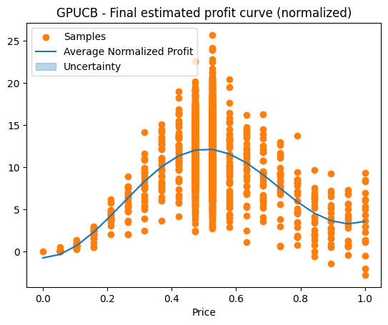
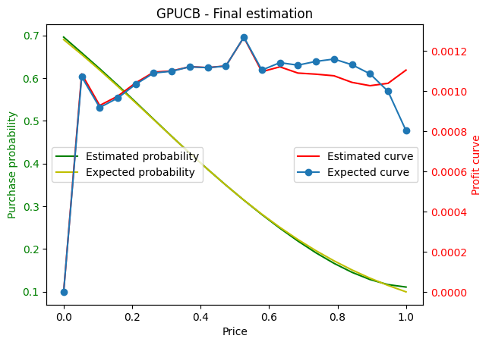
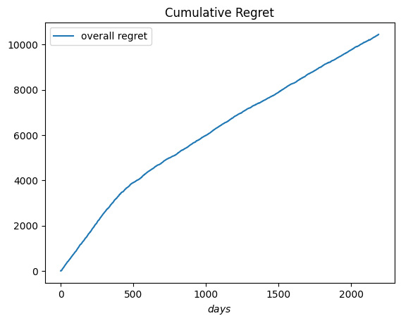
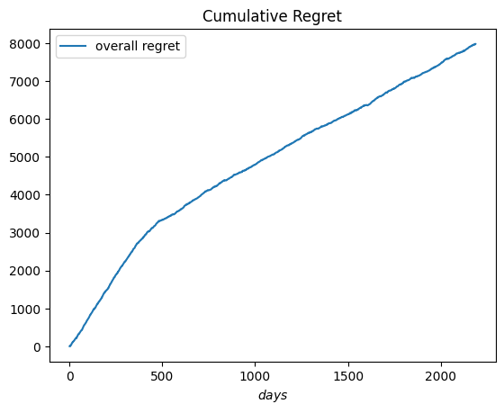
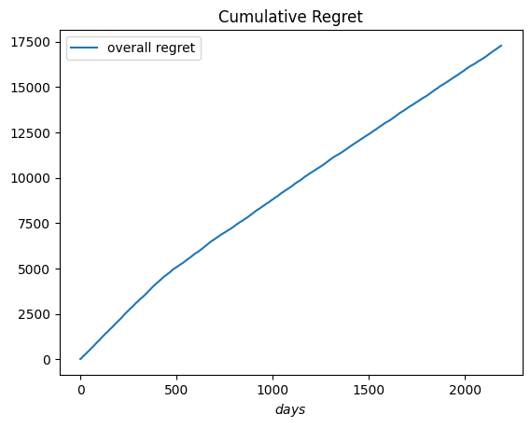
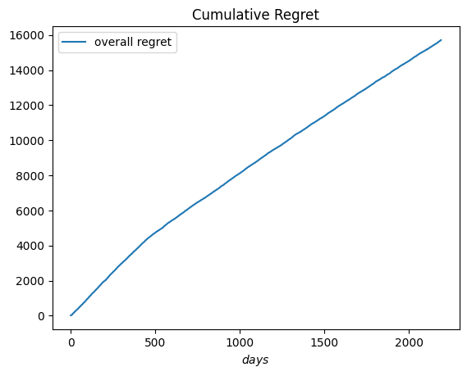
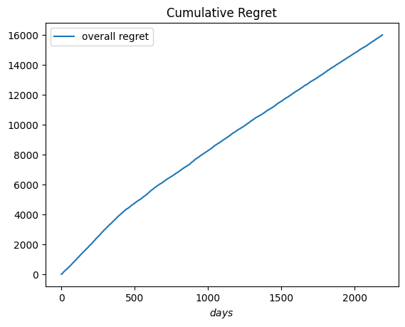
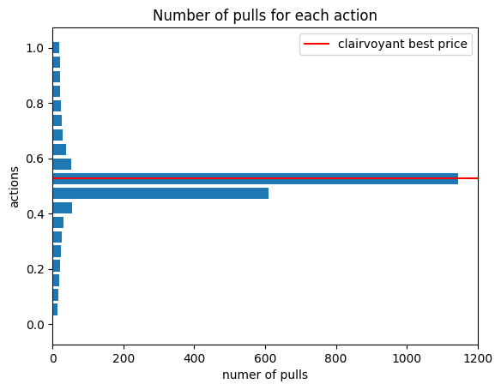
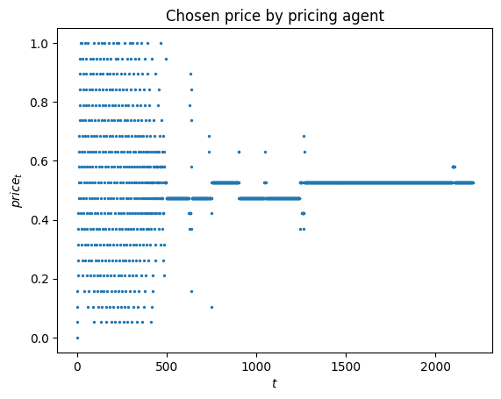

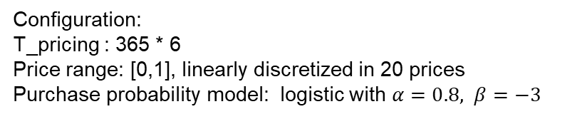
Interaction
Configuration:
T_pricing : 365 * 6
Price range: [0,1], linearly discretized in 20 prices
Purchase probability model: logistic with $α=0.8, β=−3$
T_bidding : 10000
Budget : 100
Opponents : 2 uniform bidders (infinite budget)
$$P\left(price,α,β\right)=\frac{1}{1+e^{−\left(α+β∗price\right)}}$$
0.0012 * 10000 ~= 12
Multiplicative Pacing
Continuously updated rho MP
UCB1
UCB1 with Negative Feedback
UCB1 with NF and lower scale

