Slide 1
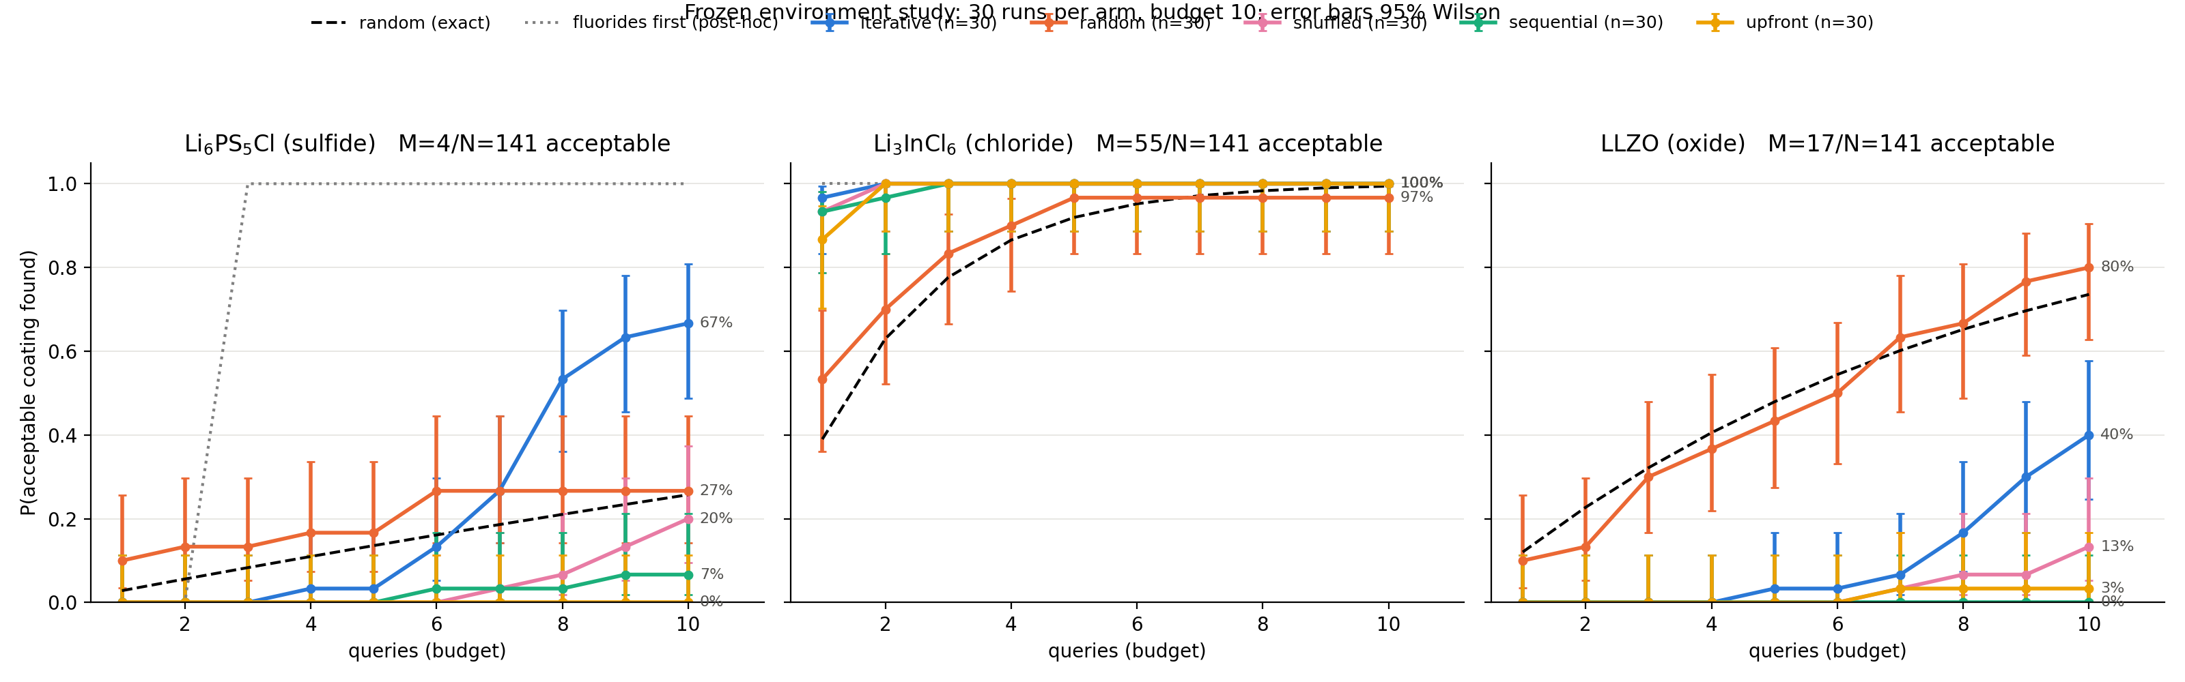
Feedback beats no feedback; random wins on LLZO
Li₆PS₅Cl (sulfide)
Iterative 20/30 vs sequential 2, shuffled 6, upfront 0, random 8 (exact 26%).
Li₃InCl₆ (chloride)
Ceiling, declared in advance: every LLM arm 30/30, random 29/30 (exact 99%).
LLZO (oxide)
Random 24/30 (exact 74%) beats every LLM arm; iterative 12/30, sequential 0.
Notes:
P(acceptable coating found by query k), 30 runs per arm, budget 10, seeds 200-229 paired across arms, frozen tables. Error bars 95% Wilson; black dashed = exact random; grey dotted = fluoride-first rule, chosen after v3 (post-hoc). Source: data/experiments/environment_v1/*/summary.json; figure: scripts/plot_environment_curves.py. Keep the LLZO random advantage visible.

Slide 2
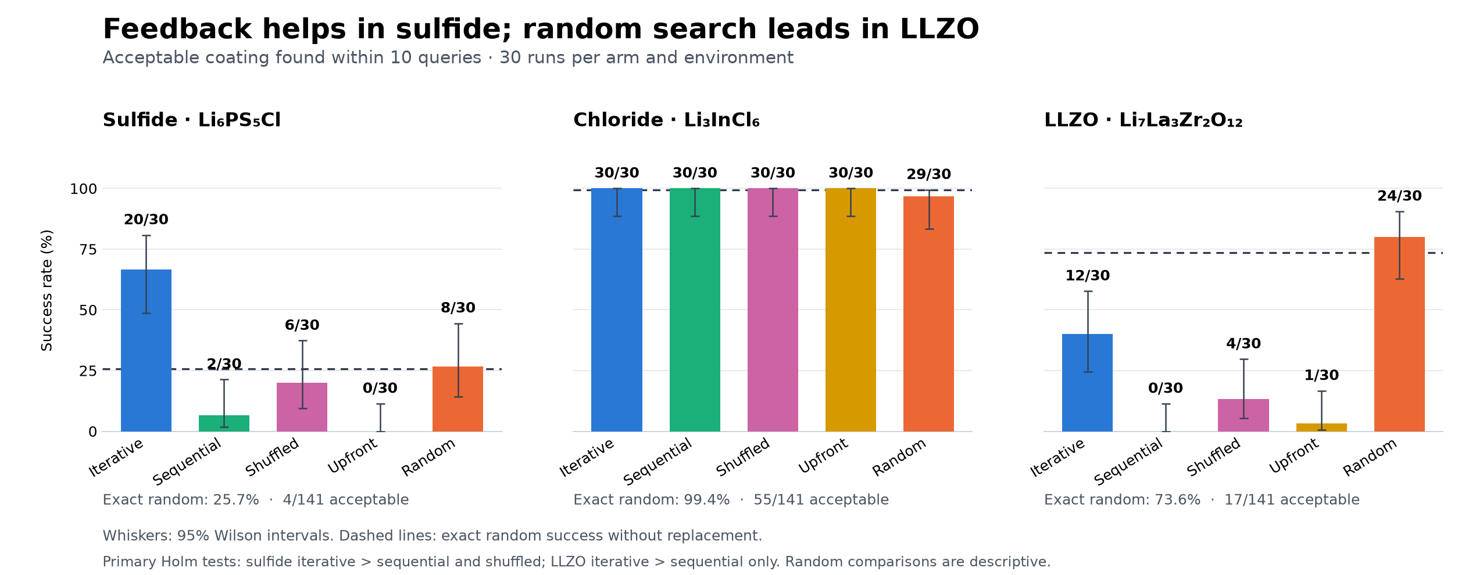
Planned comparisons: 3 of 6 survive Holm
Environment | Iterative vs | Discordant pairs | Raw p | Holm p
Sulfide | sequential | 18 / 0 | 7.6e-6 | 4.6e-5 ✓
Sulfide | shuffled | 15 / 1 | 5.2e-4 | 0.0024 ✓
Chloride | sequential | 0 / 0 | 1 | 1
Chloride | shuffled | 0 / 0 | 1 | 1
LLZO | sequential | 12 / 0 | 4.9e-4 | 0.0024 ✓
LLZO | shuffled | 11 / 3 | 0.057 | 0.17
Endpoint at query 10 with 95% Wilson intervals and exact random (Davide's review figure).
Exact two-sided McNemar, paired by seed; Holm across the six planned tests (α = 0.05). Discordant = iterative only / control only. Random vs LLM is descriptive, not a planned test. Not significant ≠ equivalent.
Notes:
Primary endpoint: acceptable found within 10 queries. Six planned contrasts (3 environments x iterative vs sequential / shuffled), Holm family size 6, enforced by analyse_environment_study.py --production. Source: data/experiments/environment_v1/environment_summary.json; independently recomputed in SYNC_ADEM_9.

Slide 3
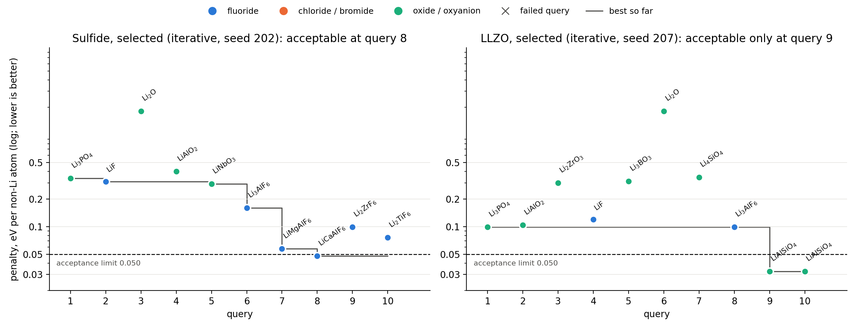
What changed the next selection
Sulfide, seed 202: useful revision
Oxides and LiF fail (≈0.3). It keeps fluoride, adds Al³⁺: Li₃AlF₆ 0.16 → LiMgAlF₆ 0.057 → LiCaAlF₆ 0.048, acceptable at query 8.
LLZO, seed 207: late adaptation
La products (LaPO₄, LaF₃, LaBO₃) noted; Li₄SiO₄ reacts little but decomposes (0.35) → LiAlSiO₄ 0.033 at query 9, then a polymorph.
Notes:
Selection rule, stated before inspecting rationales: lowest seed whose first acceptable hit is at the arm's typical query (sulfide median 8; LLZO modal 8-10). Runs: environment_v1/lpscl/iterative_r202.json and llzo/iterative_r207.json. Cited penalties match the recorded results; mechanisms in the rationales are Haiku's hypotheses, not validated chemistry. Figure: scripts/plot_trace_pair.py.

Slide 4
LLZO: random exploration wins in 10 queries
24/30
random runs succeed
12/30
iterative runs succeed
Benchmark acceptance is a thermodynamic proxy
5 of 17 acceptable LLZO structures are flagged for practical review: three LiIO₃, one LiClO₄, one Li₅IO₆ (orthoperiodate).
Post-hoc and descriptive: 18 of random's 24 successful runs also found an unflagged acceptable candidate, so the flagged compounds do not explain the whole gap.
The criterion does not establish thermal stability, processing suitability, safety or Li transport. No evidence that Haiku avoided these compounds deliberately.
Arm | Distinct formulas | Acceptable picks | Successful runs
Random | 95 | 33/300 | 24
Iterative | 33 | 29/300 | 12
Shuffled | 44 | 4/300 | 4
Upfront | 22 | 1/300 | 1
Sequential | 19 | 0/300 | 0
LLM arms concentrate on textbook coatings (Li₃PO₄, LiNbO₃, LiAlO₂, Li₂ZrO₃, Li₃BO₃, LiF), none acceptable here. Iterative adapts late and narrowly: 10 of 12 successes first hit at queries 8–10; 26 of 29 acceptable picks are LiAlSiO₄ polymorphs.
Notes:
Approved wording (Davide, SYNC_ADEM_10): In LLZO, iterative selection improves over the sequential policy, but random exploration succeeds more often within ten queries. Feedback redirects selections late toward aluminosilicates. Benchmark acceptance remains a thermodynamic proxy and includes compounds requiring separate practical review. Iterative vs shuffled in LLZO is not significant after Holm. Counts from SYNC_ADEM_10 / data/reviews.

Slide 5
What the study supports, and what it does not
Supported
Correctly attributed feedback improves selection on the sulfide pool, against both the no-feedback and the scrambled-feedback controls (Holm-significant).
Feedback beats the no-feedback policy in LLZO.
Fluoride share of iterative picks rises in the sulfide (0.28 → 0.65) and falls in LLZO (0.18 → 0.09): consistent with environment-dependent adaptation, not proof of its chemical mechanism.
Not supported
Universal superiority to random search (LLZO: random 24/30 vs iterative 12/30).
Finding the optimum: best bin sulfide 6/30 vs random 5/30; LLZO 0 for every LLM arm vs random 2/30.
Human-like mechanistic reasoning, validated coatings, or Li transport. Evaluation counts are benchmark queries, not measured compute savings.
Notes:
Headline (SYNC_ADEM_9): the value of LLM feedback depends on the environment. It improves selection on sulfide; random exploration wins on LLZO. Chloride is a declared ceiling. Fluoride shares are pooled per arm (queries 1-5 vs 6-10), descriptive; per-run records in environment_summary.json.

