Slide 1

interphAIse
AI-guided selection of
solid-state battery coatings
Main ideas and results
OSI Hackathon 2026
Project snapshot: 21 October 2026
01
Notes:
This talk presents interphAIse: its scientific question, implemented workflow, measured discovery results and atomistic validation as of 21 October 2026. The cover is an AI-generated conceptual illustration, not a computed crystal structure. Main talk: slides 1–16, approximately 15 minutes. Slides 17–21 are technical backup. Image generated with the built-in image-generation tool.
Sources (project snapshot, 21 October 2026):
/Users/davidetisi/Documents/Work/DTU/OSI_Hackathon/interphAIse/REPORT.md
/Users/davidetisi/Documents/Work/DTU/OSI_Hackathon/presentations/.build/assets/cover-provenance.json

Slide 2
Where the LLM replaces human intuition
LiCoO₂ / coating / Li₆PS₅Cl
A coating should limit reaction at both contacts and allow Li transport.
The LLM’s decision
The evaluator’s role
Interpret the calculation, revise
a chemical hypothesis, and choose
the next coating.
Calculate each property.
Compare LLM choices against
controls with the same budget.
Flagship screen: 4 V versus Li/Li⁺. Lithium transport is a design requirement outside this benchmark.
02
Notes:
The project targets the scientist’s choice of the next candidate after a calculation. The flagship stack has two contacts: cathode/coating and coating/electrolyte. Thermodynamics evaluates chemical compatibility. PET-MAD supplies a separate atomistic validation workflow. The discovery experiment does not feed adhesion into the thermodynamic score.
Sources (project snapshot, 21 October 2026):
/Users/davidetisi/Documents/Work/DTU/OSI_Hackathon/interphAIse/README.md
/Users/davidetisi/Documents/Work/DTU/OSI_Hackathon/interphAIse/SYNC_ADEM_7.md
Reviewed update, 21 October 2026:
The LLM takes over the scientist’s choice of the next candidate after interpreting a calculation. It proposes a chemical hypothesis and revises that hypothesis using queried results. The thermodynamic evaluator and PET-MAD compute properties independently. This measured task selects from a fixed pool; it does not invent new chemical compositions or reaction mechanisms. The feedback controls assess whether attributed results help choices, not whether every written rationale is scientifically sound.
/Users/davidetisi/Documents/Work/DTU/OSI_Hackathon/interphAIse/ENVIRONMENT_PROTOCOL.md
/Users/davidetisi/Documents/Work/DTU/OSI_Hackathon/interphAIse/DISCOVERY_REPORT.md

Slide 3
Three connected parts of interphAIse
01
Modelling workflow
Choose interphase, facets and rebuild actions.
LLM, rules and human policy interfaces.
02
Controlled discovery
Select coatings through a budgeted query API.
Frozen objective, baselines and feedback controls.
03
Atomistic validation
Build explicit contacts and relax with PET-MAD.
Inspect geometry and test numerical sensitivity.
The headline LLM result tests candidate selection. Broader modelling decisions remain a separate evaluation task.
03
Notes:
The initial modelling pipeline implements LLM, deterministic rules and human policy interfaces for sharp/interphase decisions, facet selection and geometry judgement. The discovery benchmark became the headline experiment. The measured feedback result concerns candidate selection only. PET-MAD validation and the offline structure viewer support a later full interface workflow. Do not present all policy decisions as experimentally demonstrated LLM benefits.
Sources (project snapshot, 21 October 2026):
/Users/davidetisi/Documents/Work/DTU/OSI_Hackathon/interphAIse/REPORT.md
/Users/davidetisi/Documents/Work/DTU/OSI_Hackathon/interphAIse/STRUCTURE_VIEWER.md
/Users/davidetisi/Documents/Work/DTU/OSI_Hackathon/interphAIse/INTEGRATED_DISCOVERY_RESULTS.md

Slide 4
The first objective hid the coating differences
Benchmark property | Original v2 | Frozen v3
Occupied eligible bins | 6 | 24
Candidates in the best bin | 41 | 1
Candidates meeting the criterion | 0 | 2
Random best-bin success after 3 queries | 99.6% | 6.0%
V3 asks how much extra reaction the contact creates.
Passing v3 measures compatibility with equilibrated endpoints, not whole-stack stability at 4 V.
04
Notes:
Original v2 included absolute endpoint decomposition. Li6PS5Cl has a 1.439628 eV/non-Li atom self-decomposition penalty at 4 V, producing a shared score floor. The frozen v3 objective evaluates extra reaction after mixing separately equilibrated endpoints, plus coating self-instability. Both versions use the same 50 candidates. V3 changes the scientific question before the main strategy runs. It is not a claim that the pristine battery stack is stable.
Sources (project snapshot, 21 October 2026):
/Users/davidetisi/Documents/Work/DTU/OSI_Hackathon/interphAIse/BENCHMARK_VALIDATION.md
/Users/davidetisi/Documents/Work/DTU/OSI_Hackathon/interphAIse/data/benchmarks/coating_v3.json

Slide 5
Two of 50 candidates pass the frozen criterion
Coating | Penalty (eV/non-Li atom) | Score bin
LiNbF6 | 0.028772 | 1
LiCaAlF6 | 0.047719 | 2
50
47
≤ 0.050
pinned structures
eligible after insulation
acceptance threshold
Penalty = maximum of coating self-instability and extra reaction at either contact.
05
Notes:
All numbers come from the frozen v3 table. There are 49 computed candidates, 47 eligible after insulation, and one retained missing-entry failure. Coating eligibility requires a known band gap of at least 2 eV. Acceptance is maximum penalty at most 0.050 eV per non-Li atom. Ranking uses 0.020-wide bins without raw-energy tiebreaking. These are proxy benchmark winners, not experimentally validated coating recommendations.
Sources (project snapshot, 21 October 2026):
/Users/davidetisi/Documents/Work/DTU/OSI_Hackathon/interphAIse/BENCHMARK_VALIDATION.md
/Users/davidetisi/Documents/Work/DTU/OSI_Hackathon/interphAIse/data/benchmarks/coating_v3.json

Slide 6
Five arms test the value of feedback
Strategy | Information available for the next choice
Upfront | One shortlist before any result
Sequential | Previous choices, without calculation results
Iterative | Previous choices and correctly associated results
Shuffled | Previous choices with reassigned result histories
Random | Uniform sampling without replacement
30 runs per arm, 10 queries per run. Haiku 5.5 for LLM arms. Failed queries remain in the budget.
06
Notes:
Main study: 30 repetitions per original arm, budget ten submitted candidate IDs, seeds 100–129. Each unknown, repeated or missing-entry query consumes budget. Direct Anthropic Haiku 5.5, temperature 1.0, output cap 4096. The shuffled arm is a later matched control with 30 runs and the same original cohort, archived on the agent branch and independently reviewed. Candidate-order pairing does not fix provider randomness. Agents receive candidate information and queried results, not the exhaustive answer table.
Sources (project snapshot, 21 October 2026):
/Users/davidetisi/Documents/Work/DTU/OSI_Hackathon/interphAIse/INTEGRATED_DISCOVERY_PROTOCOL.md
/Users/davidetisi/Documents/Work/DTU/OSI_Hackathon/interphAIse/SYNC_ADEM_5.md

Slide 7
Feedback improves acceptance in this benchmark
Original four-arm batch plus a matched shuffled follow-up. Each rate has 30 runs; uncertainty is in backup.
07
Notes:
Primary endpoint: at least one acceptable coating found by query ten. The plotted values are observed rates with n=30 in each arm. Iterative 19/30, upfront 4/30, sequential 4/30, sampled random 10/30, shuffled follow-up 6/30. Wilson intervals are in backup slide 17. Exact random acceptance is 36.33%. Correct association of feedback helps in this frozen setting, but the control does not uniquely establish chemical reasoning.
Sources (project snapshot, 21 October 2026):
/Users/davidetisi/Documents/Work/DTU/OSI_Hackathon/interphAIse/data/experiments/integrated_v3_20261021_s100/replay_audit.json
/Users/davidetisi/Documents/Work/DTU/OSI_Hackathon/interphAIse/data/reviews/shuffled_v3_20261021.json
/Users/davidetisi/Documents/Work/DTU/OSI_Hackathon/interphAIse/SYNC_ADEM_5.md
Reviewed update, 21 October 2026:
Acceptance is the demonstrated benefit. Best-bin hits remain 7/30 for iterative versus 6/30 for sampled random, and the post-hoc fluoride-first rule succeeds by query two. The result therefore does not establish general superiority in discovering optimal materials.

Slide 8
The matched controls support feedback use
+50.0 pp
+43.3 pp
Iterative versus no results
Iterative versus shuffled results
17 seeds favor iterative
2 favor sequential
Paired p = 0.000729
16 seeds favor iterative
3 favor shuffled
Paired p = 0.004425
Unadjusted paired tests. Shuffled feedback is a follow-up control; neither contrast uniquely proves chemical reasoning.
08
Notes:
Iterative vs sequential: both 2, iterative only 17, sequential only 2, neither 9. Exact two-sided McNemar p=0.000728607. Iterative vs shuffled: both 3, iterative only 16, shuffled only 3, neither 8. p=0.004425049. These reported contrasts are unadjusted. The shuffled comparison was a planned follow-up after observing the first result. Shuffling can create contradictions and products can reveal identities, so it is evidence of sensitivity to correctly associated feedback rather than unique evidence of chemical reasoning.
Sources (project snapshot, 21 October 2026):
/Users/davidetisi/Documents/Work/DTU/OSI_Hackathon/interphAIse/data/experiments/integrated_v3_20261021_s100/replay_audit.json
/Users/davidetisi/Documents/Work/DTU/OSI_Hackathon/interphAIse/data/reviews/shuffled_v3_20261021.json
/Users/davidetisi/Documents/Work/DTU/OSI_Hackathon/interphAIse/SYNC_ADEM_5.md

Slide 9
The benefit arrives late in the query budget
Query 2
First pass for the
post-hoc fluoride rule
7/30 vs 6/30
Best-bin success:
iterative vs random
A useful acceptance result, with no demonstrated gain in finding the optimum or saving expensive computation.
09
Notes:
Cumulative success is read directly from summary.json. Iterative first succeeds in 1/30 runs at query five and reaches 19/30 at query ten. The exact random line is a finite-pool probability. The post-hoc fluoride-first heuristic reaches a pass on query two and the best bin on query four. Iterative reaches the best bin in 7/30 runs vs sampled random 6/30, so acceptance gains should not be generalized into better optimum finding. The heuristic was selected after seeing the exhaustive table.
Sources (project snapshot, 21 October 2026):
/Users/davidetisi/Documents/Work/DTU/OSI_Hackathon/interphAIse/data/experiments/integrated_v3_20261021_s100/summary.json
/Users/davidetisi/Documents/Work/DTU/OSI_Hackathon/interphAIse/INTEGRATED_DISCOVERY_RESULTS.md

Slide 10
The electrolyte changes the search landscape
141 structures × 3 environments = 423 outcomes
Electrolyte | Acceptable | Random pass by 10 | Random best bin by 10
Li₆PS₅Cl | 4 / 141 | 25.7% | 19.9%
Li₃InCl₆ | 55 / 141 | 99.4% | 96.2%
Tetragonal LLZO | 17 / 141 | 73.6% | 7.1%
Chloride is near ceiling. LLZO keeps a difficult optimum.
Frozen tables are published. Only the 30-call smoke batch is approved. Production awaits cost review.
10
Notes:
The expansion evaluates 141 pinned coating structures in each of three environments with LiCoO2 at 4 V and unchanged v3 objective. There are 423 combinations, 414 successful calculations and nine explicit missing-entry outcomes; 120 eligible candidates in each environment. Dataset: 7420 compatible MP corrected GGA/GGA+U entries. Original 50 outcomes reproduce exactly. The frozen tables are complete; expanded live LLM production is pending in the reviewed local record. LLZO is an ordered tetragonal reference, not doped cubic LLZO.
Sources (project snapshot, 21 October 2026):
/Users/davidetisi/Documents/Work/DTU/OSI_Hackathon/interphAIse/EXPANSION_PROGRESS.md
/Users/davidetisi/Documents/Work/DTU/OSI_Hackathon/interphAIse/ENVIRONMENT_FREEZE_REVIEW.md
/Users/davidetisi/Documents/Work/DTU/OSI_Hackathon/interphAIse/data/benchmarks/environment_v1/manifest.json
Reviewed update, 21 October 2026:
The three frozen tables and smoke-only sign-off were pushed on davide at 40b80fa, which includes b51c14e. All 423 outcome rows and scientific fields are unchanged from the exploratory originals; only status, freeze metadata and hashes differ. The agreed design is five arms, three environments, 30 runs per arm, budget ten, seeds 200–229, with Holm correction across six paired contrasts. Adem owns the smoke batch. No new expanded live results are included in this presentation.
/Users/davidetisi/Documents/Work/DTU/OSI_Hackathon/interphAIse/ENVIRONMENT_PROTOCOL.md

Slide 11
The fluoride shortcut fails in the LLZO screen
Coating | Sulfide bin | Chloride bin | LLZO bin
LiNbF6 | 1 | 1 | 9
LiTaF6 | 1 | 1 | 8
LiF | 15 | 0 | 5
Li3PO4 | 16 | 0 | 4
LiAlSiO4 | 10 | 1 | 1
LiClO4 | 55 | 0 | 0
All sulfide passes contain F. No LLZO pass contains F.
Lower bins are better. Illustrative polymorphs selected after inspection; each bin spans 0.020 eV/non-Li atom.
11
Notes:
These examples use the lowest-ID polymorph for each formula and were selected after inspection to explain the landscape. Lower score bins are better. All four acceptable sulfide structures contain fluorine; none of the 17 acceptable LLZO structures contains fluorine. The fluoride-first ordering reaches its first pass at query 3 for expanded sulfide, 1 for chloride and 40 for LLZO, outside the ten-query budget. This demonstrates an environment-dependent computational landscape, not LLM adaptation or cross-environment learning.
Sources (project snapshot, 21 October 2026):
/Users/davidetisi/Documents/Work/DTU/OSI_Hackathon/interphAIse/EXPANSION_PROGRESS.md
/Users/davidetisi/Documents/Work/DTU/OSI_Hackathon/interphAIse/data/benchmarks/environment_v1/lco_lpscl_4v.json
/Users/davidetisi/Documents/Work/DTU/OSI_Hackathon/interphAIse/data/benchmarks/environment_v1/lco_lic_4v.json
/Users/davidetisi/Documents/Work/DTU/OSI_Hackathon/interphAIse/data/benchmarks/environment_v1/lco_llzo_4v.json

Slide 12
Bulk validation changed the interface models
−63.8 meV/atom
Rebuilt primary contacts
Li₆PS₅Cl energy decrease
after releasing symmetry
504 atoms
Cathode / LiNbF₆
Six distinct converged minima
440 atoms initially
Electrolyte / LiNbF₆
The sampled bulk arrangement changes
the lattice and the feasible contact cell.
PET-MAD model minima guide the geometry. Materials Project energies remain the basis of the thermodynamic score.
12
Notes:
Five bulk structures were relaxed with PET-MAD S 1.6.0 using symmetric and unconstrained checks. Li6PS5Cl lowers energy by 63.81 meV/atom after symmetry release; LiZr2(PO4)3 by 7.57. Multistart studies find six converged distinct electrolyte minima and five of six converged phosphate starts. Seed 0 is lowest in the sampled sets, not a proven global minimum. The first pilot facet matches cease to exist under the revised lattices and matching gates. Primary contacts were rebuilt using LiNbF6(001) against LiCoO2(001) and Li6PS5Cl(111).
Sources (project snapshot, 21 October 2026):
/Users/davidetisi/Documents/Work/DTU/OSI_Hackathon/interphAIse/BULK_RELAXATION.md
/Users/davidetisi/Documents/Work/DTU/OSI_Hackathon/interphAIse/CONTACT_PROTOCOL.md

Slide 13
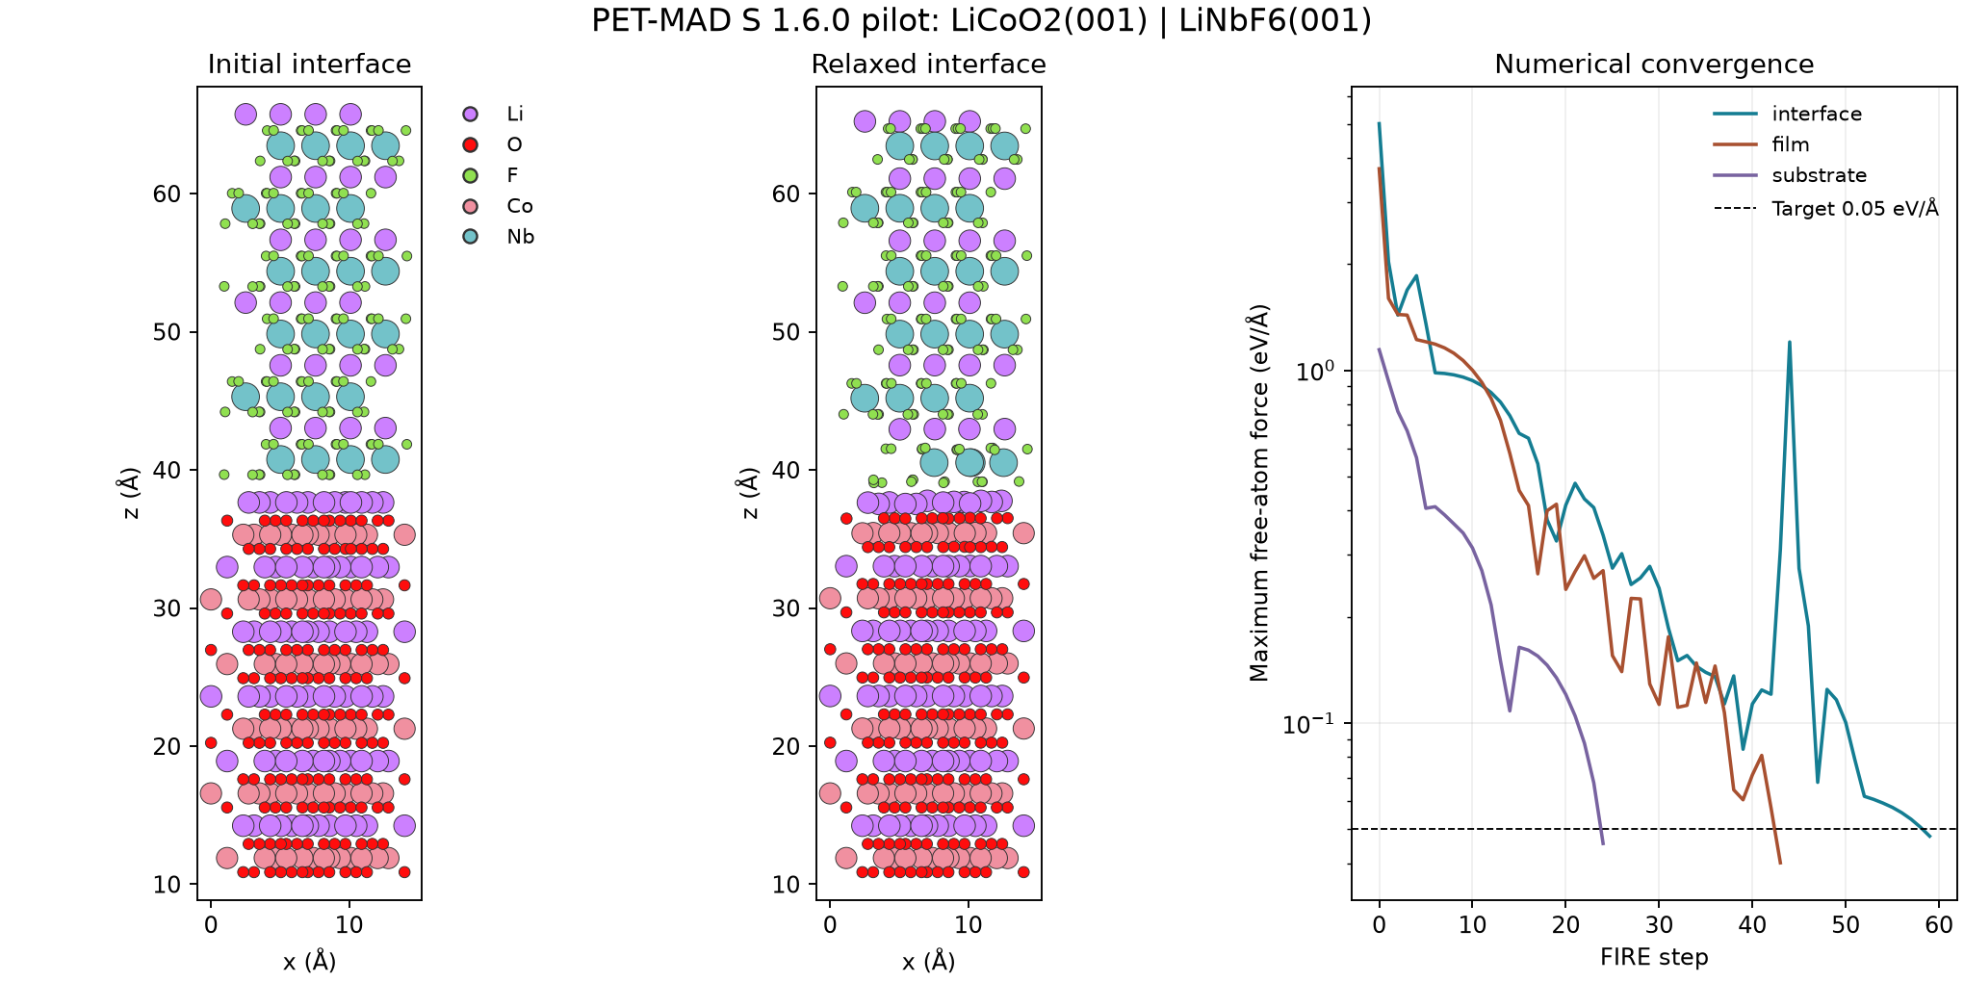
Explicit contacts make the modelling choices visible
Primary cathode contact, 504 atoms. Free atoms converge below 0.05 eV/Å; polar surfaces remain unresolved.
13
Notes:
This source figure shows the 504-atom primary LiCoO2(001)/LiNbF6(001) contact at a fixed substrate fraction of 0.34. Initial and relaxed coordinates and the free-atom convergence traces are archived. All 18 relaxations across two contacts and three constraint fractions converged on movable atoms. Free-atom convergence does not remove fixed-atom reaction forces or formal slab polarity. The figure is an actual project result, not a generated illustration.
Sources (project snapshot, 21 October 2026):
/Users/davidetisi/Documents/Work/DTU/OSI_Hackathon/interphAIse/data/petmad/constraint_test_v1/cathode_primary_f0.34/inspection.png
/Users/davidetisi/Documents/Work/DTU/OSI_Hackathon/interphAIse/CONTACT_PROTOCOL.md

Slide 14
Four electrolyte layers meet the chosen tolerance
1.53 J/m²
Relaxed adhesion
at four layers
+0.067 J/m²
Change from
three to four layers
Constraint spreads at four layers: 0.048 J/m² (adhesion), 0.024 J/m² (separation).
Tolerance met over tested settings. Adhesion still rises and both contacts remain formally polar.
14
Notes:
Thickness study holds area 170.708 Å², strain, terminations, two film layers, fixed depth 3.257602 Å (38 substrate atoms) and registry (0,0,2 Å) fixed. At 2,3,4 substrate layers: Wadh 1.3291,1.4644,1.5317 and Wsep 2.5190,2.8052,2.8579 J/m². Last increments are 0.0674 and 0.0527, below 0.1 J/m². Four layers is selected by that criterion, not a proven plateau. At four layers the constraint bracket gives Wadh spread 0.048 and Wsep spread 0.024. Formal polarity increases with thickness, so the result remains provisional.
Sources (project snapshot, 21 October 2026):
/Users/davidetisi/Documents/Work/DTU/OSI_Hackathon/interphAIse/CONTACT_PROTOCOL.md
/Users/davidetisi/Documents/Work/DTU/OSI_Hackathon/interphAIse/data/petmad/thickness_v1/run_L2/fixed_geometry_separation.json
/Users/davidetisi/Documents/Work/DTU/OSI_Hackathon/interphAIse/data/petmad/thickness_v1/run_L3/fixed_geometry_separation.json
/Users/davidetisi/Documents/Work/DTU/OSI_Hackathon/interphAIse/data/petmad/thickness_v1/run_L4/fixed_geometry_separation.json
Reviewed update, 21 October 2026:
An independent review checked all five unique archived runs (15 relaxations), adhesion arithmetic and 1,827 calculator calls plus ten separation single points. The four-layer reference is shared by the thickness and constraint tables, so it is counted once. Constraints are insensitive only within the tested bracket and tolerance. The 0.018 J/m² registry comparison at three layers is unrelaxed and does not prove equivalent relaxed registry energies. Surface Li rearrangement persists across the tested thicknesses, while residual finite-thickness and polarity effects remain unresolved.
/Users/davidetisi/Documents/Work/DTU/OSI_Hackathon/interphAIse/SYNC_CLAUDE_3.md
/Users/davidetisi/Documents/Work/DTU/OSI_Hackathon/interphAIse/data/reviews/electrolyte_thickness_review_20261021.json

Slide 15
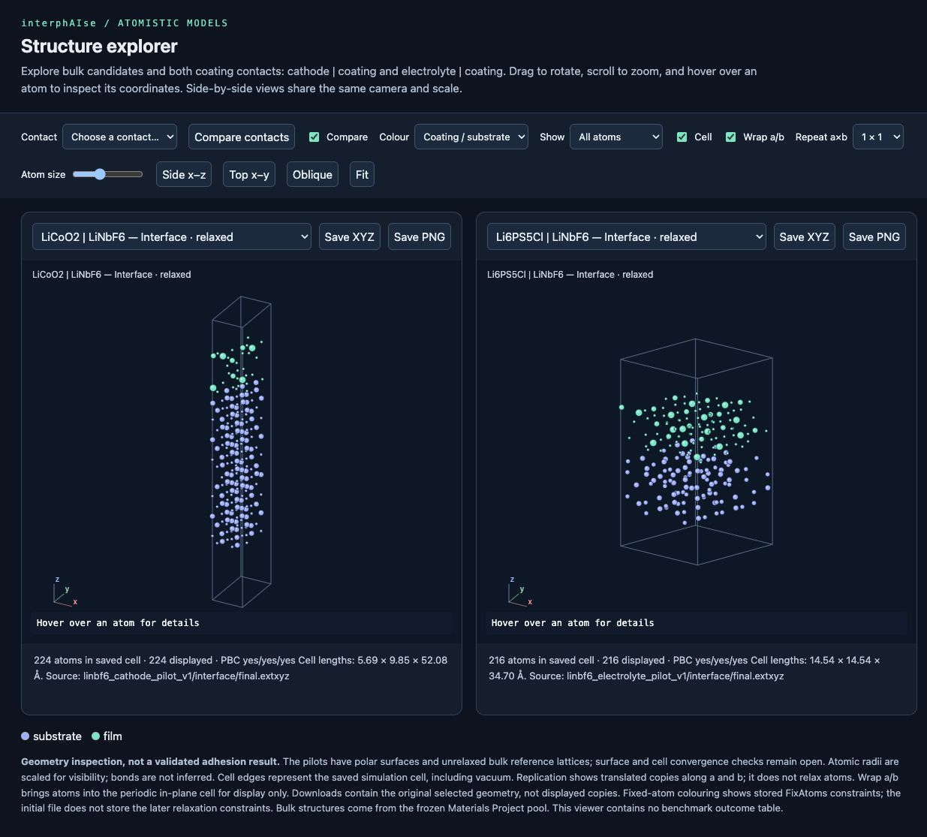
The results remain inspectable and reproducible
1,500
query outcomes independently replayed
Frozen data and objective hashes
Failed queries retained
Prompts and usage archived
Offline structure viewer shown with the earlier pilot geometries. Numerical reproducibility does not establish physical validity.
15
Notes:
Original discovery archive: 120 runs and 1200 independently replayed outcomes. Reviewed shuffled archive: 30 runs and 300 outcomes, plus all 300 prompt histories and displayed-source maps verified. Expanded 423 outcomes retain all failures, and original 50 values reproduce exactly. Thermodynamic LP vs Qhull disagreement is at floating-point precision (1.78e-15 original, 8.88e-16 expansion). The offline structure viewer supports 50 bulk candidates, saved contacts, paired geometry inspection, replication and exports. The screenshot shows the earlier pilot geometries and is labelled accordingly. Scripts discover later saved geometries when rebuilt.
Sources (project snapshot, 21 October 2026):
/Users/davidetisi/Documents/Work/DTU/OSI_Hackathon/interphAIse/STRUCTURE_VIEWER.md
/Users/davidetisi/Documents/Work/DTU/OSI_Hackathon/interphAIse/data/experiments/integrated_v3_20261021_s100/replay_audit.json
/Users/davidetisi/Documents/Work/DTU/OSI_Hackathon/interphAIse/data/reviews/shuffled_v3_20261021.json
/Users/davidetisi/Documents/Work/DTU/OSI_Hackathon/interphAIse/EXPANSION_PROGRESS.md

Slide 16
What the project establishes
Feedback helps within the frozen benchmark
19/30 successes, compared with 4/30 without results and 6/30 with shuffled results.
The chemical environment changes the answer
Sulfide favors fluorides in this proxy. LLZO challenges that shortcut.
Next: environment smoke batch and cathode thickness
A controlled selection result and an auditable modelling workflow. Experimental coating performance remains open.
16
Notes:
Closing slide for the main talk. The evidence supports useful feedback-dependent candidate selection under one frozen thermodynamic criterion. It also establishes that electrolyte chemistry changes the exhaustive landscape and that physical model choices matter for adhesion. Next work: separately approved and preregistered five-arm environment study; cathode film thickness, vacuum and registry tests; seed sensitivity; eventual transport and experimental validation. At the snapshot, environment tables are frozen but full LLM production is pending measured cost review. Do not imply the presentation work launches paid runs.
Sources (project snapshot, 21 October 2026):
/Users/davidetisi/Documents/Work/DTU/OSI_Hackathon/interphAIse/SYNC_ADEM_5.md
/Users/davidetisi/Documents/Work/DTU/OSI_Hackathon/interphAIse/EXPANSION_PROGRESS.md
/Users/davidetisi/Documents/Work/DTU/OSI_Hackathon/interphAIse/ENVIRONMENT_FREEZE_REVIEW.md
/Users/davidetisi/Documents/Work/DTU/OSI_Hackathon/interphAIse/CONTACT_PROTOCOL.md
Reviewed update, 21 October 2026:
The immediate next steps are the already approved approximately 30-call environment smoke batch and a bounded cathode coating-thickness test. Geometry-only checks give 504/600/696 atoms for two/three/four LiNbF6 layers, using an 800-atom cap with unchanged matching cell, surface cuts and physical substrate constraint. These checks provide feasible inputs, not new energy results. Afterward: vacuum, relaxed registry comparisons and the alternative electrolyte seed. Expanded LLM production still requires measured-cost review and explicit approval. Each environment run starts fresh; the study tests feedback use within each environment, not transfer of experience between environments.
/Users/davidetisi/Documents/Work/DTU/OSI_Hackathon/interphAIse/SYNC_CLAUDE_3.md
/Users/davidetisi/Documents/Work/DTU/OSI_Hackathon/interphAIse/ENVIRONMENT_PROTOCOL.md

Slide 17
Backup: uncertainty and paired comparisons
Arm | Successes | Rate | 95% Wilson interval
Iterative | 19/30 | 63.3% | 45.5% to 78.1%
Upfront | 4/30 | 13.3% | 5.3% to 29.7%
Sequential | 4/30 | 13.3% | 5.3% to 29.7%
Random | 10/30 | 33.3% | 19.2% to 51.2%
Shuffled | 6/30 | 20.0% | 9.5% to 37.3%
Paired exact p: sequential 0.000729, upfront 0.000275,
random 0.0490, shuffled 0.004425.
Reported p-values are unadjusted; the comparison with sampled random is especially uncertain.
17
Notes:
Wilson 95% intervals for each arm. Pairing is by display-order seed, not provider sampling. The random comparison has unadjusted paired p=0.0490 and should not be promoted as robust general superiority. The shuffled result is a matched follow-up. The primary endpoint is frozen criterion acceptance by query ten. Differences in inference and protocol timing are preserved.
Sources (project snapshot, 21 October 2026):
/Users/davidetisi/Documents/Work/DTU/OSI_Hackathon/interphAIse/data/experiments/integrated_v3_20261021_s100/replay_audit.json
/Users/davidetisi/Documents/Work/DTU/OSI_Hackathon/interphAIse/data/reviews/shuffled_v3_20261021.json

Slide 18
Backup: the frozen v3 thermodynamic objective
Penalty = max(self, cathode contact, electrolyte contact)
Choice | Frozen definition
Reference | Extra mixing reaction between equilibrated endpoints
Eligibility | Known band gap ≥ 2 eV
Acceptance | Penalty ≤ 0.050 eV/non-Li atom
Ranking | 0.020 eV/non-Li atom bins, with ties preserved
Data | Corrected GGA/GGA+U, MP database 2026.09.28
No transport, synthesis, kinetics or finite-temperature prediction. Endpoint instability stays visible as a diagnostic.
18
Notes:
Let h(c) be equilibrium grand-potential hull energy per non-Li atom with muLi = elemental Li reference minus 4 V. For contact endpoints c1,c2, calculate min_x[h((1−x)c1+xc2)−(1−x)h(c1)−xh(c2)]. The nonnegative score is max(coating self-decomposition, magnitudes of favourable additional reaction energies at two contacts). LP enforces non-Li conservation and nonnegative products. Original data: 4887 MP GGA/GGA+U entries across 949 subsystems, DB 2026.09.28. Band gaps and hull-prefilter provenance can come from different property calculations. Thresholds are operational, not calibrated error bars.
Sources (project snapshot, 21 October 2026):
/Users/davidetisi/Documents/Work/DTU/OSI_Hackathon/interphAIse/BENCHMARK_VALIDATION.md
/Users/davidetisi/Documents/Work/DTU/OSI_Hackathon/interphAIse/EVALUATOR_HANDOFF.md

Slide 19
Backup: bulk reference validation
Material | Volume change | Seed-0 ΔE (meV/atom) | Follow-up
LiCoO₂ | −3.10% | −0.003 | Small change
Li₆PS₅Cl | −2.04% | −63.81 | 6/6 starts converge
LiNbF₆ | −7.30% | −0.049 | Small change
LiCaAlF₆ | −4.39% | +0.012 | Small change
LiZr₂(PO₄)₃ | −3.88% | −7.57 | 5/6 starts converge
Seed 0 is lowest in both sampled multistart sets.
Sampled model minima are not established experimental phases or proven global minima.
19
Notes:
Values are from the original symmetric and unconstrained seed-0 checks, with a follow-up multistart for the two strongly distorted materials. Delta V is symmetric PET-MAD relative to MP. Stability delta E is the unconstrained check relative to symmetric PET-MAD. Tiny changes near zero should not be interpreted as robust differences. Symmetric convergence uses projected force/stress; unconstrained runs require raw maximum force ≤0.01 eV/Å and maximum stress ≤0.05 GPa. PET-MAD is a model, not a validated description of these phases.
Sources (project snapshot, 21 October 2026):
/Users/davidetisi/Documents/Work/DTU/OSI_Hackathon/interphAIse/BULK_RELAXATION.md
/Users/davidetisi/Documents/Work/DTU/OSI_Hackathon/interphAIse/BULK_REVIEW_AND_NEXT_STEPS.md

Slide 20
Backup: adhesion depends on the reference state
Contact / protocol | Relaxed Wadh | Fixed-geometry Wsep
Cathode, 504 atoms, 104 fixed | 3.479 | 5.055
Electrolyte, 440 atoms, 2 layers | 1.329 | 2.519
Electrolyte, 544 atoms, 4 layers | 1.532 | 2.858
Units: J/m²
At four layers, changing the fixed depth gives spreads of
0.048 J/m² in adhesion and 0.024 J/m² in separation.
Polarity, cathode film thickness, vacuum, registry and bulk-seed sensitivity still limit physical interpretation.
20
Notes:
Work of adhesion uses independently relaxed separated slabs at the same constraints. Fixed-geometry separation uses fragments split from the relaxed joined interface without relaxation. Their difference is the separated surfaces’ relaxation energy. Cathode 0.34 fraction values are 3.4792 and 5.0550 J/m²; four-layer electrolyte values are 1.5317 and 2.8579. Cathode fixed-force maxima remain ~2.45 eV/Å. Electrolyte Li/Cl rearrangement remains after thickness changes. Neither numerical insensitivity nor matching fixed forces proves cancellation of polar-surface errors.
Sources (project snapshot, 21 October 2026):
/Users/davidetisi/Documents/Work/DTU/OSI_Hackathon/interphAIse/CONTACT_PROTOCOL.md
Reviewed update, 21 October 2026:
The cathode constraint is a 0.34 fraction of substrate z span, selecting 104 substrate atoms; it is not a statement that exactly 34% of all interface atoms are fixed. The planned cathode coating-thickness test preserves the physical substrate mask through substrate-relative correspondence. Global atom indices change as film atoms are added.
/Users/davidetisi/Documents/Work/DTU/OSI_Hackathon/interphAIse/SYNC_CLAUDE_3.md

Slide 21
Backup: cost, provenance and next experiment
931 proposal calls
4.37M input + 0.835M output tokens
Original four-arm batch + shuffled follow-up, excluding pilots.
Agreed next study
Five arms, 30 repeats, three environments.
Smoke batch approved: about 30 calls.
Production: 2,790 calls, pending cost review.
Adem will report measured usage and projected production costs. Account billing remains unverified.
21
Notes:
Original four-arm batch: 631 proposal calls, 2773563 input tokens, 576415 output tokens. Shuffled follow-up: 300 calls, 1594978 input, 259023 output. Combined arithmetic: 931 calls, 4368541 input, 835438 output. Excludes pilot calls and unobserved provider retry costs. No monetary cost inferred. To reproduce original results: scripts/analyse_discovery_experiment.py data/experiments/integrated_v3_20261021_s100; scripts/audit_discovery_batch.py same-directory. Shuffled archive lives on reviewed agent branch 6e74e88, with local audit data/reviews/shuffled_v3_20261021.json. Expansion sources: data/benchmarks/environment_v1/manifest.json. New study proposed: five arms ×30×3 environments, seeds 200–229, budget 10, six paired contrasts with Holm correction. Full production pending cost review and approval in the local snapshot. Scientific source snapshot: davide, including thickness commit b51c14e and the frozen environment protocol published in 40b80fa.
Sources (project snapshot, 21 October 2026):
/Users/davidetisi/Documents/Work/DTU/OSI_Hackathon/interphAIse/INTEGRATED_DISCOVERY_RESULTS.md
/Users/davidetisi/Documents/Work/DTU/OSI_Hackathon/interphAIse/SYNC_ADEM_5.md
/Users/davidetisi/Documents/Work/DTU/OSI_Hackathon/interphAIse/ENVIRONMENT_FREEZE_REVIEW.md
/Users/davidetisi/Documents/Work/DTU/OSI_Hackathon/interphAIse/SYNC_ADEM_7.md
Reviewed update, 21 October 2026:
The scientific design is locked and the frozen tables are published at 40b80fa. Smoke: seed 999, upfront budget ten and sequential/iterative/shuffled budget three in each environment, approximately 30 calls before retries. Smoke runs are excluded from scientific results. Production plans 2,790 calls before retries, with seeds 200–229 and Holm correction over six comparisons. Report actual token usage, retries and expected/conservative production costs after smoke. Public list-price arithmetic is not billed account cost; no contract terms or actual billed cost are confirmed here. Only smoke spending is approved.
/Users/davidetisi/Documents/Work/DTU/OSI_Hackathon/interphAIse/ENVIRONMENT_PROTOCOL.md
/Users/davidetisi/Documents/Work/DTU/OSI_Hackathon/interphAIse/SYNC_ADEM_7.md

