Slide 1
DAI PROJECT
NETLOGO · CA MODEL
Pedestrian Roundabout as Passive DAI
A Floor Field cellular automaton study of distributed crowd coordination through spatial architecture
Based on 72 BehaviorSpace experiments — DAI_roundabout.nlogo
Burstedde (2001) · Weng (2006) · Zhang (2012) · Helbing (2005) · Yanagisawa (2019)
01 / 10

Slide 2
CORE CONCEPT
The roundabout is not just infrastructure — it is a spatial algorithm
TRADITIONAL VIEW
OUR THESIS
MECHANISM
Urban artefact
Passive DAI device
Environmental stigmergy
A junction design that physically separates conflicting traffic streams
The environment encodes gradients and constraints that convert uncoordinated local interactions into collective order — without explicit communication
Static field (topology), dynamic field (traffic memory), repulsive field (social cost) — together they delegate intelligence to the geometry
02 / 10

Slide 3
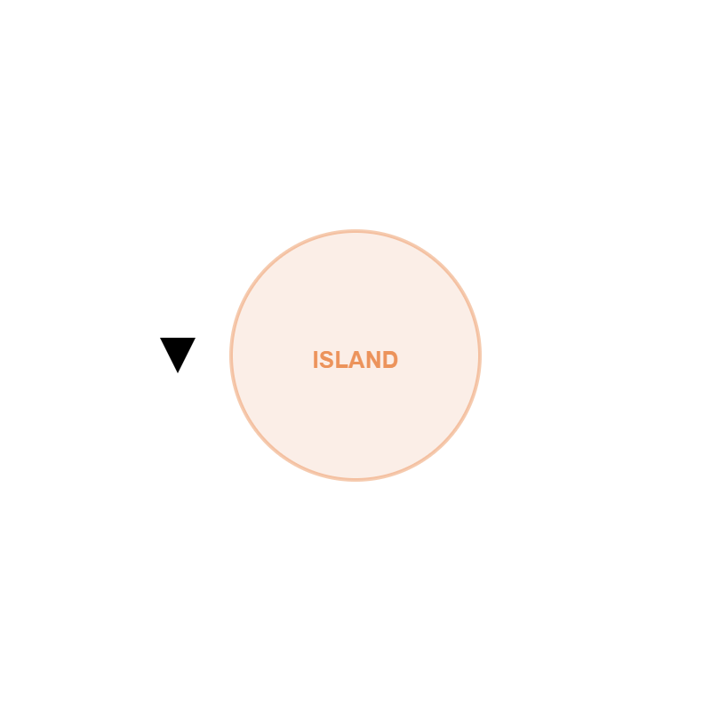
MODEL ARCHITECTURE
Floor Field CA on a 41 × 41 grid
World: 41×41 patch grid, carved into a 4-arm circular ring with inner radius r and lane width w
Island: central obstacle breaks straight-line crossing, forcing circular detours — the core DAI trick
Agents: each pedestrian occupies one cell; moves via Moore neighbourhood (8 directions + stay)
Anti-clockwise bias: injected by penalising clockwise routes in the BFS static field — no explicit rule, just a cost gradient
BFS static fields S0–S3: one per exit, computed from target cells outward; high values = attractive
03 / 10

Slide 4
MODEL MECHANICS
The stochastic transition rule
P_{ij} ∝ (1 − n_{ij}) · exp(K_{s} S_{ij} ) · exp(K_{d} D_{ij} ) · exp(−K_{r} R_{ij})
STATIC FIELD S
BFS from exit patches; penalty trick increases cost of clockwise routes, encoding anti-clockwise bias without an explicit rule
n
volume exclusion — cell occupied → probability = 0
DYNAMIC FIELD D
K_{s}
goal-seeking strength via static BFS field S
Diffusion 0.11, decay 0.15. Competitive: favours patches with own-direction traces, penalises patches with cross-direction traces
K_{d}
stigmergic herding via dynamic traffic-trace field D
K_{r}
social cost of proximity via repulsive field R
REPULSIVE FIELD R
+0.6 on occupied cell, +0.2 on neighbours each tick — a discrete local cost, not a continuous Helbing-style force
04 / 10

Slide 5
EXPERIMENT 1 — 50 RUNS
Fundamental diagram & phase transition
PEDESTRIANS
DENSITY (PED/PATCH)
MEAN EXIT TIME (TICKS)
KEY FINDING
40
0.065
150.2
Exit time grows monotonically with density, revealing a clear phase transition from laminar to congested regime — consistent with Zhang (2012) fundamental diagrams
120
0.195
159.1
200
0.325
175.5
240
0.390
184.3
INTERPRETATION
320
0.520
190.5
At low density: near-free laminar flow. At high density: spatial occupation & repulsion create intermittent, turbulent-like dynamics. The roundabout delays this collapse vs. a direct crossing — but does not eliminate it.
400
0.649
217.8
Normalised over 616 walkable patches. Ks=1.0, Kd=2.0, Kr=1.0, R=10.
05 / 10

Slide 6
EXPERIMENT 2 — 30 RUNS
Spontaneous vorticity & self-organisation
SEGREGATION INDEX Φ BY KD
SURPRISING RESULT
Kd = 0.0
1.00
φ_{max} = 1.0 for ALL Kd values
Order parameter reaches maximum regardless of dynamic field strength — even at Kd = 0 . Stabilisation tick = 0 in every run.
Kd = 0.5
1.00
Kd = 1.0
1.00
Kd = 2.0
1.00
EXPLANATION
Kd = 4.0
1.00
In a linear corridor, Kd is required to build lane formation. In a roundabout, the geometry already imposes the ordered state: island + BFS penalty trick → immediate tangential segregation. Kd refines; it does not found the order.
Kd = 8.0
1.00
n=160 pedestrians · φ stabilisation tick = 0 in all runs
DAI READING (HELBING ET AL. 2005)
The roundabout is a structural catalyst for self-organisation — more radical than emergent lane formation: the symmetry-breaking is built into the architecture, not negotiated by agents.
06 / 10

Slide 7
EXPERIMENT 3 — 20 RUNS
Island radius vs. throughput — the clogging effect
ISLAND RADIUS
TOTAL THROUGHPUT
MEAN EXIT TIME (TICKS)
KEY INSIGHT
R = 5 ✦
1052.6
199.5
A larger island does not monotonically improve performance. Beyond a critical threshold it narrows the ring, lengthens paths, and increases occupancy time — producing a geometric clogging effect.
R = 8
980.8
212.7
R = 10
951.4
220.9
R = 12
888.2
230.4
LITERATURE LINK — YANAGISAWA (2019)
The central obstacle streamlines flow only within a useful geometric window. Our data confirm: smaller R = more efficient in this configuration.
n=240 pedestrians · lane-width=8 · R=15 excluded (invalid geometry)
R = 5
1053
R = 8
981
DESIGN IMPLICATION
R = 10
951
There exists a critical minimum island radius : large enough to eliminate frontal conflict, small enough not to become a dissipative barrier.
R = 12
888
07 / 10

Slide 8
EXPERIMENT 4 — 20 RUNS
Geometry buffers repulsion stress
KR
EFF. SPEED
MEAN EXIT TIME
THROUGHPUT/TICK
NON-MONOTONIC RESULT
0.5
0.082
204.7
0.6
Metrics do not follow a simple trend with Kr — a signature of non-linear interactions between exclusion, geometry, and stochasticity.
1.0
0.086
195.2
0.4
2.0
0.070
181.1
1.0
5.0
0.095
173.7
0.8
ROBUST CONCLUSION
The system does not collapse under high repulsion. The roundabout converts frontal encounters into tangential ones , precisely the configurations where repulsion causes stall in linear geometries.
n=160 pedestrians · Ks=1.0 · Kd=2.0
BURSTEDDE (2001) LINK
Repulsion acts as a discrete local patch cost, not a continuous force. The roundabout reduces the frequency of the high-cost configurations, buffering systemic stress.
08 / 10

Slide 9
EXPERIMENT 5 — SOCIAL PROFILES
Individual optimum ≠ collective optimum
BASELINE
AGGRESSIVE
IMITATOR (HERDING)
CAUTIOUS
Normal agents
Ks↑ · Kr↓
Kd↑↑
Kr↑↑
81.6throughput
79.4throughput
77.2throughput
75.2throughput
Exit time: 400 ticks Speed: 0.627
Exit: 391 ticks — individually faster, but local clogging near exits reduces global throughput. Tragedy of the commons.
Longest exit time: 411 ticks. Blind platooning creates labyrinthine routes. Herding effect.
Lowest throughput. Hesitation paralysis at entries. Yet: highest speed & shortest exit time once moving.
DAI insight: the passive coordination embedded in the roundabout geometry is robust to moderate behavioural heterogeneity — but each extreme type erodes collective efficiency through a distinct mechanism (clogging / platooning / paralysis).
09 / 10

Slide 10
CONCLUSIONS & FUTURE WORK
The roundabout as a spatial computation device
Circular geometry converts conflicting crossing flows into compatible tangential flows — without explicit agent communication
KEY LIMITATION
Discrete CA: space, time, speed are quantised. Less faithful than continuous models for fine accelerations, perceptual anisotropy, and empirical calibration.
Self-organisation (φ=1) is geometry-driven , not stigmergy-driven: the environment is the algorithm
FUTURE WORK
An optimal island radius exists: anti-conflict benefit exceeds geometric cost only below a threshold
Critical Mix experiment: heterogeneous populations (e.g. 25% Aggressive + 75% Normal) to find the threshold where non-cooperative agents break the laminar dissipation capacity of the passive DAI. Systematic comparison: CA roundabout vs. standard crossing vs. continuous Helbing-model with same geometry.
Geometry buffers repulsion stress : high Kr does not collapse the system because frontal encounters are structurally rare
Behavioural heterogeneity degrades performance through three distinct mechanisms (clogging / platooning / paralysis)
10 / 10

