Slide 1
Life after the introduction Demo
David Gallivan
@CodingWithDavid
Notes:
Welcome everyone
Thanks for taking time out of your Saturday
Introduction
Who - Me
Why
Could be mowing the yard, told wife to edge
Note since it is a code camp, there is a lot of code
Who has heard of Blazor
Who have built the sample template app
This session is dealing with more advance topics of working with Blazor

Slide 2

Notes:
We all have seen the great demo of a new technology. We see how cool it is, how “easy” it is to use it.
Like a really cool Virtual reality tech

Slide 3
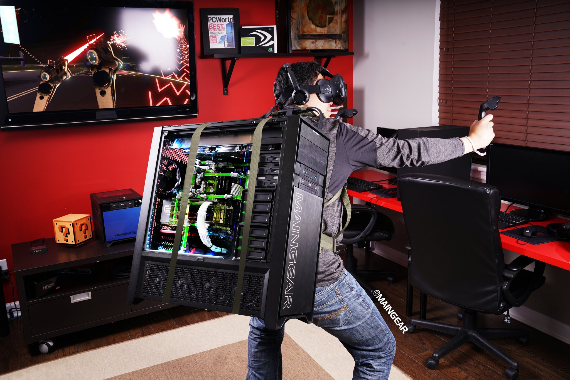
Notes:
And then there is reality!
Maybe the tech is not fully backed, tools are not ready, you have to jump through hoops to get even the demo app to run.

Slide 4

Notes:
A Strong Community
Blazor is an open-source framework and is a part of the .NET development platform that has a strong community of over 60,000 contributors from more than 3,700 companies. And counting…
The community has self-organized itself into a great group of people helping each other and promoting it through their experiments. Adrien Torris has done a magnificent job of collating resources in an aptly named Awesome Blazor collection.

Slide 5
Features to Review
> File Upload
Displaying an Image
Providing User Feedback
Spinner
Toast Message
Modal Dialogs
Authentication
CSS Frameworks
Notes:
So today we are going to take an honest look at Blazor by doing some “normal” functionality that most applications do. And we will see how Blazor can handle it

Slide 6
File Upload
Upload and store file on the server
Read or import data from them
Present in an Editor
No Separate API Endpoint
Provides access to the file data via regular .Net Stream
Works independently of SignalR Message size limits
Near native HTTP transfer speeds
Notes:
Couple of use cases
Goals

Slide 7
File Upload Demo

Slide 8
Display Image Demo
Notes:
We are doing to display a list of images on the server and then select which one to display

Slide 10
DOWNLOAD & LEARN MORE
Put URLs here
CODE & SLIDES FROM THIS TALK
Put Github Link Here
Details go here if any
David Gallivan
@CodingWithDavid

