Slide 2
Hostel Reservation Application
March 5, 2024

Slide 3
Agenda
DevOps
Git/Github
Docker
Jenkins
Kubernetes
Ansible

Slide 4
Objective
In this application, we need to collect the details from the user such as student name, father name, merit score, branch, year, category and merit score and based on the merit score management will allocate a seat for a student. Convert the microservices application into docker image and deploy in kubernetes.

Slide 5
DevOps
DevOps is a methodology in the software development and IT industry. Used as a set of practices and tools, DevOps integrates and automates the work of software development and IT operations as a means for improving and shortening the software development life cycle.

Slide 6
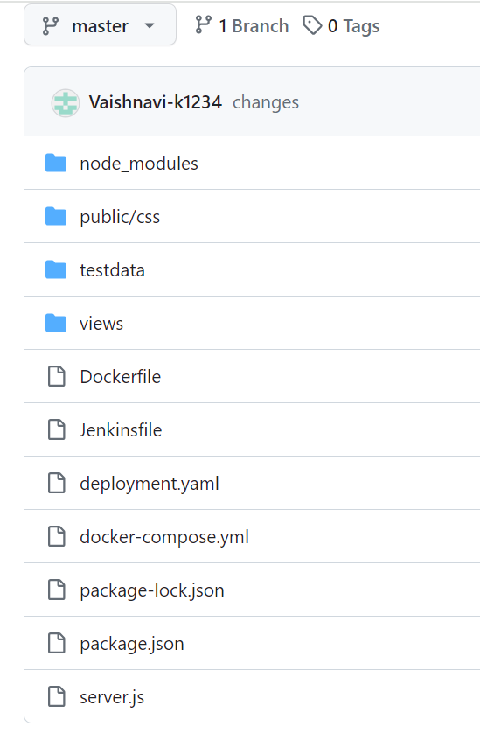
Git/ Github:
Files pushed into “hostel_reservation” repository of GitHub

Slide 7
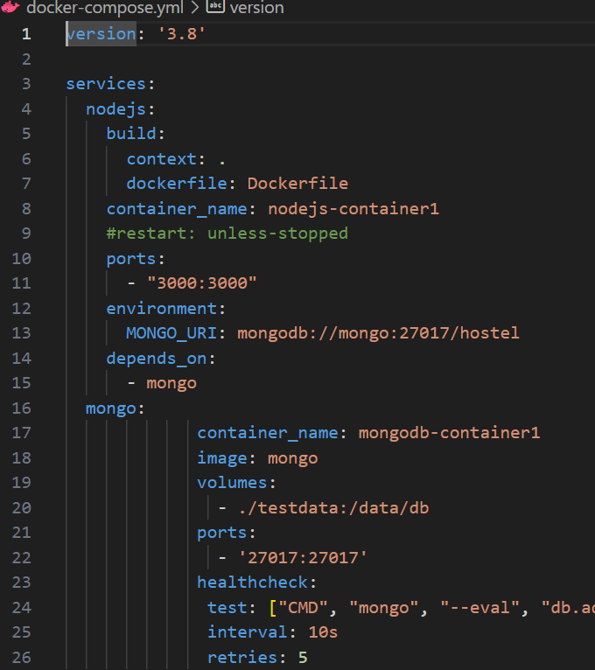
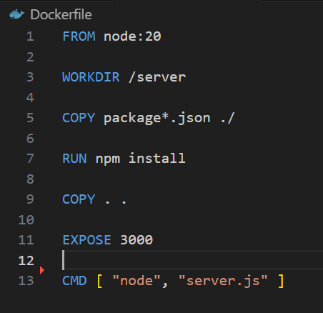
Docker

Slide 8
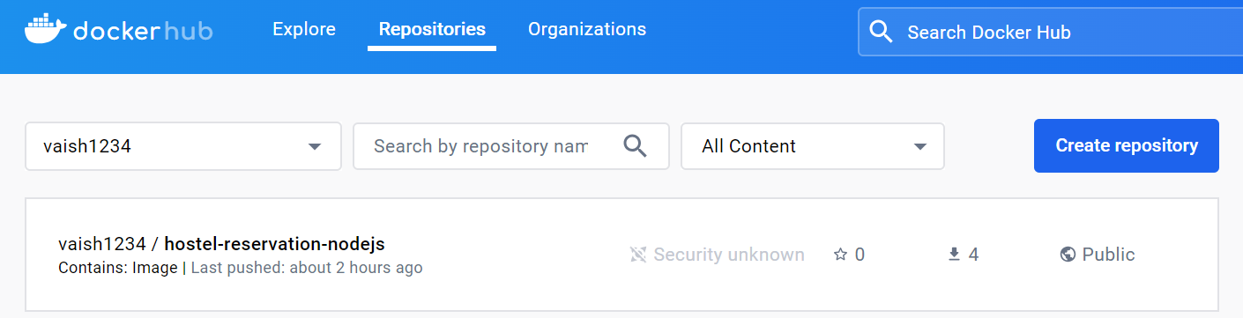
docker compose build docker compose up

Slide 9
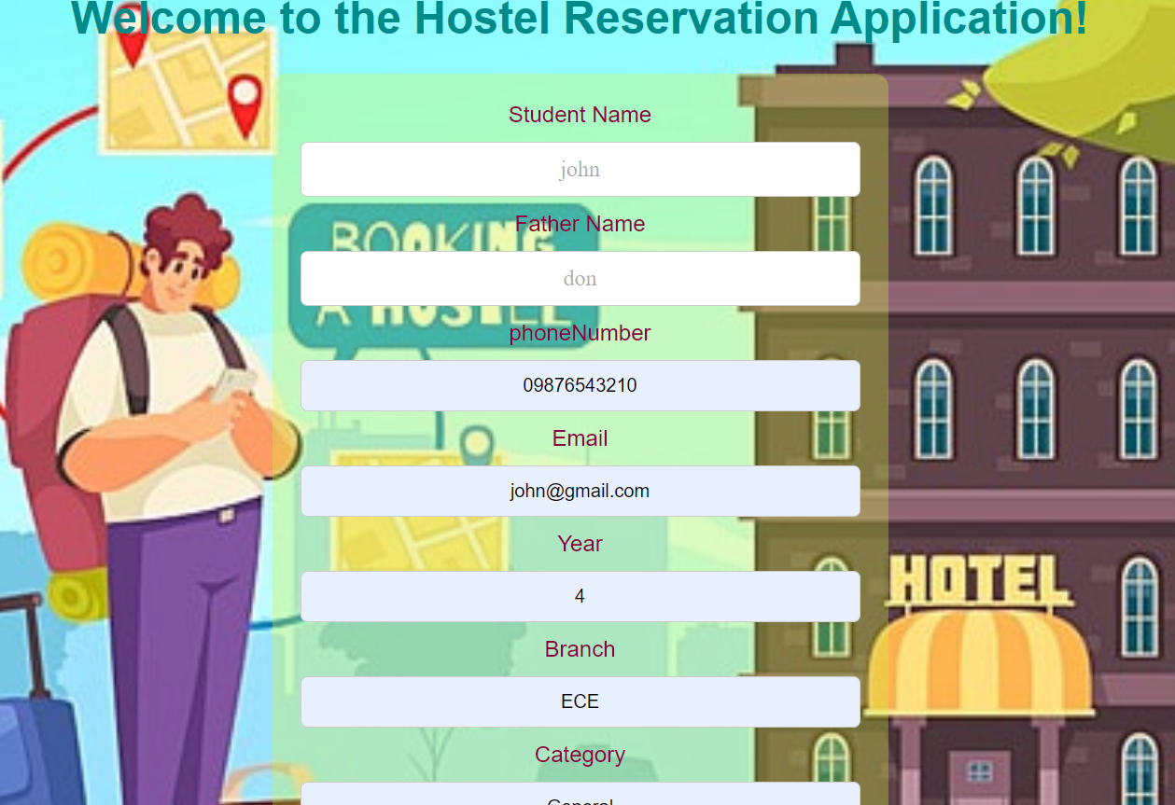
Server running on localhost: 3000

Slide 10
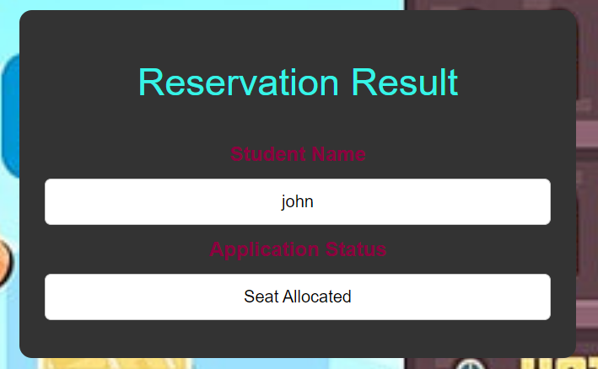
Result page

Slide 11
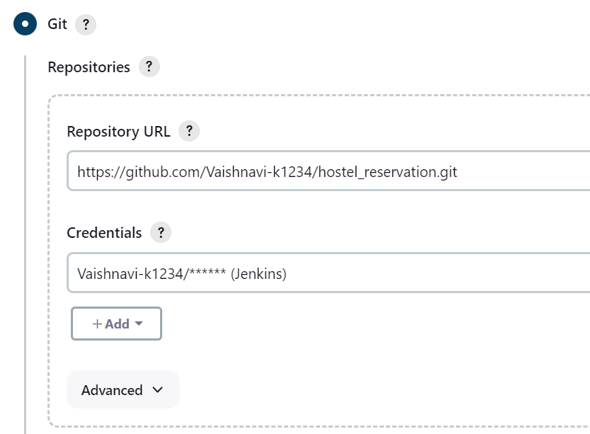
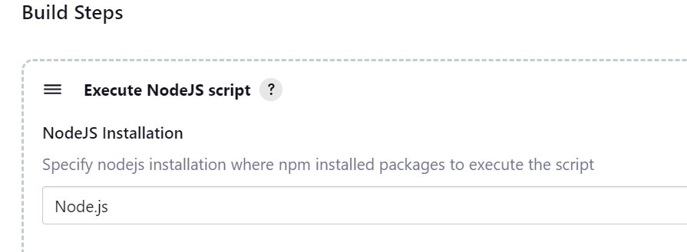
Jenkins
configurations for the created pipeline

Slide 12
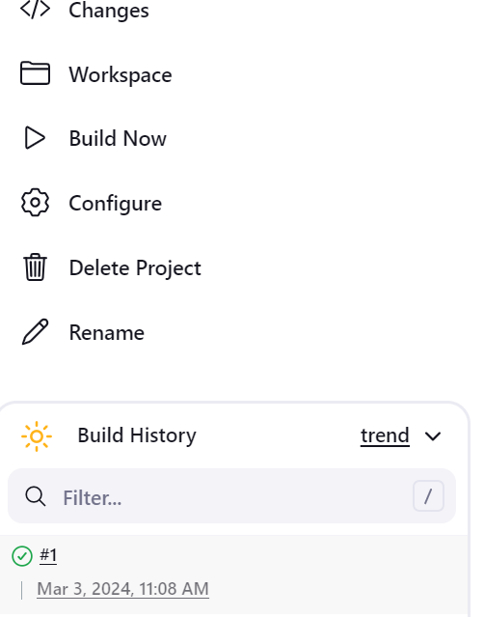
We can Build the project by clicking on ‘Build Now’ after adding all the configurations

Slide 13
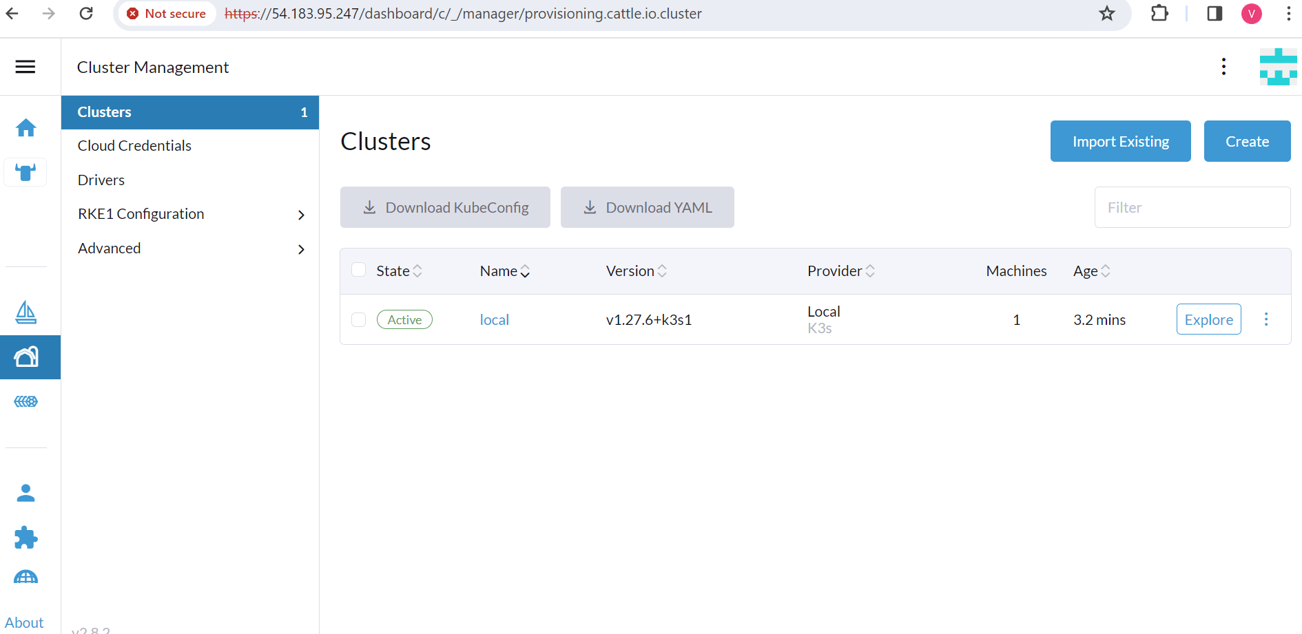
Kubernetes

Slide 14
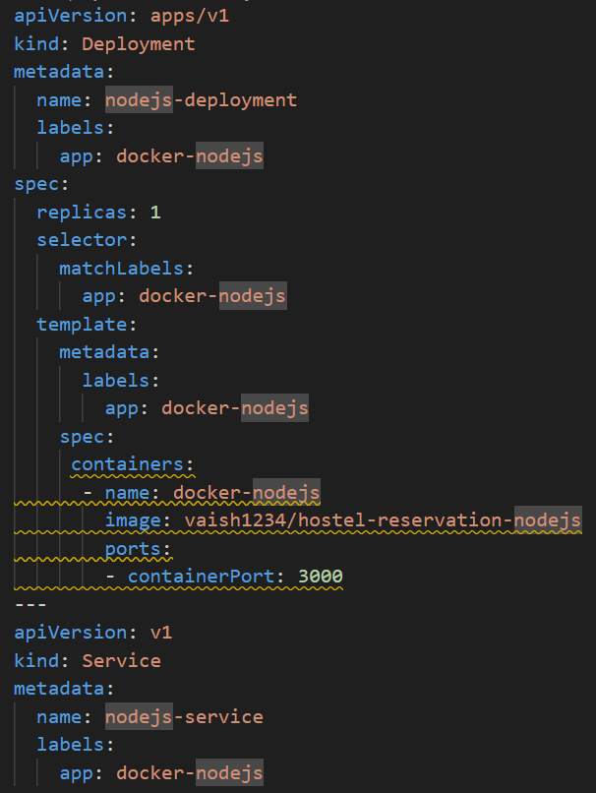
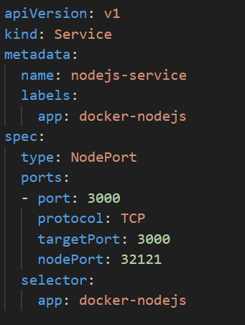
Deployment.yaml file

Slide 15
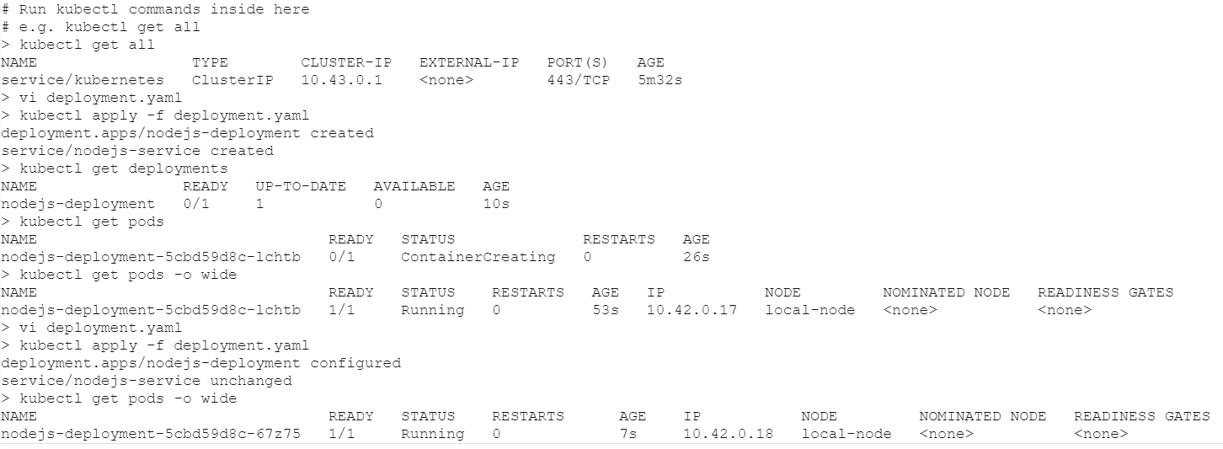
Deploying file

Slide 16
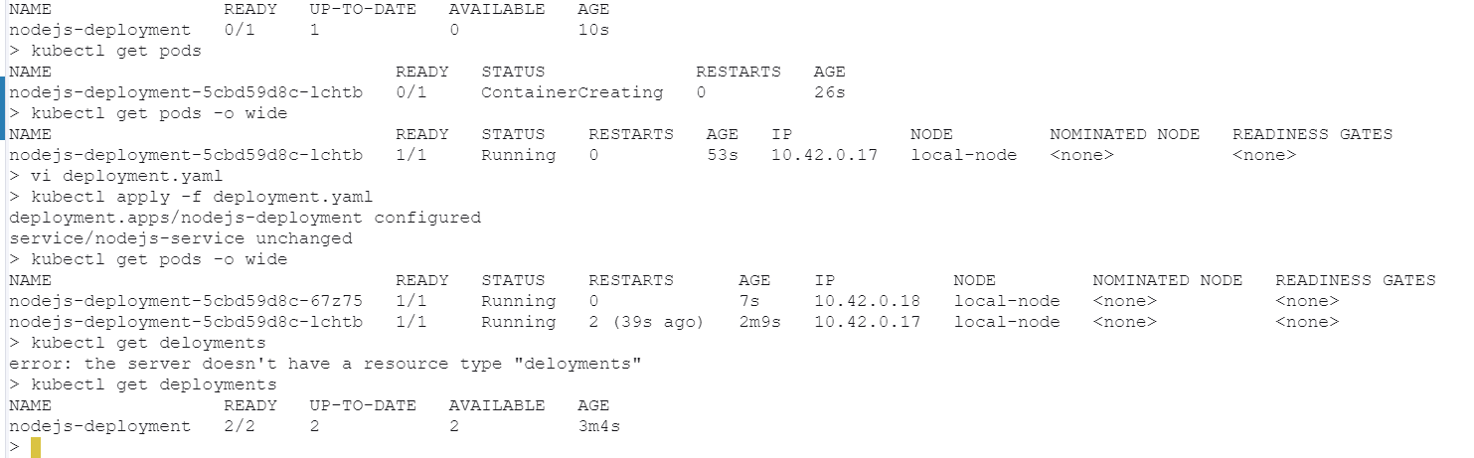
Modified deployment.yaml file by adding 2 replicas

Slide 17
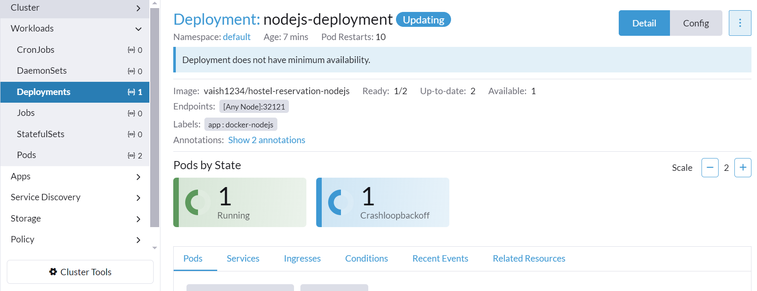
Deployment status

Slide 18
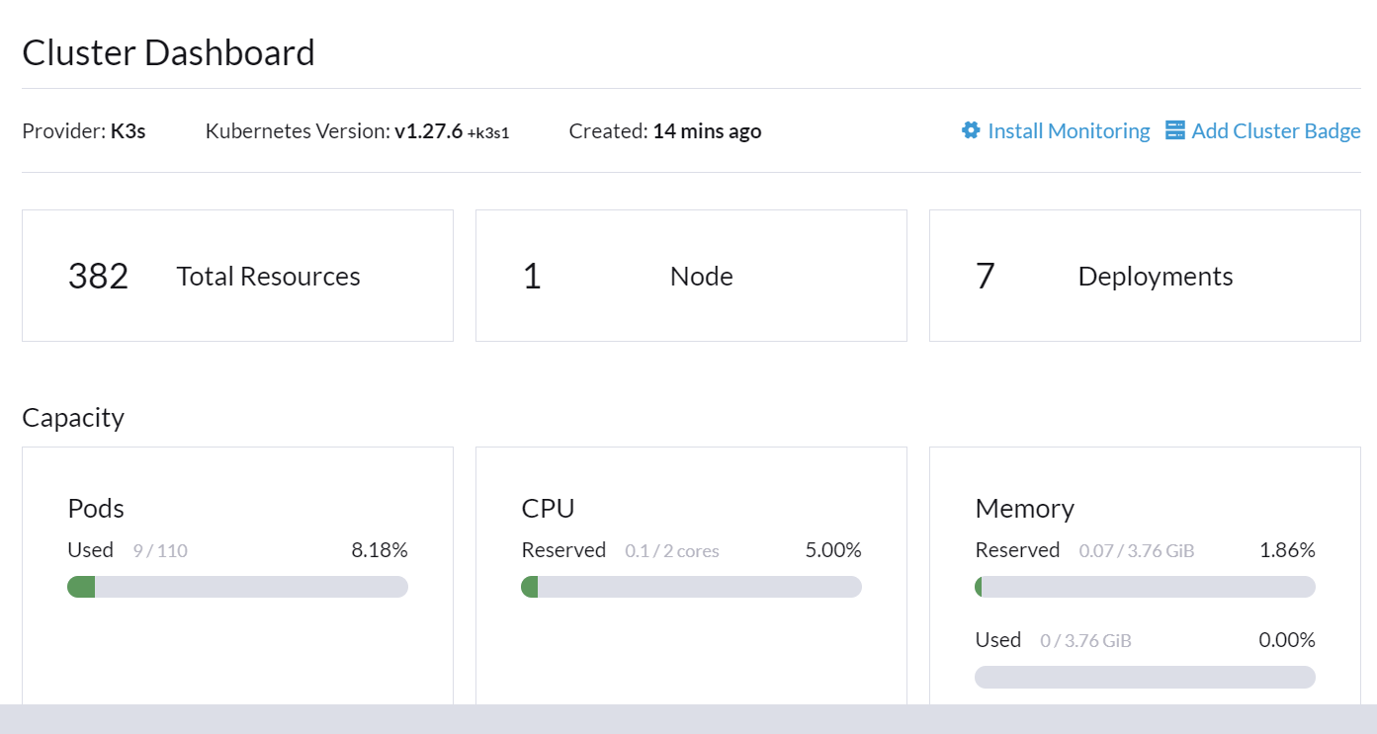

Slide 19
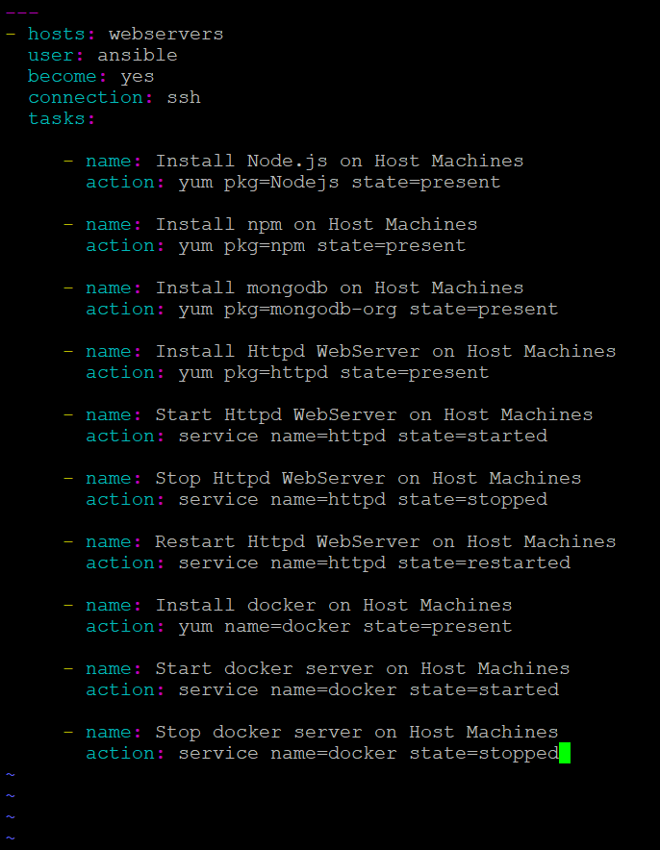
Ansible
It is a method through which we automate admin tasks. Configuration management tool turns your code into infrastructure.

