Slide 1

Accessibility and Usability
David García Díaz
Adrián Cerpa Suárez

Slide 2


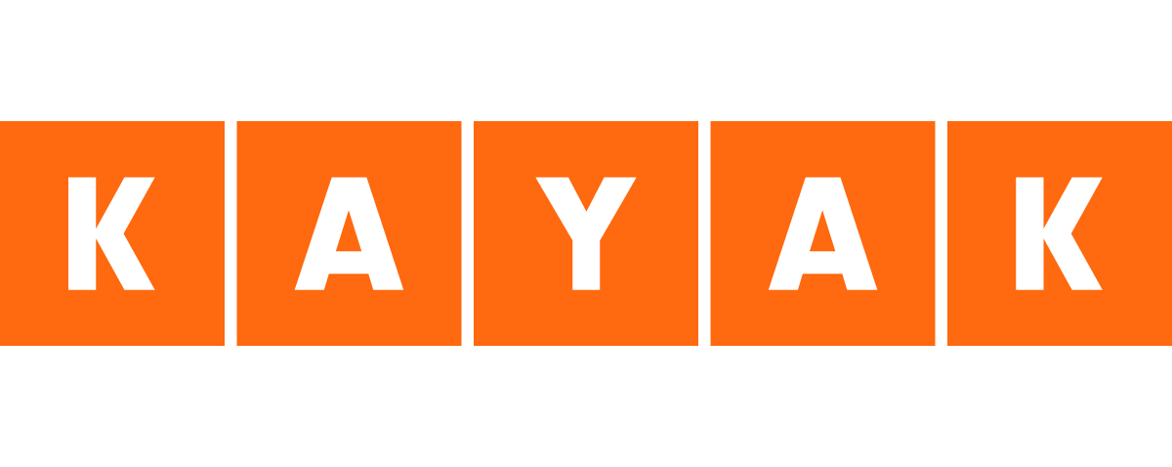
vs

Slide 3
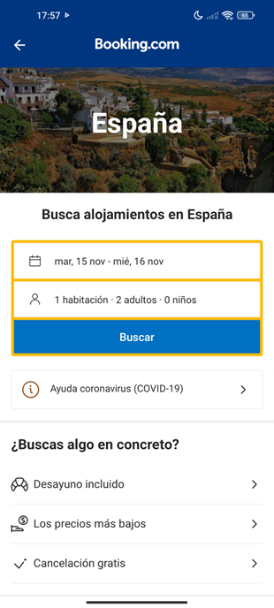
1. Strive for consistency
In the case of the Booking, we see that it is well distributed in the type of letter as well as the colors used on the website, this helps the overall website to be consistent and compact, which makes it easier for the user.
We can also see this in Kayak´s website as well, they use the same font, the menus follow a certain pattern, each one of them, etc. So, we can say that both pages strive for consistency.

Slide 4
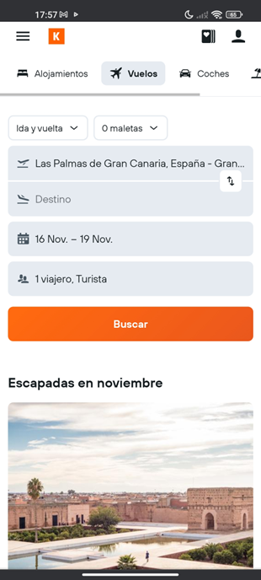
2. Seek universal usability
Both web pages are very similar, I would say that both have almost the same functionalities but Booking stands out a bit more than Kayak because of how well designed is its user interface. Booking is more understandable and clearer than when searching for information than Kayak. This doesn't mean that Kayak is not intuitive, but I think that for people who don't know how to book a reservation on their own, Booking would be a more “universally” useful option.
Also, it's worth mentioning that none of the websites have shortcuts, at least they leave some buttons which take you straight up to the different topics of the web, for example, hotels, flights, renting, etc.

Slide 5
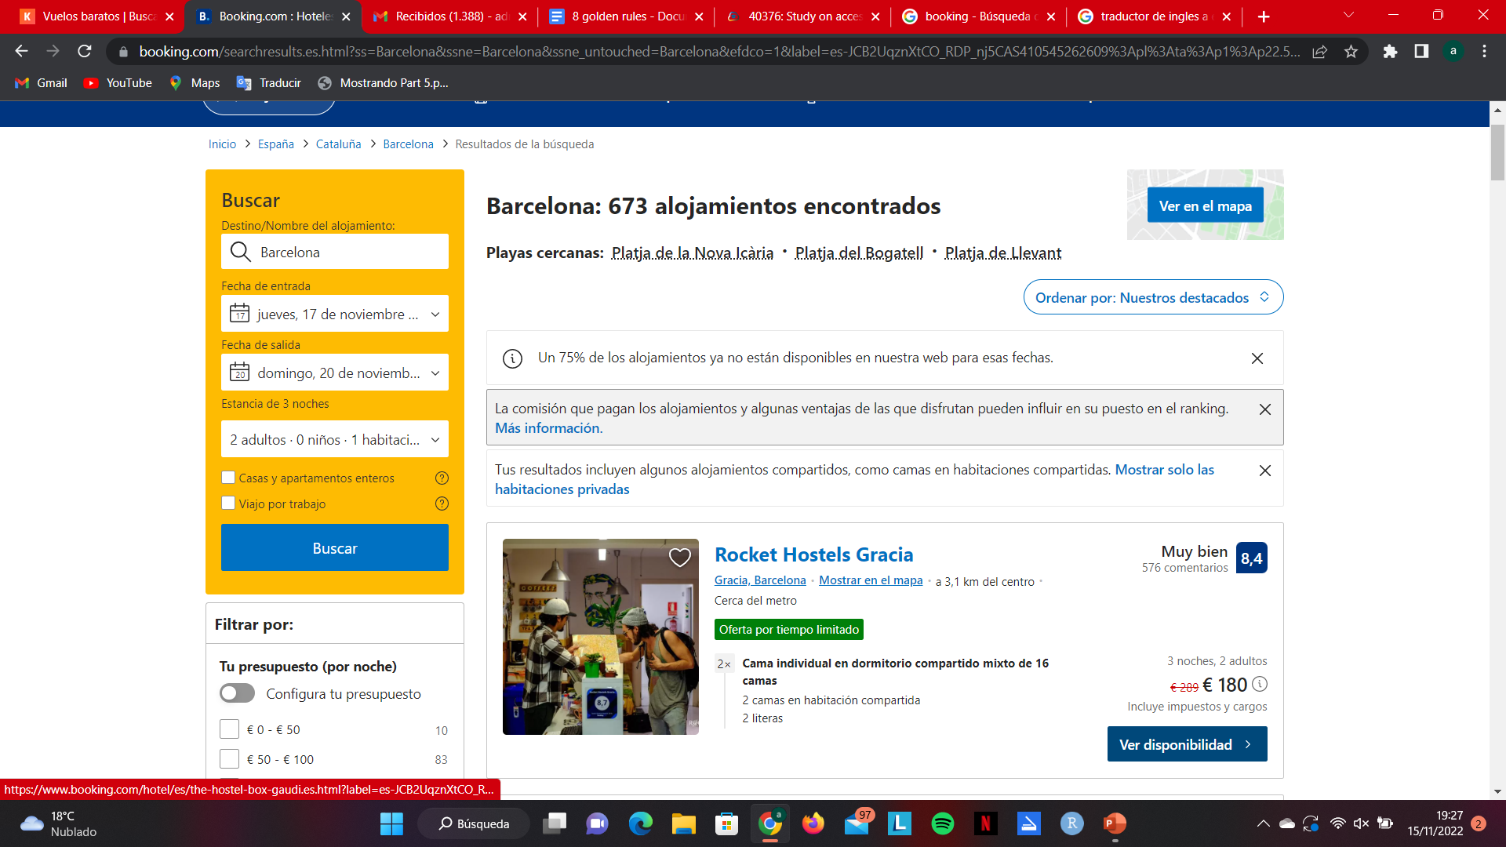
3. Offer informative feedback
Both websites seem to give good feedback, we see this when we are making a reservation and on the top of the website it appears the phases you have been following until the point you are in now, so this is helpful for the users seeing what steps they have taken.
Another example could be that while we are moving our mouse on the buttons, they change their colors meaning that they are interactive, and we are able to use them.

Slide 6
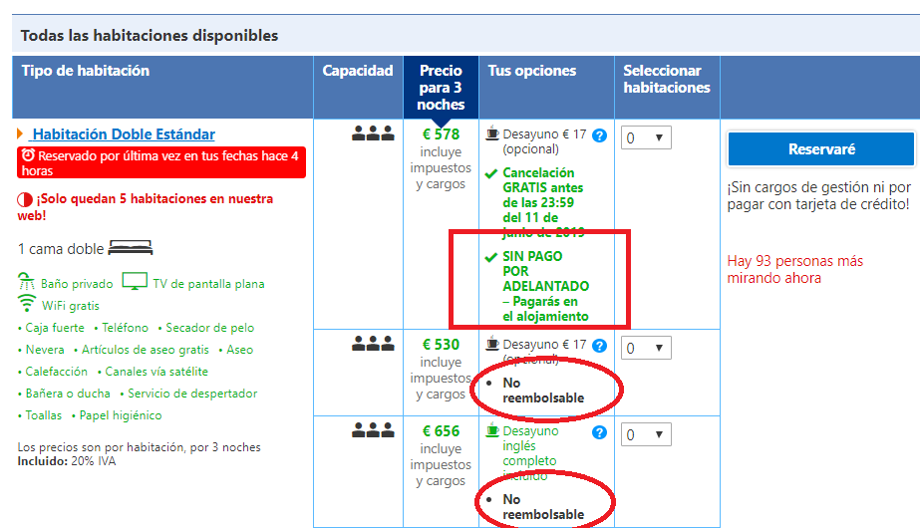
4. Design dialogs to yield closure
Comparing these two websites, I can conclude that both have fulfilled this golden rule by far.
When making a reservation or a comment or even signing up, we would always receive a message of the process status and also when the task is completed. Which is really important so that users know that they're following the steps in the right way.

Slide 7
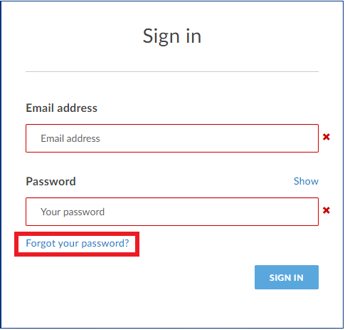
5. Prevent errors
As in the golden rule before the websites are so well designed that in case some user makes an error, maybe introducing or selecting data, automatically the website shows a text message which tells the user what they have done wrong and allow them to fix it.
This can be seen when the user tries to log in with an incorrect user or password, which is a common mistake, but more specifically related to booking hotels and flights, they don´t let the user make the awful mistake of selecting a check-in date which has already passed or maybe a flight already taken off .

Slide 8
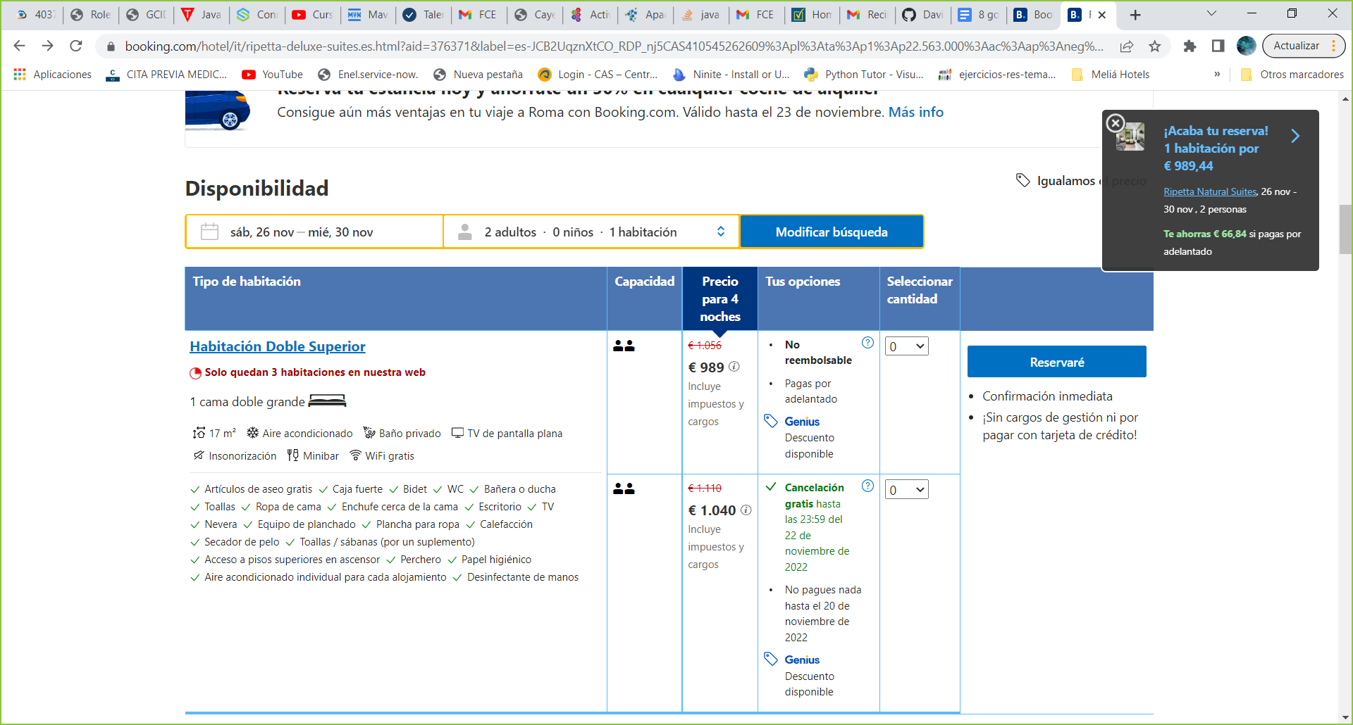
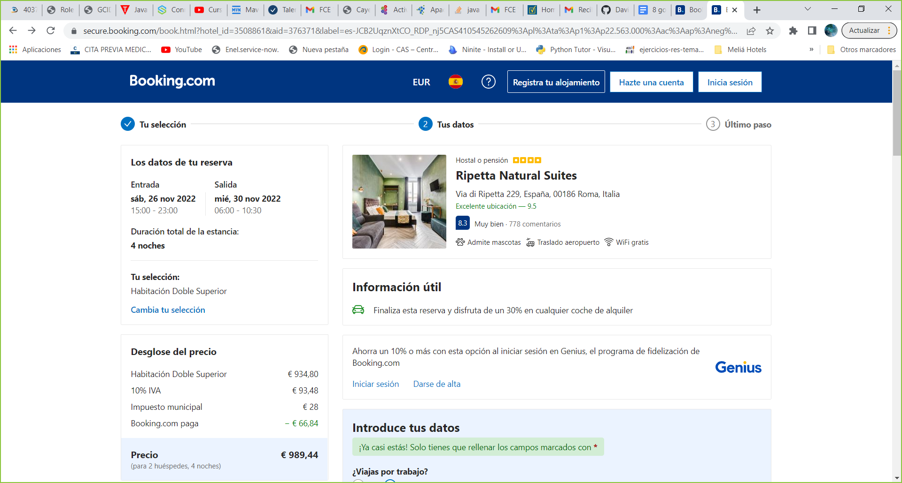
6. Permit easy reversal of actions.
Users usually make mistakes by selecting different dates for their trips and holidays, choosing the incorrect hotel room or buying more flight seats than needed. This is why the websites should always let users take step backs to make sure if they have done something wrong in the process to easily get back with no problem as nothing has happened.
As well as in the other two golden rules before this one is also well implemented in these websites.

Slide 9
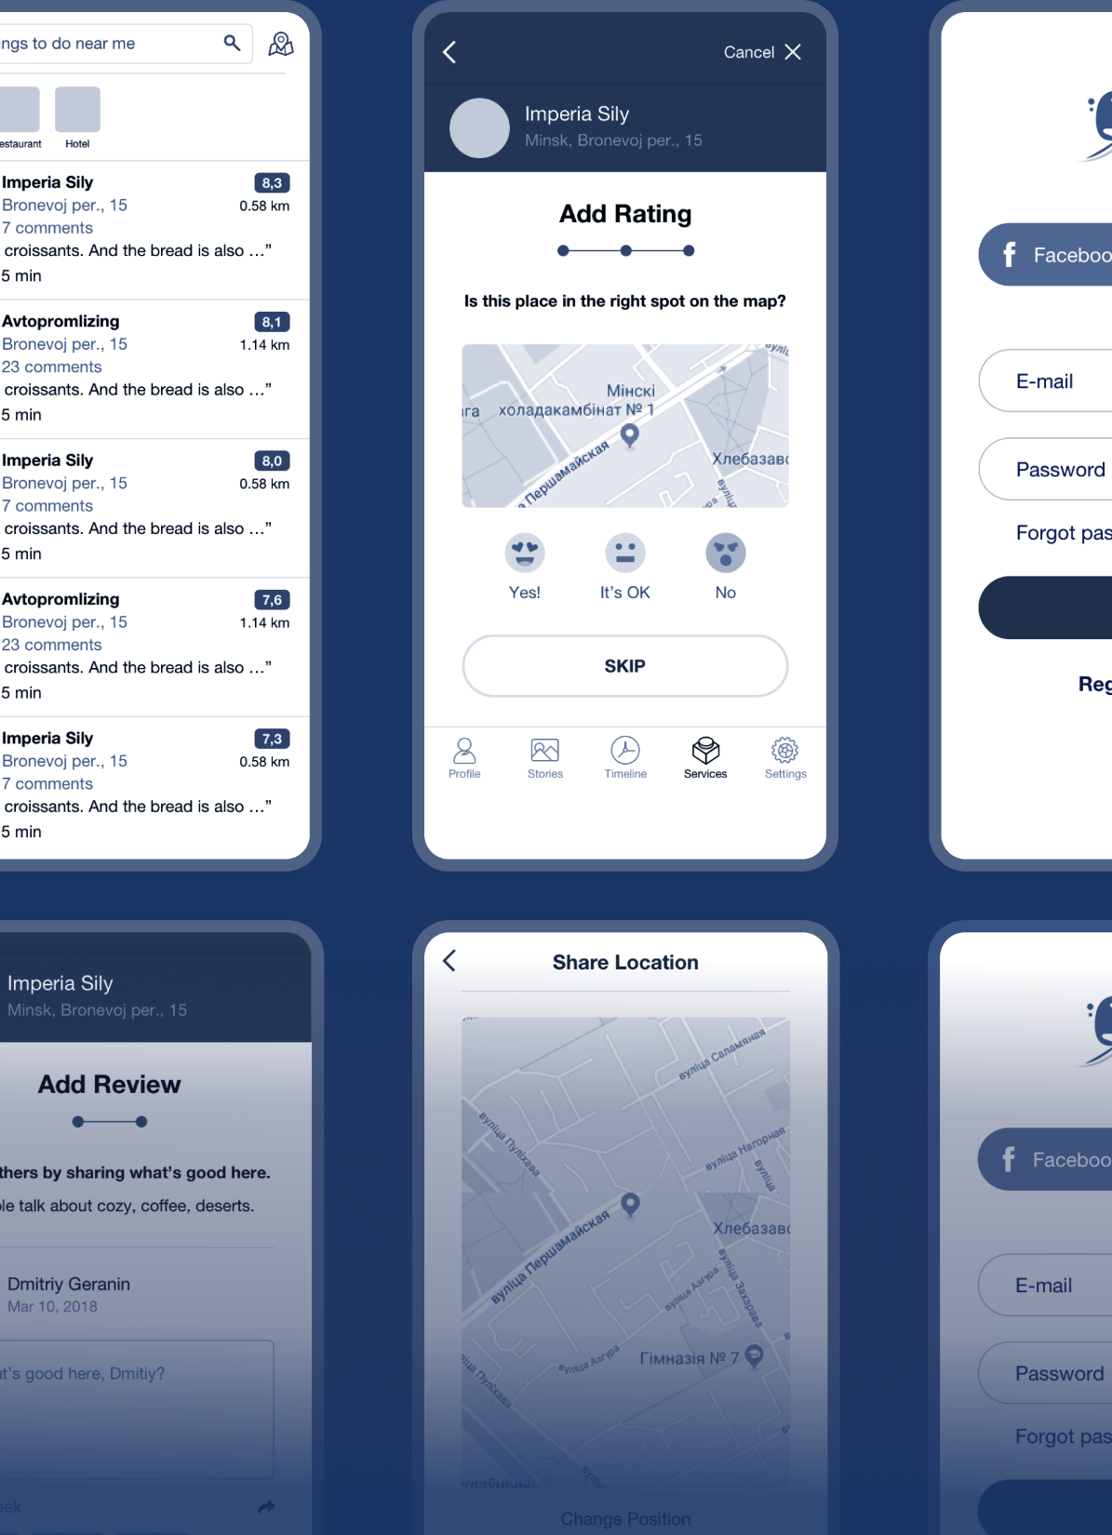
7. Keep users in control
It is known that websites are constantly changing and must be updated to keep up with technology, but for users changing their interface and the way to act in the website to which they are used to it's such a pity.
That's why the web page should try to maintain the same structure in terms of doing an action instead of inventing a new format, in this case for example to make a reservation, should be guided selecting the options available and introducing the necessary data for it, but nothing else. In that way users will have the sense of having fully control of the interface knowing always the next step to the action.

Slide 10
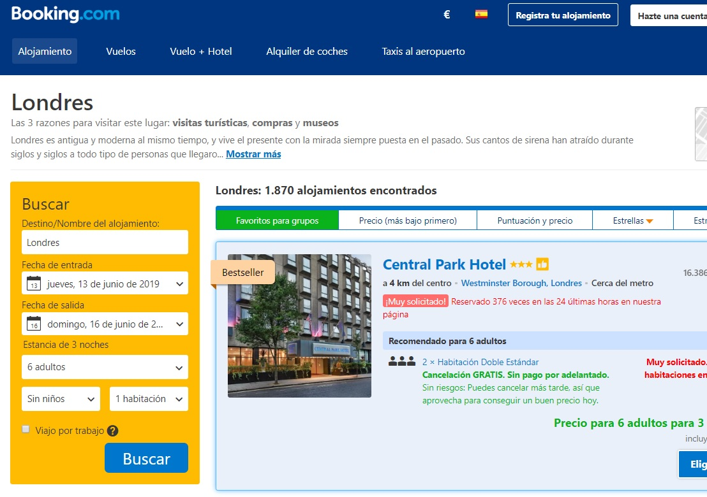
8. Reduce short-term memory load
In the case of Booking and Kayak this is not truly relatable because all the data that you introduce on the website is saved and used by the own website for next actions. So, the user does not actually need to remember any information from past displays to make the action, for example if you book a hotel in Booking you don't have to use the hotel name or the arrival time in the next steps to keep doing the reservation, you just select them in the available schedule established. Then if we look at it like that, we could agree that both websites follow the golden rule.

Slide 11

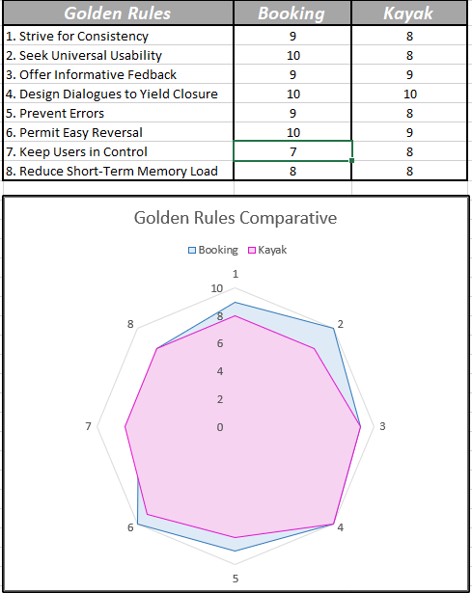



Kiviat Diagram

