Slide 1
XAML/C# to HTML/JS
Taking your skills with you
David Hanson & Andrew Clancy

Slide 2

What we like about XAML & C#

Slide 3
Why we can’t ignore HTML5 & JS
JavaScript becoming the ‘assembly language for the web’
Broad reach – mono goes some way, HTML/JS guaranteed to be ubiquitous (eg. chrome os/firefox os, Linux, IOS, WP8, Windows)
HTML5 now has feature parity with RIA based plugins. (isolated storage, web sockets, full screen mode, web workers, web RTC, 3D graphics.
Most major vendors are now focused on innovation in the HTML / JS space.
The HTML/JS community has matured and is now innovating daily.
New languages evolving to help take away the frustrations of JS
TDD, profiling & continuous deployment tools mature
Performance increasing dramatically.

Slide 4
What we’ll be doing today
Going to build a Single Page Application with multiple screens.
Cover a number of open source libraries and frameworks available in the community.
Use typescript throughout and cover some of its cool features
Implement high performance streaming data and visualisations
Crossing our fingers…..

Slide 5
Tooling
Visual studio 2012
Typescript for visual studio extension
Web essentials extension
Resharper
AngularJS resharper plugin

Slide 6

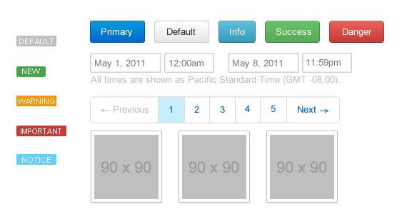

bootstrap?

Slide 7




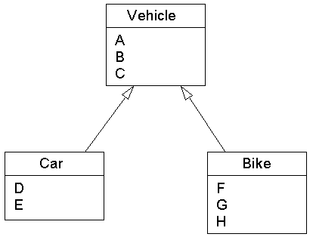


TypeScript?

Slide 8



Slide 9
Demo time!
Lets try and build something!

Slide 10
Question time!
Q&A

