Slide 1
Computer Vision – Project
Box, Axe, Briefcases
By Robert, Pulkit, David

Slide 2
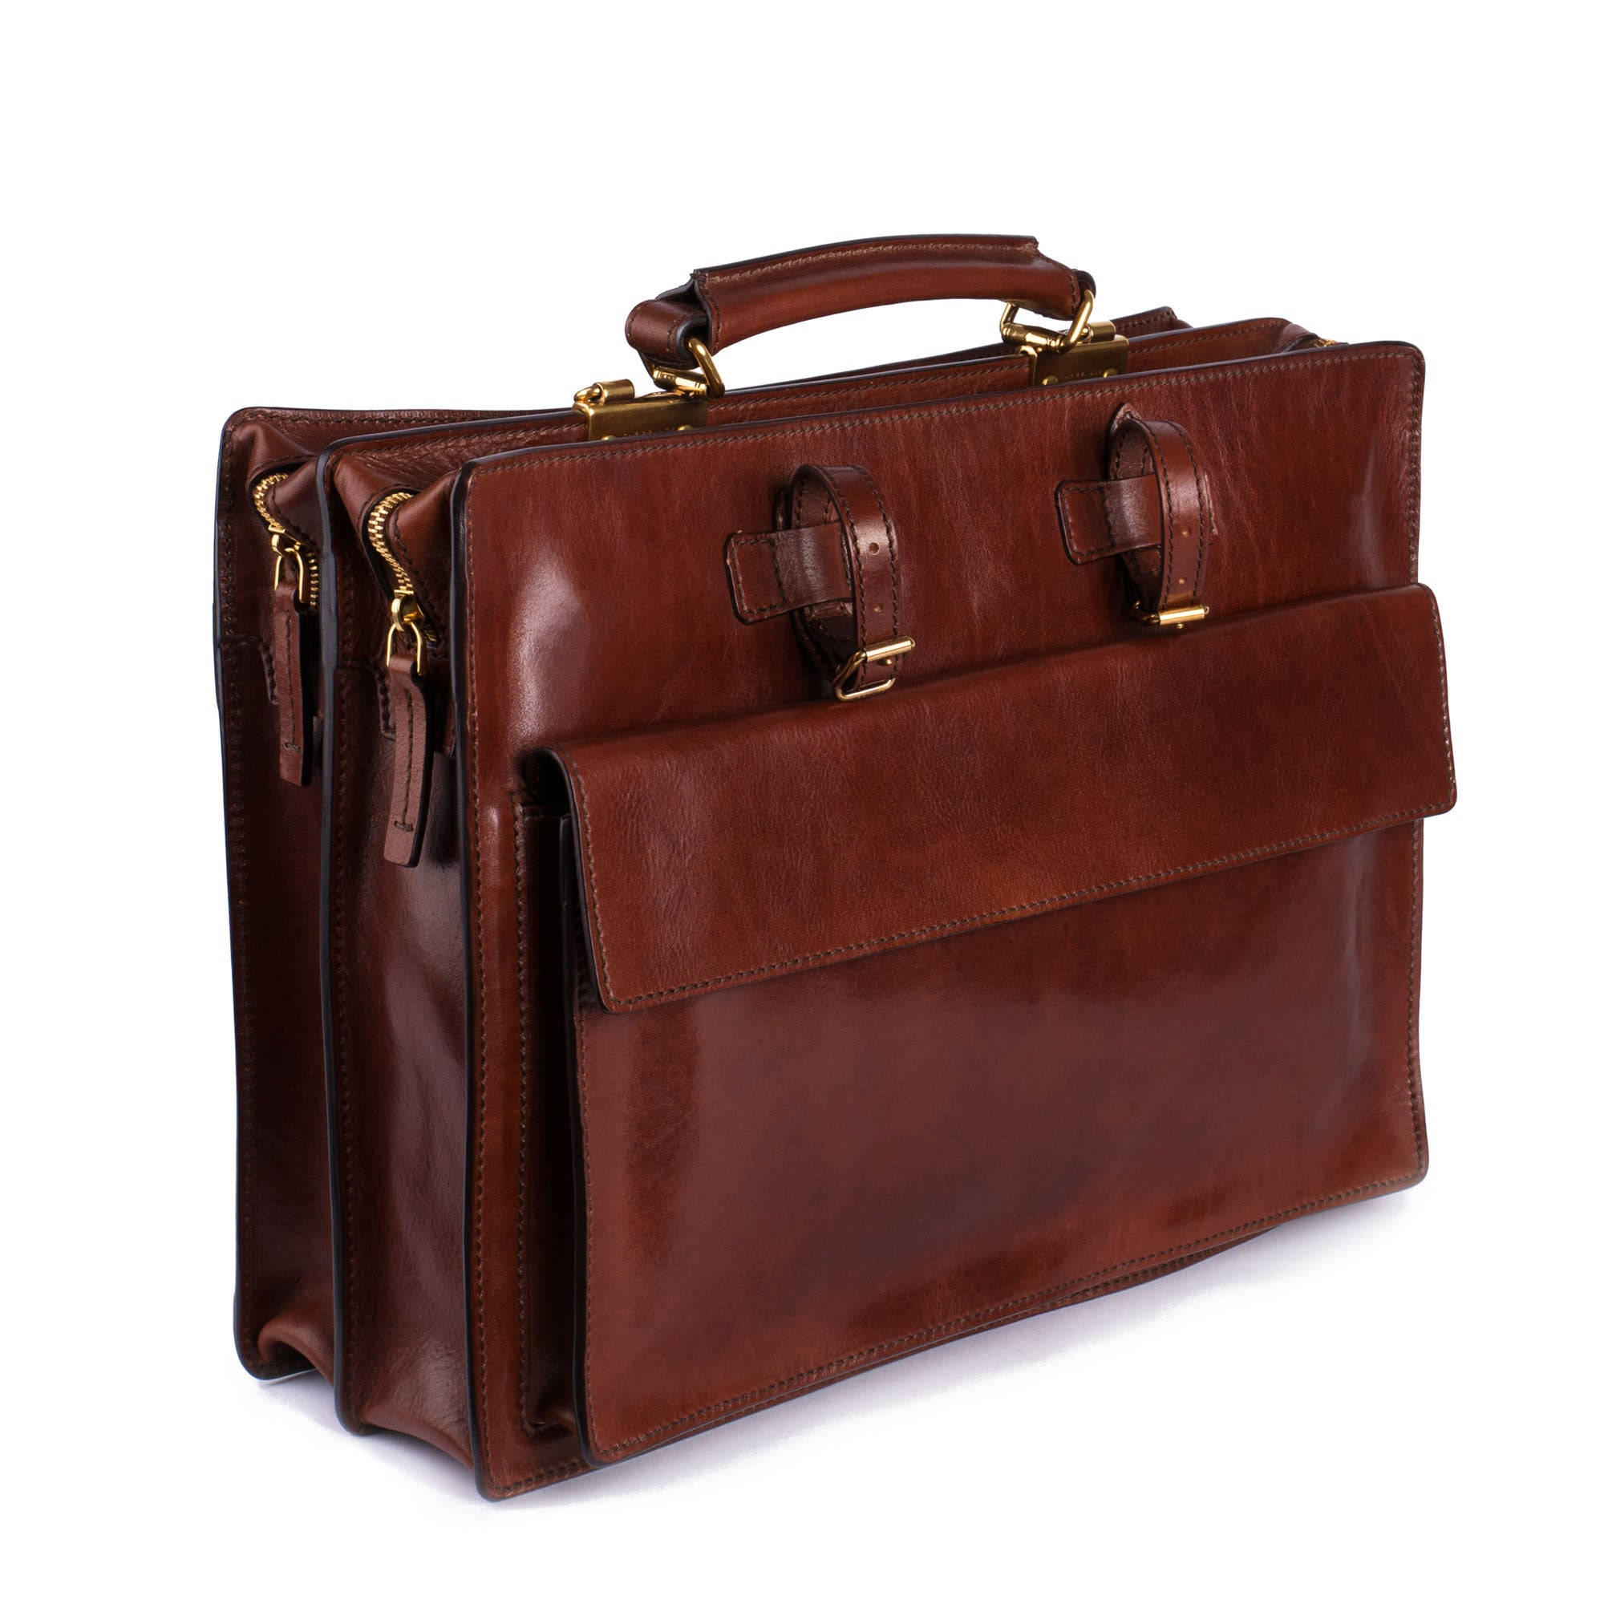
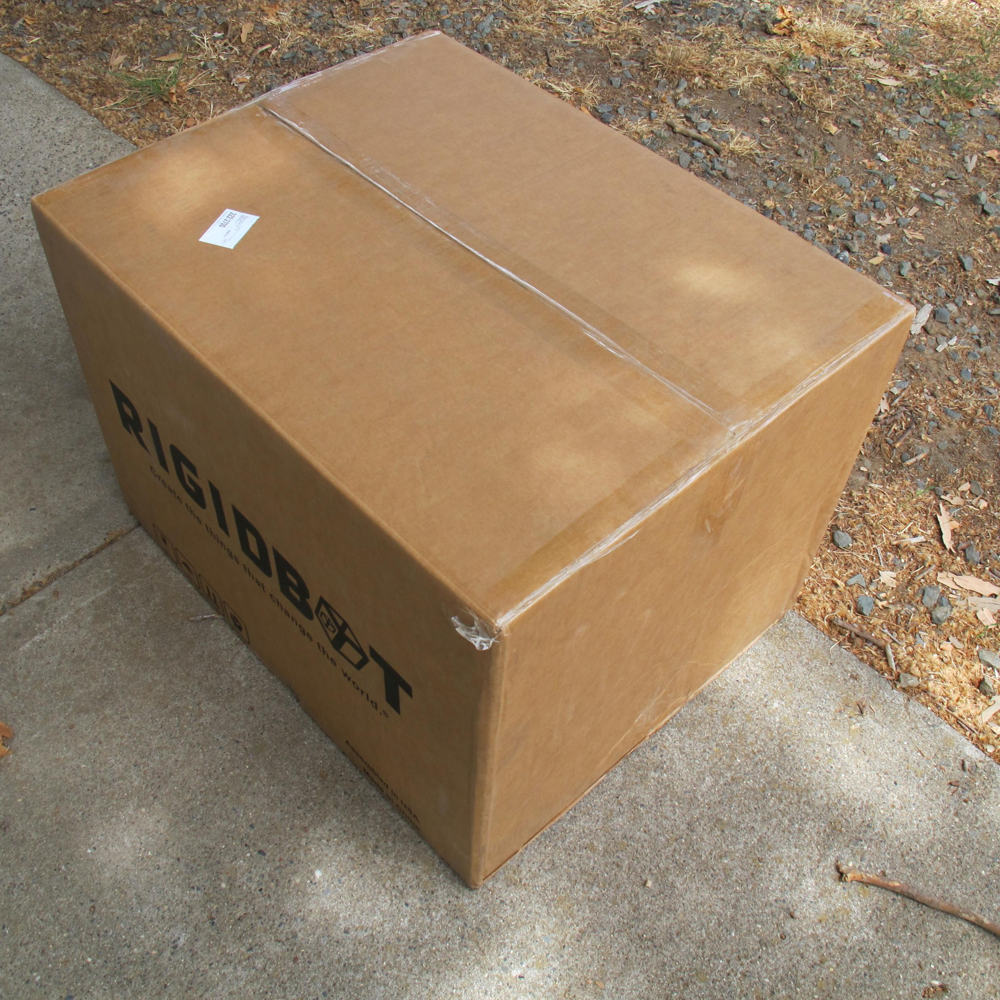
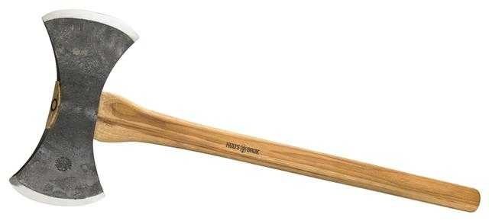
Our challenge

Slide 3

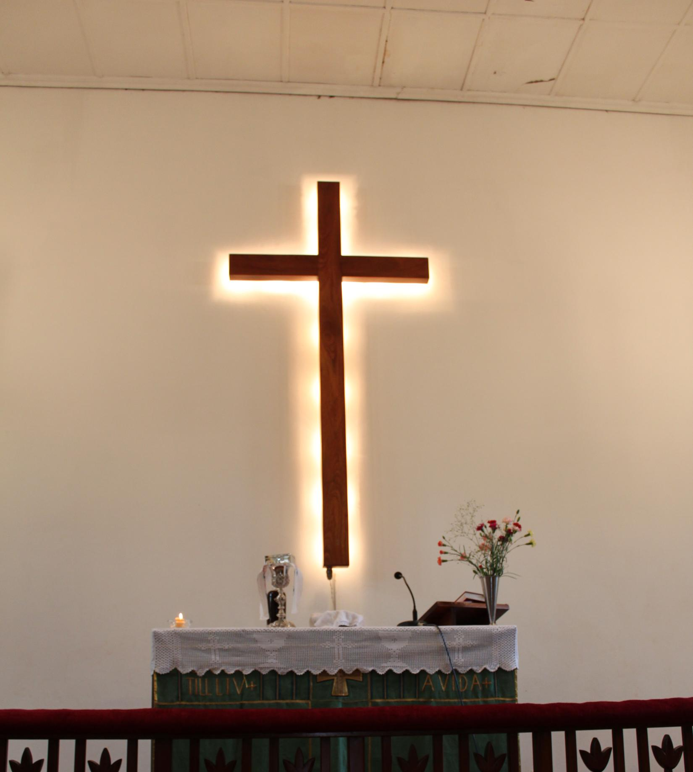
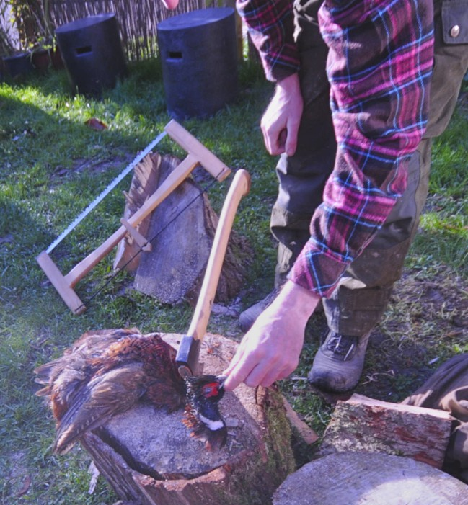
Why was it hard?
Very few images. We needed to program a web crawler
Very much noise in the images we retrieved
Pretrained does not contain class axe

Slide 4
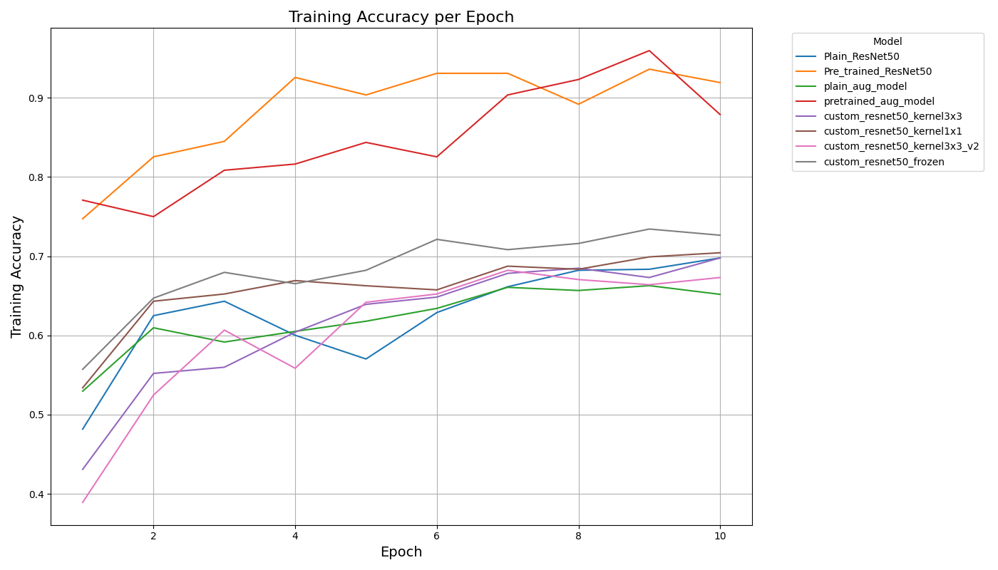
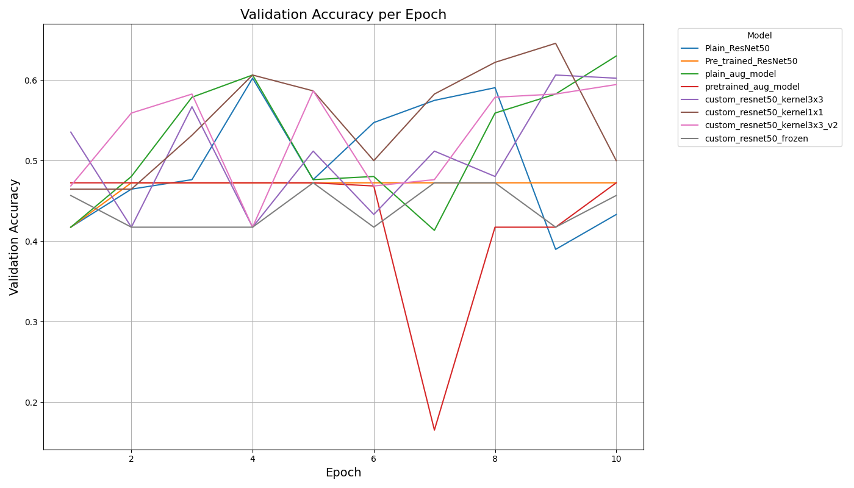
Trends

Slide 5
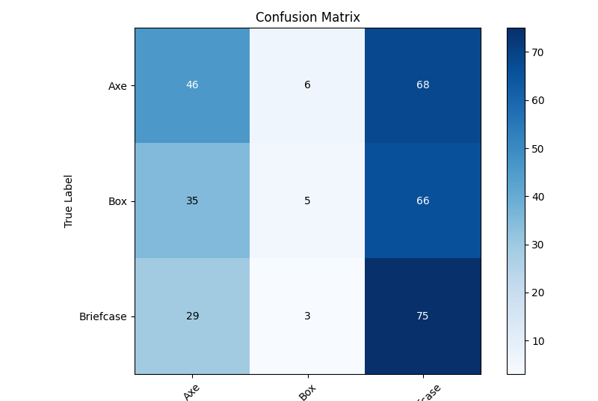
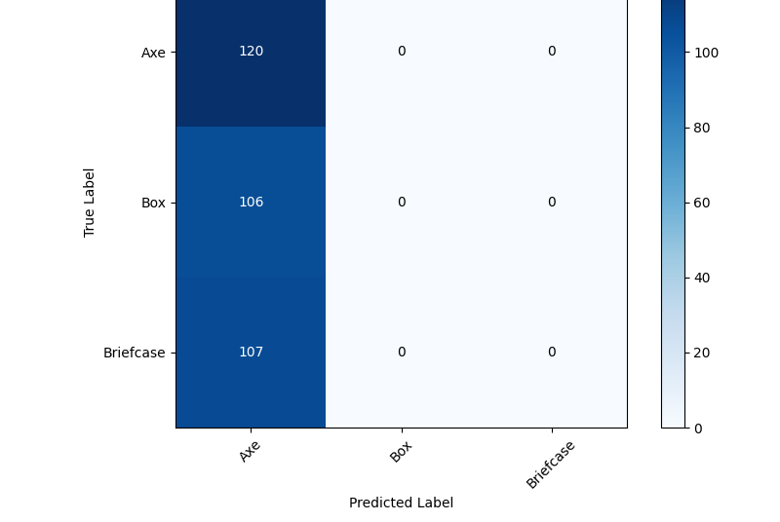
Confusion matrix
Epoch: 10
Learning rate: 0.001
plain
pretrained

Slide 6
What did we try to improve
Add augmented data
Played around with batch size
Played around with epochs
Played around with learning rate
Cleaned images from noise

Slide 7
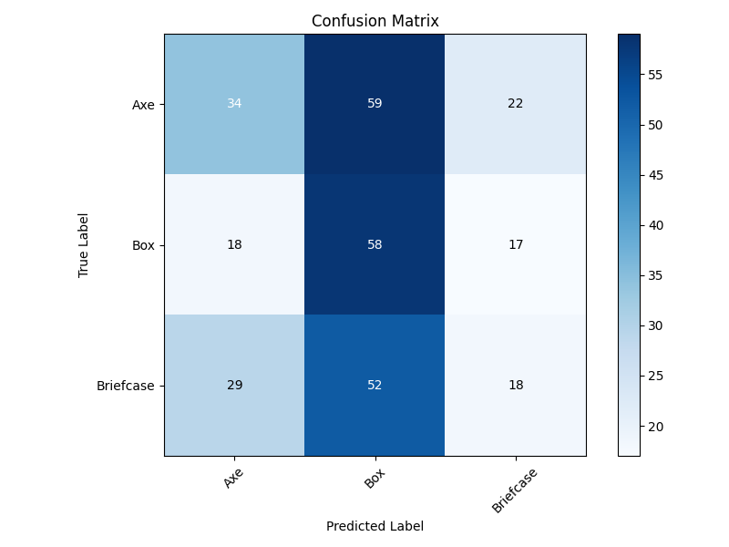
Improved and final result
accuracy: 0.4227 - val_accuracy: 0.3746
accuracy: 0.5216 - val_accuracy: 0.3746
accuracy: 0.5761 - val_accuracy: 0.3290
accuracy: 0.5739 - val_accuracy: 0.4267
accuracy: 0.5773 - val_accuracy: 0.3844
accuracy: 0.6136 - val_accuracy: 0.4984
accuracy: 0.6182 - val_accuracy: 0.4886
accuracy: 0.6477 - val_accuracy: 0.4984
accuracy: 0.6398 - val_accuracy: 0.4593
accuracy: 0.6705 - val_accuracy: 0.5668
accuracy: 0.6477 - val_accuracy: 0.4625
accuracy: 0.6648 - val_accuracy: 0.6287
accuracy: 0.6818 - val_accuracy: 0.5831
accuracy: 0.6920 - val_accuracy: 0.5863
accuracy: 0.6739 - val_accuracy: 0.5668
accuracy: 0.7182 - val_accuracy: 0.4593
accuracy: 0.7080 - val_accuracy: 0.5570
accuracy: 0.7091 - val_accuracy: 0.5928
accuracy: 0.7398 - val_accuracy: 0.6873
accuracy: 0.7295 - val_accuracy: 0.4723
accuracy: 0.7261 - val_accuracy: 0.6612
accuracy: 0.7420 - val_accuracy: 0.5733
accuracy: 0.7477 - val_accuracy: 0.6417
accuracy: 0.7636 - val_accuracy: 0.5505
accuracy: 0.7648 - val_accuracy: 0.6612
Plain_ResNet50 Runtime: 402.55 seconds
Pretrained performance didn’t change...

Slide 8
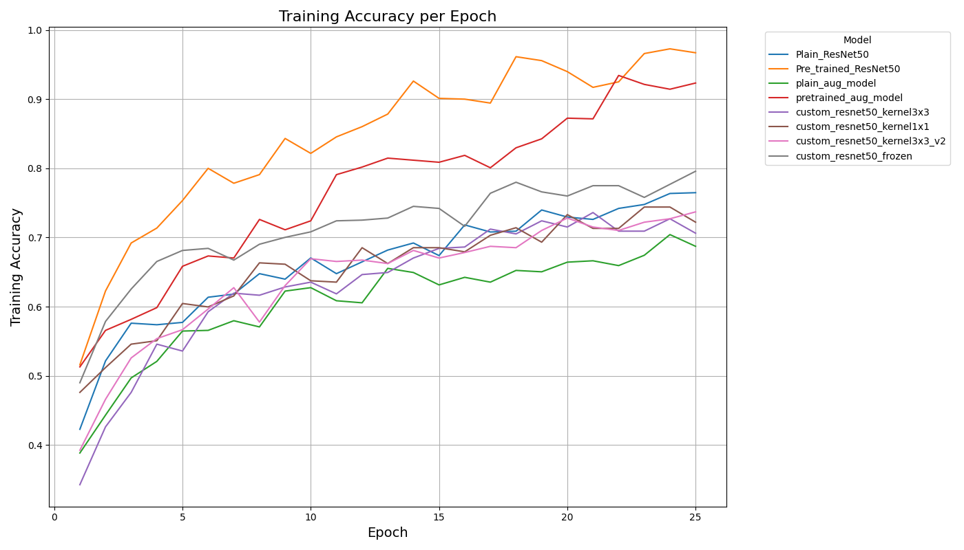
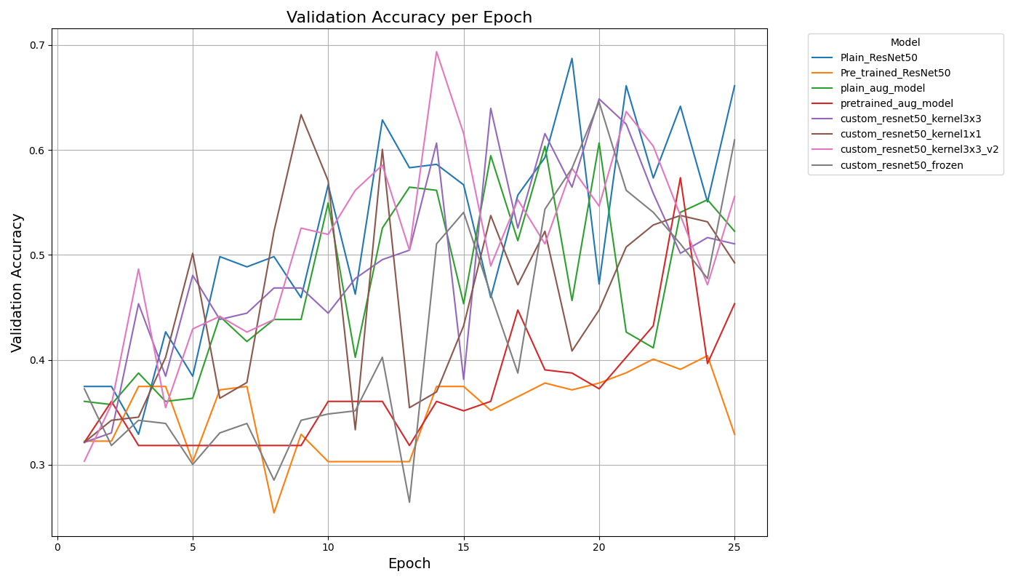
Trends v2

Slide 9
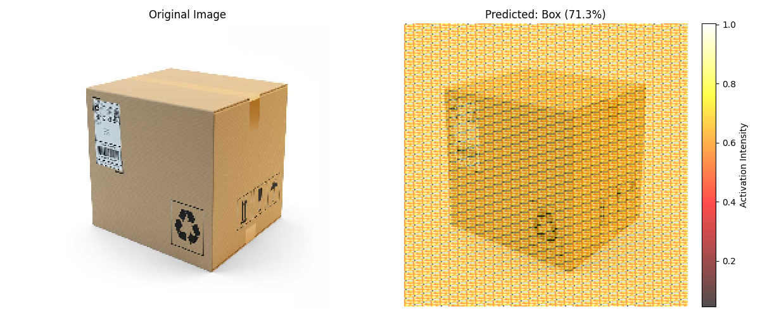
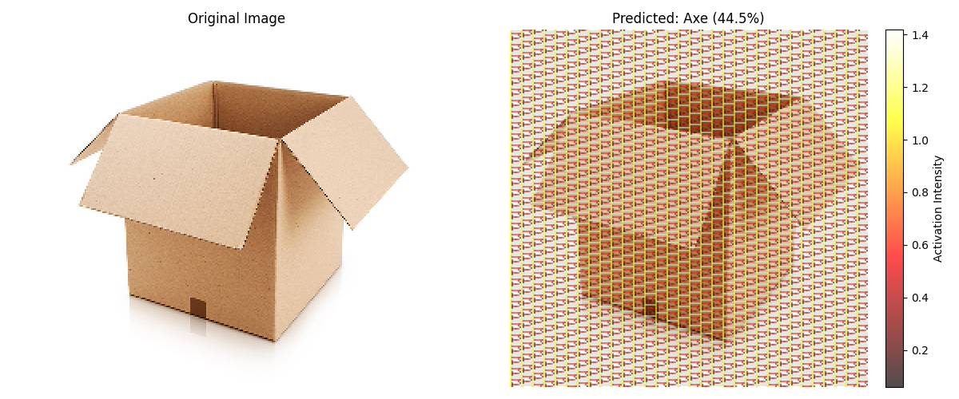
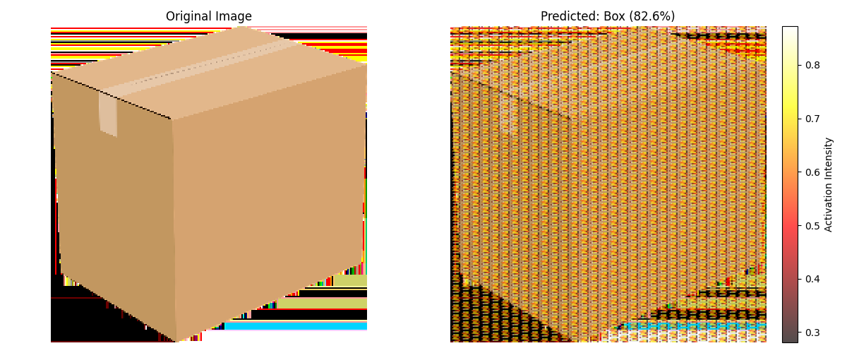
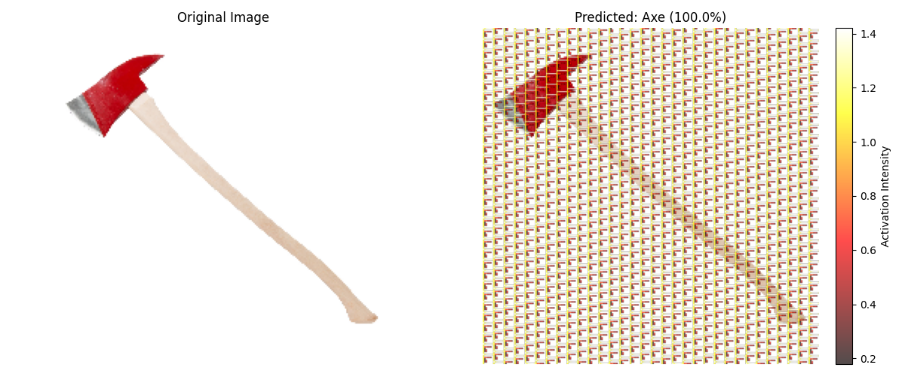
Activation maps

Slide 10
Where was the problem?
Too few images
…

