Slide 1

Enhancing financial forcasting with sentiment analysis
Enhancing financial forcasting with sentiment analysis
Author: David Höchtl BSc.
Supervisor: Dr. rer. nat. Sharwin Rezagholi, MSc

Slide 2
Idea & Research Question
Advances in NLP provide new opportunities in understanding unstructured data like financial news
Can daily aggregated sentiment extracted from news headlines improve prediction accuracy for S&P 500 stock prices?

Slide 3
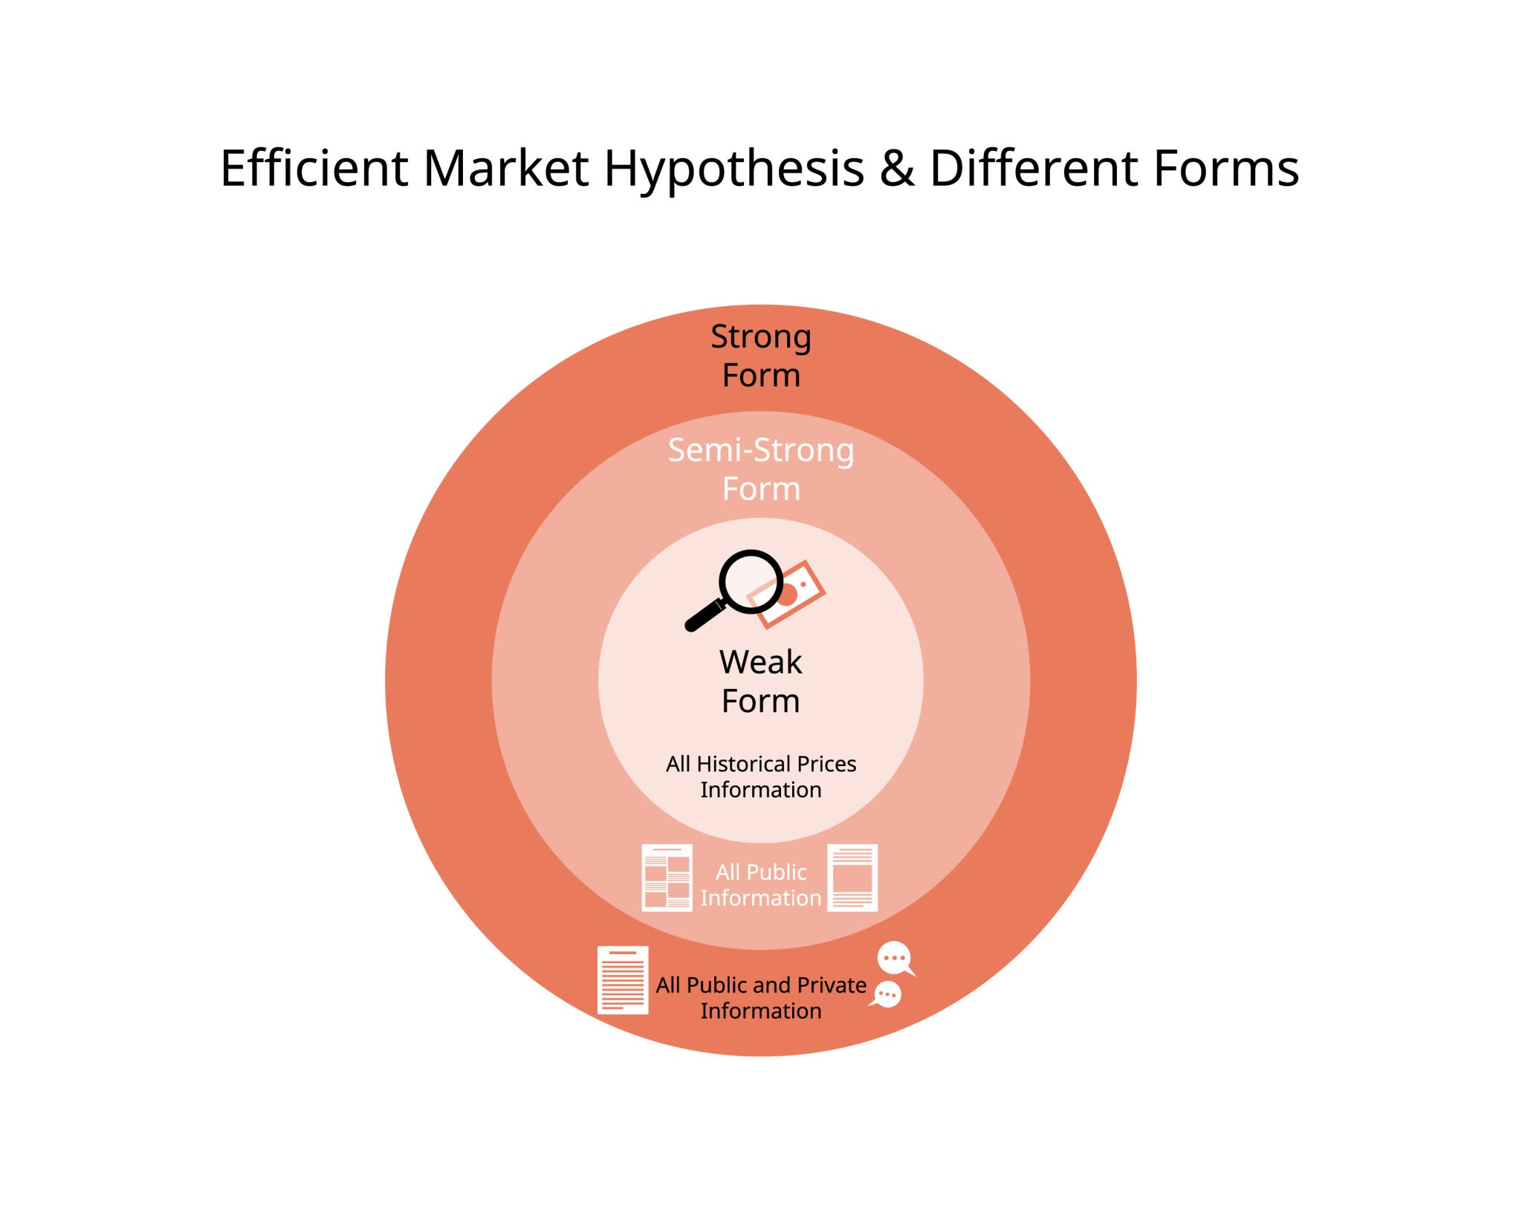
Efficient Market Hypothesis
Efficient Markets: information is reflected by the price itself
In context of this work the weak and semi-strong form are challenged

Slide 4

The engineering of the sentiment feature
adapters
Investor mood
Dataset 1
Dataset 2
preprocess
FinBERT
[1,0,-1]
...

Slide 5
Methodology
Testing on regression AND classification tasks
User multiple evaluation models (linear, non-linear)
Different experiment setups
Cross Validation

Slide 6
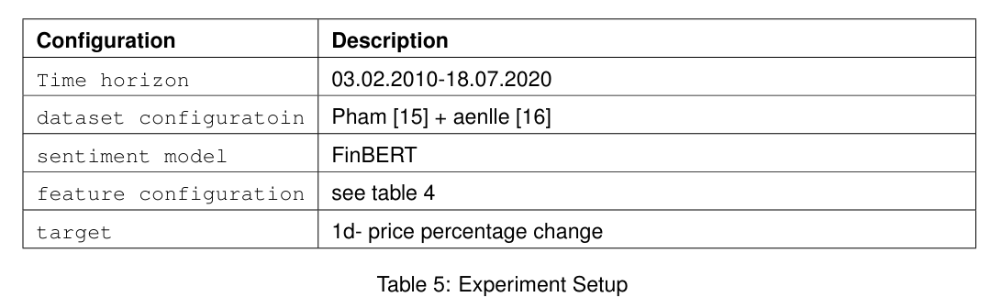
The Basic Experiment
Two Datasets with 1.9 Million headlines
4 Features Configurations (price only, sentiment only, techicals, technicals + sentiment)
Technical Indicators: (Volume, VIX, U.S. 1-Year Treasury, Moving Average 30d)

Slide 7
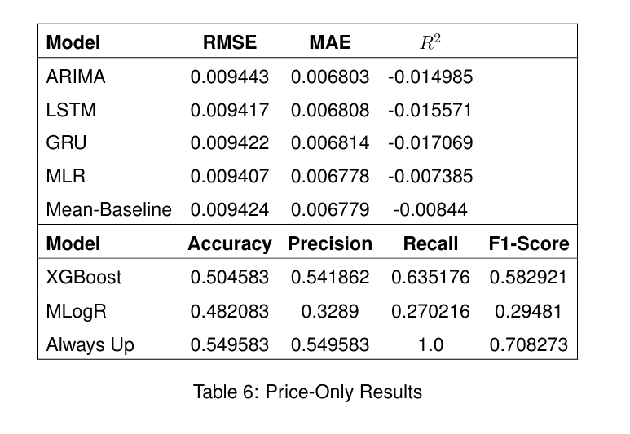
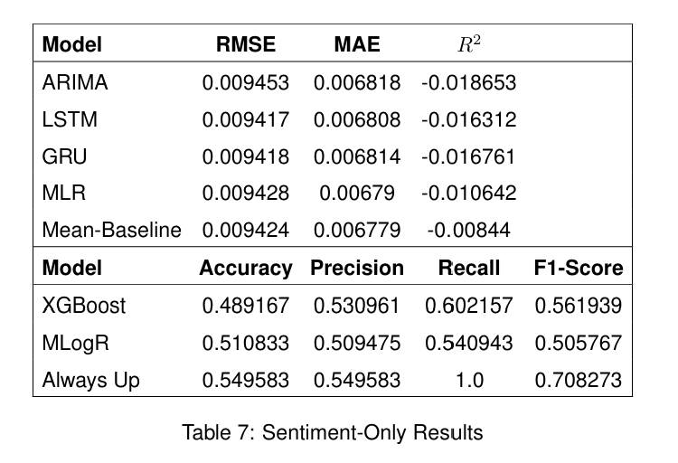
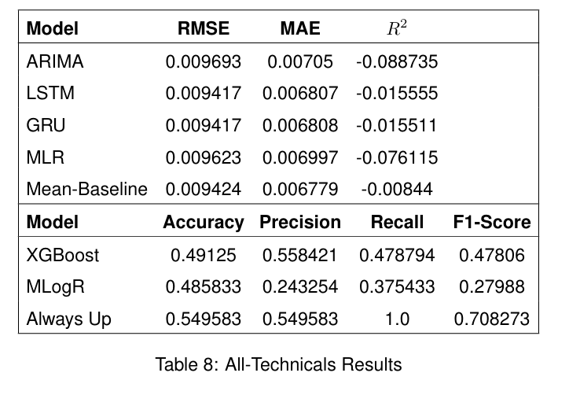
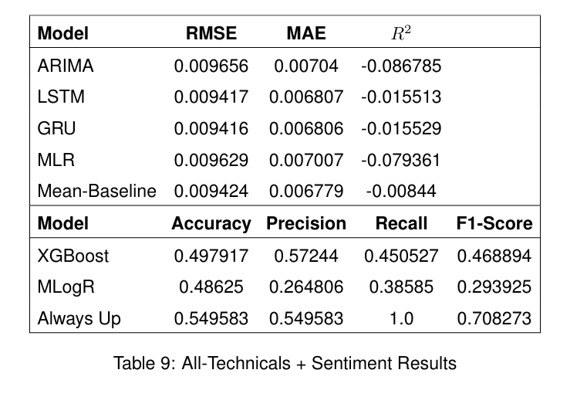
Results

Slide 8
Variations
Rolling Sentiment (averaging n-days sentiment)
Target Horizons (3d, 5d, 20d)
Sentiment Models (VADER instead of FinBERT)
Dataset configurations (irrelevant vs relevant dataset)
Preprocessing (improving the quality of datasets)

Slide 9
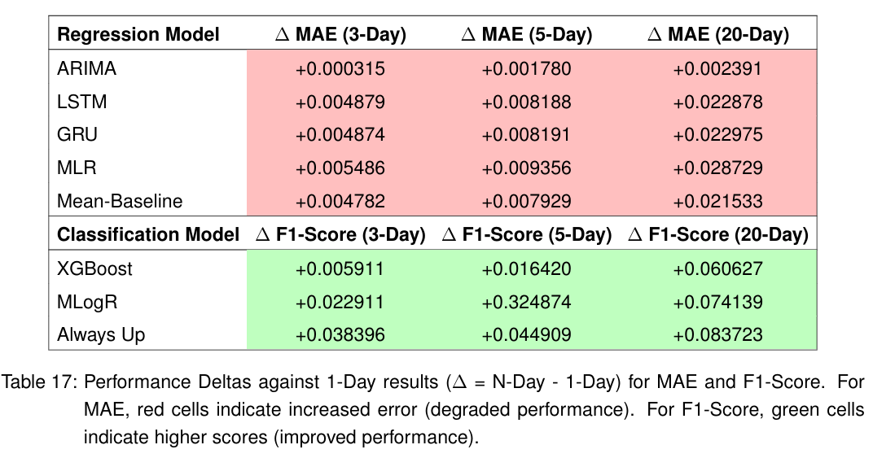
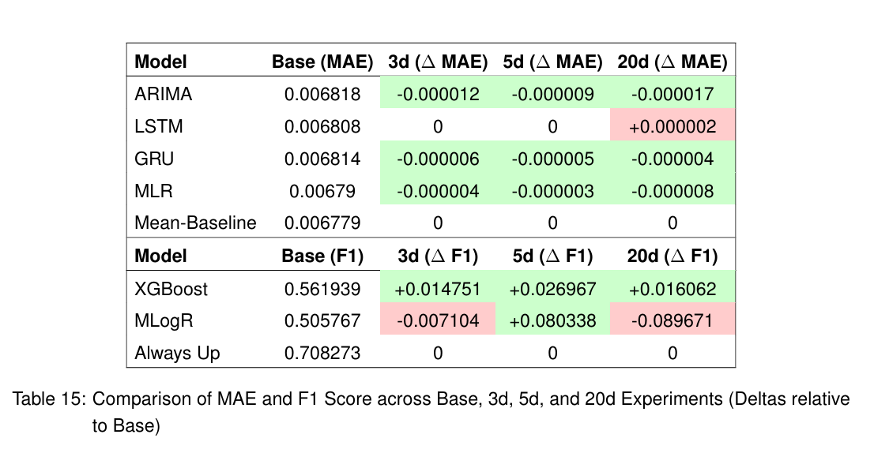
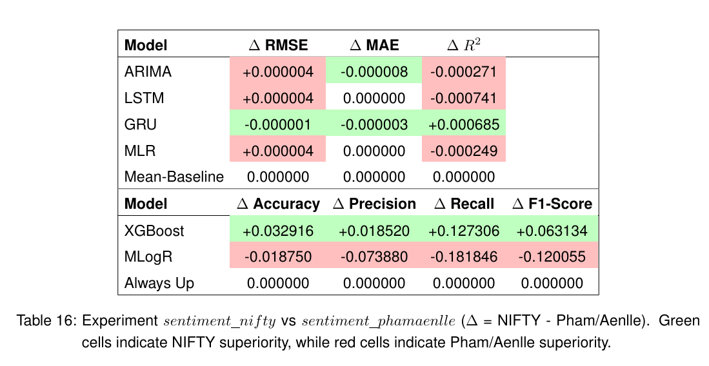
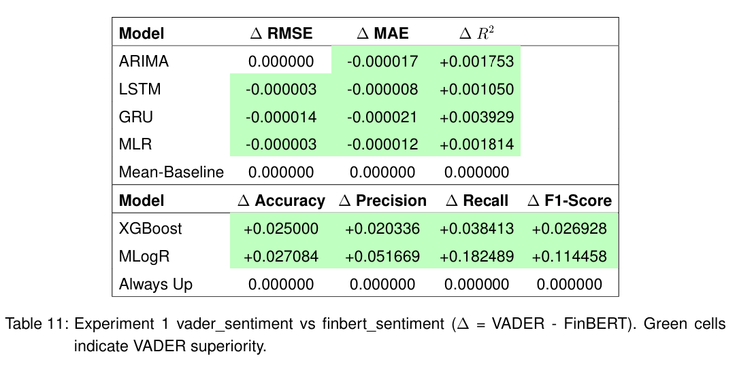
Variations
Different Target horizons
Rolling Sentiment
Different Dataset configurations
VADER instead of FinBERT

Slide 10
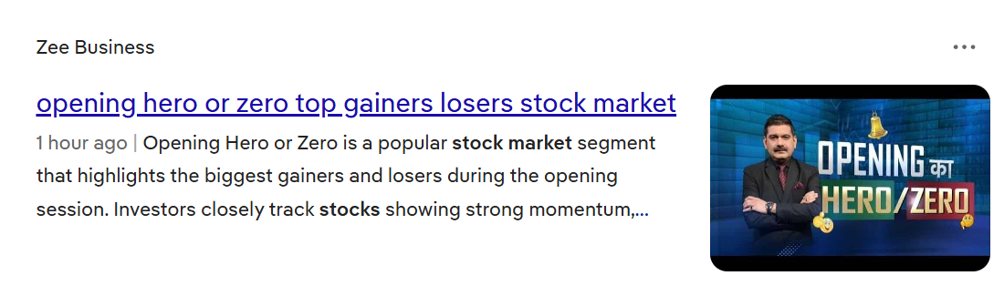
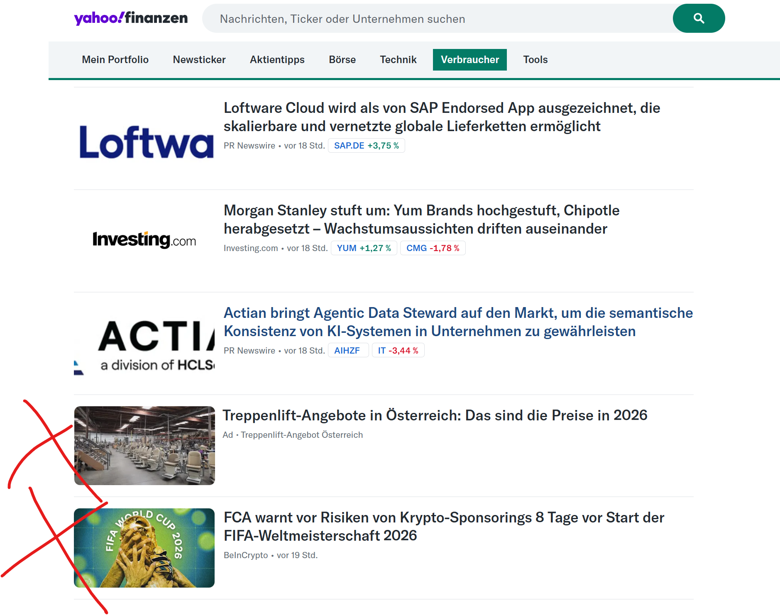





Improve the quality of the Dataset

Slide 11

Impact Scoring
Evaluated on self annotated Dataset
Engineered Prompt
Llama 3.1 Instruct (8B)
[0, 1]

Slide 12
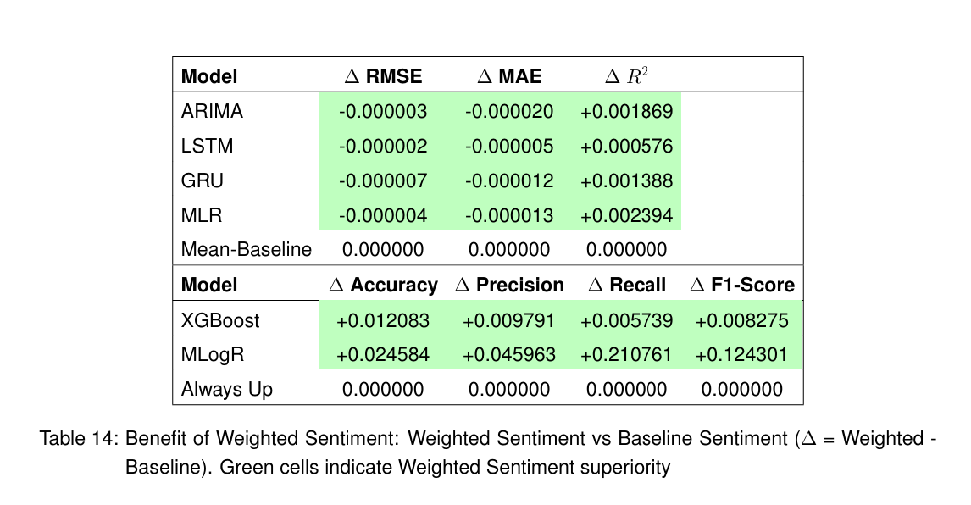
Result

Slide 13
Conclusion
In the context of the experiments daily aggregated sentiment was not enough to beat the EMH
The headline sentiment feature is insufficient
Signal lifetime is too short (daily aggregation)
Signal is noise
LLMs are very promising in doing both analysing sentiment and denoising inputs.

Slide 14
Thank you for Your Attention

Slide 15
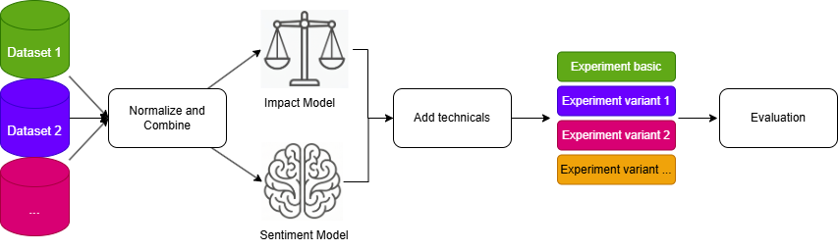

Slide 16
Variations
Rolling Sentiment →
Target Horizons
Sentiment Models
Dataset configurations
Preprocessing

Slide 17
Variations
Rolling Sentiment
Target Horizons →
Sentiment Models
Dataset configurations
Preprocessing

Slide 18
Variations
Rolling Sentiment
Target Horizons
Sentiment Models →
Dataset configurations
Preprocessing

Slide 19
Variations
Rolling Sentiment
Target Horizons
Sentiment Models
Dataset configurations →
Preprocessing

