Slide 1

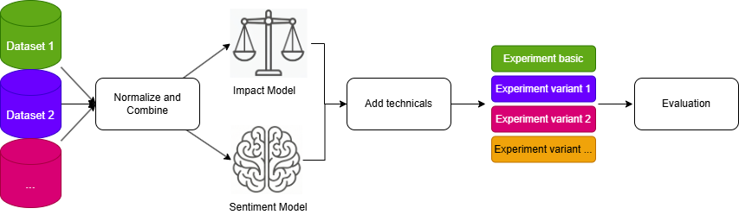
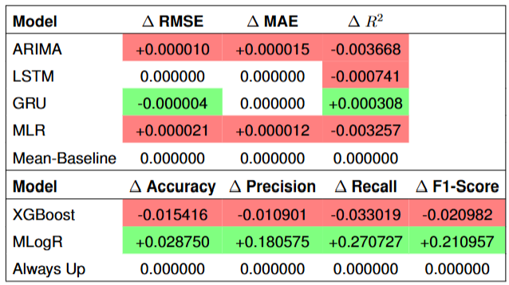
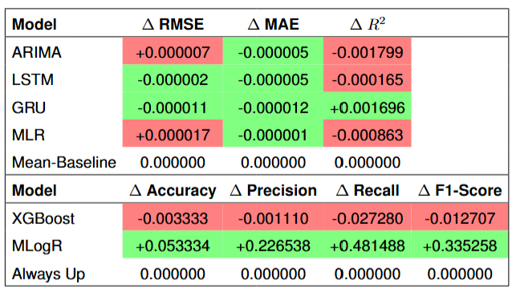


Stock market prediction with LLMs
Aka. Getting Rich by doing nothing
Author: David Höchtl BSc.
Supervisor: Dr. rer. nat. Sharwin Rezagholi, MSc.
Year: 2026
Introduction:
Rapid advances in Natural Language Processing (NLP) [1] have created new opportunities for understanding the stock market movements.
Efficient Market Hypothesis (EMH) states that all information is priced in [2]
Mixed results in literature [3] [4] [5]
Research Question: Can daily aggregated sentiment extracted from news headlines improve prediction accuracy for S&P 500 stock prices?
Methods:
Combine multiple headline datasets
Use LLMs (e.g. FinBERT) to extract investor mood
Perform denoising via an impact score model (Llama 3.1 Instruct (8B))
Use this feature in classification and regression tasks
Cross validate on multiple evaluation models and experiment variations
Results: (performance compared to predictions using only yesterday’s price changes)
+
Figure 1: Performance delta with sentiment as the sole predictor
Figure 2: Performance delta with denoised sentiment as the sole predictor
In a fair, non-lookahead setup, there is no consistent benefit in using the engineered sentiment feature, suggesting that the EMH holds for the performed experiments.
References: [1] Araci (2019) "Finbert: Financial sentiment analysis..."; [2] Malkiel & Fama (1970) "EFFICIENT CAPITAL MARKETS..."; [3] Davidovic & McCleary (2025) "News Sentiment and Stock Market Dynamics..."; [4] Zhang et al. (2018) "A novel data-driven stock price..."; [5] Farimani et al. (2022) "Investigating the informativeness..."

