Slide 1

Sentiment Analysis in financial Forecasting
David Höchtl

Slide 2
Idea & Research Question
Advances in NLP provide new opportunities in understanding unstructured data like financial news headlines
Extract sentiment via transformer -> [-1;1]
Can a daily aggregated sentiment score be utilized to improve predictive power in financial forecasting models for the S&P500 Index?
Notes:
What is the idea?

Slide 3
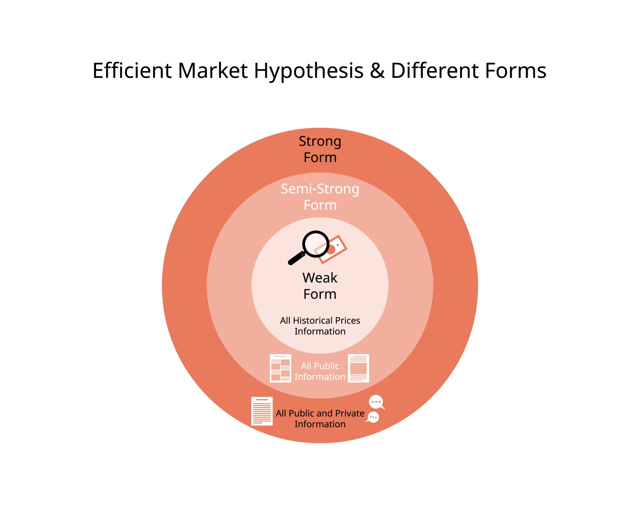
The Debate
Efficient Market Hypothesis: all information is already priced in
Results vary for similar experiments
Data used in the papers are often not publicly available and Hyperparameters are not disclosed
Notes:
I want to introduce you to

Slide 4
Methods
Matrix base = [Pt-1, volume, volatility, ...]
Matrix sentiment = [Pt-1, sentiment, volume, volatility]
...
Evaluate Model Performance:
Classification: F1, Accuracy, Precision, Recall
Regression: RMSE, MAE, AIC, BIC
Expanding Window Validation
Notes:
What are my research methods, how do i measure performance? Standard Cross Validation do not respect the “arrow of time”, shuffles randomly
Expanding window is stoa method for timeseries data. It starts with a small train window at for each fold it grows that window more to the end

Slide 5
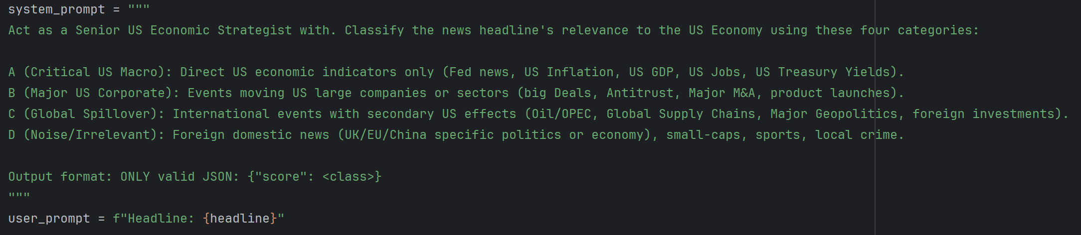
Impact Scoring
Tested on self annotated Dataset (~70 rows)
weighted_sentiment = sentiment_score * impact_score
Notes:
One novel idea that i introduce in my work

Slide 6


The Pipeline / Prototype
Investpy
[-1;1]
Sentiment-Score
FinBERT / VADER
[0;1]
Impact Score
LLAMA 3.1 Instruct
Notes:
The Pipeline
FNSPID
NIFTY
KAGGLE Datasets

Slide 7
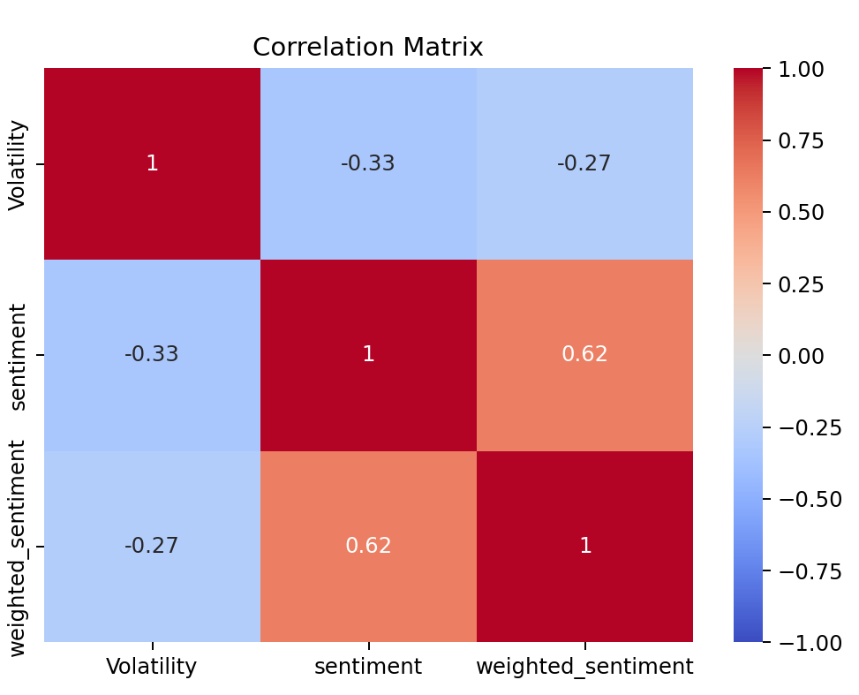
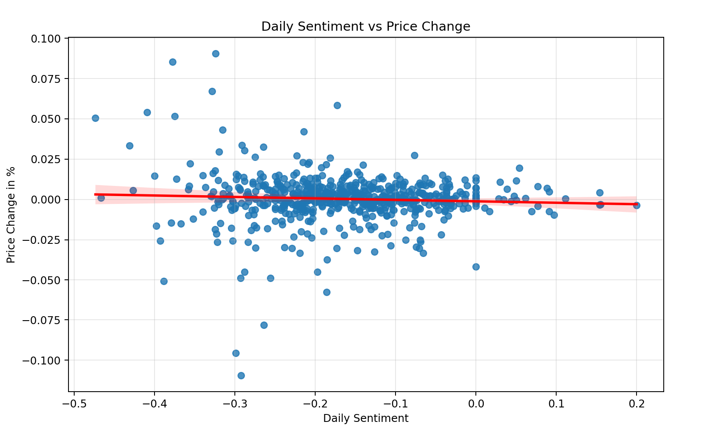
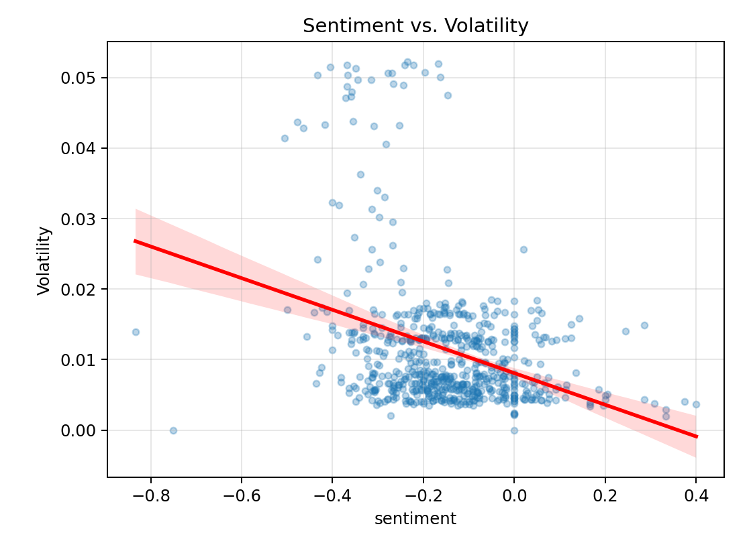
Correlations
Notes:
Bevor we go over the experiment setup

Slide 8
Experiment setup
Start: 17.12.2017
End: 06.11.2020
Datapoints: 623
Sentiment model: FinBERT
Impact model: LLAMA_3_1_Instruct
Dataset: CNBC, Guardian, Reuters Headline-Dataset with 50k Headlines
Eval-Models: ARIMA, LSTM, GRU, MLR, XGBoost, MLogR

Slide 9
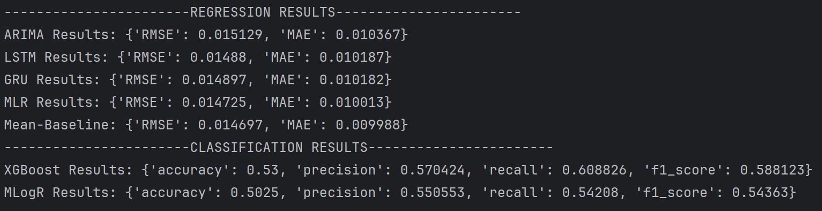










Evaluation (sentiment vs mean baseline)
Y = mean(Ytrain)

Slide 10
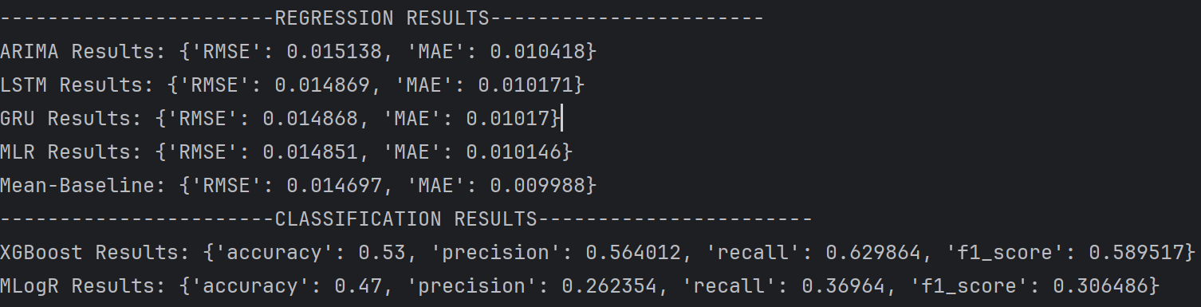
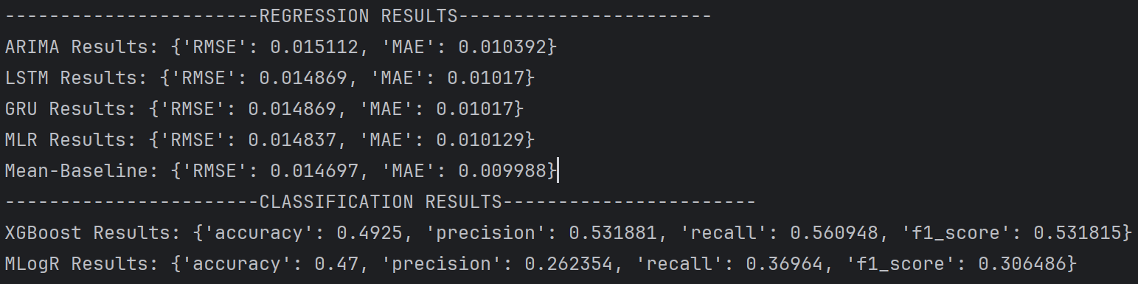








Evaluation (sentiment+tech vs tech)

Slide 11
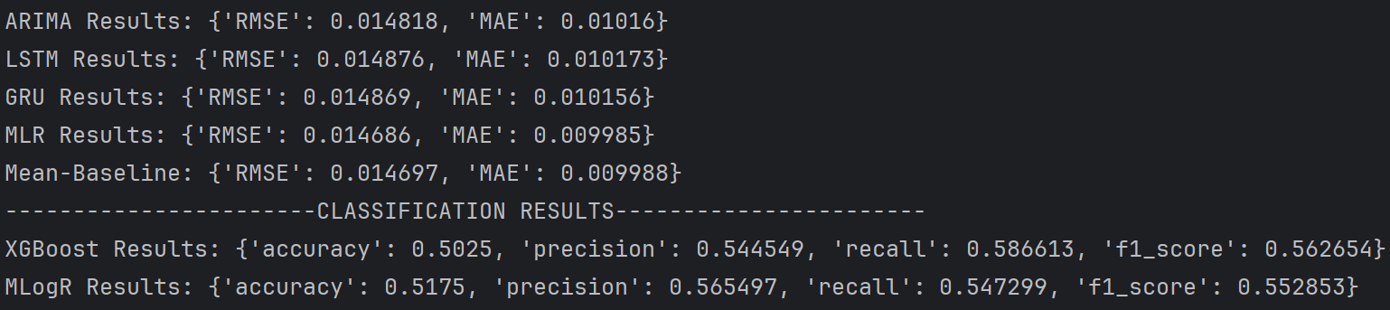













Evaluation (rolling sentiment vs sentiment)

Slide 12

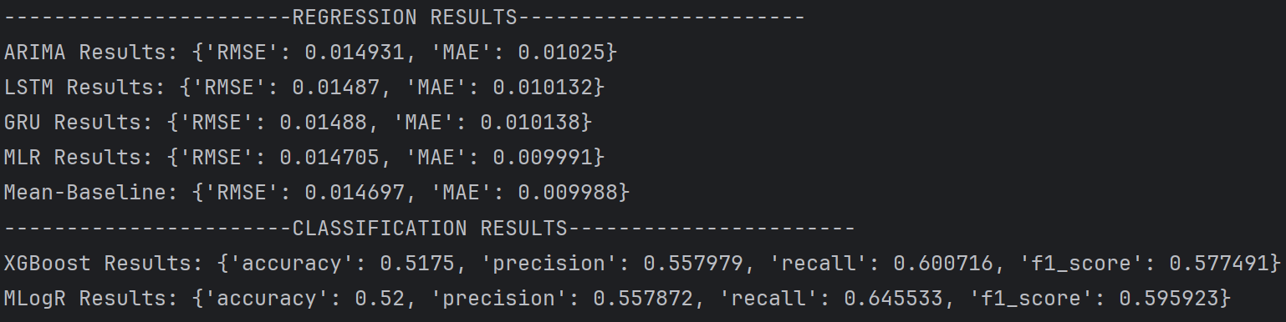












Evaluation (weighted sentiment vs sentiment)

Slide 13
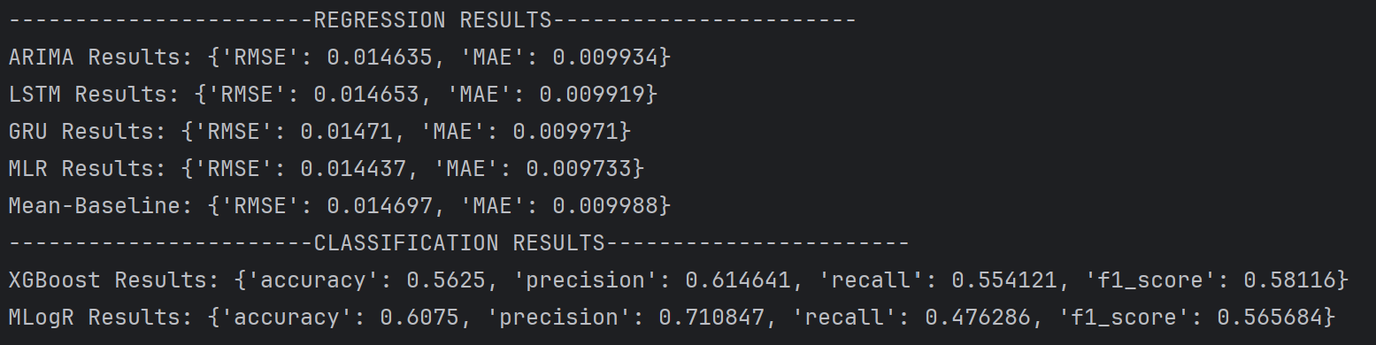
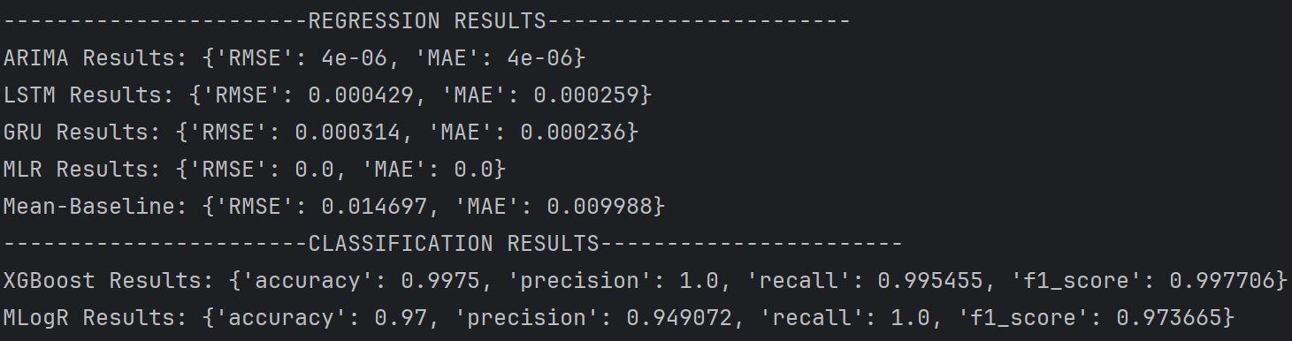
Sanity checks

Slide 14
Conclusion/Discussion
Effective market hypothesis holds for the performed experiments
Intra day sentiment may give better signals
Full article instead of only headlines
More datapoints for Deep Learning
Notes:
Sentiment seem to not give extra predictive power
Either because the signal decays too fast (or immediately)
It does not have anything to do with prices

Slide 15
Thank You for Your Attention

