Slide 1
Getting Rich with AI
Enhancing financial forcasting with sentiment analysis

Slide 2





Slide 3

Our biggest Enemy
Efficient Market Hypothesis

Slide 4

The way to a useable feature
adapters
Investor mood
Dataset 1
Dataset 2
preprocess
FinBERT
...

Slide 5
How do we know we can trust the results
Use regression AND classification tasks
Use multiple evaluation models (linear, non-linear)
Cross Validation
Multiple Experiment configurations

Slide 6
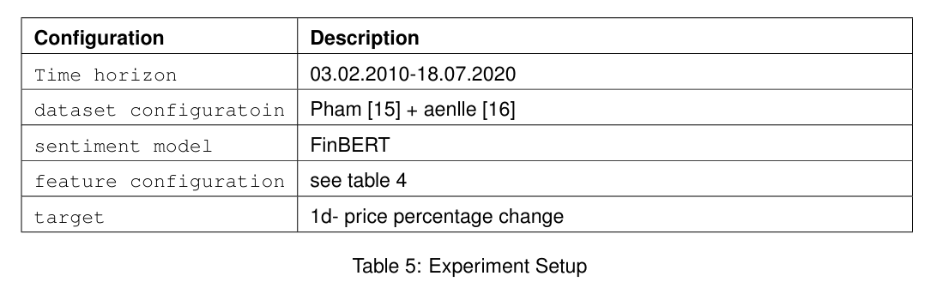
The Basic Experiment
Two Datasets with 1.9 Million headlines
4 Features Configurations (price only, sentiment only, techicals, technicals + sentiment)

Slide 7
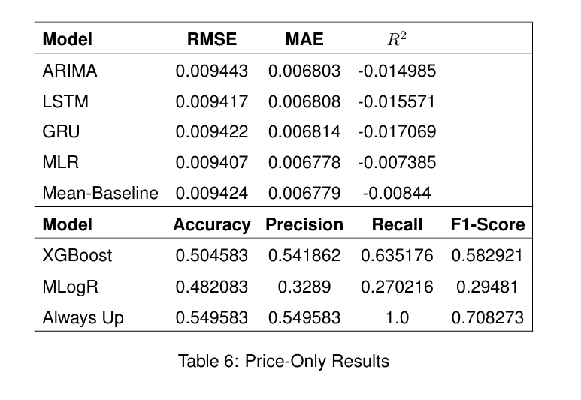
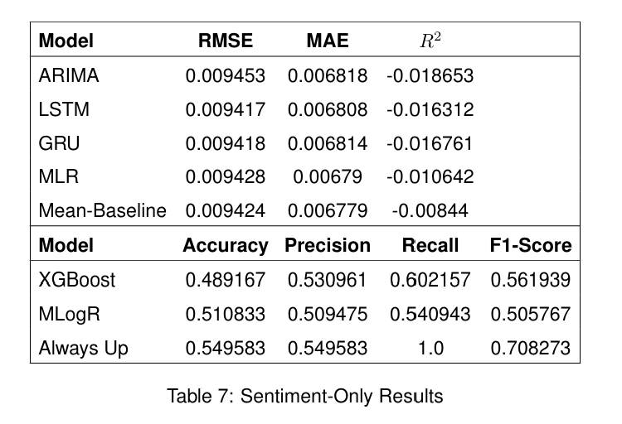
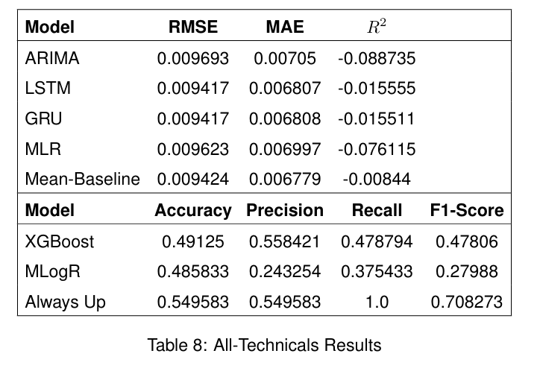
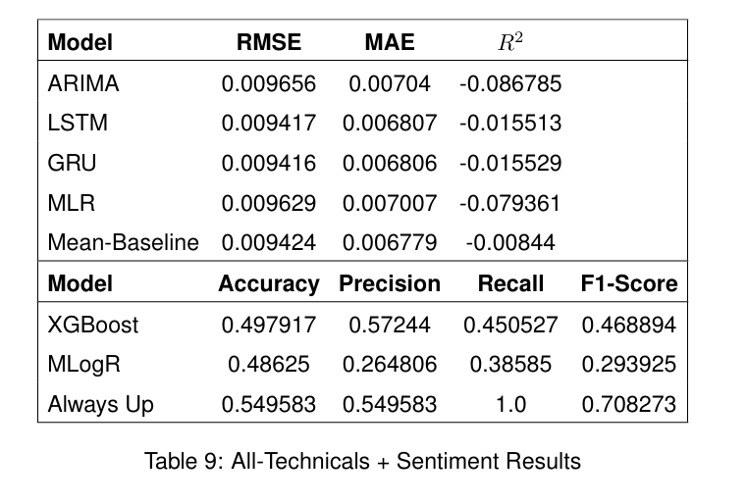
Results

Slide 8

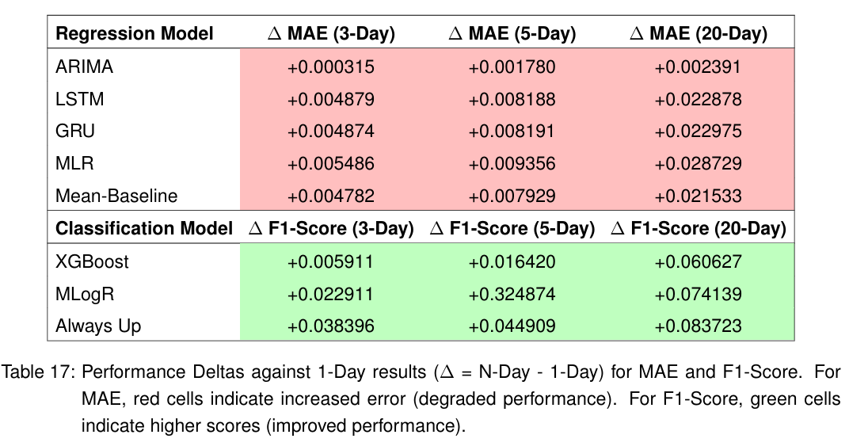
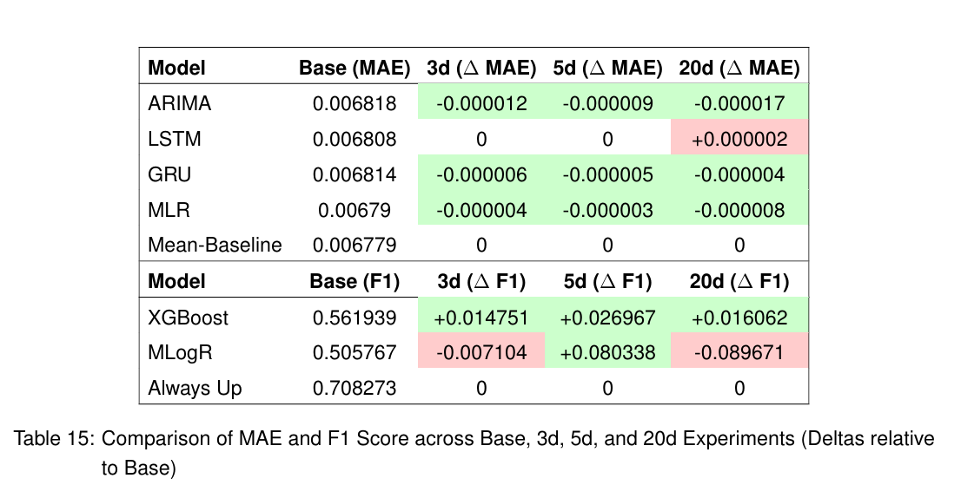
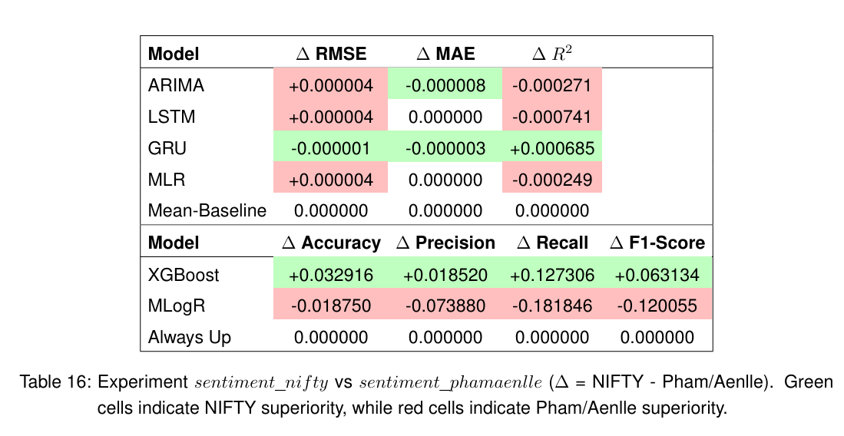
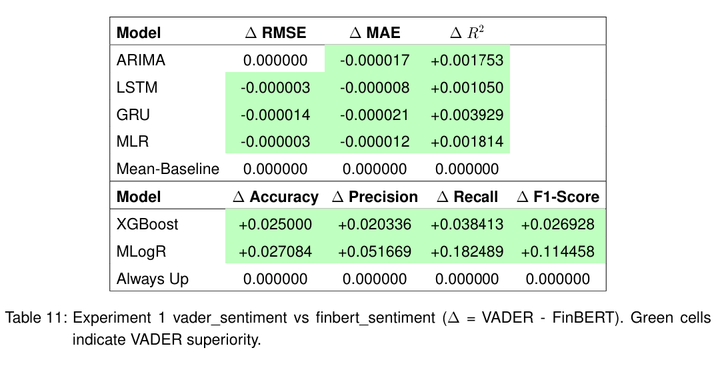
Variations
Different Target horizons
Rolling Sentiment
VADER instead of FinBERT
Different Dataset configurations

Slide 9
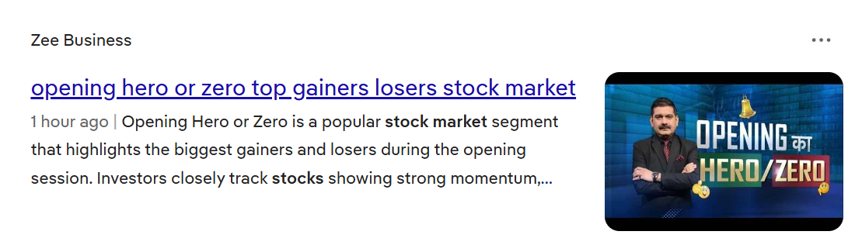
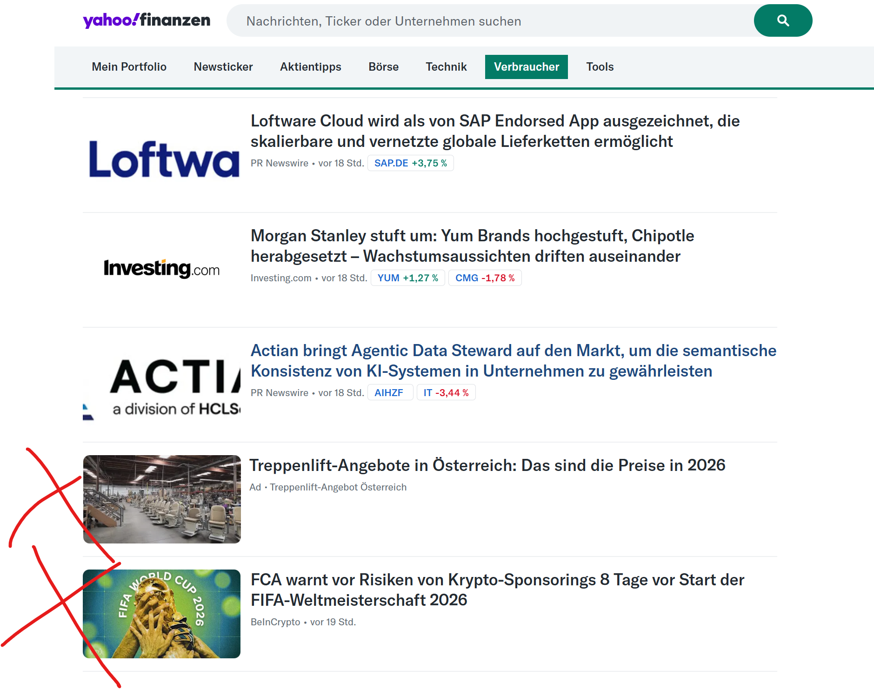





The nead of filtering

Slide 10
Impact Scoring
Engineered Prompt
Headline
Llama 3.1 Instruct (8B)
0 -> Noise
[0-1]
1 -> very important

Slide 11
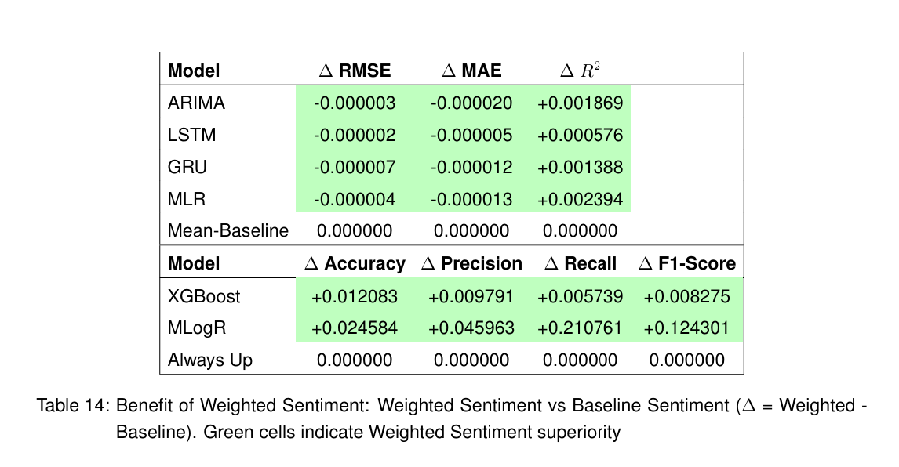
Result

Slide 12
Conclusion
Notes:
In the context of the experiments daily aggregated sentiment was not enough to beat the EMH
Headlines are very noisy and need filtering
LLMs are very promising in doing both analysing sentiment and denoising inputs.

Slide 13

Conclusion
In the context of the experiments daily aggregated sentiment was not enough to beat the EMH
Headlines are very noisy and need filtering
LLMs are very promising in doing both analysing sentiment and denoising inputs.

Slide 14
Thank you for Your Attention

Slide 15
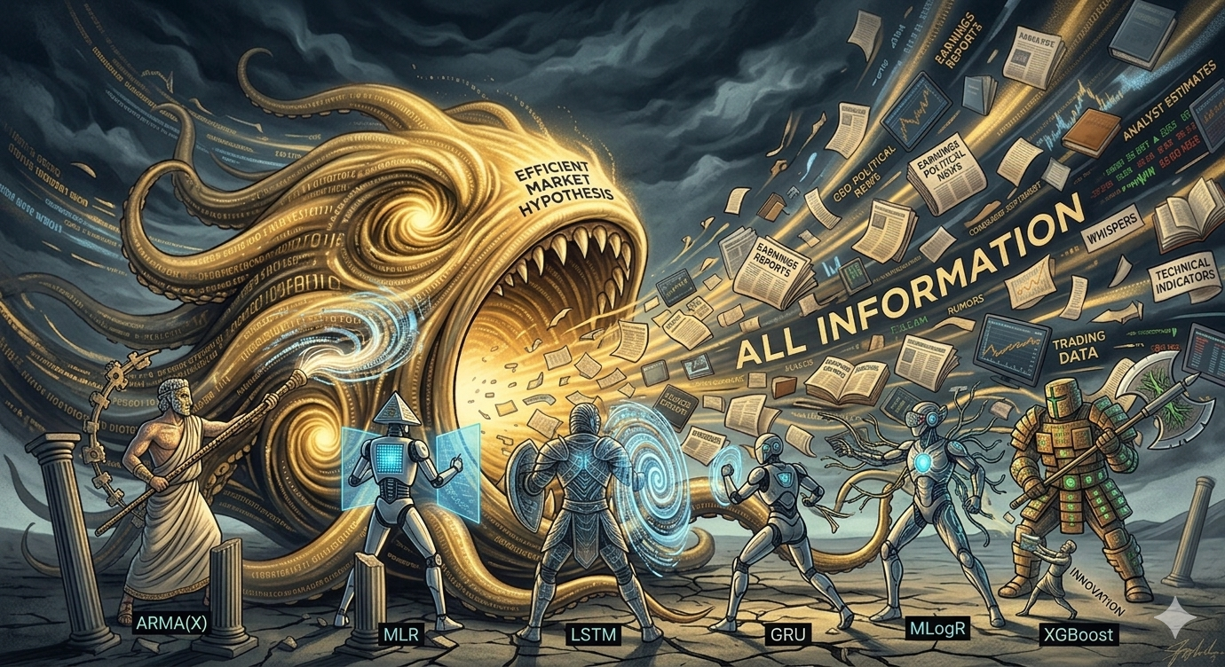
Our fighters:

