Slide 1
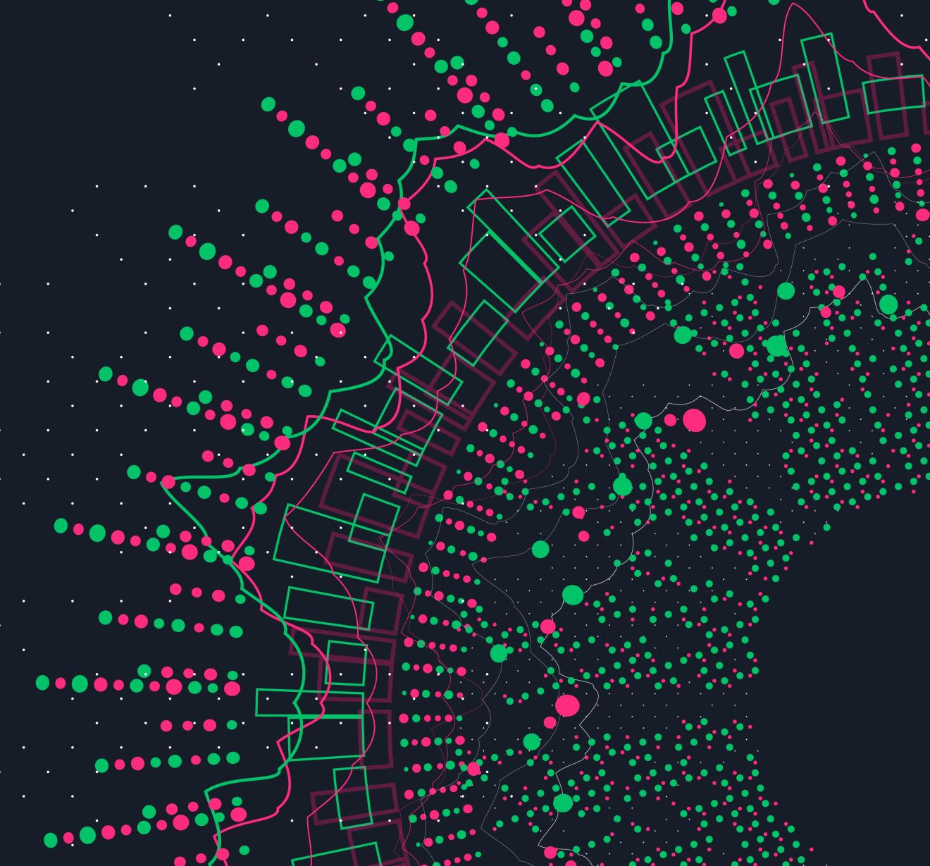
HEX-Agent
Group P (Maja, Chris, David)

Slide 2
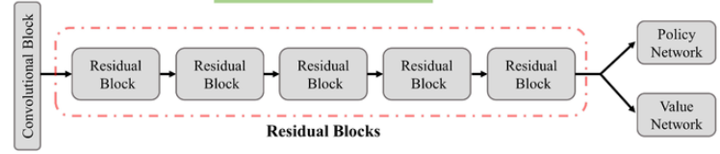
Model
INPUT (3 Channels):
Player-Stones
Opponent-Stones,
Legal-Turns
Shared Backbone:
CNN with 3 residual Blocks (Conv2D (3→128) + BatchNorm + ReLU -> 3 x Residual Block)
Policy, Value Head

Slide 3
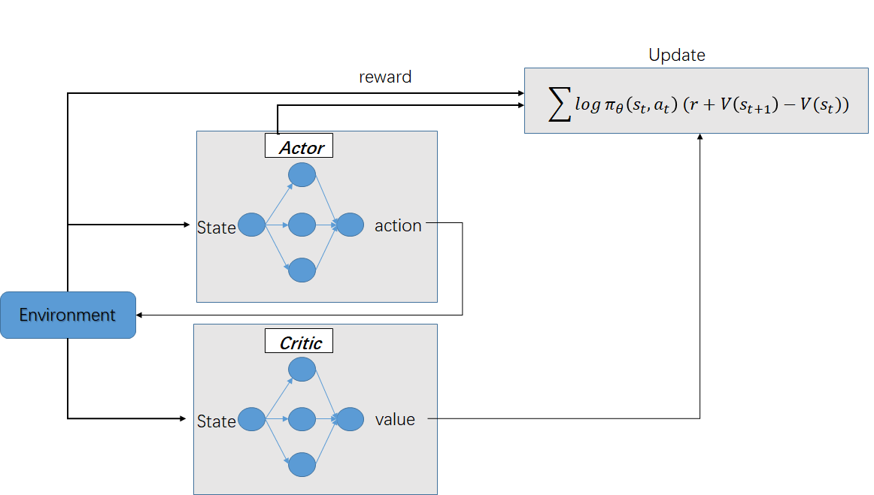
Algorithm
A2C (Advantage Actor Ctricitc)

Slide 4
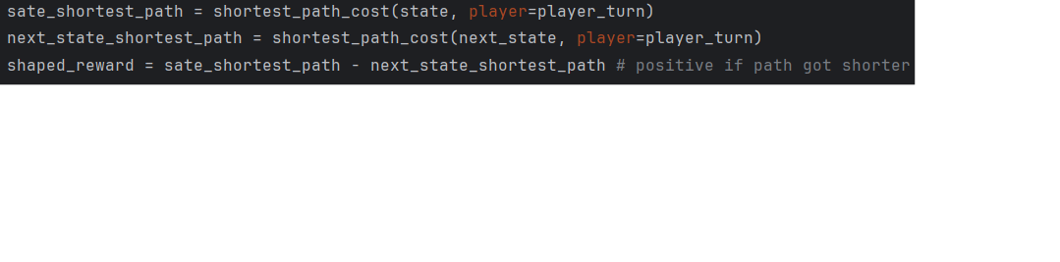
Noteable Breakthroughs
A2C is a on-policy method, but we used a replay buffer -> hurt convergence a lot
Shaped reward

