Slide 1
Midterm 1
Dave Feng

Slide 2
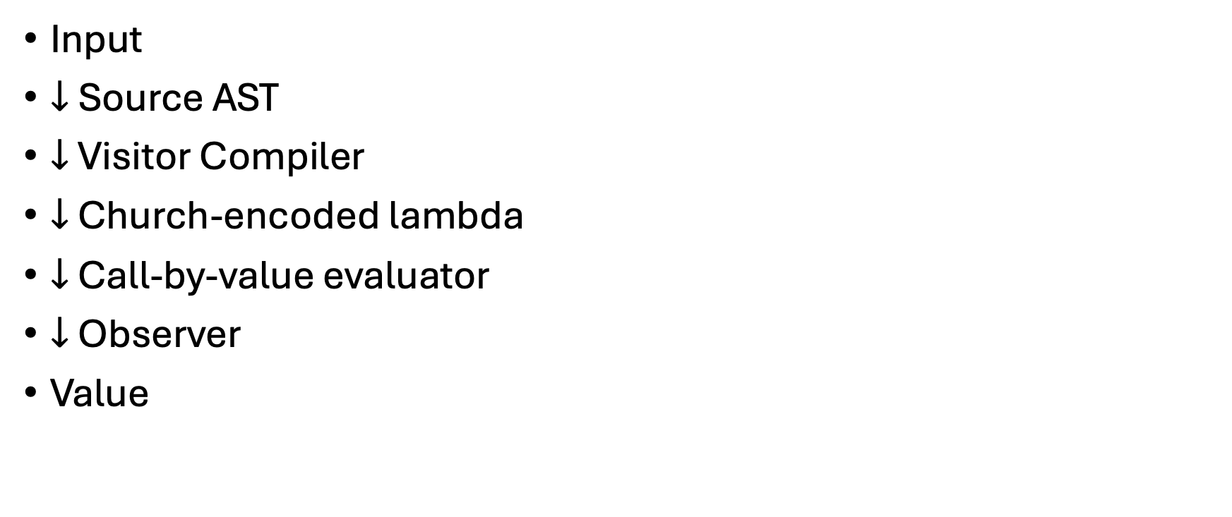
Architecture
Input
$↓$Source AST
$↓$ Visitor Compiler
$↓$ Church-encoded lambda
$↓$ Call-by-value evaluator
$↓$ Observer
Value

Slide 3
Abstract Syntax Trees
D0Eop2(op, e1, e2)
D0Eop2((+), ONE, ONE)
+
ONE
ONE

Slide 4
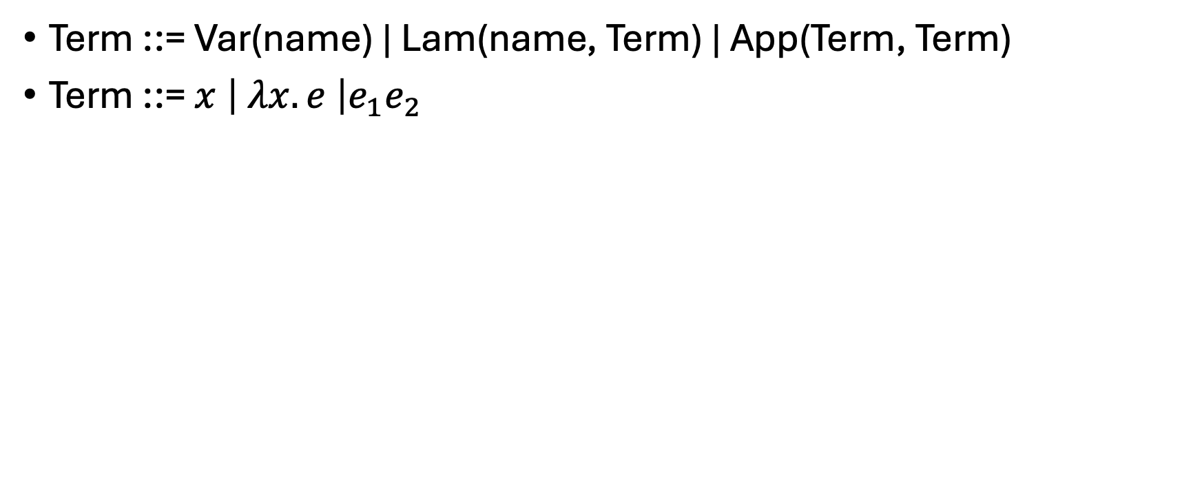
Church encoded-lambda
Term ::= Var(name) | Lam(name, Term) | App(Term, Term)
Term ::= $x \left| λx.e \right|e_{1}e_{2}$

Slide 5
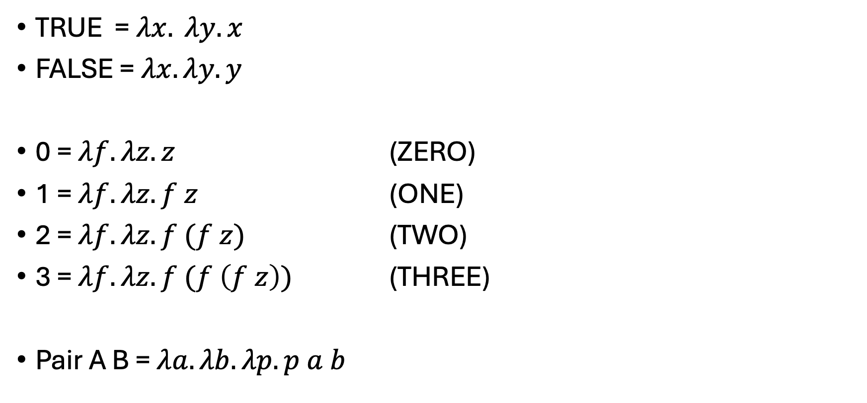
How do we represent primitives?
TRUE = $λx. λy. x$
FALSE = $λx. λy. y$
0 = $λf. λz. z$ (ZERO)
1 = $λf. λz. f z$ (ONE)
2 = $λf. λz. f (f z)$ (TWO)
3 = $λf. λz. f (f \left(f z\right))$ (THREE)
Pair A B = $λa. λb. λp. p a b$

Slide 6
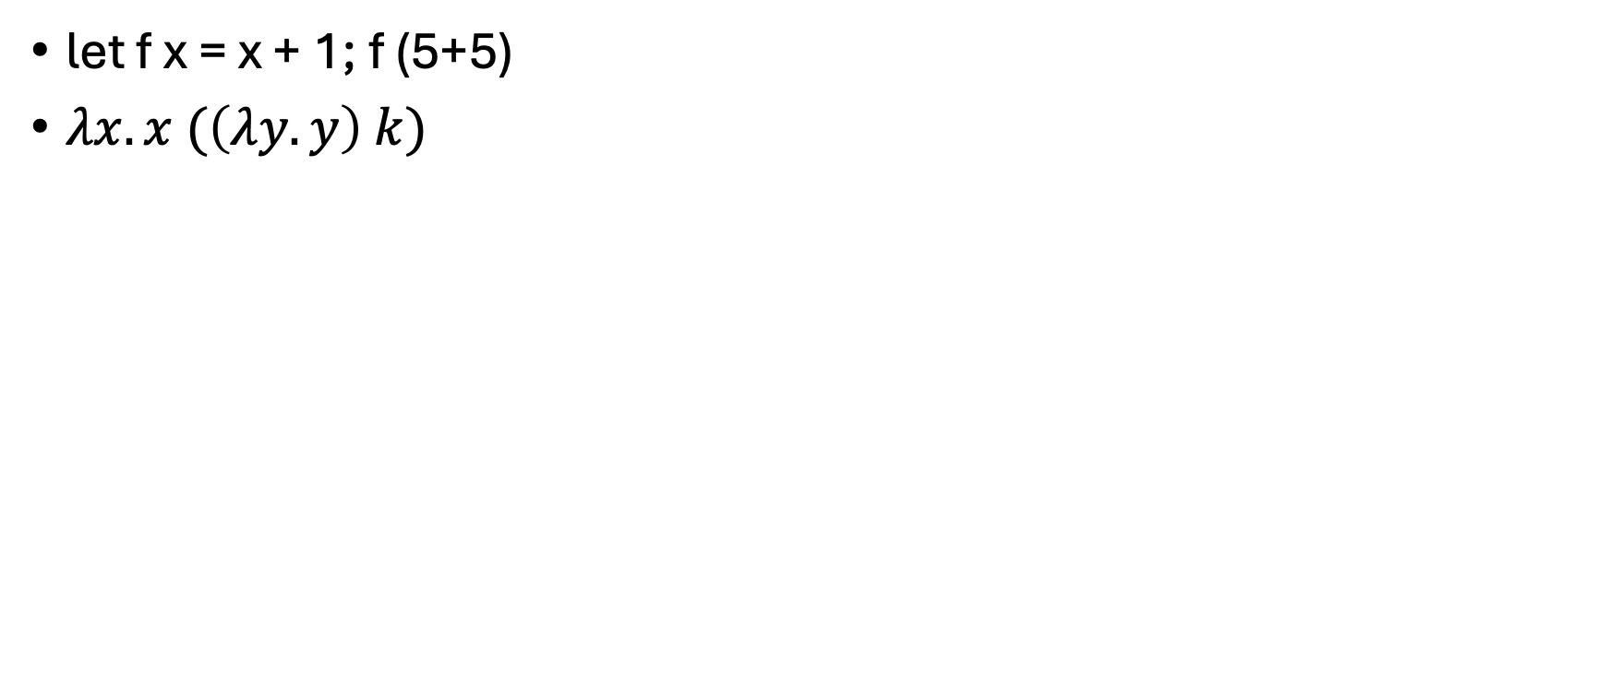
Call by value
let f x = x + 1; f (5+5)
$λx.x (\left(λy.y\right) k)$

Slide 7
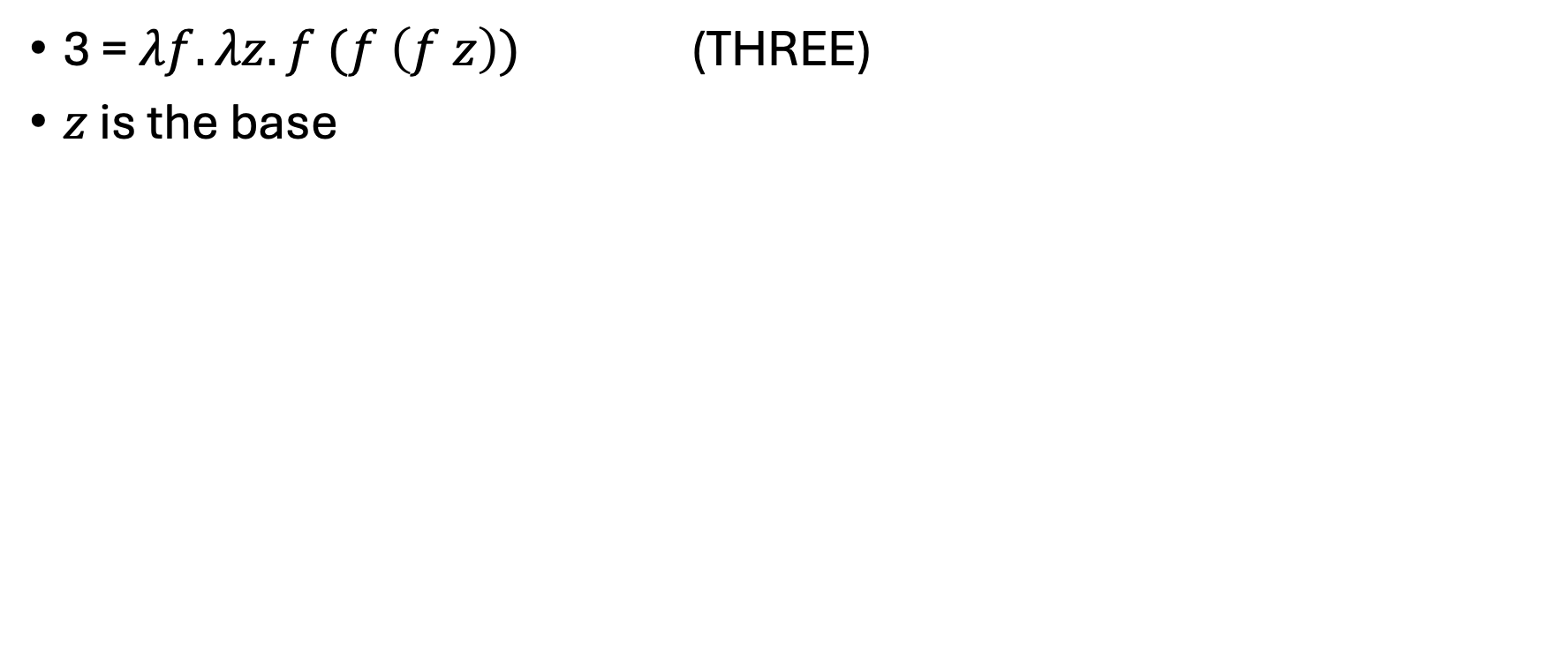
Observer
3 = $λf. λz. f (f \left(f z\right))$ (THREE)
$z$ is the base

Slide 8
Visitors
If (op = “+”) then … else …
Accept (visitor, self)
AddVisitor:
  IntAddVisitor()
  BoolAddVisitor()

