Slide 1


DPDK-P4 Configurable Switch with Buffer Overflow Management
Project Number: 22-1-2-2599
Names: Guy Davidi Amit Davidi
Advisor: Stefan Chulski

Slide 2
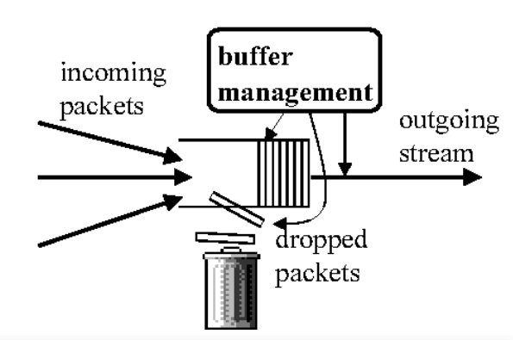
Abstract
Abstract
The Problem we want to solve:
When too many packets arrive at the switch faster than they can be processed and forwarded, a buffer overflow occurs, which leads to loss of packets, and reduced quality of service.
Goal:
On a Switch, run a packet management algorithm that will classify packets and maximize the data throughput in case of buffer overflow thus increasing QOS.
Support configurable switch which enable to change configuration in runtime.

Slide 3
Objectives
Research the P4 Programming language capabilities, the DPDK libraries and their integration.
Research real-time configurable software switches, SDNs and their practical implementation.
Improvement of Quality of Service in a buffer-overflow (High-Stress) scenario where packets are dropped.
Development of a platform that enables engineers to deploy and evaluate their next-gen on-switch algorithms.

Slide 4
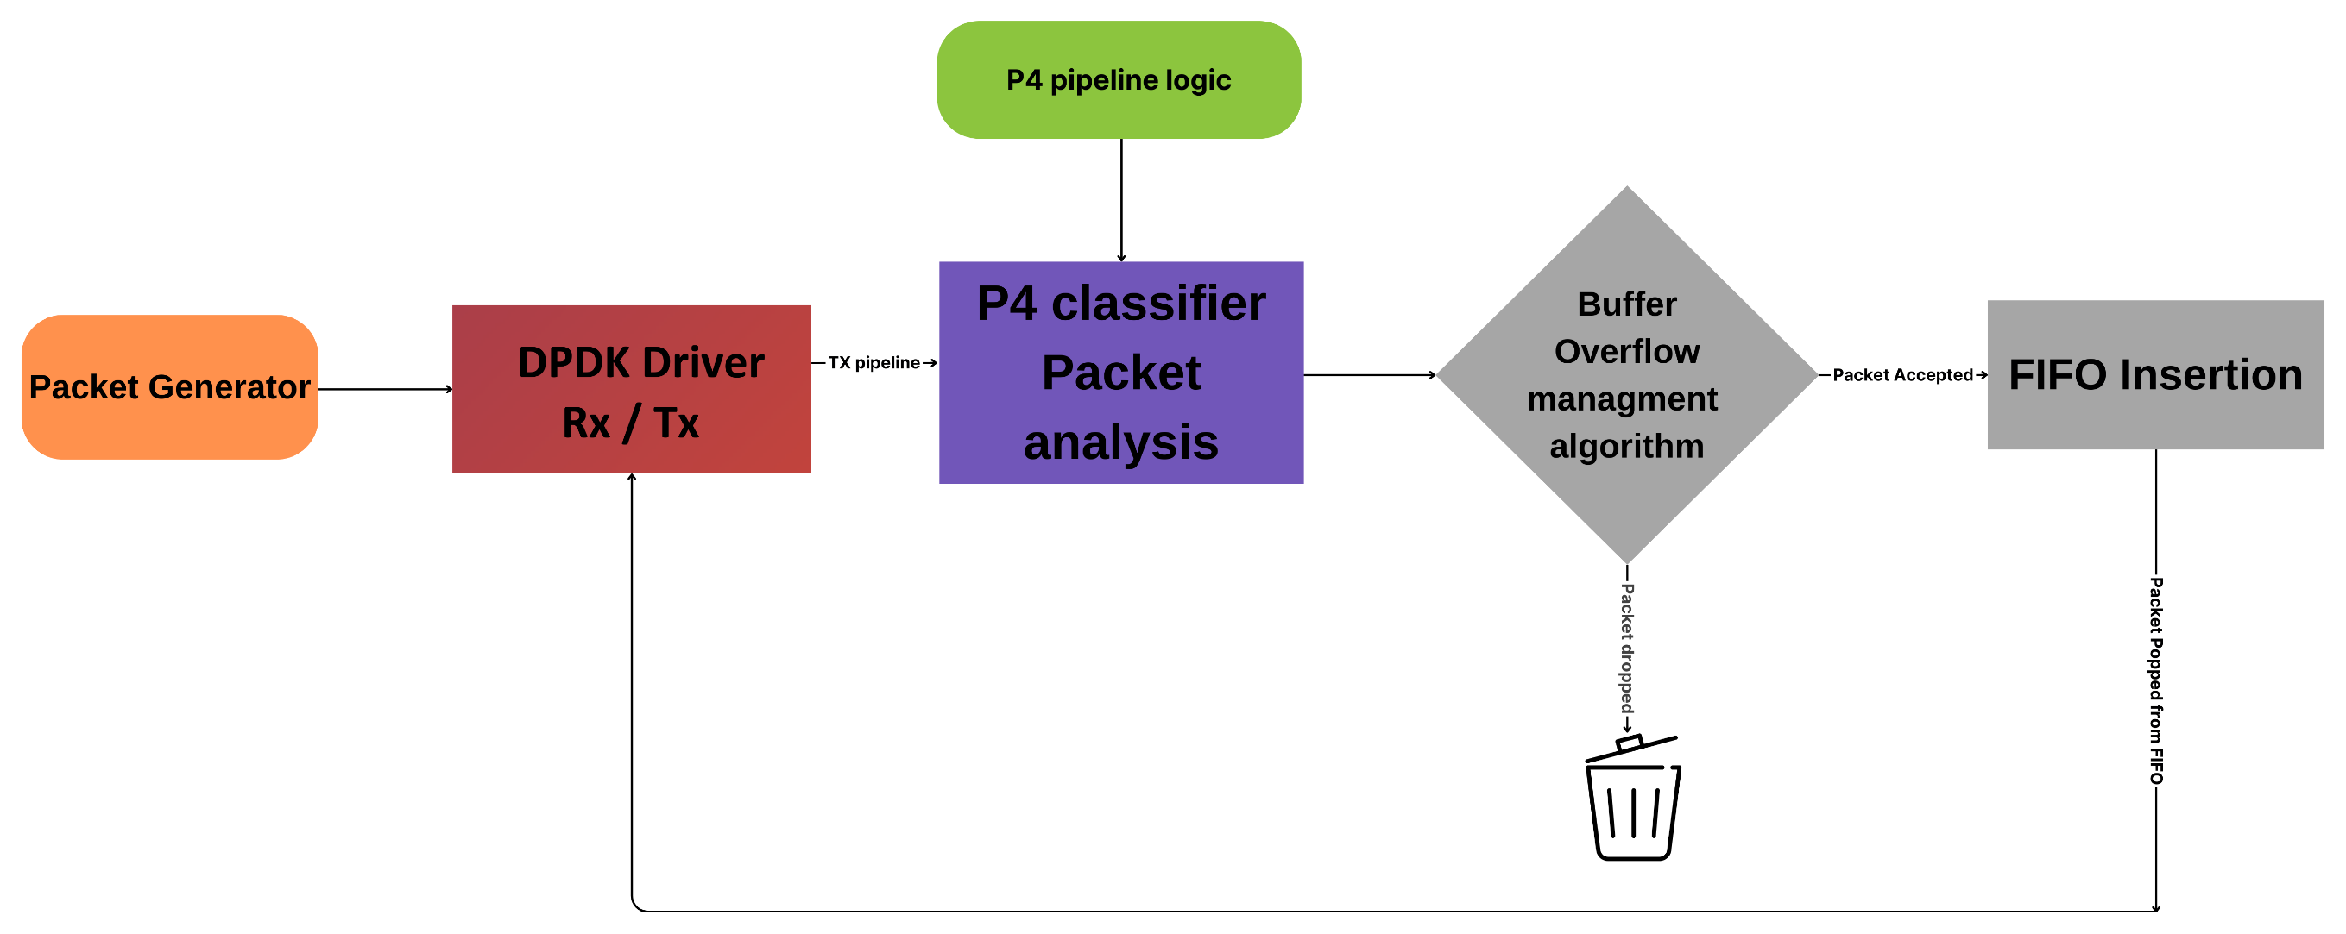
Introduction
This project involved the design and implementation of a software switch using DPDK (Data Plane Development Kit) that is configurable with P4 (Programming Protocol-Independent Packet Processors).

Slide 5
Methods
Our Integrated solution is comprised of two main stages:
A packet classifier that can be configured in real-time. The classifier is being loaded to the system in real-time using P4. The classifier assigns a Quality of Service (QoS) value to each packet.
Buffer-overflow management algorithm, Implemented in the NIC’s DPDK driver (depends on the free buffer space and the packet’s QoS).

Slide 6
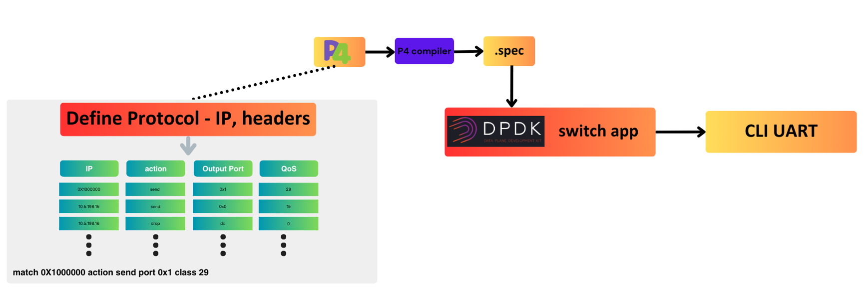
P4 classifier

Slide 7
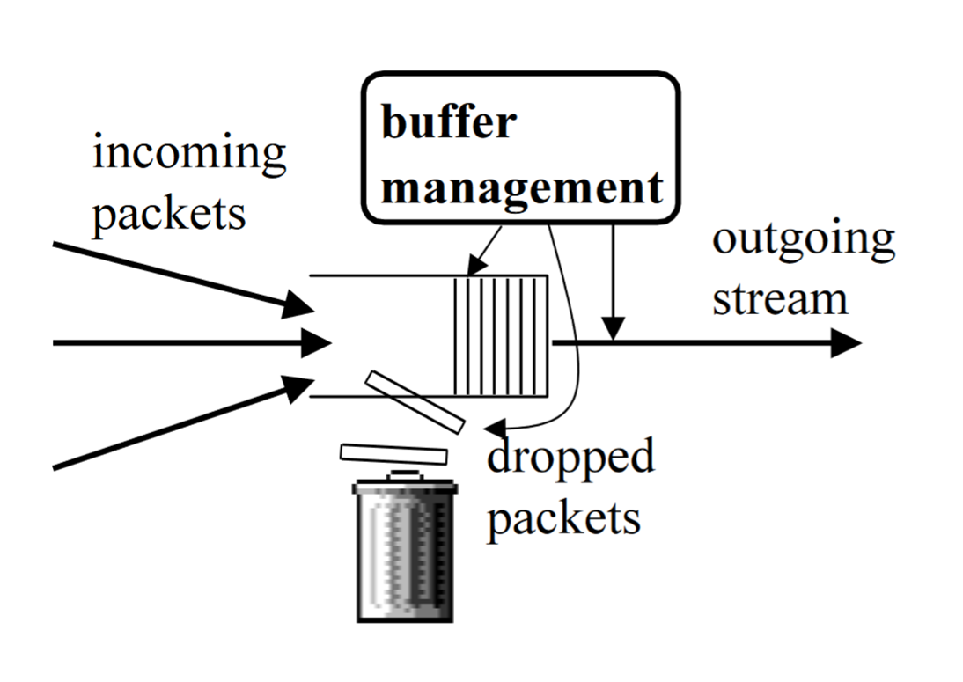
22-1-2-2599

Slide 8
22-1-2-2599
Algorithm - Default algorithm
Every packet passes.

Slide 9
22-1-2-2599
Algorithm - Three Buffers Round Robin
The buffer is split into three sub-buffers for handling packets with different priorities, and each sub-buffer is served in a round-robin manner.

Slide 10
22-1-2-2599
Algorithm - Inverse Linear algorithm Inverse Linear
Packets pass \ dropped deterministically (QoS threshold).

Slide 11
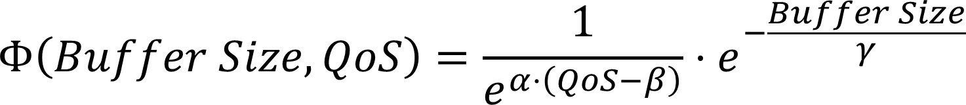
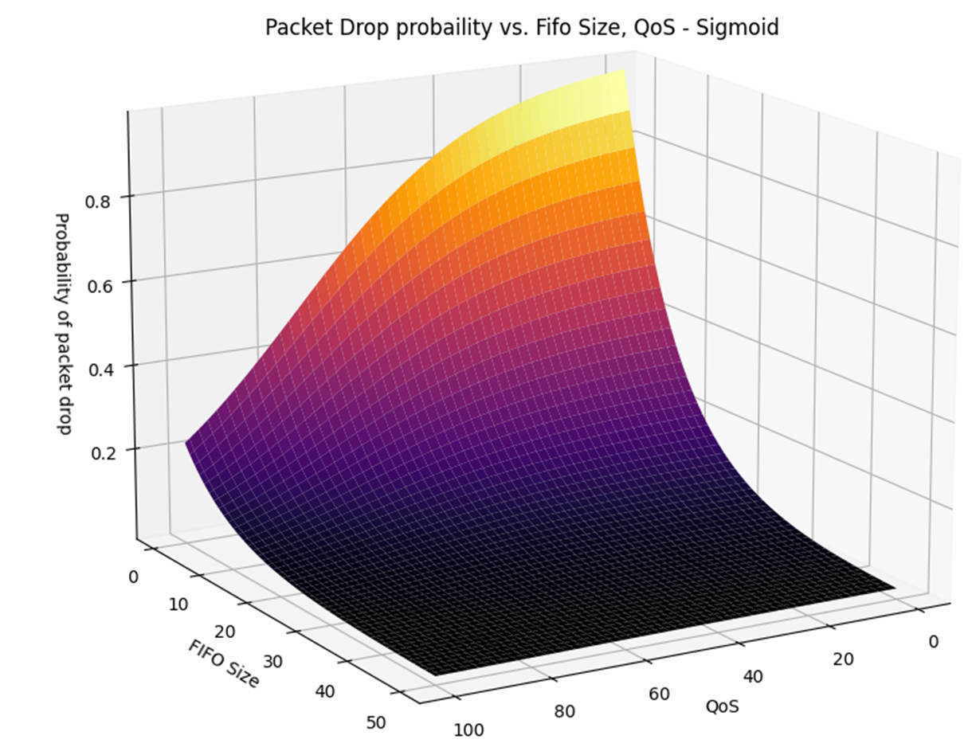

Probabilistic

Slide 12
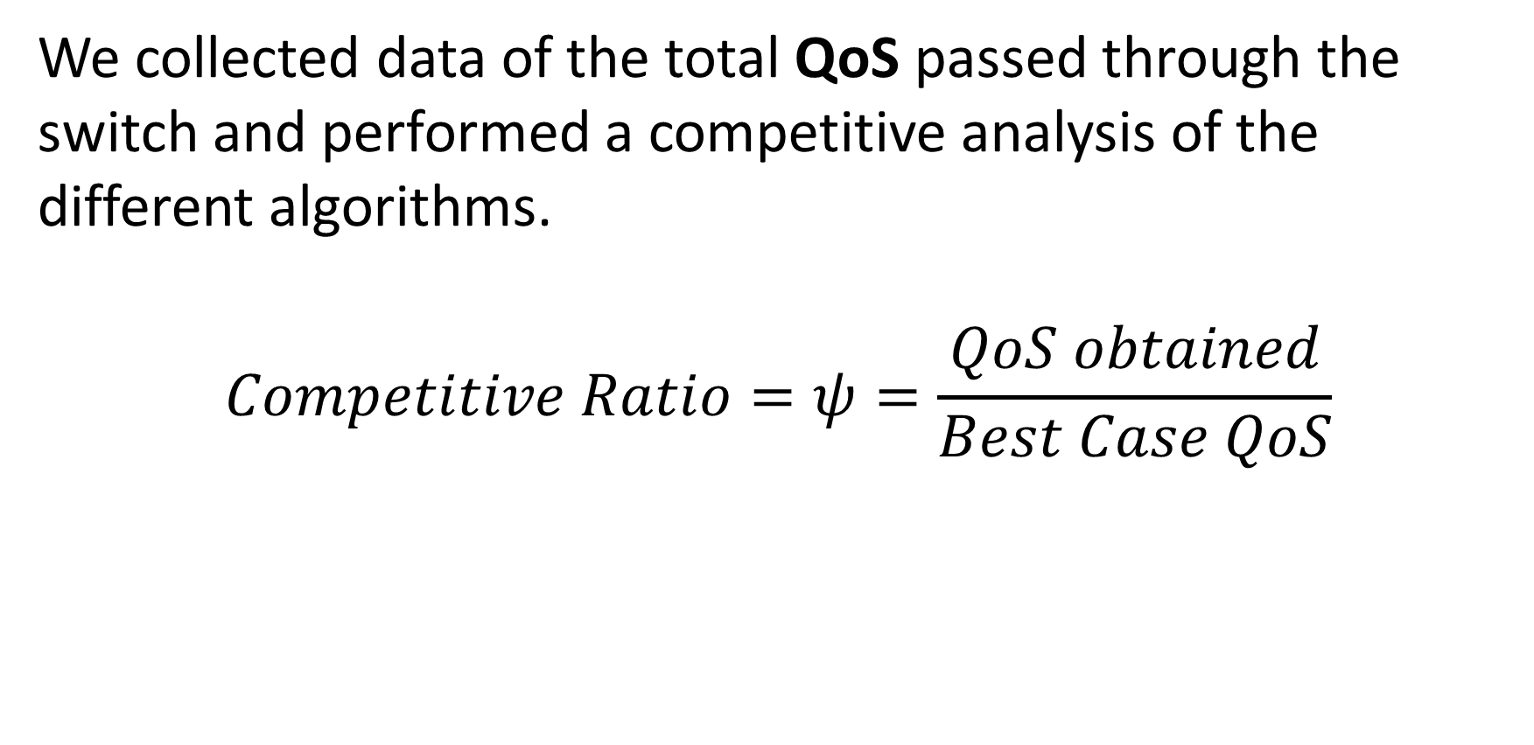
22-1-2-2599
We collected data of the total QoS passed through the switch and performed a competitive analysis of the different algorithms.
$$Competitive Ratio=ψ=\frac{QoS obtained}{Best Case QoS}$$

Slide 13
Conclusions
From the obtained results, we observe a clear improvement of the default packet forwarding procedure in a high-stress network state.
Also, The switch can support different communication protocols, which can be configured in real-time.

Slide 14
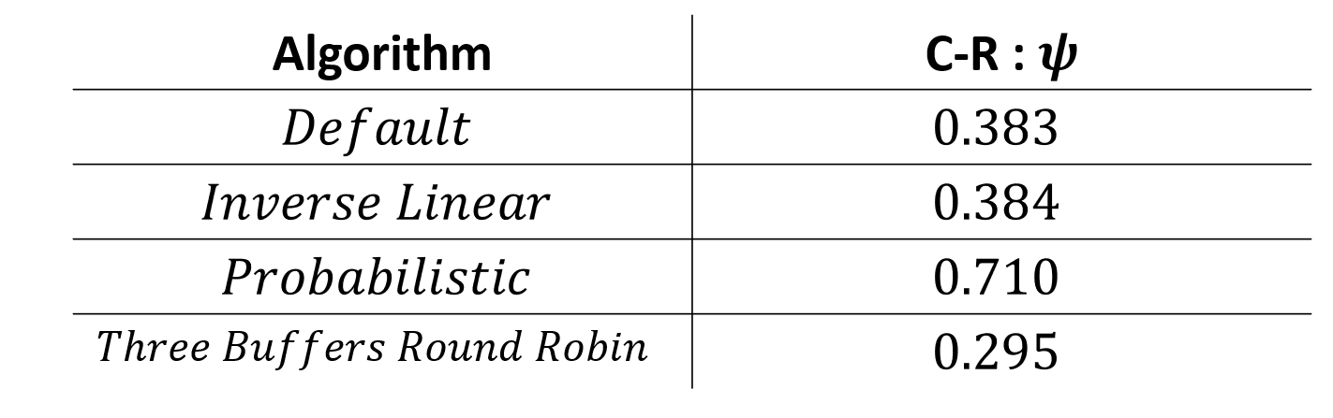
22-1-2-2599

Slide 15
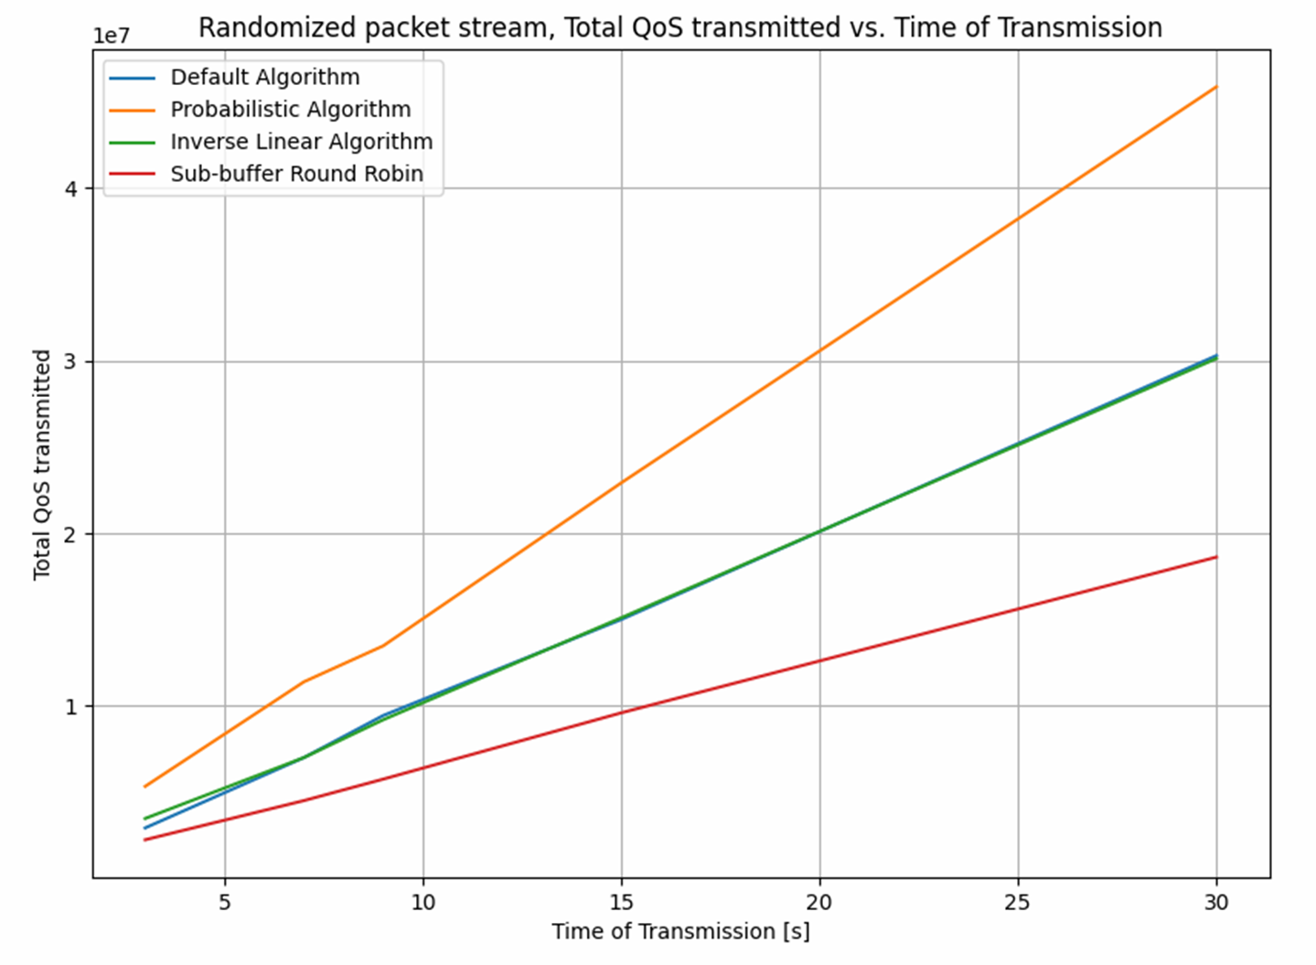
22-1-2-2599

Slide 16
Bibliography
[1] A. Kesselman, Z. Lotker, Y. Mansour, B. Schieber, M. Svirdenko and B. P Shamir. "Buffer Overflow Management in QoS Switches”
https://github.com/DavidisP4/DpdkP4BufferOverflow

