Slide 1
Problem: Determine the positions of each letter in a given string (with length < 1000001)
Input
AbAABzBCAaa
Output
  A: 0 2 3 8
  B: 4 6
  C: 7
  a: 9 10
  b: 1
  z: 5

Slide 2
Positions of each letter
Example:
Position:
String:
0 | 1 | 2 | 3 | 4 | 5 | 6 | 7 | 8 | 9 | 10
A | b | A | A | B | z | B | C | A | a | a
A | b | A | A | B | z | B | C | A | a | a
A | b | A | A | B | z | B | C | A | a | a
A | b | A | A | B | z | B | C | A | a | a
A | b | A | A | B | z | B | C | A | a | a
A | b | A | A | B | z | B | C | A | a | a
A | b | A | A | B | z | B | C | A | a | a
A | 0 2 3 8
B | 4 6
C | 7
a | 9 10
b | 1
z | 5

Slide 3

Steps
Choose a letter from ‘A’ to ‘z’ in sequence
Compare it with each character in the string
Print the position if matched
Choose: | A
Choose:
Position:
String:
0 | 1 | 2 | 3 | 4 | 5 | 6 | 7 | 8 | 9 | 10
A | b | A | A | B | z | B | C | A | a | a
A | b | A | A | B | z | B | C | A | a | a
A | b | A | A | B | z | B | C | A | a | a
A | b | A | A | B | z | B | C | A | a | a
A | b | A | A | B | z | B | C | A | a | a
Print:
Print: | A: 0, 2, 3
Print: | A: 0, 2, 3, 8
Print: | A: 0
Print: | A: 0, 2

Slide 4
Steps
Choose a letter from ‘A’ to ‘z’ in sequence
Compare it with each character in the string
Print the position if matched
依此類推
Choose: | B
Position:
String:
0 | 1 | 2 | 3 | 4 | 5 | 6 | 7 | 8 | 9 | 10
A | b | A | A | B | z | B | C | A | a | a
A | b | A | A | B | z | B | C | A | a | a
A | b | A | A | B | z | B | C | A | a | a
A | b | A | A | B | z | B | C | A | a | a
A | b | A | A | B | z | B | C | A | a | a
A | b | A | A | B | z | B | C | A | a | a
A | b | A | A | B | z | B | C | A | a | a
Print: | A: 0, 2, 3, 8 B: 4, 6
Print: | A: 0, 2, 3, 8 B: 4
Print: | A: 0, 2, 3, 8

Slide 5
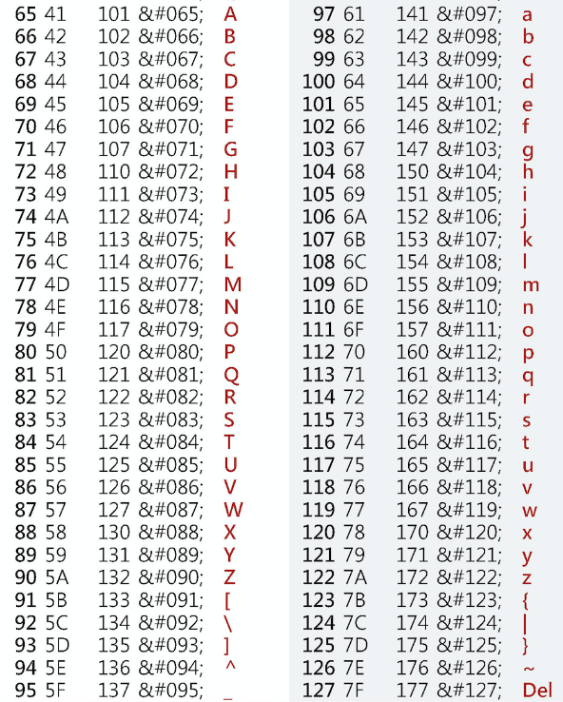
Steps
ch = ???;
while (ch<=???) {
…
…
for (i=0; ???; i++) {
if (???) {
…
printf("%c: %d", ch, ???);
…
…
…
…
}
}
…
…
…
…
…
ch++;
}
Choose a letter from ‘A’ to ‘z’ in sequence
Compare it with each character in the string
Print the position if matched
ch = 'A';
while (ch<=‘z') {
…
…
for (i=0; ???; i++) {
if (???) {
…
printf("%c: %d", ch, ???);
…
…
…
…
}
}
…
…
if(ch==‘Z’)
ch = ‘a’;
else
ch++;
}
ch = 'A';
while (ch<=‘z') {
found = 0;
len = strlen(str);
for (i=0; i<len; i++) {
if (str[i] == ch) {
if(!found) {
printf("%c: %d", ch, i);
found = 1;
} else {
printf(", %d", i);
}
}
}
…
…
if(ch==‘Z’)
ch = ‘a’;
else
ch++;
}
ch = 'A';
while (ch<=‘z') {
…
len = strlen(str);
for (i=0; i<len; i++) {
if (str[i] == ch) {
…
printf("%c: %d", ch, i);
…
…
…
…
}
}
…
…
if(ch==‘Z’)
ch = ‘a’;
else
ch++;
}
ch = 'A';
while (ch<=‘z') {
found = 0;
len = strlen(str);
for (i=0; i<len; i++) {
if (str[i] == ch) {
if(!found) {
printf("%c: %d", ch, i);
found = 1;
} else {
printf(", %d", i);
}
}
}
if(found)
printf("\n");
if(ch==‘Z’)
ch = ‘a’;
else
ch++;
}
ch = 'A';
while (ch<=‘z') {
found = 0;
len = strlen(str);
for (i=0; i<len; i++) {
if (str[i] == ch) {
if(!found) {
printf("%c: %d", ch, i);
found = 1;
} else {
printf(", %d", i);
}
}
}
if(found)
printf("\n");
if(ch==‘Z’)
ch = ‘a’;
else
ch++;
}
ch = 'A';
while (ch<=‘z') {
…
len = strlen(str);
for (i=0; i<len; i++) {
if (str[i] == ch) {
if(???) {
printf("%c: %d", ch, i);
…
} else {
printf(", %d", i);
}
}
}
…
…
if(ch==‘Z’)
ch = ‘a’;
else
ch++;
}
依此類推
Choose: | B
Position:
String:
0 | 1 | 2 | 3 | 4 | 5 | 6 | 7 | 8 | 9 | 10
A | b | A | A | B | z | B | C | A | a | a
A | b | A | A | B | z | B | C | A | a | a
A | b | A | A | B | z | B | C | A | a | a
A | b | A | A | B | z | B | C | A | a | a
A | b | A | A | B | z | B | C | A | a | a
A | b | A | A | B | z | B | C | A | a | a
A | b | A | A | B | z | B | C | A | a | a
Print: | A: 0, 2, 3, 8 B: 4, 6
Print: | A: 0, 2, 3, 8 B: 4
Print: | A: 0, 2, 3, 8

Slide 6
#include <stdio.h>
#include <string.h>
char str[1000001];
int main()
{
int i;
???
char ch;
scanf("%s", str); /* AbAABzBCAaa*/
ch = ???;
while (ch<=???) {
???
for (i=0; ???; i++) {
if (???) {
???
}
}
if (???)
printf("\n");
???
ch++;
}
}

