Slide 1
Final Project Tutorial

Slide 2
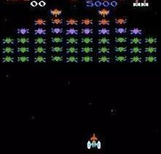
What is Allegro?
Allegro = Atari Low-Level Game Routines
Created in 1990s.
Written in C and supporting several platform, like windows, macos, linux-like platform and so on.

Slide 3
Before we start
1. bool type
A kind of data type in lots of programming languages
Like c++, java and so on.
It can only be assigned by two values:
0 – means false.
1 – means true.
You can just assign true or false to a bool variable. (e.g. bool a = true;)
Allegro implements a bool data type in itself.

Slide 4
Hello world
In this section, we will learn how to program our first allegro program.
For each allegro with display, we need to initial allegro, initial display, set and show the display, and finally, destroy all things have been initialized or created.
Let’s do it!!

Slide 5
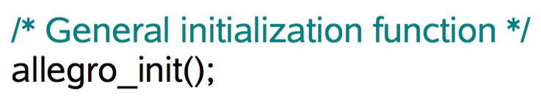
Hello world
1. Initial allegro
Step 1: #include <allegro5/allegro.h>
Step 2: Initialize.
It’s necessary to call the initialization function before doing anything else with the library.
After you calling this:
Great!!! The allegro is initialized. Now you can use any function you want in <allegro5/allegro.h>.

Slide 6
Hello world – cont.
2. Initial display
Step 1: Declare a pointer for display:
ALLEGRO_DISPLAY* display = NULL;
Step 2: Construct the display:
ALLEGRO_DISPLAY* al_create_display(int width, int height)

Slide 7
Hello world – cont.
Step 3: Set and show the display
To get color:
ALLEGRO_COLOR al_map_rgb( unsigned char r, unsigned char g, unsigned char b)
r, g, b are the integers belonging to [0, 255]
To set the whole window into the color:
void al_clear_to_color(ALLEGRO_COLOR color)
To show it:
void al_flip_display(void)

Slide 8
Hello world – cont.
Step 4: Destroy
Using function below to destroy your event_queue:
void al_destroy_event_queue(ALLEGRO_EVENT_QUEUE *queue)
Using function below to destroy your display:
void al_destroy_display(ALLEGRO_DISPLAY *display)
Please destroy all things we have initialized or created before the program closed.

Slide 9

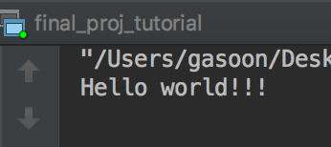
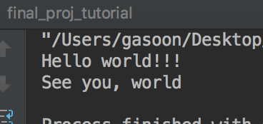
Task 1 – hello world
In this task, we will program our first allegro code -- hello world!!
Wait 5 sec…
Wait 5 sec…

Slide 10
Task 1– hello world
Please accomplish the task_1.c file.
There’s lots of hint, hoping that it might help you.
Feel free to ask us if there’s any problem.

Slide 11
Draw something!!!
In this section, we will learn how to show some words, graphics or even images in our window.

Slide 12
Draw something!!! – cont.
1. draw text on the window:
Step 1: include the following head files:
#include <allegro5/allegro_font.h> #include <allegro5/allegro_ttf.h>
Step 2: call the following function to initial:
al_init_font_addon(); // initialize the font addon al_init_ttf_addon(); // initialize the ttf (True Type Font) addon

Slide 13
Draw something!!! – cont.
1. draw text on the window:
Step 3:
void al_draw_text(const ALLEGRO_FONT *font, ALLEGRO_COLOR color, float x, float y, int flags, char const *text)
ALLEGRO_FONT *font: the font of text will be displayed.
Using this to construct:
ALLEGRO_FONT *al_load_ttf_font(char const *filename, int size, int flags)
filename = the address of your own .ttf file
size = the size of letter.
Notice: You have to construct 2 kinds of font if you want use the same .ttf file but in different size.
flags = 0 is enough.

Slide 14
Draw something!!! – cont.
1. draw text on the window:
void al_draw_text(const ALLEGRO_FONT *font, ALLEGRO_COLOR color, float x, float y, int flags, char const *text)
ALLEGRO_COLOR color: The same as we mentioned before.
ALLEGRO_COLOR al_map_rgb(unsigned char r, unsigned char g, unsigned char b)
r, g, b are the integers belonging to [0, 255]

Slide 15
Draw something!!! – cont.
1. draw text on the window:
void al_draw_text(const ALLEGRO_FONT *font, ALLEGRO_COLOR color, float x, float y, int flags, char const *text)
Float x and y: the coordiate of our text.
Flags: The flags parameter can be 0 or one of the following flags:
ALLEGRO_ALIGN_LEFT - Draw the text left-aligned (same as 0).
ALLEGRO_ALIGN_CENTRE - Draw the text centered around the given position.
ALLEGRO_ALIGN_RIGHT - Draw the text right-aligned to the given position.
Text: The words you want to draw on the window.

Slide 16
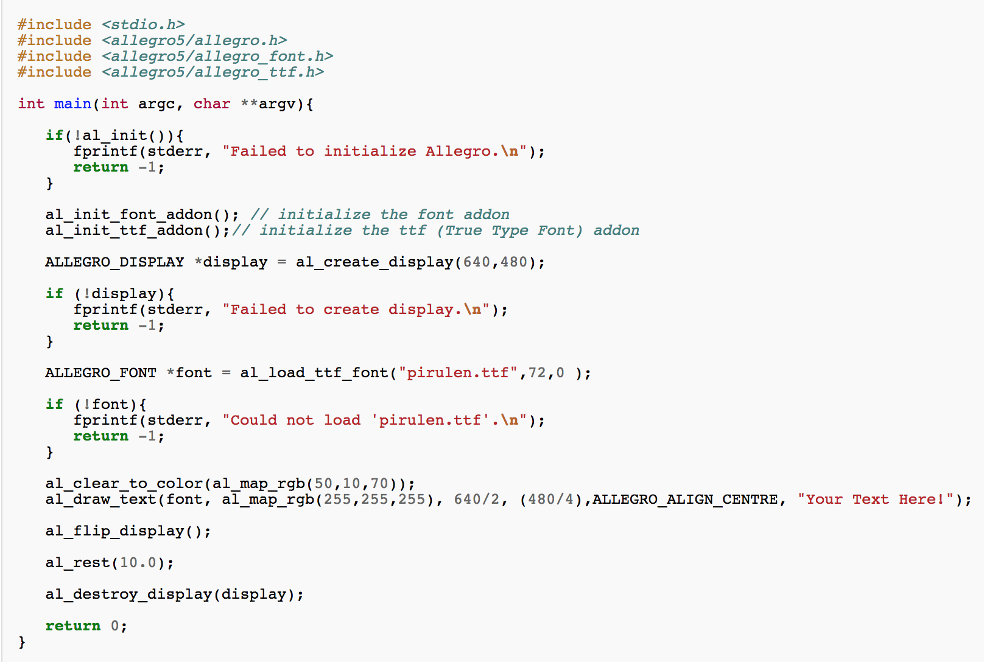
Put something!!! – cont.
1. draw text on the window

Slide 17
Draw something!!! – cont.
2. draw graphic on window:
Step 1: #include <allegro5/allegro_primitives.h>
Step 2: call the following function to initialize the library:
bool al_init_primitives_addon(void)
Step 3: call the function corresponding to the graphic you want to draw
Using rectangle as an example:
void al_draw_rectangle(float x1, float y1, float x2, float y2, ALLEGRO_COLOR color, float thickness)
x1, y1, x2, y2 - Upper left and lower right points of the rectangle
color - Color of the rectangle
thickness - Thickness of the lines, pass <= 0 to draw hairline lines
There’s bunch of functions drawing different graphics filled or not.
Using Google to explore if you need them!

Slide 18
Draw something!!! – cont.
3. draw a image
Step 1: including the following head file:
#include <allegro5/allegro_image.h>
Step 2: call the following function to initialize the library:
al_init_image_addon();
Step 3: declare a variable in ALLEGRO_BITMAP* type to contain our image:
ALLEGRO_BITMAP *img=NULL;

Slide 19
Draw something!!! – cont.
3. draw a image
Step 4: loading the image into our variable (e.g. img):
ALLEGRO_BITMAP *al_load_bitmap(const char *filename)
Filename: the address of your image file.
E.g. img = al_load_bitmap(“image.jpg”);
We can judge whether the variable img is NULL to determine whether the loading is success.

Slide 20
Draw something!!! – cont.
3. draw a image
Step 5: display the image
void al_draw_bitmap(ALLEGRO_BITMAP *bitmap, float dx, float dy, int flags)
bitmap: the variable containing the image
dx dy: the location of the image
flags can be:
ALLEGRO_FLIP_HORIZONTAL - flip the bitmap about the y-axis
ALLEGRO_FLIP_VERTICAL - flip the bitmap about the x-axis
0 – do nothing
Step 6: don’t forget to destroy all things you create and load
void al_destroy_bitmap(ALLEGRO_BITMAP *bitmap)

Slide 21
Task 2 – Just Draw!!
In this task, you are asked to draw something, including at least some words, one graphic and one image.
A sample font and image has already provided for you.
We also provided a sample code for you, filled with hint. You can either use it to design your own program, or coding from scratch.
Feel free to ask us if there’s any question!!!!
You should show something like this:

Slide 22
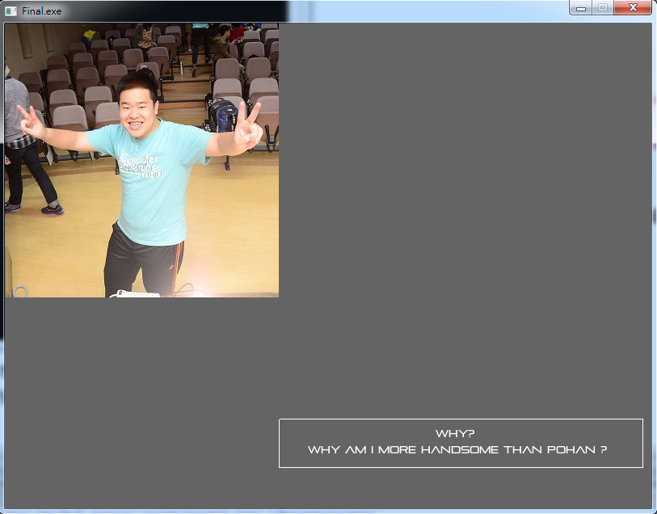

Slide 23
Deal with event
In this section, we will learn how to set up a basic interactive mechanism and deal with some interaction which is called event in the allegro.
For reach our goal, we need to initial event queue to record the event, and then process the event caught from event queue.
Now we share the method for you step by step.

Slide 24
Deal with event – cont.
1. Event
Event is something happened during the game running
Like keyboard input, click mouse, close display and so on.
2. Event_queue
Event_queue is a queue containing all event, and is the only source we catch any event.
Therefore, to let the code know what has happened, we must create a event queue first:
ALLEGRO_EVENT_QUEUE *event_queue = NULL;
event_queue = al_create_event_queue();

Slide 25
Deal with event – cont.
2. Event_queue – cont.
To set the type of event (keyboard, mouse, display, etc) recorded:
void al_register_event_source (ALLEGRO_EVENT_QUEUE *queue, ALLEGRO_EVENT_SOURCE *source)
E.g. al_register_event_source(event_queue, al_get_display_event_source(display));
Then we can get event from it.
More specific, the event we get from it must belongs to one of the source we have already registered.
If you can not get the event you expect (e.g. keyboard input), please check whether you register your keyboard as one of your event source before smashing your keyboard or your laptop.

Slide 26
Deal with event – cont.
3. Get event.
To know whether there is any event in event_queue:
bool al_is_event_queue_empty(ALLEGRO_EVENT_QUEUE *)
It will return a bool value:
1 (true) means the queue is empty;
0 (false) means there’s some event in the queue.
To get the event out of the queue:
ALLEGRO_EVENT event; (declare a variable to record the event)
void al_wait_for_event(ALLEGRO_EVENT_QUEUE * queue, ALLEGRO_EVENT* event); The program will be blocked here until the data of the earliest event have been duplicated into the allegro event we give.

Slide 27
Deal with event – cont.
4. Event type
How can we know what the event is (keyboard pressed, mouse clicked..)
Use event.type
E.g. event.type == ALLEGRO_EVENT_DISPLAY_CLOSE
The function is used to find whether the display is closed just now.

Slide 28


Task 3 – Close the window!!
Have you ever noticed that in the 2 tasks before, the window can not be closed in normal way (click the cross symbol at the corner)?
In this task, we will make it possible !!!
Wait …
Click the cross at the corner

Slide 29
Keyboard interaction
In this section, we will learn how to use keyboard and mouse as input source to interact with our program.

Slide 30
Keyboard interaction– cont.
Step 1: declare and create the event_queue and event as before.
Step 2: call bool al_init_primitives_addon(void) first then bool al_install_keyboard(void) to initial the keyboard
Step 3: register keyboard as event source to the event queue
Using ALLEGRO_EVENT_SOURCE *al_get_keyboard_event_source(void) to get the event source of keyboard
Using void al_register_event_source(ALLEGRO_EVENT_QUEUE *queue, ALLEGRO_EVENT_SOURCE *source) to register the source to event queue.

Slide 31
Keyboard interaction – cont.
Step 4: get the specific key being pressed down or bouncing up:
keycode to each button of keyboard: https://www.allegro.cc/manual/5/keyboard.html (e.g. A = ALLEGRO_KEY_A)
event.keyboard.keycode capsules the keycode of the key causing the event.
Comparing it with the keycode you design to get the result.
There are 2 event types for the keyboard:
ALLEGRO_EVENT_KEY_DOWN – indicating that there’re some keys being pressed
ALLEGRO_EVENT_KEY_UP – indicating that there’re some keys bouncing up just now.
Using event.type to judge the type of event.

Slide 32
Task 4 – control a box with keyboard!!!
Using up, down, left, right button to control the box move in the same way.
The box should move to the direction whenever the corresponding button is pressed, and stop whenever the corresponding button is released.
Press ESC to terminate the program

Slide 33
Mouse interaction
In this section, we will learn how to use mouse as input source to interact with our program.

Slide 34
Mouse interaction– cont.
Register the source of mouse to the event_queue
Using ALLEGRO_EVENT_SOURCE *al_get_mouse_event_source(void) to get the source of mouse.
Call bool al_init_primitives_addon(void) first then bool al_install_mouse(void) to initial the mouse.
To find whether the mouse is clicked just now
Compare the event.type with ALLEGRO_EVENT_MOUSE_BUTTON_DOWN
event.mouse.button capsules the information of the pressed button
1 for left button. 2 for right one, and so on so forth
To find whether the mouse is moving:
Compare the event.type with ALLEGRO_EVENT_MOUSE_AXES
Using event.mouse.x and event.mouse.y to get the position of cursor.

Slide 35
Task 5 – control a box with mouse!!!
Using mouse to determinate the location of the box.
The box should be the same place as the cursor whenever the cursor is in the window.
Press left button to make the box disappear and press it again to make it visible.
Press right button to terminate the program

