Slide 1
Speech Emotion Recognition
Benchmarking open-source and closed audio models on public emotional speech corpora,
and a roadmap for adaptation to call-centre audio
Chen Lequn · Project update · November 2026
Audio clips from public research corpora, used under their licences (CREMA-D ODbL, RAVDESS CC BY-NC-SA, TESS and MCAE-SPPS CC BY-NC, MESS CC BY, JL-Corpus CC0).
Notes:
Scope of this talk (about 35 minutes): results of benchmarking speech emotion recognition (SER) models on public emotional speech corpora, the main sources of difficulty in the task, and a plan to adapt the two strongest models to our own call-centre audio.
Audio clips are embedded: click a blue play button to start or pause a clip.

Slide 2
Outline
1
Research Objective
The speech emotion recognition (SER) task: definition, challenges and methodology
2
Public Datasets
Six emotional speech corpora: design, audio examples and inter-rater agreement
3
Benchmarking Models
Five open-source SER models and two audio LLMs: architectures and scale
4
Evaluation Results
Accuracy across corpora, effect of training-data overlap and confusion analysis
5
Error Analysis
Case studies of disagreement between models, acted labels and listeners
6
Future Work
Adaptation of emotion2vec+ and MERaLiON-SER-v1; annotation and active learning
1
Notes:
The talk has six parts. Parts two to five present the benchmark: the corpora, the models, the quantitative results and a qualitative error analysis with audio. Part six presents the proposed adaptation and annotation plan.

Slide 3
1 · RESEARCH OBJECTIVE
Task Definition
Input: speech clip
1–5 s, 16 kHz mono
"Don't forget a jacket."
SER model
(or audio LLM)
Output: one probability per class
angry
2%
disgusted
1%
fearful
3%
happy
5%
neutral
12%
sad
74%
surprised
3%
Utterance-level categorical classification into seven emotion classes
  angry · disgusted · fearful · happy · neutral · sad · surprised (the emotion2vec+ label set); the predicted label is the class of highest probability
Lexically neutral stimuli
  Each corpus uses the same sentences across all emotions, so the lexical content carries no emotional information; recognition must rely on paralinguistic cues (pitch, intensity, tempo, voice quality)
Reference labels
  Intended emotion: the emotion portrayed by the actor (all corpora)
  Perceived emotion: listener ratings per clip (CREMA-D and MCAE-SPPS), analysed in Part 2
2
Notes:
The task is utterance-level classification: one clip in, one of seven labels out. Every model returns a probability per class and the class with the highest probability is the prediction.
All corpora are lexically neutral by design: the same sentence is spoken in every emotion. A system that relies on the words therefore cannot exceed chance level; this is particularly relevant for audio LLMs, which are strong at text understanding.
The reference label is the intended emotion of the actor. For two corpora we also have the perceived emotion from listener ratings.

Slide 4
1 · RESEARCH OBJECTIVE
Challenges in Speech Emotion Recognition
1
2
3
4
Label subjectivity
Acted vs spontaneous speech
Domain shift
Training-data overlap
41.6%
6 of 6
8 kHz
4 of 6
of CREMA-D clips: listeners' majority vote equals the acted emotion
evaluation corpora are acted, short and exaggerated
telephone bandwidth, vs 16–48 kHz studio recordings in the corpora
evaluation corpora are in the training data of emotion2vec+
No single ground truth
Requires multiple raters and agreement statistics
Call-centre speech is spontaneous, subtle and mostly neutral
Benchmark accuracy is an upper bound
Also language, accent, noise and turn length
Accuracy falls 20–52 points on unseen corpora
Published scores are optimistic
Every overlap is marked (†) in our results
3
Notes:
Four sources of difficulty, each with one number.
First, label subjectivity: on CREMA-D the listeners' majority agrees with the acted emotion on only 42 percent of clips. There is no single ground truth, which we will hear in Part 2.
Second, all six corpora are acted; call-centre speech is spontaneous and mostly neutral, so benchmark accuracy is an upper bound.
Third, domain shift: telephone audio is band-limited to 8 kHz, and language, accent, noise and turn length also differ. On corpora outside their training data, the models lose 20 to 52 points of accuracy.
Fourth, training-data overlap: four of our six corpora are in the training data of emotion2vec+, so its scores on them are optimistic. We mark every such case with a dagger.

Slide 5
1 · RESEARCH OBJECTIVE
Evaluation Methodology
1 Dataset survey
2 Model survey
3 Benchmark
4 Analysis
5 Adaptation plan
37 public emotional speech corpora reviewed
42 SER models and audio LLMs reviewed
Every model run as released (zero-shot) on identical clips
Accuracy, unweighted accuracy, macro-F1, confusion matrices
Fine-tuning strategy, annotation protocol, active learning
6 corpora selected: parallel text, validated labels, clear licence
5 open models + 2 closed audio LLMs
Labels mapped to 7 shared classes
Listening-based error analysis
Roadmap with decision gates
6
21,357
7
3
corpora
clips per model
models
metrics
Open models: all clips, run locally · audio LLMs: 200 clips per corpus through their APIs · predictions and probabilities stored per clip; an HTML viewer supports listening to any prediction
4
Notes:
The methodology in five stages. We surveyed public corpora and models, selected six corpora and seven models, and ran every model as released on exactly the same clips with the same label mapping. The analysis combines standard metrics with listening to individual clips, and the final stage is the adaptation plan.
The open models were run locally on all 21,357 clips. GPT Realtime and Gemini were run through their APIs on 200 clips per corpus, sampled at even intervals over the emotions.

Slide 6
2 · PUBLIC DATASETS
Dataset Survey and Selection
37 corpora surveyed
Dataset | Language | Speakers | Clips | Hours | Emotions | Parallel text | Labels | Licence
CREMA-D | US English | 91 | 7,442 | 5.3 | 6 | 12 sentences | actor + ≈9 listeners | ODbL
MCAE-SPPS | Mandarin | 6 | 6,675 | 2.3 | 7 | 200 sentences | actor + 40 listeners | CC BY-NC
MESS | US English | 6 | 1,800 | 1.3 | 4 | 90 sentences | actor | CC BY
RAVDESS | N. Am. English | 24 | 1,440 | 1.5 | 7 | 2 sentences | actor | CC BY-NC-SA
TESS | Canadian Eng. | 2 | 2,800 | 1.6 | 7 | 200 words | actor | CC BY-NC
JL-Corpus | NZ English | 4 | 1,200 | 0.7 | 5 | 15 sentences | actor | CC0
papers, project pages, HF, Zenodo, OSF
9 downloaded
licence and access checked
6 evaluated
ESD left out (licence), THAI-SER and nEMO (language)
Selection criteria
Same sentences in every emotion (words give no clue)
Good labels, ideally listener-validated
Size, and a clear licence and download
21,357 clips, 12.7 hours, 133 speakers, 2 languages
None is spontaneous speech; MCAE-SPPS and MESS are in no model's training data
5
Notes:
We surveyed 37 public corpora, downloaded nine and evaluate six. The deciding criterion is parallel text: the same sentence in every emotion, so the words cannot give the answer away.
Two corpora, CREMA-D and MCAE-SPPS, also have listener votes per clip, which we use to show how subjective the task is. MCAE-SPPS and MESS are the two corpora no model has trained on; they are the most honest test.

Slide 7
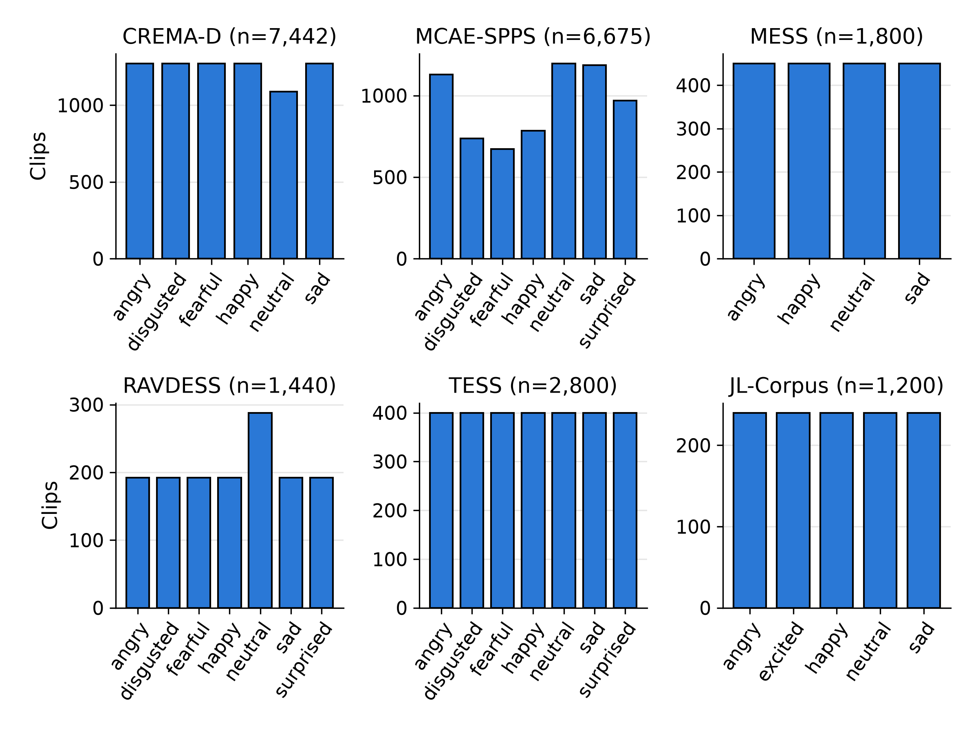
2 · PUBLIC DATASETS
Unified Label Space
 | Project label set: the 7 emotion classes of emotion2vec+, plus unknown / other
Dataset | angry | disgusted | fearful | happy | neutral | sad | surprised | unknown / other
CREMA-D | ● | ● | ● | ● | ● | ● |  | –
MCAE-SPPS | ● | ● | ● | ● | ● | ● | ● | –
MESS | ● |  |  | ● | calm | ● |  | –
RAVDESS | ● | ● | ● | ● | neutral + calm | ● | ● | –
TESS | ● | ● | ● | ● | ● | ● | pleasant surprise | –
JL-Corpus | ● |  |  | happy + excited* | ● | ● | excited* | –
● the dataset's own label is identical to the project class
orange the dataset's own label name, mapped to the project class of that column (e.g. MESS "calm" is scored as neutral)
* JL-Corpus "excited" is scored as correct if the prediction is happy or surprised
unknown / other no corpus uses it; the models' extra classes (emotion2vec+ other, <unk>; Vox-Profile contempt, other) are excluded, since the prediction is the most probable of the dataset's own emotions
Shared by all six corpora: angry, happy, neutral, sad (basis of the 4-class comparison in Part 4)
Clips per emotion in each corpus: balanced by design, unlike call-centre audio
6
Notes:
All dataset labels are mapped to the project label set: the seven emotion classes of emotion2vec+, plus unknown or other, which no corpus uses. A dot means the dataset uses the same label. Orange text shows the dataset's own label name where it had to be mapped: calm is scored as neutral in MESS and RAVDESS, pleasant surprise as surprised in TESS, and JL-Corpus excited is counted as correct if a model predicts happy or surprised.
Models with additional classes, such as emotion2vec+ "other" or Vox-Profile "contempt", never have those classes chosen, because the prediction is restricted to the dataset's own emotions. On the right, the corpora are balanced by design, which is very different from real calls, where neutral dominates.

Slide 8

2 · PUBLIC DATASETS
Dataset: CREMA-D
Language
US English
Same speaker: 1089 (female, 24) · same sentence: "I'm on my way to the meeting." · click ▶ to listen
Speakers
91 actors (48 m, 43 f, aged 20–74)
Actor
Listeners (n = 10)
neutral
neutral 7
sad 3
Size
7,442 clips · 5.3 h · 16 kHz
emotion2vec+ neutral 1.00 MERaLiON neutral 0.88
Emotions
6: no surprised
Actor
Listeners (n = 10)
Design
12 sentences × 6 emotions
angry
angry 9
emotion2vec+ angry 1.00 MERaLiON angry 0.89
Labels
actor's intent + crowd votes (≈9 listeners per clip, voice only; 2,443 raters)
Actor
Listeners (n = 10)
Licence
ODbL
happy
happy 10
emotion2vec+ happy 1.00 MERaLiON happy 0.88
In training of
emotion2vec+, MERaLiON
Actor
Listeners (n = 10)
The most used benchmark. Listener votes show what people actually hear (next slides).
sad
sad 7
neutral 3
emotion2vec+ sad 1.00 MERaLiON sad 0.80
Predictions: green = matches the actor, red = differs
7
Notes:
CREMA-D, 2014: 91 actors of different ages and ethnicities, each saying 12 sentences in six emotions. It is the only large corpus with crowd-sourced votes for every clip, which makes it valuable for studying subjectivity. Here one actress says "I'm on my way to the meeting" in four emotions; listeners agree with her on all four. Let's listen.

Slide 9
2 · PUBLIC DATASETS
Dataset: MCAE-SPPS
Language
Mandarin Chinese
Same speaker: 6 (female) · same sentence: "他们听了一个讲座 (They attended a lecture.)" · click ▶ to listen
Speakers
6 professional actors (3 m, 3 f)
Actor
Listeners (n = 40)
neutral
neutral 38
Size
6,675 clips · 2.3 h · 48 kHz
emotion2vec+ neutral 1.00 MERaLiON neutral 0.67
Emotions
all 7
Actor
Listeners (n = 40)
Design
200 sentences × 7 emotions × 6 actors
angry
angry 36
emotion2vec+ angry 1.00 MERaLiON angry 0.89
Labels
actor's intent; kept only if listeners' top choice (40 native listeners, 720 in total)
Actor
Listeners (n = 40)
Licence
CC BY-NC 4.0 (Sci Data 2026)
happy
happy 35
emotion2vec+ happy 1.00 MERaLiON happy 0.89
In training of
none
Actor
Listeners (n = 40)
Newest corpus, unseen by every model: the cleanest test of generalisation.
sad
sad 36
emotion2vec+ sad 0.98 MERaLiON sad 0.90
Predictions: green = matches the actor, red = differs
8
Notes:
MCAE-SPPS was published in Scientific Data in 2026: six professional Mandarin actors, 200 sentences, all seven emotions, and 40 native listeners per clip. Clips were kept only if listeners recognised the intended emotion more than any other. No model has seen it. The sentence here means "They attended a lecture".

Slide 10
2 · PUBLIC DATASETS
Dataset: MESS
Language
US English
Same speaker: F3 (female) · same sentence: sentence V12 (text not published) · click ▶ to listen
Speakers
6 (3 m, 3 f)
Actor
Listeners: no per-clip ratings published
neutral
Size
1,800 clips · 1.3 h · 24.4 kHz
emotion2vec+ neutral 0.93 MERaLiON neutral 0.89
Emotions
4: angry, calm (→ neutral), happy, sad
Actor
Listeners: no per-clip ratings published
Design
90 sentences × 4 emotions
angry
emotion2vec+ neutral 0.96 MERaLiON angry 0.89
Labels
actor's intent (listener ratings in the paper, not public)
Actor
Listeners: no per-clip ratings published
Licence
CC BY 4.0 (2019)
happy
emotion2vec+ happy 0.89 MERaLiON happy 0.89
In training of
none
Actor
Listeners: no per-clip ratings published
Every clip is normalised to the same loudness (≈ −27 dBFS RMS): loudness gives no clue, only pitch, timbre and timing.
sad
emotion2vec+ neutral 1.00 MERaLiON sad 0.89
Predictions: green = matches the actor, red = differs
9
Notes:
MESS, 2019: six speakers, 90 sentences, four emotions, with calm instead of neutral. One detail matters: all clips were normalised to the same loudness, so an angry clip is not louder than a sad one. Models that rely on loudness will struggle. Listen to the same speaker and sentence in four emotions.

Slide 11
2 · PUBLIC DATASETS
Dataset: RAVDESS
Language
North American English
Same speaker: Actor 02 (female) · same sentence: "Kids are talking by the door." · click ▶ to listen
Speakers
24 actors (12 m, 12 f)
Actor
Listeners: no per-clip ratings published
neutral
Size
1,440 clips · 1.5 h · 48 kHz
emotion2vec+ neutral 1.00 MERaLiON neutral 0.89
Emotions
8 → 7 (calm → neutral)
Actor
Listeners: no per-clip ratings published
Design
2 sentences × 8 emotions × 2 intensities × 2 takes
angry
emotion2vec+ angry 1.00 MERaLiON angry 0.89
Labels
actor's intent (validated: 10 ratings per file, 247 raters)
Actor
Listeners: no per-clip ratings published
Licence
CC BY-NC-SA 4.0 (2018)
happy
emotion2vec+ happy 1.00 MERaLiON happy 0.89
In training of
emotion2vec+
Actor
Listeners: no per-clip ratings published
Many speakers, few words: tests voice variation more than lexical variety.
sad
emotion2vec+ sad 1.00 MERaLiON sad 0.90
Predictions: green = matches the actor, red = differs
10
Notes:
RAVDESS, 2018: 24 actors, but only two sentences, "Kids are talking by the door" and "Dogs are sitting by the door", at normal and strong intensity. The strong versions are very expressive. emotion2vec+ has seen it.

Slide 12
2 · PUBLIC DATASETS
Dataset: TESS
Language
Canadian English
Same speaker: YAF (female, 26) · same sentence: "Say the word bar." · click ▶ to listen
Speakers
2 actresses, aged 26 and 64
Actor
Listeners: no per-clip ratings published
neutral
Size
2,800 clips · 1.6 h · 24.4 kHz
emotion2vec+ neutral 1.00 MERaLiON sad 0.90
Emotions
7 (pleasant surprise → surprised)
Actor
Listeners: no per-clip ratings published
Design
"Say the word ___" × 200 words × 7 emotions
angry
emotion2vec+ angry 1.00 MERaLiON angry 0.90
Labels
actor's intent
Actor
Listeners: no per-clip ratings published
Licence
CC BY-NC 4.0
happy
emotion2vec+ happy 1.00 MERaLiON happy 0.89
In training of
emotion2vec+
Actor
Listeners: no per-clip ratings published
Very clean and very narrow: two voices only, so one voice misjudged shifts a whole class.
sad
emotion2vec+ sad 1.00 MERaLiON sad 0.90
Predictions: green = matches the actor, red = differs
11
Notes:
TESS, from Toronto: two actresses, 26 and 64 years old, saying "Say the word" followed by one of 200 words. Very clean recordings, very exaggerated emotions, but only two voices. Remember this when we look at MERaLiON's confusion matrix.

Slide 13
2 · PUBLIC DATASETS
Dataset: JL-Corpus
Language
New Zealand English
Same speaker: female2 (female) · same sentence: "Tom beats that farmer." · click ▶ to listen
Speakers
4 (2 m, 2 f)
Actor
Listeners: no per-clip ratings published
neutral
Size
1,200 clips evaluated (of 2,400) · 0.7 h · 44.1 kHz
emotion2vec+ neutral 1.00 MERaLiON neutral 0.89
Emotions
5 primary: angry, excited, happy, neutral, sad
Actor
Listeners: no per-clip ratings published
Design
15 sentences × 5 emotions
angry
emotion2vec+ angry 1.00 MERaLiON angry 0.85
Labels
actor's intent (≈70% listener recognition for primary emotions)
Actor
Listeners: no per-clip ratings published
Licence
CC0
happy
emotion2vec+ happy 1.00 MERaLiON happy 0.88
In training of
emotion2vec+, Melati
Actor
Listeners: no per-clip ratings published
Secondary emotions (anxious, apologetic, …) are not in our label set and are not scored.
sad
emotion2vec+ sad 1.00 MERaLiON sad 0.87
Predictions: green = matches the actor, red = differs
12
Notes:
JL-Corpus, New Zealand English: four speakers and fifteen sentences. It also has secondary emotions such as apologetic or concerned, interesting for call centres, but outside our seven classes, so we score only the five primary emotions. Excited counts as happy or surprised.

Slide 14
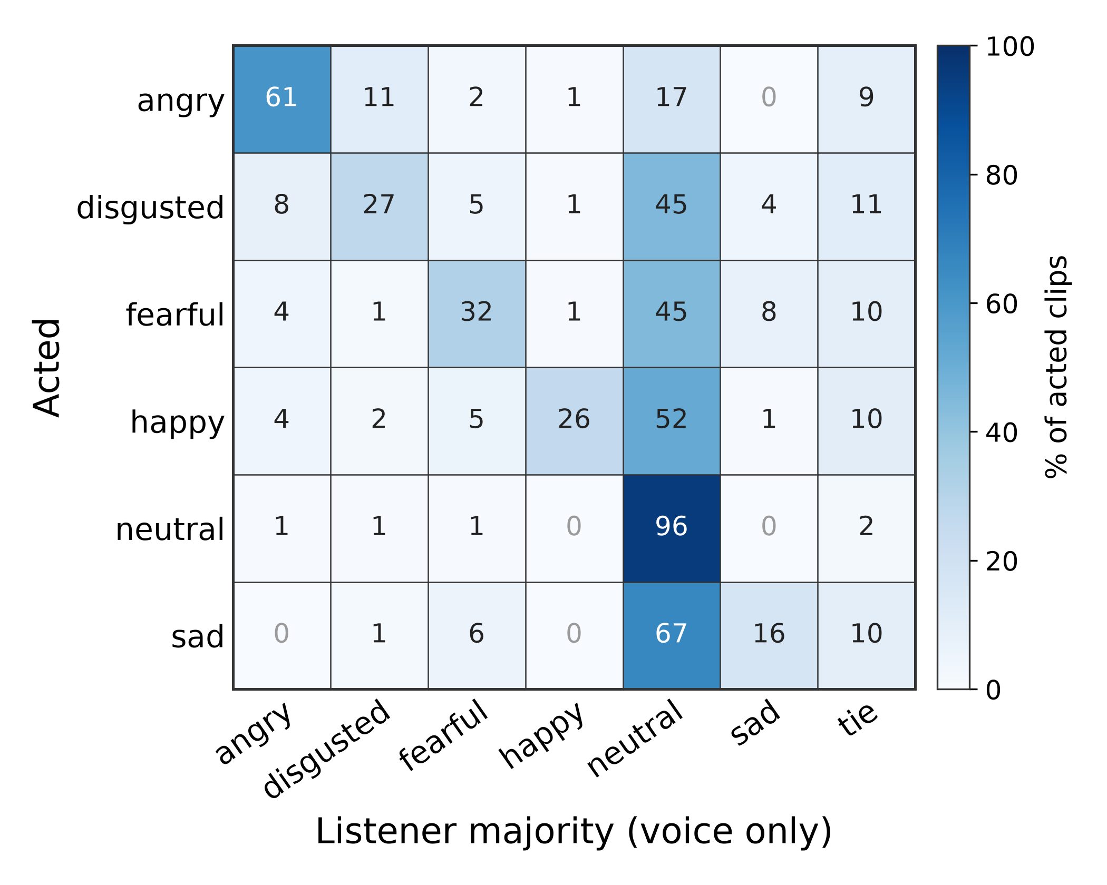
2 · PUBLIC DATASETS
Inter-Rater Agreement: Actor vs Listeners (CREMA-D)
41.6%
14.8%
of clips: listener majority = actor's emotion (8.7% ties)
of clips: not a single listener chose the actor's emotion
Neutral is easy (96%), angry moderate (61%)
Sad (16%), happy (26%), disgusted (27%), fearful (32%) are mostly heard as neutral
With the face visible, agreement rises to 76.5% (CREMA-D paper): voice alone carries less emotion than actors intend
Implication: intended and perceived emotion are distinct reference labels and must be chosen explicitly
Rows: what the actor portrayed · columns: what the listeners' majority heard (voice only)
13
Notes:
This is the key slide about subjectivity. In CREMA-D every clip was rated by about nine people who only heard the voice. The majority agreed with the actor on only 42 percent of clips, and on 15 percent of clips not one listener chose the intended emotion.
The pattern is systematic: subtle emotions such as sadness, happiness, disgust and fear are mostly heard as neutral. With the video, agreement rises to 77 percent. So the voice carries less emotion than the actors think they put in. This raises the question for our own labels: do we want the speaker's intent, or what a listener perceives? For a customer-experience use case, perception is arguably what matters.

Slide 15
2 · PUBLIC DATASETS
Intended vs Perceived Emotion: Audio Examples (CREMA-D)
Clip
Actor (intended)
Listeners (perceived, n = 10)
Model predictions
Observation
"We'll stop in a couple of minutes."
emotion2vec+ †
happy 1.00
All 10 listeners heard angry; MERaLiON agrees with them, emotion2vec+ with the actor
happy
angry 10
MERaLiON †
angry 0.72
speaker 1014 (male, 24)
Vox WavLM
happy 0.19
"The airplane is almost full."
emotion2vec+ †
fearful 1.00
All 10 listeners heard sad; both top models still predict the actor's fearful
fearful
sad 10
MERaLiON †
fearful 0.83
speaker 1089 (female, 24)
Vox WavLM
sad 0.35
"It's eleven o'clock."
emotion2vec+ †
disgusted 1.00
9 of 10 listeners heard angry; both top models predict the actor's disgusted
disgusted
angry 9
MERaLiON †
disgusted 0.70
speaker 1029 (female, 33)
Vox WavLM
neutral 0.16
"The airplane is almost full."
emotion2vec+ †
sad 1.00
All 10 listeners heard neutral; emotion2vec+ predicts sad, MERaLiON happy
sad
neutral 10
MERaLiON †
happy 0.30
speaker 1082 (female, 20)
Vox WavLM
neutral 0.53
Prediction colours: green = the actor's emotion · orange = the listeners' majority · grey = neither. † = CREMA-D is in the model's training data.
14
Notes:
Four clips where the actor and the listeners disagree completely. Play each and decide for yourself before revealing the labels.
First: acted happy, all ten listeners heard angry. Second: acted fearful, all heard sad. Third: acted disgusted, nine heard angry. Fourth: acted sad, all heard neutral.
Notice that emotion2vec+ and MERaLiON, both trained on CREMA-D's acted labels, often side with the actor, even when every human disagrees.

Slide 16
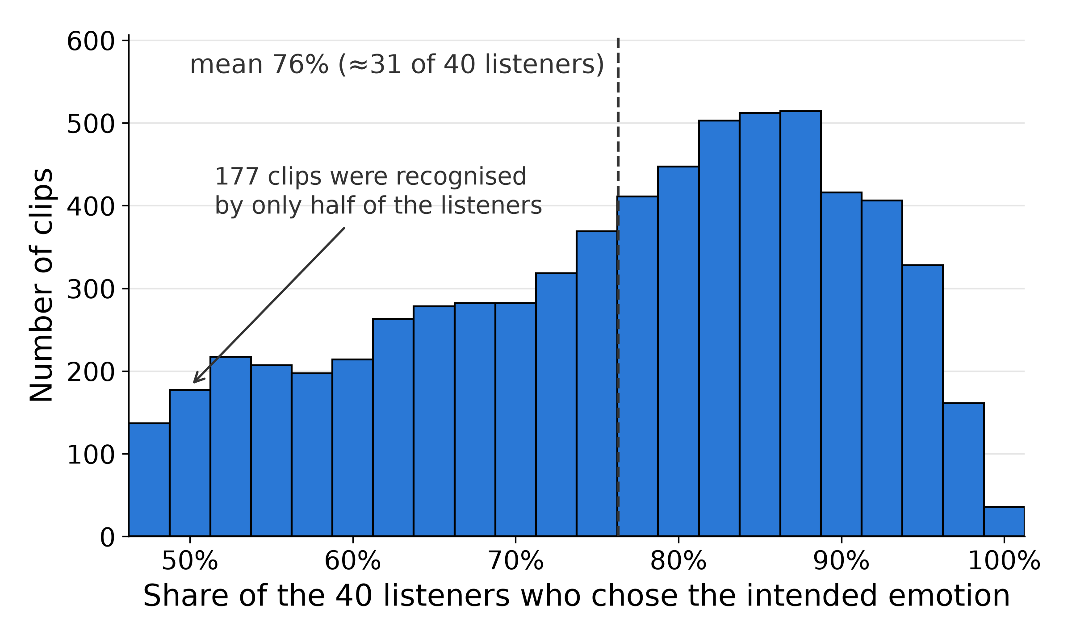
2 · PUBLIC DATASETS
Listener Recognition Rates (MCAE-SPPS)
他去看看 (He goes to take a look.)
Actor
surprised
Listeners (n = 40)
surprised 19
neutral 13
Models emotion2vec+ angry 0.70 MERaLiON surprised 0.43
你们看过这本书 (You (plural) have read this book.)
Actor
happy
Listeners (n = 40)
happy 19
surprised 13
Models emotion2vec+ happy 0.77 MERaLiON happy 0.43
How to read: each clip was rated by 40 listeners; its recognition rate is the share of them who chose the intended emotion. Each bar counts the clips with that rate
Mean 76%: a typical clip is recognised by about 31 of 40 listeners (range 47.5–100%); only 36 of 6,675 clips by all 40
Lowest: disgusted 63%, fearful 65%, happy 69% · highest: neutral 89%, sad 82%
我看着远处 (I look into the distance.)
Actor
angry
Listeners (n = 40)
angry 40
Models emotion2vec+ angry 1.00 MERaLiON angry 0.89
15
Notes:
How to read the histogram: every clip was rated by 40 native listeners. For each clip we compute the share of these 40 who chose the emotion the actor intended; this is the clip's recognition rate. The histogram counts clips per rate. For example, the bar at 50 percent counts 177 clips that were recognised by only 20 of the 40 listeners. The dashed line is the mean over all clips, 76 percent, so a typical clip is recognised by about 31 of 40 listeners. It is not the share of listeners who agree with a group of clips.
MCAE-SPPS is a curated corpus: only clips where listeners chose the intended emotion more than any other were kept. Even so, the average clip convinces 76 percent of 40 listeners, and only 36 clips convince all of them.
On the right, two borderline clips, where under half of the listeners heard the intended emotion, and a clear one, where all 40 agree and all five models are right. Ambiguity for humans and errors for models go together.

Slide 17
3 · BENCHMARKING MODELS
Model Survey and Selection
Model | Organisation | Released | Architecture | Params | Emotion training data | Classes | Licence
emotion2vec+ large | SJTU, Alibaba et al. | 2024-05 | data2vec 2.0-style encoder | 162.1M | 42.5k h pseudo-labelled (+ EmoBox) | 9 | commercial OK
MERaLiON-SER-v1 | A*STAR I²R, Singapore | 2025-10 | Whisper-medium enc. + ECAPA-TDNN | 313.4M | CREMA-D, ESD, MELD, M3ED, SG speech | 7 + VAD | commercial OK
Melati | Scicom, Malaysia | 2026-10 | Whisper large-v3 enc. (frozen) + MLP | 637.3M | 9 acted corpora (28.9k clips) | 7 | non-commercial
Vox-Profile Whisper | USC SAIL et al. | 2025-05 | Whisper large-v3 enc. (LoRA inactive) | 639.9M | MSP-Podcast (natural) | 9 | non-commercial
Vox-Profile WavLM | USC SAIL et al. | 2025-05 | WavLM-large (fully fine-tuned) | 316.2M | MSP-Podcast (natural) | 9 | non-commercial
GPT Realtime | OpenAI | 2025-08 | speech-to-speech LLM | undisclosed | undisclosed | prompted | API
Gemini 3.5 Flash | Google | 2026-05 | multimodal LLM | undisclosed | undisclosed | prompted | API
Survey: 42 entries (dedicated SER, dimensional, community checkpoints, open audio LLMs); selection: downloadable weights + runnable code, English, classes close to our 7
Dedicated SER models: 0.16–0.64B parameters; open audio LLMs: 5.5–35B; closed LLMs: size not published
Papers and model cards: emotion2vec (Ma et al., ACL Findings 2024) · MERaLiON-SER (arXiv 2511.04914) · Melati model card · Vox-Profile (Feng et al., arXiv 2505.14648) · GPT Realtime (OpenAI) · Gemini models (Google)
16
Notes:
The seven models. Five open models that we run locally, from 162 million to 640 million parameters, and two closed audio LLMs through their APIs.
Note the licence column: only emotion2vec+ and MERaLiON allow commercial use. And note the training data: that is where the daggers in the results come from.

Slide 18
3 · BENCHMARKING MODELS
Model Families: Dedicated SER Models vs Audio LLMs
Dedicated SER model (5 open models)
Implications
Waveform
Pre-trained speech encoder
data2vec · Whisper · WavLM
Pooling
over time
Classifier
head
P(7 emotions)
Dedicated models return class probabilities, run on-premises and can be adapted to call-centre audio.
Audio LLMs are convenient, but cannot be inspected or adapted, and require sending audio to an external service.
Encoder pre-trained on thousands of hours of speech (self-supervised or speech recognition); pooling and head trained on labelled emotional speech. 0.16–0.64B parameters; runs on-premises; can be fine-tuned.
Audio large language model (GPT Realtime, Gemini)
Waveform
Audio encoder
LLM decoder
(billions of parameters)
"sad"
(text)
Parser →
1 label
Text prompt
General-purpose model trained to understand and respond; emotion recognition is not its training objective. No class probabilities, no fine-tuning by us, audio processed by a cloud API.
17
Notes:
Two families of models. All five open models follow the same three-stage structure: a pre-trained speech encoder turns the waveform into a sequence of feature vectors, one every 20 milliseconds; a pooling stage summarises that sequence into one vector for the whole clip; and a small classification head maps the clip vector to class probabilities. The models differ in which encoder they use (data2vec-style for emotion2vec+, Whisper for MERaLiON, Melati and Vox-Profile Whisper, WavLM for Vox-Profile WavLM), in how they pool, and in how large the head is. The next slides map each model onto this structure.
The audio LLMs take the audio together with a text instruction and generate text, which we parse into a label. They are general-purpose models, give no probabilities and cannot be fine-tuned by us.

Slide 19
3 · BENCHMARKING MODELS
emotion2vec+ large: Architecture
Pre-trained speech encoder · 162.1M parameters in total
Pooling
Head
Waveform
16 kHz
CNN feature
extractor
7 conv layers
Projection
512 → 1024
Conv positional
encoding
+ 10 extra
tokens
Transformer
12 blocks
1024-d, 16 heads
Mean over
time
Linear
1024 → 9
+ softmax
4.2M
0.5M
6.2M
0.01M
151.2M
0
9k
CNN feature extractor: learns its own filter bank from the raw waveform; 16,000 samples per second become one 512-d feature vector every 20 ms (a learned spectrogram)
Projection and convolutional positional encoding: widen each frame to 1,024 dimensions and mix it with its neighbours (±0.9 s), so the Transformer knows the order of frames without fixed position numbers
Extra tokens: 10 learned vectors placed before the frames; in pre-training they summarise the whole utterance; removed before pooling at inference
Transformer encoder: self-attention lets every frame use information from all other frames, so each frame representation reflects the context of the whole clip (93% of the parameters)
Mean over time and linear head: the frames are averaged into one 1,024-d clip embedding; one linear layer maps it to 9 class probabilities
Input length: variable, no fixed window and no padding; memory grows with the square of the length; the authors recommend VAD-segmented utterances (training crops ≤ 20 s)
Measured from the released model.pt and FunASR 1.4.16; detailed diagram: Appendix A3. emotion2vec (Ma et al., ACL Findings 2024) · emotion2vec / emotion2vec+ code · emotion2vec+ large model card
18
Notes:
emotion2vec+ large maps onto the three-stage structure as follows: the pre-trained encoder is everything from the CNN to the Transformer; pooling is a plain mean over time; the head is a single linear layer.
The CNN feature extractor is seven one-dimensional convolution layers applied to the raw waveform. Think of it as a learned spectrogram: it slides over the audio and produces one 512-number summary every 20 milliseconds, about 50 per second.
The projection widens each of these vectors to 1,024 numbers. Transformers have no built-in notion of order, so the convolutional positional encoding mixes every frame with its neighbours within about 0.9 seconds on either side; the model thus knows which frames are adjacent. Because this is relative rather than a fixed table of positions, there is no maximum input length.
The ten extra tokens are learned vectors put in front of the sequence. During self-supervised pre-training they are trained to summarise the whole utterance; at inference they are simply removed before pooling, so they do not affect the prediction directly.
The Transformer encoder is twelve blocks of self-attention: each frame looks at all other frames and updates its representation with the context of the whole clip. This is where the model learns what emotional speech sounds like over time, and where 151 of the 162 million parameters are.
Finally the frame vectors are averaged into one clip vector, and one linear layer maps it to nine probabilities.
Input length: emotion2vec+ processes the real length of the clip, with no padding and no fixed window. The practical limit is memory, which grows with the square of the length because of self-attention; on this Mac, clips longer than about 20 seconds must run on the CPU. The authors recommend cutting long audio into utterances with voice activity detection.

Slide 20
3 · BENCHMARKING MODELS
emotion2vec+ large: Training Pipeline
emotion2vec
+ seed
+ base
+ large
self-supervised pre-training
(data2vec 2.0 style)
fine-tuned on academic
labelled data (EmoBox)
trained on filtered
pseudo-labels
trained on filtered
pseudo-labels (≈40k of 160k h)
hours of training audio (bar height not to scale)
262 h unlabelled
emotional speech
201 h
4,788 h
42,526 h
no labels
human labels
model labels
model labels
EmoBox includes CREMA-D, RAVDESS, TESS and JL-Corpus → the † on these corpora
Sources of the 42.5k h pseudo-labelled data and the training code are not published
emotion2vec (Ma et al., ACL Findings 2024) · EmoBox (Ma et al., Interspeech 2024) · emotion2vec+ large model card
19
Notes:
How emotion2vec+ was trained, and why it matters for fine-tuning. First, self-supervised pre-training on 262 hours of unlabelled emotional speech. Then three generations: seed was fine-tuned on about 200 hours of academic labelled data from EmoBox; base and large were trained on pseudo-labelled data, 4.8 thousand and 42.5 thousand hours.
Two consequences: the model has already seen four of our six corpora, and its features are already emotion features, which is why freezing it and training a small head is a strong first step.

Slide 21
3 · BENCHMARKING MODELS
MERaLiON-SER-v1: Architecture
Pre-trained speech encoder: Whisper-medium encoder (speech recognition pre-training) · 307.2M
Waveform
padded / cut
to 30 s
Log-mel
spectrogram
80 × 3000
Conv stem
2 × Conv1d
(stride 2)
+ sinusoidal
positions
(fixed)
24 Transformer blocks
d 1024 · 16 heads · FFN 4096
LoRA r16 on q/k/v (merged)
Frames
1500 × 1024
3.4M
1.5M
302.3M
Pooling and head: ECAPA-TDNN network (from speaker verification) · 6.0M, two output heads · model total 313.4M
proj_in
1024 → 512
3 ECAPA blocks
Res2 convs, dilation
1 / 2 / 3, SE
Multi-layer
aggregation
2048 → 512
Attentive
pooling: 4 scales +
3 resolutions
Embedding
MLP → 256
7 emotions (softmax)
valence · arousal · dominance
0.53M
2.23M
1.05M
1.81M
0.40M
ECAPA blocks: 1-D convolutions over time (TDNN) look at neighbouring frames; dilation 1 / 2 / 3 widens the context block by block; Res2 processes channel groups at growing scales; squeeze-excitation (SE) re-weights channels using a summary of the whole clip
Aggregation and attentive pooling: the outputs of all three blocks are concatenated (several time scales); learned attention weights each frame before averaging, so salient frames count more than pauses
Training and input: encoder frozen with LoRA (2.4M), head trained (15 epochs, 8 × H100); fixed 30 s window, 1.15 TFLOP per clip; padding is included in pooling (a 4 s clip = 200 of 1,500 frames)
MERaLiON-SER (arXiv 2511.04914) · MERaLiON-SER-v1 model card · Whisper (Radford et al., ICML 2023) · ECAPA-TDNN (Desplanques et al., Interspeech 2020) · LoRA (Hu et al., ICLR 2022)
20
Notes:
MERaLiON-SER-v1 from A*STAR in Singapore, 2025, follows the same three-stage structure. The pre-trained encoder is the encoder of Whisper-medium, a speech recognition model: the waveform is padded or cut to 30 seconds, turned into a log-mel spectrogram, passed through a small convolutional stem and 24 Transformer blocks. This produces 1,500 feature vectors of 1,024 numbers, one every 20 milliseconds, and holds 98 percent of the parameters. During MERaLiON's training the encoder was frozen and adapted with LoRA, small low-rank updates to the attention projections, which were then merged into the weights.
The second row replaces the simple mean of emotion2vec+ with a much richer pooling network called ECAPA-TDNN, borrowed from speaker verification, where it is the standard way to turn a sequence of frames into one vector that describes a voice. In plain terms: TDNN means time-delay neural network, a one-dimensional convolution that looks at a few neighbouring frames at a time. Each of the three ECAPA blocks contains such convolutions with a different dilation, 1, 2 and 3, so later blocks look at wider stretches of time. Inside a block, Res2 splits the channels into groups and processes them one after another, so different groups see different time spans, a multi-scale view. Squeeze-excitation first summarises the whole clip into one vector, then uses it to turn feature channels up or down, a form of channel attention. Multi-layer aggregation concatenates the outputs of all three blocks, so short- and long-range patterns are both kept.
Attentive pooling then computes a weight for every frame and takes a weighted average, at four temporal scales and three resolutions, so emotionally informative frames count more than pauses. A small MLP produces a 256-number clip embedding, followed by two heads: seven emotion probabilities, and three continuous dimensions, valence, arousal and dominance.
Practical points: every clip costs a full 30-second window, and the pooling does not exclude the padded silence, so for a 4-second clip only 200 of the 1,500 frames contain speech. Both matter for call audio.

Slide 22
3 · BENCHMARKING MODELS
Melati and Vox-Profile: Architectures
Melati · 637.3M · Scicom 2026 · non-commercial
Forward compute per clip
Waveform
≤ 30 s window
Whisper large-v3 encoder
32 blocks · d 1280 · frozen
Mean-pool each
of 33 layers →
learned weights
LayerNorm →
1280 → 256 → 7
emotion2vec+ (4 s)
0.09
Vox WavLM (4 s)
0.15
637.0M
0.33M (the only trained part)
Vox Whisper
1.05
Vox-Profile Whisper · 639.9M · USC 2025 · non-commercial
MERaLiON
1.15
Waveform
≤ 15 s window
Whisper large-v3 encoder
+ LoRA r16 on FFN, blocks 17–31
1×1 convs +
mean pooling
MLP heads
9 classes (+ others)
Melati
2.27
TFLOP. Whisper models pay for the full window on every clip.
636.0M + 3.1M LoRA
0.8M
Vox-Profile WavLM · 316.2M · USC 2025 · non-commercial
Melati and Vox-Profile Whisper keep the Whisper encoder as released (Vox-Profile's LoRA weights are all zero, so it has no effect).
Waveform
real length
WavLM-large
fully fine-tuned
1×1 convs +
mean pooling
MLP heads
9 classes (+ others)
315.5M
0.7M
Melati model card · Vox-Profile (Feng et al., arXiv 2505.14648) · Whisper (Radford et al., ICML 2023) · WavLM (Chen et al., IEEE JSTSP 2022)
21
Notes:
Input handling: Melati and Vox-Profile Whisper use a fixed window, 30 and 15 seconds; shorter clips are padded with zeros, which is digital silence, not white noise, and longer audio is cut. Melati pools only over the real frames. Vox-Profile WavLM processes the real length of the clip; its card recommends at most 15 seconds and warns that clips under 3 seconds are unreliable. The next slide compares all five models.
The other three open models follow the same recipe with bigger encoders. Melati freezes the Whisper large-v3 encoder, 637 million parameters, and trains only a third of a million: a learned mix of the 33 layer outputs and a small MLP. Vox-Profile has a Whisper version and a WavLM version, trained on natural podcast speech; the WavLM one is fully fine-tuned.
All three are research-only licences. And note the compute column: the Whisper-based models cost about ten to twenty-five times more per clip than emotion2vec+.

Slide 23
3 · BENCHMARKING MODELS
Dedicated SER Models: Structure and Input Handling
Model | Pre-trained encoder | Pooling | Head | Input window | Short clips | Long clips
emotion2vec+ large | data2vec 2.0-style: CNN + 12-block Transformer | mean over frames | Linear → 9 | real length | no padding | no hard limit; memory ∝ length²; VAD segments recommended
MERaLiON-SER-v1 | Whisper-medium (speech recognition) + LoRA | ECAPA-TDNN + attentive pooling | MLP → 7 (+ V/A/D) | fixed 30 s | zero-padded to 30 s; padding included in pooling | first 30 s only
Melati | Whisper large-v3, frozen | mean per layer + learned layer weights | MLP → 7 | fixed 30 s | zero-padded to 30 s; pooled over real frames only | cut at 30 s
Vox-Profile Whisper | Whisper large-v3 (LoRA inactive) | 1×1 conv + mean | MLP → 9 | fixed 15 s | zero-padded to 15 s; trained on 3–15 s, < 3 s unreliable | first 15 s only
Vox-Profile WavLM | WavLM-large, fully fine-tuned | 1×1 conv + mean | MLP → 9 | real length | no padding; trained on 3–15 s | card: at most 15 s
Padding = digital silence: Whisper-based models append zeros (not noise) up to their window; all clips in our corpora are 0.4–5.3 s, so they are always padded and never cut
Cost: a 2 s clip costs a full 30 s (or 15 s) window for Whisper-based models; emotion2vec+ and WavLM compute only the real length
Call-centre audio: long turns must be segmented (VAD) into pieces shorter than the window, and the segment predictions combined
emotion2vec (Ma et al., ACL Findings 2024) · MERaLiON-SER (arXiv 2511.04914) · Melati model card · Vox-Profile (Feng et al., arXiv 2505.14648) · Whisper (Radford et al., ICML 2023) · WavLM (Chen et al., IEEE JSTSP 2022)
22
Notes:
This table maps all five open models onto the same three stages, encoder, pooling and head, and summarises how each handles input length.
Two models, emotion2vec+ and Vox-Profile WavLM, process the real length of the clip. The three Whisper-based models, MERaLiON, Melati and Vox-Profile Whisper, always process a fixed window, 30 or 15 seconds. Shorter clips are padded with zeros, which is digital silence rather than white noise; longer audio is cut, and only the first window is used.
MERaLiON includes the padded silence in its pooling, so for a 4-second clip, 26 of the 30 seconds the head sees are silence. Melati pools only over the real frames. Since all clips in our corpora are at most about 5 seconds long, no clip was ever cut, but every clip was padded for the Whisper-based models.
For call-centre audio, long turns will have to be segmented with voice activity detection into pieces shorter than the window.

Slide 24
3 · BENCHMARKING MODELS
Audio LLM Evaluation Methodology
Audio clip
(Realtime: PCM16, 24 kHz)
System + user prompt
(below)
GPT Realtime /
Gemini 3.5 Flash
one word
label
(retry once
if invalid)
System prompt (abridged)
"You label the emotion in speech recordings for a research study. Each clip is acted speech from an emotion research dataset: an actor says a sentence whose words are neutral while portraying one emotion, so the emotion is in the voice (tone, pitch, loudness, tempo), not in the words. … Judge the voice, not the words … Answer with exactly one word from this list, in lowercase, and nothing else: angry, disgusted, fearful, happy, neutral, sad, surprised."
200 clips per corpus, sampled at even intervals over its emotions
The prompt tells the model that the words carry no emotion: the most favourable setting we could give it
Answers parsed leniently ("Anger." → angry); invalid answers asked again once
Data went to cloud APIs: only public corpora were sent
GPT Realtime (OpenAI) · Gemini models (Google)
23
Notes:
For the LLMs we built a forced-choice protocol. The audio goes in with a system prompt that explains the task and explicitly says the words are neutral, so judge the voice. The model must answer with exactly one of the seven words. We parse leniently and retry once if the answer is not a label.
This is a favourable setup for the LLMs. Only public corpora were sent to the APIs; no company audio.

Slide 25
4 · EVALUATION RESULTS
Evaluation Protocol and Metrics
Prediction = the most probable of the dataset's own emotions
  A model's extra classes (other, contempt, unknown) are ignored; chance = 1 / number of emotions in the dataset (17–25%)
Accuracy: share of clips where the prediction equals the acted emotion
  Unweighted accuracy (mean recall per emotion) and macro-F1 also reported; the ranking is the same
† = the dataset is in the model's training data
  emotion2vec+: CREMA-D, RAVDESS, TESS, JL-Corpus (EmoBox) · MERaLiON: CREMA-D · Melati: JL-Corpus · Vox-Profile: none
  A † score measures memory more than generalisation
Audio LLMs: forced choice
  System prompt: "the words are neutral; judge the voice, not the words; answer with exactly one word from: angry, disgusted, …"
  200 clips per corpus, sampled at even intervals over its emotions; an invalid answer is asked again once
24
Notes:
Scoring details. Each model may have more classes than a dataset; we only let it choose among the dataset's emotions, so chance level is one over the number of emotions.
The dagger is the most important annotation: it marks datasets the model has very probably seen during training. Those numbers are optimistic.
For the LLMs we used a strict forced-choice prompt that tells them the words are neutral.

Slide 26
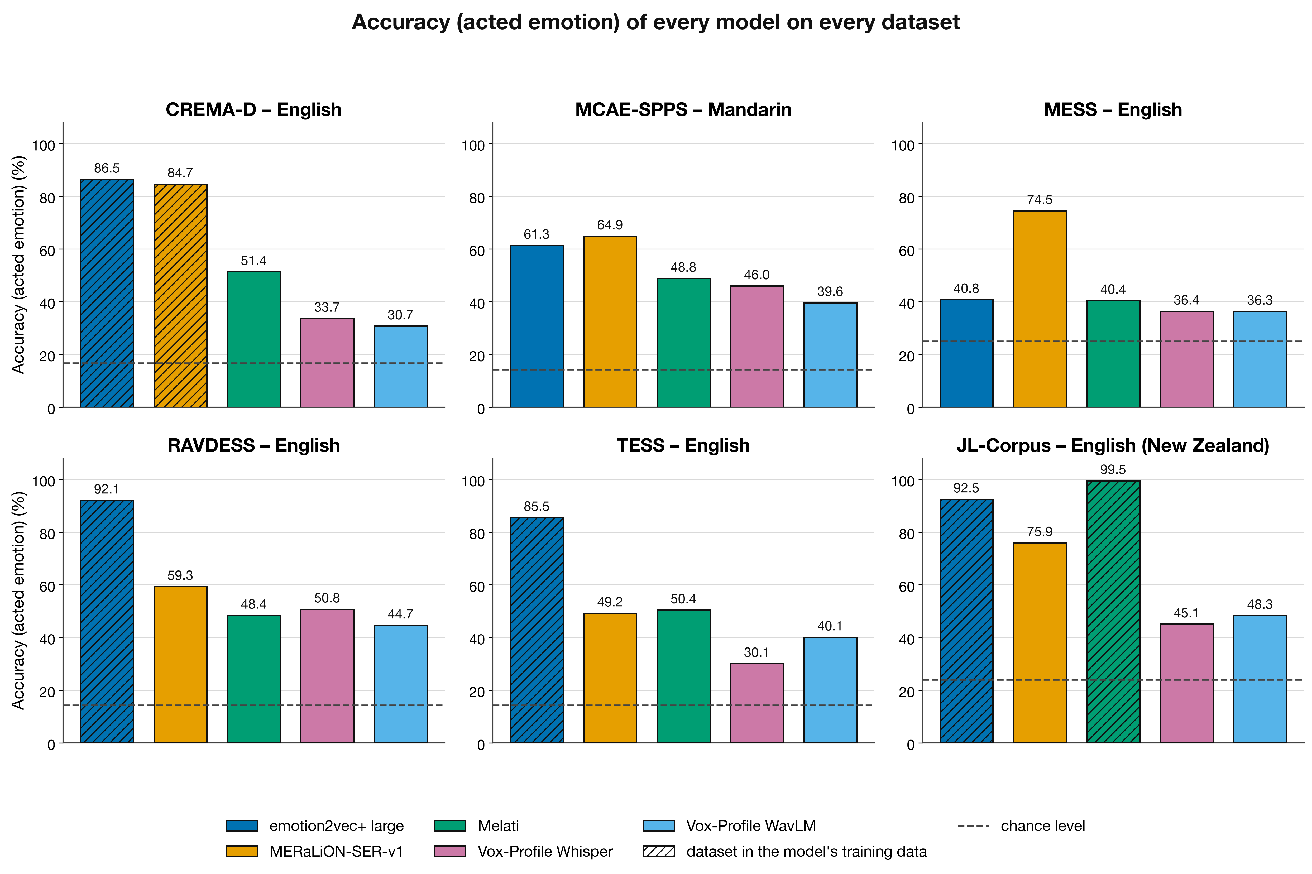
4 · EVALUATION RESULTS
Accuracy Across Models and Datasets
PLACEHOLDER: replace with the figure that includes GPT Realtime and Gemini
Accuracy vs acted emotion (%). Hatched = dataset in the model's training data; dashed = chance. Open models: all clips; audio LLMs: 200 clips per corpus.
25
Notes:
The headline figure. Blue is emotion2vec+ large, orange MERaLiON. Hatched bars mean the model trained on that dataset.
Three things to see: (1) the two best open models are well above chance everywhere; (2) Gemini is above chance but far behind; GPT Realtime is near or below chance on four of six corpora; (3) the hatched bars are the tallest: training data matters a lot.

Slide 27
4 · EVALUATION RESULTS
Accuracy Results (%)
Dataset | Chance | emotion2vec+ large | MERaLiON-SER-v1 | Melati | Vox-Profile Whisper | Vox-Profile WavLM | GPT Realtime * | Gemini 3.5 Flash *
CREMA-D English | 16.7 | 86.5 † | 84.7 † | 51.4 | 33.7 | 30.7 | 16.1 | 28.2
MCAE-SPPS Mandarin | 14.3 | 61.3 | 64.9 | 48.8 | 46.0 | 39.6 | 9.5 | 33.7
MESS English | 25.0 | 40.8 | 74.5 | 40.4 | 36.4 | 36.3 | 18.3 | 28.3
RAVDESS English | 14.3 | 92.1 † | 59.3 | 48.4 | 50.8 | 44.7 | 24.7 | 44.8
TESS English | 14.3 | 85.5 † | 49.2 | 50.4 | 30.1 | 40.1 | 1.6 | 27.2
JL-Corpus English (NZ) | 24.0 | 92.5 † | 75.9 | 99.5 † | 45.1 | 48.3 | 28.5 | 35.5
Mean | 18.1 | 76.5 | 68.1 | 56.5 | 40.3 | 39.9 | 16.4 | 32.9
Bold = best open model · † = in the model's training data (grey) · red = within 3 points of chance or below · * 200 clips per corpus
Unseen data only: MERaLiON is the most robust (65% mean on its 5 unseen corpora), emotion2vec+ drops to 51% (MCAE-SPPS, MESS)
26
Notes:
The full table. Read it column by column. emotion2vec+ is best on the four corpora it has seen, but on the two it has not seen, MCAE-SPPS and MESS, it falls to 61 and 41 percent.
MERaLiON has seen only CREMA-D, and it is the best model on both unseen corpora. Melati is perfect on JL-Corpus, which it trained on, and around 50 percent elsewhere.
Vox-Profile, trained only on natural podcast speech, is weak on acted data. GPT Realtime averages below the average chance level; Gemini is about 15 points above chance.

Slide 28
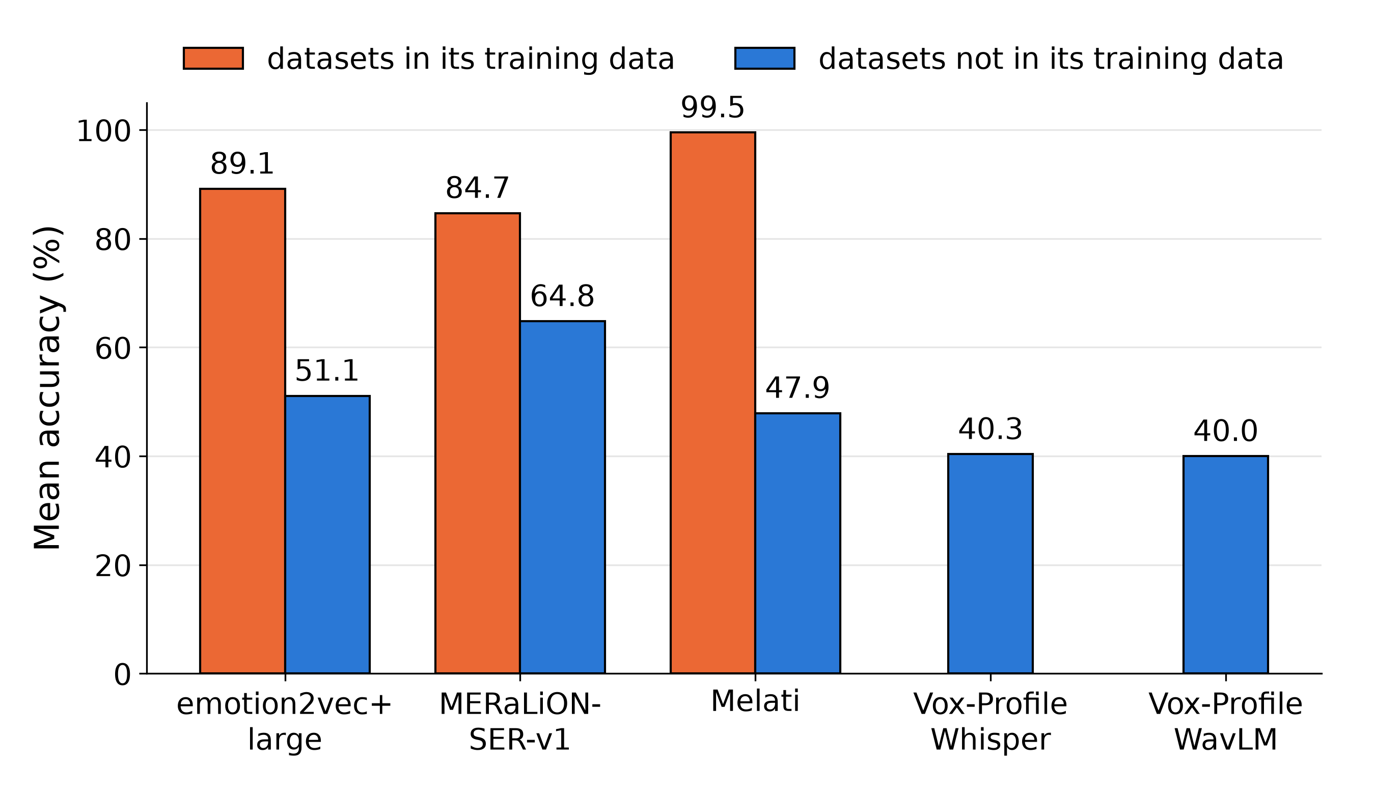
4 · EVALUATION RESULTS
Effect of Training-Data Overlap
emotion2vec+ large
  seen (4 corpora): 89% · unseen (2): 51%
MERaLiON-SER-v1
  seen (CREMA-D): 85% · unseen (5): 65%
Melati
  seen (JL-Corpus): 99.5% · unseen (5): 48%
Implication
  Published scores on popular corpora do not transfer; on call-centre audio, unseen-level accuracy is expected until the models are adapted
27
Notes:
Same data, regrouped: for each model, the mean accuracy on corpora it was trained on versus corpora it was not.
The drop is 20 to 50 points. This is the single most useful number for planning: on our own calls, which no model has seen, we should expect the unseen-level numbers or lower, not the published ones. This is the main argument for fine-tuning on our own data.

Slide 29
4 · EVALUATION RESULTS
Four-Class Comparison: Angry, Happy, Neutral, Sad
Dataset (chance 25%) | emotion2vec+ large | MERaLiON-SER-v1 | Melati | Vox-Profile Whisper | Vox-Profile WavLM
CREMA-D | 93.2 † | 93.2 † | 66.5 | 49.8 | 44.0
MCAE-SPPS | 87.8 | 88.4 | 66.2 | 58.7 | 57.1
MESS | 40.8 | 74.5 | 40.4 | 36.4 | 36.3
RAVDESS | 92.5 † | 65.4 | 64.2 | 59.0 | 59.3
TESS | 100.0 † | 73.8 | 75.4 | 49.9 | 56.4
JL-Corpus | 94.7 † | 74.6 | 99.7 † | 42.6 | 48.2
Scored only on angry, happy, neutral, sad; the model chooses among these 4
Mandarin (MCAE-SPPS, unseen by all): emotion2vec+ 88%, MERaLiON 88%
MESS stays hard for emotion2vec+ (41%): it calls almost every MESS clip neutral (next slides)
Most errors on 7 classes come from fearful, disgusted and surprised
28
Notes:
To remove the effect of different label sets, we scored every corpus on the four emotions they all share. On this easier task the top two models are nearly tied on Mandarin, 88 percent, which neither has seen.
MESS remains the outlier for emotion2vec+. The remaining difficulty on the full task comes mostly from the rarer, subtler classes: fear, disgust, surprise.

Slide 30
4 · EVALUATION RESULTS
Audio LLM Performance and the LISTEN Benchmark
Dataset | Chance | GPT Realtime | Gemini 3.5 Flash | Best open
CREMA-D | 16.7 | 16.1 | 28.2 | 86.5
MCAE-SPPS | 14.3 | 9.5 | 33.7 | 64.9
MESS | 25.0 | 18.3 | 28.3 | 74.5
RAVDESS | 14.3 | 24.7 | 44.8 | 92.1
TESS | 14.3 | 1.6 | 27.2 | 85.5
JL-Corpus | 24.0 | 28.5 | 35.5 | 99.5
Our result
  GPT Realtime: below chance on 4 of 6 corpora (mean 16% vs 18% chance)
  Gemini 3.5 Flash: above chance everywhere, but 31–64 points behind the best open model
LISTEN benchmark (Ohio State et al., 2025): arxiv.org/abs/2510.10444
  "Do audio LLMs really listen, or just transcribe?" 6 models incl. Gemini 2.5 Flash / Pro, Qwen-Omni
  Neutral words, audio only: 16.5–34.9% accuracy; models default to "neutral"
  Adding the transcript often hurts (Qwen2.5-Omni 34.0 → 19.8%)
  Non-verbal sounds (laughs, sighs): 15.7–22.7%, near chance
Interpretation: current audio LLMs rely predominantly on lexical content, which the parallel-sentence design of our corpora removes
red = below chance · 200 clips per corpus
29
Notes:
Our LLM results agree with a 2025 benchmark called LISTEN. Its authors tested six audio LLMs, including Gemini 2.5, and found that when the words are emotionally neutral, the models mostly answer neutral: 16 to 35 percent accuracy. Adding the transcript often made things worse, and on purely non-verbal sounds they were near chance.
Our corpora are designed exactly this way: neutral words, emotional voice. GPT Realtime is at or below chance on four of six corpora; Gemini does better but is far behind the dedicated models. Today's audio LLMs mostly read emotion from what is said, not how it is said.

Slide 31
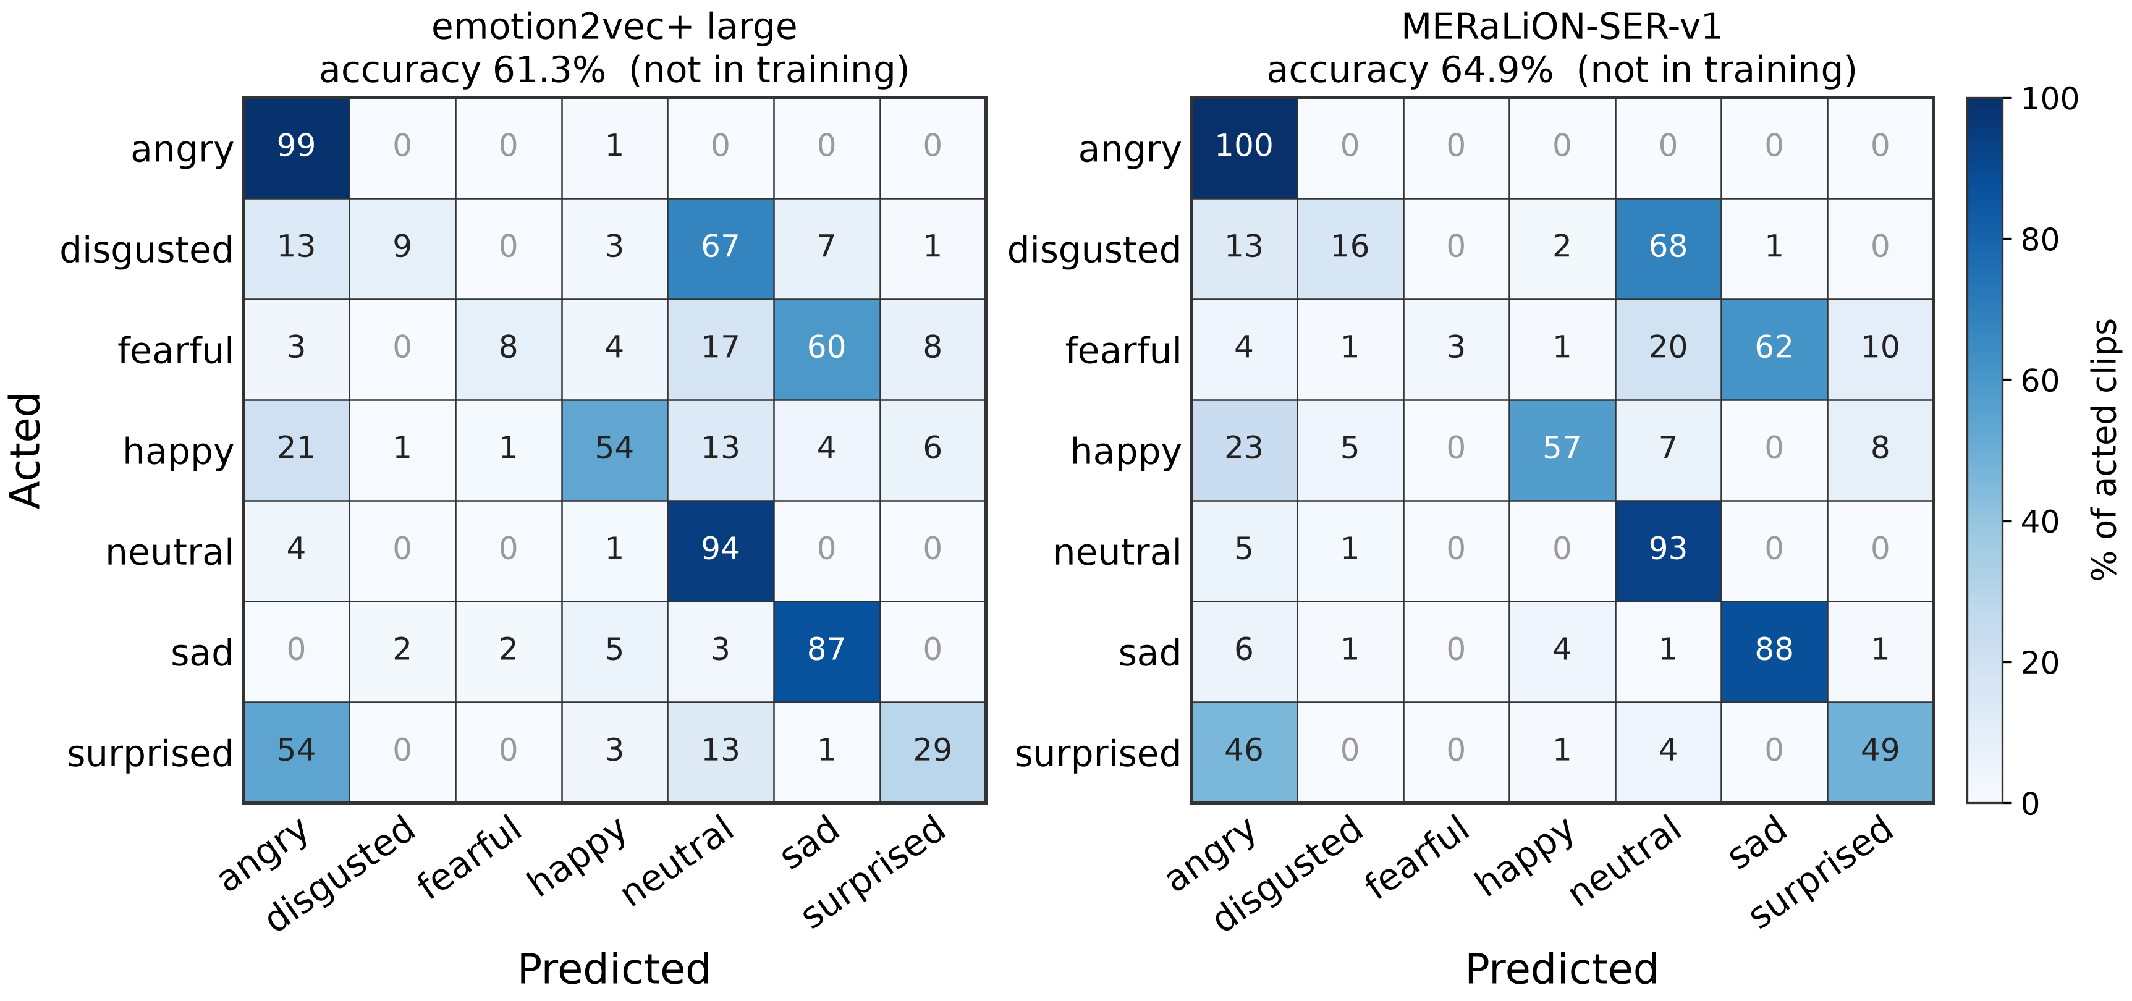
4 · EVALUATION RESULTS
Confusion Matrices: MCAE-SPPS
Solid: angry, neutral, sad
  ≥ 87% recall for both models
Shared failures
  disgusted → neutral (67–68%)
  fearful → sad (60–62%)
  surprised → angry (46–54%)
Listeners find these hard too
  MCAE-SPPS listener recognition: disgusted 63%, fearful 65% (lowest)
Rows = acted emotion, columns = prediction; each row sums to 100%. Left: emotion2vec+ large, right: MERaLiON-SER-v1.
30
Notes:
MCAE-SPPS is Mandarin and neither model has seen it, so this is the cleanest comparison. The two models behave almost identically: very good on angry, neutral and sad; disgust collapses to neutral, fear to sad, and surprise to anger.
When two independently trained models make the same mistakes, and listeners also find disgust and fear the hardest, the cue is probably ambiguous in the audio itself.

Slide 32
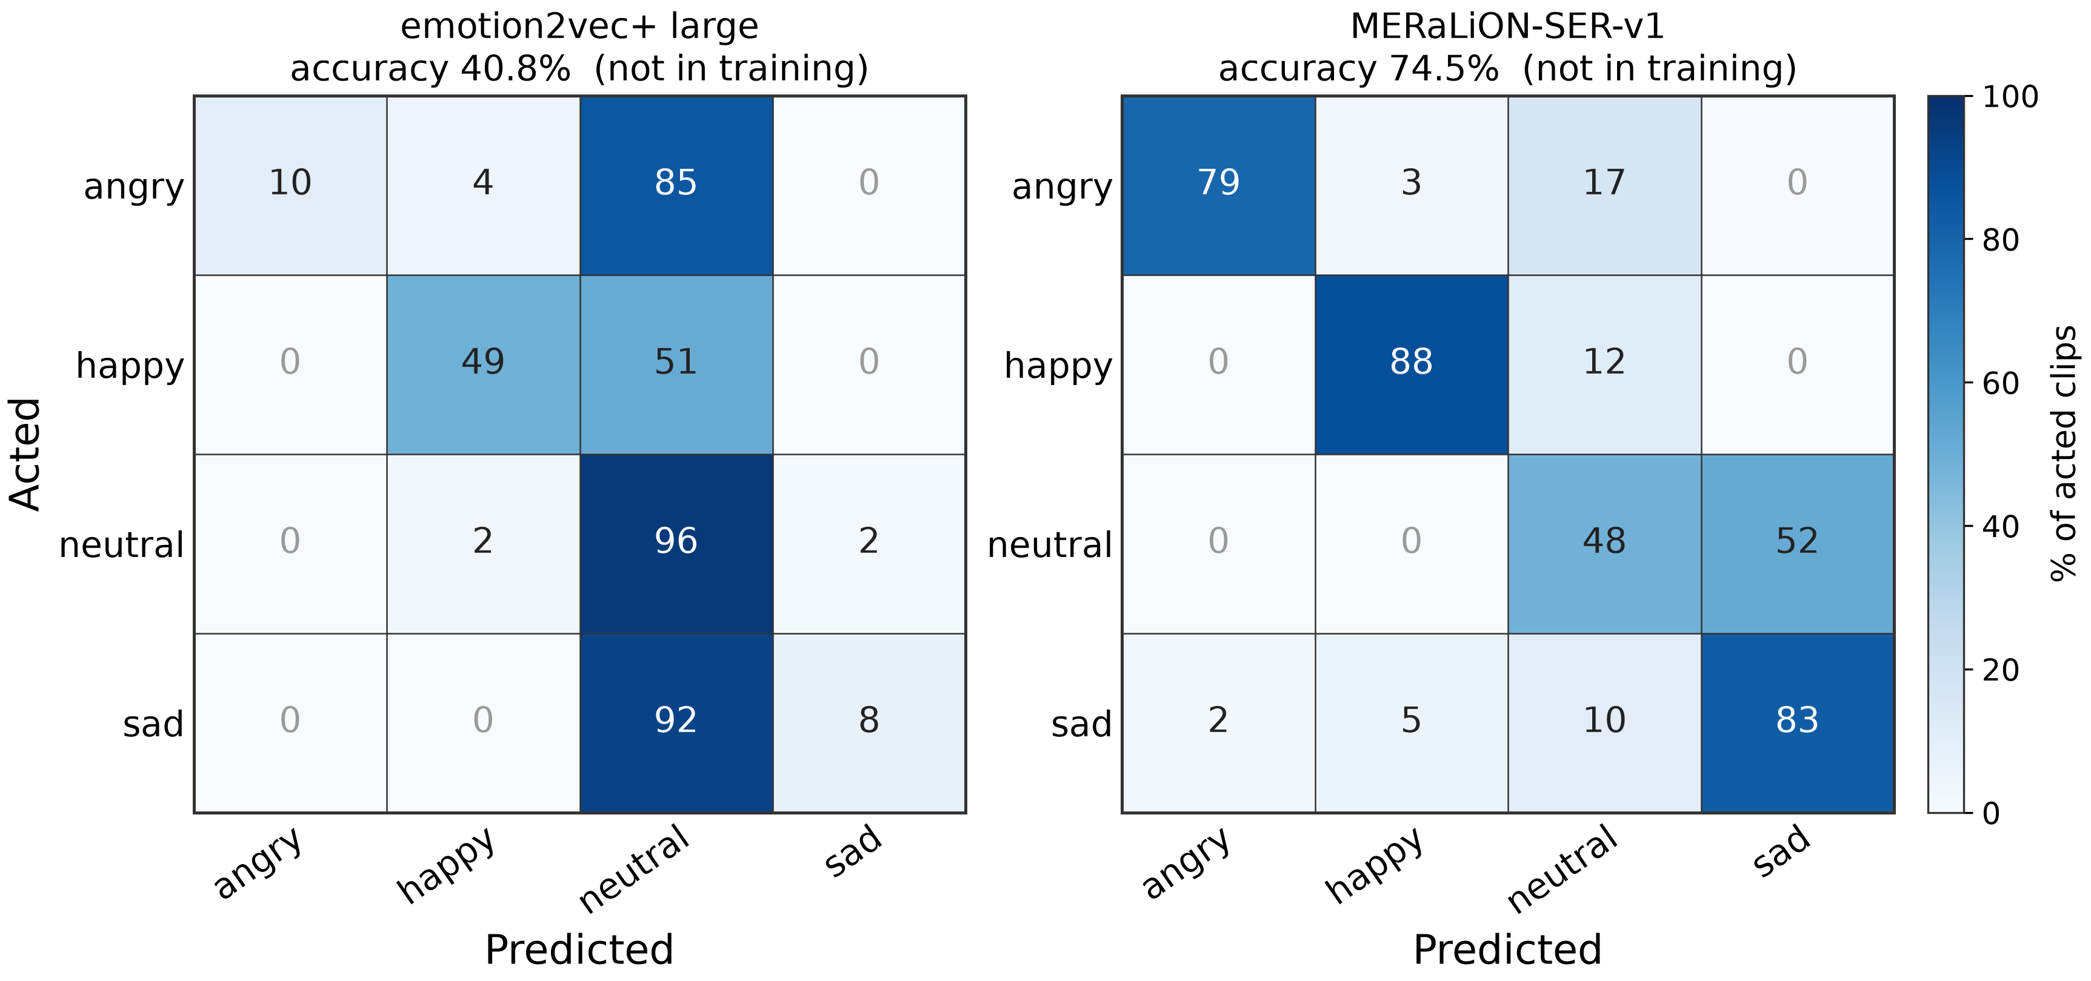
4 · EVALUATION RESULTS
Confusion Matrices: MESS
emotion2vec+ (41%)
  85% of angry and 92% of sad clips → neutral
  MESS equalises loudness, which may remove a cue it relies on (not yet tested)
MERaLiON (75%)
  angry, happy, sad ≥ 79%
  MESS "calm" → sad in 52%: calm is not quite neutral (label mapping)
Implication
  Retraining the classification head on in-domain clips (option A) is the low-cost remedy for this type of shift
Rows = acted emotion, columns = prediction; each row sums to 100%. Left: emotion2vec+ large, right: MERaLiON-SER-v1.
31
Notes:
MESS shows two different failure modes. emotion2vec+ predicts neutral for nearly everything, including 85 percent of angry clips. MESS normalises every clip to the same loudness, which may remove a cue the model relies on; that is a hypothesis we have not tested. Either way it is a domain problem, and exactly what a new head trained on a few hundred local clips would address.
MERaLiON is good on three classes; its main error is calm heard as sad. Remember we mapped MESS calm to neutral, so part of this is our label mapping.

Slide 33
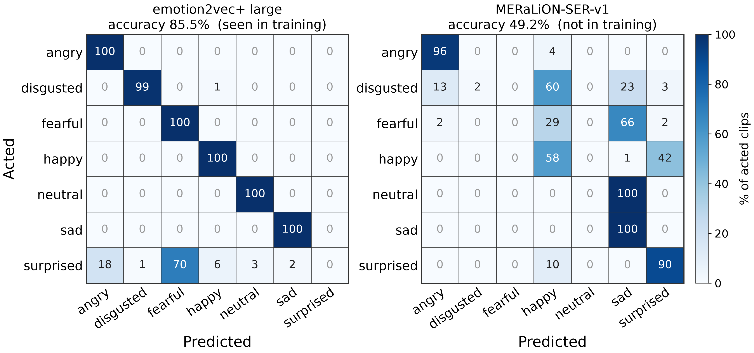
4 · EVALUATION RESULTS
Confusion Matrices: TESS
emotion2vec+ (seen, 86%)
  perfect on six emotions
  "pleasant surprise" → fearful in 70%, never surprised
MERaLiON (unseen, 49%)
  neutral → sad in 100%
  disgusted → happy 60%, fearful → sad 66%
Only 2 speakers
  a systematic misjudgement of one voice shifts an entire class; speaker diversity matters as much as the number of clips
Rows = acted emotion, columns = prediction; each row sums to 100%. Left: emotion2vec+ large, right: MERaLiON-SER-v1.
32
Notes:
TESS has only two speakers. emotion2vec+ has seen it and is perfect except for pleasant surprise, which it calls fearful: a label-convention issue.
MERaLiON, which has not seen TESS, hears every neutral clip as sad. With only two voices, one systematic misjudgement of a voice moves an entire class. For our own data: many different callers, not many clips from a few callers.

Slide 34
4 · EVALUATION RESULTS
Model Agreement with Actor vs Listener Labels (CREMA-D)
Disputed clips: the 3,699 CREMA-D clips whose listeners' majority differs from the acted emotion. For each model, the share of these clips on which it predicts:
Models trained on CREMA-D's acted labels reproduce the actor
  emotion2vec+ 82%, MERaLiON 77% (CREMA-D is in their training data)
Models trained on perceived labels follow the listeners
  Vox-Profile (MSP-Podcast, listener-annotated natural speech): 62–65%; its low accuracy partly reflects the choice of reference label
Implication
  Our annotation will record perceived emotion; the models must therefore be adapted to perceived labels
33
Notes:
This analysis uses CREMA-D only, because it is the corpus with both acted labels and listener votes for every clip. We take the 3,699 clips on which the listeners' majority differs from the acted emotion. For each model, the dark part of the bar is the share of those clips where the model predicts the acted emotion, the orange part where it predicts what the listeners heard, and the grey part where it predicts something else.
emotion2vec+ and MERaLiON, both trained on CREMA-D's acted labels, side with the actor in about 80 percent of the disputed clips: they have learned the acted labels rather than what people hear. The Vox-Profile models, trained on listener annotations of natural podcast speech, side with the listeners about two thirds of the time. Part of Vox-Profile's low accuracy therefore reflects which reference label we score against.

Slide 35
5 · ERROR ANALYSIS
Error Analysis: Overview
Four kinds of disagreement
  Models side with the listeners against the actor (CREMA-D)
  Models confidently wrong on corpora they never saw (MESS, MCAE-SPPS, TESS, RAVDESS)
  The two top models disagree with each other
  The ground truth itself is doubtful (listeners split)
Procedure: each clip is played before its labels are shown, then compared with
  the actor's intended emotion
  the listener votes (where published)
  all five models' predictions with their probabilities († = model trained on this corpus)
Guiding question: does the error lie with the model or with the reference label?
34
Notes:
This part is a qualitative error analysis based on listening. Ten clips were selected with the two top models in mind, in four groups. Each clip is played before its labels and predictions are shown, so the audience can form its own judgement. The guiding question is whether an error lies with the model or with the reference label.

Slide 36
5 · ERROR ANALYSIS
Error Analysis: Why Audio LLMs Fall Short
Our benchmark: GPT Realtime is below chance on 4 of 6 corpora; Gemini 3.5 Flash is 31–64 points behind the dedicated models. Published studies explain why:
1. Audio LLMs rely on words rather than voice
2. Strong bias towards "neutral"
3. Results depend on the prompt
16–35% accuracy
70% of answers
> 20 points
when the words carry no emotion
from gpt-realtime-2 are "neutral"
macro-F1 difference from prompt wording alone
LISTEN, EACL 2026
VocalAffectBench, 2026
VoxEmo, 2026
4. Few-shot examples do not improve accuracy
5. Voice cues are encoded but not used
6. No confidence scores
no gain
lost before the answer
label only
1–8 audio examples fix the output format only
speaking style is present inside the audio encoder
no probabilities or thresholds; cloud-only
When Demonstrations Fail, SLT 2026
Heard but Not Heeded, 2026
ASOM, ICASSP 2027
Papers: LISTEN · VoxParadox · VocalAffectBench · VoxEmo · Hearing the Order · When Demonstrations Fail · Heard but Not Heeded · C²SER · ASOM
35
Notes:
Before listening to individual errors: why do audio LLMs perform so poorly? Our numbers are consistent with a growing body of work.
First, audio LLMs rely on words rather than voice. LISTEN, at EACL 2026, shows that with emotionally neutral words and audio only, six audio LLMs reach 16 to 35 percent and default to neutral; VoxParadox, at ICML 2026, shows Audio Flamingo 3 collapsing to 17 percent when the transcript is misleading.
Second, a strong bias towards neutral: VocalAffectBench, a 2026 study on acted speech, finds that 45 percent of all model outputs are neutral, and gpt-realtime-2 answers neutral 70 percent of the time, with the lowest accuracy, 28 percent, against 44 percent for gemini-3.5-flash. This matches what we see.
Third, inconsistency and prompt sensitivity. Generative outputs are stochastic; VoxEmo finds more than 20 points of macro-F1 difference between prompt wordings, and "Hearing the Order", at Interspeech 2026, finds that just shuffling the answer options changes accuracy by up to 24 percent and reorders the models. VoxEmo also observes that the spread of outputs across prompts resembles the disagreement among human listeners. How often the label flips when exactly the same request is repeated has not been measured systematically yet; this is one of our candidate research questions.
Fourth, few-shot examples do not help: at SLT 2026, adding one to eight audio examples improved answer formatting but not accuracy, and shuffling the example labels changed nothing, so the models do not learn the audio-to-emotion mapping from examples.
Fifth, the information is encoded but not used: speaking style is present inside the audio encoder but lost before the answer, and hallucinated answers are common.
Sixth, practical: only a label comes back, no calibrated probabilities, and the closed models change version and run in the cloud.
References:
1. LISTEN: Chen et al., "Do Audio LLMs Really LISTEN, or Just Transcribe? Measuring Lexical vs. Acoustic Emotion Cues Reliance", EACL 2026. https://arxiv.org/abs/2510.10444
1. VoxParadox: Pang, Chaubey and Soleymani, ICML 2026. https://arxiv.org/abs/2605.27772
2. VocalAffectBench: Debaupte et al., arXiv 2026. https://arxiv.org/abs/2608.28932
3. VoxEmo: Zhang, Chou, Narayanan and Hain, "VoxEmo: Benchmarking Speech Emotion Recognition with Speech LLMs", submitted to Interspeech 2026. https://arxiv.org/abs/2603.08936
3. Hearing the Order: Lin et al., Interspeech 2026. https://arxiv.org/abs/2510.00628
4. When Demonstrations Fail: Piao et al., IEEE SLT 2026. https://arxiv.org/abs/2603.20433
5. Heard but Not Heeded: Koduru et al., arXiv 2026. https://arxiv.org/abs/2609.00727
5. C2SER: Zhao et al., IEEE/ACM TASLP. https://arxiv.org/abs/2502.18186
6. ASOM: Bellver-Soler et al., ICASSP 2027. https://arxiv.org/abs/2610.22401

Slide 37

5 · ERROR ANALYSIS
Error Analysis: Agreement with Listeners
CREMA-D · speaker 1068 (male, 34)
Model predictions (probability)
Consistent with listeners, not with the acted label
"It's eleven o'clock."
emotion2vec+ †
angry 0.67
Acted happy (high intensity), 9 of 10 listeners heard angry, and both top models say angry: is the model wrong or the label?
Actor
happy
MERaLiON †
angry 0.82
Melati
angry 0.96
Listeners (n = 10)
Vox Whisper
happy 0.24
angry 9
Vox WavLM
fearful 0.14
CREMA-D · speaker 1066 (male, 25)
Model predictions (probability)
Consistent with listeners, not with the acted label
"I think I've seen this before."
emotion2vec+ †
disgusted 1.00
Acted angry, 8 of 10 listeners heard disgusted; both top models say disgusted (emotion2vec+ at 100%).
Actor
angry
MERaLiON †
disgusted 0.92
Melati
happy 0.34
Listeners (n = 10)
Vox Whisper
neutral 0.25
disgusted 8
neutral 2
Vox WavLM
neutral 0.28
Bars: listener votes and each model's probability for its predicted label (green = actor's emotion). † = corpus in the model's training data.
36
Notes:
Two CREMA-D clips. In the first, the actor intended happy, nine of ten listeners heard angry, and both top models say angry. In the second, acted angry, eight listeners heard disgusted, and both models say disgusted. Scored against the actor these are errors; against the listeners they are correct. For our own data, where labels will come from listeners, this is what we want the model to do.

Slide 38
5 · ERROR ANALYSIS
Error Analysis: Domain Shift (1/2)
MESS · speaker M2 (male)
Model predictions (probability)
Domain shift
(sentence text not published)
emotion2vec+
neutral 1.00
Acted angry on unseen MESS; all five models say neutral, emotion2vec+ at 100%. emotion2vec+ calls 81% of MESS clips neutral.
Actor
angry
MERaLiON
neutral 0.88
Melati
neutral 0.96
Listeners: no per-clip ratings published
Vox Whisper
neutral 0.40
Vox WavLM
neutral 0.43
MCAE-SPPS · speaker 5 (female)
Model predictions (probability)
Domain shift
"他听了一个讲座 (He attended a lecture.)"
emotion2vec+
angry 0.88
38 of 40 listeners heard surprise, yet emotion2vec+, MERaLiON and Melati say angry. Mandarin surprise is heard as angry by models (MERaLiON: 46% of surprised clips).
Actor
surprised
MERaLiON
angry 0.82
Melati
angry 0.98
Listeners (n = 40)
Vox Whisper
surprised 0.58
surprised 38
Vox WavLM
fearful 0.24
Bars: listener votes and each model's probability for its predicted label (green = actor's emotion). † = corpus in the model's training data.
37
Notes:
MESS: acted angry, and all five models say neutral, emotion2vec+ with probability 1.00. Recall that emotion2vec+ labels 81 percent of MESS neutral, and MESS removes loudness differences. MCAE-SPPS: 38 of 40 listeners heard surprise, yet three models say angry. Mandarin surprise is systematically heard as anger by the models. High probability does not mean correct outside the training domain.

Slide 39
5 · ERROR ANALYSIS
Error Analysis: Domain Shift (2/2)
TESS · speaker YAF (female, 26)
Model predictions (probability)
Domain shift
"Say the word read."
emotion2vec+ †
neutral 1.00
Neutral on TESS (unseen for MERaLiON): MERaLiON says sad at 0.91, as it does for all 400 TESS neutral clips; emotion2vec+ (trained on TESS) is right.
Actor
neutral
MERaLiON
sad 0.91
Melati
neutral 0.69
Listeners: no per-clip ratings published
Vox Whisper
neutral 0.46
Vox WavLM
neutral 0.43
RAVDESS · speaker Actor 17 (male)
Model predictions (probability)
Domain shift
"Dogs are sitting by the door."
emotion2vec+ †
surprised 1.00
Surprised (strong) on RAVDESS: emotion2vec+ (trained on RAVDESS) says surprised at 100%, MERaLiON says fearful at 0.91.
Actor
surprised
MERaLiON
fearful 0.91
Melati
angry 0.65
Listeners: no per-clip ratings published
Vox Whisper
surprised 0.47
Vox WavLM
surprised 0.24
Bars: listener votes and each model's probability for its predicted label (green = actor's emotion). † = corpus in the model's training data.
38
Notes:
TESS: a neutral clip that MERaLiON calls sad with 0.91, as it does for all 400 neutral TESS clips; emotion2vec+, trained on TESS, is right. RAVDESS: a strong surprise; emotion2vec+, trained on RAVDESS, is right, MERaLiON says fearful at 0.91. The pattern is the same in both directions: the model that has seen the corpus wins.

Slide 40
5 · ERROR ANALYSIS
Error Analysis: Model Disagreement
MESS · speaker F3 (female)
Model predictions (probability)
Model disagreement indicates uncertainty
(sentence text not published)
emotion2vec+
neutral 1.00
Acted sad: four models say sad, but emotion2vec+ says neutral at 100%; a confident outlier.
Actor
sad
MERaLiON
sad 0.90
Melati
sad 0.51
Listeners: no per-clip ratings published
Vox Whisper
sad 0.51
Vox WavLM
sad 0.25
MCAE-SPPS · speaker 6 (female)
Model predictions (probability)
Model disagreement indicates uncertainty
"他们有个计划 (They have a plan.)"
emotion2vec+
neutral 0.82
The models split exactly as the listeners do: 22 of 40 heard happy, 17 neutral; MERaLiON says happy, emotion2vec+ neutral.
Actor
happy
MERaLiON
happy 0.87
Melati
happy 0.99
Listeners (n = 40)
Vox Whisper
neutral 0.33
happy 22
neutral 17
Vox WavLM
surprised 0.29
Bars: listener votes and each model's probability for its predicted label (green = actor's emotion). † = corpus in the model's training data.
39
Notes:
MESS: four models say sad, emotion2vec+ alone says neutral, at probability 1.00. MCAE-SPPS: 22 listeners heard happy and 17 neutral, and the two models split the same way. Model disagreement often marks clips that humans also find ambiguous; this is exactly the signal we will use to pick clips for human review in active learning.

Slide 41
5 · ERROR ANALYSIS
Error Analysis: Ambiguous Ground Truth
CREMA-D · speaker 1006 (female, 58)
Model predictions (probability)
Questionable reference label
"It's eleven o'clock."
emotion2vec+ †
happy 0.92
Acted angry (medium intensity), but the 9 listeners split three ways (angry 3, happy 3, neutral 3): there is no majority at all. Both top models say happy (0.92 and 0.86): scored as wrong, yet as many listeners heard happy as angry.
Actor
angry
MERaLiON †
happy 0.86
Melati
happy 0.66
Listeners (n = 9)
Vox Whisper
neutral 0.28
angry 3
happy 3
neutral 3
Vox WavLM
neutral 0.37
CREMA-D · speaker 1030 (female, 42)
Model predictions (probability)
Questionable reference label
"We'll stop in a couple of minutes."
emotion2vec+ †
disgusted 0.77
Acted fearful, but none of 10 listeners chose fear and votes are spread over five emotions; any prediction is defensible (15% of CREMA-D clips get no vote for the acted emotion).
Actor
fearful
MERaLiON †
fearful 0.88
Melati
angry 0.80
Listeners (n = 10)
Vox Whisper
neutral 0.33
neutral 3
angry 2
disgusted 2
sad 2
Vox WavLM
neutral 0.29
Bars: listener votes and each model's probability for its predicted label (green = actor's emotion). † = corpus in the model's training data.
40
Notes:
CREMA-D, first clip: the intended emotion is angry, but the nine listeners split three ways, angry, happy and neutral, three votes each; there is no majority at all, and both top models say happy. Second clip: acted fearful, but no listener chose fear; votes are spread over five emotions. Scoring these as model errors is unfair. With our own data we should keep such clips as ambiguous, with their vote distribution, rather than force a single label.

Slide 42
5 · ERROR ANALYSIS
Error Analysis: Summary
Reference labels are uncertain
Many "errors" are defensible: listeners hear the same emotion as the model. Accuracy against a single label understates model quality and obscures genuine failures.
Probabilities are over-confident out of domain
Probability 1.00 on incorrect predictions (MESS, TESS); raw confidence cannot serve as a quality gate on call-centre audio before calibration on in-domain data.
Training data determines the outcome
On every disputed clip, the model trained on that corpus is correct. Call-centre audio is unseen by all models, so in-domain data is decisive.
Disagreement is an informative signal
Clips on which the models disagree, or the listeners split, are the most informative for human review: the basis of the annotation plan.
41
Notes:
Four lessons from listening. Labels are uncertain, so some errors are not errors. Confidence is unreliable outside the training domain. The model trained on a corpus wins the disputed clips. And disagreement between models or listeners indicates where human review is most valuable, which leads directly to the annotation plan.

Slide 43
6 · FUTURE WORK
Model Shortlist for Adaptation
 | emotion2vec+ large | MERaLiON-SER-v1
Accuracy, corpora not in training | 51% (2 corpora) | 65% (5 corpora)
Accuracy, all 6 corpora (mean) | 76% (4 seen) | 68% (1 seen)
Parameters | 162.1M | 313.4M (98% in the Whisper encoder)
Backbone | data2vec 2.0-style encoder (CNN + 12 Transformer blocks) | Whisper-medium encoder + ECAPA-TDNN
Classes | 9 (includes our 7) | exactly our 7 + arousal, valence, dominance
Languages in training | not published (multilingual) | English (incl. Singapore), Mandarin, Malay, Tamil
Input length | any length (memory grows with length²) | fixed 30 s window (padded / cut)
Licence | FunASR model licence: commercial use allowed | MERaLiON Public Licence: commercial use allowed
Fine-tuning code | none official; small PyTorch loop | none official (inference code only); model class has a LoRA path
Melati and Vox-Profile are excluded: non-commercial licences, and weaker on unseen data. The audio LLMs are excluded: far less accurate, and no control over the model.
42
Notes:
Why these two. They are the two best models, they both allow commercial use, and they are complementary: emotion2vec+ is smaller and handles any clip length, and is strongest where it has seen similar data; MERaLiON generalises better to unseen corpora, matches our seven classes exactly and is multilingual.
Melati and Vox-Profile are research-only licences. The LLMs are not competitive and are black boxes.

Slide 44
6 · FUTURE WORK
Domain Gap: Public Corpora vs Call-Centre Audio
 | Public corpora (benchmark) | Our customer calls
Speech | acted, exaggerated, one emotion per clip | spontaneous, subtle, mixed and changing within a call
Channel | studio microphone, 16–48 kHz | telephone, 8 kHz G.711, compression, noise
Length | 1–5 s sentences | long turns: need segmentation (VAD) into 3–10 s pieces
Class balance | balanced by design | mostly neutral; angry or upset callers are rare but matter most
Labels | the actor's intended emotion | none: must be created by listeners
Unseen-corpus accuracy (51–65%) is the realistic starting point, before any channel or spontaneity effects
Quick check before labelling: re-run the benchmark through a simulated telephone channel (G.711, already built for the deepfake work)
43
Notes:
Everything that made the benchmark clean is different on our calls: spontaneous speech, the telephone channel, long turns, and a heavy neutral majority. And there are no labels.
So the realistic expectation is the unseen-corpus accuracy or lower. A cheap first experiment is to pass the benchmark through a simulated G.711 telephone channel, which we already implemented for the anti-deepfake evaluation, to measure the channel effect alone.

Slide 45
6 · FUTURE WORK
Problem Formulation
Semi-supervised domain adaptation with active learning
Source domain: public corpora
acted speech · studio 16–48 kHz
intended (acted) labels · balanced classes
Target domain: call-centre audio
spontaneous speech · telephone 8 kHz
perceived labels (few) · mostly neutral
+ abundant unlabelled target audio
adaptation
Three kinds of shift between the domains
Covariate shift
Label shift
Annotation shift
input distribution: channel, accent, speaking style, noise
class proportions: balanced in the corpora, mostly neutral in calls
label meaning: intended emotion of an actor vs emotion perceived by listeners
Component | Uses | Purpose
Supervised fine-tuning (A–D) | few human-labelled target clips | adapt the head, then more of the encoder
Domain-adaptive pre-training (E) | unlabelled target audio | adapt the encoder to telephone speech without labels
Self-training (E′) | pseudo-labelled target audio | add confident, agreeing model predictions as training data
Active learning | selection of clips for annotation | spend listener time on the most informative clips
44
Notes:
In machine-learning terms, our plan is semi-supervised domain adaptation with active learning. The source domain is the public acted corpora on which the models were trained; the target domain is our call-centre audio, for which we will have only a limited number of labels, but plenty of unlabelled recordings.
The two domains differ in three ways. Covariate shift: the input itself differs, telephone channel, accents, spontaneous speaking style and noise. Label shift: the class proportions differ, balanced in the corpora and dominated by neutral in calls. Annotation shift: the meaning of the label differs, the emotion an actor intended versus the emotion a listener perceives.
The plan combines four standard components: supervised fine-tuning with the few labelled clips, options A to D; domain-adaptive pre-training on unlabelled call audio, option E; self-training with pseudo-labels, E prime; and active learning, which decides which clips our listeners should label.

Slide 46
6 · FUTURE WORK
Retraining / Fine-tuning Strategy: Overview
A New linear head
B Layer mix + MLP
C LoRA / top blocks
D Full fine-tuning
E Continued pre-training
linear probing
layer-weighted probing
parameter-efficient fine-tuning (PEFT)
full fine-tuning
domain-adaptive pre-training (DAPT)
Pooling + head
linear layer
layer weights + MLP
trained
trained
then A, B or C
Encoder: upper blocks
frozen
frozen
LoRA or unfrozen
trained
self-supervised
Encoder: lower blocks
frozen
frozen
frozen
trained
self-supervised
CNN / front end
frozen
frozen
frozen
frozen
self-supervised
Human-labelled clips
Human-labelled clips
Human-labelled clips
Human-labelled clips
Human-labelled clips
0.5k–5k
1k–5k
≥ 5k
≥ 10k
none (unlabelled audio)
feasible
feasible
feasible
feasible
feasible
recommended start
frozen
trained with labels
adapted with labels (LoRA)
trained without labels
A → B → C → D is a ladder: each step is a separate experiment on the same speaker-independent split, adopted only if it improves on the previous one; D once ≥ 10k labelled clips exist. E is complementary: it adapts the encoder with unlabelled call audio before A–D.
45
Notes:
Five ways to adapt a pre-trained model, ordered from the cheapest to the most expensive. Each column is the same network drawn as four parts: the CNN front end at the bottom, the lower and upper encoder blocks, and pooling with the classification head at the top. Grey means frozen, green means trained with our labels, orange means adapted with small LoRA matrices, purple means trained without labels.
A trains only a new final layer. B keeps the encoder frozen as well, but combines the outputs of all encoder layers and trains a small neural network on top. C additionally adapts the upper encoder blocks, either with LoRA or by unfreezing them. D trains the whole network.
"Human-labelled clips" is the number of clips annotated by our listeners that each option needs to work reliably, including training, validation and test data.
A, B, C and D form a ladder: we try A, then B, then C, each as a separate experiment on the same data split, and we move up only if the step improves the result. D trains the whole network; with our four H100 GPUs compute is not an obstacle, but it needs at least ten thousand labelled clips to beat the frozen options, so it is the last step. E is different: it continues the model's own label-free pre-training on our unlabelled call audio, of which we have plenty, and is then followed by A to D.

Slide 47
6 · FUTURE WORK
Retraining / Fine-tuning Strategy: Details and Feasibility
 | What is done | Trainable parameters (emotion2vec+) | Human-labelled clips | Compute (one GPU; H100 ≈ 2–3 × A100) | Feasibility
A | Linear probing — keep the whole model fixed; compute one 1,024-d clip embedding per labelled clip once; train only a new linear layer (logistic regression) on these embeddings | ≈ 9k | 0.5k–5k | minutes on a CPU | feasible · baseline
B | Layer-weighted probing — encoder fixed; keep the outputs of all 12 Transformer layers (lower layers carry acoustic and prosodic detail, upper layers more abstract information), learn 12 mixing weights, then a small 2-layer neural network (MLP 1024 → 256 → K) classifies | ≈ 0.26M | 1k–5k | minutes (features cached once) | feasible · recommended start
C | Parameter-efficient fine-tuning (PEFT) — add small trainable low-rank matrices (LoRA) to the attention layers, or unfreeze only the top 2–4 blocks; the encoder itself adapts to call audio | 0.6–1.6M (LoRA); 25–50M (top blocks) | ≥ 5k | 0.1–0.2 A100-h ≈ 0.03–0.1 H100-h per 10k clips × 10 epochs | feasible once ≈ 5k clips exist
D | Full fine-tuning — train all layers except the CNN, with a low learning rate and layer-wise decay | 158M | ≥ 10k, better 20k–100k | 0.2–0.4 A100-h ≈ 0.07–0.2 H100-h per 10k clips × 10 epochs | feasible on 4 × H100 once ≥ 10k clips exist
E | Domain-adaptive pre-training (DAPT) — continue the label-free pre-training objective (data2vec: predict the model's own representations of masked audio) on unlabelled call audio; then apply A, B or C | 162M (no labels) | none; 10–1,000 h of unlabelled audio | 5–10 A100-h ≈ 2–5 H100-h (10–20 h of audio); 600 A100-h ≈ 200–300 H100-h (1,000 h) | feasible: abundant unlabelled audio
Human-labelled clips: clips annotated with the 4-listener protocol, split by speaker into training, validation and test sets
Why start frozen: emotion2vec+ was already trained on ≈40k hours of emotion data, so its frozen features are emotion features; full fine-tuning rarely beats a frozen encoder below ≈5k clips and overfits to the training speakers
E caveat: no official emotion2vec pre-training code; the objective must be rebuilt from fairseq data2vec 2.0. For MERaLiON (Whisper, trained on transcripts) unlabelled audio is used through pseudo-labelling instead
Parameter counts measured on the released weights; data ranges inferred from published studies (Chen & Rudnicky 2021, Wang et al. 2021, PEFT-SER 2023, Wagner et al. 2023, SAILER 2025); compute estimated (docs/finetuning_emotion2vec_plus_large_en.md).
46
Notes:
The same five options in detail.
Option A, a linear probe: the pre-trained model is not changed at all. We pass every labelled clip through it once, keep the 1,024-number clip embedding, and train a logistic regression on these numbers. It needs only a few hundred clips per class and trains in minutes on a laptop CPU.
Option B is our recommended starting point. The encoder stays frozen, but instead of using only the output of the last Transformer layer we keep the outputs of all twelve layers. Lower layers carry more acoustic and prosodic detail, upper layers more abstract information, and for emotion the best information is often in the middle. The model learns twelve weights to mix the layers, and a small two-layer neural network, an MLP, classifies the mixture. Because the encoder is frozen, the layer outputs are computed once and every training run takes minutes, which allows proper cross-validation.
Option C lets the encoder itself adapt to call audio, either by adding small LoRA matrices to the attention layers, about one million parameters, or by unfreezing the top two to four blocks. It needs a pass through the encoder at every training step and more data, about five thousand clips.
Option D trains everything except the CNN. Compute is not a constraint with four H100 GPUs: ten thousand clips for ten epochs take minutes. Published studies show it pays off only with about ten thousand labelled clips or more, so it comes after C, once active learning has produced enough labels.
Option E uses no labels: we continue the self-supervised pre-training objective on our own unlabelled call audio, which we have in abundance, so the encoder learns what telephone speech sounds like. Afterwards we apply A, B or C. The caveat is that the original pre-training code is not public and must be rebuilt from fairseq. For MERaLiON, whose Whisper encoder was trained on transcripts rather than self-supervised, unlabelled audio is used through pseudo-labelling instead.

Slide 48
6 · FUTURE WORK
Continued Pre-training (Option E): How It Works
Teacher sees the full clip
targets: one per 20 ms frame
(average of the top 8 layers, normalised)
Intuition: fill in the blanks
  Hide parts of the audio and ask the model what was there
  The answer is not the waveform but the teacher's interpretation of it, so details such as noise and phase do not matter
What is learned
  To fill the gaps from context, the encoder must model voice, prosody (pitch, rhythm, energy) and phonetic content
  On call audio: the 8 kHz channel, line noise, accents and spontaneous speaking style
Cautions
  May dilute the emotion-specific features of emotion2vec+: small learning rate, few epochs, mix in public emotional speech, re-run the benchmark
  No official training code: teacher copied from the student, a new small decoder, objective from fairseq data2vec 2.0
Teacher encoder
(no gradient)
EMA: teacher weights = slow running
average of the student weights
L2 loss on the masked frames
Student sees the same clip,
≈ half of the frames masked
Student encoder
(trained)
small
decoder
?
?
?
?
predictions for the masked frames
+ utterance-level loss: the 10 extra tokens predict the teacher's average over the whole clip (emotion2vec)
Data: unlabelled customer speech (5–30 s VAD segments, random crops). After training, the teacher and the decoder are discarded; the adapted student encoder replaces the original one in options A–D.
Method: data2vec (Baevski et al., ICML 2022) · data2vec 2.0 (Baevski et al., ICML 2023) · emotion2vec (Ma et al., ACL Findings 2024) · DAPT (Gururangan et al., ACL 2020) · TAPT for SER (Chen & Rudnicky, 2021)
47
Notes:
How continued pre-training works. It is self-supervised: the training signal comes from the audio itself, with no emotion labels.
There are two copies of the encoder. The teacher sees the complete clip and produces, for every 20-millisecond frame, a target vector: the average of its top eight Transformer layers, normalised. The student sees the same clip with about half of the frames masked out, in short contiguous blocks, and has to predict the teacher's vectors for the masked frames. The loss is the squared distance between prediction and target, counted only on the masked frames. emotion2vec adds a second, utterance-level loss: its ten extra tokens must predict the teacher's average over the whole clip, which pushes the model to capture the overall state of the utterance, where emotion lives.
The teacher is not trained by gradients. Its weights are an exponential moving average of the student's weights, a slowly moving version of the student. This, together with the normalised targets, prevents the trivial solution of both networks outputting a constant.
Intuitively it is a fill-in-the-blank exercise, but the student must reproduce the teacher's interpretation of the hidden audio rather than the raw waveform. To do that from context, it has to model the speaker's voice, the pitch and rhythm, and what is being said. Continued on our call audio, the encoder adapts to the telephone channel, line noise, accents and spontaneous speech, without any labels. Afterwards the teacher and decoder are discarded and the adapted encoder is used for options A to D.
The method was introduced as data2vec by Baevski and colleagues at ICML 2022, made efficient as data2vec 2.0 at ICML 2023, and adapted to emotion by emotion2vec. Continuing pre-training on in-domain data is known as domain-adaptive pre-training, after Gururangan et al. 2020, and was applied to speech emotion recognition by Chen and Rudnicky.
References:
data2vec: Baevski et al., "data2vec: A General Framework for Self-supervised Learning in Speech, Vision and Language", ICML 2022. https://arxiv.org/abs/2202.03555
data2vec 2.0: Baevski et al., "Efficient Self-supervised Learning with Contextualized Target Representations for Vision, Speech and Language", ICML 2023. https://arxiv.org/abs/2212.07525
emotion2vec: Ma et al., "emotion2vec: Self-Supervised Pre-Training for Speech Emotion Representation", Findings of ACL 2024. https://arxiv.org/abs/2312.15185
Domain-adaptive pre-training: Gururangan et al., "Don't Stop Pretraining: Adapt Language Models to Domains and Tasks", ACL 2020. https://arxiv.org/abs/2004.10964
Task-adaptive pre-training for SER: Chen and Rudnicky, "Exploring Wav2vec 2.0 Fine-tuning for Improved Speech Emotion Recognition", 2021. https://arxiv.org/abs/2110.06309
Code for the objective: fairseq data2vec. https://github.com/facebookresearch/fairseq/tree/main/examples/data2vec

Slide 49
6 · FUTURE WORK
Continued Pre-training: Why a Weak Teacher Is Enough
There is no correct answer to match, only consistency: what the student infers from part of the clip must agree with what the teacher computes from the whole clip.
The information comes from the audio
  The teacher saw the hidden frame; the student did not. Matching the teacher means recovering what is in the audio
No trivial solution
  Both networks could output a constant; a slowly moving teacher and normalised targets prevent this (shown empirically in BYOL and data2vec)
On call audio
  The teacher need not know telephone speech in advance: features that cannot be predicted from narrowband context are pushed out, and the teacher is pulled along with the student
Still to verify
  Better telephone representations do not guarantee better emotion features: compare B with and without E
1 Teacher starts weak
2 Student learns structure
even a random network turns the hidden audio into a fixed "fingerprint": meaningless, but it depends on what was said and how
to predict the fingerprint of a hidden frame, the student must infer that frame from its context: pitch, voice, sounds
repeat
4 Targets get richer
3 Teacher follows (EMA)
a better teacher produces more informative targets (speaker, intonation over the clip), so the student must learn more
the teacher's weights are a slow average of the student's, so it inherits what the student has learned
Method: BYOL (Grill et al., NeurIPS 2020) · data2vec (Baevski et al., ICML 2022) · data2vec 2.0 (Baevski et al., ICML 2023) · emotion2vec (Ma et al., ACL Findings 2024)
48
Notes:
A natural question: if the teacher is not good, how can matching it teach the student anything? The answer is that the objective is not correctness but consistency, a principle called bootstrapping.
Step one: at the start the teacher may be a random network. Even so, its output for a frame depends on the actual audio of that frame and its neighbours, like a fixed fingerprint. The teacher saw the hidden frame; the student did not.
Step two: to predict the fingerprint of a hidden frame, the student has to infer what was in that frame from the context: how the pitch continues, whose voice it is, which sound is being produced. So it learns the structure of speech, even though the targets themselves are meaningless at first.
Step three: the teacher's weights are a slow moving average of the student's, so the teacher inherits what the student has learned.
Step four: a better teacher produces richer targets, for example information about the speaker or the intonation across the clip, and the student has to learn more to match them. Steps two to four repeat, and both networks improve together.
The trivial solution, both networks outputting the same constant, is prevented by the slowly moving teacher and by normalising the targets; this was shown to work empirically in BYOL and data2vec.
For continued pre-training on our calls, the teacher does not need to understand telephone speech beforehand. Features that cannot be predicted from narrowband context produce large errors and are pushed out, and the teacher follows the student into the new domain. Whether the adapted representation is also better for emotion must be checked experimentally, by comparing option B with and without option E.
References:
BYOL: Grill et al., "Bootstrap Your Own Latent: A New Approach to Self-Supervised Learning", NeurIPS 2020. https://arxiv.org/abs/2006.07733
data2vec: Baevski et al., "data2vec: A General Framework for Self-supervised Learning in Speech, Vision and Language", ICML 2022. https://arxiv.org/abs/2202.03555
data2vec 2.0: Baevski et al., "Efficient Self-supervised Learning with Contextualized Target Representations for Vision, Speech and Language", ICML 2023. https://arxiv.org/abs/2212.07525
emotion2vec: Ma et al., "emotion2vec: Self-Supervised Pre-Training for Speech Emotion Representation", Findings of ACL 2024. https://arxiv.org/abs/2312.15185

Slide 50
6 · FUTURE WORK
Fine-tuning emotion2vec+ large: Frozen and Trainable Layers
E: continued self-supervised pre-training on unlabelled call audio updates the whole encoder (no labels)
Waveform
16 kHz
CNN feature
extractor
7 conv layers
Projection +
conv positional
encoding
Transformer
blocks 1–8
(1024-d, 16 heads)
Transformer
blocks 9–12
Pooling
mean, or weighted
sum of 12 layers
New head
Linear / MLP
→ K classes
—
4.2M
6.8M
100.8M
50.4M
0–12
9k–0.26M
frozen in A, B, C (D: all but the CNN trained)
LoRA or unfrozen in C; trained in D
trained in A, B, C, D
Step 1 (≈1–3k labelled clips): B — freeze the encoder, cache the 12 layer outputs once, train the layer weights + MLP (≈0.26M parameters); minutes per run, so full speaker cross-validation is affordable
In parallel (unlabelled audio): E — continue self-supervised pre-training on call audio (10–100 h of audio ≈ 2–30 H100-h), then repeat B on the adapted encoder and compare
Step 2 (≈5k labelled clips): C — LoRA rank 8 on all 12 blocks (0.6–1.6M) or unfreeze blocks 9–12 (50M); encoder learning rate 1e-5–3e-5, head 1e-4–1e-3
Step 3 (≥ 10k labelled clips): D — all layers except the CNN (158M); low learning rate with layer-wise decay; mix in public data to avoid forgetting; ≈ 0.07–0.2 H100-h per 10k clips × 10 epochs
49
Notes:
Concretely for emotion2vec+. Grey parts stay frozen whenever we train with labels: the CNN, the projection and positional encoding, and the lower eight Transformer blocks. Green parts are always trained: pooling and a new classification head. The orange top four blocks are adapted only in option C.
The purple line marks option E: continued self-supervised pre-training on our unlabelled call audio updates the whole encoder without any labels. After E, we repeat option B on the adapted encoder and compare with B on the original encoder.
Full fine-tuning, option D, is the third step: computationally easy on our four H100 GPUs, but only worthwhile once active learning has produced at least ten thousand labelled clips.

Slide 51
6 · FUTURE WORK
Fine-tuning MERaLiON-SER-v1: Frozen and Trainable Layers
Waveform
(30 s window)
Conv stem +
positions
Whisper encoder
24 blocks
(1024-d, 16 heads)
LoRA r8 on q/k/v
(all 24 blocks)
ECAPA-TDNN +
hybrid pooling +
embedding MLP
Heads
7 emotions + valence,
arousal, dominance
—
4.9M
302.3M
1.18M
6.0M
68k–135k
frozen in A, B, C (trained in D)
added in C (LoRA adapters)
trained (A: heads only; B, C, D: all green)
Option | Trains | Trainable | Cost per training clip
A | heads only (on cached 256-d embeddings) | 68k | none after one forward pass
B | ECAPA + pooling + MLP + heads (as in the original recipe) | 6.1M | cache encoder output once (3 MB per clip): minutes per run
C | B + LoRA r8 on encoder q/k/v | 7.3M | ≈ 2.3 TFLOP per clip · 0.2–0.3 H100-h per 10k clips × 10 epochs
D | everything (except the fixed positions) | 311.8M | ≈ 3.4 TFLOP per clip · 0.3–0.5 H100-h per 10k clips × 10 epochs
E′ | Self-training — B or C on pseudo-labelled call audio (confident, agreeing predictions of both models) | as B / C | one inference pass over the unlabelled pool
B mirrors how MERaLiON itself was trained: encoder frozen, head trained
Unlabelled audio: Whisper was trained on transcripts, not self-supervised, so E is replaced by pseudo-labelling (E′), as MERaLiON's own training did with emotion2vec+ labels
D (all 311.8M parameters) runs on 4 × H100 once ≥ 10k labelled clips exist; while fine-tuning, mask padding in pooling and consider a shorter window
50
Notes:
The same logic for MERaLiON. Ninety-eight percent of its parameters are the Whisper encoder, which was already frozen in the original training. So option B, retraining the ECAPA head, the pooling and the output heads, six million parameters, is exactly the original recipe applied to our data. Because the encoder is frozen we can cache its output once and each training run takes minutes.
If B plateaus, option C adds LoRA adapters to the encoder attention, about 1.2 million extra parameters.
Unlabelled audio cannot be used through continued self-supervised pre-training here, because the Whisper encoder was trained on transcripts rather than with a self-supervised objective. Instead we use pseudo-labelling: both models label the unlabelled call audio, and clips on which they agree with high confidence are added as training data. MERaLiON's own training used exactly this idea, with labels from emotion2vec+. Full fine-tuning of all 311.8 million parameters, option D, is computationally easy on four H100 GPUs, about half an H100-hour per ten thousand clips and ten epochs, and becomes worthwhile once we have at least ten thousand labelled clips. Fine-tuning is also the moment to fix the unmasked padding and possibly shorten the 30-second window, which would make inference about four times cheaper.

Slide 52
6 · FUTURE WORK
Data and Compute Requirements
Option | Data | emotion2vec+ large | MERaLiON-SER-v1
A | 0.5k–5k labelled | minutes on a CPU | one encoder pass per clip (≈ 1 min per 1k clips)
B | 1k–5k labelled | minutes (12 layer outputs cached) | minutes (encoder output cached, 3 MB per clip)
C | ≥ 5k labelled | 0.1–0.2 A100-h · 0.03–0.1 H100-h per 10k clips × 10 epochs | 0.5–0.65 A100-h · 0.2–0.3 H100-h per 10k clips × 10 epochs
D | ≥ 10k labelled | 0.2–0.4 A100-h · 0.07–0.2 H100-h per 10k clips × 10 epochs | 0.8–1 A100-h · 0.3–0.5 H100-h per 10k clips × 10 epochs
E | 10–1,000 h unlabelled | 5–10 A100-h · 2–5 H100-h (10–20 h of audio); 600 A100-h · 200–300 H100-h (1,000 h) | pseudo-labelling: one pass over 100k clips, 0.3–0.7 A100-h · 0.1–0.35 H100-h
4 × H100
available; each option fits on one GPU. 45 runs (5 folds × 3 learning rates × 3 seeds) of D on 10k clips ≈ 3–9 H100-h, about 1–2 h on 4 GPUs
3–5k → 10k+
human-labelled clips: 3–5k for B and C, ≥ 10k for D; complemented by unlabelled call audio for E
Estimates for one GPU: A100 at 50–100 TFLOPS sustained with ×2 overhead; H100 counted 2–3 × faster. With 4 × H100, folds and seeds run in parallel (wall-clock ≈ ¼). MERaLiON computes a full 30 s window per clip (1.15 TFLOP), 13× emotion2vec+ on a 4 s clip; caching the frozen encoder output avoids this cost in A and B.
Labels are the bottleneck, not GPUs: with 4 × H100 even full fine-tuning takes minutes to hours
Learning curves flatten after a few thousand clips; the exact point is determined on our own data (train on 10 / 25 / 50 / 100%)
Speaker-independent splits are essential: no caller appears in both training and test data
emotion2vec+: measured FLOPs (21.9 GFLOP per second of audio) and M4 Max timings; E scaled from emotion2vec's published pre-training compute. MERaLiON: Whisper-medium encoder on a 30 s window.
51
Notes:
Compute is not the limiting factor: every feasible option runs on a single GPU, and options A and B take minutes. The cost that matters is the number of runs needed for proper cross-validation, and above all the human labels.
An H100 is about two to three times faster than an A100, so all A100 estimates divide by two to three; with four H100s, cross-validation folds run in parallel. Even full fine-tuning of emotion2vec+ on ten thousand clips takes minutes per run. The plan is therefore sized by labels: three to five thousand human-labelled clips for options B and C, at least ten thousand for D, and our large pool of unlabelled call audio through option E: continued pre-training for emotion2vec+, and pseudo-labelling for MERaLiON.

Slide 53
6 · FUTURE WORK
Full Fine-tuning (D): Feasibility and Decision Criteria
< 1 H100-h
≈ 22,000
≈ 90–120 h
per run on 10k clips × 10 epochs (emotion2vec+ 0.07–0.2, MERaLiON 0.3–0.5): compute is not the constraint
annotation decisions for 10k clips: 1k seed × 4 listeners + 9k verified × 2 listeners
of listener time at 15–20 s per decision, ≈ 23–30 h per listener for 4 listeners (to be re-measured in the seed round)
Risks and mitigations
Complementary route: pseudo-labels
Risk | Mitigation
Few speakers → overfitting to their voices | Sample across calls and customers; split training, validation and test by customer
Class imbalance (mostly neutral; few angry clips) | Active learning targets clips predicted as rare emotions
Label noise limits the gain over C | Measure inter-rater agreement (κ); use vote distributions as soft labels
Forgetting of other classes and languages | Mix in public labelled data; re-run the public benchmark before and after
Train D on human labels plus pseudo-labels: clips of the 100k pool on which both models agree with high confidence
Precedent: emotion2vec+ and MERaLiON were themselves trained on pseudo-labelled data
Caveat: pseudo-labels reinforce existing model biases; the test set stays purely human-labelled
Decision gate at ≈ 5k labelled clips: train C and D on 10 / 25 / 50 / 100% of the data and compare the learning curves. Adopt D only if C has plateaued and D still improves with more data; otherwise continue with C and collect more labels.
52
Notes:
Is full fine-tuning feasible for us? Computationally, clearly yes: one run on ten thousand clips for ten epochs takes well under one H100-hour, and a complete cross-validation of forty-five runs fits in one to two hours on our four GPUs.
The real requirement is about ten thousand human-labelled clips. With our protocol, a thousand seed clips labelled by four listeners and nine thousand clips verified by two listeners, that is about twenty-two thousand annotation decisions. At fifteen to twenty seconds per decision this is roughly ninety to one hundred and twenty listener-hours, about a week of part-time work per listener for four listeners. The labelling tool records the time spent per clip, so we will re-measure this in the seed round.
The main risks concern data quality rather than quantity: too few distinct callers, too few angry clips, label noise from listener disagreement, and forgetting of other classes or languages. Each has a mitigation listed in the table.
A complementary route is to add pseudo-labels: clips from the unlabelled pool on which both models agree with high confidence. emotion2vec+ and MERaLiON were themselves trained this way. Pseudo-labels reinforce model biases, so the test set must remain purely human-labelled.
Decision: at about five thousand labelled clips we compare learning curves of C and D. D is adopted only if C has plateaued while D keeps improving with more data.

Slide 54
6 · FUTURE WORK
Main Challenges in Adapting to Call-Centre Audio
Low inter-rater agreement
Class imbalance
Lexical content carries emotion
Telephone channel (8 kHz)
Natural speech is more ambiguous than acted speech; agreement between listeners sets the ceiling for any model.
Most call segments are neutral; angry segments, the most important ones, may be only a few percent.
The benchmark removed lexical cues on purpose; in real calls the words ("this is ridiculous") are informative, and acoustic models ignore them.
Both models were trained on 16 kHz wideband speech; telephone audio has no content above 4 kHz.
Mitigation
Mitigation
Opportunity
Mitigation
Measure κ in the seed round before scaling up
Keep vote distributions as soft labels
Merge rare or confusable classes if κ stays low
Active learning targets clips predicted as rare emotions
Class-weighted loss or balanced sampling
Report unweighted accuracy and macro-F1, not accuracy
Fuse the acoustic model with a text-emotion model on ASR transcripts
Start with late fusion of the two probability vectors
Re-run the benchmark through a simulated G.711 channel to measure the drop
Option E and fine-tuning on telephone audio
Same resampling in training and inference
53
Notes:
Four challenges stand out.
First, inter-rater agreement. Natural speech is far more ambiguous than acted speech, and agreement between listeners sets the ceiling for any model. We measure it in the seed round before scaling up, keep vote distributions as soft labels, and merge classes if agreement stays low.
Second, class imbalance. Most segments are neutral, and angry segments, which matter most, may be only a few percent. Active learning deliberately looks for them, the loss is class-weighted, and we report unweighted accuracy and macro-F1 rather than plain accuracy.
Third, words matter in real calls. Our benchmark removed lexical cues on purpose, but customers often say what they feel, and purely acoustic models ignore it. Fusing the acoustic model with a text-emotion model on ASR transcripts is a clear opportunity; the LISTEN finding that LLMs rely on words becomes an asset here.
Fourth, the telephone channel. Both models were trained on 16 kHz speech; telephone audio has nothing above 4 kHz. We first measure the drop by re-running the benchmark through a simulated G.711 channel, then address it with continued pre-training and fine-tuning on telephone audio.

Slide 55
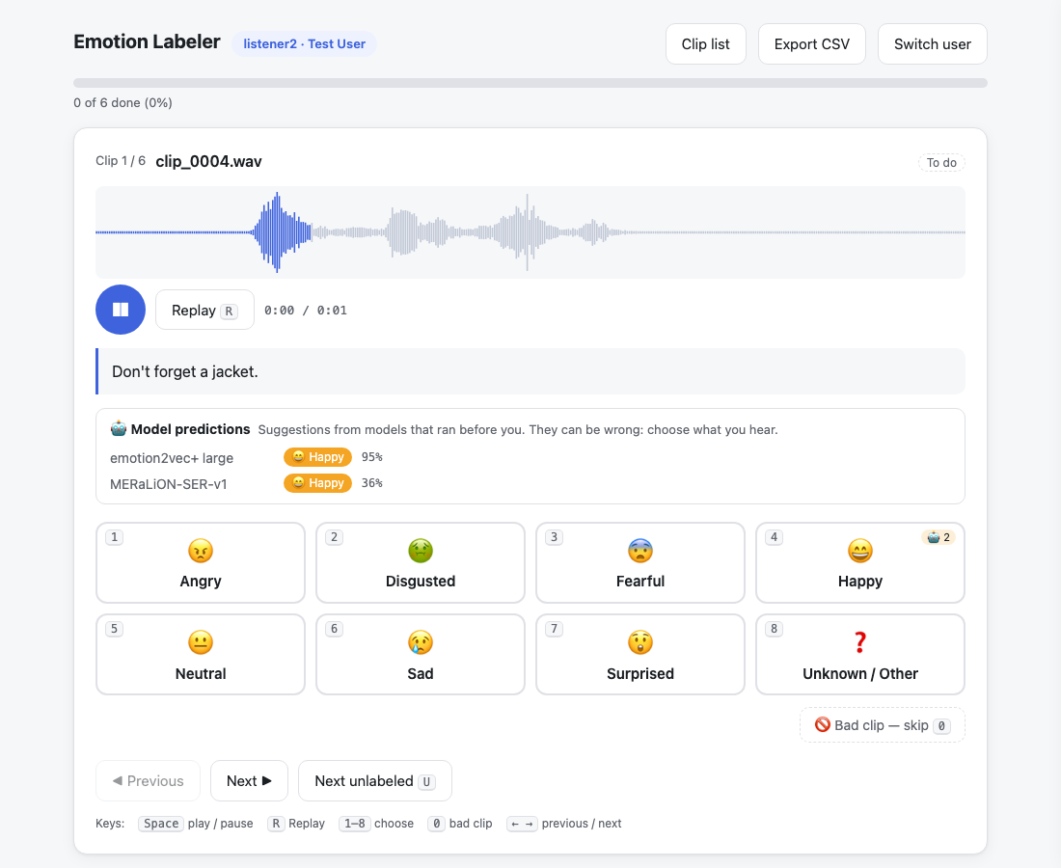
6 · FUTURE WORK
Annotation Protocol
Four listeners per clip
  A single rating is not a reliable reference: CREMA-D listeners agree with the actor on ≈4 in 10 clips; four votes allow agreement to be measured and ambiguity to be recorded
Decision rule
  ≥ 3 of 4 agree → label
  2–2 or all different → "ambiguous": keep the vote distribution as a soft label, or adjudicate
  any "bad clip" vote (noise, overlap, silence) → review and drop
Quality control
  Inter-rater agreement (Fleiss' κ / Krippendorff's α) per round
  Gold clips repeated to check consistency; short calibration session with examples first
Bias control
  Seed set and test set: model hints off (predictions_mode "off")
  Verification rounds: hints on, to speed up checking
Our offline labelling tool (single HTML file, no install, nothing leaves the PC): random order per listener, keys 1–8, bad-clip option, optional model hints, CSV per listener
54
Notes:
Labels are the bottleneck, so the protocol matters. Four listeners per clip, majority vote; ties are not forced into a class but kept as ambiguous with the vote distribution, which we can use as a soft training target.
We built a small offline labelling tool for this: one HTML file, no installation, no network; each listener gets their own shuffled order and writes their own CSV. It can show model predictions as hints, which we switch off for the seed and test sets to avoid anchoring the listeners.

Slide 56
6 · FUTURE WORK
Active Learning Pipeline
① Seed labels
1k clips × 4 listeners
majority vote
② Fine-tune
emotion2vec+ and MERaLiON
(B first; C from ≈5k, D from ≥10k)
③ Predict
unlabelled pool
≈100k clips
add to training set,
repeat
Fixed test set
≈500 clips, 4 listeners, separate callers
never trained on: score every round
⑤ Human verification
2 listeners confirm or correct
(3rd if they disagree)
④ Select for review
low confidence · two models disagree
rare emotions · random audit
 | New labels | Total | Option
Round 0 | 1k (4 listeners) | 1k | B (+ E in parallel)
Round 1 | ≈1k selected from 100k | ≈2k | B
Round 2 | ≈1.5k | ≈3.5k | B, C
Round 3 | ≈1.5k | ≈5k | C
Round 4+ | ≈2–3k per round | ≥10k | D
Verifying a proposed label is faster than labelling from scratch, and uncertain clips are the most informative for training
Stopping criterion: no further improvement of the test-set score between rounds
Disagreement between the two models is an additional selection signal at no cost
55
Notes:
This is the active learning loop. Round zero: one thousand clips, each labelled by four listeners, majority vote. Fine-tune both models. Run them on a large unlabelled pool, around one hundred thousand clips.
Then, instead of labelling at random, select the clips the models are unsure about, the clips where the two models disagree, and clips predicted as rare emotions such as anger, plus a random sample to check calibration. Two listeners verify or correct those, and we retrain.
A fixed test set, labelled by four listeners from callers never used for training, is scored after every round; we stop when it stops improving. Within three rounds we reach about five thousand verified clips, enough for option C; further rounds take us beyond ten thousand, where full fine-tuning, option D, becomes worthwhile. In parallel, the unlabelled pool is used for continued pre-training of emotion2vec+ and for pseudo-labels.

Slide 57
6 · FUTURE WORK
Roadmap
Step 1
Preparation
Step 2
Seed annotation
Step 3
First adaptation
Step 4
Active learning
Sample calls; segment into 3–10 s customer turns (VAD)
Agree on the label set (7 + unknown, or call-centre classes)
Re-run the benchmark through a telephone channel
1k clips × 4 listeners + 500-clip test set
Measure inter-rater agreement
Zero-shot baseline of both models on the test set
Option B for both models
E on unlabelled call audio (emotion2vec+), pseudo-labels (MERaLiON)
Speaker-independent cross-validation vs zero-shot
Rounds of predict → select → verify → retrain
C at ≈ 5k; D at ≥ 10k labelled clips if the learning curves justify it
Track per-class recall, especially angry
Decision gates
Go: label set and data access agreed
Go: agreement acceptable (κ), baseline known
Go: clear gain over zero-shot
Gate at ≈ 5k: C vs D learning curves · Stop: test score plateaus
56
Notes:
Four steps, each with a gate. Step one is preparation, including the decision on the label set: we may want call-centre categories such as frustrated instead of disgusted or surprised; the labelling tool makes the label set a configuration change.
Step two produces the seed labels and the test set, and tells us how much our own listeners agree. Step three is the first adaptation: option B for both models, plus the use of unlabelled call audio through continued pre-training for emotion2vec+ and pseudo-labelling for MERaLiON. Step four is the active learning loop, moving to option C at about five thousand labelled clips.

Slide 58
CONCLUSION
Summary
1
Emotion labels are subjective
Listeners disagree with actors and with each other; annotation requires multiple listeners and soft labels.
2
Dedicated SER models outperform audio LLMs
Best open model 65–99.5% per corpus vs Gemini 27–45% and GPT Realtime 2–29%; audio LLMs rely on lexical content (consistent with LISTEN).
3
Training-data overlap inflates benchmark scores
Corpora seen in training score 20–52 points higher; on call-centre audio, unseen-level accuracy (≈50–65%) is expected before adaptation.
4
Shortlist: emotion2vec+ large and MERaLiON-SER-v1
Highest accuracy, licences permitting commercial use, complementary strengths.
5
Adaptation strategy
Frozen encoder with a new head first (B), LoRA (C) from ≈5k and full fine-tuning (D) from ≥10k labelled clips on 4 × H100; unlabelled call audio through E / pseudo-labelling.
6
Annotation strategy
1k seed clips × 4 listeners, then active learning on ≈100k unlabelled clips: 3–5k verified labels for B and C, ≥10k for D.
57
Notes:
Six conclusions: the subjectivity of the labels, the gap between dedicated models and audio LLMs, the effect of training-data overlap, the shortlist, the adaptation strategy and the annotation strategy.

Slide 59
Thank you — questions?
Code, reports and listening viewer: emotion_recognition/ (README, reports/summary.md, outputs/viewer.html)

Slide 60
APPENDIX
A1 · Unweighted accuracy and macro-F1 (open models, all clips)
Unweighted accuracy (mean recall per emotion, %)
Macro-F1 (%)
Dataset | emotion2vec+ large | MERaLiON-SER-v1 | Melati | Vox-Profile Whisper | Vox-Profile WavLM
CREMA-D | 86.5 † | 84.9 † | 52.4 | 35.2 | 32.1
MCAE-SPPS | 54.2 | 57.8 | 48.1 | 40.9 | 36.7
MESS | 40.8 | 74.5 | 40.4 | 36.4 | 36.3
RAVDESS | 92.3 † | 61.3 | 49.3 | 49.3 | 42.4
TESS | 85.5 † | 49.2 | 50.4 | 30.1 | 40.1
JL-Corpus | 92.5 † | 75.9 | 99.5 † | 45.1 | 48.3
Dataset | emotion2vec+ large | MERaLiON-SER-v1 | Melati | Vox-Profile Whisper | Vox-Profile WavLM
CREMA-D | 86.6 † | 84.7 † | 46.7 | 29.9 | 27.4
MCAE-SPPS | 50.1 | 54.4 | 43.3 | 35.2 | 33.6
MESS | 35.2 | 74.7 | 37.5 | 26.8 | 28.7
RAVDESS | 92.2 † | 59.7 | 46.6 | 44.5 | 38.4
TESS | 79.8 † | 37.9 | 43.4 | 17.4 | 31.6
JL-Corpus | 92.3 † | 77.3 | 99.5 † | 47.3 | 50.5
† in the model's training data · bold = best · same ranking as accuracy
Source: emotion_recognition/reports/summary.md (evaluate.py, 2026-10-29)
58

Slide 61
APPENDIX
A2 · Label mapping to the seven project classes
Project class | CREMA-D | MCAE-SPPS | MESS | RAVDESS | TESS | JL-Corpus
angry | ANG | Anger | A | 05 angry | angry | angry
disgusted | DIS | Disgust | – | 07 disgust | disgust | –
fearful | FEA | Fear | – | 06 fearful | fear | –
happy | HAP | Happiness | H | 03 happy | happy | happy; excited (happy counts)
neutral | NEU | Neutral | C (calm) | 01 neutral; 02 calm | neutral | neutral
sad | SAD | Sadness | S | 04 sad | sad | sad
surprised | – | Surprise | – | 08 surprised | ps (pleasant surprise) | excited (surprised also counts)
not evaluated |  |  |  |  |  | anxious, apologetic, assertive, concerned, encouraging (1,200 clips)
Model side: emotion2vec+ "other" and "<unk>", Vox-Profile "Contempt" and "Other" are never chosen (the prediction is the most probable of the dataset's emotions).
Source: emotion_recognition/docs/label_mapping.md
59

Slide 62
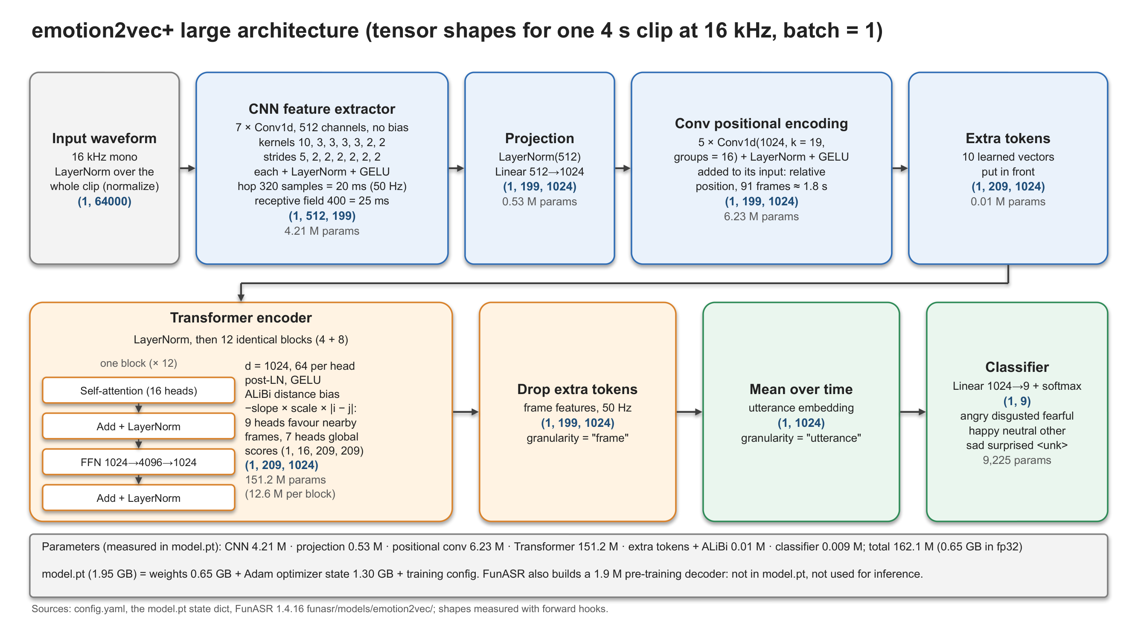
APPENDIX
A3 · emotion2vec+ large: Detailed Architecture
60
Notes:
Detailed architecture of emotion2vec+ large with tensor shapes for a 4-second clip at 16 kHz, measured with forward hooks on the released model.

