Slide 1
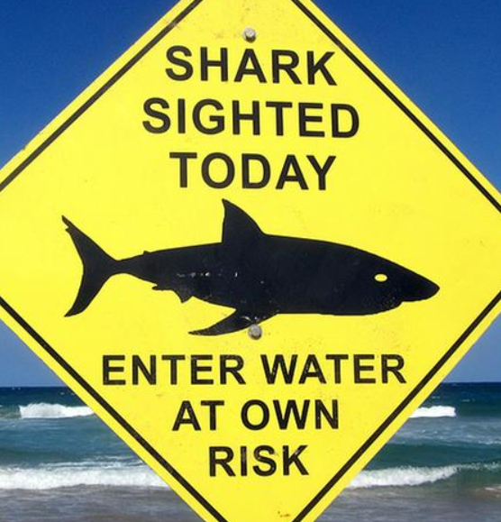


W2-PANDAS-PROJECT
Goals:
To eliminate the no valid values
To standardize the data set
To generate statistics about the attacks
Global Shark Attack File:
To provide current and historical data on shark/human interactions
File purpose: “With a better understanding of these interactions, we can minimize the risk of being injured by a shark and concentrate on the conservation of all shark species worldwide”.
DAVID MARTÍN CASERO

Slide 2
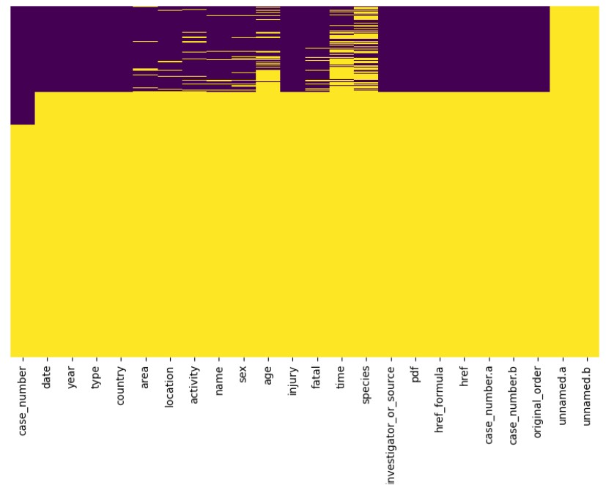
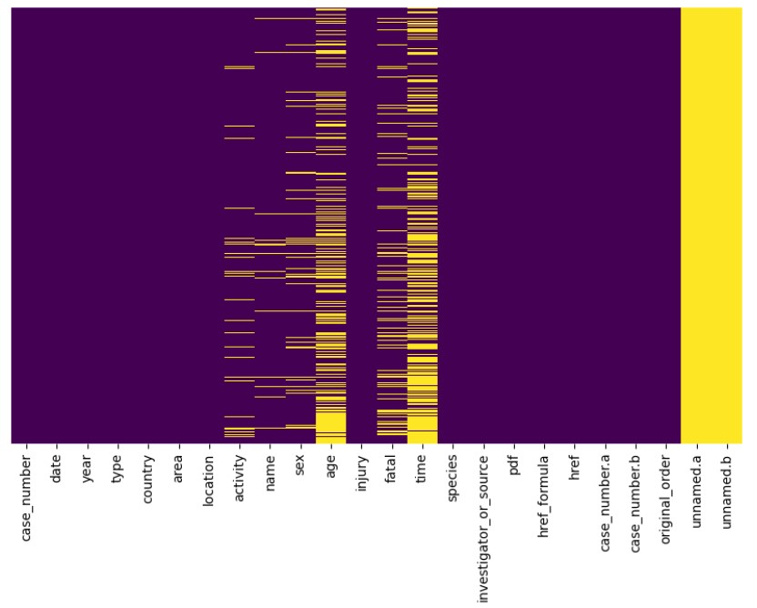
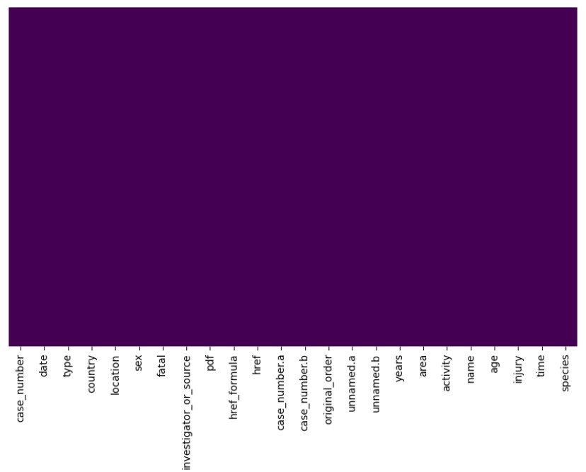
Non-Valid values per column during and after the analysis
DAVID MARTÍN CASERO

Slide 3
Unique values per column after the analysis
Column name | Initial | Final | Final information included
case_number | 6287 | 2912 | Case ID (1 the oldest, 2912 the newest)
date | 5433 | 2650 | Day, month and year
years | 249 | 161 | Year
type | 8 | 6 | boating, unprovoked, provoked, invalid, questionable, sea disaster
country | 212 | 84 | The country
area | 825 | 363 | The Area
location | 4108 | 2264 | the specific place where the incident occurred
activity | 1532 | 28 | Activity carried out during the incident
name | 5230 | 2001 | The name of the person involved
sex | 6 | 3 | Male, female or unknown
age | 157 | 74 | The age of the person involved
injury | 3737 | 16 | They type of injury provoked in the person (Wound, lacerations…)
fatal | 8 | 3 | Yes, not or unknown
time | 366 | 199 | The time when the incident occured
species | 1549 | 37 | The shark specie involved
DAVID MARTÍN CASERO

Slide 4
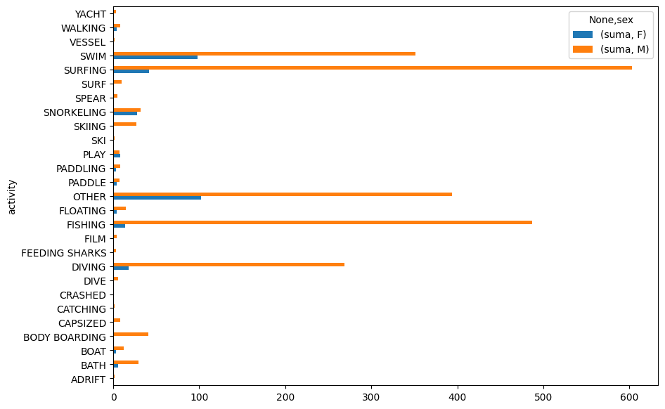
Count per activity carried out
DAVID MARTÍN CASERO

Slide 5
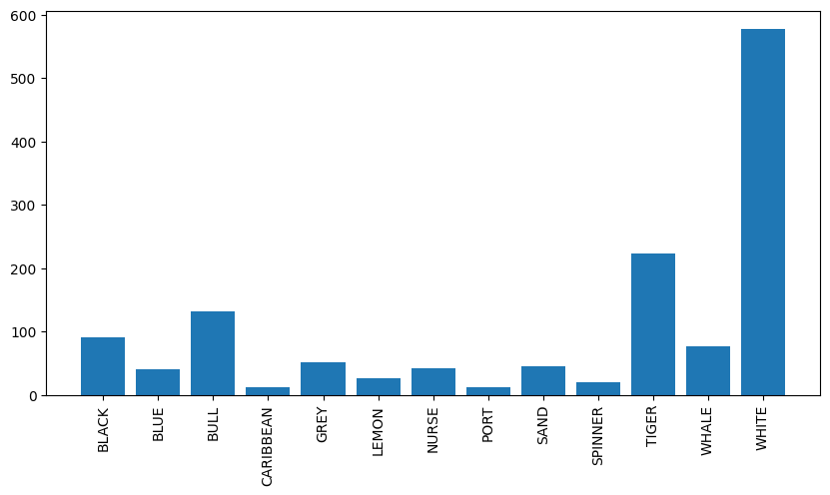
Count attacks per species
DAVID MARTÍN CASERO

Slide 6
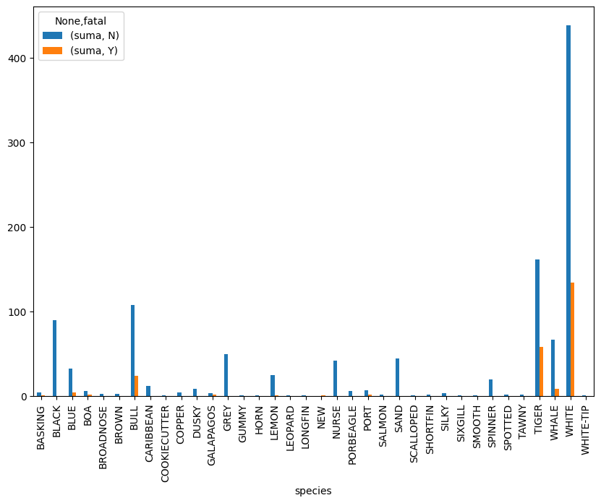
Attacks per species and if fatal or not
DAVID MARTÍN CASERO

Slide 7
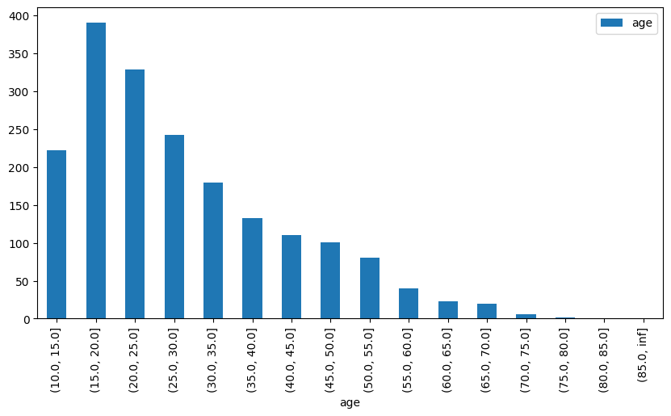
Count per age range
DAVID MARTÍN CASERO

Slide 8
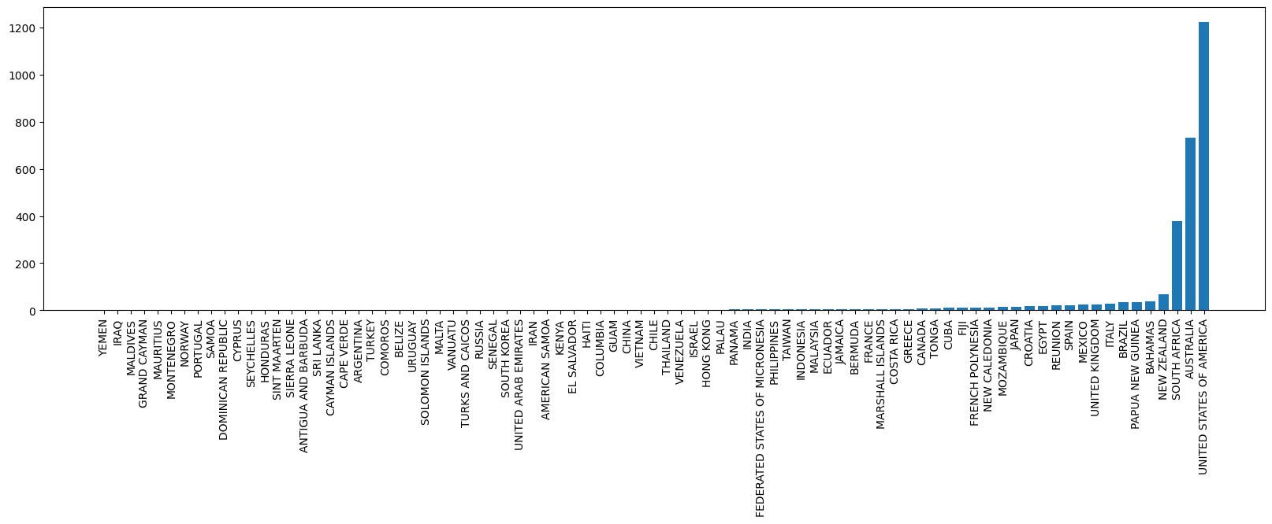
Count per country
DAVID MARTÍN CASERO

