Slide 1
Learning Management System
Course CSE 408: Software Development
Adnan Farooque
Student ID: 1305044
David Meril Tudu
Student ID: 1305120
Md. Sayeduzzaman
Student ID: 0405035

Slide 2
What is Learning Management System?
According to Wikipedia,
A learning management system is a software application for the administration, documentation, tracking, reporting and
delivery of educational courses or training programs.
In short it is known as LMS.

Slide 3
What is LMS?
In other words
It is a platform that allows enrolment.
Provides a gateway to manage all the in's and out's of students,
Tracks when a student logs in and logs out.
Keeps track of assessment results (tests on learning content).
Provides a library for learning to be delivered to a learner.

Slide 4
Some Examples Of LMS
Some well Known LMS
Moodle
Canvas
BlackBoard
Google Classroom

Slide 5
Who Uses LMS?
Schools
Universities
Business Institution
Where we need to train employees on a particular tool.

Slide 6
Why Use LMS?
Benefits of LMS.
Centralized Learning
Track learning progress
Provide Digital learning
Manage learner communication
Provide class content

Slide 7
Key Features Of LMS
Managing learners, courses, roles, and generating reports.
This helps uploading courses, assigning roles, and generating various reports.
Making a course calendar.
This feature helps in managing the course activities.
Messaging and notifications.
Learners and trainers can send reminders and notifications, including upcoming training and events.
Regular Assessments of tests and quizzes.
Trainers will be able to arrange tests, quizzes and asses them.

Slide 8
Additional Features
Badges.
There will be distribution of badges. Learners will achieve this by doing well in the arranged tests and quizzes.
Future Prediction of courses.
This feature will calculate the probability of the allotment of courses. By using this feature the administrators will be able to prioritize the courses.

Slide 9
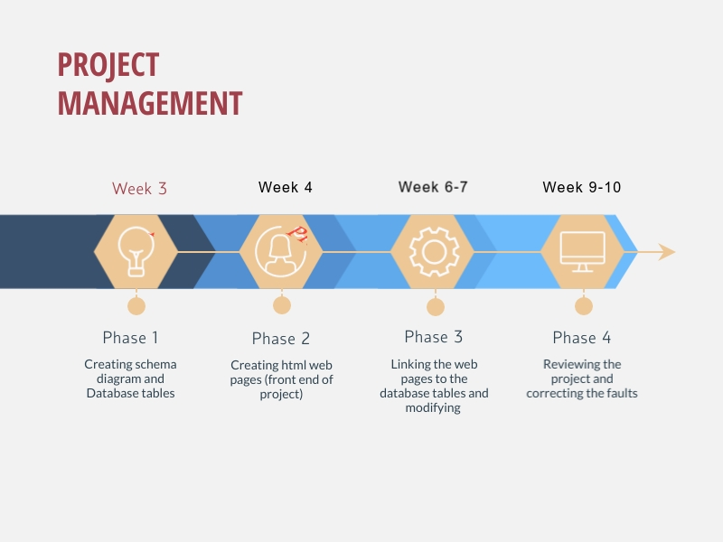
Timeline of the project

Slide 10
Timeline of the project
Week 5: First prototype demonstration with mapping between design and development
Week 8: Second prototype demonstration with mapping between design and development
Week 11: Unit testing on selected components
Week 12: Dry run on final presentation
Week 13: Final presentation of the full software – Centrally presented

Slide 11
Development tools
Frontend : css, html, java script
Backend: Django
Database: Django
VCS: github

Slide 12

Thank You

