Slide 1
Data Stormers
Andrew, Jeff, Deelan, David, manahil

Slide 2
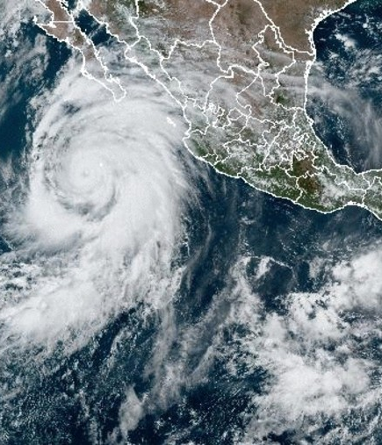
Agenda
Introduction
Research Questions
Data Sources
Geographic Focus
Types of Storms
Data Analysis & Findings

Slide 3
Introduction
Tornado disaster analysis

Slide 4

Research questions
Main questions the study aims to answer:
Do areas with frequent storms experience greater depreciation in home values compared to areas with fewer storms?
What is the impact on property values in the most storm-affected areas vs. less affected areas?
Which types of storms are most and least destructive?

Slide 5
Data sources

Slide 6
Geographic Focus
ENHANCING YOUR PRESENTATION

Slide 7
Types of Storms

Slide 8
Data Analysis & Findings

Slide 9

Descriptive Statistics

Slide 10
Comparative Analysis
Ex
Ex

Slide 11
Impact by Storm Type

Slide 12
Geographic Differences

Slide 13
Conclusion

