Slide 1

R
Dra. Ana Ruth Escoto Castillo

Slide 2





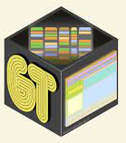

Paquetes
select()
filter()
summarise()
Tidyverse

Slide 3
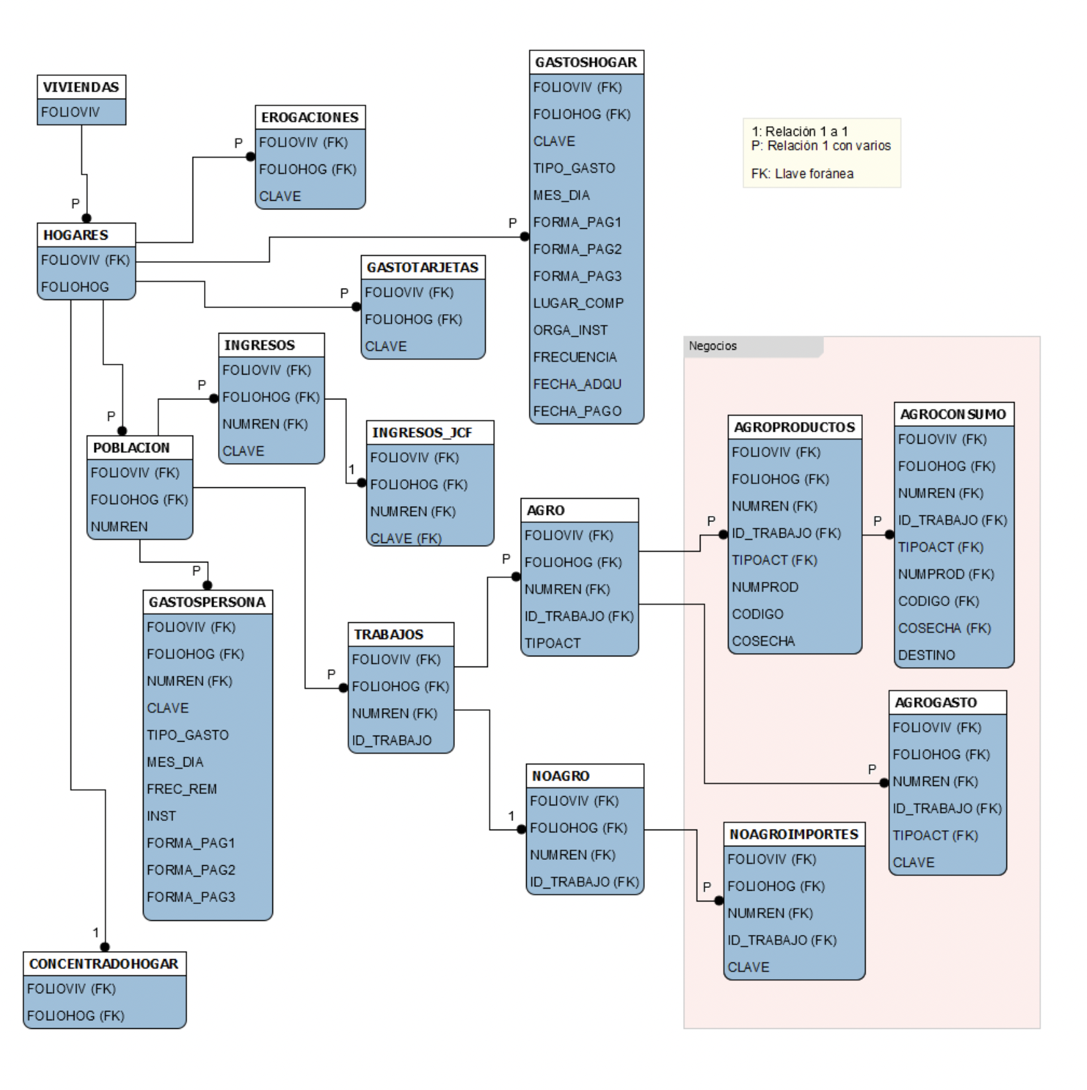

Slide 4
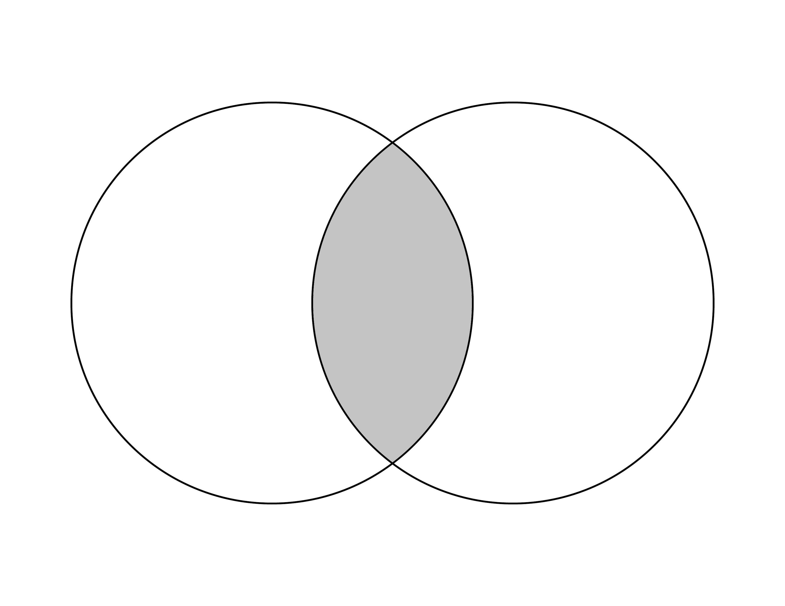
merge() all=FALSE
dplyr::inner_join()

Slide 5
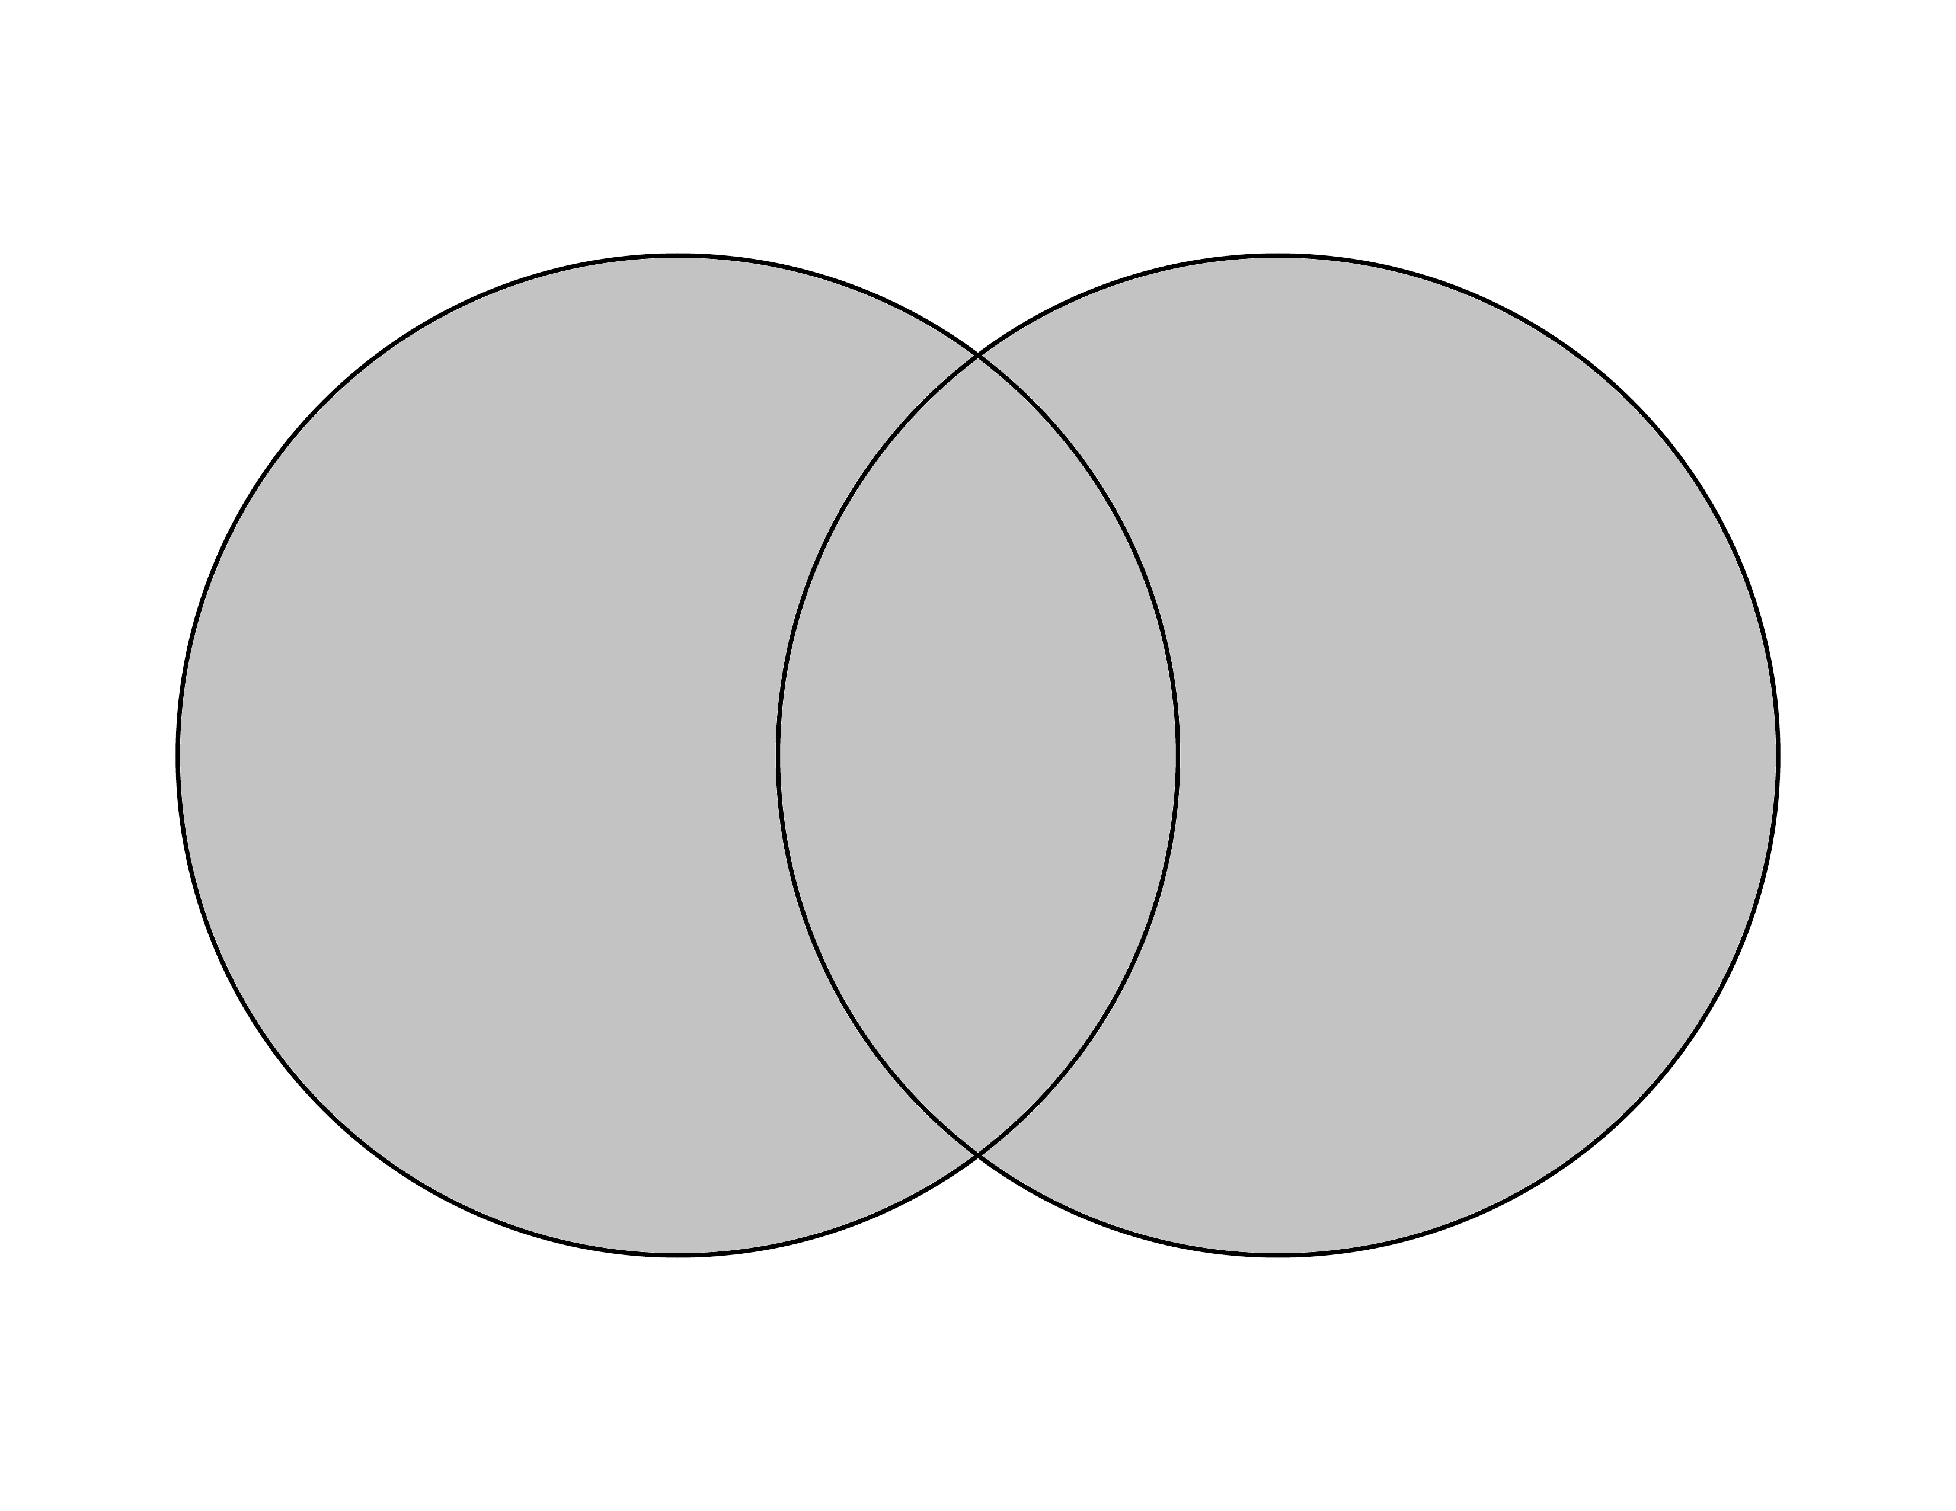
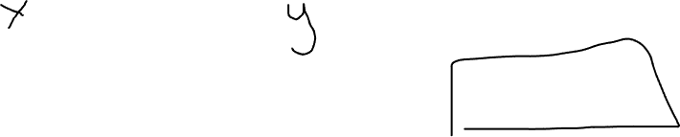
merge() all=TRUE
dplyr::full_join()

Slide 6
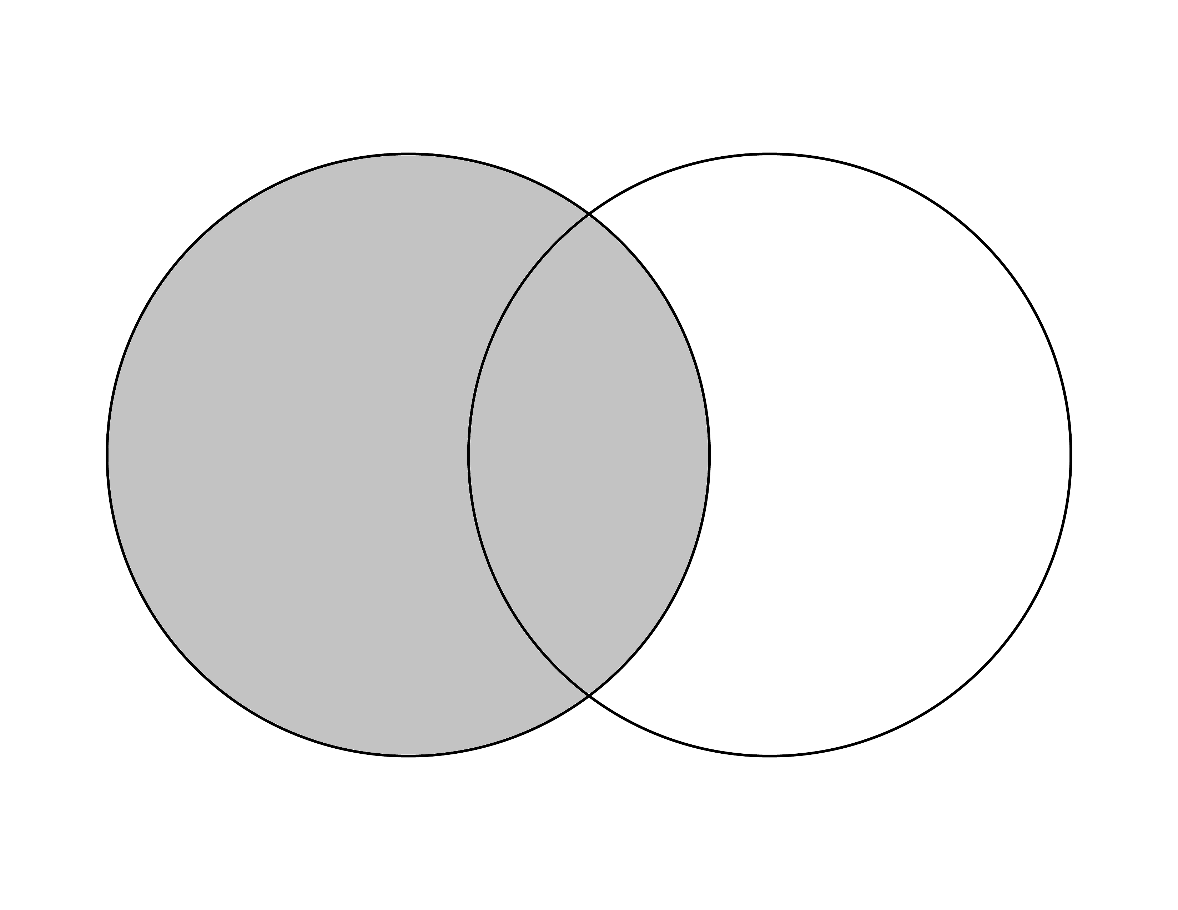
merge() all.x=TRUE
dplyr::left_join()

Slide 7
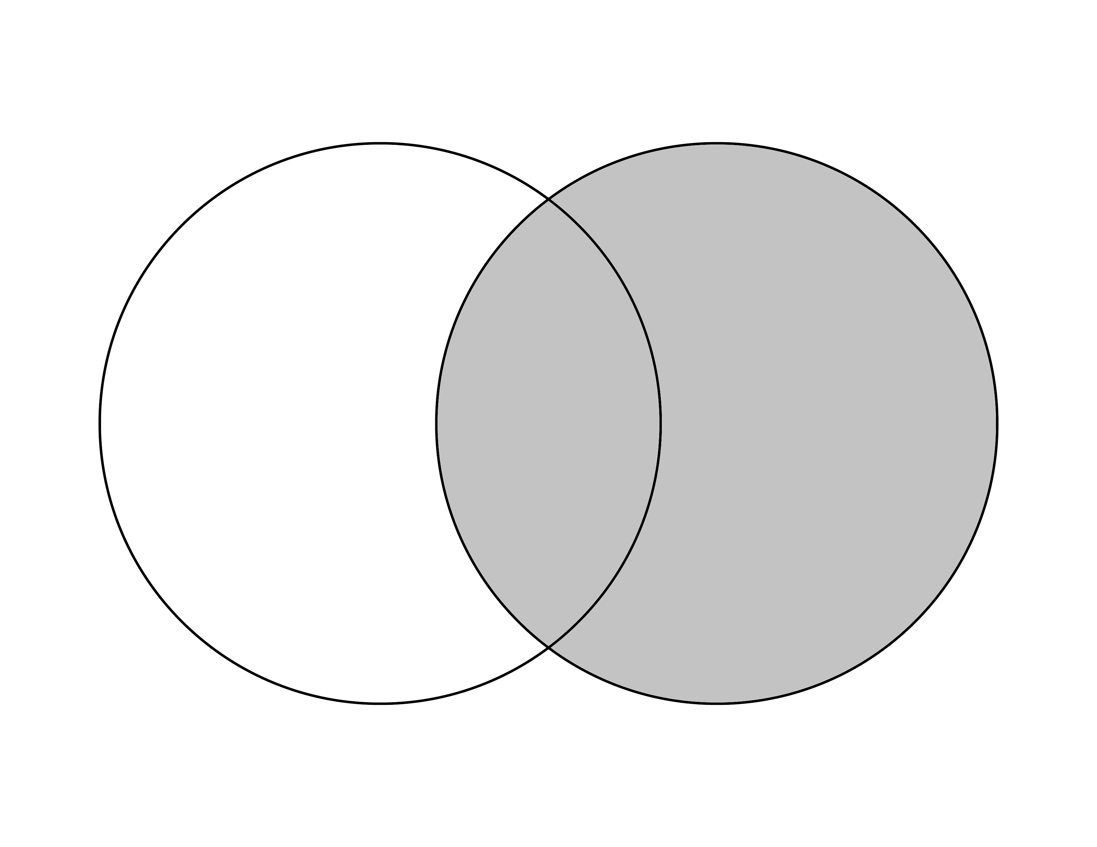
merge() all.y=TRUE
dplyr::right_join()

