Slide 1
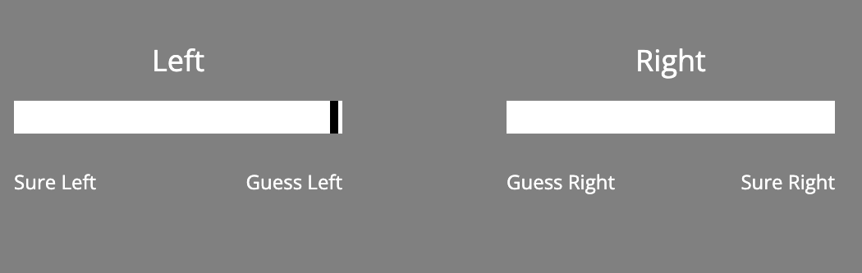
Well-done!
That concludes the practice session.
In the next section, you will continue to perform the dots task.
You must still make your initial choice:

Slide 2
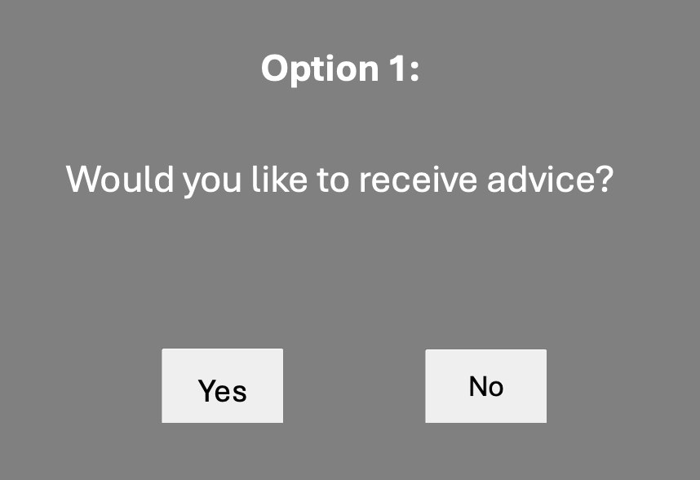
After your choice, you will have the option to receive advice.

Slide 3
This advice will be displayed as a single word, e.g. “LEFT”
Advice:
LEFT

Slide 4
The words “LEFT” or “RIGHT” indicate the advice is to select the Left or Right box as having more dots.
Advice:
RIGHT

Slide 5
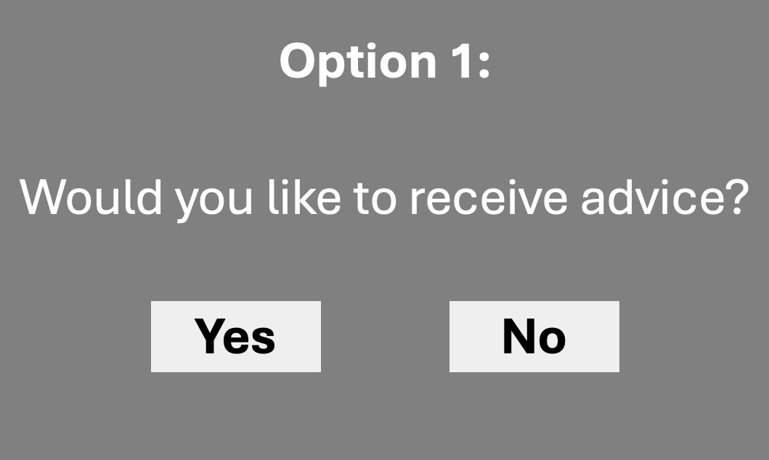
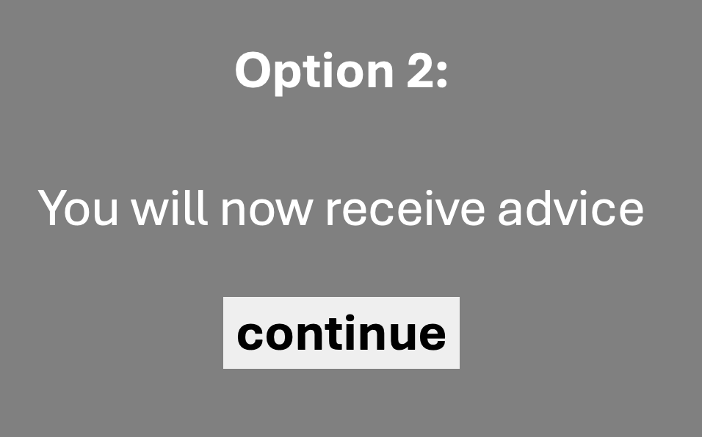
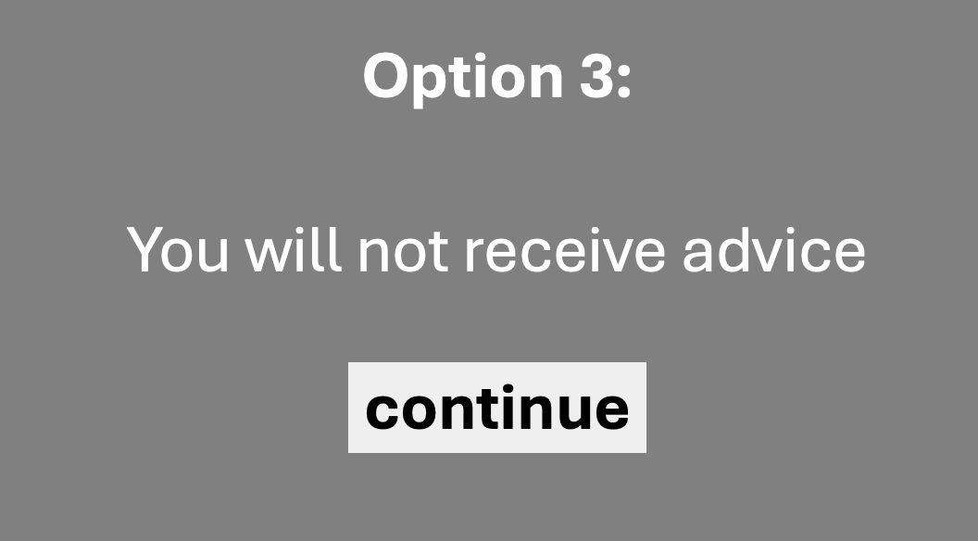
Please make sure your first decision is accurate.
This is because you will not always receive advice.
There are 3 possibilities:

Slide 6
After these options, you will be asked to enter your final decision:
What is your final decision?

Slide 7
Ready?
Press Continue, below

Slide 8
Option 1:
Would you like to receive advice?
Yes
No

Slide 9
Option 2:
You will now receive advice
continue

Slide 10
Option 3:
You will not receive advice
continue

