Slide 1
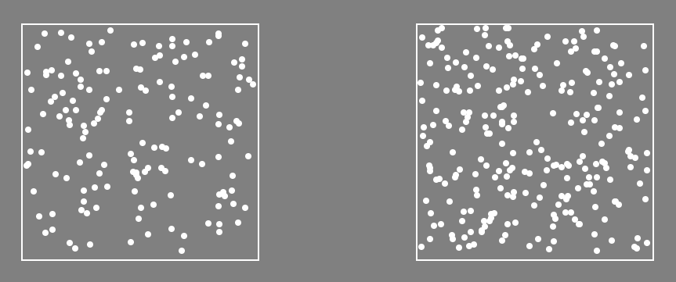
Welcome!
In this experiment, you must quickly decide which of two boxes contains more dots, like this:
In this case, there are more dots on the “Left”.

Slide 2
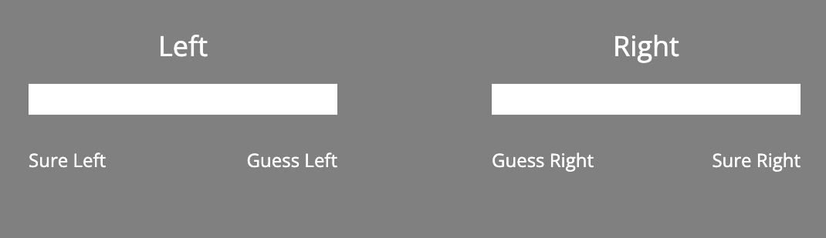
The dots will only be shown very briefly on screen.
After they are shown, to submit your response, you will click on a slider like the one below:

Slide 3
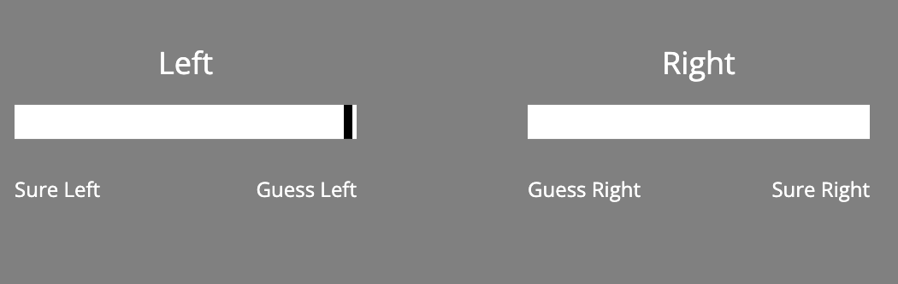
Clicking here means you are guessing there were mode dots on the Left.:

Slide 4
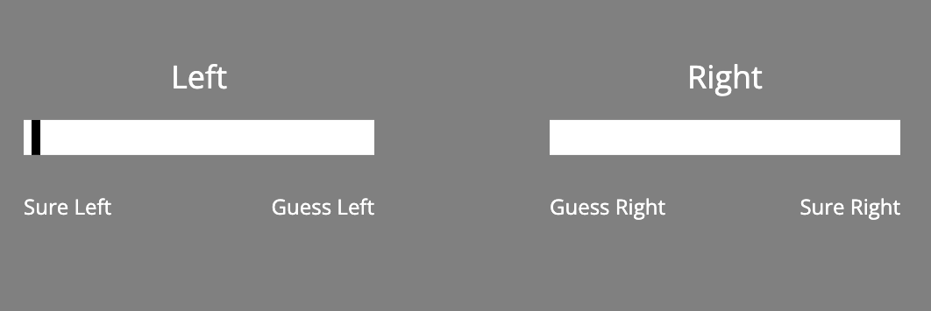
Clicking here means you are confident there were mode dots on the Left:

Slide 5
Remember!
The dots are only shown briefly.
Try to answer as quickly and accurately as possible.
Click below to begin a practice.

