Slide 1
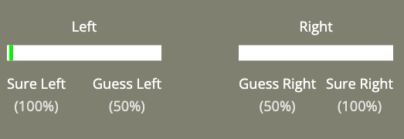
Well-done!
That concludes the practice session.
In the next section, you will continue to perform the dots task.
You must still make your initial choice:

Slide 2
After your choice, you will have the option to receive advice from an AI-based decision support system.
This system has been designed to enhance human-decision making, and has been trained on large datasets of past participant performance.

Slide 3
Using probabilistic modelling and machine learning techniques, the AI predicts what will be the correct answer based on past participant responses.

Slide 4
The goal of this system is to help users improve their accuracy by providing real-time recommendations tailored to perceptual decision-making processes.
(More information regarding this AI is available in the debrief at the end of this experiment)

Slide 5
While the AI is not always correct, it has been designed to be as helpful as possible, reflecting state-of-the-art research on human-AI collaboration.

Slide 6
This advice from this AI will be displayed as a single word:
Advice:
LEFT

Slide 7
The words “LEFT” or “RIGHT” indicate the advice is to select the Left or Right box as having more dots.
Advice:
RIGHT

Slide 8
Please make sure your first decision is accurate.
This is because you will not always have the option to receive advice.
There are 3 possibilities:

Slide 9
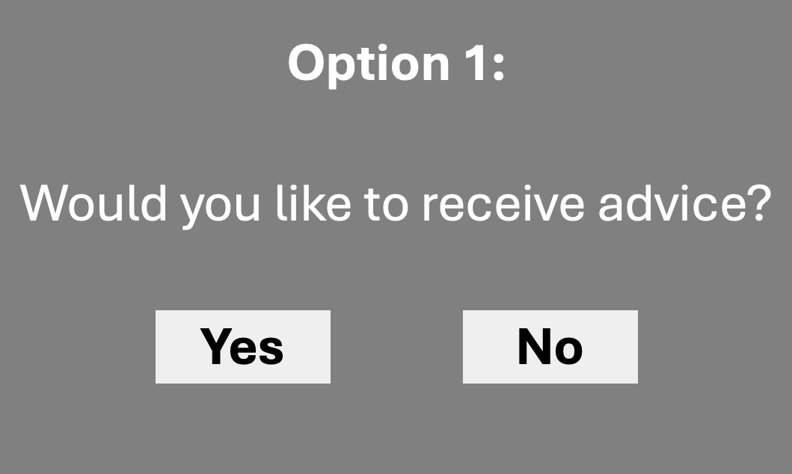
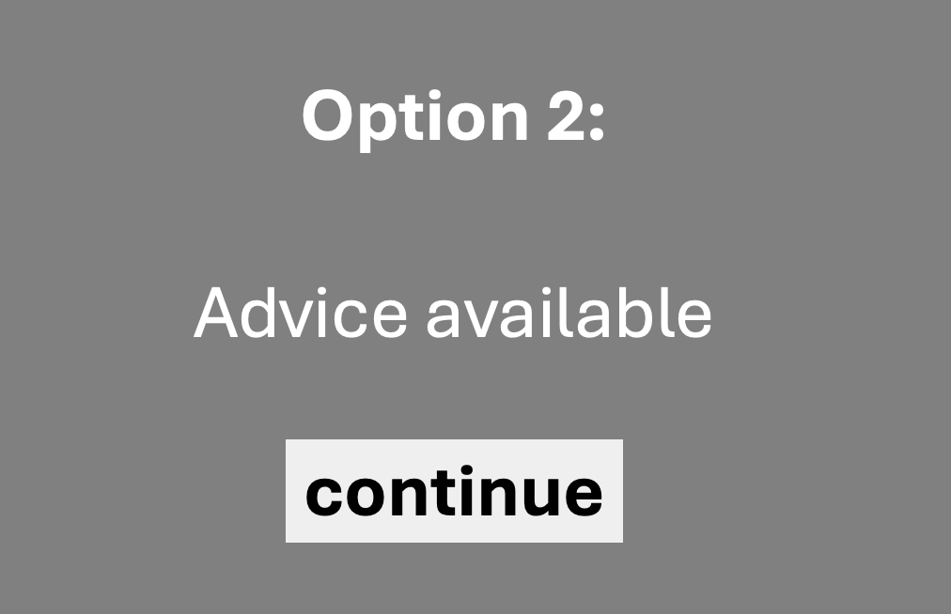
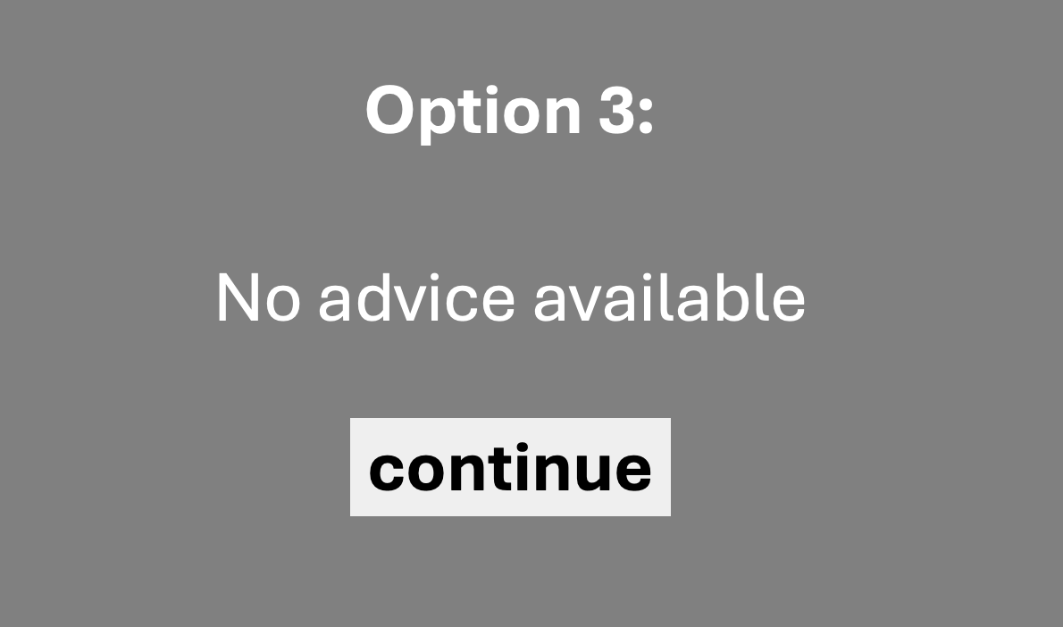
After your initial decision, you will either:
choose to receive advice
Be shown advice
Not receive advice

Slide 10
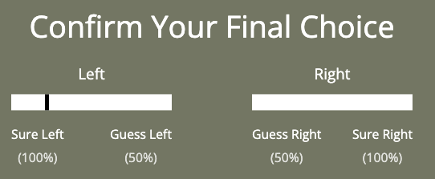
After these options, you will be asked to confirm your final decision by clicking once more.
Your previous decision will be shown in black:
Your previous decision

Slide 11
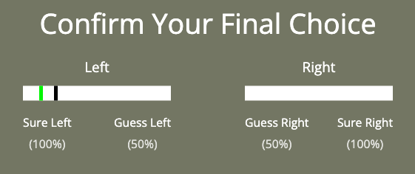
Clicking on either slider will show your new decision in green:
Your Final
decision

Slide 12
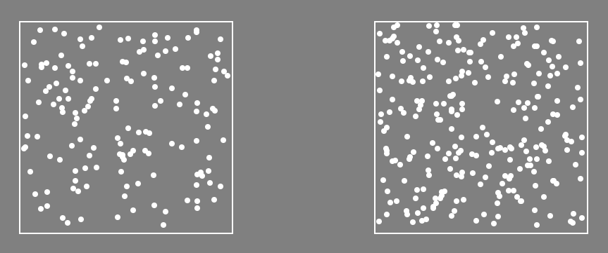
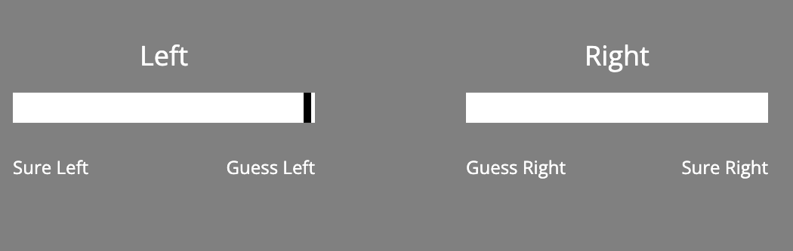
Here is an example trial sequence:
Advice (or not)
first confidence
LEFT
final confidence
fixation
dots
+
?
?
+
Time

Slide 13
Ready?
Press Continue, below

Slide 14
Option 1:
Would you like to receive advice?
Yes
No

Slide 15
Option 2:
Advice available
continue

Slide 16
Option 3:
No advice available
continue

