Slide 1
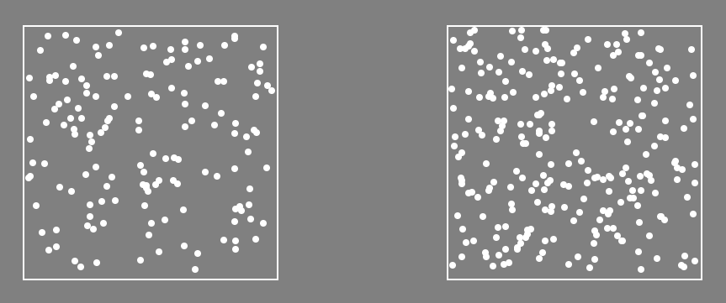
Welcome!
In this experiment, you must quickly decide which of two boxes contains more dots, like this:
In this case, there are more dots on the “Left”.

Slide 2
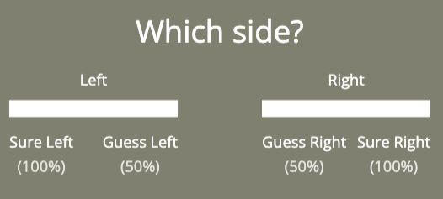
After they are shown you will click on a slider like
the ones below to rate how confident you are in your decision.
The scale ranges from “Sure” to “Guess”:

Slide 3
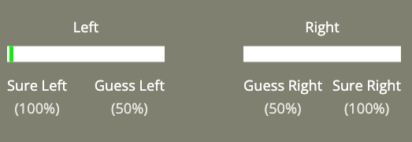
Clicking here:
means you are confident there were more dots on the Left

Slide 4
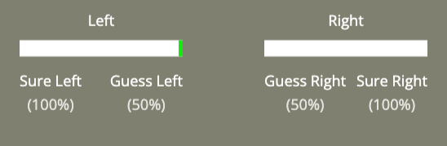
Clicking here:
means you are guessing there were more dots on the Left

Slide 5
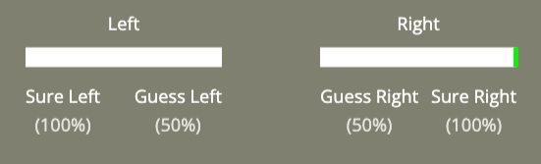
Clicking here:
means you are confident there were more dots on the Right

Slide 6
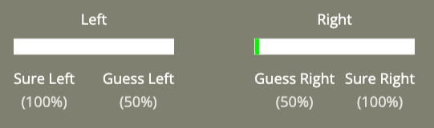
Clicking here:
means you are guessing there were more dots on the Right

Slide 7
Remember!
The dots are only shown briefly.
Try to answer as quickly and accurately as possible.
Click below to begin a practice.

