Slide 1
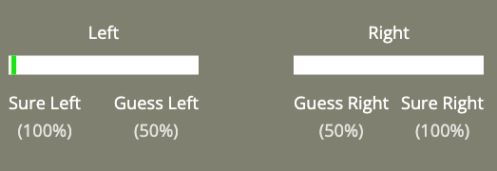
Well-done!
That concludes the practice session.
In the next section, you will continue to perform the dots task.
You must still make your initial choice:

Slide 2
After your choice, you will have the option to receive advice from an AI-based decision support system.
This system has been designed to enhance human-decision making, and has been trained on large datasets of past participant performance.

Slide 3
Using probabilistic modelling and machine learning techniques, the AI predicts what will be the correct answer based on past participant responses.

Slide 4
The goal of this system is to help users improve their accuracy by providing real-time recommendations tailored to perceptual decision-making processes.
(More information regarding this AI is available in the debrief at the end of this experiment)

Slide 5
While the AI is not always correct, it has been designed to be as helpful as possible, reflecting state-of-the-art research on human-AI collaboration.

Slide 6
This advice from this AI will be displayed as a single word:
Advice:
LEFT

Slide 7
The words “LEFT” or “RIGHT” indicate the advice is to select the Left or Right box as having more dots.
Advice:
RIGHT

Slide 8
Please make sure your first decision is accurate.
This is because you will not always have the option to receive advice.
There are 3 possibilities:

Slide 9
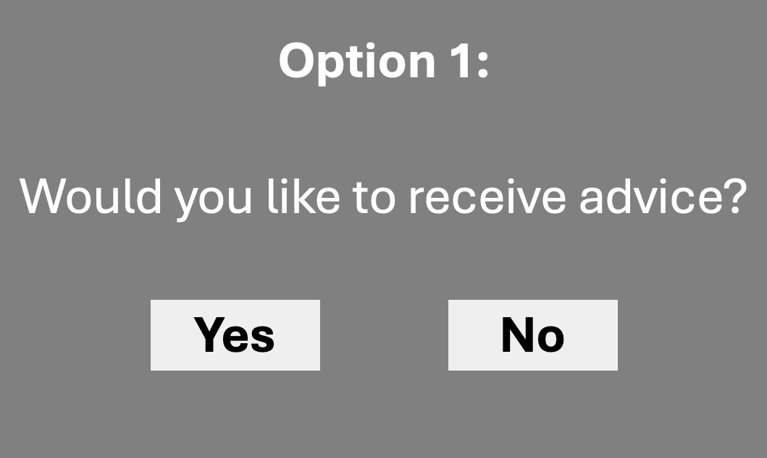
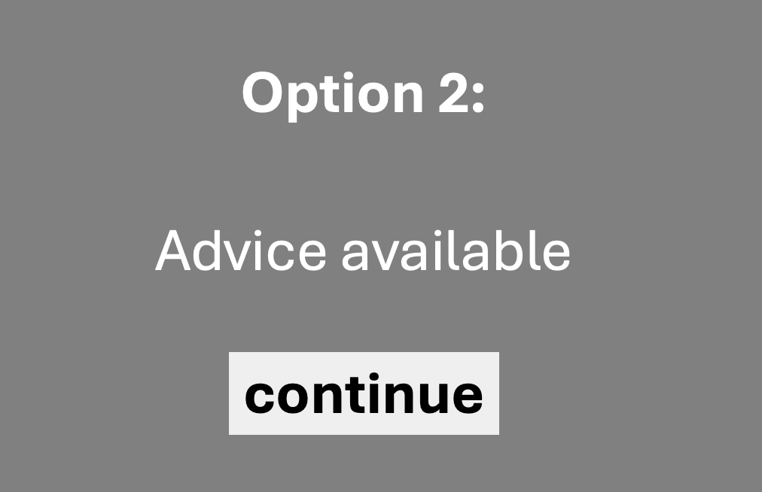
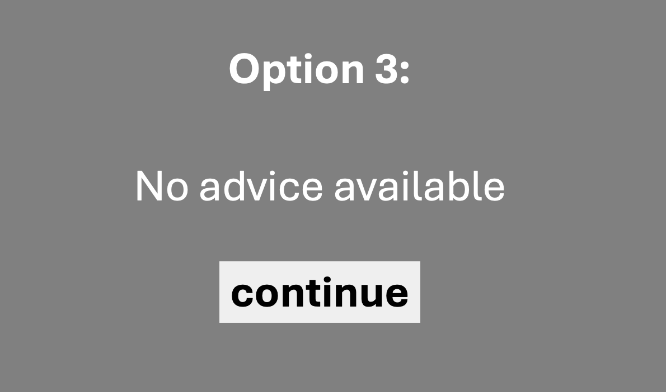
After your initial decision, you will either:
choose to receive advice
Be shown advice
Not receive advice

Slide 10
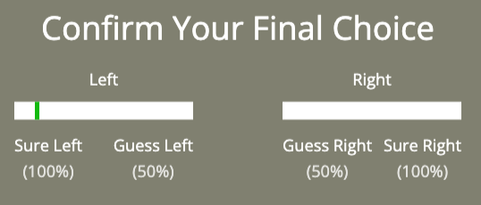
After these options, you will be asked to confirm your final decision by clicking once more:
Your previous decision

Slide 11
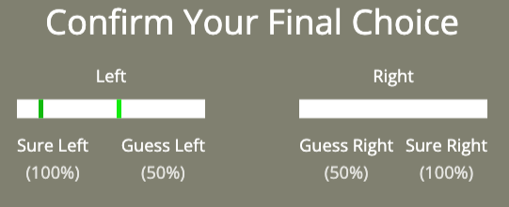
After these options, you will be asked to confirm your final decision by clicking once more:
Your Final
decision

Slide 12
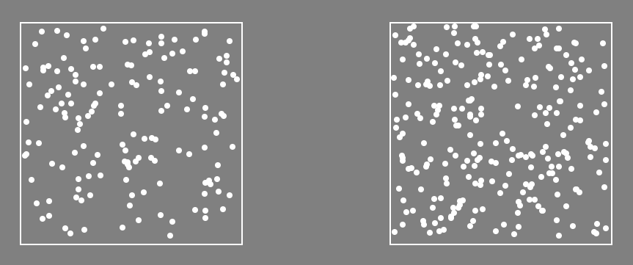
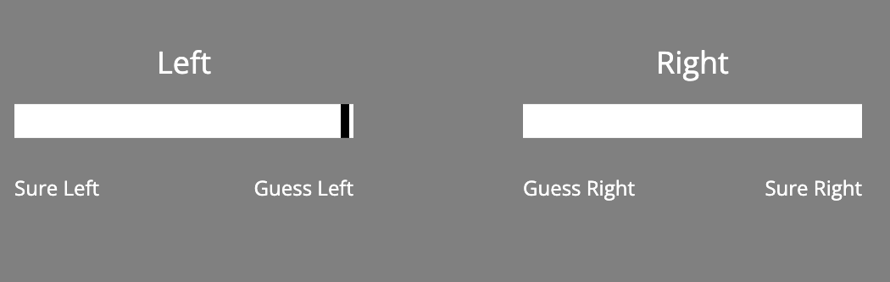
Here is an example trial sequence:
Advice (or not)
first confidence
LEFT
final confidence
fixation
dots
+
?
?
+
Time

Slide 13
Ready?
Press Continue, below

Slide 14
Option 1:
Would you like to receive advice?
Yes
No

Slide 15
Option 2:
Advice available
continue

Slide 16
Option 3:
No advice available
continue

