Slide 1
Well-done!
That concludes the practice session.
In the next section, you will continue to perform both
the visual search and digit-span-backward tasks

Slide 2
Now however, we will additionally provide short breaks between these tasks.
During these breaks, different images may be shown on the screen.

Slide 3

For example, you may be shown a natural image like this:

Slide 4
Please do not look away from the screen.
At the end of the experiment,
we will ask you specific questions relating to these images.

Slide 5
Sometimes, no image may be displayed at all, and only a fixation cross shown on screen:
+
vs
In both cases, please do not look away from the screen.

Slide 6
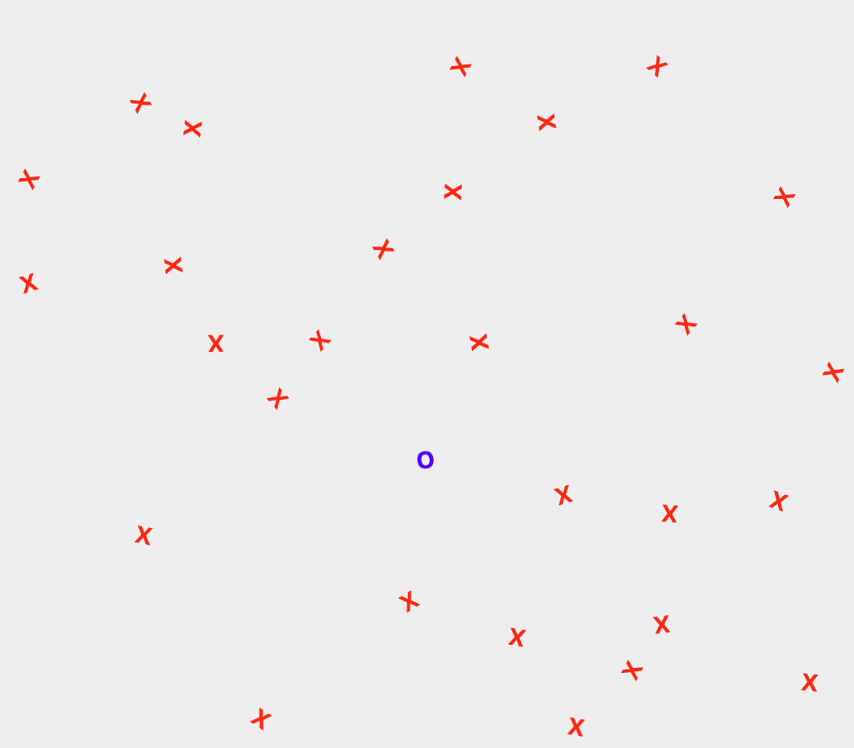
Here is an example trial sequence:
Image (or not)
Digit-span task
LEFT
Digit-span task
Fixation
Visual search
+
7,6,3,1…
7,6,3,1…
+
Time

Slide 7
Ready?
Press Continue, below

